Slide 1



Signal processing and Networking for Big Data Applications:
Sampling, Computing and Storage Perspectives
Zhu Han,
Depart. of Electrical and Computer Engineering
University of Houston, TX, USA

Slide 2
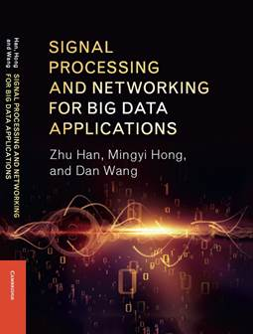
Outline
Overview and Basics Review
Sublinear Sampling
Big Scale Computing
  Optimization Basics
  BCD and BSUM
  ADMM
  Sparse Optimization
  Mixed Integer Programming
Big Data Storage and Software
Application Example

Slide 3
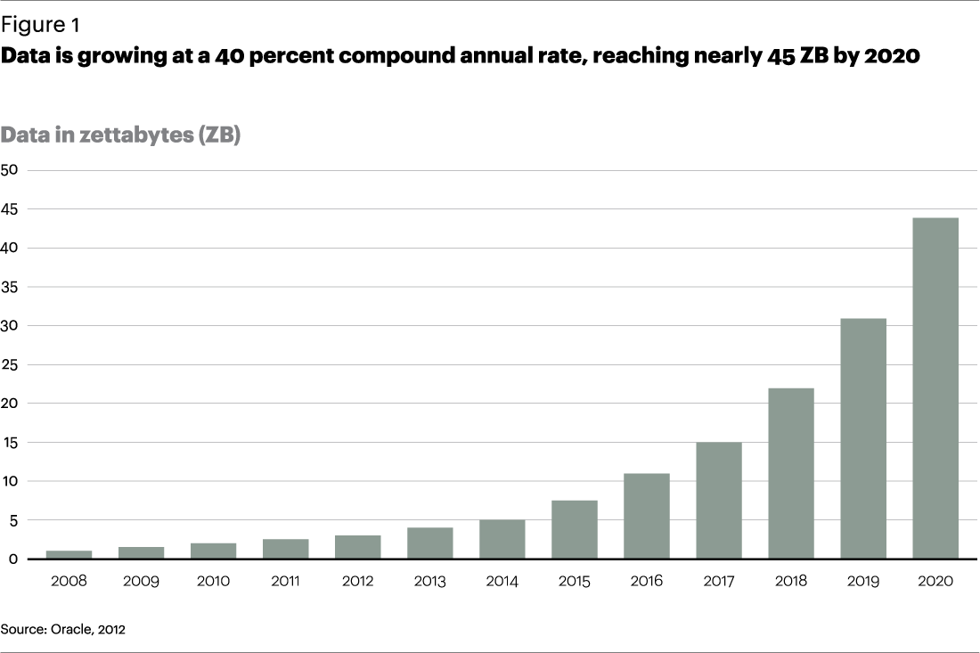
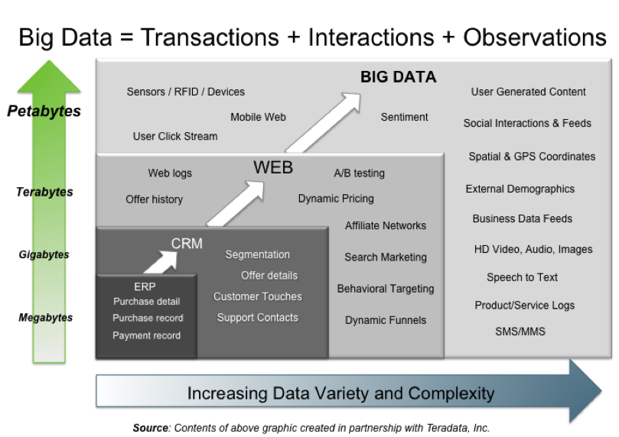
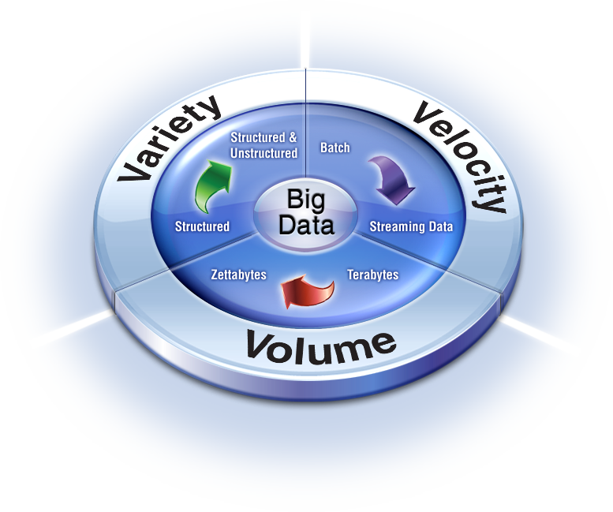
Big Data 3V characteristics
Size of data increases exponentially
Types of data are very heterogeneous
  Technology makes it possible to analyze ALL available data
Need to calculate fast
Key dimensions
  Volume, Velocity and Variety
  Variability and Veracity

Slide 4
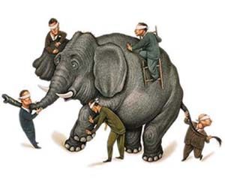
However
Nobody knows exactly how to handle big data
We zoom to
  Sampling, Computing and Storage Perspectives
  Networking and Smart Grid Applications

Slide 5
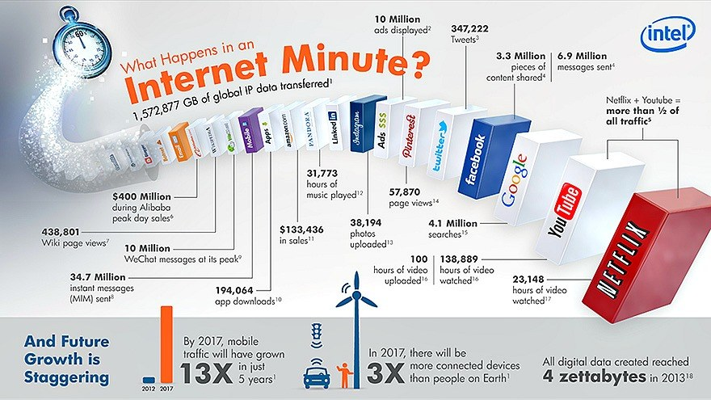
Data Mining

Slide 6
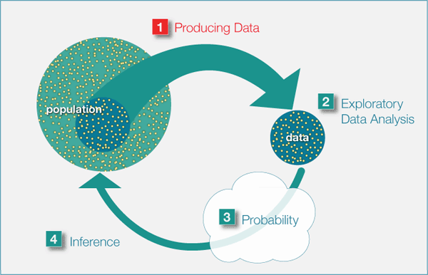
Big Data Sampling
Example of 2016 US
President Election

Slide 7
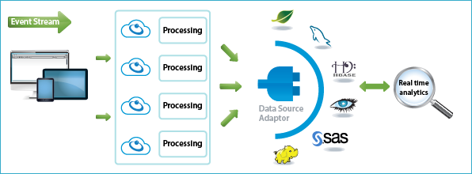
Big Data Real Time Processing

Slide 8
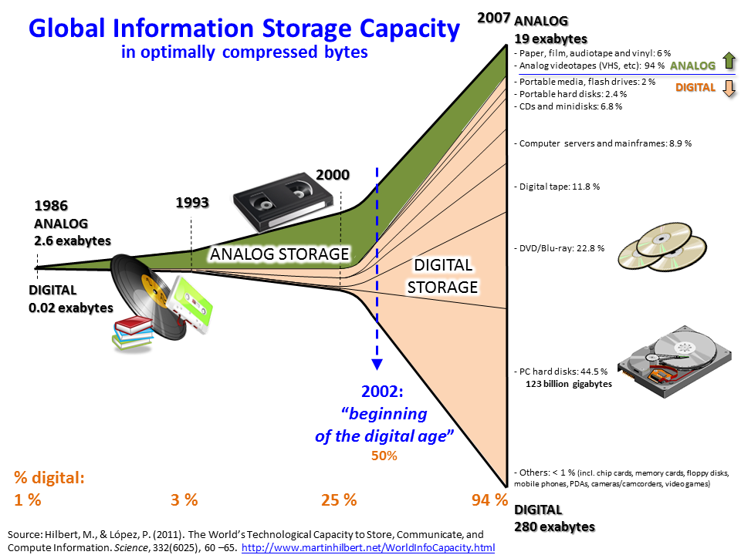

Big Data Storage

Slide 9
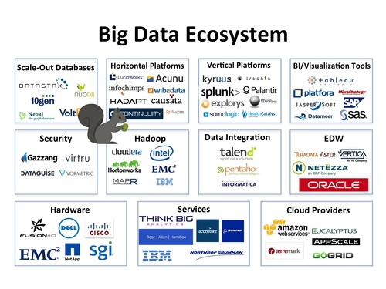
Big Data Ecosystem

Slide 10
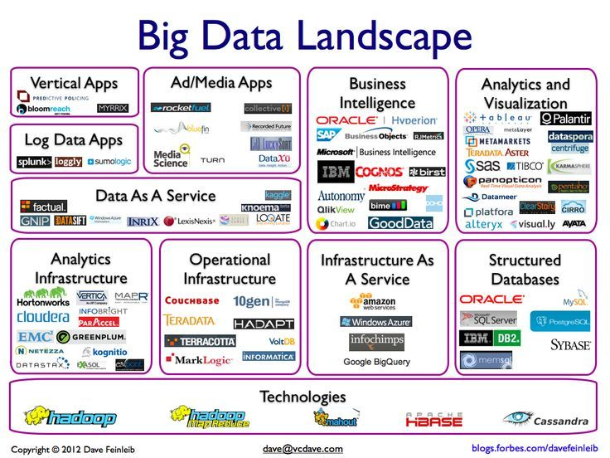
Big Data Landscape

Slide 11
Outline
Overview and Basics Review
Sublinear Sampling
Big Scale Optimization
  Optimization Basics
  BCD and BSUM
  ADMM
  Sparse Optimization
  Mixed Integer Programming
Big Data Storage and Software
Application Example

Slide 12

What Can We Hope For?
What can an algorithm compute if it
  reads only a sublinear portion of the data?
  runs in sublinear time?
Some problems have exact deterministic solutions
For most interesting problems algorithms must be
  approximate
  randomized
Quality of approximation
Resources
number of queries
running time

Slide 13


A Two Cat Problem
Deterministic Algorithm

Slide 14


A Two Cat Problem
One cat
How about you have two cats?

Slide 15
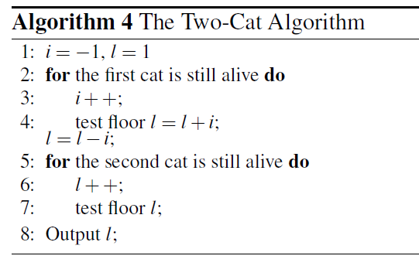
A Two Cat Problem
1,3,6,10,15,21,28
Total number is square root of n, between the number of two samples is also square root of n
When you have two pieces of resources, split them even.

Slide 16
A Housewife Example
Stochastic Algorithm
Assume that there is a group of people who can be classified into different categories.
One category is the housewife.
We want to know the percentage of the housewife in this group, but the group is too big to examine every person.
A simple way is to sample a subset of people and see how many of these people in it belong to the housewife group.
This is where the question arise: how many samples are enough?

Slide 17


A Housewife Example
Not a function of data size!

Slide 18
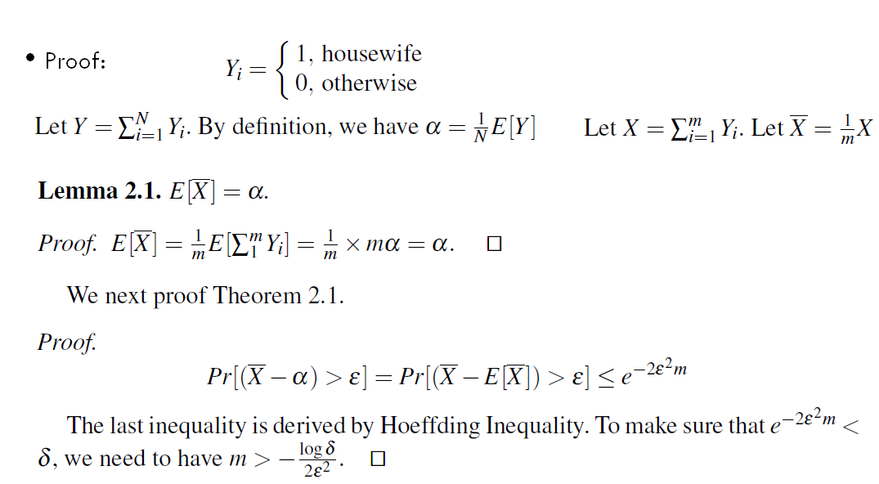
A Housewife Example

Slide 19
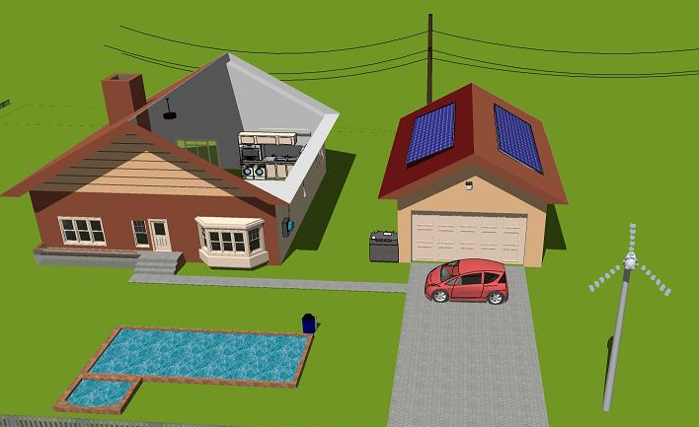
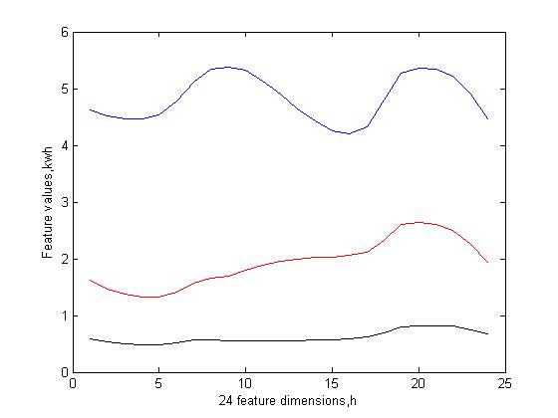
Industry Example: Load Profiling
From smart meter data, try to tell users’ usage behaviors
  CEO, 1%, Audience here
  Worker, middle class, myself
  Homeless, slave, Ph.D. students

Slide 20
Take home message
Tradeoff between accuracy and complexity
Sublinear algorithms are much more efficient than linear algorithms for massive data sets
A good sample strategy is needed
Many applications such as election poll

Slide 21
Outline
Overview and Basics Review
Sublinear Sampling
Big Scale Computing
  Optimization Basics
  BCD and BSUM
  ADMM
  Sparse Optimization
  Mixed Integer Programming
Big Data Storage and Software
Application Example

Slide 22
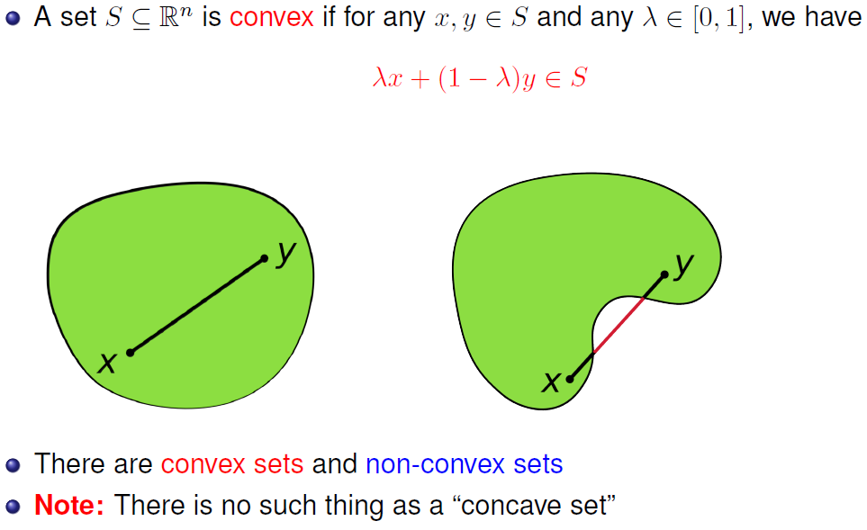
Convex Set

Slide 23
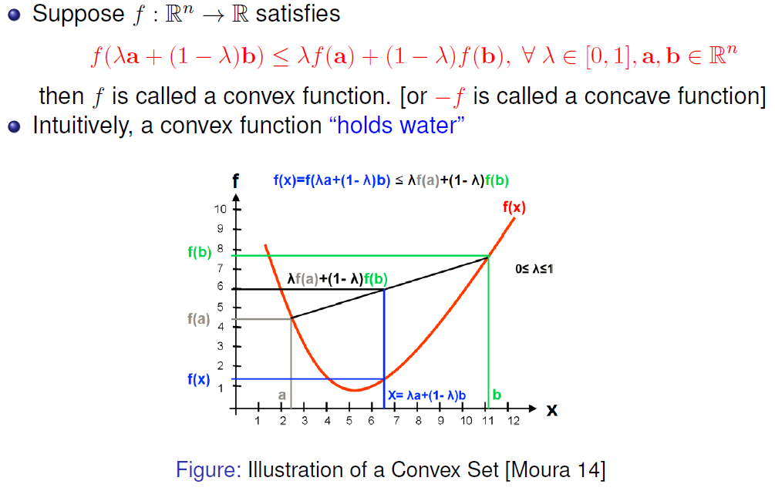
Convex Function

Slide 24
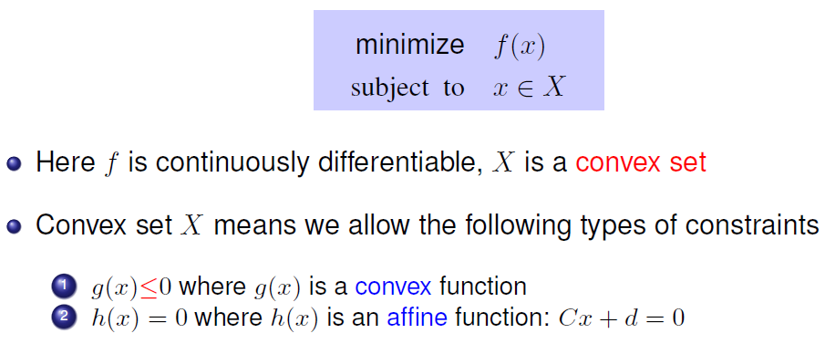
Convex Optimization
Convex means local minimum = global minimum

Slide 25
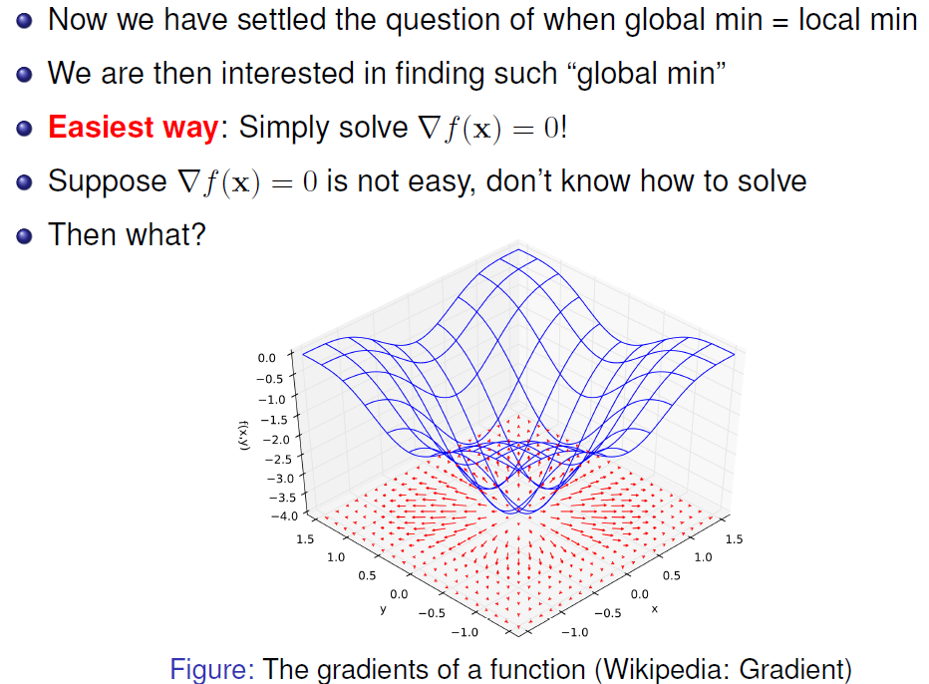
Algorithms to Find Optimum

Slide 26
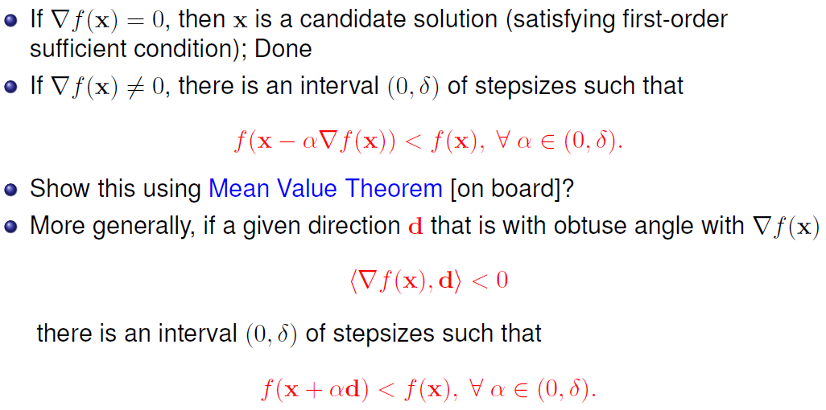
Gradient Descent Method
Notes:
Check what is mean value theorem

Slide 27
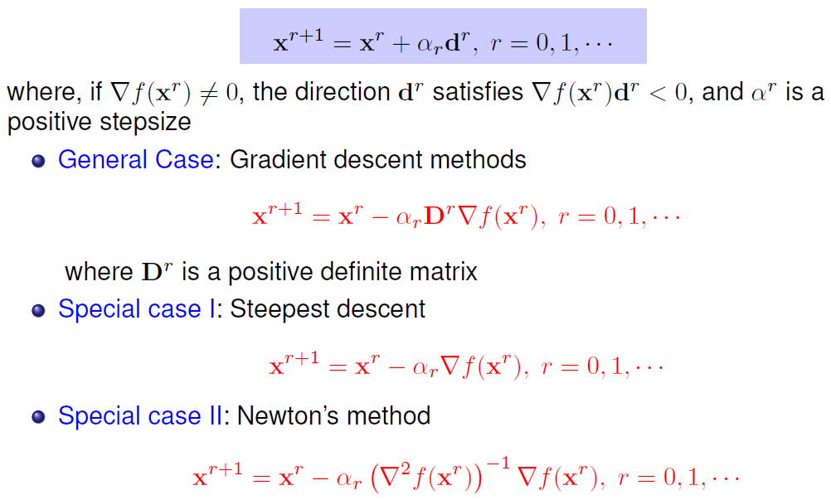
Iterative Descent Method
Step size needs to be adaptive

Slide 28
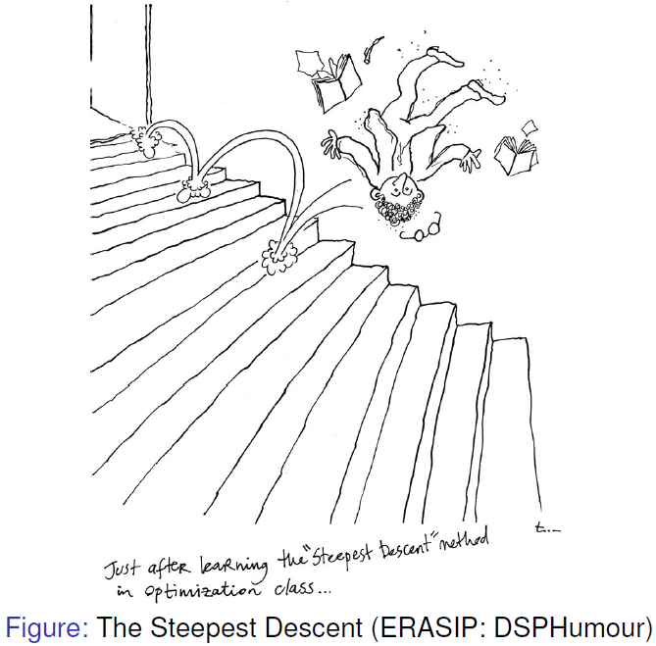
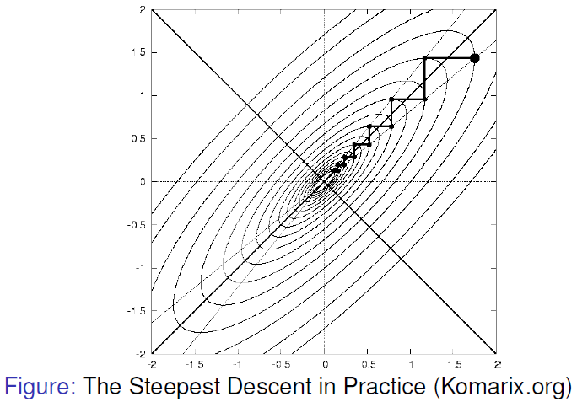
Shortcoming of Gradient Method
However, in practice steepest descent may have slow convergence

Slide 29
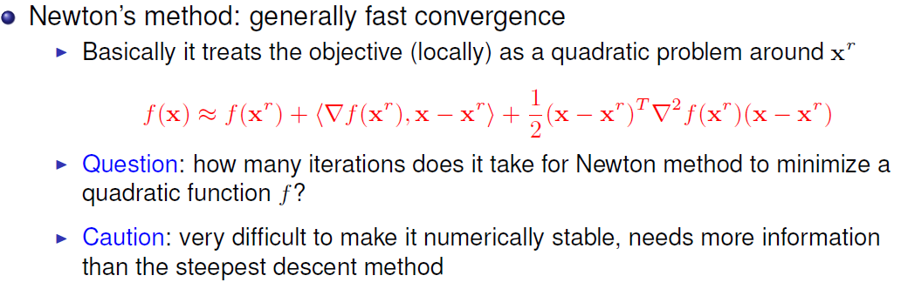
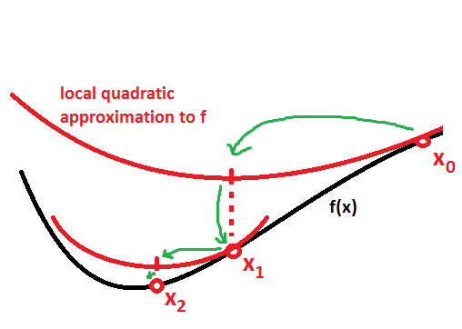
Newton’s Method

Slide 30
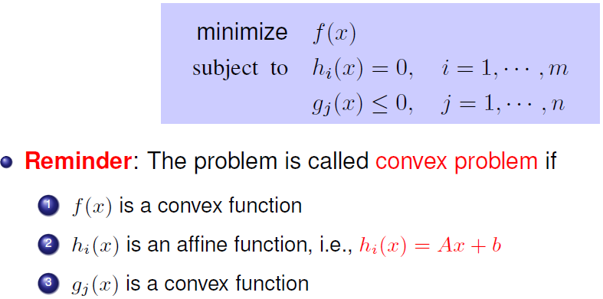
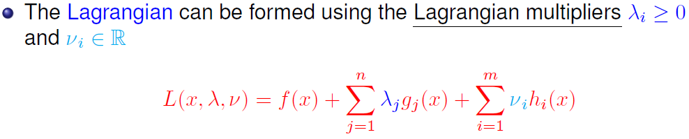
Lagrangian Multiplier

Slide 31
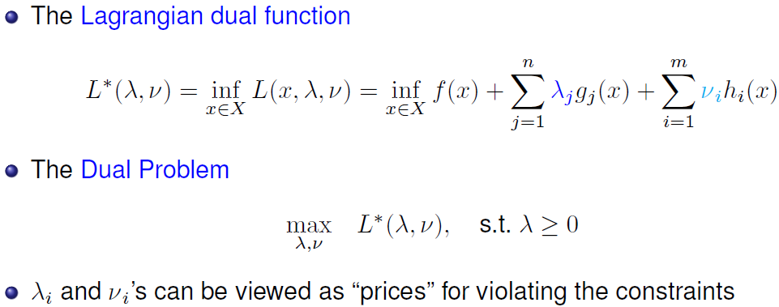
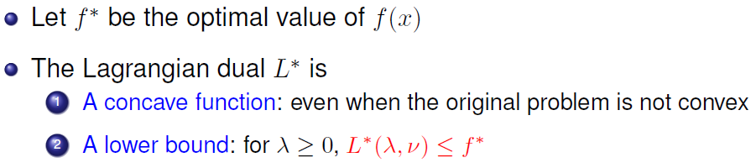
Duality

Slide 32
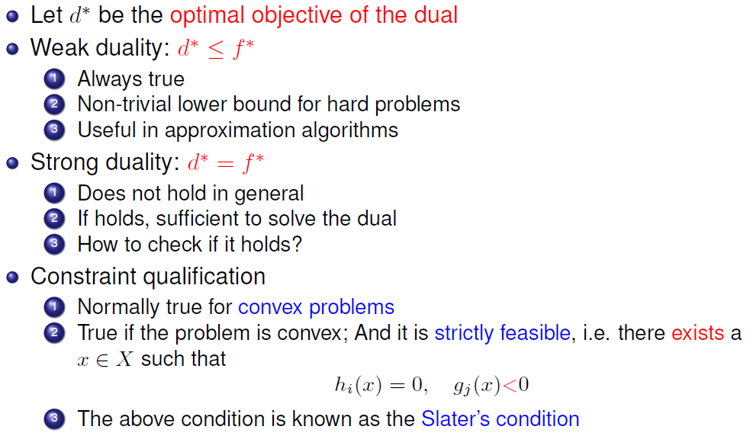
Duality
Notes:
Slater’s condition, what is h and what is g

Slide 33
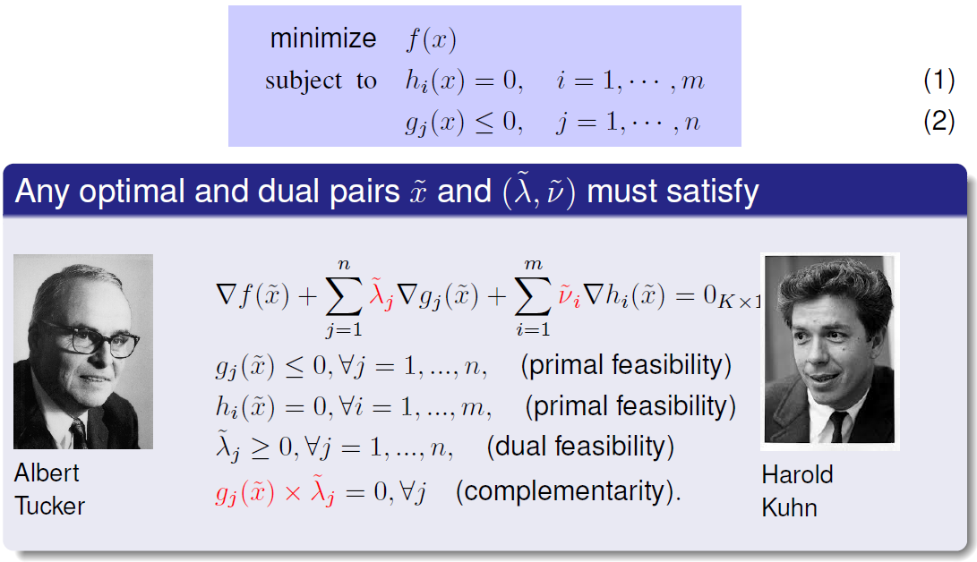
KKT Condition: When to Stop?
Draw a figure on the board
Notes:
Use board to explain

Slide 34
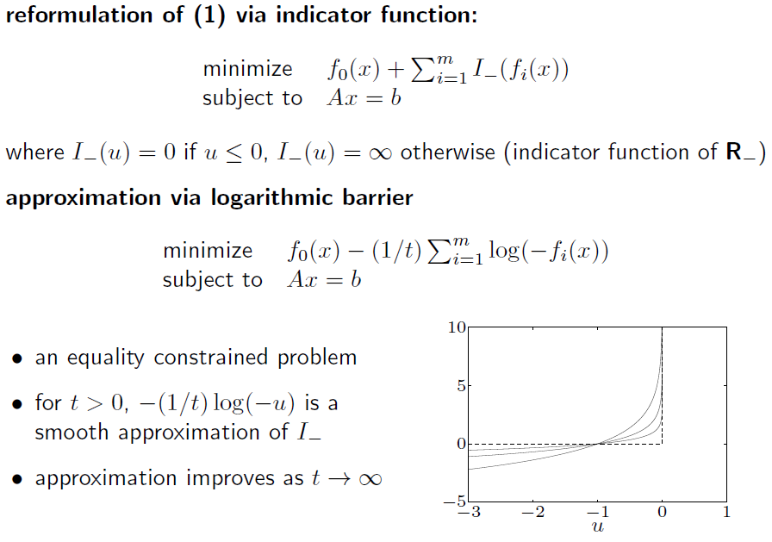
Barrier Function

Slide 35
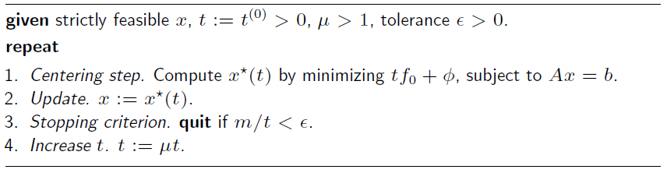
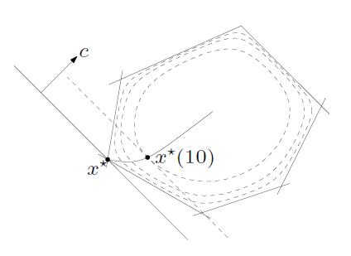
Interior Point Method

Slide 36
Outline
Overview and Basics Review
Sublinear Sampling
Big Scale Computing
  Optimization Basics
  BCD and BSUM
  ADMM
  Sparse Optimization
  Mixed Integer Programming
Big Data Storage and Software
Application Example

Slide 37
Large-Scale Optimization
Generally, optimization algorithms for solving problems of such huge sizes should satisfy
  Simple Subproblem: Each of their computational steps must be simple and easy
  Parallel Implementable: Algorithm is implementable in distributed and/or parallel manner (e.g., in HPC clusters)
  Fast Convergence: A high-quality solution can be found using a small number of iterations
Key: Explore intrinsic decomposability of the problem

Slide 38
BCD Algorithm
A popular family of optimization algorithms: block coordinate descent (BCD) method (a.k.a. the alternating minimization)
The basic steps:
  Partition the entire optimization variables into small blocks
  Optimize one block variable (or few blocks of variables) at each iteration, while holding the remaining variables fixed.
Example of writing a paper

Slide 39
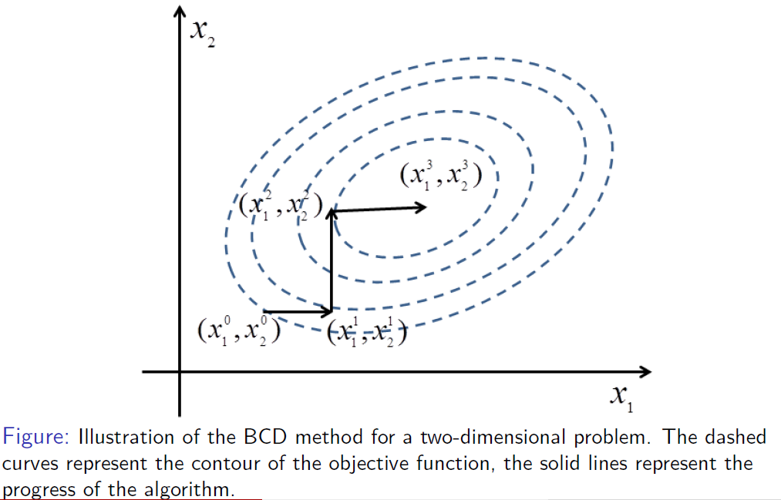
Graphically

Slide 40
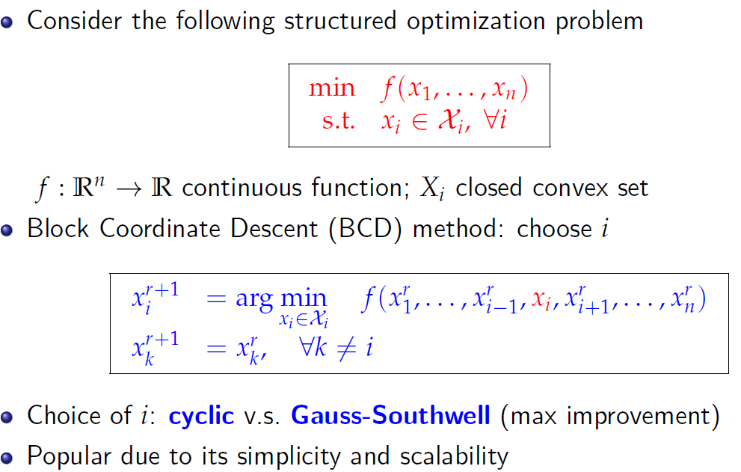
Introduction

Slide 41
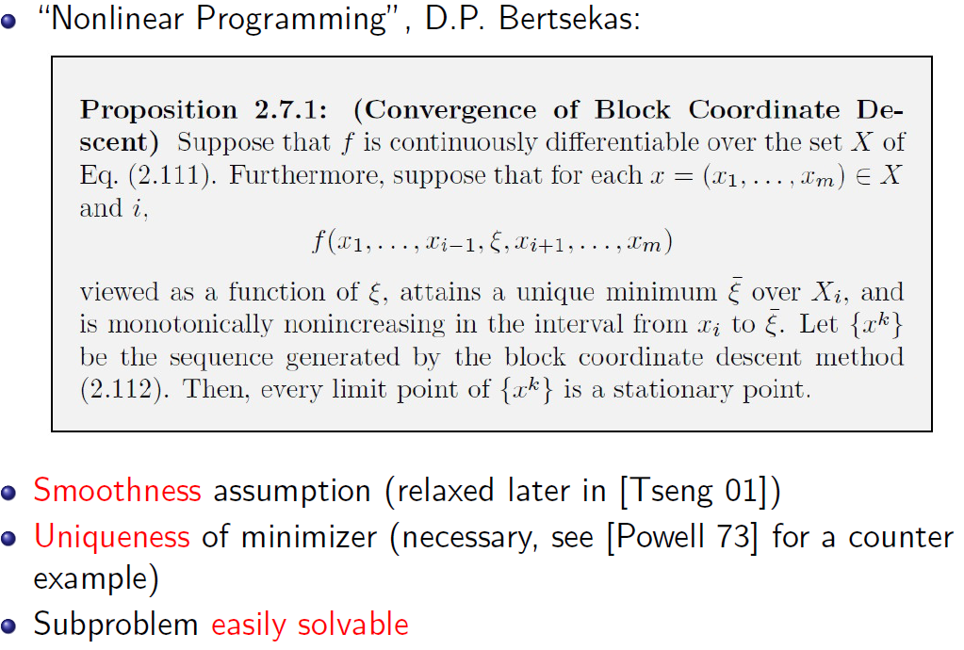
Convergence of BCD
Notes:
Need to study this slide more

Slide 42
Limit of BCD
BCD becomes quite limited for solving large-scale problems
What if the optimizer is not unique (the tensor decomposition problem)?
What if the sub-problem is not easy e.g. non-convex, or convex but not closed form, or is very expensive to obtain an exact global min (the precoder design problem)?
Coupling constraints (the multi-commodity TE problem)?
How to enable parallelization?
Any theoretical guarantees?
Possible cycling solutions between blocks

Slide 43
BSUM Method
Introduce a unifying framework - the Block Successive Upper Bound Minimization (BSUM) [Razaviyayn-H.-Luo 13]
Generalizes all BCD type algorithms
Main Idea: Successively optimize certain upper-bounds of the original objective, in a block-by-block manner
Significantly expands the application domain of BCD
Covers many classical algorithms
  Expectation Maximization (EM) [Dempster et al 77]
  Concave-Convex Procedure (CCCP) [Yuille 03]
  Multiplicative Nonnegative Matrix Factorization (NMF) [Lee and Seung 99]

Slide 44
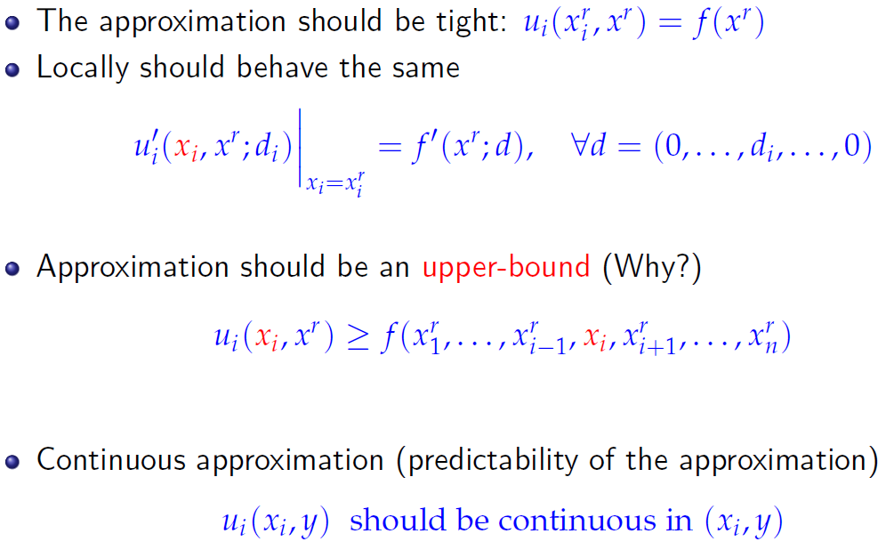
What is an “appropriate" approximation?

Slide 45
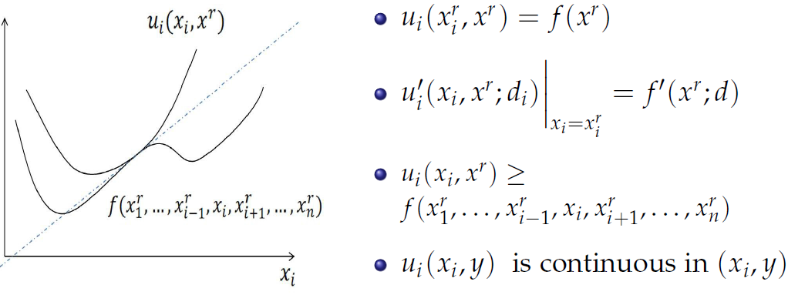
Assumption A for BSUM

Slide 46
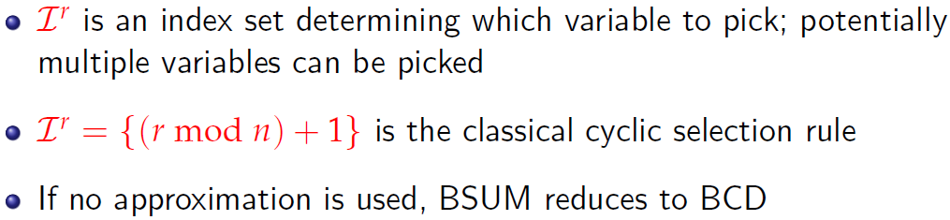
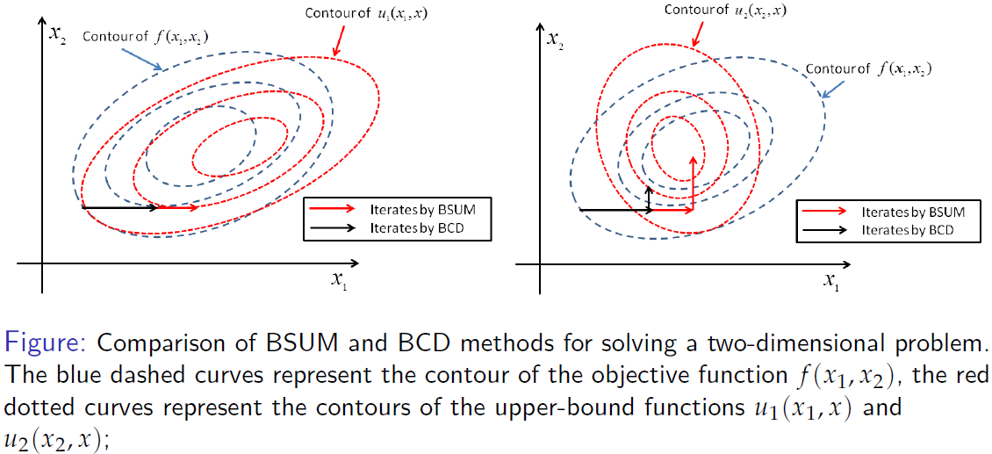
BSUM Algorithm

Slide 47
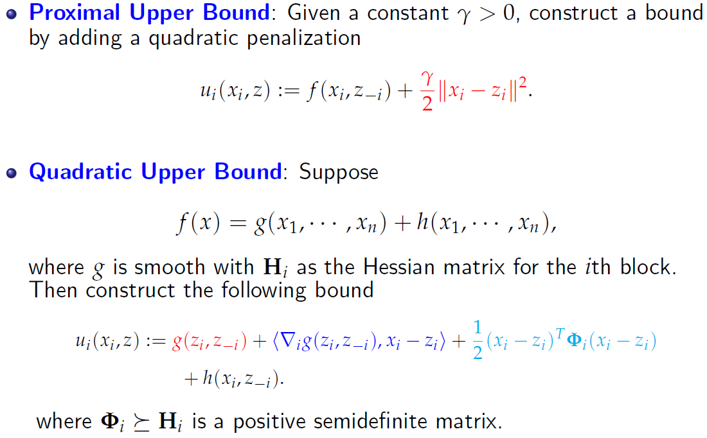
Popular Upper-Bounds

Slide 48
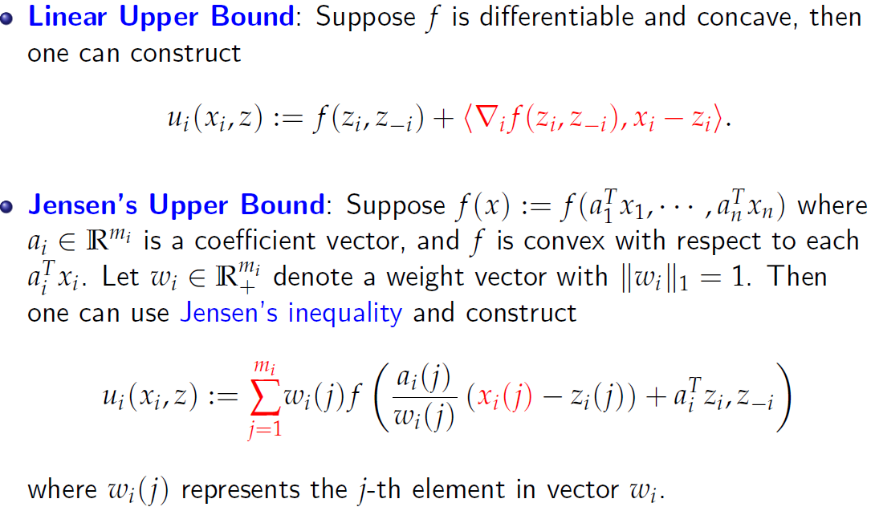
Popular Upper-Bounds (Cont.)

Slide 49
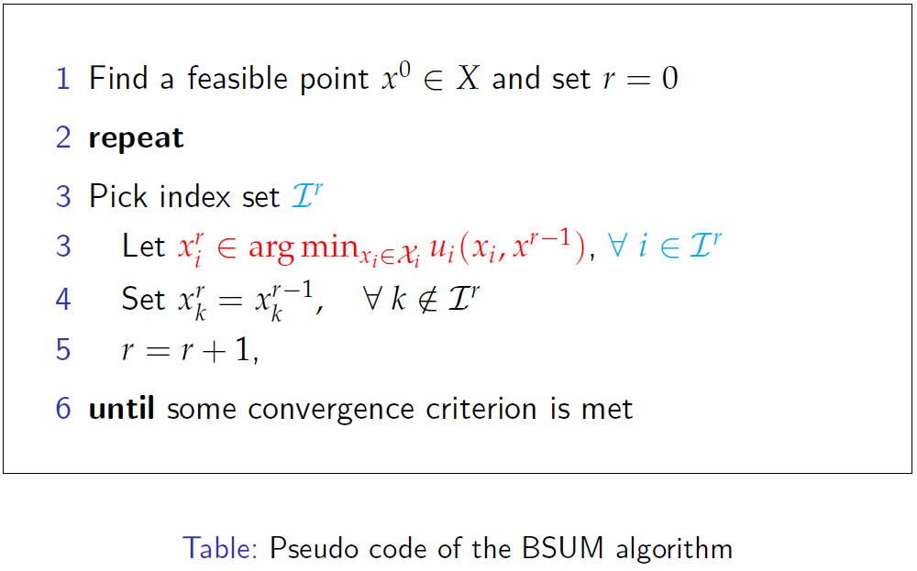
BSUM Algorithm

Slide 50
Outline
Overview and Basics Review
Sublinear Sampling
Big Scale Computing
  Optimization Basics
  BCD and BSUM
  ADMM
  Sparse Optimization
  Mixed Integer Programming
Big Data Storage and Software
Application Example

Slide 51
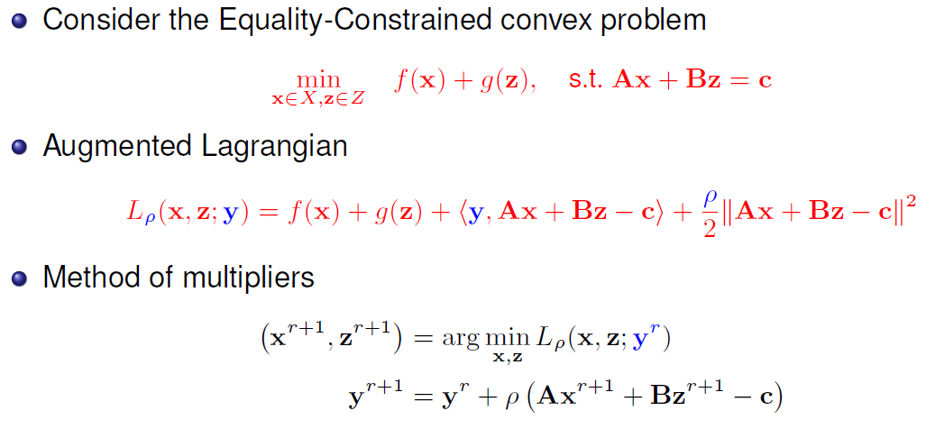
The ADMM Algorithm

Slide 52
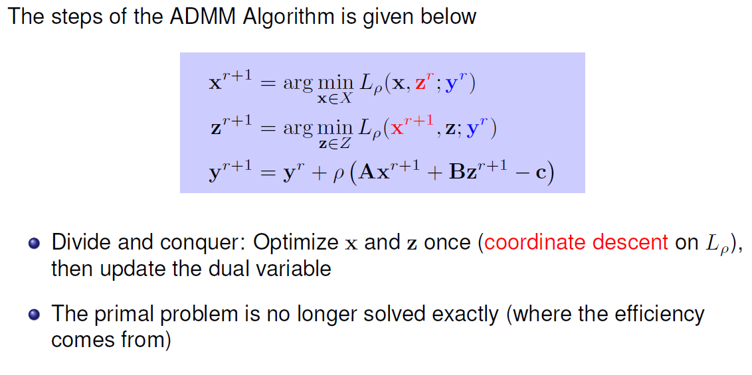
The ADMM Algorithm
California government
Texas
government
US
Congress

Slide 53
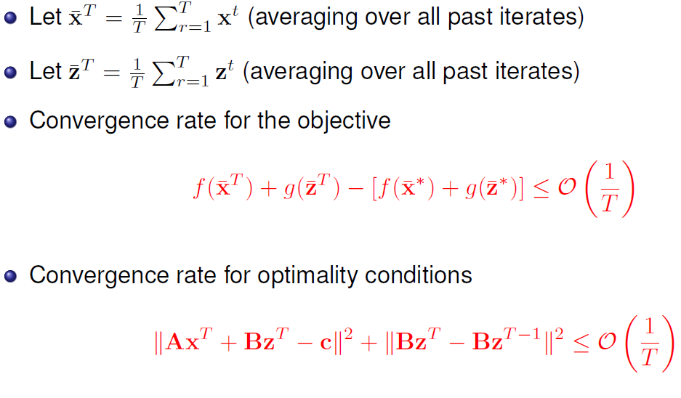
Convergence Rate

Slide 54
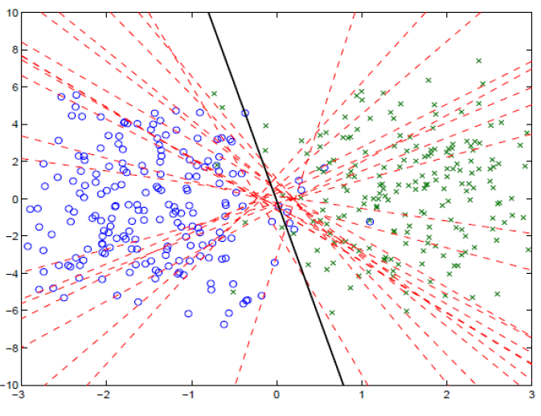
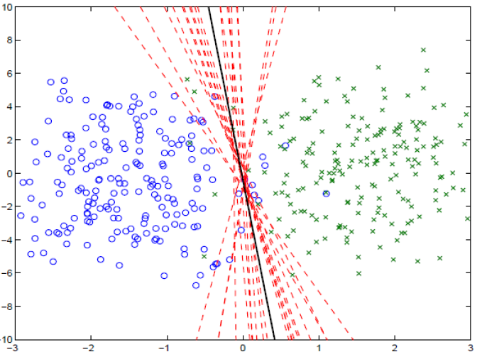
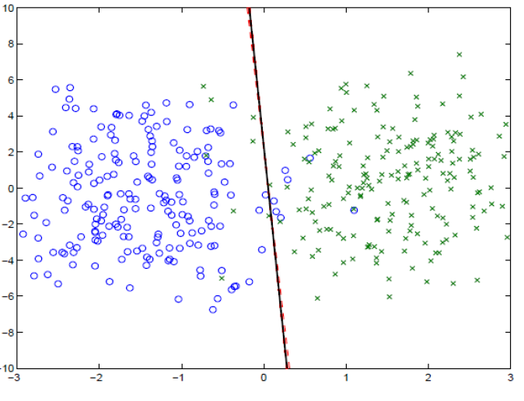
Consensus SVM (from Boyd)
Iterations 1, 5, and 40

Slide 55

Summary For Different Types
“Multi-Block ADMM for Big Data Optimization in Smart Grid," invited, International Conference on Computing, Networking and Communications, Anaheim, CA, February 2015

Slide 56
Outline
Overview and Basics Review
Sublinear Sampling
Big Scale Computing
  Optimization Basics
  BCD and BSUM
  ADMM
  Sparse Optimization
  Mixed Integer Programming
Big Data Storage and Software
Application Example

Slide 57

Traditional Signal Acquisition Approach
The Typical Signal Acquisition Approach
Sample a signal very densely (at lease twice the highest frequency), and then compress the information for storage or transmission
Image Acquisition
This 18.1 Mega-Pixels digital camera senses 18.1e+6 samples to construct an image.
The image is then compressed using JPEG to an average size smaller than 3MB – a compression ratio of ~12.
Notes:
Before I start to talk about the novel approach of signal acquisition, let’s do a little bit review of how people acquire signal with the traditional approach. Usually, we sample a signal very densely and then compress the information for storage or transmission. Take this 6.1 mega-pixels DC as an example. It senses a large number of samples to construct an image. The image is then compressed using JPEG with an compression ratio of about 20 to an average size of smaller than 1MB.

Slide 58
Compressive Sensing?
A natural question to ask is
?
Could the two processes (sensing & compression) be combined
Move the burden from sampling to reconstruction
The answer is YES!
This is what Compressive Sensing (CS) is about.
Notes:
Facing with the problems mentioned above, a natural question to ask is Could the two processes, say, sensing and compressing be combined? The answer is Yes! And this is CS about.

Slide 59

CS and Sparse Optimization Concept
Sparse X
Random linear projection
Dimension reduction from X to Y
  M > Klog(N/K)
Change sampling burden to computation
Notes:
CS theory claims that, when a signal is sparse, it could be sensed compressively and got fully recovered with over whelming probability. The signal could be sparse either by itself or after some known transformation. X here is an example of sparse signal, with limited number of nonzero entries which are denoted by the colored blocks.
Then by implementing a proper projection, we could realize a compressed sampling, compressed means that we realized a dimension reduction during the process. Besides, the dimension reduction is done with no or litter loss of information of the original signal.
Then you may curious about how this dimension reduction is done, CS theory shows that by simply multiplying the signal with a random matrix, the sparse information will be well preserved in the measurement for signal reconstruction.
And the random matrix could be one of those with IID, since it had been proved that these random matrix satisfies the RIP which has been proved as the necessary conditions for CS.
Then in the signal reconstruction part, as the number of unknowns outweigh the number of measurement, the problem becomes ill posed. However, this problem could be treated as a convex optimization problem, and there are a number of algorithms for solving this kind of problem, including l1 norm minimization, ````
Here is a simple example shows how CS works. Our signal here has 256 entries within which, only 4 are nonzero. We sampled it following CS theory and got 25 samples which is 10% of the signal length, shows in the middle of the figure. Then, using the widely used l1 norm minimization algorithm, we got our signal exactly recovered from the samples.

Slide 60
CS Concept
K-Sparse
Signal
Compressed
Samples
Exact
Recovery
Random Linear
Projection (RIP)
K<m<<n
Notes:
CS theory claims that, when a signal is sparse, it could be sensed compressively and got fully recovered with over whelming probability. The signal could be sparse either by itself or after some known transformation. X here is an example of sparse signal, with limited number of nonzero entries which are denoted by the colored blocks.
Then by implementing a proper projection, we could realize a compressed sampling, compressed means that we realized a dimension reduction during the process. Besides, the dimension reduction is done with no or litter loss of information of the original signal.
Then you may curious about how this dimension reduction is done, CS theory shows that by simply multiplying the signal with a random matrix, the sparse information will be well preserved in the measurement for signal reconstruction.
And the random matrix could be one of those with IID, since it had been proved that these random matrix satisfies the RIP which has been proved as the necessary conditions for CS.
Then in the signal reconstruction part, as the number of unknowns outweigh the number of measurement, the problem becomes ill posed. However, this problem could be treated as a convex optimization problem, and there are a number of algorithms for solving this kind of problem, including l1 norm minimization, ````
Here is a simple example shows how CS works. Our signal here has 256 entries within which, only 4 are nonzero. We sampled it following CS theory and got 25 samples which is 10% of the signal length, shows in the middle of the figure. Then, using the widely used l1 norm minimization algorithm, we got our signal exactly recovered from the samples.

Slide 61

Sparse optimization models
Some concepts about norm

Slide 62

Sparse optimization models
Some concepts about norm

Slide 63

Sparse optimization models
Some concepts about norm

Slide 64


Sparse optimization models
The L1 norm of x can be replaced by regularization functions corresponding to transform sparsity, joint sparsity, low ranking, as well as those involving more than one regularization terms.

Slide 65
Outline
Overview and Basics Review
Sublinear Sampling
Big Scale Computing
  Optimization Basics
  BCD and BSUM
  ADMM
  Sparse Optimization
  Mixed Integer Programming
Big Data Storage and Software
Application Example

Slide 66

Mixed-integer Linear Programming
Some integer variables and some continuous variables

Slide 67



Benders Decomposition
Initialization
  Loop index ν = 1
  Solve
  This problem has the trivial solution:

Slide 68



Benders Decomposition
Subproblem
  Solve
  The solution of the subproblem is:
  Dual variable values:

Slide 69



Benders Decomposition
Convergence checking
  Upper bound: variable is in the middle and not the final one
  Lower bound: objective function is lower bound and the constraints are relaxed
  Stopping criterion:

Slide 70

Benders Decomposition
Master problem
  Update loop index ν = ν +1
  Solve:
  Obtain the optimal solution and continue to solve subproblem
Benders Cuts

Slide 71
Benders Decomposition
The geometric interpretation
Benders cuts’ slope is generated from dual variables
Current upper bound
Current lower bound
Approximation using hyperplanes

Slide 72
Benders Decomposition
START
Solve master problem
Solve sub problem
yes
Add Benders cut
Terminate?
no
END

Slide 73








Hybrid Quantum Benders' Decomposition Algorithm
$\underline{t}=\overline{t}$ ?
D-Wave hybrid solver: use classical computation to assist quantum annealing.
“Hybrid Quantum-Classical Computing for Future Network Optimization,” IEEE Network 2022

Slide 74
Outline
Overview and Basics Review
Sublinear Sampling
Big Scale Computing
  Optimization Basics
  BCD and BSUM
  ADMM
  Sparse Optimization
  Mixed Integer Programming
Big Data Storage and Software
Application Example

Slide 75
Hadoop
Open-source implementation of frameworks for reliable, scalable, distributed computing and data storage.
A flexible and highly-available architecture for large scale computation and data processing on a network of commodity hardware.
Designed to answer the question: “How to process big data with reasonable cost and time?”
Original from Yahoo! MapReduce is a closed source framework by Google, which provides Map and Reduce operations.

Slide 76
HaDoop
Since its debut on the computing stage, MapReduce has frequently been associated with Hadoop. Java-based implementation of MapReduce
Hadoop is an open source implementation of MapReduce and is currently enjoying wide popularity
Hadoop presents MapReduce as an analytics engine and under the hood uses a distributed storage layer referred to as Hadoop Distributed File System (HDFS)

Slide 77
Key components
Hadoop Common: Common utilities
(Storage Component) Hadoop Distributed File System (HDFS): A distributed file system that provides high-throughput access. HDFS mimics Google File System (GFS)
  Many other data storage approaches also in use
  E.G., Apache Cassandra, Apache Hbase, Apache Accumulo (NSA-contributed)
(Scheduling) Hadoop YARN: A framework for job scheduling and cluster resource management
(Processing) Hadoop MapReduce (MR2): A YARN-based system for parallel processing of large data sets
  Other execution engines increasingly in use, e.g., Spark

Slide 78
Design of Hadoop Distributed File System (HDFS)
Master-Slave design
Master Node
  Single NameNode for managing metadata
Slave Nodes
  Multiple DataNodes for storing data
Other
  Secondary NameNode as a backup

Slide 79
HBase
NoSQL data store build on top of HDFS
Based on the Google BigTable paper (2006)
Can handle various types of data
Stores large amount of data (TB,PB)
Column-Oriented data store
Big Data with random read and writes
Horizontally scalable

Slide 80
HaDoop YaRn
YARN is the architectural center of Hadoop that allows multiple data processing engines such as interactive SQL, real-time streaming, data science and batch processing to handle data stored in a single platform, unlocking an entirely new approach to analytics.
YARN is the foundation of the new generation of Hadoop and is enabling organizations everywhere to realize a modern data architecture.

Slide 81
Map Reduce
Map:
  Accepts input key/value pair
  Emits intermediate key/value pair
R
E
D
U
C
E
Reduce :
  Accepts intermediate key/value* pair
  Emits output key/value pair
Very
big
data
M
A
P
Partitioning
Function
Result

Slide 82
Spark VS mapreduce/hadoop
MapReduce/

Slide 83
MapReduce VS Hadoop
MapReduce | Hadoop
Google | Yahoo
GFS | HDFS
Bigtable | HBase
Closed source | Open source

Slide 84
Outline
Overview and Basics Review
Sublinear Sampling
Big Scale Computing
  Optimization Basics
  BCD and BSUM
  ADMM
  Sparse Optimization
  Mixed Integer Programming
Big Data Storage and Software
Application Example

Slide 85

MOTIVATION
Joint optimal scheduling for gird-connected and islanded operation
85

Slide 86










SYSTEM MODEL
Main grid
…
Microgrid 1
Microgrid 2
Microgrid N
Power balance constraints
Self generation
Power from main grid
Power from neighbors
86

Slide 87
Islanded operation
Main grid
…
Microgrid 1
Microgrid 2
Microgrid N
87

Slide 88




Islanded constraints
For microgrid in islanded mode
Fraction of load curtailment
For microgrid in normal mode
Ramping constraints
88

Slide 89

Problem formulation
Microgrid generation cost and load curtailment minimization problem
Large-scale problem
89

Slide 90

Parallel algorithm
Master computer
Normal operation
Solve normal problem for $y^{o},{\left\{x_{i}^{o}\right\}}_{∀i}$
$y^{o,1}, {\left\{x_{i}^{o,1}\right\}}_{∀i}$,$λ^{1},μ^{1}$
$$y^{o}{,\left\{x_{i}^{o}\right\}}_{∀i}$$
$y^{o,N}, {\left\{x_{i}^{o,N}\right\}}_{∀i}$,$λ^{N},μ^{N}$
$$y^{o}{,\left\{x_{i}^{o}\right\}}_{∀i}$$
$y^{o}{,\left\{x_{i}^{o}\right\}}_{∀i}$
$y^{o,2}, {\left\{x_{i}^{o,2}\right\}}_{∀i}$,$λ^{2},μ^{2}$
Islanded operation
Solve for $y^{o,2}, {\left\{x_{i}^{o,2}\right\}}_{∀i}$
Update $λ^{2},μ^{2}$
Computer 1
Computer 2
Computer N
Islanded operation
Solve for $y^{o,1}, {\left\{x_{i}^{o,1}\right\}}_{∀i}$
Update $λ^{1},μ^{1}$
Islanded operation
Solve for$y^{o,N}, {\left\{x_{i}^{o,N}\right\}}_{∀i}$
Update $λ^{N},μ^{N}$
90

Slide 91


Simulation results
Converge to optimum after about 40 iterations
The fraction of load curtailment
when switching into the islanded mode: sparse number of microgrids have to reduce loads
91

Slide 92

Big data algorithm implementation
MapReduce programming model
Normal operation
Solve normal problem for $y^{o},{\left\{x_{i}^{o}\right\}}_{∀i}$
Master computer
Islanded operation
Solve for $y^{o,1}, {\left\{x_{i}^{o,1}\right\}}_{∀i}$
Update $λ^{1},μ^{1}$
Computer 1
Islanded operation
Solve for $y^{o,2}, {\left\{x_{i}^{o,2}\right\}}_{∀i}$
Update $λ^{2},μ^{2}$
Computer 2
Islanded operation
Solve for$y^{o,N}, {\left\{x_{i}^{o,N}\right\}}_{∀i}$
Update $λ^{N},μ^{N}$
Computer N
92

Slide 93


Map reduce algorithm for admm
Faster with a larger number of microgrids
93

Slide 94

Conclusion

Slide 95









http://wireless.egr.uh.edu/
http://www2.egr.uh.edu/~zhan2
95

