Slide 1

5G Technology Tutorials
Zhu Han
Department of Electrical and Computer Engineering
University of Houston, Houston, TX, USA
Slides on http://wireless.egr.uh.edu/research.htm

Slide 2
Table of Content
Overview of 5G
Key Technologies
Device-to-device Communication
Small Cell Network (HetNet)
Full Duplex

Slide 3
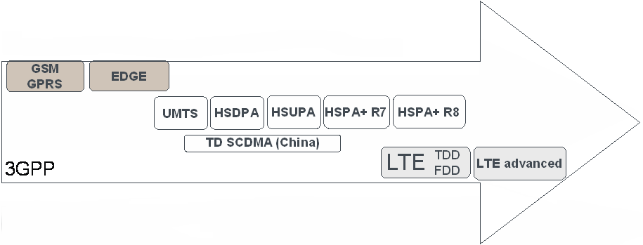
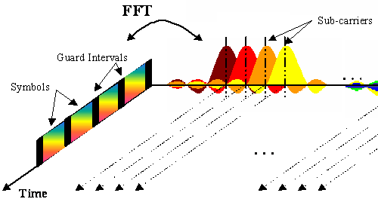
Standardization Facilitates Technology Evolution
Each new evolution builds on the established market of the previous
Backwards-compatible evolution
But larger technology steps require revolutions:
1995
2000
2005
2010
2015
From TDMA:
to CDMA:
to OFDMA:

Slide 4

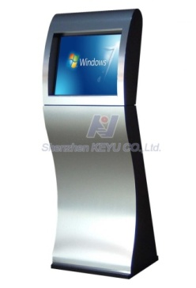
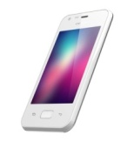


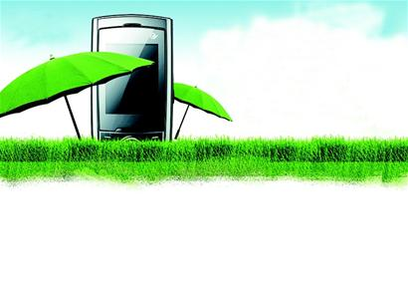
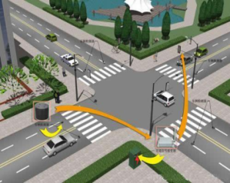
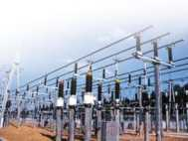
KPIs
6 Key Performance Indicators (KPIs) for 5G
10Gbps
1000X Capacity
(Traffic and Connections)
10X User Rate Anywhere
(100M-1Gbps)
10X Peak Data Rate
(10+Gbps)
But what is 5G? D2D, small cell, Massive MIMO or full duplex?
1000X Energy&Cost Reduce
10X Low Latency,
High reliability
5-10X Spectrum Efficiency

Slide 5
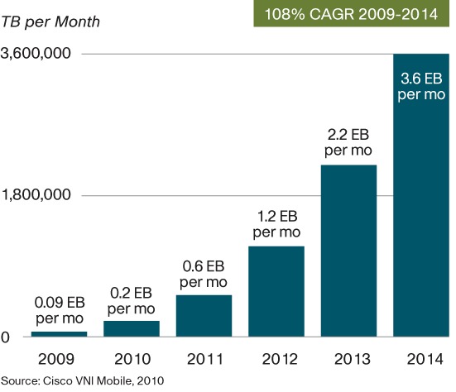
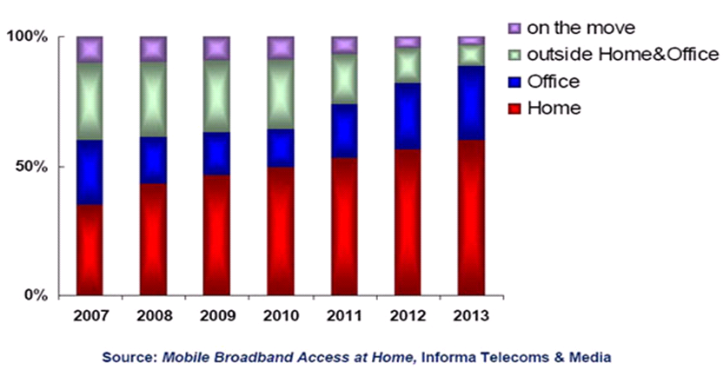
Future Wireless Challenges
Mobile Internet and Smart Phones
Bandwidth and data traffic boost (Cisco)
Data traffic increases 2 times/per year, 1000 times by 2020
Wireless network cannot support that!
Information aggregate to hotspot and local area
70% in office and hotspot, over 90% in future
Hotspot QoS cannot be guaranteed!
Bandwidth demand over 1200MHz，ITU assignment less than 600MHz

Slide 6
Table of Content
Overview of 5G
Key Technologies
Device-to-device Communication
Small Cell Network (HetNet)
Full Duplex

Slide 7
Possible Solutions
Add fixed AP
Combine Cellular and Ad-hoc
Cell Capacity
Ad-hoc opti-mal rate
By “Shannon Theory”，network capacity relies on bandwidth and APs
Current：Add fixed APs
Sum rates
Number of UE
P. Gupta and P. Kumar, “The capacity of wireless networks,” IEEE Transactions on Information Theory, vol. 46, no. 2, pp. 388-404, Mar. 2000.

Slide 8






Definition and Benefits
Definition of Device-to-Device (D2D) Communications
D2D communications commonly refer to the technologies that enable devices to communicate directly without an infrastructure of access points or base stations.
Increase network capacity
Extend coverage
Offload data
Improve energy efficiency
Create new applications
eNB
eNB

Slide 9


Deployment Roadmap
Cellular unaware D2D
Cellular network is not aware of D2D
2 RATs, e.g. 3G + Wifi
No cooperation between cellular and D2D
Cellular aware D2D
Cellular network is aware of D2D
2 RATs, e.g. LTE + Wifi
Kind of cooperation between cellular and D2D
Cellular controlled D2D
Cellular network fully controls D2D
A single RAT, e.g. LTE-A
D2D is a part of cellular communication
RAT1
RAT1
RATs converging
RAT1
flow1
flow1
flow1
flow2
RAT2
UE2
RAT2
flow2
UE2
flow2
UE2
UE1
UE1
UE1
Scenario A
Scenario B
Scenario C
D2D Benefits Scenario A Scenario B Scenario C
Traffic offload
Unified & Simplified comm.
User experience improvement
Cellular capacity enhancement

Slide 10



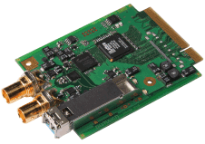








Scenario A: Cellular Unaware
Example structure:
Typical applications
Data synchronization, Social networking, Mobile advertising, Automation control, etc.
New App
3G
3G
App
App
Data synchronization
Wifi
Wifi
BS
BS
Mobile advertising
Node functionality
User device: application distribute flows among different RATs
No impact on RAN & CN nodes
social network
Key technology
D2D opportunity identification & neighbor discovery
Flow distribution among different RATs
Cognitive radio technology
Benefits/Gains
Offload cellular traffic
Unified & Simplified communications

Slide 11

Scenario B: Cellular aware
Node functionality
User device: new D2D coordination function
RAN node: No impact
CN node: new D2D coordination function
Typical applications
Cellular P2P: A, B, C receive data from CN, and share the non-achieved data among themselves
CN node
Core Network
Example structure:
NB
Core Network
New coordination function/services
NB
A
B
C
App
LTE
App
LTE
Key technology
D2D opportunity identification
D2D coordination
Benefits/Gains
Better user experience, e.g. QoS, mobility, etc.
Core network traffic offload
Unified & Simplified communications
Wifi
Wifi

Slide 12


Scenario C: Cellular controlled
Node functionality
User device: New D2D control & interface
RAN nodes: New D2D control function
CN nodes: New D2D control function
Typical applications
Cooperative transmission: Mobiles interact to jointly transmit and/or receive information in cellular environments.
Example structure:
eNB
New D2D control function/services
Core Network
Key technology
D2D control
D2D air interface design
Cooperative transmission
App
App
Cellular
Benefits/Gains
Cellular capacity improvement
Better QoS, security & mobility support
Core network traffic offload
Unified & Simplified communications
New Cellular D2D interface

Slide 13
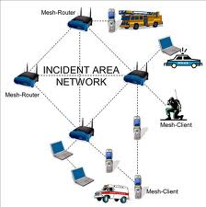
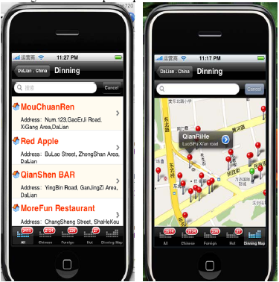
D2D Local Area Networks
RAT | Solution | Benefits | Frequency | Disadvantages
Wireless Mesh | WLAN + Ad Hoc | Flexible | Un-authorized | QoS in-guaranteed
D2D LAN | Cellular +Ad Hoc | Flexible | Authorized | QoS guaranteed
Smart-phones and data-service based mobile internet
eNB
eNB
D2D LAN
UEs can be connected in an Ad-hoc way and use cellular frequency with guaranteed QoS
Create new services for operators and vendors
Expand to many other areas
Wireless Mesh
Mobile social networks:
Mobile + social
Connected via mobiles
Information push, sharing, etc
New business model

Slide 14
D2D LAN System
D2D LAN Protocol
MME
S-GW
System configuration
Frequency | Authorized
System | TDD
Network | Cellular network and D2D LAN
UE mode | Cellular/D2D
Topology | Multi-cell
Control | Core network, eNB, and UE
EPC
Key issues
Usage scenarios, services, and billing
Channel model
Physical layer
MAC layer
Network layer
Cellular
D2D LAN:
Subnet
Parallel to Cellular
Flexible topology
Controlled by core network and eNB
D2D
E-UTRAN

Slide 15
D2D LAN Problems
MME
S-GW
Realize full connection，networks become complicated
Core Net
Introduce“device”freedom
Space, Time, Frequency, and Device, joint optimization
Communication Freedom increase
Cellular
Support high-date transmission，interference becomes severe
Realize four dimension optimization，resource management is challenging
D2D LAN

Slide 16
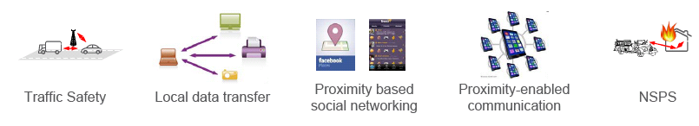
3GPP R12 on D2D
Drastically different requirements
The LTE platform would have the advantage over others, such as Wi-Fi and Bluetooth that operate device to device protocols, because they use license exempt spectrum.
Proximity-based applications and services represent a recent and enormous social-technological trend
These applications and these services are based on the awareness that two devices or two users are close to each other
Awareness of proximity carries value, and generates demand for an exchange of traffic between them
Direct D2D communication is also essential for public safety services
e.g. in case of lack of network infrastructure in disaster situations)
3GPP has imitated work on enhancing the LTE-EPC platform to support these capabilities

Slide 17
Table of Content
Overview of 5G
Key Technologies
Device-to-device Communication
Small Cell Network (HetNet)
Full Duplex

Slide 18
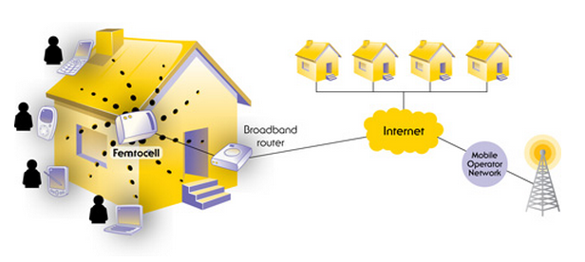
Overview of Femtocells
Femtocells are low-power wireless access points that operate in licensed spectrum to connect standard mobile devices to a mobile operator’s network using residential DSL or cable broadband connections.

Slide 19
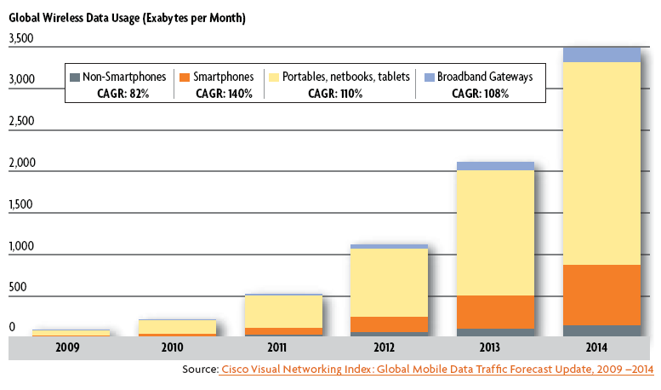
Overview of Femtocells
Why femtocells is needed?
Exponentially increasing wireless data traffic.

Slide 20
Overview of Femtocells
The key attributes of femtocells:
Mature mobile technology
Operating in licensed spectrum
Generating coverage and capacity
Using internet-grade backhaul
At competitive prices
Fully managed by licensed operators
Question
What is the difference from WIFI: some control
What is different from microcell: backhaul

Slide 21
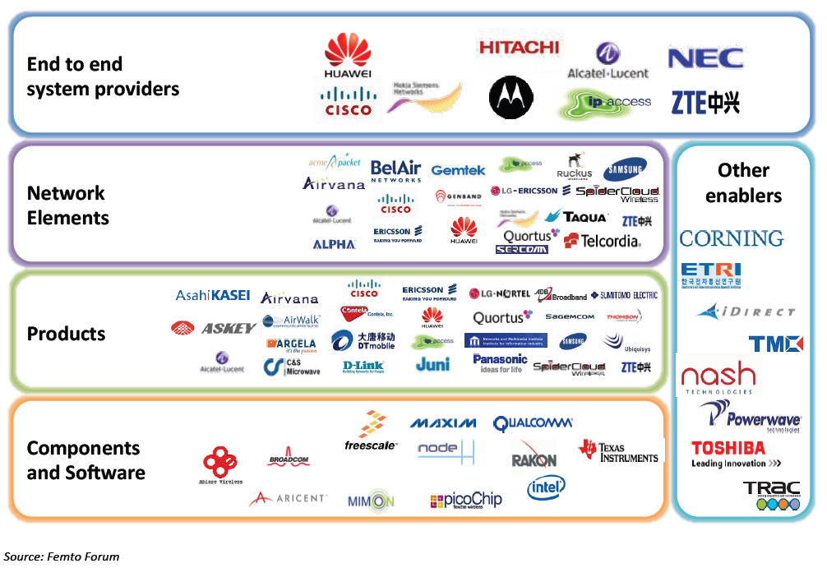
A Brief History of Femtocells
Femtocell ecosystem

Slide 22
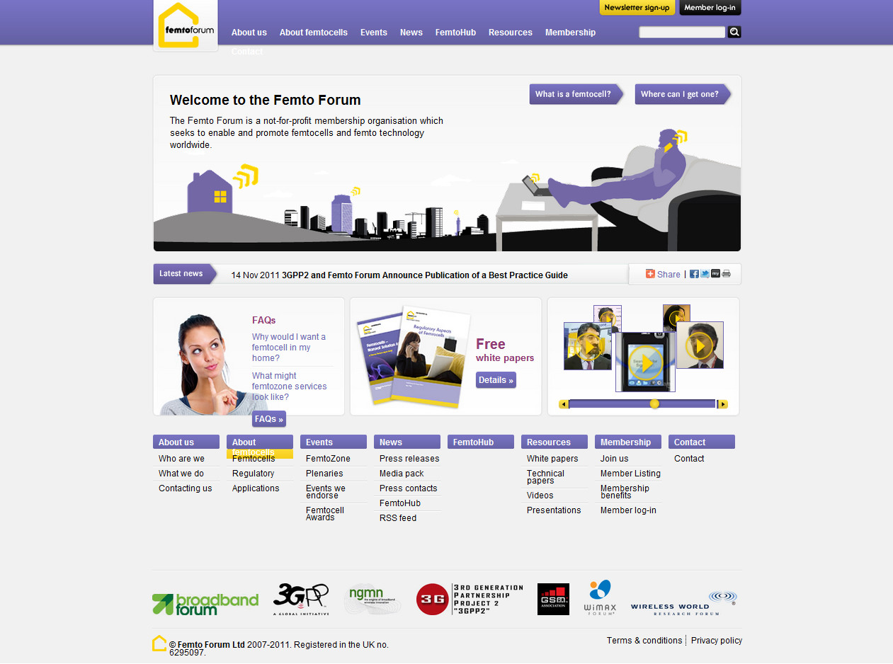
Femtocell Standardization
The governing body for standardization is the Femto Forum (www.femtoforum.org).

Slide 23
Femtocell Standardization
Mission:
The mission is to advance the development and adoption of small cells for the provision of high-quality 2G/3G/4G coverage and services within residential, enterprise, public and rural access markets.
3G or 4G
The Femto forum is active in two main areas:
Standardization, regulation & interoperability;
Marketing & promotion.

Slide 24
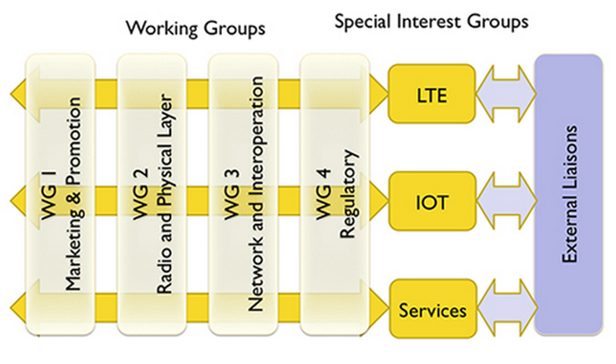
Femtocell Standardization
Working groups
The marketing & promotion group
The radio & physical layer group
The networks & interoperability group
The regulatory group

Slide 25
Femtocell Standardization
3GPP standards for UMTS femtocells
Interface between the femtocell (Home Node B - HNB) and the femto network gateway (HNB Gateway, HNB-GW)
Security protocols to authenticate femtocell (HNBs) and secure communications across the un-trusted Internet
Management protocols for “touch free” Operations, Administration, and Management (OA&M) of femtocells (HNB devices)

Slide 26
Femtocell Standardization
3GPP2 standards for CDMA femtocells
SIP/IMS-based 1x circuit services architecture
Packet data architecture
Security framework
Enhancements to mobile devices to make them more femto-aware
Foundations of femtozone services (Local IP Access and Remote IP Access)
Femtocell management architecture

Slide 27
Femtocell Standardization
The need for LTE femtocells
There is a limit to how many outdoor cell sites can be built;
The spectrum available to any particular operator is limited;
Cell site backhaul is expensive.
LTE is the first cellular technology which will be able to take full advantage of femtocell.
The large quantity of dynamically allocated time and frequency slots.

Slide 28
Femtocell Standardization
LTE architecture with deployed HeNB GW

Slide 29
Femtocell Models
Traditional hexagonal grid model
Dozens of systems parameters can be modeled;
Other-cell interference can be modeled simply;
The results is sufficiently accurate to enable the evaluation of new proposed techniques.
Multi-tiered cellular model
Macrocells
Picocells
Femtocells
Possibly further radiating elements

Slide 30
Femtocell Models
Link level modeling
Channel status depend on a large number of factors
The propagation environment
Range & distance
Carrier frequency
Antenna placement
Antenna type
The channel behavior of femtocell channels is similar to WiFi channels.
Indoor, Winner II channel

Slide 31
Femtocell Models
System level model
Multi-tiered networks models begin with a spatial point process to statistically model the base station locations of each tier.
The simplest and best known such point process is the Poisson point process.
The base station positions are all independent which allows substantial tools to be brought to bear from stochastic geometry.

Slide 32
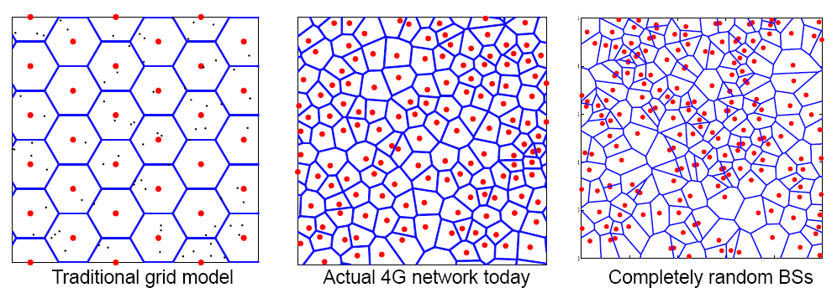
Femtocell Models
System level model

Slide 33
Femtocell Models
Femtocell access control model
Closed subscriber group (CSG)
Only pre-registered mobile users can use a certain femtocell.
Open subscriber group (OSG)
Any mobile can use any femtocell or at least one that is “open”.

Slide 34
Femtocell Models
Femtocell network model
Keep the grid model for macro base stations, drop femtocells “on top” of it, either randomly or in a deterministic fashion;
Focus on a single femtocell dropped in the cellular network;
Drop both the macrocells and femtocells randomly;
Keep all the channel gains and possibly even the various per-user capacities general, without specifying the precise spatial model for the various base stations.

Slide 35
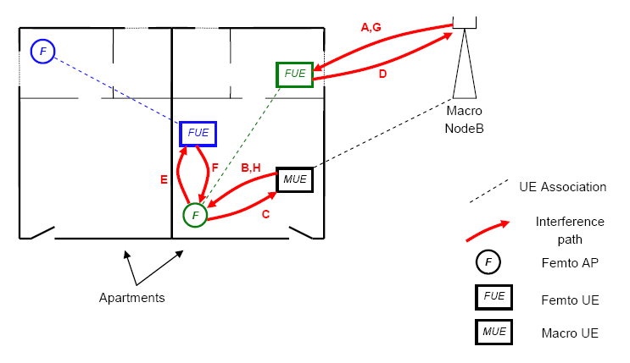
Overview of Key Challenges
Technical challenges
Interference scenario relationships

Slide 36
Overview of Key Challenges
Technical challenges
Interference coordination
3G CDMA femtos
power control strategies
Reserving a “femto-free” band
4G LTE femtos
Backhaul-based coordination
Dynamic orthogonalization
Subband scheduling
Adaptive fractional frequency reuse

Slide 37
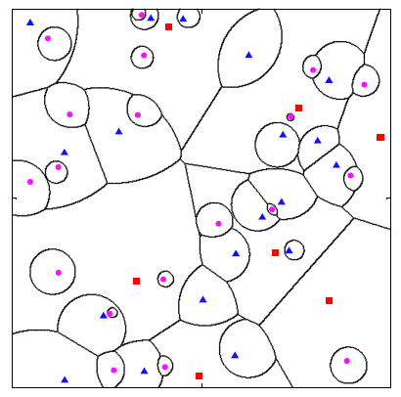
Overview of Key Challenges
Technical challenges
Cell association and biasing
Biasing: users are actively pushed onto small cells.

Slide 38
Conclusion
Demand for cellular data services skyrockets
Femtocell
Organic plug-and-play deployment
Highly democratic cost
Possible chaos to the network
Forecast
Dense femtocell deployment
Economic and capacity benefit

Slide 39
Table of Content
Overview of 5G
Key Technologies
Device-to-device Communication
Small Cell Network (HetNet)
Full Duplex

Slide 40
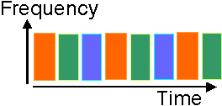
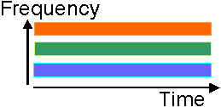
Background of Full-Duplex Techniques
Traditional half duplex: using orthogonal resources
Time-division duplex
Frequency-division duplex
Problems
The orthogonal resources are allocated for reception and transmission.
Solutions
The same resources are allocated for reception and
transmission
Time-division duplex
Frequency-division duplex
Spectral loss
Full-duplex
Comms

Slide 41
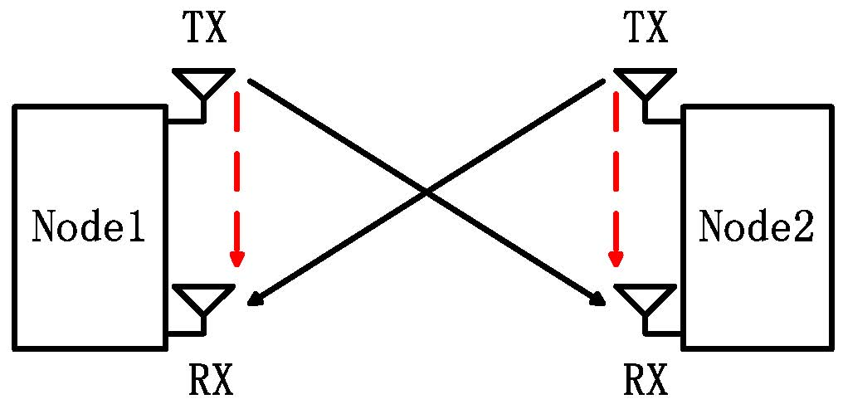
Full Duplex Introduction
A full duplex system allows communication at the same time and frequency resources.
Advantages
High spectral efficiency
Same time & same frequency band
Low cost
Readily use the existing MIMO radios
Hardware advancement, etc.
: Signal of interest
: Self interference
Full duplex communication

Slide 42
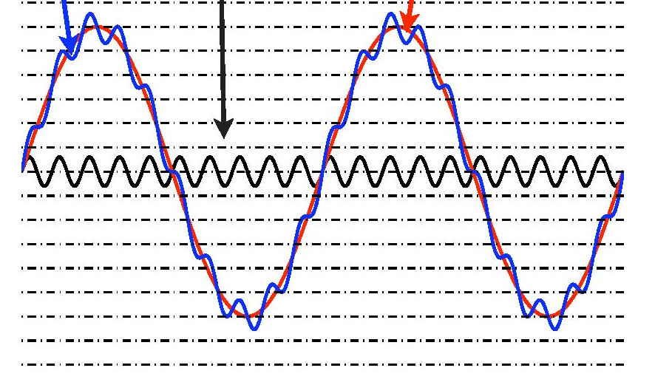
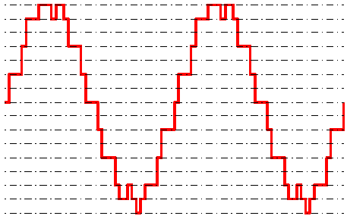
Main Challenges
Traditional Challenges
Very large self interference
50-110dB larger than signal of interest
Depending on inter-node distance
ADC is the bottleneck
Limited dynamic range: saturation distortion.
Limited precision: signal of interest is less than noise.
1 bit ADC is 6 dB in SNR
Self interference costs 8-18 bits
Need to reduce interference before ADC
Received signal
Signal of interest
Self interference
Fig. 6 Very large Self interference
Fig. 7 Signal after quantization

Slide 43
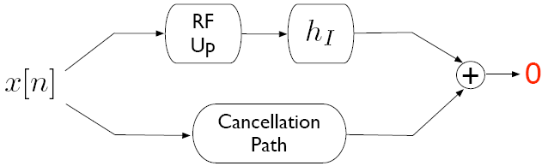
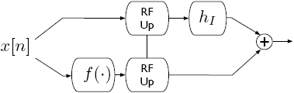
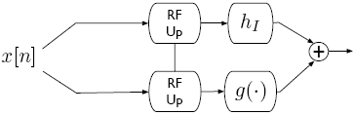
Self-interference Cancellation
Self interference channel
Passive antenna propagation suppression
Active cancelation
Active analog cancelation
Active digital cancelation
Pre-mixer Post-mixer

Slide 44
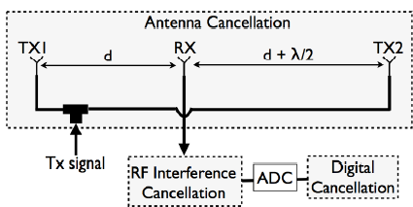
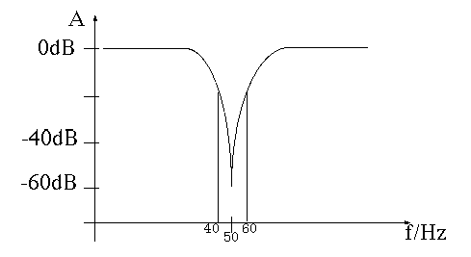
Passive Propagation Cancellation
MIMO system
Example, two transmitting antenna has 180 degree difference at the receiving antenna
Multiple antenna for beamforming, nulling and self-interference cancellation.
Challenges: Narrow band.
For wideband, wavelength is different,
so the cancellation is not good

Slide 45
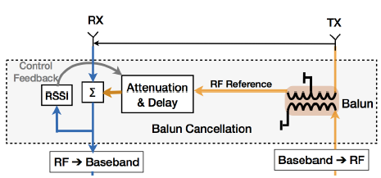
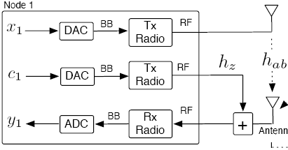
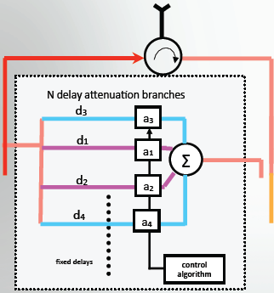
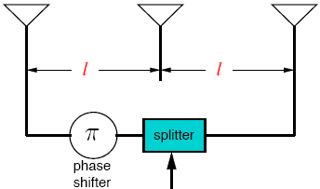
Active Analog Cancelation (2)
Post-mixer
Pre-mixer
Post-mixer
Post-mixer
x
Post-mixer
x
DAC
ADC

Slide 46
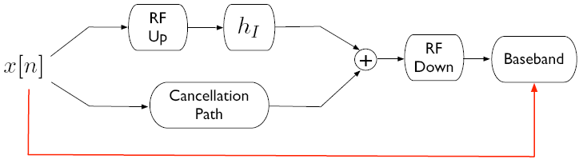
Active Digital Cancelation
Conceptually simpler – requires no new “parts”
Two-step cancellation:
Estimate the self residual interference channel h_{RI} through training symbols
Cancel h_{RI}x[n] at baseband
Useless if interference is too strong (ADC bottleneck)

Slide 47
Resource Allocation Problem Summary (1)
Mode Switch
Half-duplex radio
Due the limited size of transmitter and receiver, many wireless communication systems suffer from the spatial correlation which degrades the performance gain of HD mode.
Full-duplex radio
It allows a node to send and receive signals at the same time in the same frequency band.
However, it is practically impossible to have perfect self interference cancelation, and thus, the amount of RSI greatly affects the performance of FD system.
As a result, in some scenarios, the HD mode may outperform the FD mode for certain RSI values.
This motivates the adaptive mode switching between the FD and HD modes based on the RSI and channel conditions

Slide 48
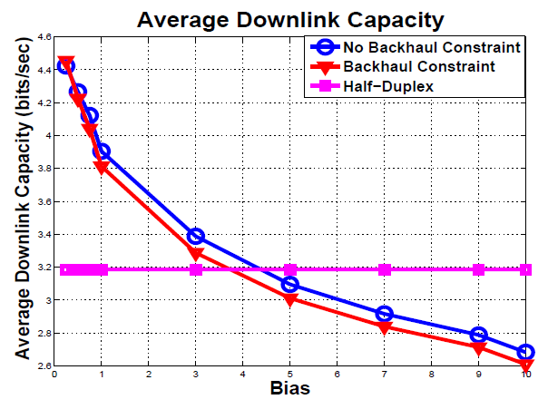
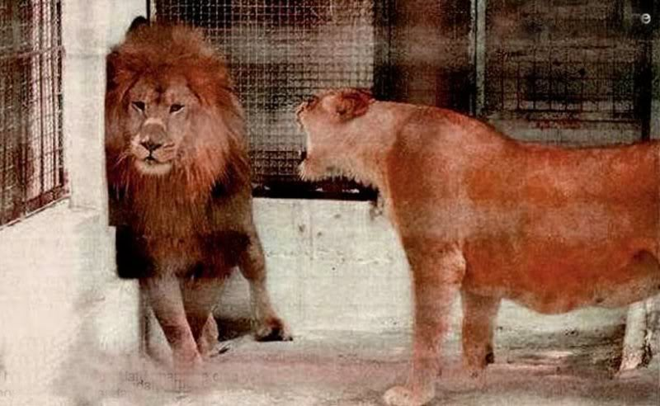
Numerical Results and intuition
Bias: connection to FAP and BS
Backhaul constraint
Switch between HD and FD
Human brain is full duplex, but sometime it is better to be half duplex…
Notes:
It is expected that by increasing the spatial correlation coefficients between antennas that the HD performance will degrade.
However, FD performance is independent of the spatial correlation between the antennas.
It can be clearly noticed that the proposed scheme was able to switch between FD and HD to choose the transmission mode with the highest throughput

Slide 49
Resource Allocation Problem Summary (2)
Power Control
due to RSI, power control algorithm needs to be properly redesigned in order to maximize system performance of all users.
FD-MIMO:
The antennas at the FD node are divided into transmit and receive antenna sets
Water-filling power allocation can be applied at the transmit antenna set to maximize the sum rate based on individual power constraint.
FD-Relay:
In FD-Relay networks with individual power constraint at each relay, the relayed signals are corrupted by the RSI,
Power allocation can be considered to reduce RSI subject to total and individual power constraints

Slide 50
Resource Allocation Problem Summary (3)
Power Control
FD-OFDMA: for FD-OFDMA with one FD BS and HD multiple users, uplink (transmit) and downlink (receive) users are paired to communicate with FD BS at the same time.
The transmit power can be allocated at the BS side with total power constraint by splitting the power among all he subcarriers for different user pairs.
At the user side, power control needs to take into account the inter-user distance among the transmit-receiver user pair.
FD-HetNet:
Similar to FD-OFDMA, the power control can be performed for the FD BS and femtocell access points (FAPs) and HD users in FD-HetNet to optimize the network performance.
However, both the inter-cell interference and RSI need to be considered jointly in optimizing the overall network performance.

Slide 51
Resource Allocation Problem Summary (3)
Transmit Beamforming:
The robust transmit beamforming algorithms can improve the signal strength at the receiver side,
and meanwhile reduce the self interference subject to various design criteria.
FD-MIMO: the transmit antenna set at each FD nodes can perform beamforming to simultaneously transmit information and reduce the interference to its own received signals
FD-OFDMA:
The FD BS is equipped with multiple antennas, consisting of transmit and receive antenna sets,
while the users only operate in the HD transmission mode due to hardware constraint.
The BS can construct beamformer to support multiple users in the downlink while maximizing the received SNRs at
BS by minimizing the RSI.

Slide 52
Resource Allocation Problem Summary (4)
Link Selection
For a FD communication system, each antenna can be configured to transmit or receive the signals.
This will create multiple possible virtual links between two nodes, with one virtual link representing the channel from a transmit antenna of one node to a receive antenna of the other.
An important question arisen is how to optimally select the link for each direction to optimize the system performance.
Antenna selection in FD-MIMO systems
Joint antenna and relay selection in FD-Relay systems
Coordinated multiple point transmission

Slide 53
Resource Allocation Problem Summary (5)
Subcarrier Allocation
In a FD-OFDMA network consisting of one FD BS with N_{f} subcarriers, N_{u} uplink users, and N_{d} downlink users,
a fundamental challenge is how to pair uplink and downlink users, and allocate subcarrier across these user pairs;
The subcarrier allocation involves
allocating the different subsets of subcarriers to different users
taking into account the RSI at the BS and the co-channel interference between the uplink and downlink users within each user pair.
In FD-Relay networks, consisting of multiple source and destination nodes, and FD relay nodes using OFDM transmission,
the corresponding subcarriers should be also properly allocated at the relay for different source-destination pairs.

Slide 54
Conclusions
This tutorial presented the recent development of FD bascis and discussed representative FD communications:
FD CRN, FD CSMA/CD, and FD-HetNet networks.
The associated resource allocation problems are discussed:
e.g. mode switch, power control, link selection and pairing, interference-aware beamforming, and subcarrier assignment.
A few examples on FD resource allocation are illustrated:
FD communication is very promising, which enables many potential future research applications, e.g.,
FD MIMO
FD Relay networks
FD Two Way Relay
FD D2D
FD OFDM

