Slide 1
Mission-Oriented Dynamic Resource Management
Technology in Space Information Networks
Zhu Han
Thanks for Dr. Di Zhou

Slide 2
Outline
Introduction and motivation
Research works
A collaborative data scheduling with joint forward and backward induction (JFBI) algorithm
A data arrival distribution robust two-stage recourse (DADR-TR) algorithm
Conclusions

Slide 3
Outline
Introduction and motivation
Research works
A collaborative data scheduling with joint forward and backward induction algorithm
A data arrival distribution robust two-stage recourse (DADR-TR) algorithm
Conclusions

Slide 4
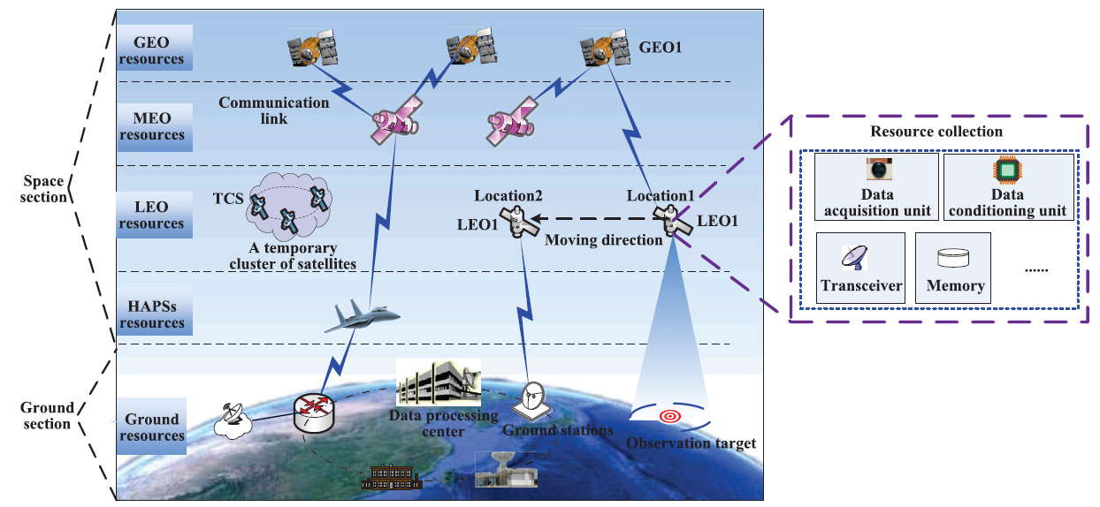
Introduction and Motivation
Network composition
Network composition
Space section: GEO, MEO, LEO, and HAPSs, and so on
Ground section: ground stations, data processing center, mission management center, and so on
An example of SIN architecture and resources carried by satellites

Slide 5
Introduction and Motivation
Network characteristics
Network characteristics
Multi-layer heterogeneous network
High dynamic topology
Dynamic and limited resources
Complicated mission requirements
Difficult to upgrade
An example of SIN architecture and resources carried by satellites

Slide 6
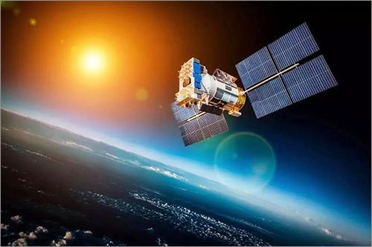
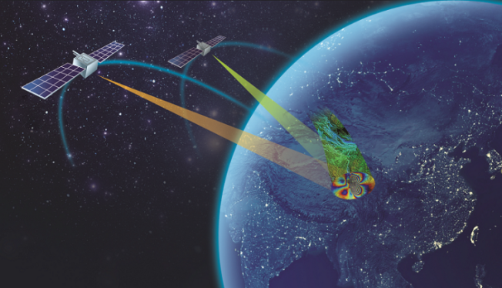

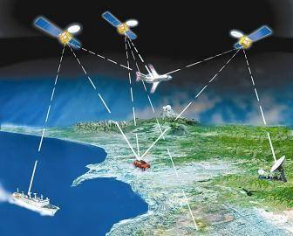
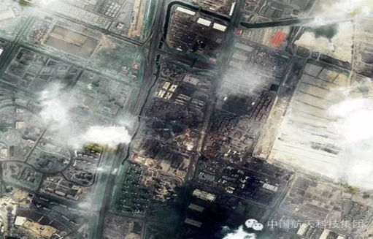
Introduction and Motivation
Typical applications
Land survey
Emergency rescue
satellite smart agricultural machinery
Disaster relief
navigation and positioning

Slide 7
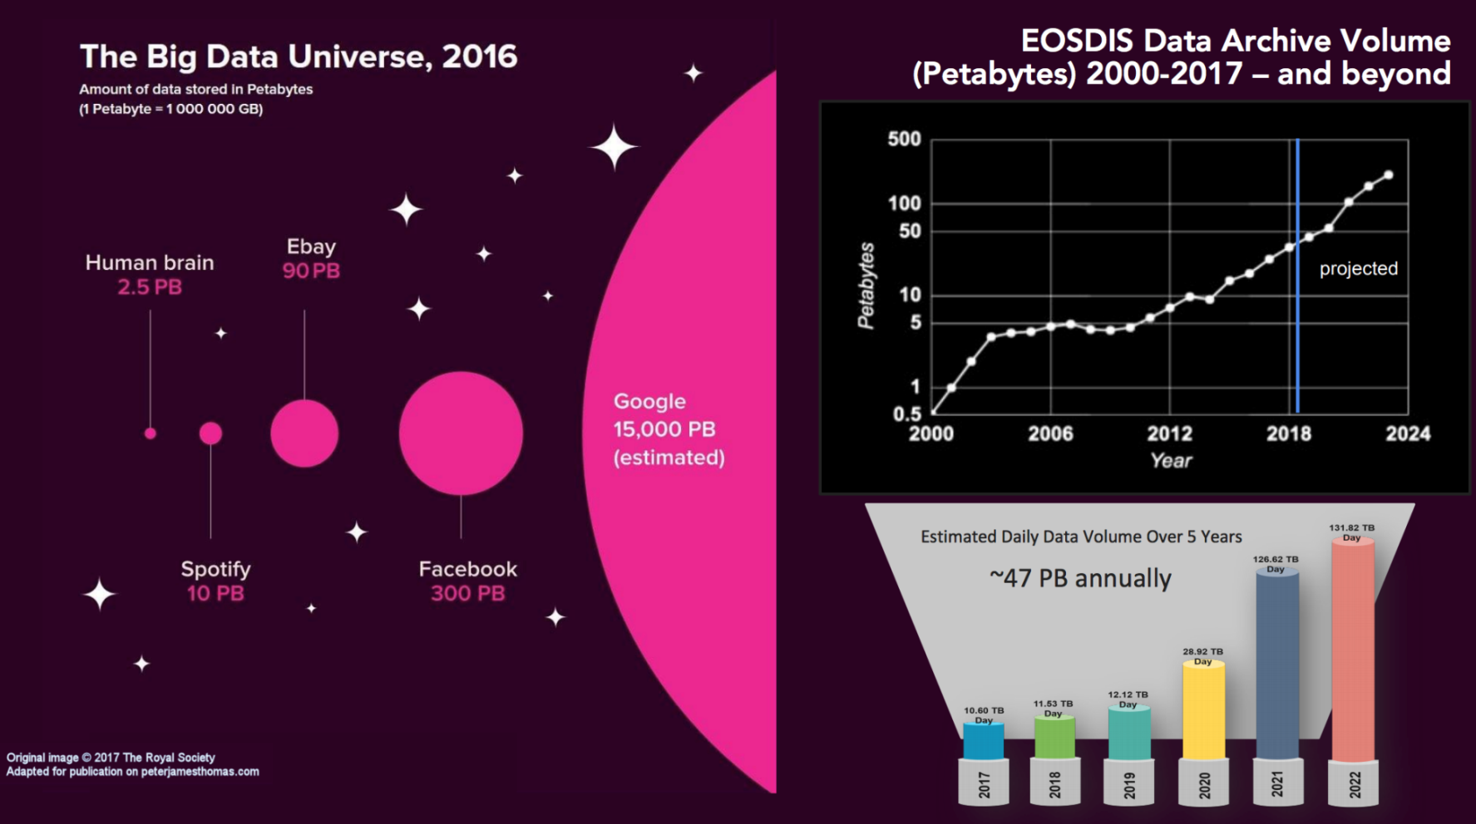
Introduction and Motivation
Earth Observing System Data and Information System (EOSDIS) which belongs to NASA for Earth Science, forecast that in the next three years (i.e., by 2022), the daily data volume will reach 131 TB/day.
The era of big space data

Slide 8

Introduction and Motivation
Examples of mission execution: 2 Earth observation missions (emergency and conventional), 2 low-orbit observation satellites, 1 geosynchronous orbit relay satellite, 2 ground stations
Efficiently coordinate multi-dimensional network resources to achieve service quality assurance for different missions
LEO storage resource
GEO relay satellite
GEO transmission resource
A certain shortage of resources can be replaced by another relatively abundant resources, thereby improving the overall performance of the network.
Land survey
Emergency rescue

Slide 9
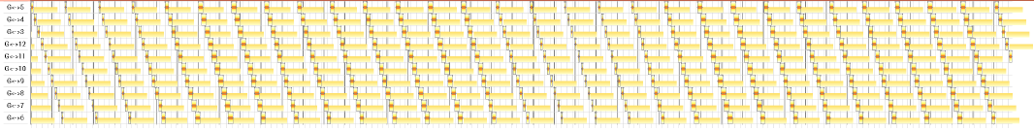
Introduction and Motivation
Challenge 1
The transformation relationship of multidimensional resources in complex space-time environment
Resource availability is time-varying
Transmission windows
Transmission resources
Observation resources
Observation windows
Time
Energy harvesting windows
Traditional static graph theory can not characterize the evolution of network topology and the dynamic changes of multi-dimensional resources in SINs.

Slide 10
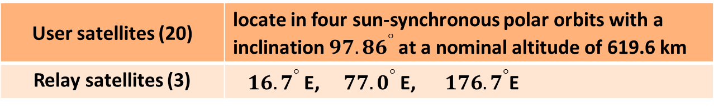
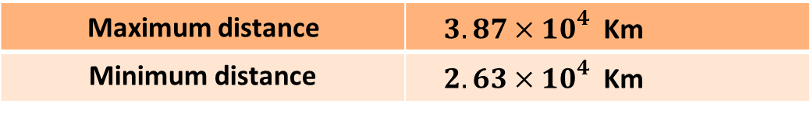
Introduction and Motivation
Challenge 1
The transformation relationship of multidimensional resources in complex space-time environment
Resource status is time-varying
User satellites (20) | locate in four sun-synchronous polar orbits with a inclination ${97.86}^{°}$at a nominal altitude of 619.6 km
Relay satellites (3) | ${16.7}^{°}$E, ${77.0}^{°}$ E, ${176.7}^{°}$E
Inter-satellite :
inversely proportion to the square of distance
Maximum distance | $3.87×{10}^{4}$ Km
Minimum distance | $2.63×{10}^{4}$ Km
Satellite downlinks: weather conditions
Rain attenuation can be obtained according to Recommendation ITU-R P.618-12.
Rainfall intensity(mm/h) | 0(clear) | 2 | 5 | 10
Rain attenuation (dB) | 0 | 5 | 12 | 20

Slide 11
Introduction and Motivation
Challenge 2
Multidimensional resource conflict relationship
Resource conflict factors (mobile characteristics, energy states, etc.) are time-varying
The existence of resource conflicts has time-varying characteristics
Satellite movement
Limited energy resource
Energy status

Slide 12
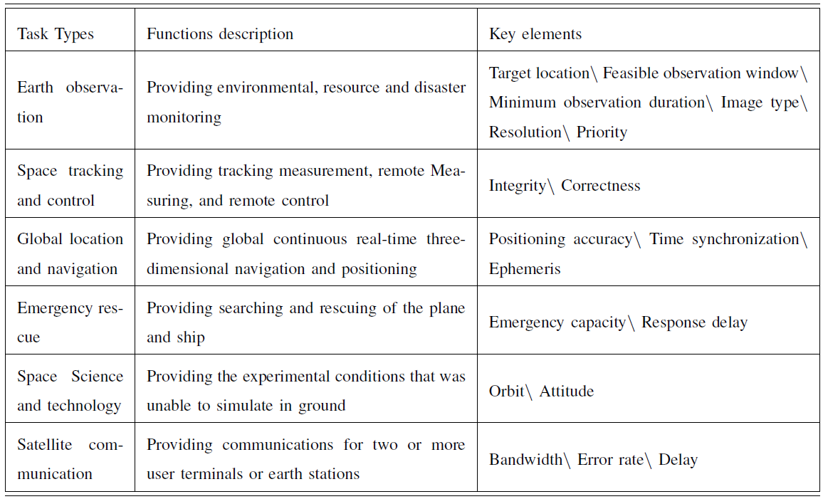
Introduction and Motivation
Challenge 3
Diverse mission requirements
The variety of resources, the diversity of requirements for different missions, the network resources and the time-varying conflicts between resources pose great challenges to the resource management in SINs.

Slide 13
Introduction and Motivation
Motivation
Assume that the data collected by satellite is predictable (static optimization for data scheduling planning)
Predictable data arrival
Existing algorithms
Insert the random missions directly into the planned mission sequence, seriously affecting the planned missions
Stochastic data arrival
It is a basic question of how to design efficient resource management strategies to well match the stochastically arrived mission data.
Make the optimization for the current planning horizon
Neglect the corresponding affection for the next planning horizon
The resources state (e.g., energy and storage status) at the end of the current planning horizon may be poor
A small amount of mission data arrives
A large amount of mission data arrives

Slide 14
Outline
Introduction and motivation
Research works
A collaborative data scheduling with joint forward and backward induction algorithm
A data arrival distribution robust two-stage recourse (DADR-TR) algorithm
Conclusions

Slide 15
JFBI Algorithm - Introduction
Dynamic channels
1:dynamic network topology
2: dynamic channel status
Feasible network topology
Selecting the optimal feasible network topology plays a pivotal role in matching well with the limited network resources and stochastically arrived mission data.

Slide 16
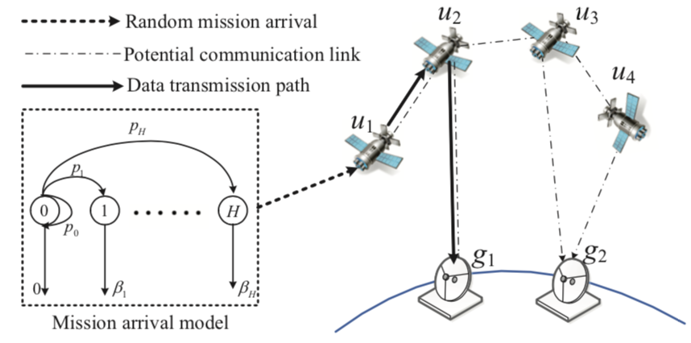



JFBI Algorithm - System model
Network model
We consider a typical time-slotted SSNs constituted by:
Small satellites U= {u_{1,} u_{2,…,} u_{U}}
Ground stations G = {g_{1,} g_{2,…,} g_{G}}
z_{l,t} represent the time slot (TS) which belongs to the t-th slot of the l-th cycle
Random mission arrival model
Let
be the random arrivals (number of bits) collected by satellites at the end of TS z_{l,t}
is i.i.d. across TSs according to a general distribution
Cycle
Time slot

Slide 17
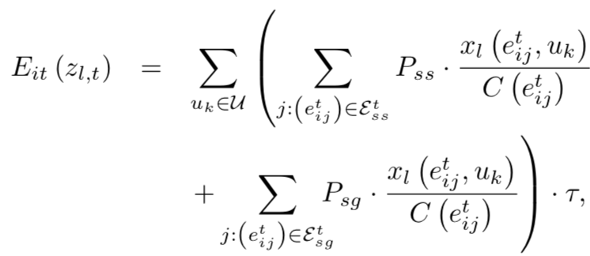
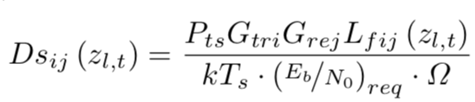
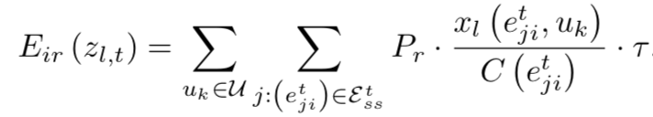
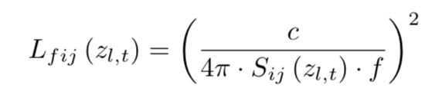


JFBI Algorithm - System model
Inter-satellite contact model
Energy dynamics model
Achievable transmission data rate:
Energy consumption for transmitting data
Energy consumption for receiving data
The free space loss:
Nominal operation energy consumption
Total energy consumption
Harvested energy

Slide 18

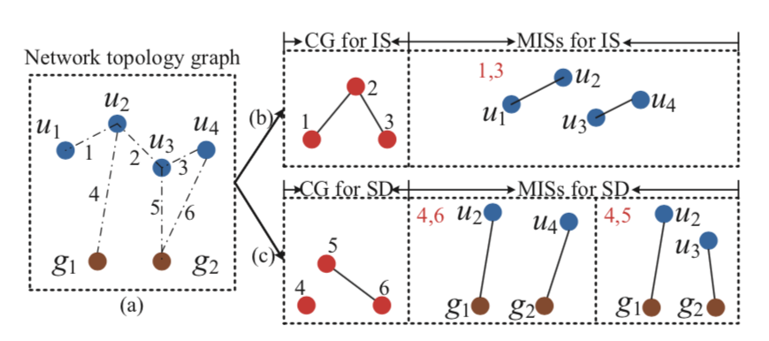
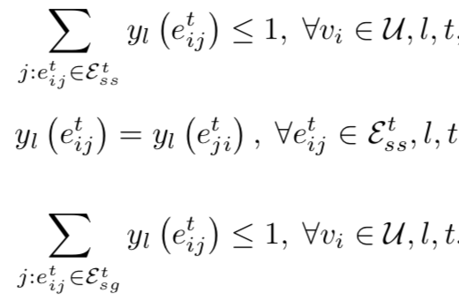
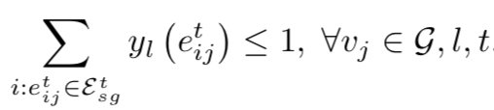
JFBI Algorithm
An infinite MDP
State:
system storage state and battery energy state
Action:
Feasible network topology
contact constraints
Initial network topology
conflict graphs
Feasible network topology
Maximum feasible IS and SD contacts selection schematic

Slide 19
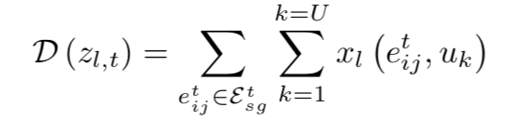
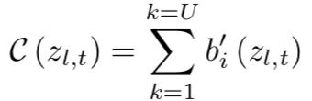

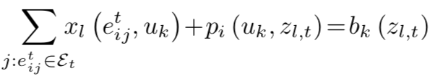


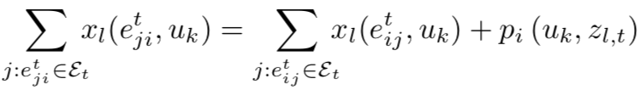







JFBI Algorithm
An infinite MDP
the total amount of the downloaded data
Reward:
the total amount of the data which remains in the satellites’ storage
s.t.
: the immediate reward of taking action in state , which can be obtained by solving an LP problem
flow conservation constraints
Communication link, battery, and storage capacity constraints

Slide 20
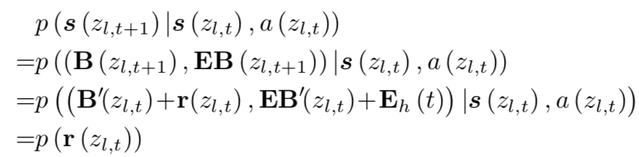
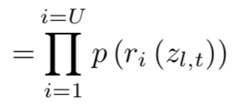
JFBI Algorithm
An infinite MDP
State Transition probabilities:
During a cycle for different TS
Between two different cycles
Proposition. The system state transition process during a cycle and between two cycles have the Markov property.

Slide 21

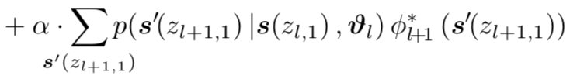

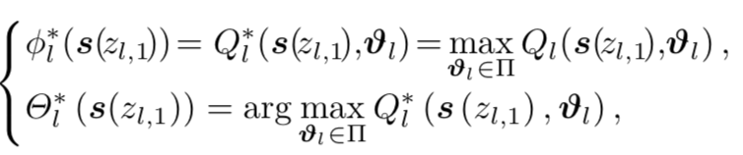

JFBI Algorithm
A joint forward and backward induction solution
Forward part
Bellman’s optimal equations for infinite cycles
A value iteration approach
Q-values functions
Convergence condition:

Slide 22
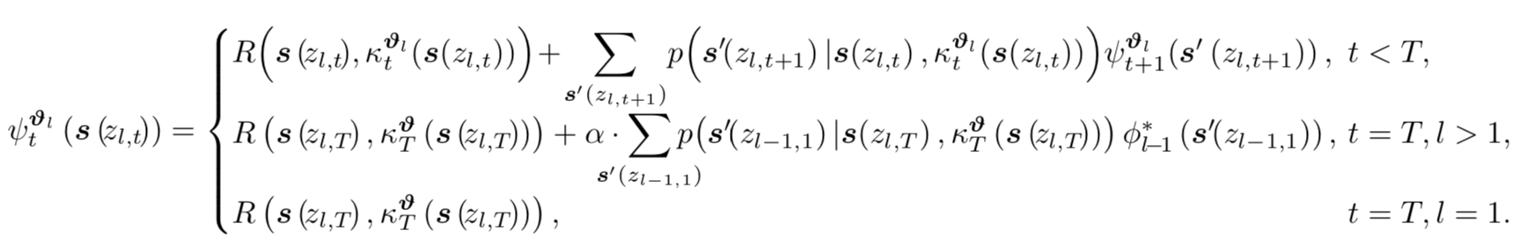
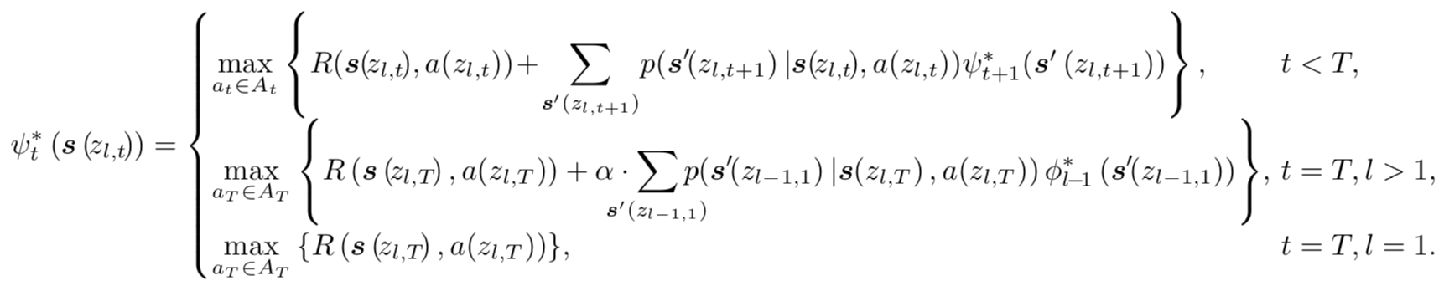
JFBI Algorithm
A joint forward and backward induction solution
Backward part
Reward-to-go function in the t-th slot during cycle l
Bellman’s optimal equations for finite slots in one cycle

Slide 23
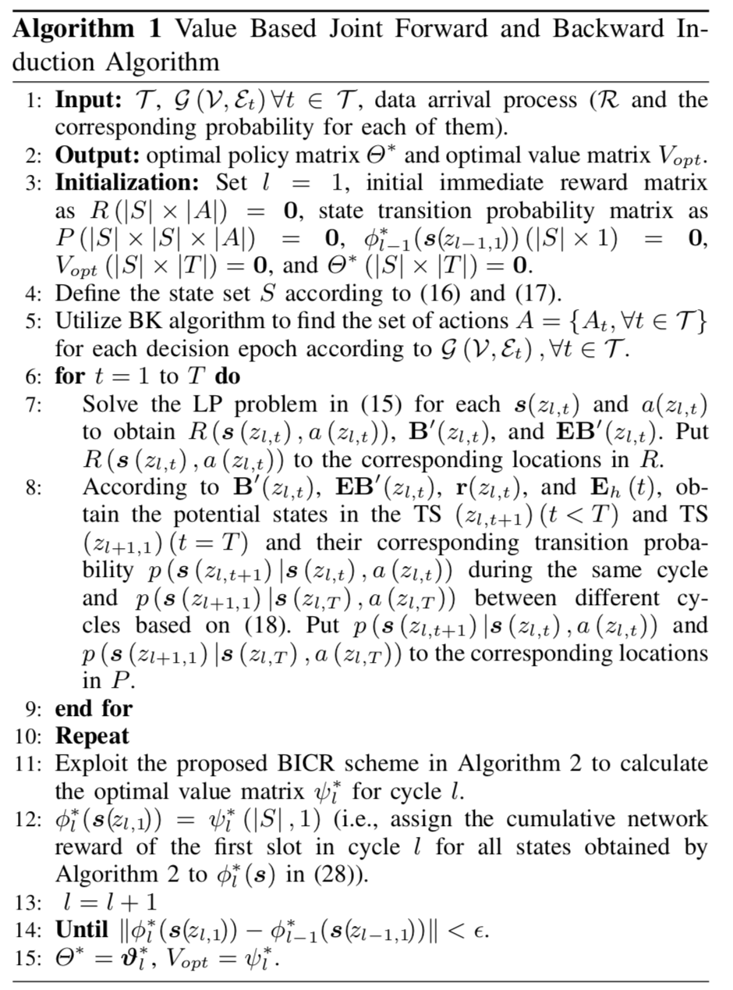
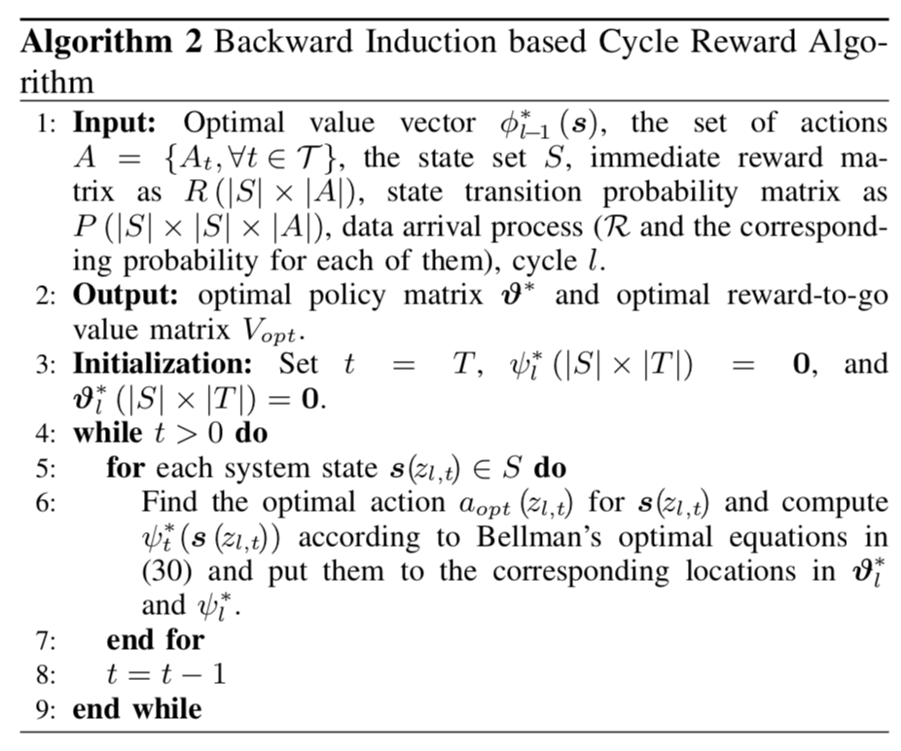
JFBI Algorithm

Slide 24
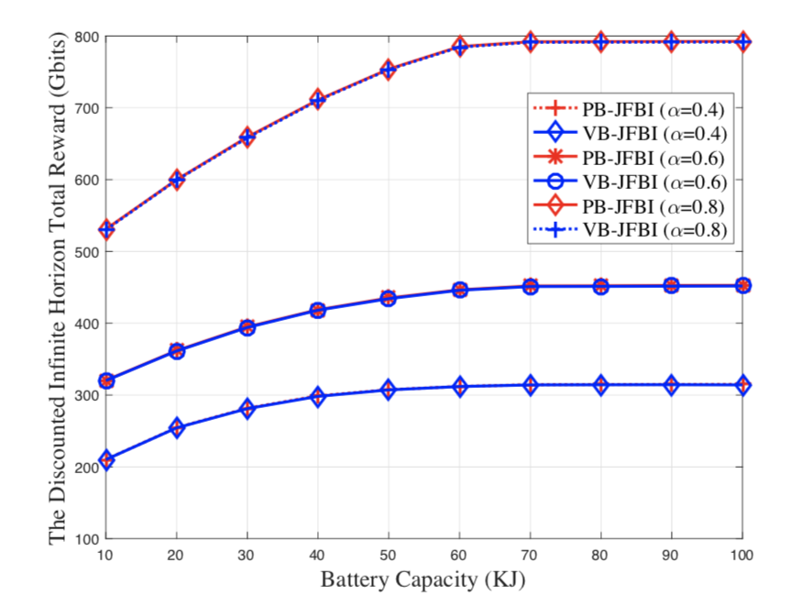
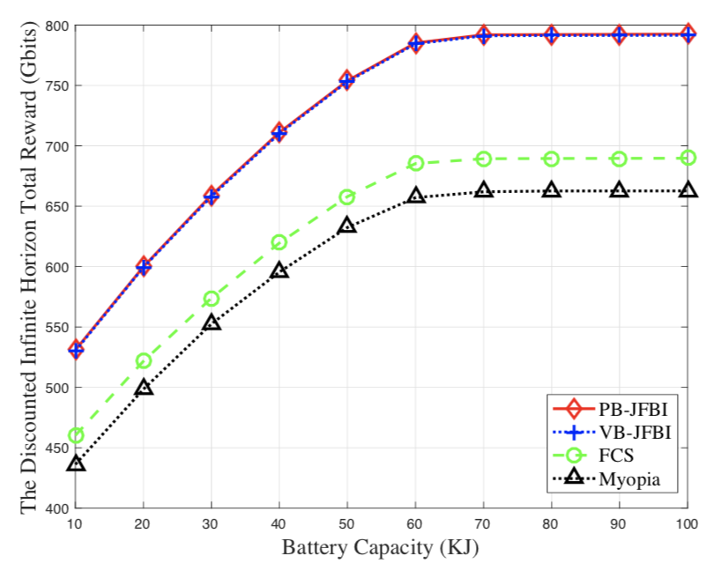
JFBI Algorithm - Simulations
Simulation Setup
Six satellites are distributed over 2 sun-synchronous orbits at a height of 554.8km and with inclinations of 93.6◦ and 86.4◦, respectively.
Three ground stations locate at Beijing (40◦N, 116◦E), Kashi (39.5◦N, 76◦E), and Qingdao (36◦N, 120◦E);
Performance evaluation for different discounting factors α and the discounted infinite horizon total reward versus battery capacity

Slide 25
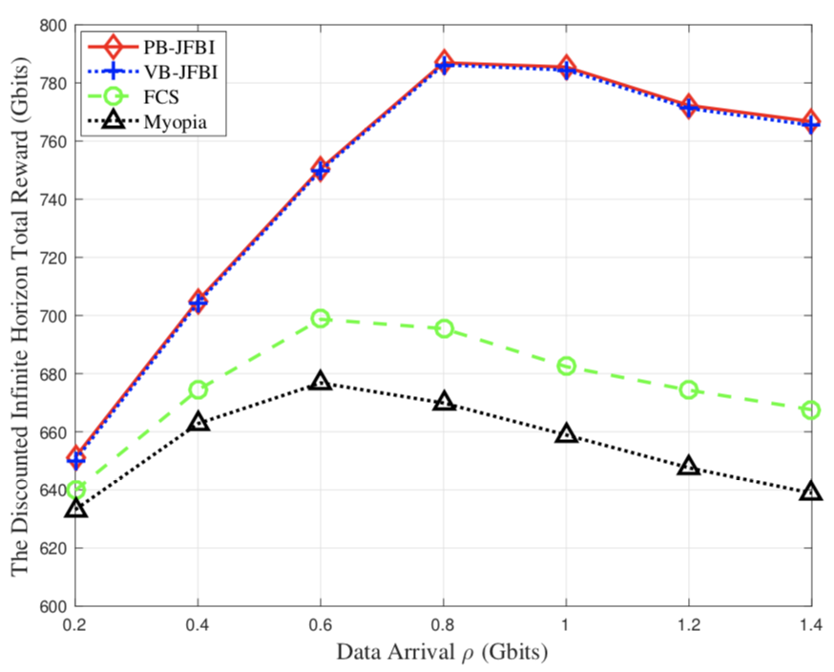
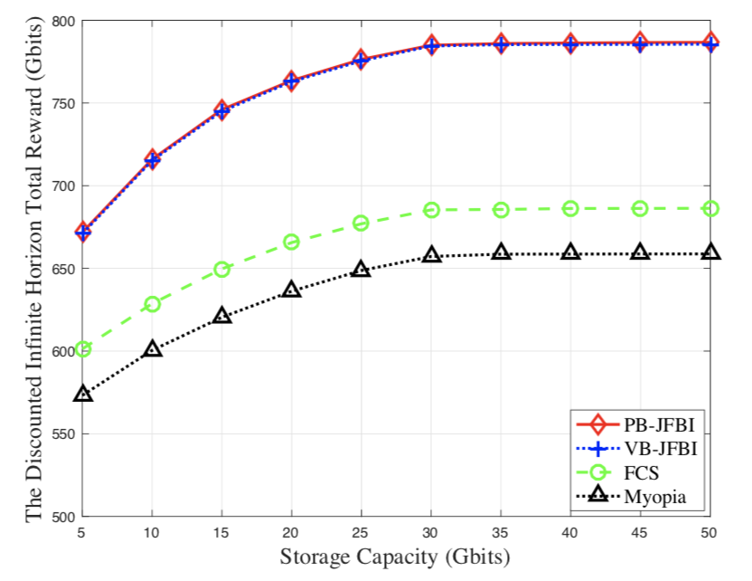
JFBI Algorithm - Simulations
Simulation Setup
Six satellites are distributed over 2 sun-synchronous orbits at a height of 554.8km and with inclinations of 93.6◦ and 86.4◦, respectively.
Three ground stations locate at Beijing (40◦N, 116◦E), Kashi (39.5◦N, 76◦E), and Qingdao (36◦N, 120◦E);
The discounted infinite horizon total reward versus data arrival ρ and storage capacity

Slide 26
Outline
Introduction and motivation
Research works
A collaborative data scheduling with joint forward and backward induction algorithm
A data arrival distribution robust two-stage recourse (DADR-TR) algorithm
Conclusions

Slide 27

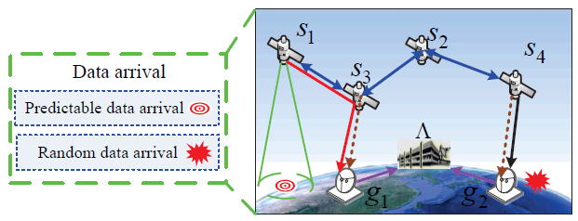
DADR-TR Algorithm - System model
Network model
We consider a two-stage distributed satellite cluster network (DSCN) system operating slotted time which is constituted by:
Sensing satellites S= {s_{1,} s_{2,…,} s_{S}}
Ground stations R = {g_{1,} g_{2,…,} g_{G}}
A data processing center
, T₁ is the end of the TS in the first stage and T₁ is that in the second stage.
The first stage：deterministic mission arrival
The second stage: partial mission arrival information
Planning horizon

Slide 28
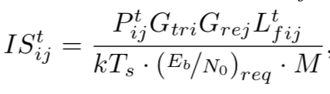
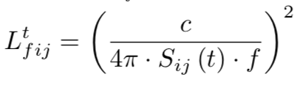



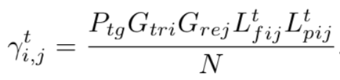
DADR-TR Algorithm - System model
Two-stage data arrival model
We utilize a three-tuple to characterize a sensing data, i.e.,
In the First stage: MMC can predict the data arrival information according
to statistic information for targets of interest; data set:
In the second stage: partially known the distribution of the specific data demand, e.g., mean and variance of the random amount of data
data set:
Channel model
The achievable data rate of an inter-satellite link which is mainly influenced by distance and power :
The achievable data rate of a satellite-ground link is affected mainly by rain attenuation:
free space loss
The distance between two satellites
SNR
rain attenuation

Slide 29

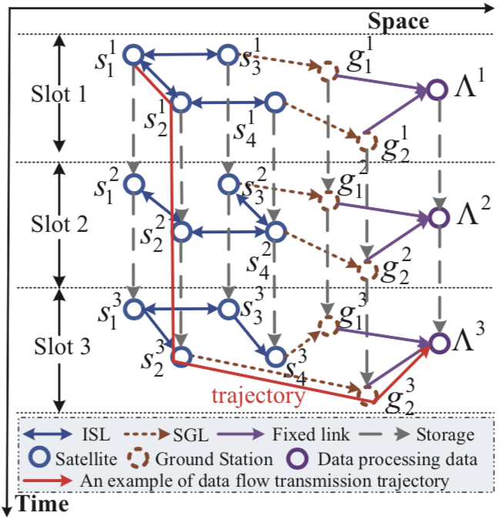








DADR-TR Algorithm - System model
Graph model
Characterize the multi-resource correlation relationship over the dynamic SNs during
the whole planning horizon.
Vertices:
Edges: dynamic communication links set:
Storage edges set: ,
Fixed edges set:
Trajectory: capture the sequentially
chained multi-dimensional resources,

Slide 30
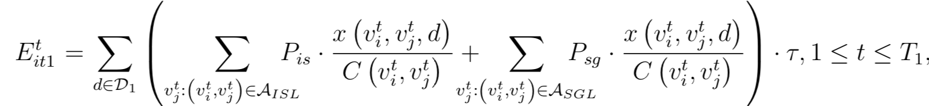
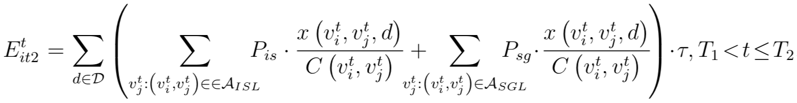
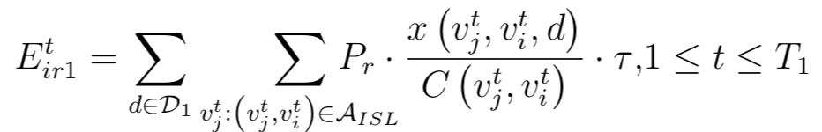
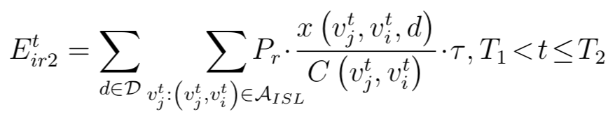


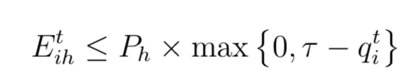
DADR-TR Algorithm - System model
Energy-related model
Energy consumption for data transmission:
Energy consumption for data reception:
Energy consumption for nominal operation:
Total energy consumption of satellite s_{i} during time slot t:
Energy harvesting:

Slide 31

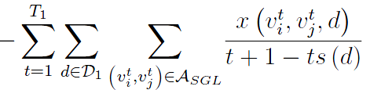

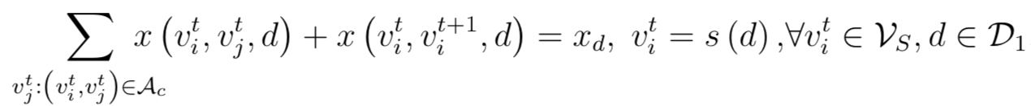
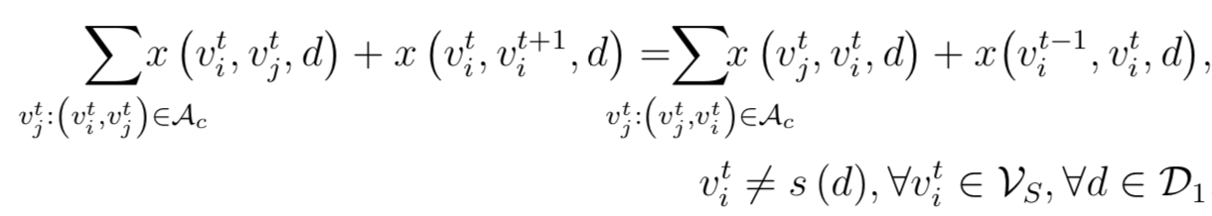
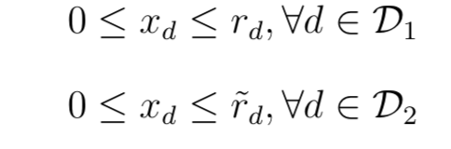
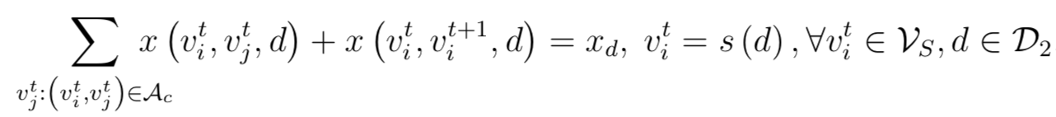
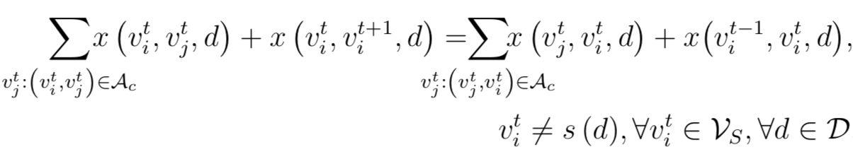


DADR-TR Algorithm - System model
Problem formulation
negative-reward in the first stage
Data flow conservation constraints
Capacity constraints
Energy constraints

Slide 32





DADR-TR Algorithm - System model
Problem formulation
Challenges:
Multi-variate integral
Partially known distribution of

Slide 33


DADR-TR Algorithm
Problem equivalence conversion framework
The key idea is that convert a stochastic optimization with unknown data arrival distribution in the second stage problem P1 into a deterministic conic optimization problem, which is computationally tractable.
Utilize the moment information to define an ambiguity set of distributions for the exact distribution of
Estimate an upper bound

Slide 34









DADR-TR Algorithm
Problem equivalence conversion framework
Exploit linear decision rule to recast the constraints
the strong duality of conic optimization problem

Slide 35




DADR-TR Algorithm - Simulations
Simulation Setup
Six satellites are distributed over 2 sunsynchronous orbits at a height of 619.6km and with an inclination of 97.86◦.
Four ground stations locate at Beijing (40◦N, 116◦E), Kashi (39.5◦N, 76◦E), Sanya (18◦N, 109.5◦E) and Qingdao (36◦N, 120◦E);
m is the number of the random variables
CPU Time Consumption (seconds) and average network reward performance

Slide 36

DADR-TR Algorithm - Simulations
Simulation Setup
Six satellites are distributed over 2 sunsynchronous orbits at a height of 619.6km and with an inclination of 97.86◦.
Four ground stations locate at Beijing (40◦N, 116◦E), Kashi (39.5◦N, 76◦E), Sanya (18◦N, 109.5◦E) and Qingdao (36◦N, 120◦E);
Total network reward and the second-stage network reward versus the first-stage data demand
Notes:
to demonstrate the efficacy of the proposed
DADR-TR algorithm, we compare it with three benchmark
algorithms, i.e., the greedy scheme, resource reservation for
the randomness (RRFR) scheme, and the shortest path maximum flow (SPMF) algorithm. In the greedy scheme, the randomness
of data arrival in the second stage is neglected and the
network reward in each TS is maximized without considering
the resource status at the end of each TS. While in RRFR,
the energy status at the end of the first stage is guaranteed
to be equal to or larger than 0.5 ・ EBmax to deal with
the randomness of data arrival in the second stage. Besides,
SPMF algorithm adopt a shortest path based scheme to obtain
a feasible multi-paths for a data flow, which allows that a
data flow can be divided into several parts to transmit using
different trajectories, i.e., delivery paths.
We evaluate two performance metrics,
i.e., the total network reward (TNR) and the second-stage
network reward (SSNR). Specifically, TNR denotes the sum
of the reward in the first stage and the second stage. SSNR
refers to the network reward obtained in the second stage
that shows the robustness of different schemes. Although
DADR-TR algorithm computes the worst expected network
reward, we can obtain the specific data delivery planning in
the first stage and further obtain the resource status (i.e., buffer
and battery) at the end of the first stage. For fair comparison,
we utilize the same and specific data arrival information which
satisfy the mean and variance of the random data arrival
to calculate the second-stage network reward for all three
schemes according to their resource status at the end of the
first stage.

Slide 37

DADR-TR Algorithm - Simulations
Simulation Setup
Six satellites are distributed over 2 sunsynchronous orbits at a height of 619.6km and with an inclination of 97.86◦.
Four ground stations locate at Beijing (40◦N, 116◦E), Kashi (39.5◦N, 76◦E), Sanya (18◦N, 109.5◦E) and Qingdao (36◦N, 120◦E);
Total network reward and the second-stage network reward versus the mean of second stage data demand

Slide 38

DADR-TR Algorithm - Simulations
Simulation Setup
Six satellites are distributed over 2 sunsynchronous orbits at a height of 619.6km and with an inclination of 97.86◦.
Four ground stations locate at Beijing (40◦N, 116◦E), Kashi (39.5◦N, 76◦E), Sanya (18◦N, 109.5◦E) and Qingdao (36◦N, 120◦E);
TNR and SSNR versus battery capacity

Slide 39
Outline
Introduction and motivation
Research works
A collaborative data scheduling with joint forward and backward induction algorithm
A data arrival distribution robust two-stage recourse (DADR-TR) algorithm
Conclusions

Slide 40
Conclusions
A finite-embedded-infinite two-level dynamic programming framework is the first approach to formulate the data scheduling process over stochastic data arrival regarding contact selection in Small Satellite Networks.
We consider a more realistic distributionally robust long-term data arrival model, which only needs partial moment distribution information of the stochastic data arrival in the second stage.
A distributionally robust two-stage stochastic optimization framework is developed for joint energy management, buffer management, and communication capacity allocation.

Slide 41
Thanks for your time!
Question
&
Answer

