Slide 1
Hypergraph Theory for Wireless Networking
Zhu Han, John and Rebecca Moores Professor
Electrical and Computer Engineering Department
Computer Science Department
University of Houston, Houston TX
Supported by NSF
Thanks to Dr. Long Zhang, Dr. Lisu Yu and Dr. Hongliang Zhang

Slide 2
Outline
1.
Motivation
2.
Hypergraph Basics
Basic concepts
Hypergraph coloring
Hypergraph matching
Hypergraph machine learning
3.
Applications
Device-to-Device Communications
Mobile Edge Computing
User-Centric Ultra-Dense Networks

Slide 3
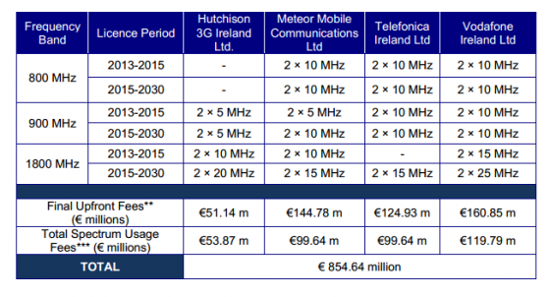
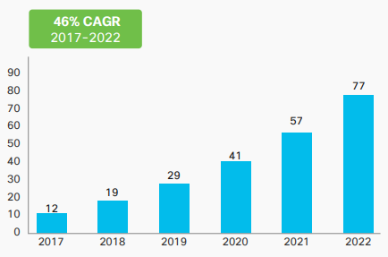
Future Wireless Challenge
Explosion of data
V.S.
Limited spectrum
Exabytes per Month

Slide 4
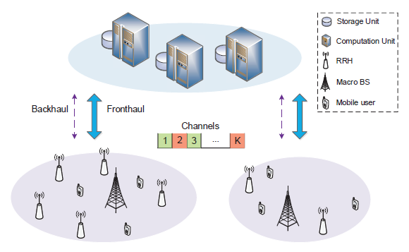
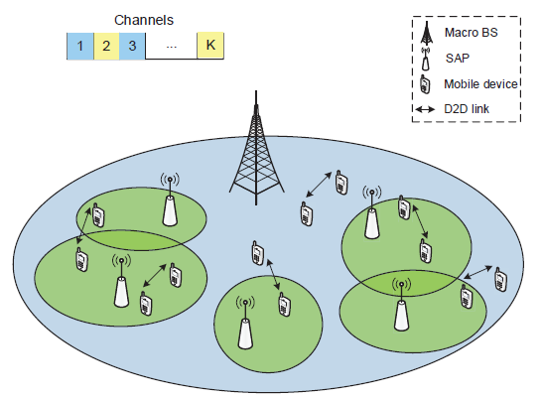
Possible Solution
Ultra-dense Networks, Device-to-Device, etc.
The cumulative interference will be significant
The relations among entities are complicated

Slide 5
Motivation
Why hypergraph?
Graph is a pairwise relationship, and cannot model the relations among multiple users.
The hyperedges in hypergraph can contain a subset of the vertices, and are suitable to capture the relations among multiple users.
The relations among entities (e.g., interference) in the future networks are complicated, and thus hypergraph is necessary to model the relations.

Slide 6
Outline
1.
Motivation
2.
Hypergraph Basics
Basic concepts
Hypergraph coloring
Hypergraph matching
Hypergraph machine learning
3.
Applications
Device-to-Device Communications
Mobile Edge Computing
User-Centric Ultra-Dense Networks

Slide 7



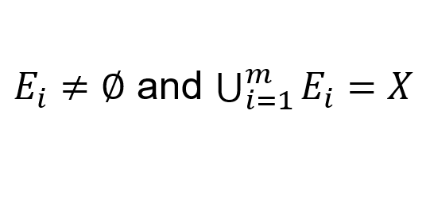
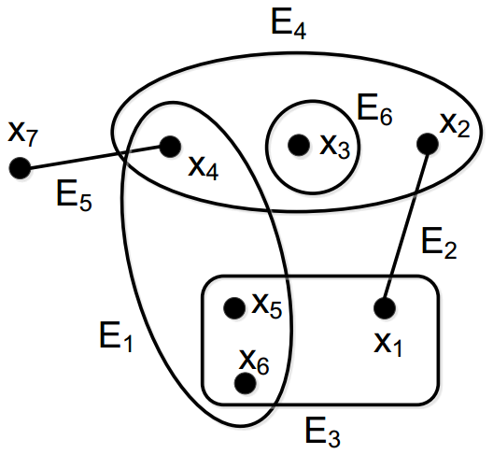


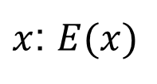
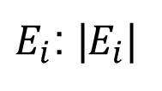
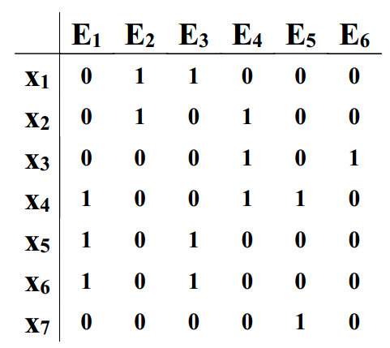

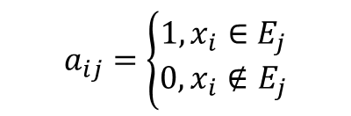
Definition
Hypergraph
Let be a finite set. A hypergraph on is a family of subsets of such that
is called the vertex and is call the hyperedge
Set of hyperedges containing vertex
Cardinality of the edge
Incidence Matrix
A matrix with n rows and m columns
Rows: vertices
Columns: hyperedges
Notes:
x or v, notation and figure are different

Slide 8





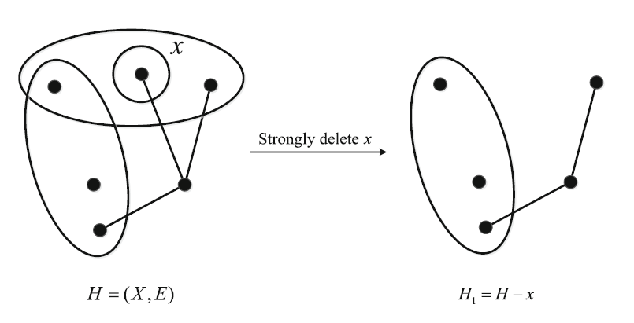
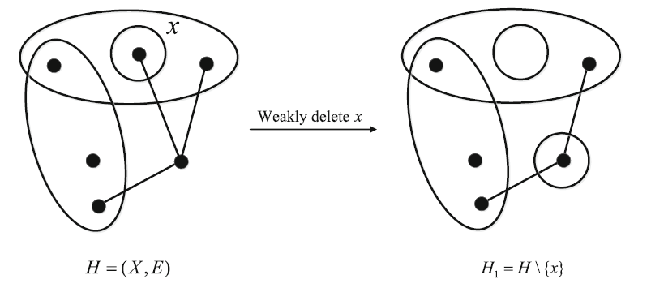
Hypergraph Operations
Strong deletion of a vertex
A strong deletion of from is to delete all the hyperedges in from , and also delete from .
Weak deletion of a vertex
A weak deletion of from is to only remove from and each hyperedge in .

Slide 9






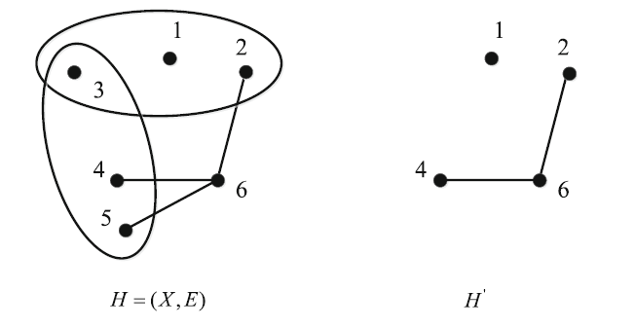
Subhypergraph
Subhypergraph
Let be a hypergraph. Hypergraph such that and can be called a subhypergraph of .
Hypergraph is called an induced subhypergraph of if , and the hyperedges (of completely contained in ) form .
An induced subhypergraph can be obtained by strong deletion of vertices.
Notes:
induced subhypergraph

Slide 10

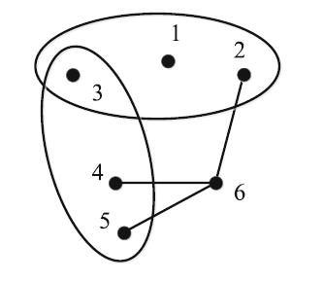







Transversal and Matching
Stable (independent) set
A subset of vertices which contains no hyperedge , e.g. {1,2,4,5}
The largest cardinality of a stable set is called stability number, denoted by
Transversal
A set is a transversal if for each
The cardinality of a minimum transversal is
Transversal
Matching
In hypergraph , hyperedges which pairwise have no common vertices are called a matching
A perfect matching is a matching which contains every vertex of a hypergraph. (this example has no perfect matching due to 1)
Matching
is a stable set:
Notes:
稳定集：不包括任何超边的顶点子集。如{1,3,6}，{1,2,4,5}（最大稳定集）
稳定数：稳定集的最大势。
遍历：与任何一个超边都有交集的顶点子集。
最小遍历的势。
匹配：超边子集中任意元素均不包括共同顶点。
完美匹配：该匹配包括所有顶点。

Slide 11
Outline
1.
Motivation
2.
Hypergraph Basics
Basic concepts
Hypergraph coloring
Hypergraph matching
Hypergraph machine learning
3.
Applications
Device-to-Device Communications
Mobile Edge Computing
User-Centric Ultra-Dense Networks

Slide 12
Introduction
Hypergraph coloring
A labeling of the vertex set with the color set
One-to-one assignment
Types of hypergraph coloring
Weak coloring
Strong coloring
Uniform coloring
Different types of hypergraph coloring
Have different requirements
Can be solved by the same coloring algorithm

Slide 13
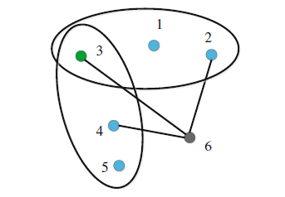


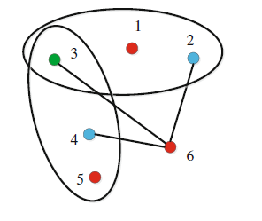
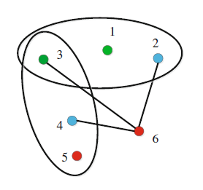
Coloring
Weak coloring (e.g. resource allocation)
Every hyperedge should contain at least 2 colors
: The minimum number of colors needed
Propositions:
Weak coloring
The cardinality of a color set * stable number. >=|X|
The vertices in the transversal is colored differently
Strong coloring (e.g. color map)
All the vertices in a hyperedge are colored differently
Uniform coloring (e.g. scheduling)
The difference of the numbers of vertices with the same color is always to within 1
Strong coloring
Uniform coloring
Notes:
Uniform coloring两种颜色的顶点数差值小于1

Slide 14





Hypergraph Coloring Algorithm
Monodegree
Maximum cardinality of a subfamily such that
looks like a star, where is the center of the star (e.g. 4)
Coloring Algorithm
Find an ordering of the vertices according to their monodegrees
The vertices are colored in the reverse order
For each vertex, we use the first available color in the set of colors
Subfamily
Notes:
For vertex 4, the subfamily is shown in red. Thus, its monodegree is 4. Different from the degree in graph, two hyperedges might have two common vertices. But we focus on those hyperedges which have on common vertex because they are more important in topology.

Slide 15
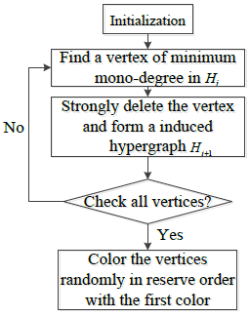
Hypergraph (Weak) Coloring Algorithm
x₁
x₂
x₇
x₆
x₃
x₄
x₅

Slide 16
Outline
1.
Motivation
2.
Hypergraph Basics
Basic concepts
Hypergraph coloring
Hypergraph matching
Hypergraph machine learning
3.
Applications
Device-to-Device Communications
Mobile Edge Computing
User-Centric Ultra-Dense Networks

Slide 17



Introduction
Hypergraph matching
Find a set of disjoint hyperedges
-uniform hypergraph
Each hyperedge has vertices
Special case: -dimensional matching
e.g. project with 3 students
It is hard to find the maximum weighted matching for an arbitrary hypergraph
In practice, we consider the -uniform hypergraph
-uniform hypergraph matching problem is also NP-hard for
Local search algorithm

Slide 18







Basic Definitions
Representative graph
Given hypergraph , the representative graph of is the graph
Hyperedges in are vertices in , and intersections of hyperedges correspond to edges in
-claw
A -claw is defined as a subgraph of whose center vertex connects to independent vertices
e₁
2-claw
e₁
3
1
2
e₅
Hypergraph
e₅
e₄
Representative
graph
4
e₄
e₂
5
e₃
6
e₂
e₃

Slide 19

Hypergraph Matching Algorithm
Find an initial matching by some greedy algorithms.
Search for a -claw that can improve the overall performance for all
Add the containing talons to the matching
Remove all hyperedges that intersect with them from the matching
The above process will be repeated until all the -claws are examined.
Hypergraph
Representative graph
Hypergraph
Hypergraph
e₁
e₁
Talon
e₁
e₁
2
e₅
3
1
3
1
2
3
1
2
e₄
e₅
e₄
e₅
e₄
e₅
4
e₄
4
4
e₂
e₃
6
e₂
e₂
e₃
e₂
e₃
6
5
Talon
5
6
5
e₃
An initial matching
Center vertex
(e.g. 2-claw)
Add talons
Remove hyperedges
Is new matching
better?
Notes:
P18

Slide 20
Outline
1.
Motivation
2.
Hypergraph Basics
Basic concepts
Hypergraph coloring
Hypergraph matching
Hypergraph machine learning
3.
Applications
Device-to-Device Communications
Mobile Edge Computing
User-Centric Ultra-Dense Networks

Slide 21
Introduction
An example
U.S. President Donald Trump pays state visit to China. Trump arrives at Beijing on Nov. 8, 2017. Chinese President Xi Jinping hosts a welcome ceremony for Donald Trump in Beijing, and he says his visit is successful and historic.
U.S. President Donald Trump
Trump
U.S. President Donald Trump
Trump
Donald Trump
Chinese President Xi Jinping
Donald Trump
Chinese President Xi Jinping
his
he
his
he

Slide 22








Problem Definition
Problem description
Given the weighted hypergraph
: pairwise weight between any two vertices, derived by
: diagonal matrix with the m-th diagonal element being the sum of elements of the m-th row of
-way normalized cut: Partition the vertex set into disjoint subsets by solving the following problems:
overall Similarity
n-th column of
within cluster Similarity
Mixed integer non-convex problem
S. X. Yu and J. Shi, “Multiclass Spectral Clustering,” IEEE Int. Conf. Computer Vision, 2003

Slide 23



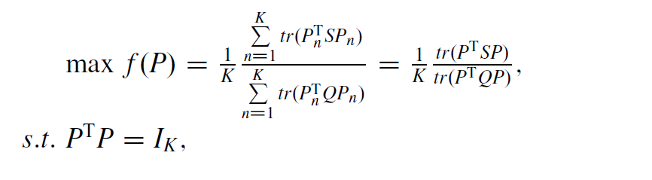

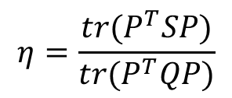



Clustering Algorithm
Approximation
, to indicate the inter-cluster separability
Define , and is an orthogonal matrix
Transformed into a sum-trace-ratio optimization problem:
Algorithm
Relax the elements in to be continuous
Compute the trace ratio
Compute the largest eigenvalues of and define their associated eigenvectors as
Recover the optimal discrete solution from the continuous solution

Slide 24
Machine Learning
Types of Learning Algorithms
Supervised
Learning
Unsupervised
Learning
Reinforcement Learning
Classification
Regression
Grouping
Clustering
Simulation-based Optimization
Genetic Algorithm
Dynamic Programming
Applications:
ranking, recommendation systems, visual identity tracking, face verification, and speaker verification.
Applications:
the field of density estimation in statistics, other domains involving summarizing and explaining data features.
Applications:
used in autonomous vehicles or in learning to play a game against a human opponent.
Notes:
23

Slide 25
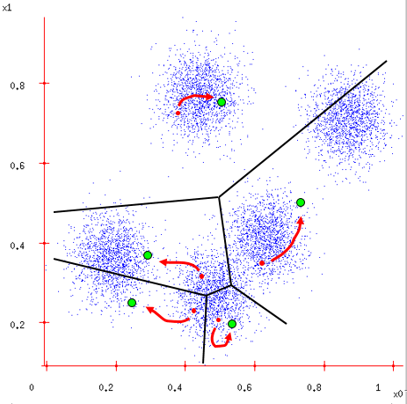
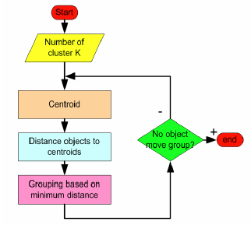
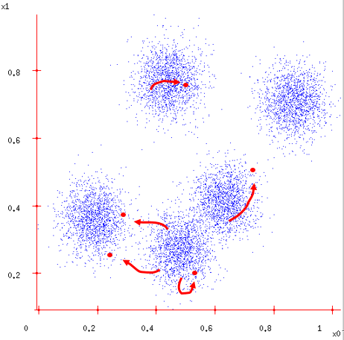
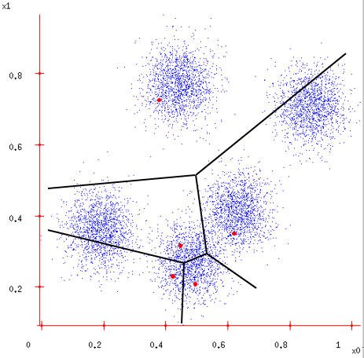
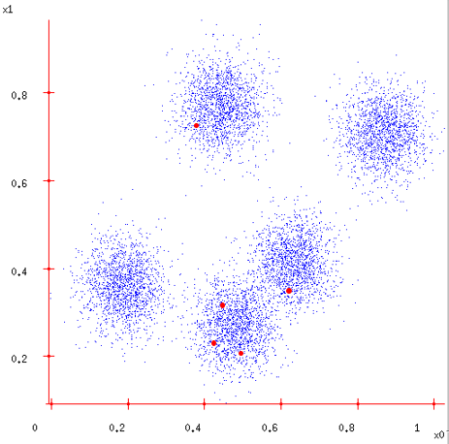
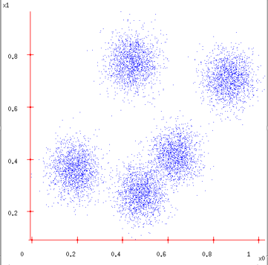
Clustering (K-means)
K=5

Slide 26
Outline
1.
Motivation
2.
Hypergraph Basics
Basic concepts
Hypergraph coloring
Hypergraph matching
Hypergraph machine learning
3.
Applications
Device-to-Device Communications
Mobile Edge Computing
User-Centric Ultra-Dense Networks

Slide 27
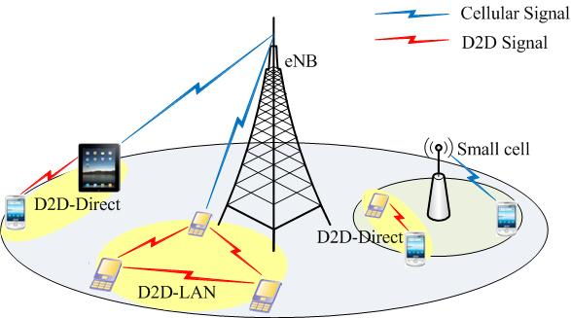
Introduction
Device-to-Device (D2D) communications:
Allow mobile users to communicate with each other directly by reusing the cellular radio resources
Benefits:
Improve spectral efficiency
Reduce energy consumption
Offload cellular data
Extend cell coverage
H. Zhang, L. Song, and Z. Han, “Radio Resource Allocation for Device-to-Device Underlay Communication Using Hypergraph Theory,” IEEE Trans. Wireless Commun., vol. 15, no. 7, pp. 4852-4861, Jul. 2016.

Slide 28
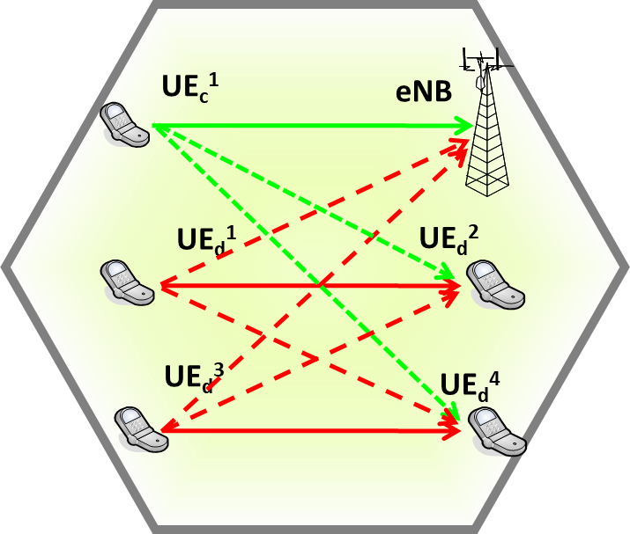
Introduction
Challenges: Interference
Inter-tier interference: Interference among D2D users
Cross-tier intereference: Interference between cellular and D2D users
Solution:
Proper resource assignment
Efficient interference management

Slide 29
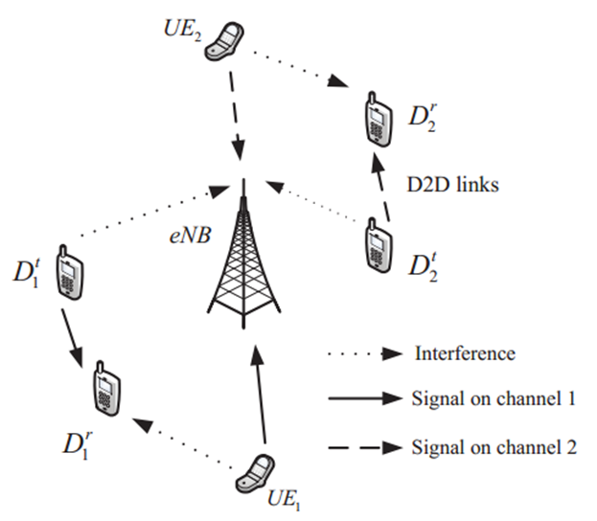
System Model
An uplink scenario
Two types of users
Cellular user: orthogonal access
D2D user: underlay of cellular communications
A D2D/cellular user can utilize at most one channel
Transmit power: fixed
Interference
Cellular user -> D2D receiver
D2D transmitter -> base station and other D2D receivers

Slide 30
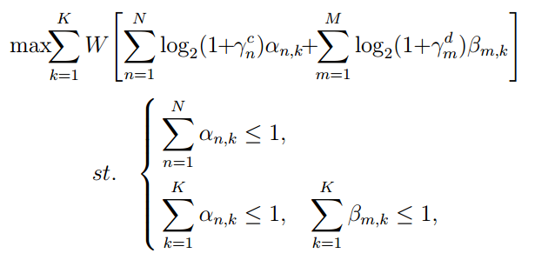
Problem Formulation
Objective
Maximize the system sum-rate by optimizing channel allocation for cellular and D2D users
Optimization problem
Channel allocation for cellular users
Channel allocation for D2D users
A channel can be allocated to at most one cellular user
A D2D/cellular user can utilize at most one channel

Slide 31
Hypergraph Formulation
Combinatorial optimization problem
NP-hard
Graph coloring is an approximate and efficient method for such a resource allocation problem
To model the accumulative interference from multiple D2D users, hypergraph model is adopted
Hypergraph model
Channels: different colors
Cellular/D2D users: vertices
Interference relations: hyperedges

Slide 32
Hypergraph Construction
Independent interferers recognition
Pairwise comparison
Wanted signal ratio to the interference is below a threshold
Each user and its independent interferers will form edges
Cumulative interferers recognition
Independent interferers will not be cumulative interferers
Wanted signal to the cumulative interference ratio is below a threshold
Each user and its cumulative interferers will form hyperedges
Solution
Weak coloring (two channel/color)
The number of colors may not be sufficient: select a color randomly

Slide 33
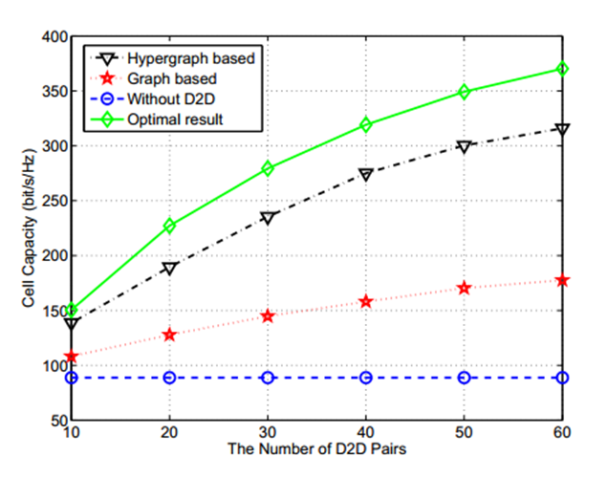
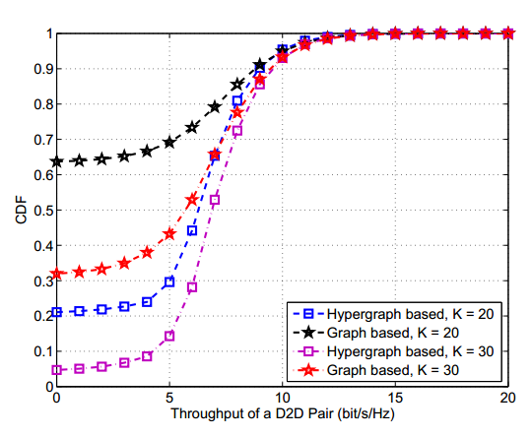
Simulation Results
Hypergraph based scheme can achieve a higher data rate than the graph based one
The outage probability for D2D users obtained by the hypergraph scheme is lower

Slide 34
Brief Summary
D2D underlay communications
Since multiple D2D users can share the same channel, the cumulative interference might be severe
Hypergraph is adopted to model the cumulative interference
D2D/cellular users: vertices
Channels: colors
Interference relations: hyperedges
Hypergraph coloring is an efficient method to allocate the resources

Slide 35
Outline
1.
Motivation
2.
Hypergraph Basics
Basic concepts
Hypergraph coloring
Hypergraph matching
Hypergraph machine learning
3.
Applications
Device-to-Device Communications
Mobile Edge Computing
User-Centric Ultra-Dense Networks

Slide 36
Introduction
Mobile edge computing (MEC) has potentials to bring multiple benefits by extending computation and storage resources to the network edge.
Network Functions Virtualization (NFV) can virtualize network services and functions as multiple virtual machines (VMs) on top of commoditized physical machines (PMs).
To implement the NFV-enabled MEC architecture, virtual network functions (e.g., virtualized computing and storage services) are deployed at the MEC data center by creating VM instances simultaneously running on PMs.
One important challenge lies in how to efficiently achieve the VM placement on top of the PMs and allocate the virtualized resources to the UEs satisfying the requirement of workloads.

Slide 37
Motivation
VM placement problem in existing works was formulated bearing in mind an obvious technique constraint that a single VM instance must be running on one PM.
For example, VM monitor software known as hypervisor cannot support the creation of one single VM instance that spans multiple PMs.
However, the cutting-edge vSMP hypervisor from ScaleMP can aggregate multiple PMs into a single highly capable VM.
Our work intends to achieve an energy efficient VM placement by characterizing much more complex mapping relation between VM instances and PMs, which involves the VM placement across several PMs.

Slide 38







System Model (1/2)
One MEC system consisting of one eNB integrated with a MEC data center and L UEs.
The MEC data center:
M PMs to provide physical resources, i.e., processor cores and memory sizes:
N VM instances running on M PMs:
PMs → Available resource vector:
VM instances → Resource shape vector:
UEs → Resource requirement vector:

Slide 39


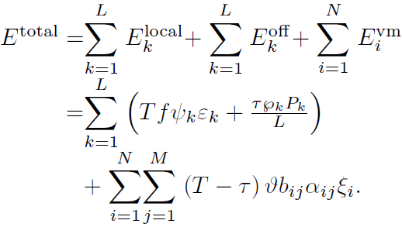

System Model (2/2)
We adopt a partial computation offloading model, and also derive the energy consumption during the following three stages:
Local Computing
Energy consumption per processor cycle for local computing
Total energy consumption of the MEC system for computing and offloading during time duration T:
Computation Offloading
Maximum transmit power of UE
Transmit power of UE
Computing at MEC data center
Energy consumption per processor cycle for computing at VM instance

Slide 40
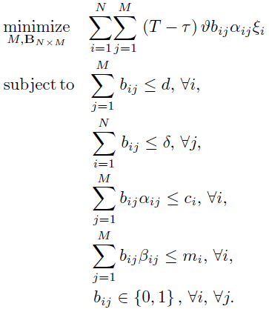
Problem Formulation
Our objective is to minimize the total energy consumption for computing and offloading, aiming to obtain the optimal VM placement:
N×M 0-1 VM placement matrix
Virtualized resources of VM instance v_{i} can be placed across at most d PMs
PM p_{j} can host at most δ VM instances
Constraints of number of processor cores and amount of memory sizes
Binary variable to indicate whether VM instance v_{i} is placed on PM p_{j}

Slide 41
Hypergraph Construction (1/2)
We construct the weighted hypergraph model based on the complex placement relation between VM instances and PMs:
Complex Placement Relation
Virtualized resources of VM instance v_{i} can be placed across at most d PMs
PM p_{j} can host at most δ VM instances
transformation
Incidence Matrix

Slide 42




Hypergraph Construction (2/2)
Weighted hypergraph model:
Vertex
VM instance
Hyperedge
PM
Hyperedge weight
accumulated energy consumption for computing in a hyperedge
transformation
Our target for the energy consumption minimization problem is to find an (M*)-perfect matching as a collection of M* vertex-disjoint hyperedges with the maximum total weight by covering as many vertices as possible in .

Slide 43

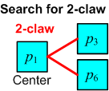
Hypergraph Matching Algorithm Design
For a generalized hypergraph matching problem, seeking a maximum-weight subset of vertex-disjoint hyperedges is NP hard.
We use local search to find a suboptimal solution.
1
Construct Representative graph
every vertex of
every hyperedge of
2
Search for φ-claw
An initial matching {p₂,p₄}
Updated matching {p₃,p₆}
Better?
Notes:
P42

Slide 44
Brief Summary
We formulate the energy consumption minimization problem as an intractable 0-1 integer linear programming problem with an uncertain number of PMs and unknown linear summation constraints.
We transform the optimization problem into a non-uniform weighted hypergraph model.
The energy efficient VM placement is converted to find a maximum-weight hypergraph matching.
We propose a hypergraph matching algorithm via local search to seek a maximum-weight subset of vertex-disjoint hyperedges.
Notes:
43

Slide 45
Outline
1.
Motivation
2.
Hypergraph Basics
Basic concepts
Hypergraph coloring
Hypergraph matching
Hypergraph machine learning
3.
Applications
Device-to-Device Communications
Mobile Edge Computing
User-Centric Ultra-Dense Networks

Slide 46
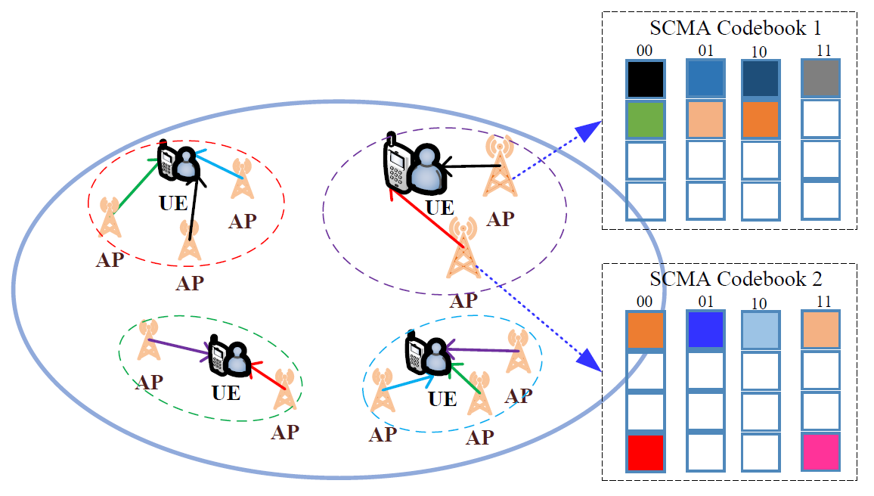
System Model
Sparse code multiple access (SCMA)
Fig. An example of codebook allocation based system model in user-centric ultra-dense networks.

Slide 47
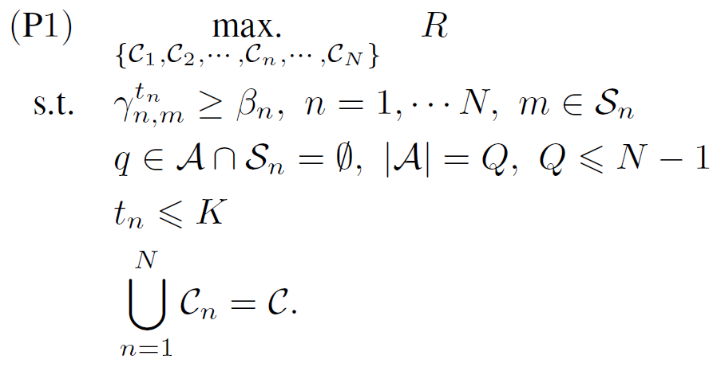
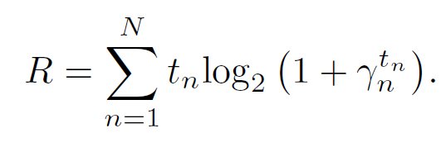
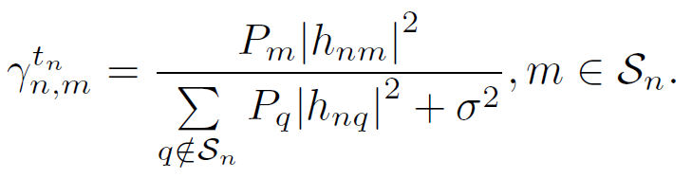
Problem Formulation
Codebook set
Ensure the QoS
Sharing N-1 different codebooks
At most K APs in each group sharing different codebooks
Total codebooks
where
Sum Rate
SINR

Slide 48
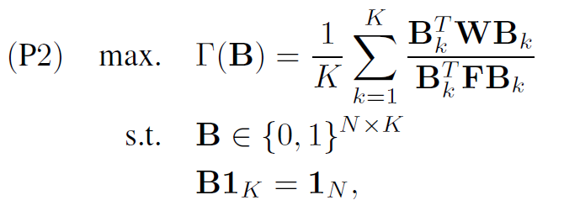
Hypergraph Clustering Problem
Problem (P1) can be transformed as a typical hypergraph clustering problem (P2)
Consider the weighted hypergraph 𝐻=(𝑋,𝐸,𝑊)
The vertices represent the UEs, and the interference relation is
denoted by the hyperedges when the UEs share the same codebook.
K-way normalized cut: Partition the vertex set 𝑋 into K disjoint subsets

Slide 49
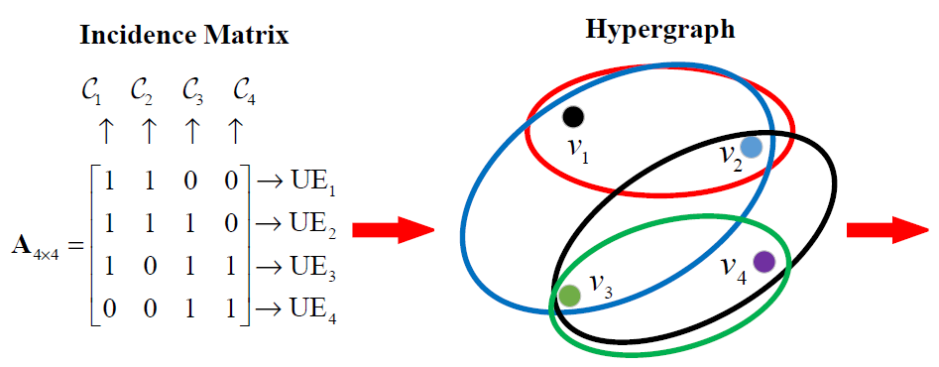
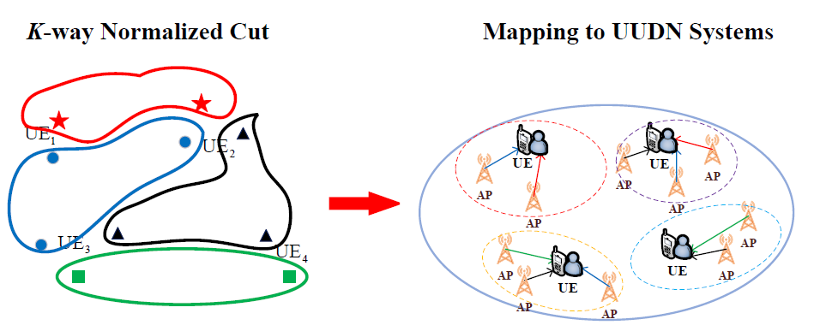
An Illustrative Example
K-way normalized cut hypergraph clustering
Notes:
It can be seen that we partition the dataset into 4 disjoint clusters with four different colors based
clusters. In each cluster, they share the same codebooks. However, their distance is very large, so the interference can
be ignored. While the APs around the UEs share different codebooks, so they are allocated in the different clusters with
no interference. Thus, from this example, it can be noted that ML algorithms are powerful in solving the hypergraph-model based
optimization problems.
48

Slide 50
Descriptions
We partition the dataset into disjoint clusters with different colors based clusters.
In each cluster, they share the same codebooks. However, their distance is very large, so the interference can be ignored.
The APs around the UEs share different codebooks, so they are allocated in the different clusters with
no interference.

Slide 51
Brief Summary
Hypergraph theory is a powerful mathematical tool used in wireless communication to manage the resource allocation and interference cancellation problems.
Hypergraph clustering is one of the important methods to solve the integer nonlinear program (INLP) or mixed integer nonlinear program (MINLP).
Machine learning (ML) algorithm is a good choice to help hypergraph clustering to solve the complex resource allocation problems due to the high density of APs/UEs in the UUDNs.
Notes:
50

Slide 52
Conclusions
We have introduced the basic preliminaries of hypergraph theory, and have focused on three kinds of hypergraph based approaches:
Hypergraph coloring: To label the vertex set with a color set
Hypergraph matching: To find a set of disjoint hyperedges
Hypergraph clustering: To partition the vertex set into K disjoint subsets
We have provided three emerging application cases for wireless networking, including D2D underlay communications, MEC, and user-centric UDNs.
Compared with classic graph theory, hypergraph theory is an enabling theoretical tool to model the complex relations among multiple entities.
Compared with other integer optimization
Some hypergraph structures have low complexity algorithms. Generally, the hypergraph should be constructed before the algorithm, and the topology of hypergraph will help to reduce the number of iterations. But in the optimization theory, the algorithm usually has a lot of iterations.
Hypergraph theory also provides an intuitive analysis tool. The relations among the elements are shown in the hypergraph directly.

Slide 53

Thank
You !

