Slide 1
Tutorial: Markov chain Monte Carlo
Professor Zhu Han
Department of Electrical Engineering
University of Houston
Thanks for Qiuyang Shen and Yan Zhu

Slide 2

Outline
Motivations
MCMC Algorithms
Applications
Conclusions
Ref link @https://www.azernews.az/oil_and_gas/127728.html. Photograph by Trend.

Slide 3
Outline
The motivations of Markov chain Monte Carlo
Bayesian Inference
MCMC sampling algorithms
Bayesian inference and random-walk sampling
Hybrid Monte Carlo Sampling
Self-parameterizing method: trans-dimensional MCMC
Accelerate Bayesian inference: tempering method
Applications
Statistical inference of earth resistivity model
Intermittent connectivity model in satellite links
Conclusion
Notes:
In detail,

Slide 4
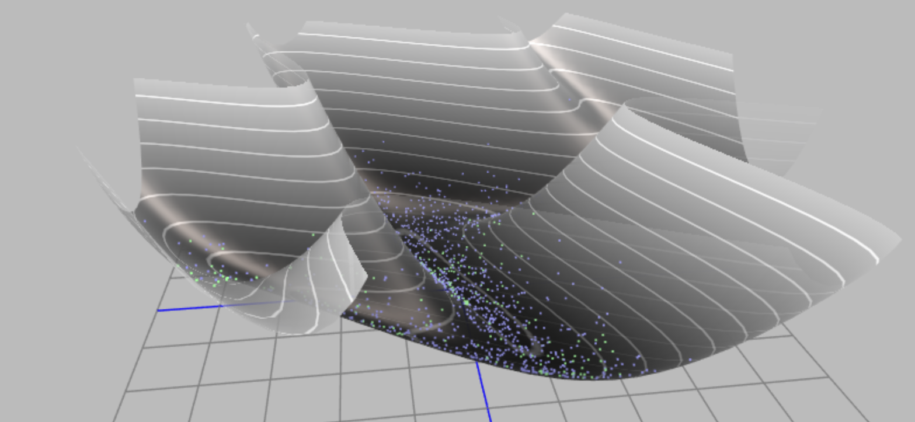
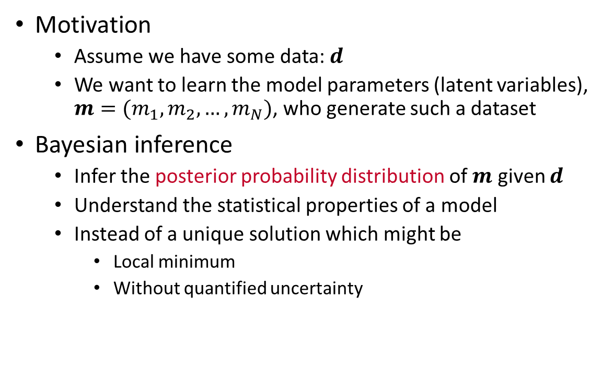
Bayesian inference
Motivation
Assume we have some data: $d$
We want to learn the model parameters (latent variables), $m=(m_{1},m_{2},…,m_{N})$, who generate such a dataset
Bayesian inference
Infer the posterior probability distribution of $m$ given $d$
Understand the statistical properties of a model
Instead of a unique solution which might be
Local minimum
Without quantified uncertainty

Slide 5
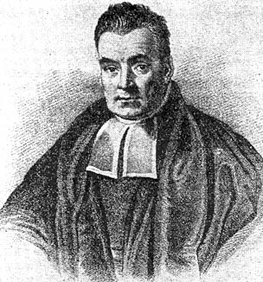
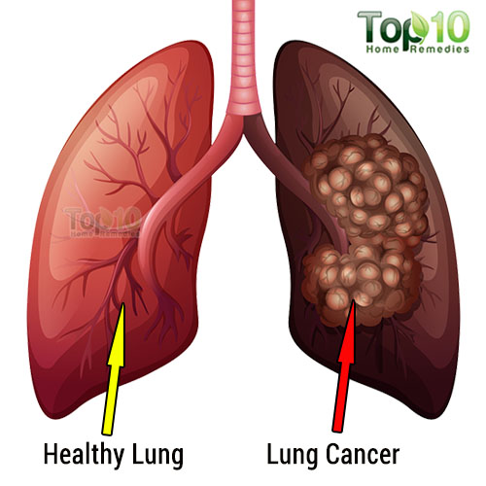
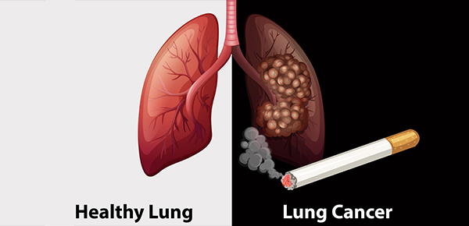
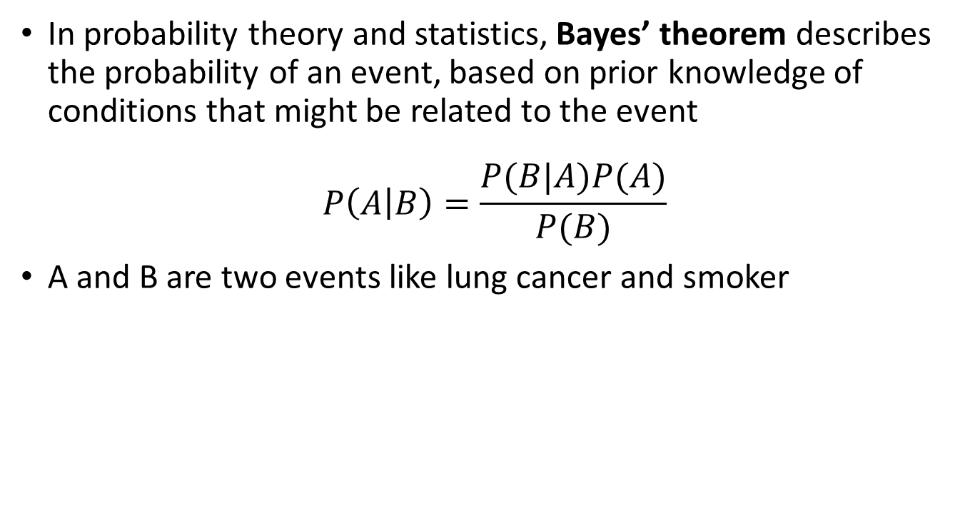


Bayes’ theorem
In probability theory and statistics, Bayes’ theorem describes the probability of an event, based on prior knowledge of conditions that might be related to the event
$$P\left(A | B\right)=\frac{P(B|A)P(A)}{P(B)}$$
A and B are two events like lung cancer and smoker
Thomas Bayes (1701 - 1761)
$$P(Lung cancer)$$
$$P(Lung cancer|smoker)$$
Conditional probability
Notes:
For example, if lung cancer is related to smoking, then, using Bayes’ theorem, a smoker can be used to more accurately assess the probability that has lung cancer, compared to the assessment of the probability of cancer made without knowledge of the person’s smoking behavior.

Slide 6

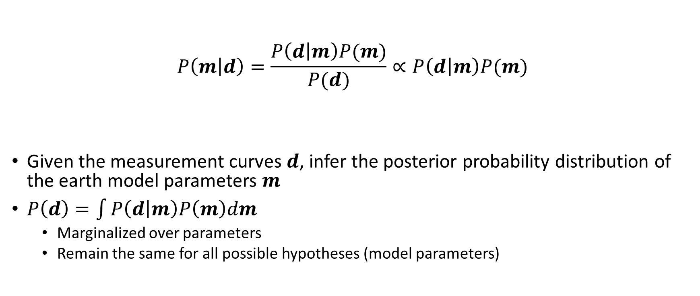
Bayesian inference
Likelihood
Prior
Posterior
$$P\left(m | d\right)=\frac{P\left(d | m\right)P(m)}{P(d)}∝P\left(d | m\right)P(m)$$
Given the measurement curves $d$, infer the posterior probability distribution of the earth model parameters $m$
$P\left(d\right)=\int{P\left(d | m\right)P\left(m\right)dm}$
Marginalized over parameters
Remain the same for all possible hypotheses (model parameters)
Evidence
Notes:
Bayesian inference is a method of statistical inference in which Bayes' theorem is used to update the probability for a hypothesis as more evidence or information becomes available.
evidence is the distribution of the observed data marginalized over the parameter

Slide 7
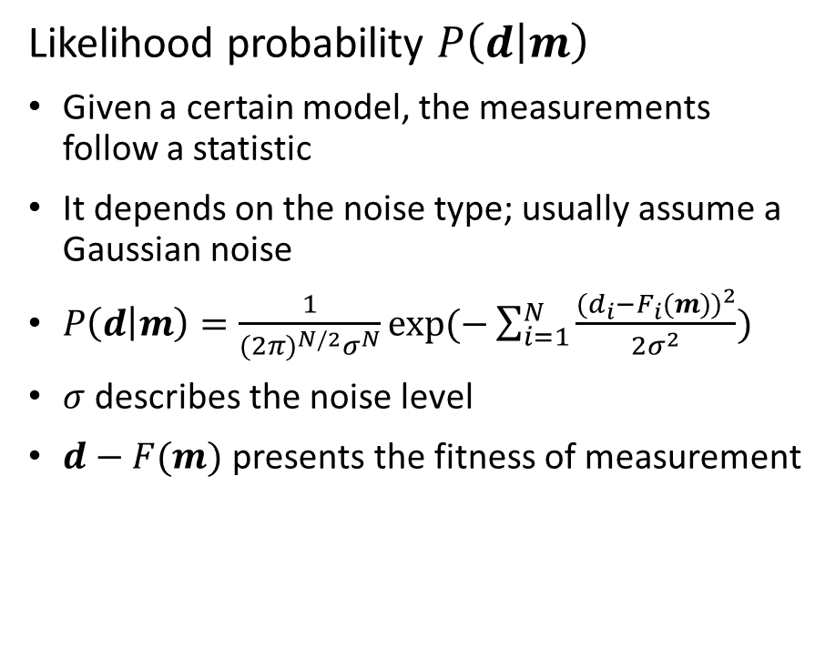

Likelihood and prior
Likelihood probability $P\left(d | m\right)$
Given a certain model, the measurements follow a statistic
It depends on the noise type; usually assume a Gaussian noise
$P\left(d | m\right)=\frac{1}{{(2π)}^{N/2}σ^{N}}exp⁡(−\sum_{i=1}^{N}{\frac{{(d_{i}−F_{i}(m))}^{2}}{2σ^{2}}})$
$σ$ describes the noise level
$d−F(m)$ presents the fitness of measurement
Prior probability $P(m)$
The estimated probability of the model before observing measurement
Very commonly as a constraint to regularize the model parameters
Notes:
* The likelihood function measures goodness-of-fit
* The prior distribution represents prior information about the inferred quantities

Slide 8



Markov Chain Monte Carlo (MCMC) method
posterior probability: $P\left(m | d\right)=\frac{P(d|m)P(m)}{\int{P(d|m)P\left(m\right)dm}}$
To understand the posterior probability distribution, we need a sampling method
MCMC Methods
A class of algorithms sample from a probability distribution
By constructing a Markov chain whose stationary distribution is the same as posterior distribution
Mean?
Posterior Distribution?
Mode?
Range?
Variance?
Notes:
-END A problem is how this mechanism can accommodate a construction of a stationary distribution

Slide 9
Outline
Motivations
Bayesian inference and sampling methods
Markov chain Monte Carlo method
Metropolis-Hastings algorithm
Beyond random-walk: a hybrid Monte Carlo
Hamiltonian dynamic
Hybrid Monte Carlo sampling
Self-parameterizing method: trans-dimensional MCMC
Reversible-jump MCMC
Birth-death simulation
Accelerate Bayesian inference: tempering method
Optimization and probabilistic function
Parallel tempering method
MCMC Algorithms
Applications
Conclusions

Slide 10
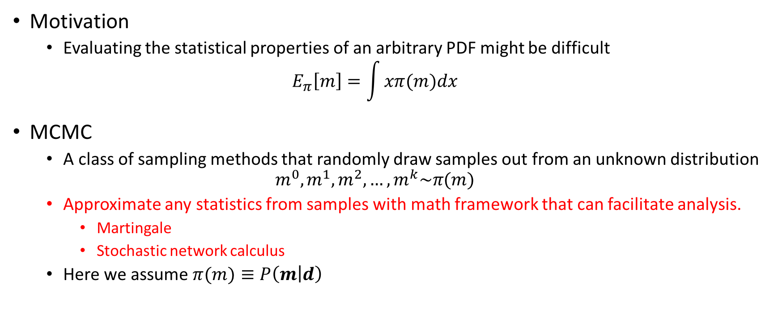
Markov chain Monte Carlo method
Motivation
Evaluating the statistical properties of an arbitrary PDF might be difficult
$$E_{π}\left[m\right]=\int{xπ(m)dx}$$
MCMC
A class of sampling methods that randomly draw samples out from an unknown distribution
$$m^{0},m^{1},m^{2},…,m^{k}\sim π(m)$$
Approximate any statistics from samples with math framework that can facilitate analysis.
Martingale
Stochastic network calculus
Here we assume $π(m)≡P\left(m | d\right)$

Slide 11
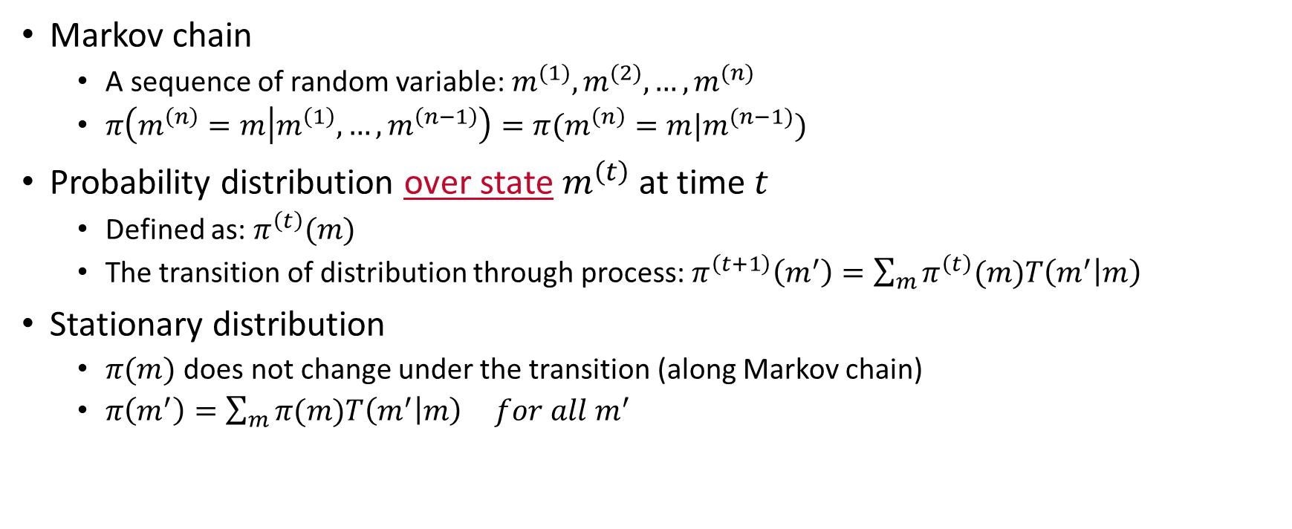
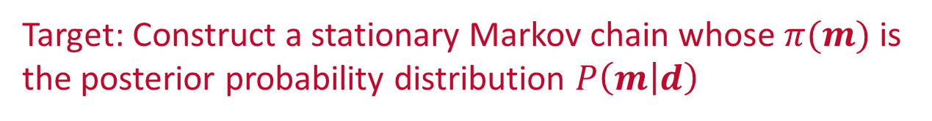

Construct a stationary Markov chain
Markov chain
A sequence of random variable: $m^{(1)},m^{(2)},…,m^{(n)}$
$π\left(m^{\left(n\right)}=m | m^{\left(1\right)},…,m^{\left(n−1\right)}\right)=π(m^{\left(n\right)}=m|m^{(n−1)})$
Probability distribution over state $m^{\left(t\right)}$ at time $t$
Defined as: $π^{\left(t\right)}(m)$
The transition of distribution through process: $π^{\left(t+1\right)}\left(m^{′}\right)=\sum_{m}{π^{\left(t\right)}(m)T\left(m^{′} | m\right)}$
Stationary distribution
$π(m)$ does not change under the transition (along Markov chain)
$π\left(m^{′}\right)=\sum_{m}{π(m)T\left(m^{′} | m\right)} for all m^{′}$
Transition kernel $T(m^{′}|m)$
Target: Construct a stationary Markov chain whose $π(m)$ is the posterior probability distribution $P\left(m | d\right)$
Notes:
- the probability of nth event depends only on the state attained in the previous event
- A system does not have only one state, but has a distribution over state

Slide 12
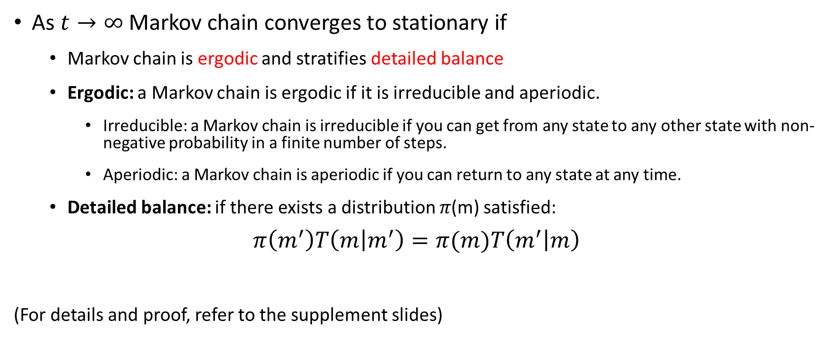
stationary distribution
As $t→∞$ Markov chain converges to stationary if
Markov chain is ergodic and stratifies detailed balance
Ergodic: a Markov chain is ergodic if it is irreducible and aperiodic.
Irreducible: a Markov chain is irreducible if you can get from any state to any other state with non-negative probability in a finite number of steps.
Aperiodic: a Markov chain is aperiodic if you can return to any state at any time.
Detailed balance: if there exists a distribution 𝜋(m) satisfied:
$$π\left(m^{′}\right)T\left(m | m^{′}\right)=π(m)T\left(m^{′} | m\right)$$
(For details and proof, refer to the supplement slides)

Slide 13
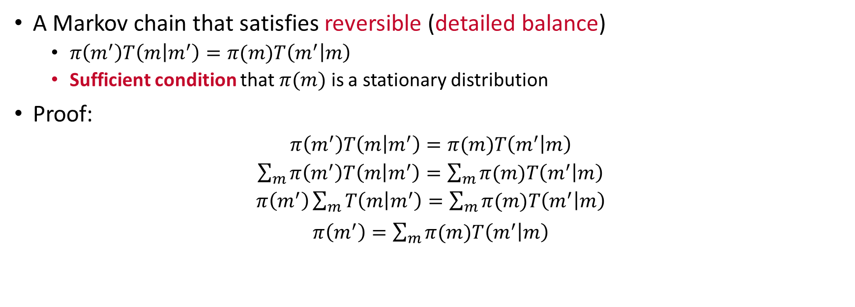
Construct a stationary Markov chain
A Markov chain that satisfies reversible (detailed balance)
$π\left(m^{′}\right)T\left(m | m^{′}\right)=π(m)T\left(m^{′} | m\right)$
Sufficient condition that $π(m)$ is a stationary distribution
Proof:
$π\left(m^{′}\right)T\left(m | m^{′}\right)=π(m)T\left(m^{′} | m\right)$
$\sum_{m}{π\left(m^{′}\right)T\left(m | m^{′}\right)}=\sum_{m}{π(m)T\left(m^{′} | m\right)}$
$π\left(m^{′}\right)\sum_{m}{T\left(m | m^{′}\right)}=\sum_{m}{π(m)T\left(m^{′} | m\right)}$
$π\left(m^{′}\right)=\sum_{m}{π(m)T\left(m^{′} | m\right)}$
How to design a transition kernel to achieve detailed balance?
Notes:
The transition of chain distribution from current state to the next state equals to its reverse transition
Because the summation of the probability from m prime to all possible m equals to one

Slide 14
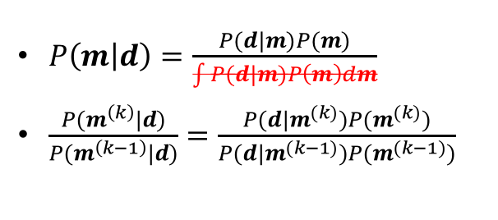
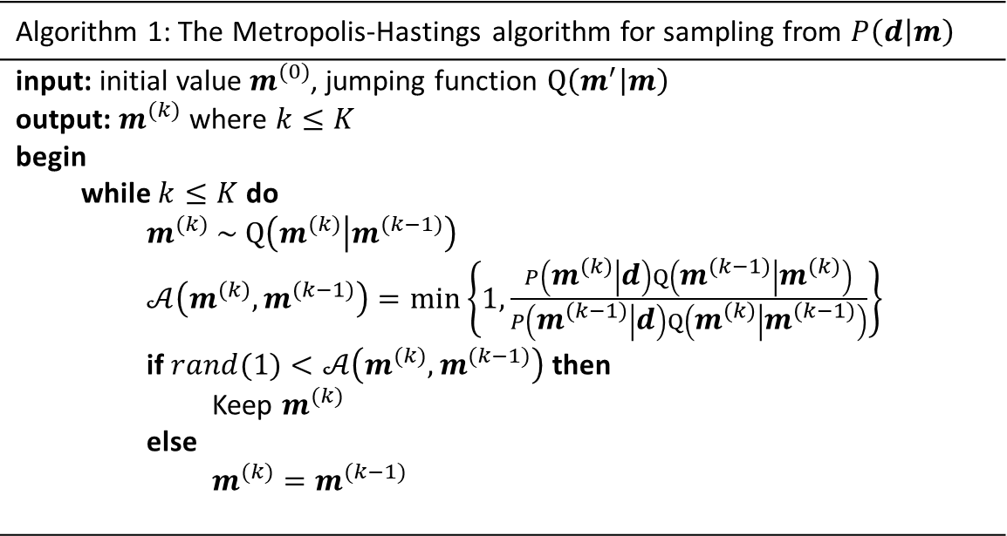
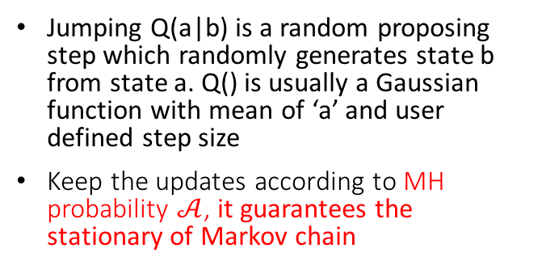
Metropolis-Hastings algorithm
A method that generate a sequence of random samples from a probability distribution iteratively
Algorithm 1: The Metropolis-Hastings algorithm for sampling from $P\left(d | m\right)$
input: initial value $m^{(0)}$, jumping function $Q\left(m^{′} | m\right)$ output: $m^{(k)}$ where $k≤K$ begin while $k≤K$ do $m^{(k)} \sim Q\left(m^{(k)} | m^{(k−1)}\right)$ $𝒜\left(m^{(k)},m^{(k−1)}\right)=\min\left\{1,\frac{P\left(m^{(k)} | d\right)Q\left(m^{(k−1)} | m^{(k)}\right)}{P\left(m^{(k−1)} | d\right)Q\left(m^{(k)} | m^{(k−1)}\right)}\right\}$ if $rand(1)<𝒜\left(m^{(k)},m^{(k−1)}\right)$ then Keep $m^{(k)}$ else $m^{(k)}=m^{(k−1)}$
$P\left(m | d\right)=\frac{P(d|m)P(m)}{\int{P(d|m)P\left(m\right)dm}}$
$\frac{P(m^{\left(k\right)}|d)}{P(m^{\left(k−1\right)}|d)}=\frac{P(d|m^{(k)})P(m^{(k)})}{P(d|m^{(k−1)})P(m^{(k−1)})}$
Jumping Q(a|b) is a random proposing step which randomly generates state b from state a. Q() is usually a Gaussian function with mean of ‘a’ and user defined step size
Keep the updates according to MH probability $𝒜$, it guarantees the stationary of Markov chain
Notes:
Denominator

Slide 15
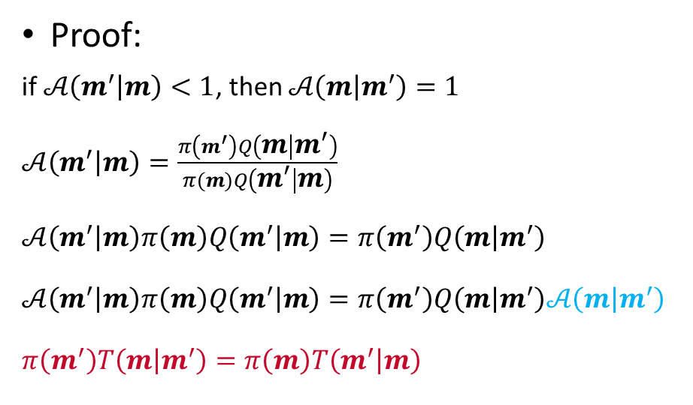
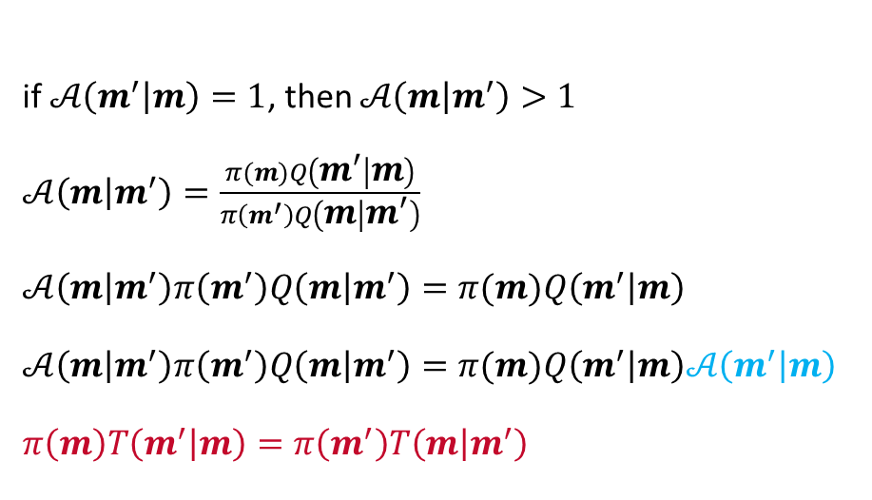
Metropolis-Hastings algorithm
Recall: sufficient condition that $π(m)$ is a stationary distribution
$π\left(m^{′}\right)T\left(m | m^{′}\right)=π(m)T\left(m^{′} | m\right)$
Proof:
if $𝒜\left(m^{′} | m\right)<1$, then $𝒜\left(m | m^{′}\right)=1$
$𝒜\left(m^{′} | m\right)=\frac{π\left(m^{′}\right)Q\left(m | m^{′}\right)}{π(m)Q\left(m^{′} | m\right)}$
$𝒜\left(m^{′} | m\right)π\left(m\right)Q\left(m^{′} | m\right)=π\left(m^{′}\right)Q\left(m | m^{′}\right)$
$𝒜\left(m^{′} | m\right)π\left(m\right)Q\left(m^{′} | m\right)=π\left(m^{′}\right)Q\left(m | m^{′}\right)𝒜\left(m | m^{′}\right)$
$π\left(m^{′}\right)T\left(m | m^{′}\right)=π\left(m\right)T\left(m^{′} | m\right)$
if $𝒜\left(m^{′} | m\right)=1$, then $𝒜\left(m | m^{′}\right)>1$
$𝒜\left(m | m^{′}\right)=\frac{π(m)Q\left(m^{′} | m\right)}{π\left(m^{′}\right)Q\left(m | m^{′}\right)}$
$𝒜\left(m | m^{′}\right)π\left(m^{′}\right)Q\left(m | m^{′}\right)=π(m)Q\left(m^{′} | m\right)$
$𝒜\left(m | m^{′}\right)π\left(m^{′}\right)Q\left(m | m^{′}\right)=π(m)Q\left(m^{′} | m\right)𝒜\left(m^{′} | m\right)$
$π\left(m\right)T\left(m^{′} | m\right)=π\left(m^{′}\right)T\left(m | m^{′}\right)$
Notes:
To show that the acceptance probability maintain the detailed balance

Slide 16
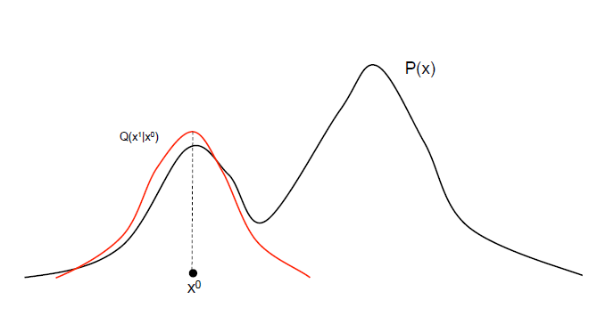
Example: If $Q\left(x^{′} | x\right)$ is a Gaussian centered on $x$ $A\left(x^{′} | x\right)=min⁡[1, \frac{P\left(x^{′}\right)}{P\left(x\right)}$]
Sample from a bimodal distribution $P\left(x\right)$.
Initialize $x^{(0)}$
…

Slide 17
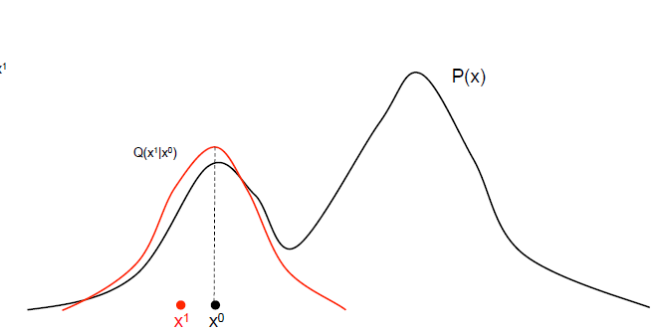
Example: If $Q\left(x^{′} | x\right)$ is a Gaussian centered on $x$ $A\left(x^{′} | x\right)=min⁡[1, \frac{P\left(x^{′}\right)}{P\left(x\right)}$]
Sample from a bimodal distribution $P\left(x\right)$.
Initialize $x^{(0)}$
Draw, accept $x^{(1)}$
…

Slide 18
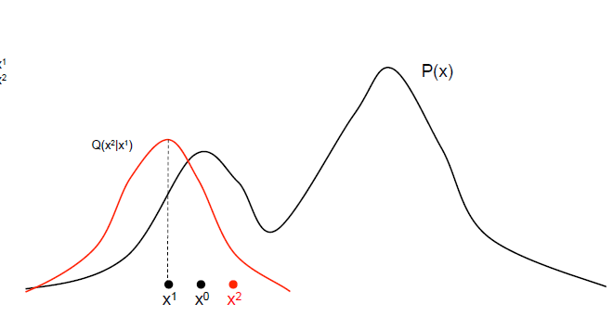
Example: If $Q\left(x^{′} | x\right)$ is a Gaussian centered on $x$ $A\left(x^{′} | x\right)=min⁡[1, \frac{P\left(x^{′}\right)}{P\left(x\right)}$]
Sample from a bimodal distribution $P\left(x\right)$.
Initialize $x^{(0)}$
Draw, accept $x^{(1)}$
Draw, accept $x^{(2)}$
…

Slide 19
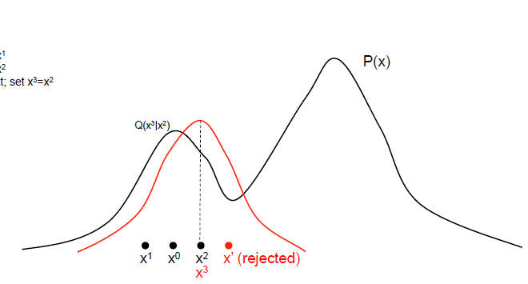
Example: If $Q\left(x^{′} | x\right)$ is a Gaussian centered on $x$ $A\left(x^{′} | x\right)=min⁡[1, \frac{P\left(x^{′}\right)}{P\left(x\right)}$]
$x^{′}$ has been rejected because $\frac{P\left(x^{′}\right)}{P\left(x^{2}\right)}$ is very small.
Sample from a bimodal distribution $P\left(x\right)$.
Initialize $x^{(0)}$
Draw, accept $x^{(1)}$
Draw, accept $x^{(2)}$
Draw, but reject, set $x^{(3)}=x^{(2)}$
…

Slide 20
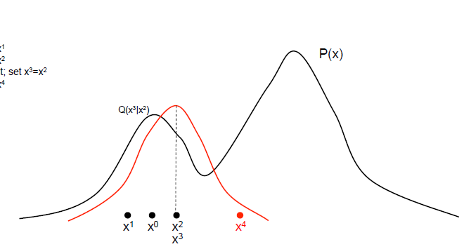
Example: If $Q\left(x^{′} | x\right)$ is a Gaussian centered on $x$ $A\left(x^{′} | x\right)=min⁡[1, \frac{P\left(x^{′}\right)}{P\left(x\right)}$]
Sample from a bimodal distribution $P\left(x\right)$.
Initialize $x^{(0)}$
Draw, accept $x^{(1)}$
Draw, accept $x^{(2)}$
Draw, but reject, set $x^{(3)}=x^{(2)}$
Draw, accept $x^{(4)}$
…

Slide 21
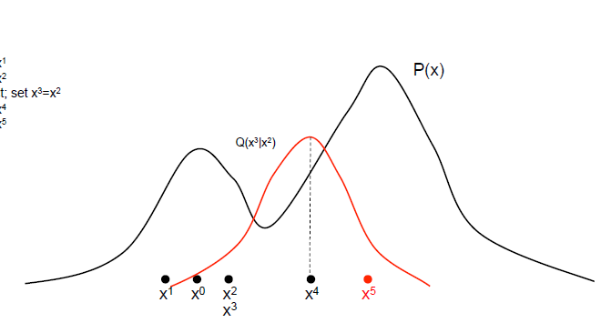
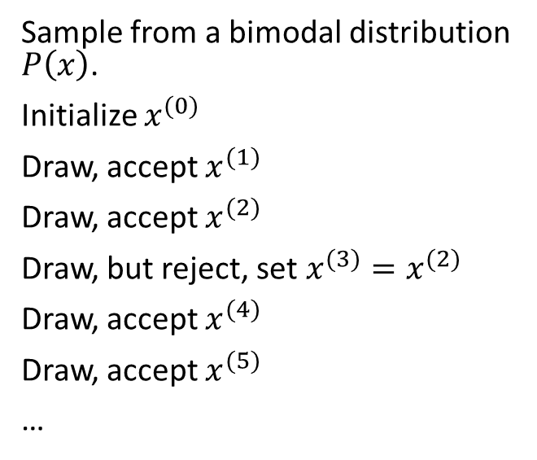
Example: If $Q\left(x^{′} | x\right)$ is a Gaussian centered on $x$ $A\left(x^{′} | x\right)=min⁡[1, \frac{P\left(x^{′}\right)}{P\left(x\right)}$]
Sample from a bimodal distribution $P\left(x\right)$.
Initialize $x^{(0)}$
Draw, accept $x^{(1)}$
Draw, accept $x^{(2)}$
Draw, but reject, set $x^{(3)}=x^{(2)}$
Draw, accept $x^{(4)}$
Draw, accept $x^{(5)}$
…

Slide 22
Example:
Collect sufficient samples (depends on the problem)
Evaluate the statistics
Draw a histogram

Slide 23
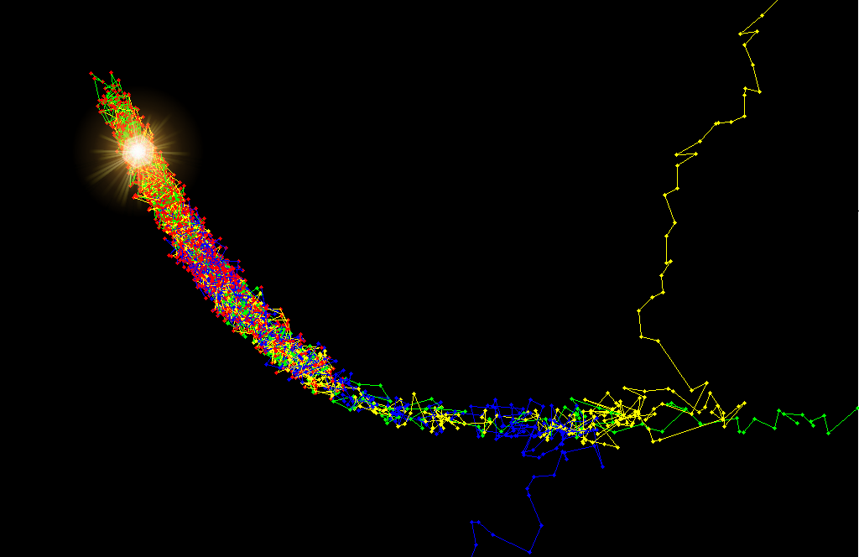
Hybrid Monte Carlo
Motivation
Statistical inversion conquers a local minima problem via sampling approach
Random-walk behaves slow moving
A combination of gradient-based method with sampling brings help
Hybrid Monte Carlo
Simulated Hamiltonian dynamical system
The candidate follows a gradient drift
Boost sampling speed
A gradient-drifted sampling method
Notes:
The previous section introduced the foundation of statistical Bayesian inference using random-walk. It stresses on the local minima problem by introducing a stochastic process.

Slide 24

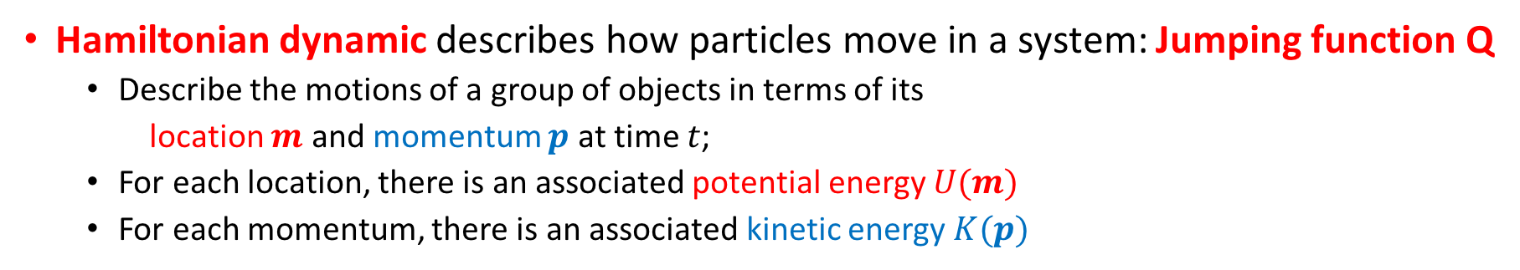
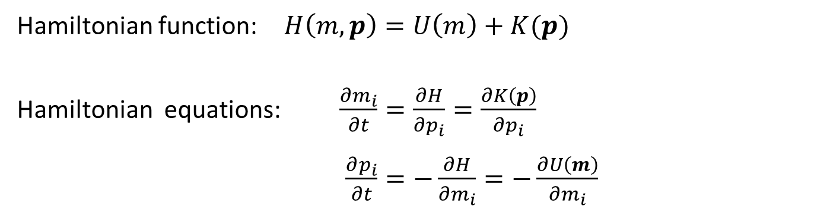
Hamiltonian Dynamic
Hamiltonian dynamic describes how particles move in a system: Jumping function Q
Describe the motions of a group of objects in terms of its
location $m$ and momentum $p$ at time $t$;
For each location, there is an associated potential energy $U(m)$
For each momentum, there is an associated kinetic energy $K(p)$
Hamiltonian function: $H\left(m,p\right)=U\left(m\right)+K(p)$
Hamiltonian equations: $\frac{∂m_{i}}{∂t}=\frac{∂H}{∂p_{i}}=\frac{∂K\left(p\right)}{∂p_{i}}$
$\frac{∂p_{i}}{∂t}=−\frac{∂H}{∂m_{i}}=−\frac{∂U\left(m\right)}{∂m_{i}}$
The total energy
Conversion between potential and kinetic energy

Slide 25
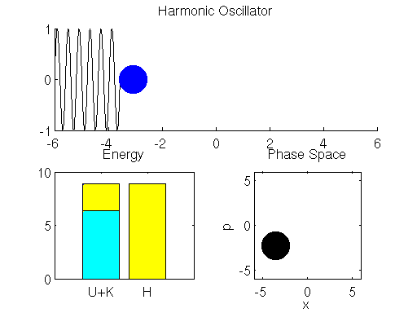
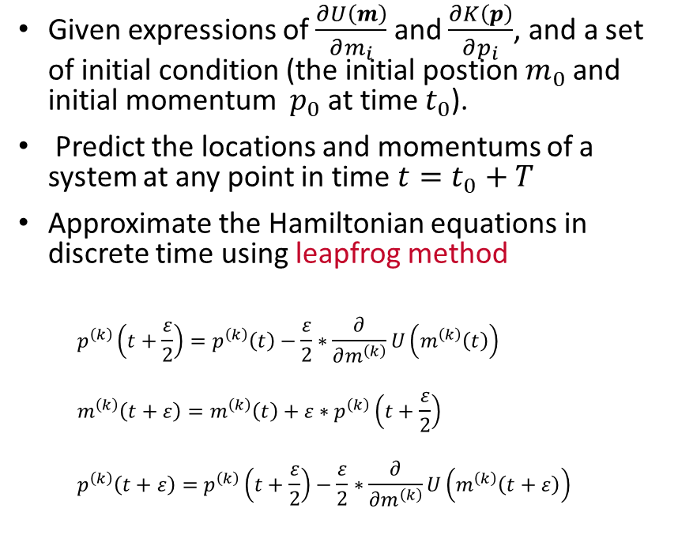
Hamiltonian Dynamic
Given expressions of $\frac{∂U\left(m\right)}{∂m_{i}}$ and $\frac{∂K\left(p\right)}{∂p_{i}}$, and a set of initial condition (the initial postion $m_{0}$ and initial momentum $p_{0}$ at time $t_{0}$).
Predict the locations and momentums of a system at any point in time ${t=t}_{0}+T$
Approximate the Hamiltonian equations in discrete time using leapfrog method
$$p^{\left(k\right)}\left(t+\frac{ε}{2}\right)=p^{\left(k\right)}\left(t\right)−\frac{ε}{2}∗\frac{∂}{∂m^{\left(k\right)}}U\left(m^{\left(k\right)}\left(t\right)\right)$$
$$m^{\left(k\right)}\left(t+ε\right)=m^{\left(k\right)}\left(t\right)+ε∗p^{\left(k\right)}\left(t+\frac{ε}{2}\right)$$
$$p^{\left(k\right)}\left(t+ε\right)=p^{\left(k\right)}\left(t+\frac{ε}{2}\right)−\frac{ε}{2}∗\frac{∂}{∂m^{\left(k\right)}}U\left(m^{\left(k\right)}\left(t+ε\right)\right)$$
Discretizing step size
m
Ref: Simple Harmonic Movement from Physics GIFs @https://gifsdefisica.com/2019/01/23/movimento-harmonico-simples-sistema-massa-mola-2/

Slide 26
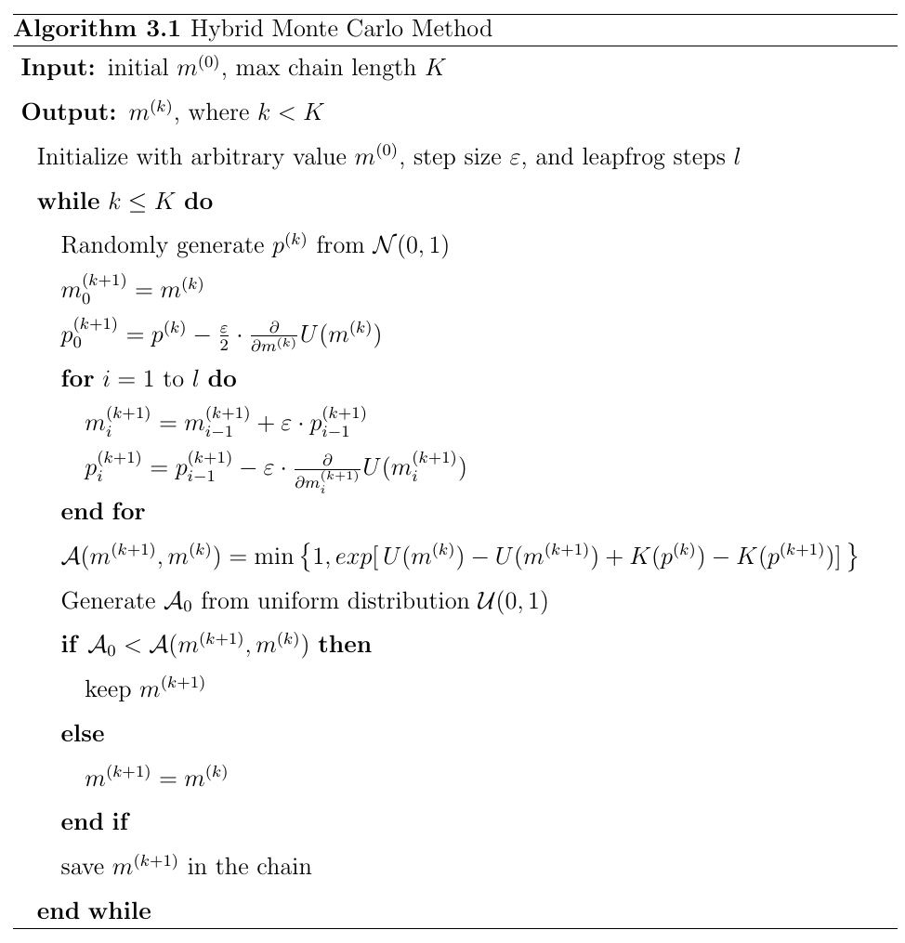
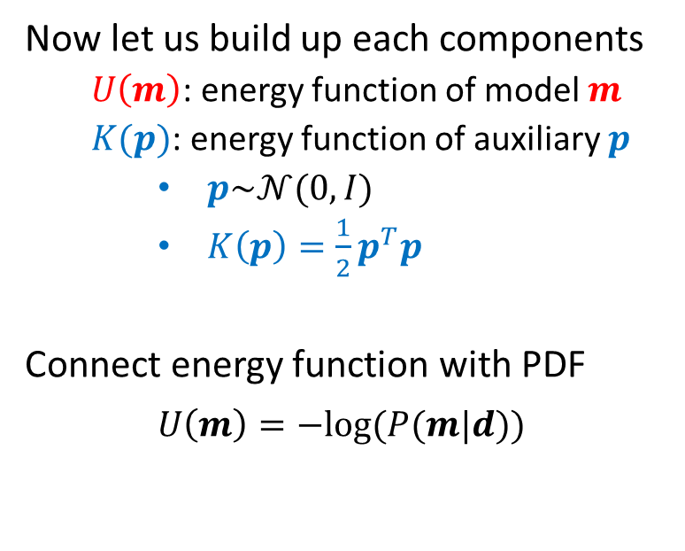
Hybrid Monte Carlo
Now let us build up each components
$U\left(m\right)$: energy function of model $m$
$K(p)$: energy function of auxiliary $p$
$p\sim 𝒩(0,I)$
$K\left(p\right)=\frac{1}{2}p^{T}p$
Connect energy function with PDF
$U\left(m\right)=−log⁡(P(m|d))$
Notes:
Now we need to accommodate each components in H dynamic to a Bayesian inference problem and see how to construct a sampling method.
- In fact, any optimization problem can transfer to a statistical sampling problem through a transformation ... But we will…

Slide 27
Hybrid Monte Carlo
Current sample
Leapfrog simulation of Hamiltonian dynamic
Candidate
Fast search/movement
to the next state
MH accepting rule
New sample

Slide 28



Trans-dimensional MCMC method
2 ohm.m
Dip = 78°
100 ohm.m
Which model is better??
The tool provides rich but complex information
The problem becomes much harder to solve while even the assumption of earth model is uncertain.
3 ohm.m
Three-layer model
1 ohm.m
20 ohm.m
2 ohm.m
Dip = 78°
100 ohm.m
$$P\left(m_{k},k | d\right)∝P\left(d | m_{k},k\right)P\left(m_{k} | k\right)P(k)$$
Now, the type of model, or the number of layers, $k$, becomes an unknown parameter to which we want to sample
$$P\left(m | d\right)∝P\left(d | m\right)P(m)$$
3 ohm.m
50 ohm.m
3 ohm.m
Seven-layer model
Notes:
tMCMC is an extension to standard MCMC that allows simulation of the posterior distribution on spaces of varying dimensions.
Thus, the simulation is possible even if the number of parameters in the model is not known.

Slide 29
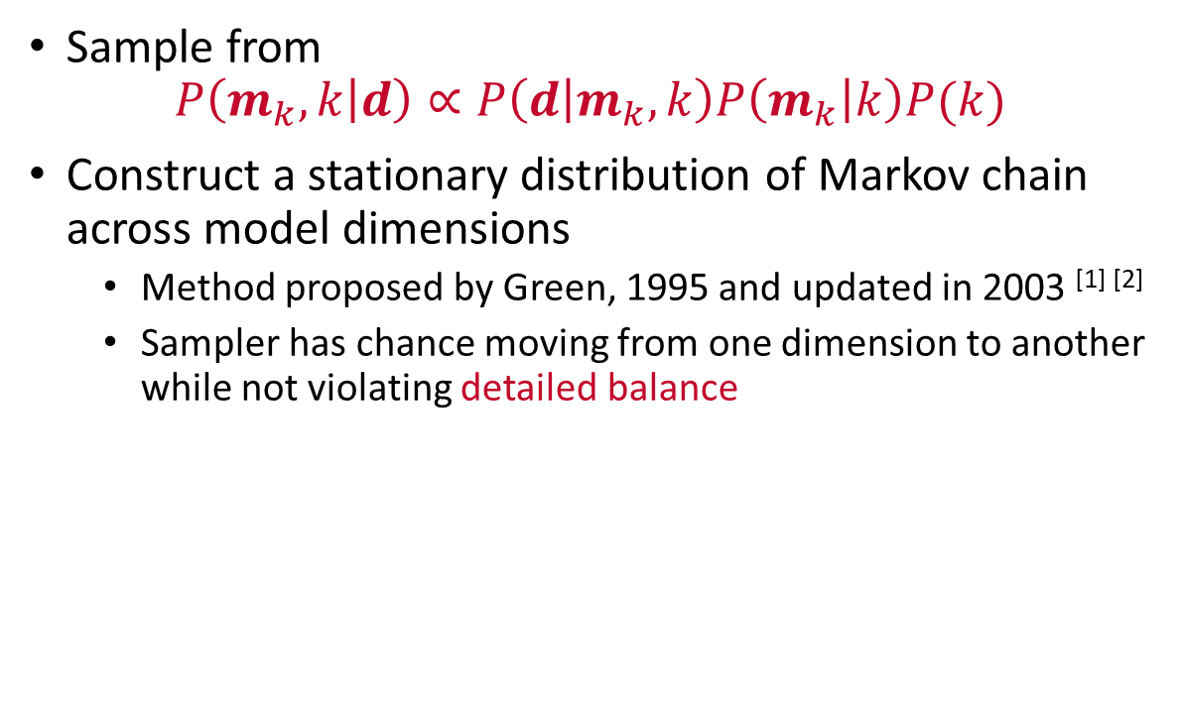
Reversible-jump MCMC
Sample from
$$P\left(m_{k},k | d\right)∝P\left(d | m_{k},k\right)P\left(m_{k} | k\right)P(k)$$
Construct a stationary distribution of Markov chain across model dimensions
Method proposed by Green, 1995 and updated in 2003 ^{[1] [2]}
Sampler has chance moving from one dimension to another while not violating detailed balance
4d
2d
3d
[1] Green, P.J. and Hastie, D.I., 2009. Reversible jump MCMC. Genetics, 155(3), pp.1391-1403.
[2] Green, P.J., 2003. Trans-dimensional Markov chain monte Carlo. Oxford Statistical Science Series, pp.179-198.
Notes:
Across model simulation
the different dimensions are sampled proportional to this support by the observed data, resulting in an efficient approach to sampling a trans-dimensional space. Hence, trans-dimensional sampling can be more efficient than sampling a sequence of individual state spaces.

Slide 30
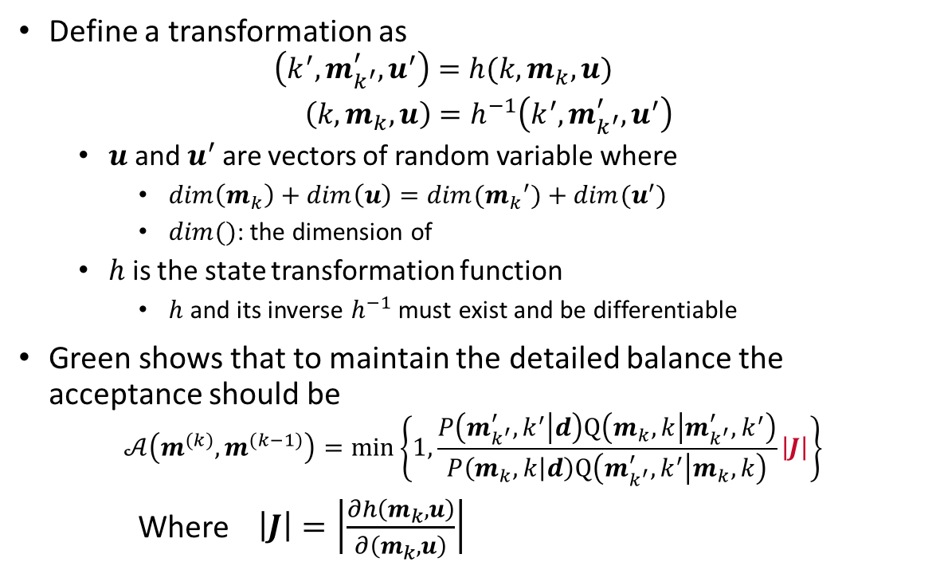
Reversible-jump MCMC
Define a transformation as
$$\left(k^{′},m_{k^{′}}^{′},u^{′}\right)=h(k,m_{k},u)$$
$\left(k,m_{k},u\right)=h^{−1}\left(k^{′},m_{k^{′}}^{′},u^{′}\right)$
$u$ and $u^{′}$ are vectors of random variable where
$dim\left(m_{k}\right)+dim\left(u\right)=dim({m_{k}}^{′})+dim(u^{′})$
$dim()$: the dimension of
$h$ is the state transformation function
$h$ and its inverse $h^{−1}$ must exist and be differentiable
Green shows that to maintain the detailed balance the acceptance should be
$$𝒜\left(m^{(k)},m^{(k−1)}\right)=\min\left\{1,\frac{P\left(m_{k^{′}}^{′},k^{′} | d\right)Q\left(m_{k},k | m_{k^{′}}^{′},k^{′}\right)}{P\left(m_{k},k | d\right)Q\left(m_{k^{′}}^{′},k^{′} | m_{k},k\right)}\left|J\right|\right\}$$
Where $\left|J\right|=\left|\frac{∂h\left(m_{k},u\right)}{∂\left(m_{k},u\right)}\right|$
4d
2d
3d
the determinant of the Jacobian for the diffeomorphism $h$ from $\left(k,m_{k}\right)$to $\left(k^{′},m_{k^{′}}^{′}\right)$
Notes:
The introduction of u preserve the dimensional changes and therefore deducting to an updated acceptance probability
The Jacobian term “normalizes” the difference in volume between two spaces of different dimension.

Slide 31
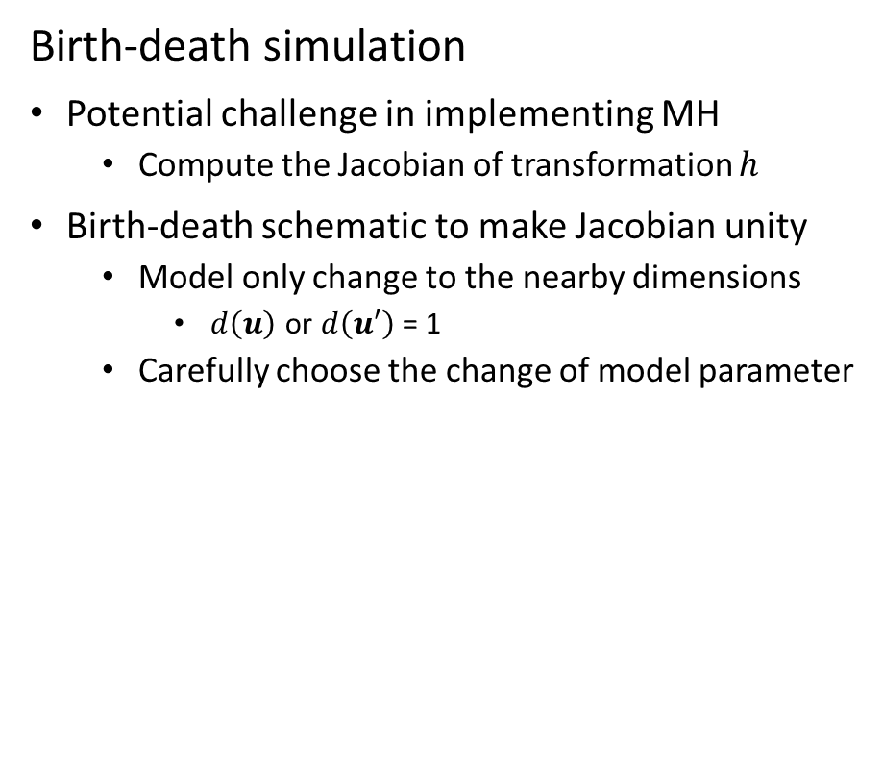
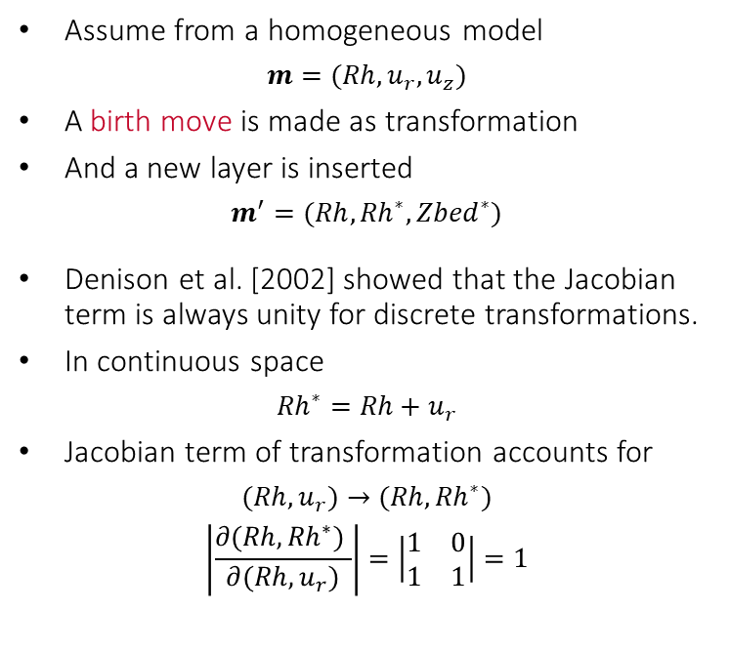


Analytical example
Birth-death simulation
Potential challenge in implementing MH
Compute the Jacobian of transformation $h$
Birth-death schematic to make Jacobian unity
Model only change to the nearby dimensions
$d\left(u\right)$ or $d\left(u′\right)$ = 1
Carefully choose the change of model parameter
Assume from a homogeneous model
$$m=(Rh,u_{r},u_{z})$$
A birth move is made as transformation
And a new layer is inserted
$$m^{′}=(Rh,{Rh}^{∗},{Zbed}^{∗})$$
Denison et al. [2002] showed that the Jacobian term is always unity for discrete transformations.
In continuous space
$${Rh}^{∗}=Rh+u_{r}$$
Jacobian term of transformation accounts for
$$(Rh,u_{r})→(Rh,{Rh}^{∗})$$
$$\left|\frac{∂(Rh,{Rh}^{∗}) }{∂(Rh,u_{r})}\right|=\left|\begin{matrix}1 & 0 \\ 1 & 1\end{matrix}\right|=1$$
$$\left|\frac{∂h\left(m_{k},u\right)}{∂\left(m_{k},u\right)}\right|$$
$$=1$$
Notes:
Two preconditions:
The resistivity of new layer is change from the original layer it divided from
The transformation of adding new interface is in discrete space

Slide 32
Birth-death simulation
Death move: select an existing interface randomly and remove it;
Birth move: insert an artificial interface at a random depth;
We start from a two-layer model with one interface…
Merge two neighboring layers;
Perturb one model parameter of a newborn layer;

Slide 33
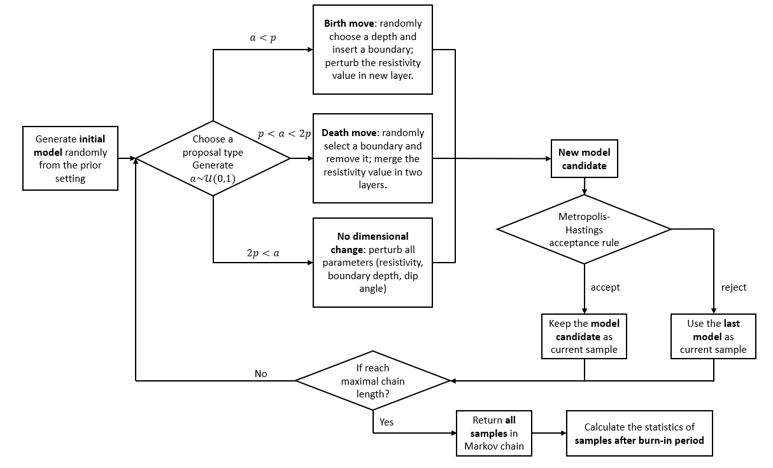
Birth-Death simulation

Slide 34
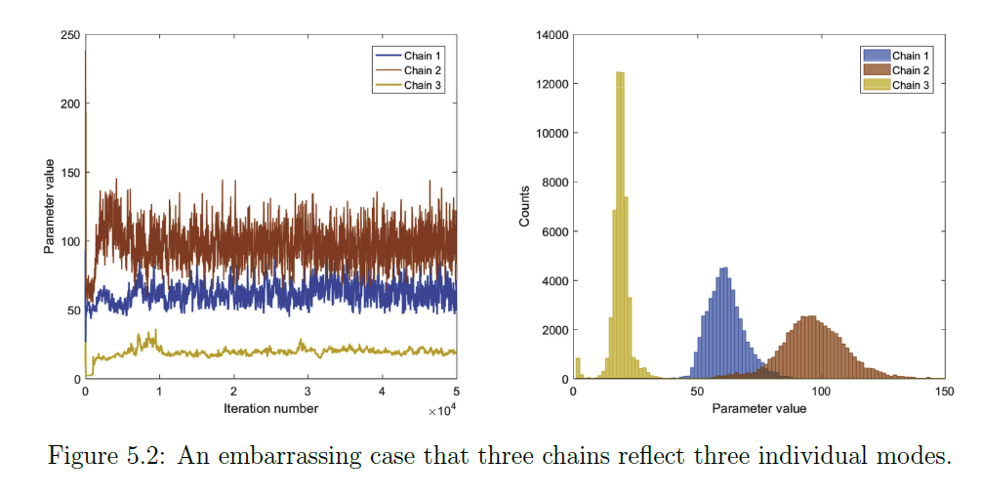
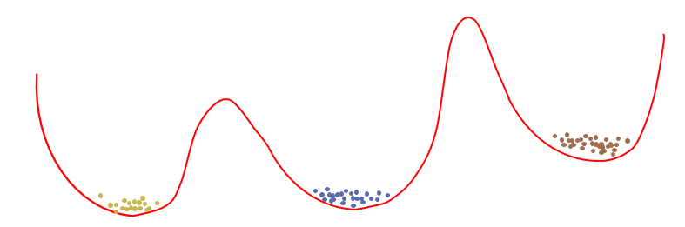
Accelerate Bayesian inference
The pains of sampling methods
tMCMC makes acceptance rate worse
Sequential process no parallism
Some ways to draw samples in parallel?
Try to launch multiple samplers at the same time.

Slide 35
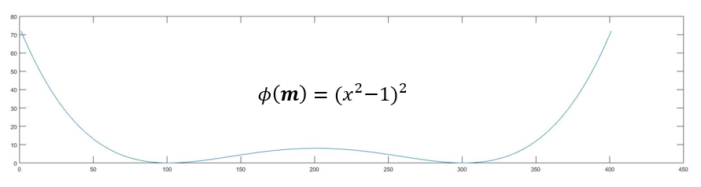
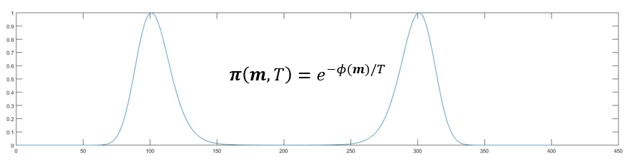

Optimization and probabilistic function
Connect optimization problem to dynamic energy system
Instead find a unique solution of $φ\left(m\right)=\left\|d−F(m)\right\|$
Sampling from its probability density function (PDF)
$π\left(m,T\right)=e^{−φ\left(m\right)/T}$
The global minimal of $φ\left(m\right)$ maximize its PDF $π\left(m,T\right)$
Notes:
A common way to connect an optimization problem to a dynamic energy system

Slide 36
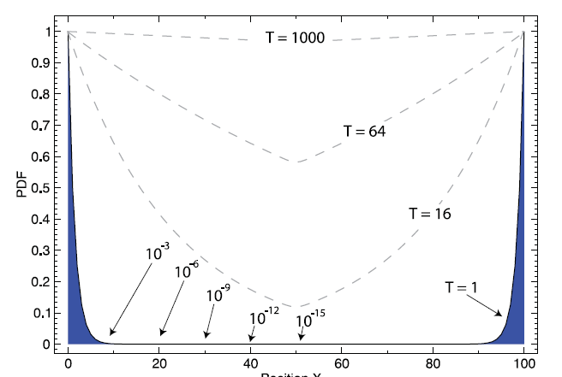
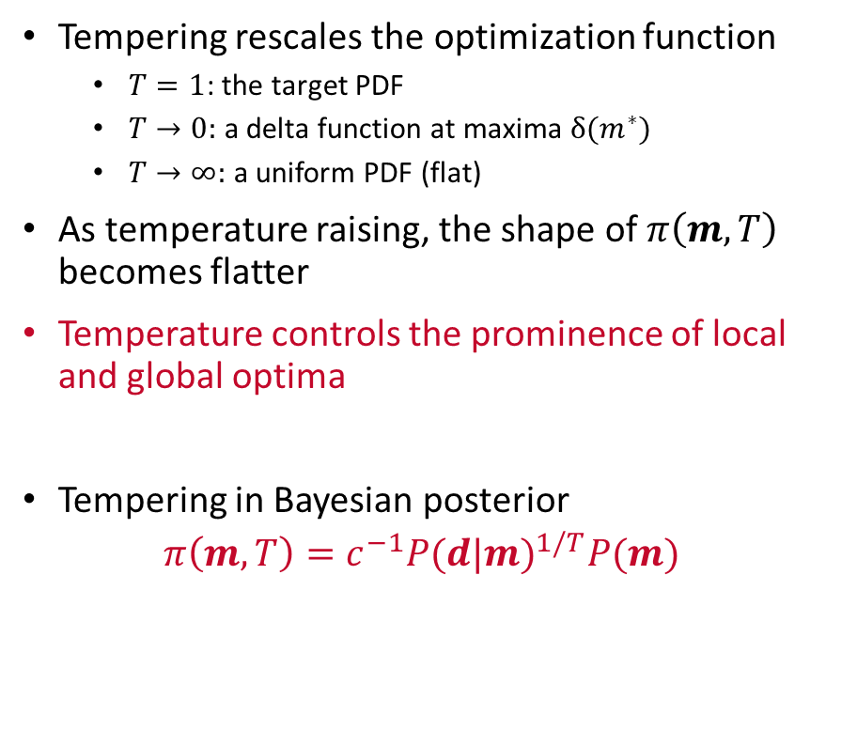
From the view of energy: Tempering
Tempering rescales the optimization function
$T=1$: the target PDF
$T→0:$ a delta function at maxima $δ(m^{∗})$
$T→∞:$ a uniform PDF (flat)
As temperature raising, the shape of $π\left(m,T\right)$ becomes flatter
Temperature controls the prominence of local and global optima
Tempering in Bayesian posterior
$π\left(m,T\right)=c^{−1}{P(d|m)}^{1/T}P(m)$
Flatten distribution to avoid local optimums and explore entire distribution faster
A bimodal distribution
Notes:
So what does temperature control?

Slide 37
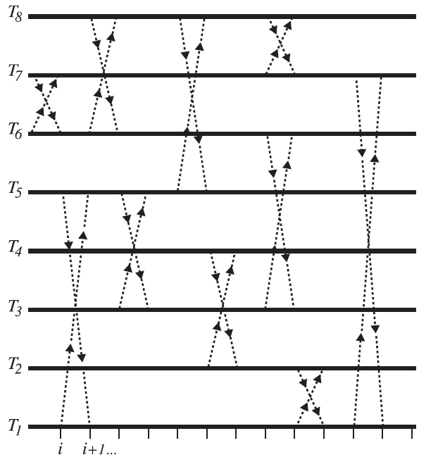
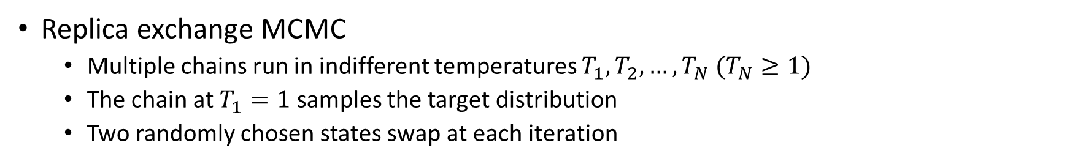
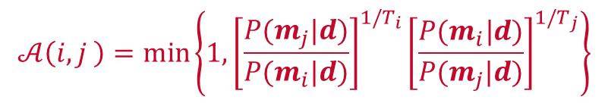
Parallel tempering
Replica exchange MCMC
Multiple chains run in indifferent temperatures $T_{1},T_{2}, …,T_{N} (T_{N}≥1)$
The chain at $T_{1}=1$ samples the target distribution
Two randomly chosen states swap at each iteration
Advantage
The states at higher temperatures have higher chance to jump out from high correlated regions
How to ensure the detailed balance?
$$𝒜\left(i,j \right)=\min\left\{1,{\left[\frac{P(m_{j}|d)}{P(m_{i}|d)}\right]}^{1/T_{i}}{\left[\frac{P(m_{i}|d)}{P(m_{j}|d)}\right]}^{1/T_{j}}\right\}$$
Notes:
* While the chains at other temperatures sample the distributions flattened from the original one
* Because the sampled distributions are flatter

Slide 38
Outline
Motivations
Oil gas application: earth mode inference using trans-dimensional MCMC algorithm
Communication application:
MCMC Algorithms
Applications
Conclusions

Slide 39

example on earth model inference
A synthetic five-layer model
Given measurements $d$ of this model
Infer the posterior distribution
$$P\left(d | m\right)$$
Use trans-dimensional MCMC sampling
Prior constraint (all uniform)
$k:2 \sim 20$ layers
$Zbed:0 \sim 100$ feet
$Rh:0.1 \sim 1000 ohmm$ in logarithm
Minimum bed thickness: 1 ft
10 ohm.m
16 ft
100 ohm.m
15 ft
1 ohm.m
8 ft
21 ft
50 ohm.m
10 ohm.m

Slide 40


Example: sampling across models
Number of layers along the MC chain steps
Histogram of number of layers

Slide 41



Histogram of possible model interfaces
Probability heatmap of resistivity value
Comparison of true model (white) mean model (green)

Slide 42



Example on SDAR 7-Layer model interpretation
Notes:
Instead of sampling independently from different dimensions, tMCMC tells which model has higher probability

Slide 43


An application using multiple chains MCMC sampling
20k iterations and 2.6 mins each point
Single chain
20k iterations and 3 mins each point
16 chains

Slide 44

Intermittent connectivity model in satellite links
Irregular distributions of the active period and inactive period of satellite-ground link
Alternatively transitions between the active period and inactive period
Different sojourn times in different states
MCMC based irregular distribution matching

Slide 45

Intermittent connectivity model in satellite links
Markov chain constructed by the MCMC
Irregular distribution of active period and inactive period

Slide 46



Main procedure of the MCMC
Start from a number $θ_{i}$ within the support of $p\left(θ_{i}\right).$
Step 1: Draw a number $θ_{j}$ from the proposal distribution ${{J(θ}_{j}|θ}_{i}).$
Step 2: Calculate the Metropolis-Hastings ratio:
Step 3: Determine the transition probability matrix
$$r=\frac{p(θ_{j})J(θ_{i}|θ_{j})}{p(θ_{i})J(θ_{j}|θ_{i})}.$$
$$P\left(θ_{j} | θ_{i}\right)=J\left(θ_{j} | θ_{i}\right)min\left\{1,r\right\}.$$

Slide 47

Intermittent connectivity model in satellite links
The distribution of active period which does not have a regular distribution, such as exponential, erlang, etc.
MCMC matching result
The distribution of inactive period, which has the similar features

Slide 48
Outline
Motivations
A Hybrid Monte Carlo method which combines gradient-drift with random sampling is provided to overcome the low sampling rate problem.
A self-parameterizing scheme using trans-dimensional Markov chain Monte Carlo method is designed to infer the model complexity, which avoid over-parameterizing or under-parameterizing problems.
MCMC is able to mimic the irregular distributions of the active period and inactive period of satellite links, which makes the communications system more accurate.
A bridge from practical data to analysis tools
MCMC Algorithms
Applications
Conclusions

Slide 49


Q&A
“Iron and Thunder” by Patrick Soper

Slide 50


Example in Oil & Gas: Inference of earth model profile using directional EM logging data
Understand the earth model characteristic $m$ who generates a set of measurements $d$
Optimize the data misfit
$$\min{{\left\|d−F(m)\right\|}^{2}}$$
Usually by gradient-based optimization method.
The solution is unique
The solution might be local
Constraint terms must be applied
Example of earth model inference
Mapping-while-drilling service provided by Schlumberger
Reference: Bø, Øystein, et al. "Reservoir Mapping While Drilling." Oilfield Review 27.1 (2015).
Notes:
The ultra .. Tools make a broad range of services possible.
To implement a reliable service with maximal performance, the logging data interpretation is one key step

Slide 51




Challenge when facing ultra-deep logging data
Ultra-deep sensitivity introduces a much larger depth of investigation
With larger DoI, more geological features are within the scope
The earth model to be invert becomes complicated
The solution space of earth model becomes very complex
2D resistivity profile grouped by multiple 1D inverse results
The inverse modeling is very complicated where the problem is
High dimensional
Highly nonlinear in solution space
Many local minima
Reference: Schlumberger Geosphere HD Mapping While Drilling Service
Demo from: https://indd.adobe.com/view/37a5d5eb-2e7e-44dc-811b-b0d23f0f257d
Notes:
Solving the inverse problem is never an easy task. Our dissertation is motivated by several challenges.

