Slide 1
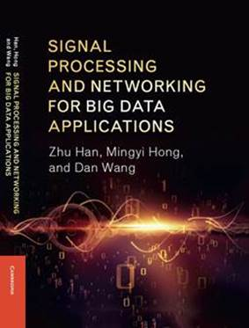
Signal processing and Networking for Big Data Applications Lecture 2: Preliminary Review
Zhu Han
University of Houston
http://www2.egr.uh.edu/~zhan2/big_data_course/

Slide 2
outline
Machine learning basics (thanks for Xunsheng Du and Huaqing Zhang)
Supervised learning: support vector machine (SVM)
Unsupervised learning: K-means
Reinforcement learning

Slide 3
Machine Learning Basics
“Computers the ability to learn without being explicitly programmed”
Types:
Supervised learning: The computer is presented with example inputs and their desired outputs, given by a "teacher", and the goal is to learn a general rule that maps inputs to outputs.
Unsupervised learning: No labels are given to the learning algorithm, leaving it on its own to find structure in its input. Unsupervised learning can be a goal in itself (discovering hidden patterns in data) or a means towards an end (feature learning).
Reinforcement learning: A computer program interacts with a dynamic environment in which it must perform a certain goal (such as driving a vehicle or playing a game against an opponent). The program is provided feedback in terms of rewards and punishments as it navigates its problem space.

Slide 4
Supervised Learning: SVM
Binary classification can be viewed as the task of separating classes in feature space:
w^{T}x + b = 0
w^{T}x + b > 0
w^{T}x + b < 0
f(x) = sign(w^{T}x + b)

Slide 5
Supervised Learning: SVM
Which of the linear separators is optimal ?

Slide 6

Supervised Learning: SVM
Distance from example x_{i} to the separator is
Examples closest to the hyperplane are support vectors.
Margin ρ of the separator is the distance between support vectors.
ρ
r
Intuitively, we’re going to maximize the margin ρ

Slide 7


Linear SVM Mathematically
Let training set {(x_{i}, y_{i})}_{i=1..n}, x_{i}∈R^{d}, y_{i} ∈ {-1, 1} be separated by a hyperplane with margin ρ. Then for each training example (x_{i}, y_{i}):
For every support vector x_{s} the above inequality is an equality. After rescaling w and b by ρ/2 in the equality, we obtain that distance between each x_{s} and the hyperplane is
Then the margin can be expressed through (rescaled) w and b as:
w^{T}x_{i} + b ≤ - ρ/2 if y_{i} = -1
w^{T}x_{i} + b ≥ ρ/2 if y_{i} = 1
⇔
y_{i}(w^{T}x_{i} + b) ≥ ρ/2

Slide 8

Linear SVMs Mathematically (cont.)
Then we can formulate the quadratic optimization problem:
Which can be reformulated as:
Find w and b such that
is maximized
and for all (x_{i}, y_{i}), i=1..n : y_{i}(w^{T}x_{i} + b) ≥ 1
Find w and b such that
Φ(w) = ||w||²=w^{T}w is minimized
and for all (x_{i}, y_{i}), i=1..n : y_{i} (w^{T}x_{i} + b) ≥ 1

Slide 9
Solving the Optimization Problem
Find w and b such that
Φ(w) =w^{T}w is minimized
and for all (x_{i}, y_{i}), i=1..n : y_{i} (w^{T}x_{i} + b) ≥ 1
Need to optimize a quadratic function subject to linear constraints.
Quadratic optimization problems are a well-known class of mathematical programming problems for which several (non-trivial) algorithms exist.
The solution involves constructing a dual problem where a Lagrange multiplier α_{i} is associated with every inequality constraint in the primal (original) problem:
Find α₁…α_{n} such that
Q(α) =Σα_{i} - ½ΣΣα_{i}α_{j}y_{i}y_{j}x_{i}^{T}x_{j} is maximized and
(1) Σα_{i}y_{i} = 0
(2) α_{i} ≥ 0 for all α_{i}

Slide 10
The Optimization Problem Solution
Given a solution α₁…α_{n} to the dual problem, solution to the primal is:
Each non-zero α_{i} indicates that corresponding x_{i} is a support vector.
Then the classifying function is (note that we don’t need w explicitly):
Notice that it relies on an inner product between the test point x and the support vectors x_{i}.
Also keep in mind that solving the optimization problem involved computing the inner products x_{i}^{T}x_{j} between all training points.
w =Σα_{i}y_{i}x_{i} b = y_{k} - Σα_{i}y_{i}x_{i} ^{T}x_{k} for any α_{k} > 0
f(x) = Σα_{i}y_{i}x_{i}^{T}x + b

Slide 11
Linear SVMs: summary
The classifier is a separating hyperplane.
Most “important” training points are support vectors; they define the hyperplane.
Quadratic optimization algorithms can identify which training points x_{i} are support vectors with non-zero Lagrangian multipliers α_{i}.
Both in the dual formulation of the problem and in the solution training points appear only inside inner products:
Find α₁…α_{N} such that
Q(α) =Σα_{i} - ½ΣΣα_{i}α_{j}y_{i}y_{j}x_{i}^{T}x_{j} is maximized and
(1) Σα_{i}y_{i} = 0
(2) 0 ≤ α_{i} ≤ C for all α_{i}
f(x) = Σα_{i}y_{i}x_{i}^{T}x + b

Slide 12
Non-linear SVMs
Datasets that are linearly separable with some noise work out great:
But what are we going to do if the dataset is just too hard?
How about… mapping data to a higher-dimensional space:
0
x
0
x
x²
0
x

Slide 13
Non-linear SVMs: Feature spaces
General idea: the original feature space can always be mapped to some higher-dimensional feature space where the training set is separable:
Φ: x → φ(x)

Slide 14
The “Kernel Trick”
The linear classifier relies on inner product between vectors K(x_{i},x_{j})=x_{i}^{T}x_{j}
If every datapoint is mapped into high-dimensional space via some transformation Φ: x → φ(x), the inner product becomes:
K(x_{i},x_{j})= φ(x_{i}) ^{T}φ(x_{j})
A kernel function is a function that is eqiuvalent to an inner product in some feature space.

Slide 15

The “Kernel Trick”
Example:
2-dimensional vectors x=[x₁ x₂]; let K(x_{i},x_{j})=(1 + x_{i}^{T}x_{j})²,
Need to show that K(x_{i},x_{j})= φ(x_{i}) ^{T}φ(x_{j}):
K(x_{i},x_{j})=(1 + x_{i}^{T}x_{j})²,= 1+ x_{i1}²x_{j1}² + 2 x_{i1}x_{j1} x_{i2}x_{j2}+ x_{i2}²x_{j2}² + 2x_{i1}x_{j1} + 2x_{i2}x_{j2}=
= [1 x_{i1}² $\sqrt{2}$x_{i1}x_{i2} x_{i2}² $\sqrt{2}$x_{i1} $\sqrt{2}$x_{i2}]^{T} [1 x_{j1}² $\sqrt{2}$x_{j1}x_{j2} x_{j2}² $\sqrt{2}$x_{j1} $\sqrt{2}$x_{j2}] =
= φ(x_{i}) ^{T}φ(x_{j}), where φ(x) = [1 x₁² $\sqrt{2}$x₁x₂ x₂² $\sqrt{2}$x₁ $\sqrt{2}$x₂]
Thus, a kernel function implicitly maps data to a high-dimensional space (without the need to compute each φ(x) explicitly).

Slide 16
What Functions are Kernels?
For some functions K(x_{i},x_{j}) checking that K(x_{i},x_{j})= φ(x_{i}) ^{T}φ(x_{j}) can be cumbersome.
Mercer’s theorem:
Every semi-positive definite symmetric function is a kernel
Semi-positive definite symmetric functions correspond to a semi-positive definite symmetric Gram matrix:
K(x₁,x₁) | K(x₁,x₂) | K(x₁,x₃) | … | K(x₁,x_{n})
K(x₂,x₁) | K(x₂,x₂) | K(x₂,x₃) |  | K(x₂,x_{n})
… | … | … | … | …
K(x_{n},x₁) | K(x_{n},x₂) | K(x_{n},x₃) | … | K(x_{n},x_{n})
K=

Slide 17


Examples of Kernel Functions
Linear: K(x_{i},x_{j})= x_{i}^{T}x_{j}
Mapping Φ: x → φ(x), where φ(x) is x itself
Polynomial of power p: K(x_{i},x_{j})= (1+ x_{i}^{T}x_{j})^{p}
Mapping Φ: x → φ(x), where φ(x) has dimensions
Gaussian (radial-basis function): K(x_{i},x_{j}) =
Mapping Φ: x → φ(x), where φ(x) is infinite-dimensional: every point is mapped to a function (a Gaussian); combination of functions for support vectors is the separator.

Slide 18
Non-linear SVMs Mathematically
Dual problem formulation:
The solution is:
Optimization techniques for finding α_{i}’s remain the same!
Take home message: supervise learning victim algorithm Kernel +SVM
Find α₁…α_{n} such that
Q(α) =Σα_{i} - ½ΣΣα_{i}α_{j}y_{i}y_{j}K(x_{i}, x_{j}) is maximized and
(1) Σα_{i}y_{i} = 0
(2) α_{i} ≥ 0 for all α_{i}
f(x) = Σα_{i}y_{i}K(x_{i}, x_{j})+ b

Slide 19
SVM applications
SVMs are currently among the best performers for a number of classification tasks ranging from text to genomic data.
SVMs can be applied to complex data types beyond feature vectors (e.g. graphs, sequences, relational data) by designing kernel functions for such data.
SVM techniques have been extended to a number of tasks such as regression [Vapnik et al. ’97], principal component analysis [Schölkopf et al. ’99], etc.

Slide 20
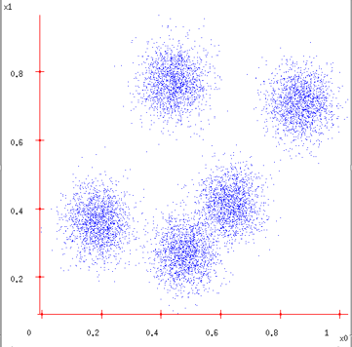
Unsupervised Learning: K-Means
Ask user how many clusters they’d like. (e.g. k=5)

Slide 21
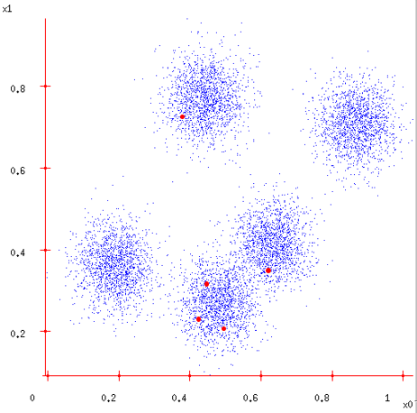
Unsupervised Learning: K-Means
Ask user how many clusters they’d like. (e.g. k=5)
Randomly guess k cluster Center locations

Slide 22
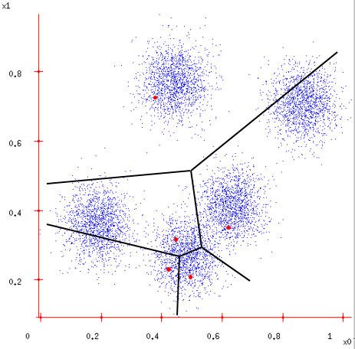
Unsupervised Learning: K-Means
Ask user how many clusters they’d like. (e.g. k=5)
Randomly guess k cluster Center locations
Each datapoint finds out which Center it’s closest to. (Thus each Center “owns” a set of datapoints)

Slide 23
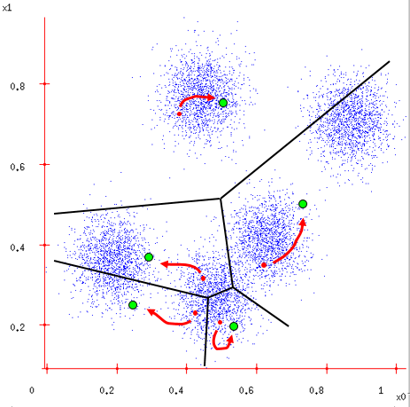
Unsupervised Learning: K-Means
Ask user how many clusters they’d like. (e.g. k=5)
Randomly guess k cluster Center locations
Each datapoint finds out which Center it’s closest to.
Each Center finds the centroid of the points it owns

Slide 24
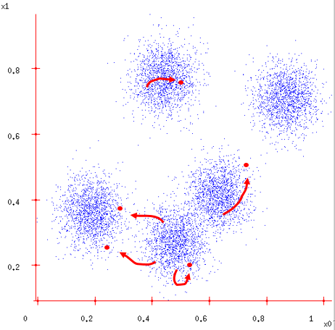
Unsupervised Learning: K-Means
Ask user how many clusters they’d like. (e.g. k=5)
Randomly guess k cluster Center locations
Each datapoint finds out which Center it’s closest to.
Each Center finds the centroid of the points it owns…
…and jumps there
…Repeat until terminated!

Slide 25
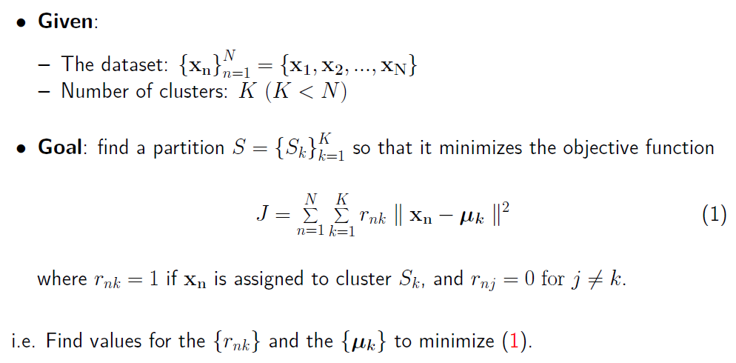
K-Means problem formulation

Slide 26
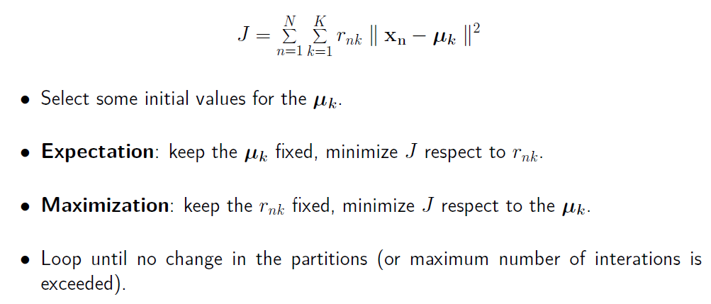
K-Means: EM algorithm

Slide 27
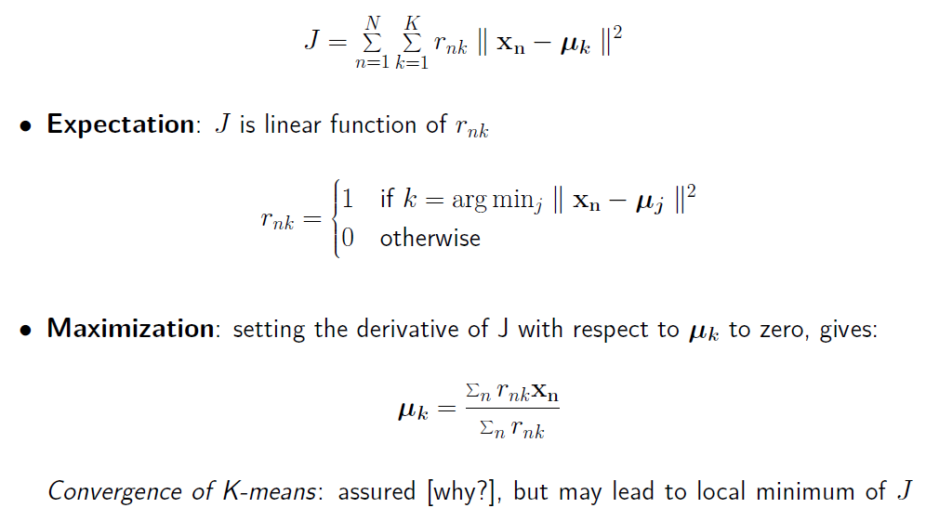
K-Means: EM algorithm

Slide 28
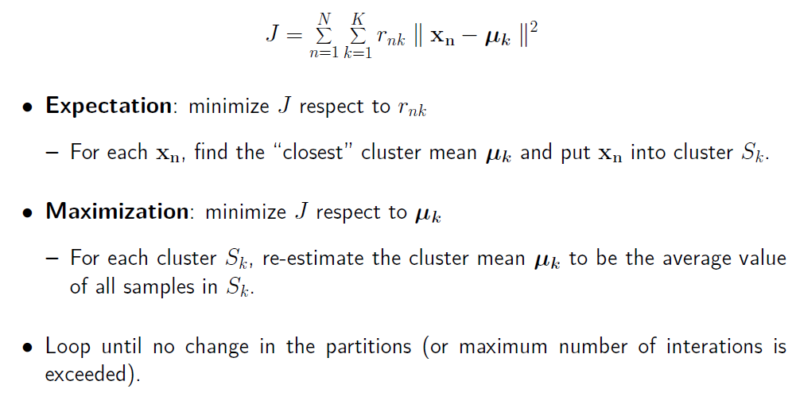
K-Means: EM algorithm

Slide 29
Weaknesses of K-Mean Clustering
When the numbers of data are not so many, initial grouping will determine the cluster significantly.
The number of cluster, K, must be determined before hand. Its disadvantage is that it does not yield the same result with each run, since the resulting clusters depend on the initial random assignments.
We never know the real cluster, using the same data, because if it is inputted in a different order it may produce different cluster if the number of data is few.
It is sensitive to initial condition. Different initial condition may produce different result of cluster. The algorithm may be trapped in the local optimum.

Slide 30
Applications of k-means clustering
It is relatively efficient and fast. It computes result at O(tkn), where n is number of objects or points, k is number of clusters and t is number of iterations.
k-means clustering can be applied to machine learning or data mining
Used on acoustic data in speech understanding to convert waveforms into one of k categories (known as Vector Quantization or Image Segmentation).
Also used for choosing color palettes on old fashioned graphical display devices and Image Quantization.
Take home message: unsupervised learning victim algorithm: K-Mean

Slide 31

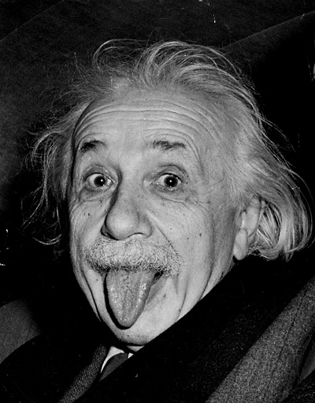
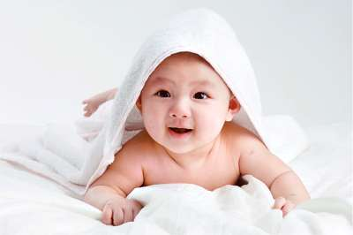
Reinforcement Learning
Effective and Efficient Method
Dummy
Expert
Policy
(Machine)

Slide 32

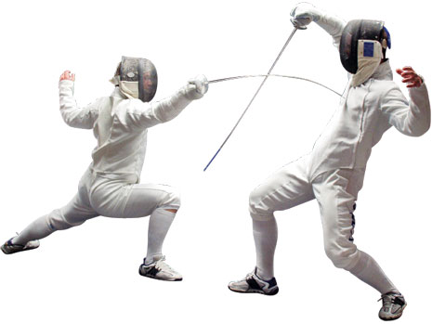

An Example
1
Today
1
-100
0
Have Fun
0
1
Fencing Event
Study & Discussion
0
100
Submit Paper

Slide 33
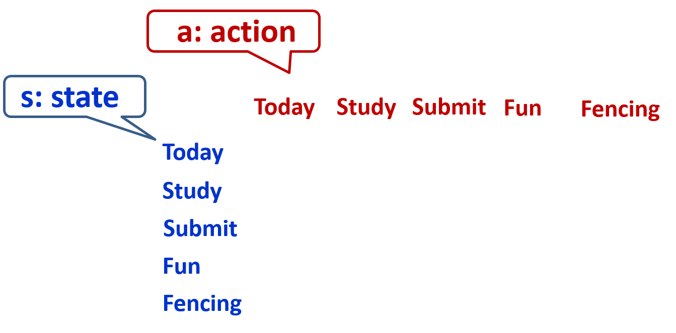

Rewards
$$Q(s,a)$$
Initially set to zero

Slide 34




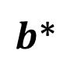
Q-Learning
Fencing
$$a$$
Study
Fun
$b$*
Study
$$s$$
$$s′$$
Fun

Slide 35
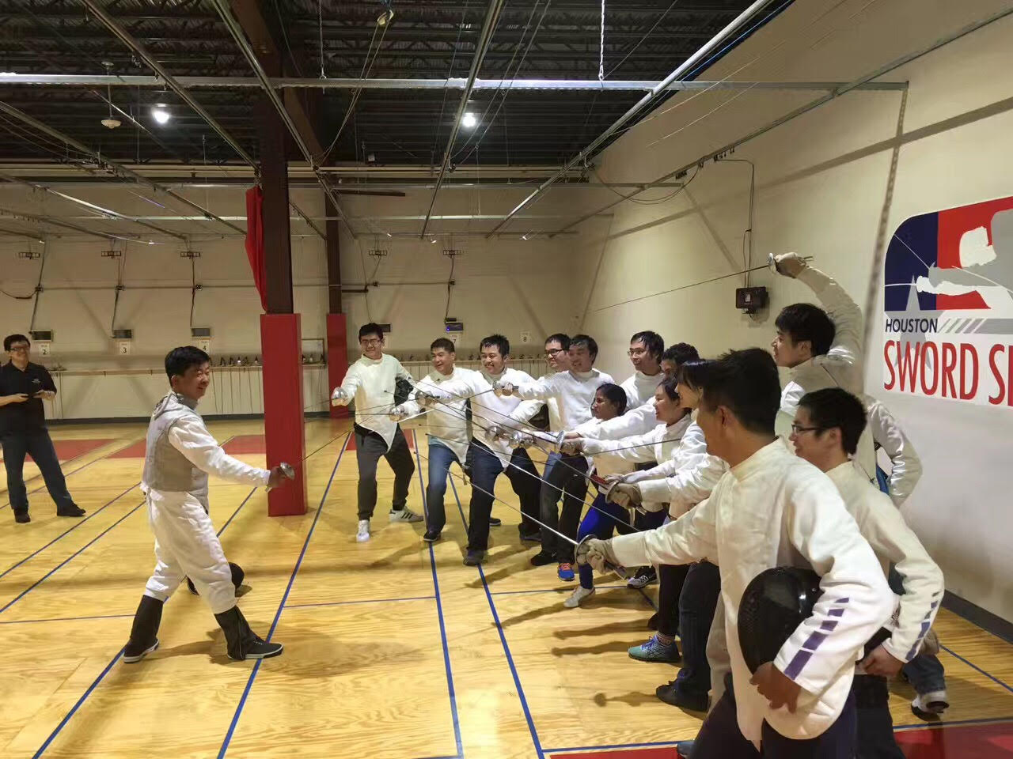
Results
52.2
317182 Games
52.2
Today
-100
1 million steps
Learning rate: 0.9999954
Discount rate: 0.8
Epsilon: 0.1
64
Have Fun
64
52.2
Fencing Event
Study & Discussion
80
100
Submit Paper

Slide 36
Summary
Convex optimization
Read Stephen Boyd slides and videos
Machine learning basics
Supervised learning: support vector machine (SVM)
Unsupervised learning: K-means
Reinforcement learning: Q learning

