Slide 1
Signal processing and Networking for Big Data Applications
Lectures 10-11: Deep Learning Basics
http://www2.egr.uh.edu/~zhan2/big_data_course/
Zhu Han
University of Houston
Thanks for Dr. Hien Nguyen slides and help by Xunshen Du and Kevin Tsai

Slide 2
outline
Motivation and overview
  Why deep learning
  Basic concepts
  CNN, RNN vs. DBN
Idea of Deep Feedforward Networks
Example: Learning XOR
Output Units

Slide 3
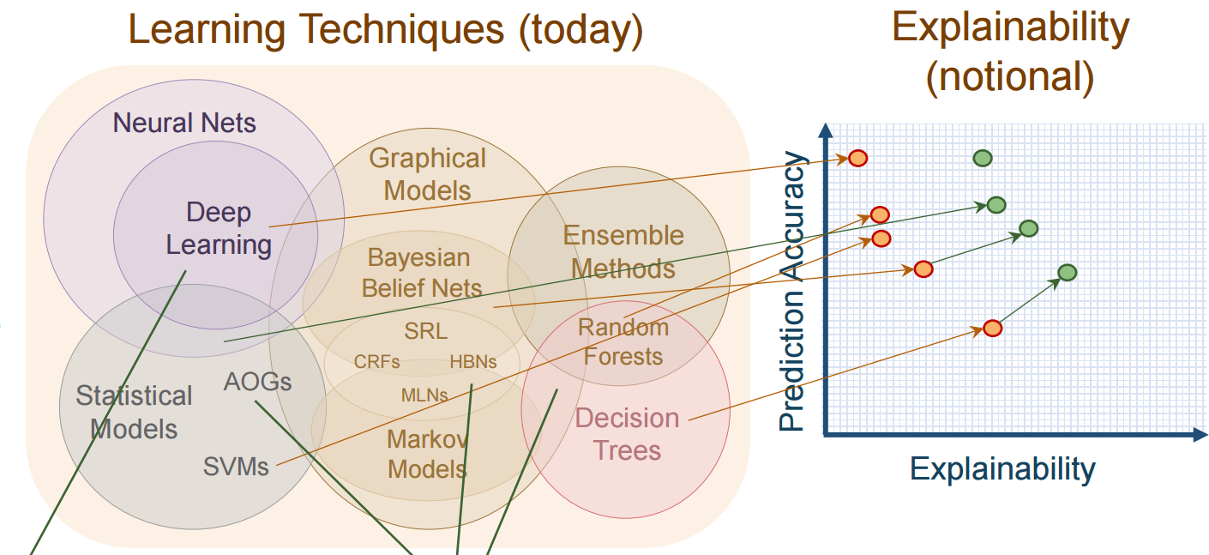
Which one is better? Answer “it depends”
Classic method such as Random forest might be good if
  you don't have a lot of data, or
  training data have categorical features, or
  you want a more explainable model, or
  you want high run-time speed.
Deep learning is good when you have a lot of training data of the same or related domain.
Deep networks could be much slower than random forest.
Appropriate scaling and normalization have to be done to the data to improve the convergence speed.

Slide 4
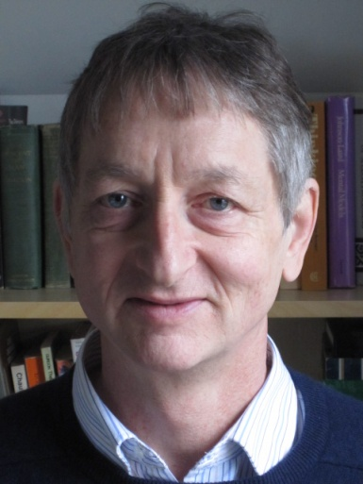
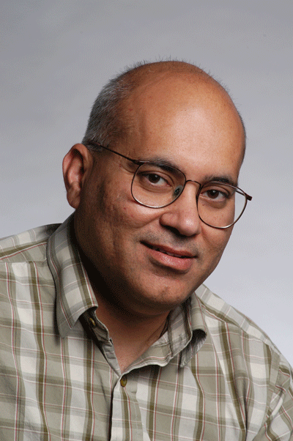


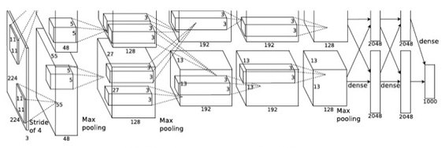
Why Deep Learning?
Beat me on IMAGENET!
How can I convince you?
Hinton
Malik
Alex

Slide 5
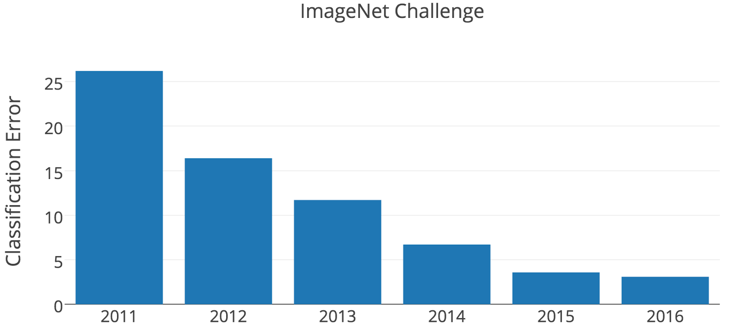
Why Deep Learning
Complex engineered systems
AlexNet

Slide 6
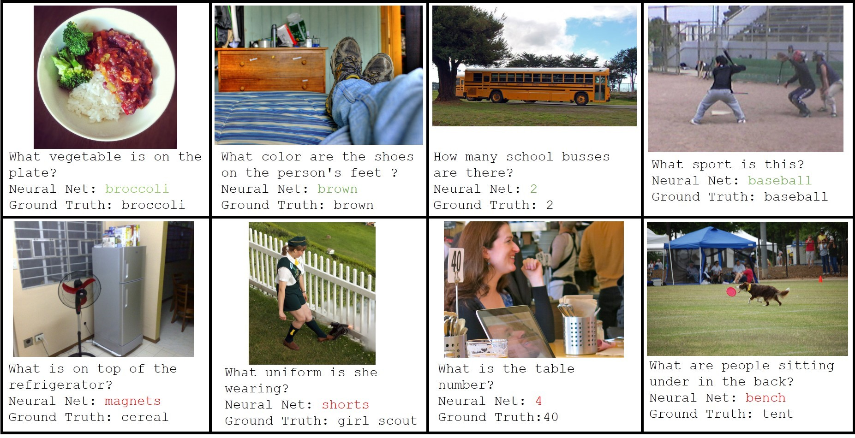
Why Deep Learning

Slide 7
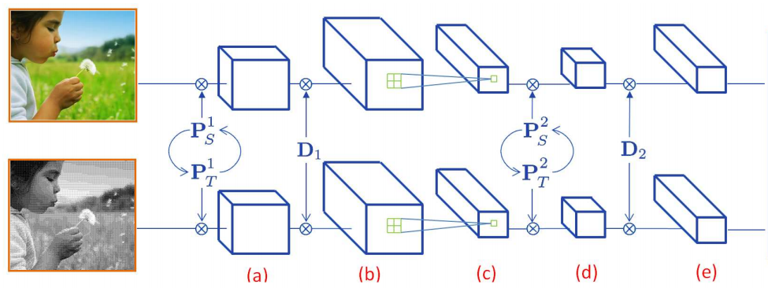
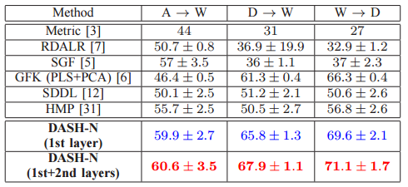
Why Deep Learning
Depth improves domain adaptation

Slide 8
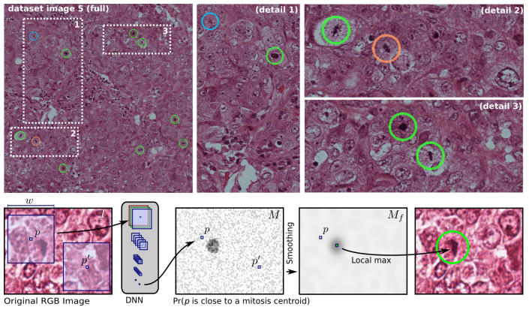
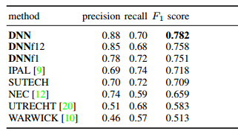
Why Deep Learning

Slide 9
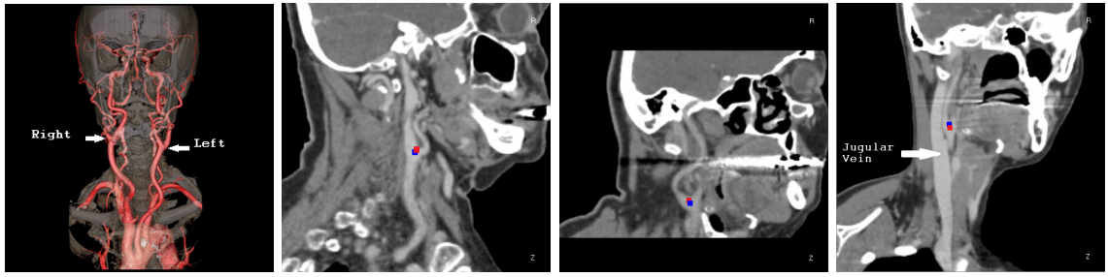
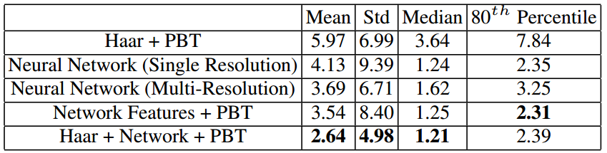
Why Deep Learning
Carotic artery bifurcation landmark detection

Slide 10
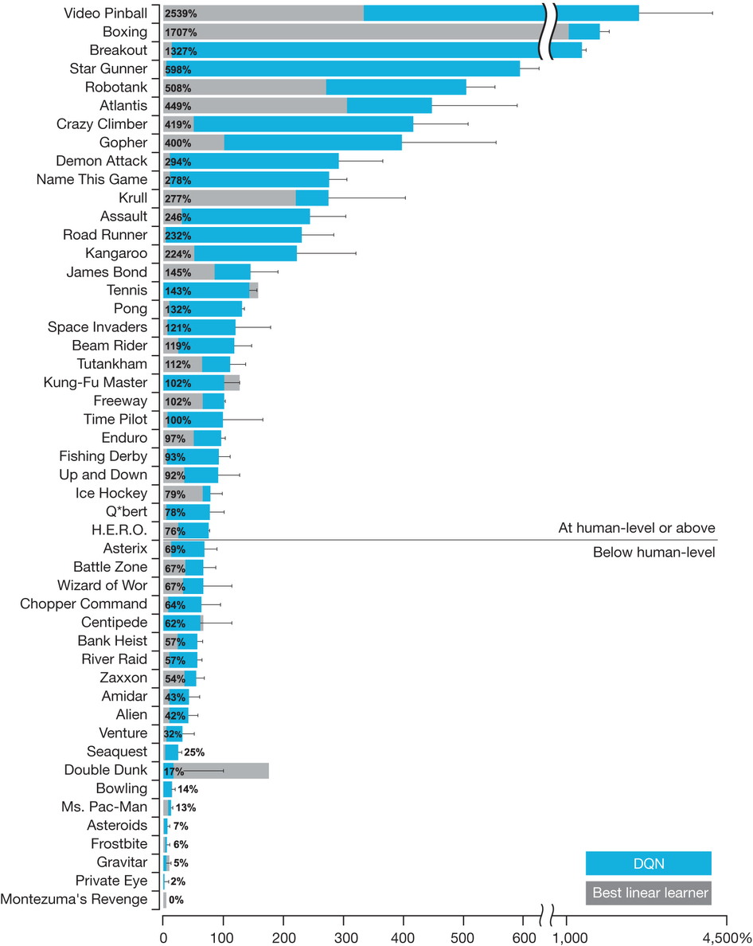
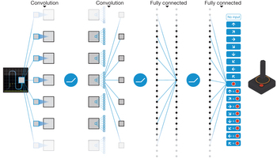
Why Deep Learning
Deep Reinforcement Learning

Slide 11
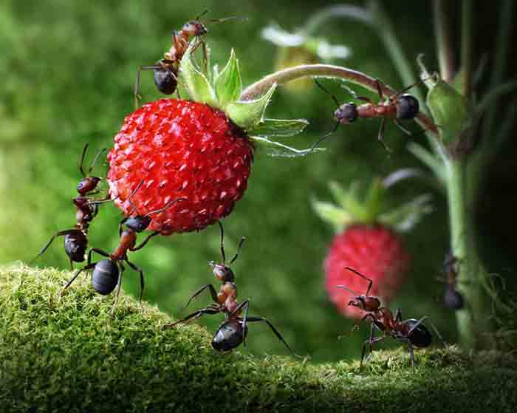
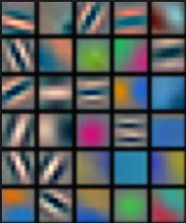
Why Deep Learning
“Deep” in deep learning:
  Some functions computable with a polynomial-size logic gates circuit of depth k will require exponential size for depth k − 1 [Hastad Johan, Theory of computing, 1986]
  Complex patterns is composed of repeated simples patterns (Everything in the universe is within you)
  Curse of dimensionality: Convergence rate decreases exponentially with dimension of data. DL was dead around 1990s.
Notes:
We say that the expression of a function is compact when it has few computational elements, i.e., few degrees of freedom that need to be tuned by learning. Compact means more generalizable in machine learning.
The depth of an architecture is the maximum length of a path from any input of the graph to any output of the graph,
there are functions computable with a polynomial-size logic gates circuit of depth k that require exponential size when restricted to depth k − 1
there are functions computable with a polynomial-size logic gates circuit of depth k that require exponential size when restricted to depth k − 1
J. H˚astad, “Almost optimal lower bounds for small depth circuits,” in Proceedings of the 18th annual ACM Symposium on Theory of Computing, pp. 6–20, Berkeley, California: ACM Press, 1986

Slide 12




Why now?
Big annotated datasets become available:
  ImageNet:
  Google Video:
  Mechanical Turk
  Crowsourcing
GPU processing power
Better stochastic gradient descents:
  AdaGrad, AdamGrad, RMSProp

Slide 13
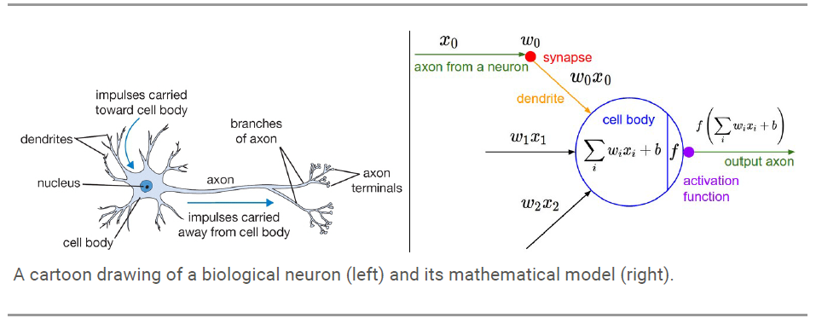
Biological Neuron and Modeling

Slide 14
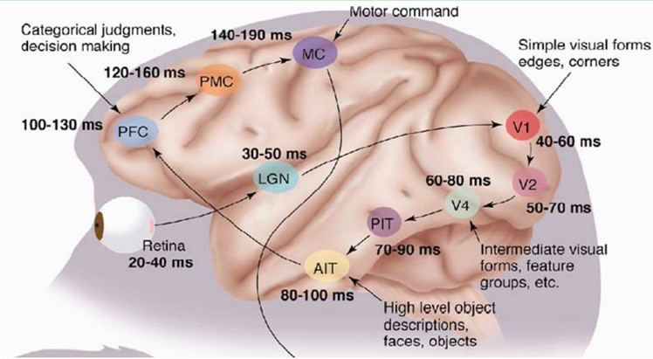
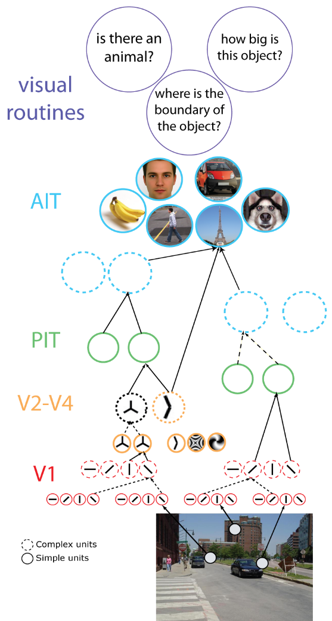
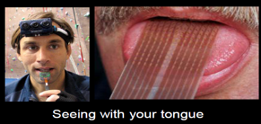
Hierarchical Structure Deep Learning
1981, David Hubel & Torsten Wiesel: The Mamalian Visual Cortex is Hierarchical
14

Slide 15
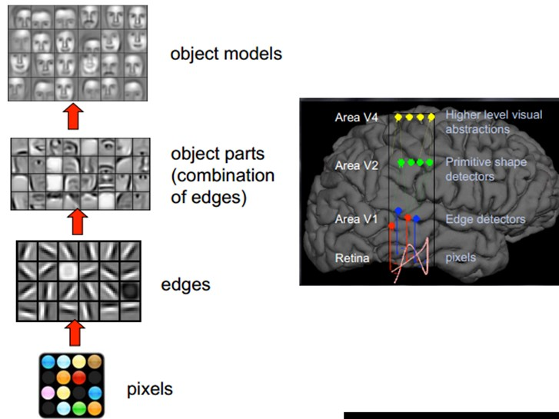

Deep Learning Structure
Hinton

Slide 16
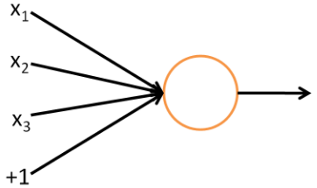
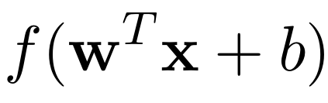

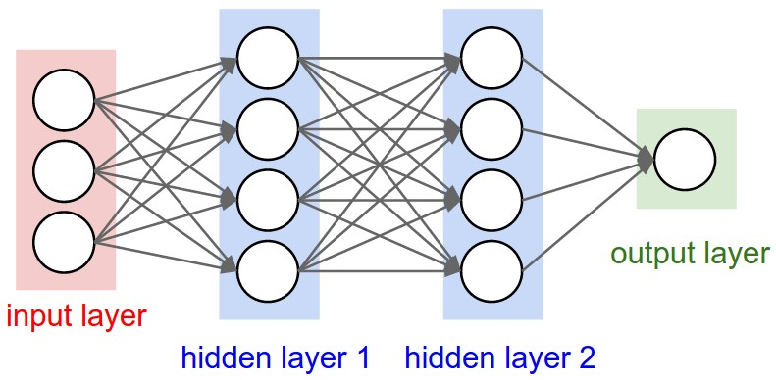
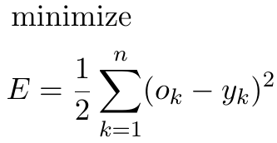

Fully Connected
Feed-Forward Network
Linear transformation followed by non-linear rectification
Training of NN
Back propagation

Slide 17
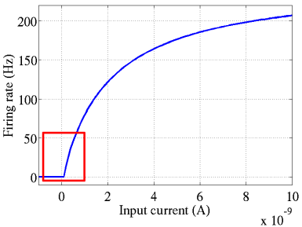
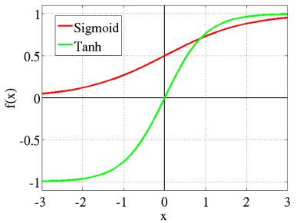
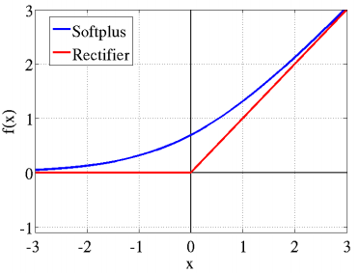
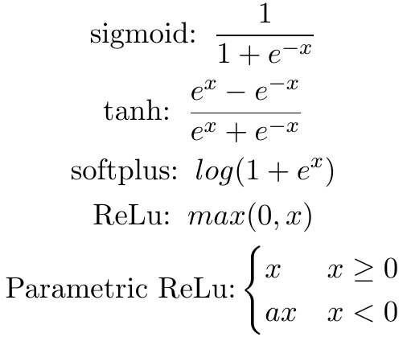
Rectifier Functions
Activation function from biological data

Slide 18
Rectifier Linear Unit (ReLU)
Pros:
  Faster to compute
  Help reduce vanishing gradient problem
  Sparse activation
    More biologically plausible
    More robust to noise
    Information disentanglement, etc
Cons:
  Very negative neuron cannot recover due to zero gradient → Parametric ReLu come to rescue

Slide 19
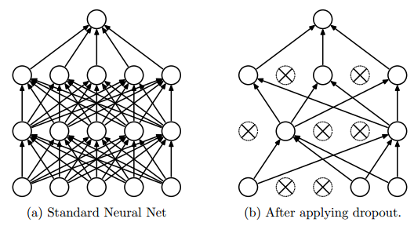
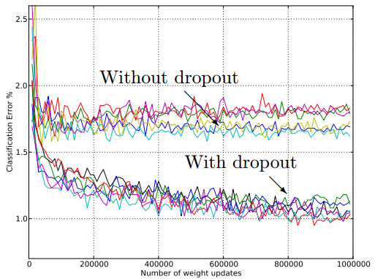
Dropout
Hilton et. al. 2012
Randomly pick some neurons and replace their value with 0 during training
Reduce overfitting (Pediatric ADHD) and co-adaptation

Slide 20
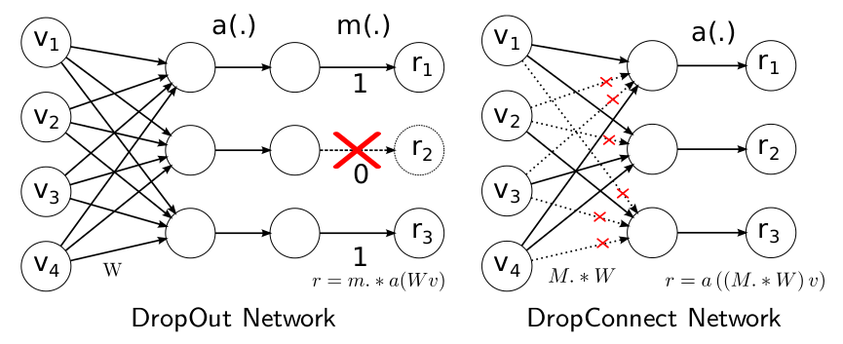
DropConnect
Wang et. al. ICML 2013
Randomly remove connections
Claim to work better than dropout

Slide 21
Other Tips
Data augmentation / perturbation
Batch normalization
L1/L2 regularization:
  Big network with regularizer often outperform small network
Parameters search using Bayesian optimization
… hundreds of different tricks
Modern Alchemy

Slide 22
outline
Motivation and overview
  Why deep learning
  Basic concepts
  CNN, RNN vs. DBN
Idea of Deep Feedforward Networks
Example: Learning XOR
Output Units

Slide 23
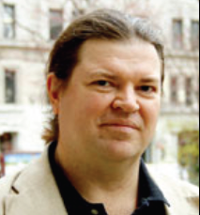
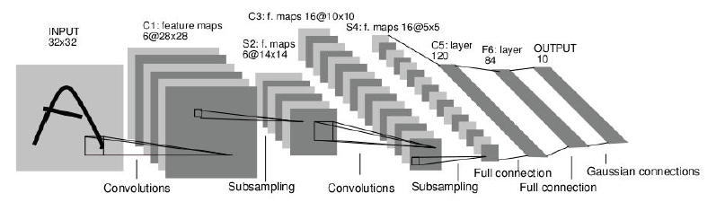
Type 1: Convolutional Neural Networks (CNNs)
LeCun et al. 1989
Neural network with specialized connectivity structure

Slide 24
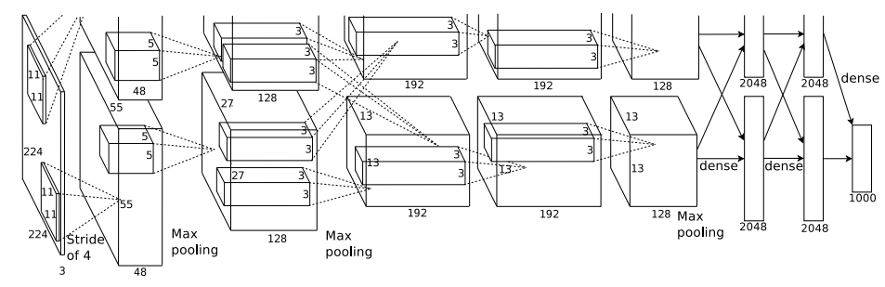
AlexNet
Same model as LeCun’98 but:
  Bigger model (8 layers)
  More data (106 vs 103 images)
  GPU implementation (50x speedup over CPU)
  Better regularization (DropOut)
7 hidden layers; 650,000 neurons; 60,000,000 parameters
Trained on 2 GPUs for a week

Slide 25
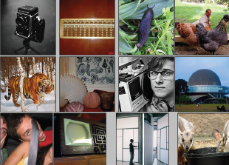
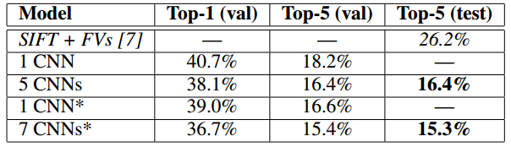

AlexNet
14 million labeled images, 20k classes
Images gathered from Internet
Human labels via Amazon Turk

Slide 26
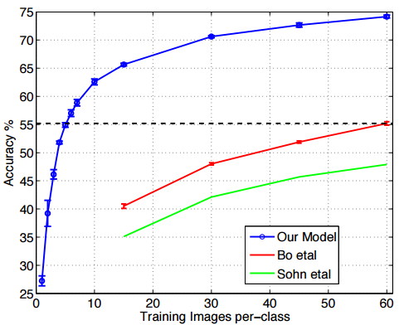
Pre-Training Effect
Pretrain with ImageNet Network
Fine-tune on a small set of samples
Dataset: Caltech-256
Zeiler & Fergus, arXiv 1311.2901, 2013

Slide 27
CNN Structure
FEATURE MAPS
Feed-forward:
  Convolve input
  Non-linearity (rectified linear)
  Pooling (local max)
Supervised
Train convolutional filters by back-propagating classification error
POOLING
NON-LINEAR RECTIFIER
CONVOLUTION (LEARNED)
INPUT IMAGE

Slide 28
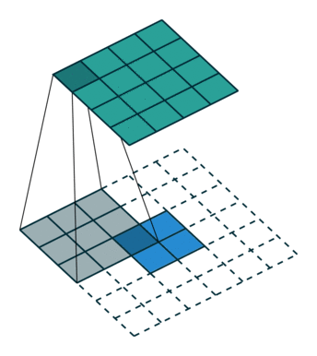
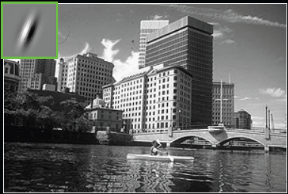
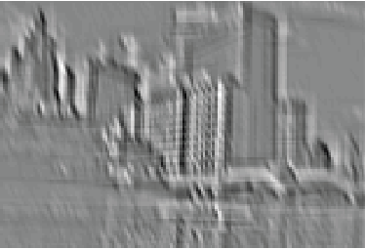
Filtering
Convolution
  Filter is learned during training
  Same filter at each location
  Each filter looks at local region only

Slide 29
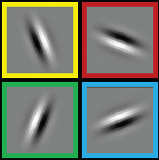
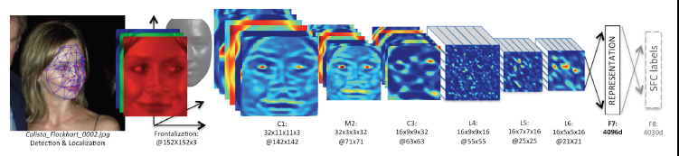
Filtering
Multiple filters at each layer
More complex patterns at deeper layers

Slide 30
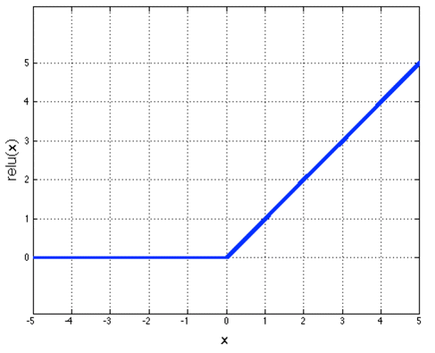
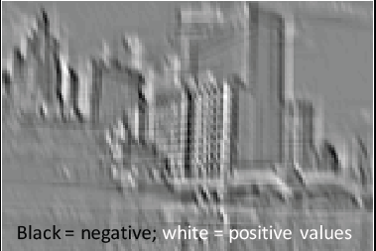
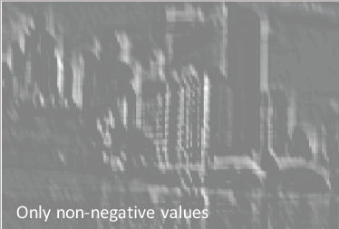
Non-Linearity
Rectified linear function
  Applied per-pixel
  Output = max(0,input)

Slide 31
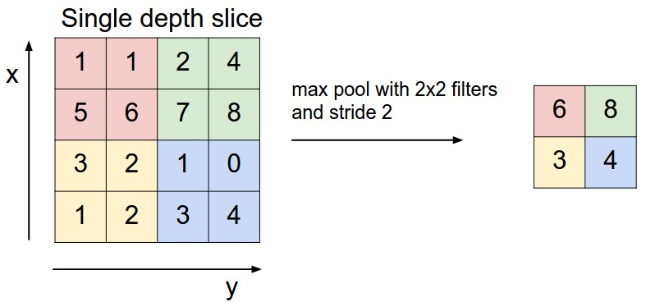
Pooling
Spatial Pooling
  Non-overlapping / overlapping regions
  Sum or Max
  Boureau et al. ICML’10 for theoretical analysis
Notes:
Max pooling make it more invariant to local transformation like translation.

Slide 32
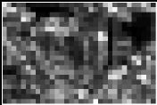
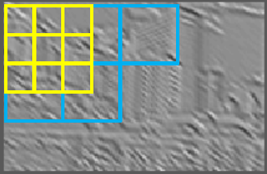
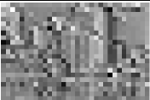
Pooling
Spatial Pooling
  Non-overlapping / overlapping regions
  Sum or Max
  Boureau et al. ICML’10 for theoretical analysis
Max
Sum

Slide 33
Role of Pooling
Spatial pooling
  Invariance to small transformations
  Larger receptive fields
Variants:
  Pool across feature maps
  Tiled pooling

Slide 34
Going Deeper
Deeper architectures
Current best models are much deeper than AlexNet

Slide 35



Going Deeper
CaffeNet
8 layers
Google inception network 22 layers
Google Inception Network
22 layers
Residual network
152 layers

Slide 36

Detection with CNNs
Sometime we also want to locate specific objects in the scene
Traditional approaches:
  Scan over entire images, at different scales
  Construct a feature for each location
  Apply a classifier on that feature
Sophisticated tricks to speedup scanning (Integral image, subwindow search)
Combine multiple hand-engineered features
Difficult to scale up to multiple classes

Slide 37

Detection with CNNs
Faster R-CNN, NIPS 2015
Perform regression of bounding box coordinates and object class at the same time
Jointly learn features and regressors
Currently best performer in PASCAL detection

Slide 38


Segmentation with CNNs
Noh et. al., ICCV 2015
Add unpooling and upsampling layers
Competitive performance on PASCAL dataset

Slide 39

Reinforcement Learning with CNNs
Robot takes action, get reward, and enter new state
Goal: Find optimal policy for robot
Q-learning:

Slide 40


Reinforcement Learning with CNNs
Sensor data
Robot action
Action-value function jointly learned with image features
Outperform human expert (and linear method)

Slide 41

Reinforcement Learning with CNNs
Model probability of next action with CNN
Predict distribution of opponent’s next action
→ feed into policy learning
Play with itself to improve policy
ALPHA GO
GO game

Slide 42

Self-Driving Car with CNNs
NVIDIA

Slide 43
Why CNNs work well
Small number of variables
Jointly learn features and classifier
Hierarchically learning complex patterns → mitigate curse of dimensionality
Designed to be invariant to shift/translation

Slide 44

Type 2: Recurrent Neural Network
Vast number of tasks involve time series data
Need long term dependency:
  “I grew up in France… I speak fluent French.”

Slide 45

Recurrent Network

Slide 46

Recurrent Network

Slide 47

Recurrent Network

Slide 48

Long Short-Term Memory Network

Slide 49

Long-Short Term Memory Network

Slide 50
Long-Short Term Memory Network
Rafal et. al., JMLR 2015
Forget gate is most important
Output gate is least important
Adding positive bias (1 or 2) to forget gate → help reduce vanishing gradient → greatly improves performance of LSTM

Slide 51

Sequence to Sequence
Could apply to sequence of input and output

Slide 52


Example: Video to Text with LSTM
Connect CNN with stack of LSTM

Slide 53
Network Visualization
What were learned in deep networks
Raw coefficients of learned filters in higher layers are difficult to interpret
Two main approaches:
  Project activation back to pixel space
  Optimize input image to maximize response of a particular neuron / feature map
Notes:
Some times, we want to know what we have learned in deep networks. But the information in hidden layers is hard to interpret. There are two approaches that we can use to implement this. First, project the information in higher layers back to the input space. Second, alter the input image to see which part of the image cause the significant response to the feature map(the output of the hidden layer)

Slide 54
Network Visualization
Projection from higher layers back to input
  Visualizing and Understanding Convolutional Networks, Matt Zeiler & Rob Fergus, ECCV 2014
  Deep Inside Convolutional Networks: Visualising Image Classification Models and Saliency Maps, Karen Simonyan, Andrea Vedaldi, Andrew Zisserman, arXiv 1312.6034, 2013
  Object Detectors Emerge in Deep Scene CNNs, Bolei Zhou, Aditya Khosla, Agata Lapedriza, Aude Oliva, Antonio Torralba, ICLR 2015
Notes:
There are a few references related to “projecting from higher layers back to input”

Slide 55

Network Visualization
Divide image into regions
Iteratively remove regions with least change in output score
Zhou & Torralba
Notes:
For the first method(projection), we can follow these two procedures:
Divide image into regions ; iteratively remove regions with least change in output score (just a brute-force approach to find out the target learned part)

Slide 56

Network Visualization
Find K images producing highest response of a neuron
Occlude random regions to find the most critical one, i.e. causing largest change in output
Object detectors emerge!
Notes:
Find K images producing highest response of a neuron; Occlude random regions to find the most critical one, i.e. causing largest change in output

Slide 57


Network Visualization
Optimize input to maximize particular output:
  Erhan et. al. 2009, Le et. al. [NIPS 2010]
  Output depends on initialization
Google Deep Dream
Notes:
For the second method, see the Google Deep Dream team paper

Slide 58



Network Visualization
Google Deep Dream
Ask network to enhance what it sees
Notes:
Basic idea is ask network itself to enhance what it sees.

Slide 59



Type 3: Deep Belief Network:
Restricted Boltzmann Machine
Each link associates with a probability; It is parametric
men
women

Slide 60




Deep belief network layered structure
After learning an RBM, treat the activation probabilities of its hidden units as the data for training the RBM one layer up
Stacking a number of the RBMs learned layer by layer from bottom-up gives
“Trained” methods for better clustering

Slide 61

Comparisons

Slide 62
Deep Learning Software
Caffe: https://github.com/BVLC/caffe
Theano: http://deeplearning.net/software/theano
Torch: http://torch.ch/
Matlab: https://github.com/rasmusbergpalm/DeepLearnToolbox
TensorFlow: https://www.tensorflow.org/

Slide 63

Deep Learning Software

Slide 64
Thank you

