Slide 1
Signal processing and Networking for Big Data Applications Lecture 17-18: Deep Learning Advanced Topics
http://www2.egr.uh.edu/~zhan2/big_data_course/
Zhu Han
University of Houston

Slide 2
outline
Deep Reinforcement Learning
Meta Learning
Overview
Meta Learning problem formulation
Fuzzy Neural Networks
Generative Adversarial Networks
Transfer Learning
Overview
Transfer learning problem details
Federated Learning

Slide 3
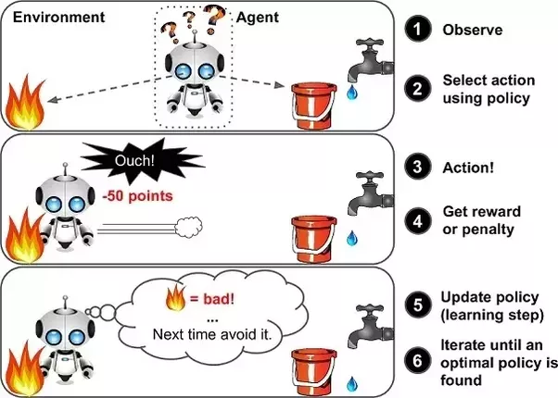
Reinforcement Learning is an area of Machine Learning aimed at creating agents capable of taking actions in an environment in a way that maximizes rewards over time.
Image source: https://www.quora.com/What-is-reinforcement-learning

Slide 4
Introduction to RL
Compare RL with traditional supervised and unsupervised learning:
In supervised and unsupervised learning, the goal is generally to find patterns in the data. In RL, the goal is to find a good policy.
Unlike in supervised learning, the agent is not explicitly given the “right” answer. It must learn by trial and error.
Unlike in unsupervised learning, there is a form of supervision, through rewards. We do not tell the agent how to perform the task, but we do tell it when it is making progress or when it is failing.

Slide 5
Introduction to RL
From the policy optimization point of view, how to classify RL ?
Policy Gradient
Reinforcement Learning
Direct Update Policy:
Q-Learning
based on
Markov Decision Process

Slide 6




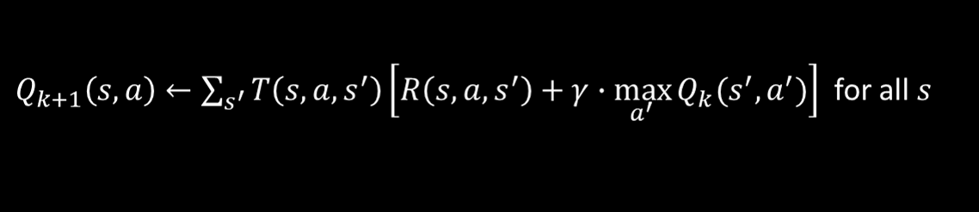
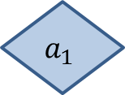
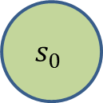
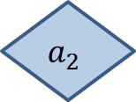
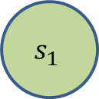
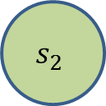
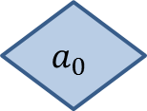


Introduction to RL
Markov Decision Process in RL
0.8
$$a_{1}$$
+40
$$a_{1}$$
0.1
1.0
0.1
-50
$$s_{0}$$
$$a_{2}$$
$$s_{1}$$
0.2
$$s_{2}$$
$$a_{2}$$
1.0
+10
0.8
$$a_{0}$$
$$a_{0}$$
0.3
1.0
0.7
Bellman Optimality Equation
Value Iteration
Q-Value Iteration

Slide 7
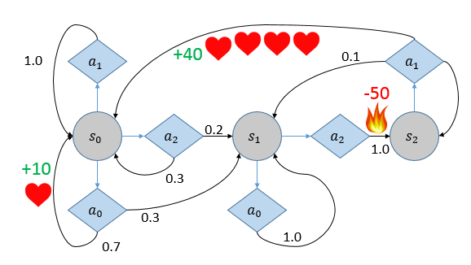
Introduction to RL
Necessary Condition for being a RL problem
1. Know reward after action

Slide 8
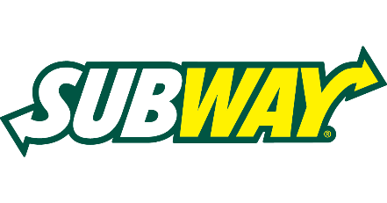
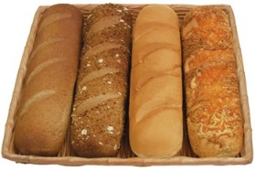
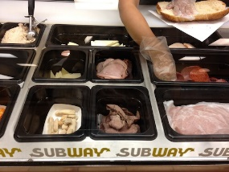
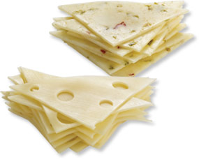
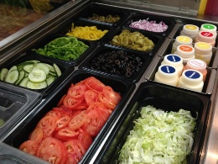


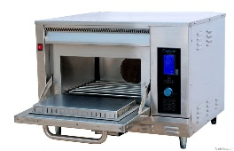







Introduction to RL
Necessary Condition for being a RL problem
2. Furthermore, the reward may be known way after action was executed
$$t_{0}$$
$$t_{1}$$
$$t_{2}$$
$$t_{3}$$
$$t_{4}$$
$$t_{5}$$
Choose bread
Choose meat
Choose cheese
Toasted ?
Choose veg & sauce
enjoy
Discount rate
80%
80%
80%
80%
“Only when you enjoy your sandwich, you know the reward for choosing cheese”

Slide 9
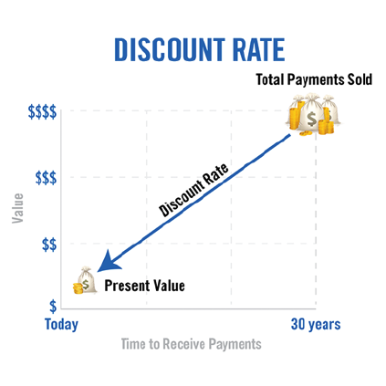
Introduction to RL
Necessary Condition for being a RL problem
2. Furthermore, the reward may be known way after action was executed

Slide 10
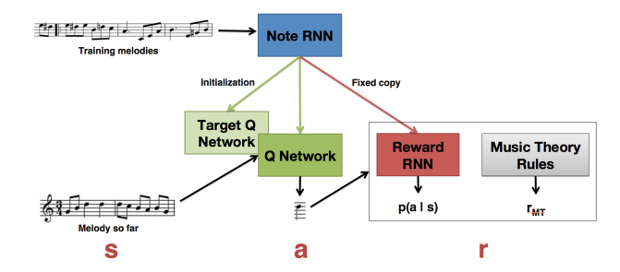
Deep Reinforcement Learning
“Tuning Recurrent Neural Networks With Reinforcement Learning”

Slide 11
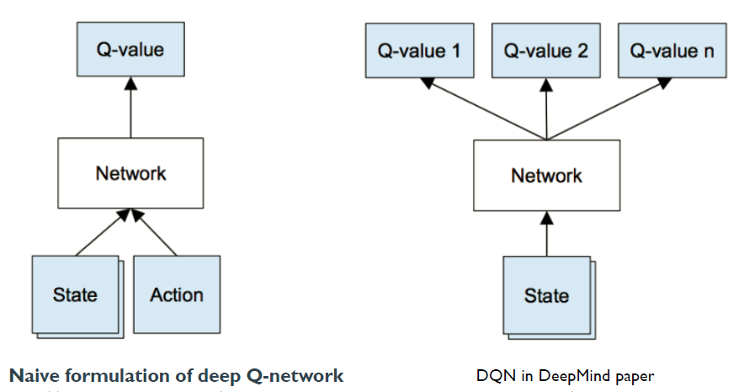
Deep Reinforcement Learning

Slide 12
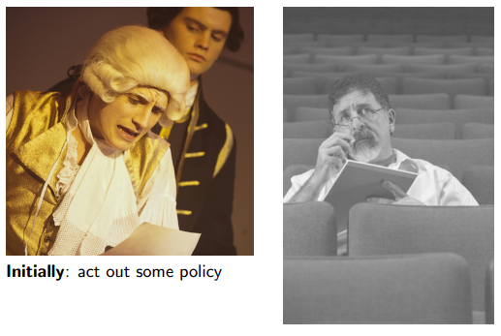
actor-critic

Slide 13
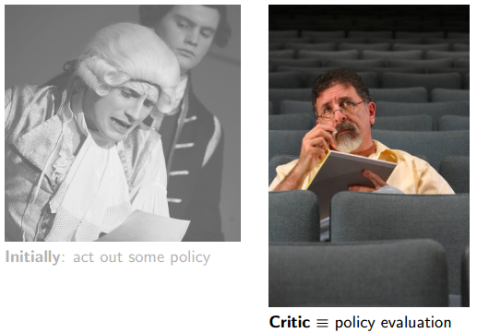
actor-critic

Slide 14
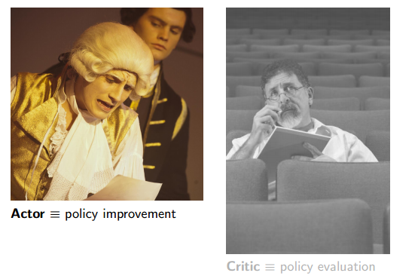
actor-critic

Slide 15
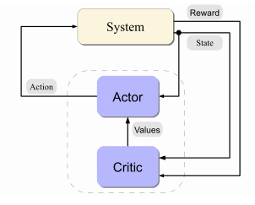
actor-critic

Slide 16
outline
Deep Reinforcement Learning
Meta Learning
Overview
Meta Learning problem formulation
Fuzzy Neural Networks
Generative Adversarial Networks
Transfer Learning
Overview
Transfer learning problem details
Federated Learning

Slide 17

Supervised DL Success Stories
• AlexNet (2012): First CNN (15.4%)
• ZFNet (2013): 15.4% to 11.2%
• VGGNet (2014): 11.2% to 7.3%
• GoogLeNet (2014): 11.2% to 6.7%
• ResNet (2015): 6.7% to 3.57%
• CUImage (2016): 3.57% to 2.99%
• SENet (2017): 2.99% to 2.251%
Image classification
• Human error: 5.1%
• Surpassed in 2015
Notes:
So, before we talked about meta-learning. let's see some dl success stories.
Supervised DL has maken a great Success in the area of computer vison , voice recognition and so on.
As shown in this figure, in the domain of image classification, human error is 5.1%
Deep convolutional networks has surpass the performance of the human in 2015 with the error only 3.57%.
and achieve even more accurate performance in the year of 2016 and 2017

Slide 18
Deep RL Success Stories
Artificial Intelligence --> Machine Learning --> Deep Learning -->
Deep Reinforcement Learning --> Deep Meta Learning
Notes:
And the DRL also made an impressive success in games. For example:
The DQN or some improved methods ,using just raw image inputs, in Atari games as shown in these figures ,
outperforms all previous approaches and also surpasses a human expert on most of the games.

Slide 19
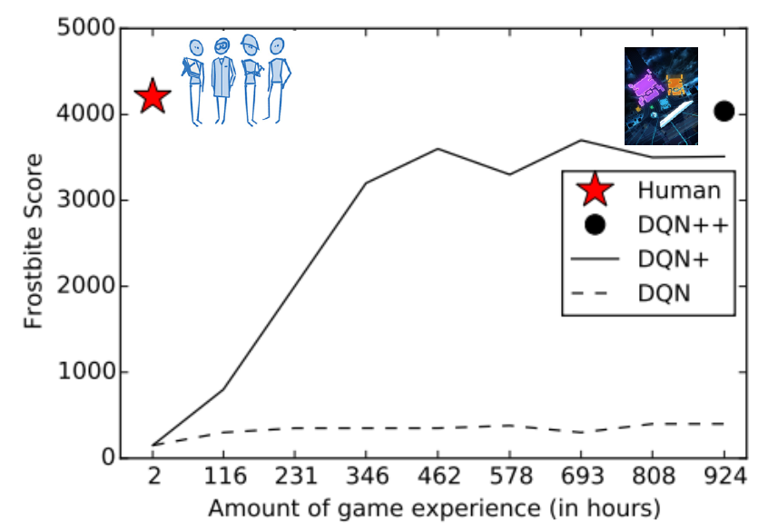
What's problem?
Current success of deep learning relies greatly on big labelled data or samples.
DQN in Pong Game
DQN in Frostbite Game
Notes:
So, what's the problem? The problem is that current success of deep learning relies greatly on big labelled data or samples.
In some situations in the area of medicine and security, we only have few data of each class.
And it is impractical and expensive to obtain such amount of labeled image data.
Also, DRL esp model free algorithm is sample inefficient. It need more than thousand times of trial and error iteration steps.
As we can see in the figure, In the games like frostbite or pong, Dqn take about 40 days to get human-level score,
while human just need 2 hours. In other words, DRL is learning slow, human can learn fast.
That's the reason why ,at present, these DRL method can only perform good in simulation or static environment
These method can not be used in real world. Because real world is a dynamic environment.
Actually, We want the agent learn quickly to solve the new problem and adapt quickly to the change of the environment,
we do not want it to take another forty days for training.

Slide 20
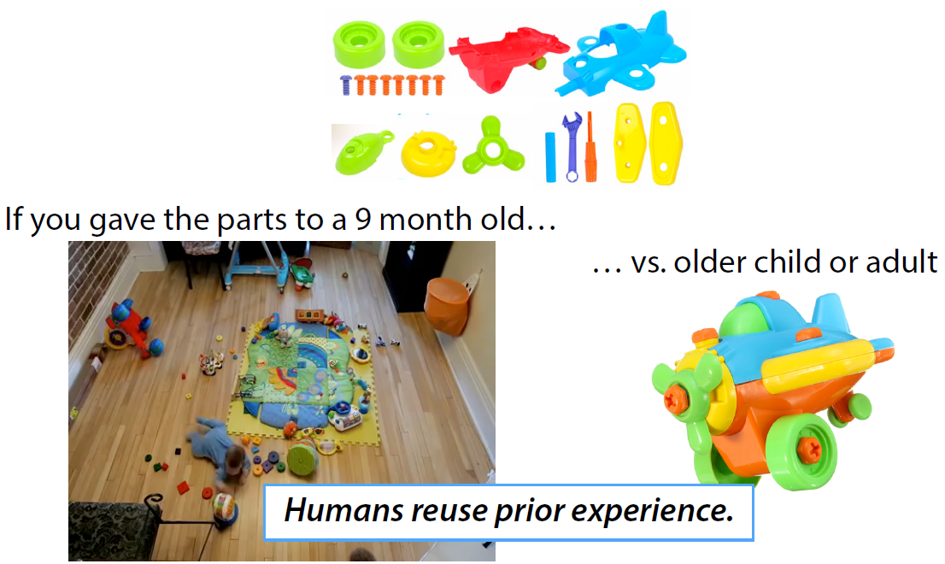
How faster learning?
Humans effectively utilize prior knowledge and experiences to learn new skills quickly.
Reinforcement Learning
Meta Learning
Meta-learning
Key to AGI
Notes:
so, the question is how to learn faster? Let me give you a example. There are the parts of the airplane toys
If you gave the parts to a 9 month old baby, the outcome maybe a mass, because the baby know nothing about the airplane.
It is like reinforcement learning, learn from scratch.
However if you gave them to older child or adult, they can make a plane in a short time because they know
what is airplane and maybe have some knowledge or experiences about it.
Thus , the answer is that humans effectively utilize prior knowledge and experiences to learn new skills quickly.
That is Meta-learning, which is the key to artificial general intelligence.

Slide 21
Outline for meta learning
Introduction
Datasets
Approaches
Conclusions
Future work
Notes:
here is the outline. Firstly, i will introduce what is mete learning. and give a example to inllustrate the concept of
meta learning.
Then I will talk about he datasets for training and testing a meta learning algorithm.
Three classical kinds of approaches of meta learning will be talked in details
Finally, we will draw the conclusions and talk about the work in the future.

Slide 22
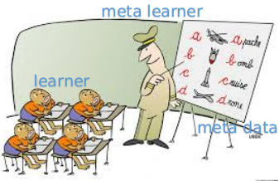
Introduction
meta-learning = learning to learn
- learning to learn from many related tasks
- learn new task fast, using few samples
Optimizer (Meta learner)
What is Meta?
- Hyperparameters:learning rate, batch size,input size, etc
- Structure of Neural Networks
- Parameters of Neural Networks
- Optimizer selection:SGD, Adam, etc
- Q-function
- Policy
......
Optimizee ( Learner or Base Model)
Notes:
meta-learning equals to learning to learn from many related tasks, so be able to learn new task fast, using just few samples.
There are mainly two modules in meta-learning : the learner and meta learners
We often call the model (M) as an learner which can be represented by neural net. It can be seen as a low-level network and sometimes be called an optimizee.
The optimizer (O) or meta-learner is a higher-level model which is updating the weights of the lower-level network (the model). like a teacher guide the student to learn efficient.
And What is meta? in neural networks, the meta can be........

Slide 23
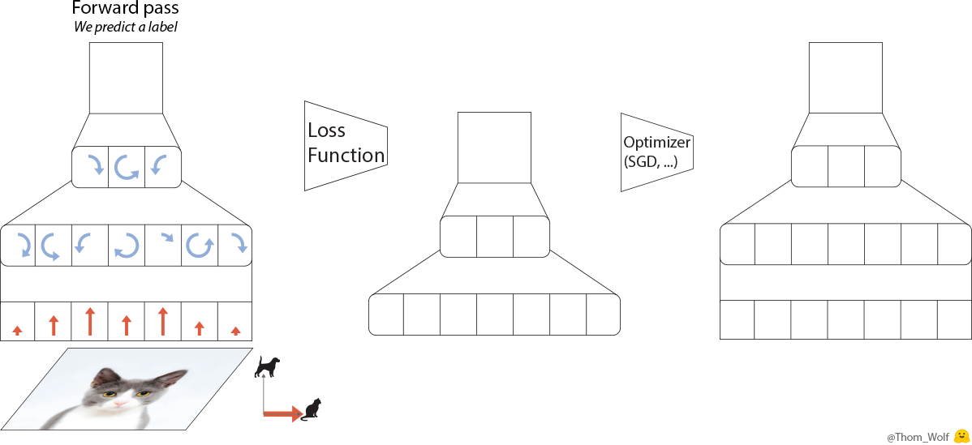

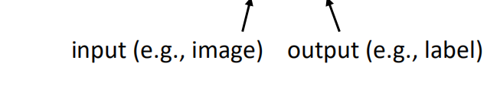
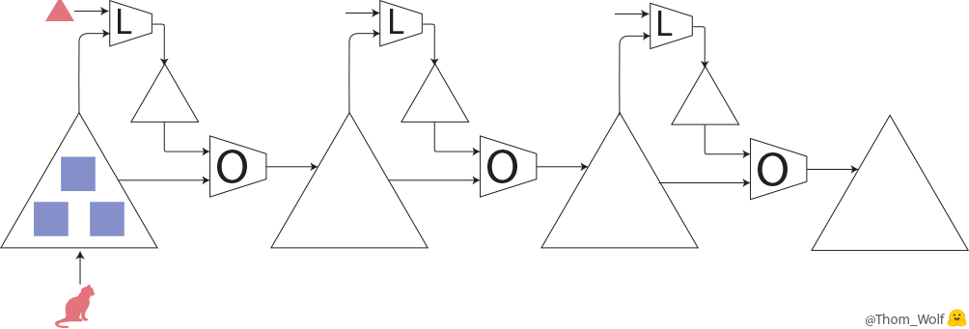
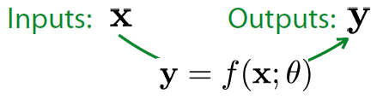
Introduction
What is supervised learning?
Supervised learning: Given a distribution over examples (single task), learn a function that minimizes the loss.
Optimizer
Model ( Learner)
Supervised learning for image classification
Notes:
So,first let us take an look at what is supervised learning? Here is an example.
Let's see what happens when we train a simple neural net to classify images of dogs and cats.
we have a single training image of a cat together with a label indicating that this image represents a cat.
We forward pass the data,and predict a label. By compare it with groundtruth ,we get the loss.
We can compute the gradient of loss and applied to each parameter of the neural net to reduce the difference between the label currently predicted by the neural net and the real label which is called backpropagation.
After the backpropagation comes the optimizer which computes updated parameters for the model. This is where training a neural net becomes more of an art than a science as there are so many possible optimizers and optimization settings (hyper-parameters).

Slide 24
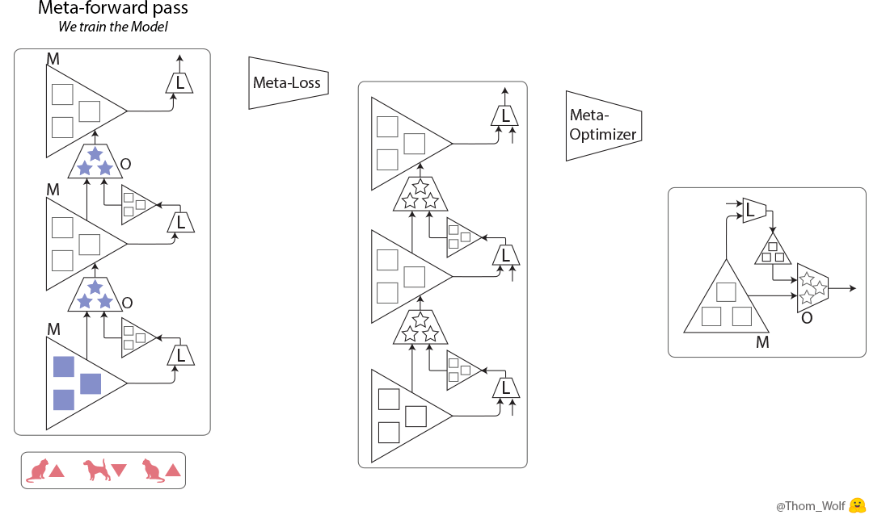
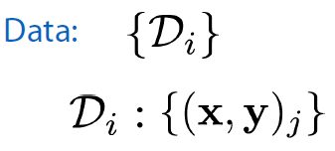
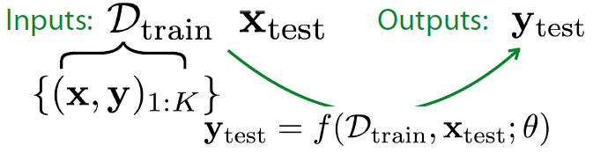
Introduction
What is meta-learning?
Meta-Learning:
Given a distribution over tasks, output an adaptation rule that can be used at test time to generalize from just a few examples.
■ Initial parameters of the Model ( Learner or Optimizee)
★ Parameters of the Optimizer (Meta learner)
Meta-Learning for image classification
Notes:
Let's turn to meta-learning. The idea of meta-learning is to learn the learning process. by trainig on different related
datasets, not just datapoints in classical deep learning
we have two modules to train in meta-learning.
The triangle is What is called the model (M). It can be seen as a low-level network and sometimes called an optimizee or a learner. The weights of the model are the ■ on the drawings.
The parallelogram is the optimizer (O) or meta-learner is a higher-level model which is updating the weights of the lower-level network (the model). The weights of the optimizer are the ★ on the drawings.
In the case of the meta-learner, we would like a meta-loss that is indicative of how well the meta-learner is performing its task: training the model.
One possibility is then to compute the loss of the model on some training data, the lower the loss, the better the training was.
We can compute a meta-loss at the end or even just combine the losses of the model that we already compute during the training (e.g. by summing them).
We also need a meta-optimizer to update the weights of the optimizer like SGD or ADAM.

Slide 25
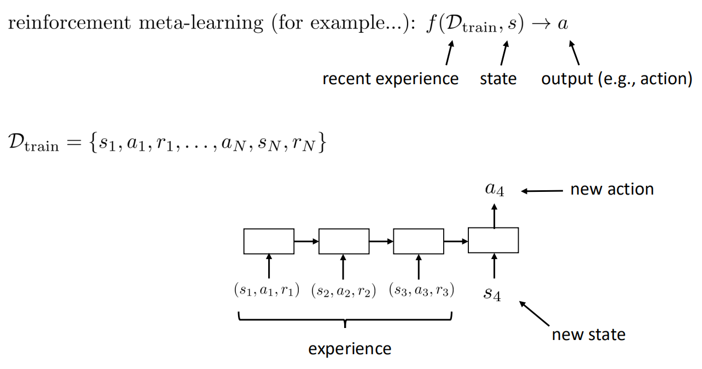
Introduction
The meta-learning problem in RL
In RL, the goal of Meta-Learning is to enable an agent to quickly acquire a policy for a new test task using only a small amount of experience.
Entire task (MDP)
Notes:
Let's look at the meta learning problem in the area of RL.
In reinforcement learning (RL), the goal of meta learning is to enable an agent to quickly acquire a policy for
a new test task using only a small amount of experience in the test setting.
The difference is that The entire task Dtrain is therefore a Markov decision process (MDP) which including
the recent experience.

Slide 26

Introduction
The design & optimization of f()
Meta-learning can be seen as learning a function f() by training on a large number of related tasks to capture the common knowlege to solve new tasks quickly.
Choose parameters θ to reduce the expected learning cost across a distribution of datasets p(D):
Notes:
Dtrain is a number of related tasks, not data points.

Slide 27
Datasets
1. Image Classification for supervised meta-learning
Omniglot dataset: 20+ instances from 1623 characters from 50 different alphabets
30 classes for training,20 for testing
Mini-ImageNet: a subset of the well-known ImageNet dataset, it consists of 84 *84 color images from 100 different classes with 600 instances per class.
64 classes for training,16 for validation,20 for testing
Notes:
Here are the datasets for meta-learning.
Instead of training on a big dataset in traditional dl, During meta train, we try to learn and adapt on a small training set ,
for example, when we take one or a few gradient steps to those images
The goal is to get good generalization performance on classifying the images on the right.

Slide 28
Datasets
2. Meta RL
Visual navigation(OpenAI,DeepMind)
Robot control(OpenAI)
Notes:
Here are the simulation environments for meta RL, like DRL, we usually use maze for visual navigation tasks
and robot for control tasks.
2D,3D ,maze: input raw images and rewards, the goal is to find the way to exit the maze quickly
robot: input the parameter of the body, the goal is to ran faster.

Slide 29
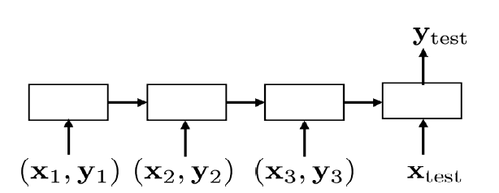
Approaches
1. Using recurrent network
Learned an RNN that ingests experience
Notes:
There are many kinds of method appeared in recent two years.
let's talk about the approach of using recurrent network which is mainly adopted by many papers.
The idea is that we can learned an RNN that ingests experience to represent the model function.

Slide 30
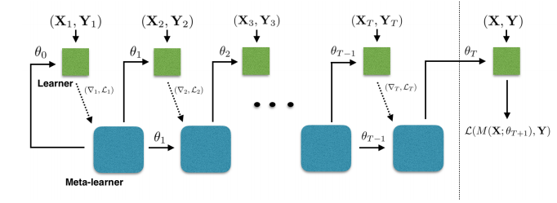
Approaches
1. Using recurrent network
Idea: an LSTM based meta-learner model to learn the exact optimization algorithm used to train another learner neural network classifier in the few-shot regime.
Y= M(X; θ)
Training set D_{train}
Test set D_{test}
Forward pass of the LSTM meta-learner
Learning rate for the updates
Forget gate
[1] Ravi, Sachin and Larochelle, Hugo. Optimization as a model for few-shot learning. In International Conference on Learning Representations (ICLR), 2017.
Notes:
Here is a paper using recurrent network for meta-learning on few-shot tasks
The keyidea of the paper is propose an LSTM based meta-learner model to learn the exact optimization algorithm used to train another learner neural network classifier in the few-shot regime.
The learner is M, where M(X; θ) is the output of learner M using parameters θ for inputs X.
Suppose we have a learner neural net classifier that we want to train on Dtrain. The standard optimization algorithms used to train deep neural networks are some variant of gradient descent, which uses updates of the form θt = θ t−1 − αt ∇θt−1 Lt
We can see this update is similar to the update for the cell state in an LSTM. Thus, the paper propose training a meta-learner LSTM on many related tasks to learn an update rule for training the model learner.

Slide 31
Approaches
1. Using recurrent network
Average classification accuracies on Mini-ImageNet
[1] Ravi, Sachin and Larochelle, Hugo. Optimization as amodel for few-shot learning. In International Conference on Learning Representations (ICLR), 2017.
Notes:
Here is the detailed steps of the algorithm.
And here is the performance in few-shot image classificaition in Mini-imageNet Dataset.
As we can see in the tabel ,the results of the method are much better than other four methods
in 1 shot and 5 shot 5 class image classification.

Slide 32
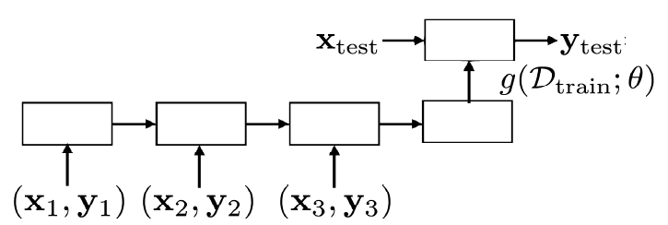
Approaches
2. Learned optimizer
optimizer
Notes:
In traditional deep learning, optimization algorithms like SGD,ADAM are still designed by hand.
How about cast the design of an optimization algorithm as a learning problem and learned a optimizer

Slide 33
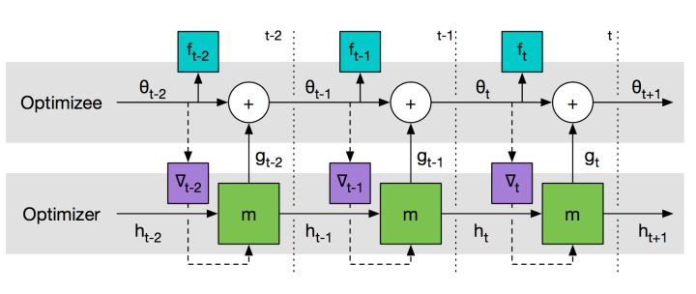

Approaches
2. Learned optimizer
Meta learner
Learner
g
f
LSTM-based optimizer training architecture
Loss function for the optimizer:
[1] Andrychowicz, Marcin, Denil, Misha, Gomez, Sergio, Hoffman, Matthew W, Pfau, David, Schaul, Tom, and de Freitas, Nando. Learning to learn by gradient descent by gradient descent. In Advances in Neural Information Processing Systems, 2016
Notes:
This paper shows how the design of an optimization algorithm can be cast as a learning problem.
The optimizer (left) is provided with performance of the optimizee (right) and proposes updates to increase the optimizee's performance.
the final optimizee is f with parameters is θ, the optimizer is g
The paper takes the update steps gt to be the output of a recurrent neural network m,parameterized by φ,

Slide 34
Approaches
2. Learned optimizer
Comparisons between learned and hand-crafted optimizers performance.
[1] Andrychowicz, Marcin, Denil, Misha, Gomez, Sergio, Hoffman, Matthew W, Pfau, David, Schaul, Tom, and de Freitas, Nando. Learning to learn by gradient descent by gradient descent. In Advances in Neural Information Processing Systems, 2016
Notes:
These figures are the Comparisons between learned and hand-crafted optimizers performance.
Learned optimizers are shown with solid lines and hand-crafted optimizers are shown with dashed lines.
Left: Performance of different optimizers on randomly sampled 10-dimensional quadratic functions.
Center: the LSTM optimizer outperforms standard methods training the base network on MNIST.
Right: Learning curves for steps 100-200 by an optimizer trained to optimize for 100 steps.
This figure is the Optimization performance on the CIFAR-10 dataset and subsets.
Shown on the left is the LSTM optimizer versus various baselines trained on CIFAR-10 and tested on a held-out test set. Thetwo plots on the right are the performance of these optimizers on subsets of the CIFAR labels.

Slide 35

Approaches
3. Learned initialization
Idea: Train over many tasks, to learn parameter vector θ that transfers
loss function
transition distribution
initial observations
episode length
meta-objective
[1] Finn, C., Abbeel, P., & Levine, S. (2017). Model-Agnostic Meta-Learning for Fast Adaptation of Deep Networks. arXiv:1703.03400.
Notes:
The key idea of the paper is training over many tasks, to learn parameter vector θ that transfers,
it is equal to learn a good initializtion of the model for fast fine tune.
The Task T includes the L, q,transition distribution and episode length H.
The meta-objective is choose optimal parameters θ to minimize the total loss of the Task Ti

Slide 36
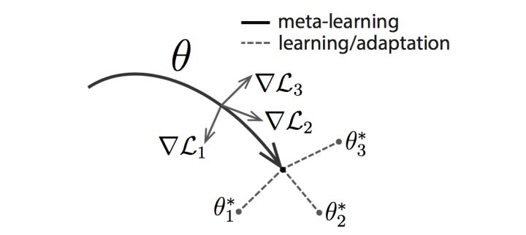
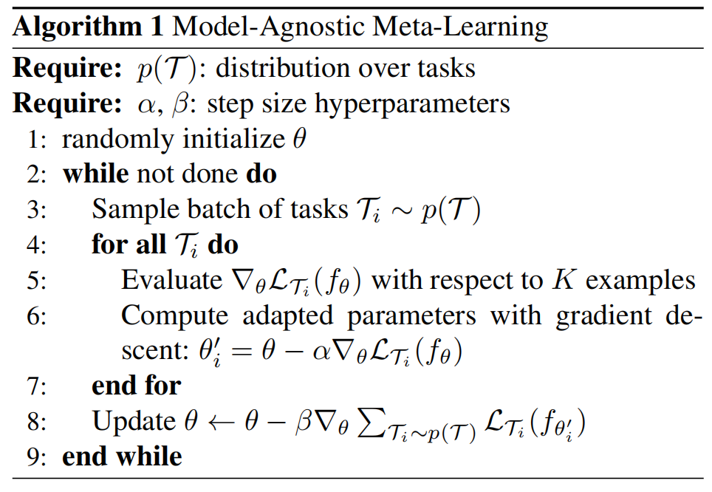
Approaches
3. Learned initialization
The model is represented by aparametrized function f_{θ} with parameters θ.
When adapting to a new task T_{i} , the model's parameters θ become θ’
θ parameter vector being meta-learned
Meta-update
θ_{i}* optimal parameter vector for task i
[1] Finn, C., Abbeel, P., & Levine, S. (2017). Model-Agnostic Meta-Learning for Fast Adaptation of Deep Networks. arXiv:1703.03400.
Notes:
Here are the illustration and steps of the algorithm.

Slide 37
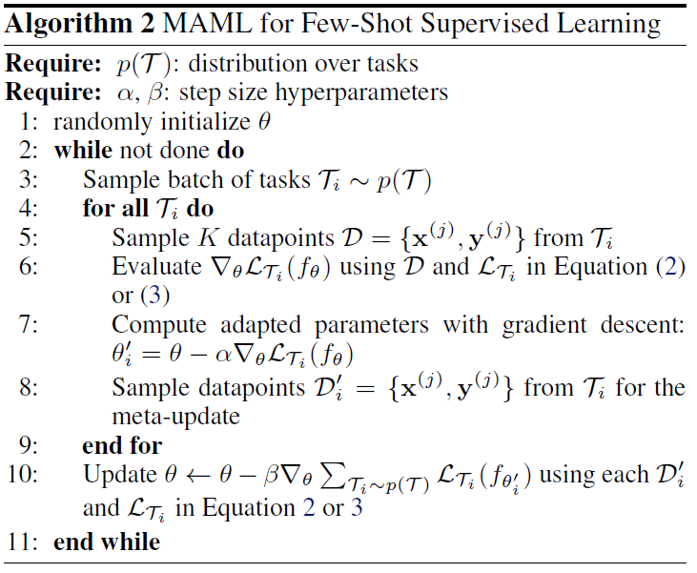
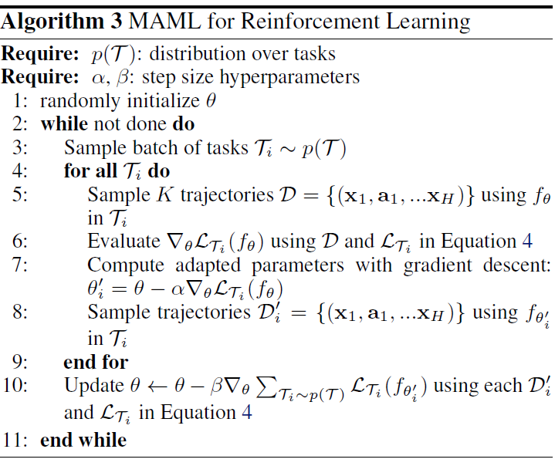
Approaches
3. Learned initialization
[1] Finn, C., Abbeel, P., & Levine, S. (2017). Model-Agnostic Meta-Learning for Fast Adaptation of Deep Networks. arXiv:1703.03400.
Notes:
Here are the steps of the algorithm. The method can be used in both supervised learning and reinforcement learning.

Slide 38
Approaches
3. Learned initialization
Reinforcement Learning
Classification
[1] Finn, C., Abbeel, P., & Levine, S. (2017). Model-Agnostic Meta-Learning for Fast Adaptation of Deep Networks. arXiv:1703.03400.
Notes:
These are the performance of MAML in image classification for omniglot and miniImagenet dataset and in RL environment(robot and navigation)
As we can see in these figure, despite the fact the method is quite simple and model agnostic, it can outperform exiting techniques using neural networks which are complicated and hard to train.

Slide 39
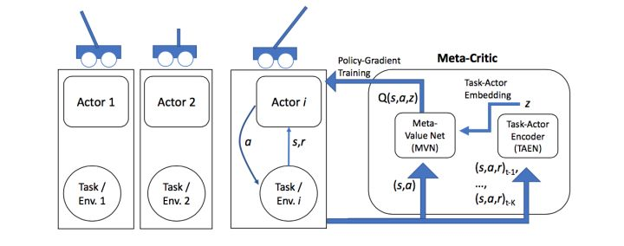
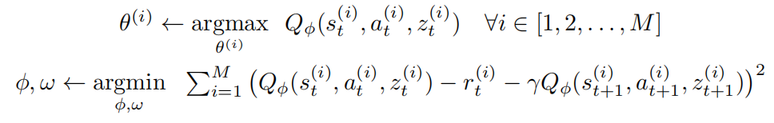
Approaches
4. Learned loss function
Idea: learn a meta-critic: an action-value function neural network that learns to
criticise any actor trying to solve any specified task.
Actor:policy network
Critic:value network
[1] Flood Sung, Zhang L, Xiang T, Hospedales T, et al. Learning to Learn: Meta-Critic Networks for Sample Efficient Learning. arXiv:1706.09529, 2017.
Notes:
The framework is motivated by actor-critic reinforcement learning.
The keyidea is to learn a meta-critic network: an action-value function neural network that learns to
criticise any actor trying to solve any specified task.
The difference is that it has one teacher --- the meta-critic neurel networks also using RNN and many learner actors.

Slide 40
Approaches
5. Using memory
Meta Networks
Idea：Architectures with augmented memory capacities, such as Neural Turing Machines (NTMs), can quickly encode and retrieve new information.
Idea：learns a meta-level knowledge across tasks and shifts its inductive biases via fast parameterization for rapid generalization.
[1] Santoro, Adam, Bartunov, Sergey, Botvinick, Matthew, Wierstra, Daan, and Lillicrap, Timothy. Meta-learning with memory-augmented neural networks, 2016.
[2] Munkhdalai T, Yu H. Meta Networks. arXiv:1703.00837, 2017.
Notes:
The keyidea of the paper on the left is Architectures with augmented memory capacities, such as Neural Turing Machines (NTMs), offer the ability to quickly encode and retrieve new information, and hence can potentially obviate the downsides of conventional models.
The keyidea of the paper on the right is learning a meta-level knowledge across tasks and shifts its inductive biases via fast parameterization for rapid generalization. It is also equiped Memory module to store the meta knowlege.

Slide 41
Approaches
6. Using attention
Simple Neural Attentive Learner (SNAIL)
Idea：a class of simple and generic meta-learner architectures that use a novel combination of Temporal Convolutions and soft attention.
The former to aggregate information from past experience and the latter to pinpoint specific pieces of information.
TC layer
Attention
layer
[1] Nikhil Mishra et al, A SIMPLE NEURAL ATTENTIVE META-LEARNER,ICLR 2018.
Notes:
The Idea of this paper is a class of simple and generic meta-learner architectures that use a novel combination of temporal convolutions and soft attention;
As shown in the figure: The architecture of the nn is two blocks of TC layers (orange) are interleaved with two causal attention layers (green).
The former to aggregate information from past experience and the latter to pinpoint specific pieces of information.

Slide 42
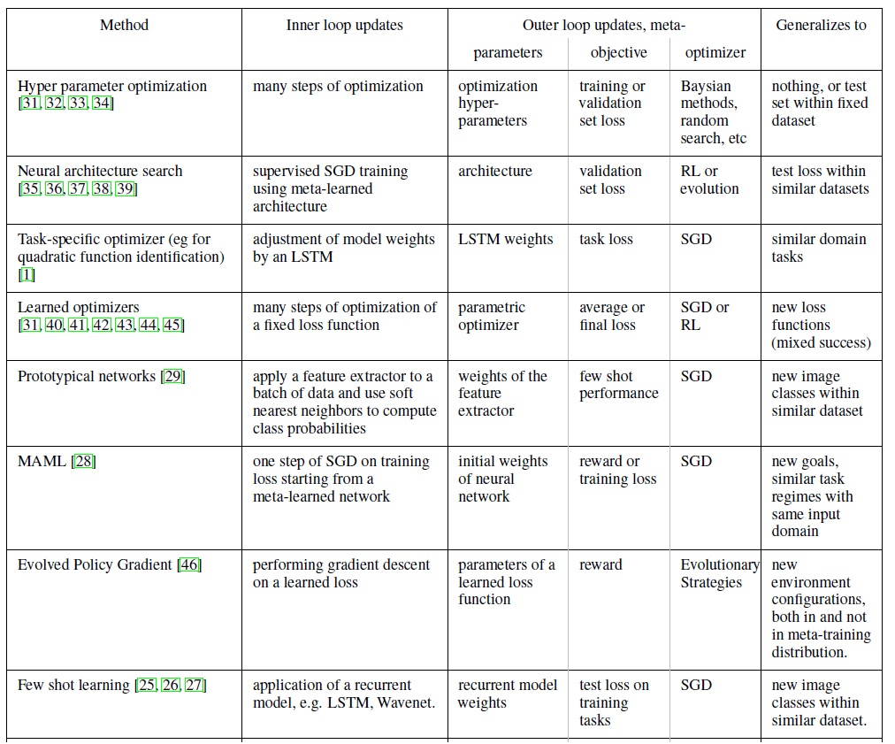
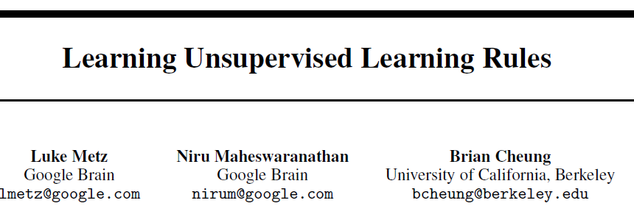
Approaches
Notes:
This table is from a new paper in Mar,2018 with the name :learning unsupervised learning rules.
As shown in this table , there are also many papers using other kinds of method appeared in recent two years.

Slide 43
References
1. Meta Learning for Optimization
Task distribution: different neural networks, weight initializations, and/or different loss functions
Bengio et al.,(1990) Learning a synaptic learning rule
Naik et al., (1992) Meta-neural networks that learn by learning
Hochreiter et al., (2001) Learning to learn using gradient descent
Younger et al., (2001), Meta learning with backpropagation
Andrychowicz et al., (2016) Learning to learn by gradient descent by gradient descent
Chen et al., (2016) Learning to Learn for Global Optimization of Black Box Functions
Wichrowska et al., (2017) Learned Optimizers that Scale and Generalize
Ke et al., (2017) Learning to Optimize Neural Nets
Wu et al., (2017) Understanding Short-Horizon Bias in Stochastic Meta-Optimization
Notes:
Here are the references.
These papers is about meta learning for optimization.
The task distribution is different neural networs, weight initializations,and different loss funtions.

Slide 44
References
2. Meta Learning for Classification
Task distribution: different classification datasets (input: images, output: class labels)
Hochreiter et al., (2001) Learning to learn using gradient descent
Younger et al., (2001), Meta learning with back propagation
Koch et al., (2015) Siamese neural networks for one-shot image recognition
Santoro et al., (2016) Meta-learning with memory-augmented neural networks
Vinyals et al., (2016) Matching networks for one shot learning
Ravi et al., (2017) Optimization as a model for few-shot learning
Munkhdalai et al., (2017) Meta Networks
Snell et al., (2017) Prototypical Networks for Few-shot Learning
Shyam et al., (2017) Attentive Recurrent Comparators
Finn et al., (2017) Model-Agnostic Meta-Learning for Fast Adaptation of Deep Networks
Mehrotra et al., (2017) Generative Adversarial Residual Pairwise Networks for One Shot Learning
Mishra et al., (2017) Meta-Learning with Temporal Convolutions
Li et al., (2017) Meta-SGD: Learning to Learn Quickly for Few Shot Learning
Finn and Levine, (2017) Meta-Learning and Universality: Deep Representations and Gradient Descent can Approximate
any Learning Algorithm
Anon@OpenReview, (2017) Recasting Gradient-Based Meta-Learning as Hierarchical Bayes
Flood Sung et al.,(2018)Learning to Compare- Relation Network for Few-Shot Learning

Slide 45
References
3. Meta Learning for RL
Task distribution: different environments
Schmidhuber. Evolutionary principles in self-referential learning. (1987)
Wiering, Schmidhuber. Solving POMDPs with Levin search and EIRA. (1996)
Schmidhuber, Zhao, Wiering. Shifting inductive bias with success-story algorithm, adaptive Levin search,
and incremental self-improvement. (MLJ 1997)
Schmidhuber, Zhao, Schraudolph. Reinforcement learning with self-modifying policies (1998)
Zhao, Schmidhuber. Solving a complex prisoner’s dilemma with self-modifying policies. (1998)
Schmidhuber. A general method for incremental self-improvement and multiagent learning. (1999)
Singh, Lewis, Barto. Where do rewards come from? (2009)
Singh, Lewis, Barto. Intrinsically Motivated Reinforcement Learning: An Evolutionary Perspective (2010)
Niekum, Spector, Barto. Evolution of reward functions for reinforcement learning (2011)
Duan et al., (2016) RL2: Fast Reinforcement Learning via Slow Reinforcement Learning
Wang et al., (2016) Learning to Reinforcement Learn
Finn et al., (2017) Model-Agnostic Meta-Learning
Mishra, Rohinenjad et al., (2017) Simple Neural AttentIve meta-Learner
Frans et al., (2017) Meta-Learning Shared Hierarchies
Flood Sung et al.,(2017) Learning to Learn Meta-Critic Networks for Sample Efficient Learning
Nikhil Mishra et al, (2018) A SIMPLE NEURAL ATTENTIVE META-LEARNER,ICLR .

Slide 46
outline
Deep Reinforcement Learning
Meta Learning
Overview
Meta Learning problem formulation
Fuzzy Neural Networks
Generative Adversarial Networks
Transfer Learning
Overview
Transfer learning problem details
Federated Learning

Slide 47
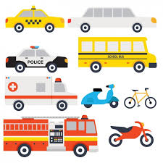
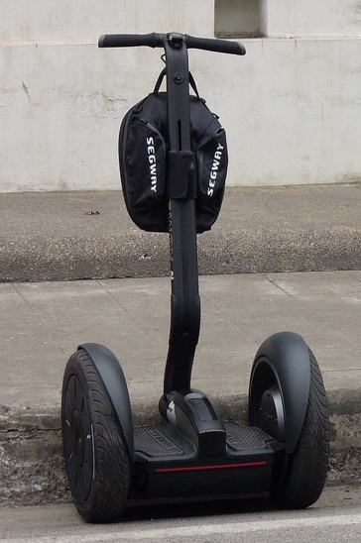
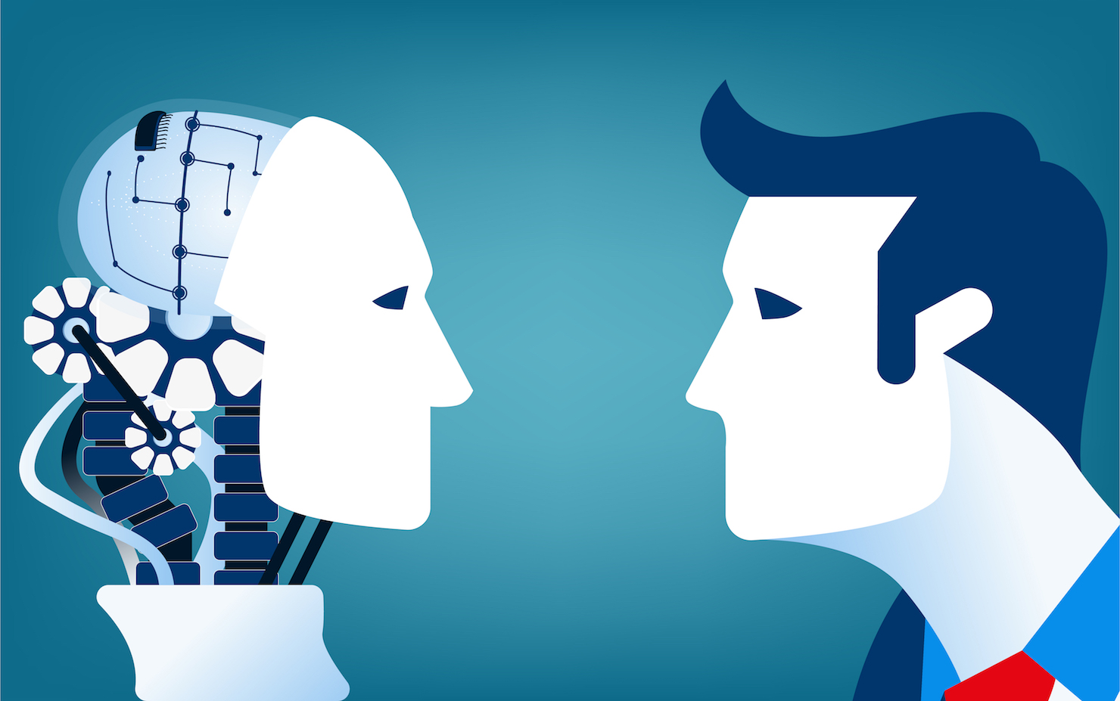

The key to intelligence is “versatility”

Slide 48
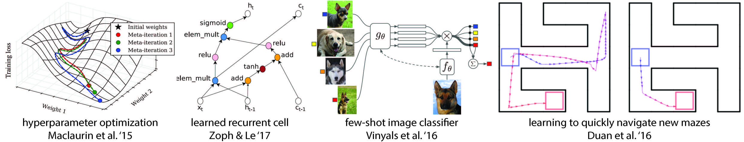
Techniques of meta-learning:
hyperparameter optimization; neural network optimization;
good network architectures; few-shot image recognition; fast reinforcement learning

Slide 49


Meta-Learning problem formulation (universal):
1) model:
2) tasks:
where is the loss function of a specific task. is a distribution over initial observation. is the transition distribution. is the episode length
Note: In i.i.d. supervised learning problem, the length
The loss provides task-specific feedback (make sense for both supervised learning or MDP based RL).

Slide 50

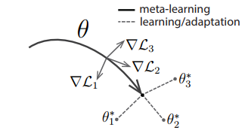
In meta-learning scenario, we consider a distribution over task that we want our model to be able to adapt to.
In the K-shot learning setting, new task is drawn from , from only samples (from the observation ). A feedback will be generated by
Generally, tasks used for meta-learning are held out during meta-learning

Slide 51


Slide 52



The meta-objective:
If we use one gradient descent update, then the adapted parameters for that task are:
Before, we move to the next batch of tasks, we update the parameters of the model θ using Stochastic Gradient Descent SGD:

Slide 53


MAML for supervised learning
For continuous regression or discrete classification, the frequently used loss functions are MSE and cross entropy:
Mean Square Error
Cross Entropy

Slide 54


Slide 55

MAML for reinforcement learning
It’s a Markov Decision Process(MDP) problem with horizon H:
Loss function for RL
Negative of “R”
reward function

Slide 56

The main difference (with supervised learning) is in Step 3 and 5, where data comes from environment

Slide 57

Simulation for MAML few-shot supervised learning

Slide 58

Simulation for MAML few-shot reinforcement learning

Slide 59
Conclusion
A meta-learning method based on learning easily adaptable model parameters through gradient descent
It is simple and does not introduce any learned parameters for meta-learning
It can be combined with any model representation that is amenable to gradient-based training, and any differentiable objective, including classification, regression, and reinforcement learning
since our method merely produces a weight initialization, adaptation can be performed with any amount of data and any number of gradient steps

Slide 60
outline
Deep Reinforcement Learning
Meta Learning
Overview
Meta Learning problem formulation
Fuzzy Neural Networks
Generative Adversarial Networks
Transfer Learning
Overview
Transfer learning problem details
Federated Learning

Slide 61
FDNN outline
Fuzzy logic
Fuzzy Logic vs. Neural Networks
Fuzzy deep neural network (FDNN)
Application

Slide 62
Fuzzy logic
Definition of fuzzy:
Fuzzy – “not clear, distinct, or precise; blurred”.
Fuzzy logic can be defined as a superset of conventional (Boolean) logic that has been extended to handle the concept of partial truth - truth values between “completely true” and “completely false”.

Slide 63


Fuzzy logic

Slide 64




Fuzzy logic
Fuzzy logic representation:
Every problem must represent in terms of fuzzy sets. What is fuzzy set?
Slowest
Slow
Fast
Fastest
[ 0.0 – 0.30]
[ 0.25 – 0.60]
[ 0.50 – 0.75 ]
[ 0.80 – 1.00 ]

Slide 65


Fuzzy logic
A fuzzy set is a pair $\left(U,m\right)$, where $U$ is a set, and $m:U→\left[ 0, 1 \right]$, a membership function.
For each $x∈U$, $m(x)$ is called the grade of membership of $x$ in $(U,m).$ The function $m=μ(A)$ is called the membership function of the fuzzy set of $A=(U,m).$
If $m(x)=0$, $x$ is called not included in the fuzzy set.
If $m(x)=1$, $x$ is called fully included in the fuzzy set.
If $0<m(x)<1$, $x$ is called partially included in the fuzzy set.
Provides a way to write symbolic rules with terms like “medium” but evaluate them in a quantified way.

Slide 66

Fuzzy logic
The membership function:
represents the degree of truth as an extension of valuation
maps set U to the unit interval [0,1]

Slide 67


Fuzzy logic
Fuzzy logic Operates on a bunch of IF-THEN statements.
Example – fan speed controller

Slide 68
Fuzzy logic
Defuzzification:
the process of producing a quantifiable result in Crisp logic.
interprets the membership degrees of the fuzzy sets into a specific decision or real value.
Typical methods includes: AI (adaptive integration), COG (center of gravity), FCD (fuzzy clustering defuzzification), FM (fuzzy mean), etc.

Slide 69

Fuzzy logic
Fuzzy system diagram:

Slide 70
fdNN outline
Fuzzy logic
Fuzzy Logic vs. Neural Networks
Fuzzy deep neural network (FDNN)
Application

Slide 71
Fuzzy Logic vs. Neural Networks
Similarities:
They can be used for solving a problem (e.g. pattern recognition, regression or density estimation) if there does not exist any mathematical model of the given problem.

Slide 72
Fuzzy Logic vs. Neural Networks
Differences:
- While neural networks are low-level computational structures that perform well when dealing with raw data, fuzzy logic deals with reasoning on a higher level, using linguistic information acquired from domain experts.
- Fuzzy systems lack the ability to learn and cannot adjust themselves to a new environment. On the other hand, although neural networks can learn, they are opaque to the user.

Slide 73

Fuzzy Logic vs. Neural Networks
Summary:
Obviously, fuzzy logic and neural networks are natural complementary tools in building intelligent systems.

Slide 74
fdNN outline
Fuzzy logic
Fuzzy Logic vs. Neural Networks
Fuzzy deep neural network (FDNN)
Application

Slide 75

FDNN
Cooperative Fuzzy Neural Network
This configuration learns fuzzy set from given training data. This is usually performed by fitting membership functions with a neural network. The fuzzy sets are then determined offline. They are then utilized to form the fuzzy system by fuzzy rules that are given (not learned) as well.

Slide 76

fdnn
Cooperative Fuzzy Neural Network (cont.)
This system learns all membership function parameters online, i.e., while the fuzzy system is applied. Thus initially fuzzy rules and membership functions must be defined beforehand. Moreover, the error has to be measured in order to improve and guide the learning step.

Slide 77

FDNN
Hybrid Fuzzy Neural Network
Here, the fuzzy system is interpreted as special kind of neural network. The advantage of such hybrid NFS is its architecture since both fuzzy system and neural network do not have to communicate any more with each other. They are one fully fused entity. These systems can learn online and offline.

Slide 78
fdnn
Advantages:
- Suitable for uncertain or approximate reasoning and they allow decision making with estimated values under incomplete or uncertain information ^{[1]}.
- More robust than non-fuzzy models against the sensitivity of variations of the data ^{[2]}.
[1].El Hatri, Chaimae, and Jaouad Boumhidi. "Fuzzy deep learning based urban traffic incident detection." Cognitive Systems Research (2017).
[2].De la Rosa, Erick, and Wen Yu. "Data-Driven Fuzzy Modeling Using Deep Learning." arXiv preprint arXiv:1702.07076 (2017).

Slide 79


Application
Biomedical image classification:
Deng Y, Ren Z, Kong Y, et al. A hierarchical fused fuzzy deep neural network for data classification[J]. IEEE Transactions on Fuzzy Systems, 2017, 25(4): 1006-1012.

Slide 80

Application
Attackers detection among passengers:
Zheng Y J, Sheng W G, Sun X M, et al. Airline passenger profiling based on fuzzy deep machine learning[J]. IEEE transactions on neural networks and learning systems, 2017, 28(12): 2911-2923.

Slide 81

application
Traffic incidents detection:
El Hatri C, Boumhidi J. Fuzzy deep learning based urban traffic incident detection[J]. Cognitive Systems Research, 2017.

Slide 82
outline
Deep Reinforcement Learning
Meta Learning
Overview
Meta Learning problem formulation
Fuzzy Neural Networks
Generative Adversarial Networks
Transfer Learning
Overview
Transfer learning problem details
Federated Learning
Federated Learning

Slide 83
outline
Introduction
Motivation
GAN Model
Experiments
Pros and Cons
References

Slide 84

INTRODUCTION
Introduced by Ian Goodfellow et al. in 2014
Class of Artificial Intelligence algorithms
Two neural networks competing with each other

Slide 85


GENERATIVE MODEL
Given training data, generate new samples from the same distribution
Learn p_{model}(x) similar to p_{data}(x)

Slide 86

Why GENERATIVE MODEL?
Generate more data samples
Simulation and planning (Reinforcement learning)
Density estimation (Unsupervised learning)
Missing data (Semi-supervised learning)

Slide 87

Generative adversarial network (gan)
Framework with two deep neural networks pitted against each other
Discriminative model
Tries to discriminate between
Samples from the data distribution
Samples from the model distribution
Generative model
Tries to ‘trick’ discriminator by generating samples that are hard to discriminate

Slide 88








analogy
Counterfeiter
Police
Competition drives both to improve until counterfeits are indistinguishable

Slide 89
Zero-sum game
GAN is a two player minimax zero-sum game
One player maximizes the value function – Discriminator, D
The other player minimizes the value function – Generator, G
Probability that x came from the data rather than the generator
Prior on input noise variables
Mapping to data space
Value function

Slide 90

Gan training algorithm
Gradient ascent on the discriminator
Gradient descent on the generator

Slide 91

Gan training algorithm
Poorly fit
After updating D
After updating G
Equilibrium
----- Discriminative distribution, D
___ Generative distribution, G
….. Data distribution

Slide 92

Optimal discriminator, d
D is trained in the inner loop of the algorithm, converging to D*(x)
After updating D
----- Discriminative distribution, D

Slide 93
Optimal generator, G
Gradient of D has guided G(z) to flow to regions that are more likely to be classified as data
After updating G
___ Generative distribution, G

Slide 94

Mixed strategy equilibrium
After several steps of training, G and D reach a point at which both cannot improve because p_{g} = p_{data}
The discriminator is unable to differentiate between the two distributions
D(x) = $\frac{1}{2}$

Slide 95

Global minimum
The virtual training criterion
The global minimum of the virtual training criterion
Achieved if and only if p_{g} = p_{data}
Generative model perfectly replicates the data distribution

Slide 96

experiments
MNIST Dataset
Toronto Face Database (TFD)
Samples drawn from the generator network after training

Slide 97
Pros and cons
Advantages
Markov chains not needed
Only backpropagation used to obtain gradients
No inference needed during learning
Many functions can be incorporated into the model
Disadvantages
No explicit representation of p_{g}(x)
D must be synchronized well with G during training
G must not be trained too much without updating D

Slide 98
references
I. Goodfellow, J. Pouget-Abadie, M. Mirza, B. Xu, D. Warde-Farley, S. Ozair, A. Courville, and Y. Bengio, “Generative Adversarial Nets,” in 27th International Conference on Neural Information Processing Systems, Montreal, Canada, Dec. 2014.\
Zhu, Banghua, Jiantao Jiao, and David Tse. "Deconstructing Generative Adversarial Networks." arXiv preprint arXiv:1901.09465 (2019).

Slide 99
outline
Deep Reinforcement Learning
Meta Learning
Overview
Meta Learning problem formulation
Fuzzy Neural Networks
Generative Adversarial Networks
Transfer Learning
Overview
Transfer learning problem details
Federated Learning

Slide 100
Introduction
Big data world
Fast computing
Machine learning model for specific task
Lack of well labeled data in various scenarios

Slide 101

What is Transfer Learning?
Transfer learning is a machine learning technique where a model trained on one task is re-purposed on a second related task.
Notes:
Transfer learning is essential in any kind of learning. Humans are not taught every single task or problem in order to be successful at it. Everyone gets into situations that have never been encountered, and we still manage to solve problems in an ad-hoc manner. The ability of learning from a large number of experiences, and exporting 'knowledge' into new environments is exactly what transfer learning is all about. From this perspective, transfer learning and generalisation are highly similar on a conceptual level. The main distinction is that transfer learning is often used for 'transferring knowledge across tasks, instead of generalising within a specific task'. Transfer learning is thus intrinsically connected to the idea of generalisation that is necessary in all machine learning models.
Transfer learning is key to ensure the breakthrough of deep learning techniques in a large number of small-data settings. Deep learning is pretty much everywhere in research, but a lot of real-life scenarios typically do not have millions of labelled data points to train a model. Deep learning techniques require massive amounts of data in order to tune the millions of parameters in a neural network. Especially in the case of supervised learning, this means that you need a lot of (highly expensive) labelled data. Labelling images sounds trivial, but for example in Natural Language Processing (NLP), expert knowledge is required to create a large labelled dataset. The Penn treebank for example, a Part-of-Speech tagging corpus, was 7 years in the making and required close cooperation of trained linguists. Transfer learning is one way of reducing the required size of datasets in order for neural networks to be a viable option. Other viable options are moving towards more probabilistically inspired models, which typically are better suited to deal with limited data sets.
Transfer learning has significant advantages as well as drawbacks. Understanding these drawbacks is vital for successful machine learning applications. Transfer of knowledge is only possible when it is 'appropriate'. Exactly defining what appropriate means in this context is not easy, and experimentation is typically required. You should not trust a toddler that drives around in a toy car to be able to ride a Ferrari. The same principle holds for transfer learning: although hard to quantify, there is an upper limit to transfer learning. It is not a solution that fits all problem cases.

Slide 102


What is Transfer Learning?
Traditional Supervised Learning Scenario
Model A
Model B
98% acc
50% acc

Slide 103
What is Transfer Learning?
Transfer knowledge
Model A
Model B
98% acc
90% acc

Slide 104


Definition of Transfer Learning
Source
Target
A source domain $D_{s}$ consists of a feature space $𝕏_{s}$
A marginal probability distribution $P\left(X_{s}\right)$ where $X_{s}=x_{1},⋯,x_{2}∈𝕏_{s}$
Given $D_{s}$, a task $𝒯_{s}$ consists of a label space $𝕐_{s}$ and learn $P\left(Y_{s} | X_{s}\right)$ from training data where $Y_{s}=y_{1},⋯,y_{2}∈𝕐_{s}$
With target domain $D_{T}$ and target task $𝒯_{T}$, learn $P\left(Y_{T} | X_{T}\right)$ with the information gained from $D_{s}$ and $𝒯_{s}$ where $D_{s}≠D_{T}$ or $𝒯_{s}≠𝒯_{T}$

Slide 105

Transfer Learning Scenarios
$𝕏_{s}≠𝕏_{T}$
Different feature spaces
$P\left(X_{s}\right)≠P\left(X_{T}\right)$
Different marginal probability distributions
$𝕐_{s}≠𝕐_{T}$
Different label spaces
$P\left(Y_{s} | X_{s}\right)≠P\left(Y_{T} | X_{T}\right)$
Different conditional probability distributions

Slide 106

Why Transfer Learning?
Notes:
It is indisputable that ML use and success in industry has so far been mostly driven by supervised learning. Fuelled by advances in Deep Learning, more capable computing utilities, and large labeled datasets, supervised learning has been largely responsible for the wave of renewed interest in AI, funding rounds and acquisitions, and in particular the applications of machine learning that we have seen in recent years and that have become part of our daily lives. If we disregard naysayers and heralds of another AI winter and instead trust the prescience of Andrew Ng, this success will likely continue.
It is less clear, however, why transfer learning which has been around for decades and is currently little utilized in industry, will see the explosive growth predicted by Ng. Even more so as transfer learning currently receives relatively little visibility compared to other areas of machine learning such as unsupervised learning and reinforcement learning, which have come to enjoy increasing popularity: Unsupervised learning -- the key ingredient on the quest to General AI according to Yann LeCun as can be seen in Figure 5 -- has seen a resurgence of interest, driven in particular by Generative Adversarial Networks. Reinforcement learning, in turn, spear-headed by Google DeepMind has led to advances in game-playing AI exemplified by the success of AlphaGo and has already seen success in the real world, e.g. by reducing Google's data center cooling bill by 40%. Both of these areas, while promising, will likely only have a comparatively small commercial impact in the foreseeable future and mostly remain within the confines of cutting-edge research papers as they still face many challenges.
The current use of machine learning in industry is characterised by a dichotomy:
On the one hand, over the course of the last years, we have obtained the ability to train more and more accurate models. We are now at the stage that for many tasks, state-of-the-art models have reached a level where their performance is so good that it is no longer a hindrance for users. How good? The newest residual networks [1] on ImageNet achieve superhuman performance at recognising objects; Google's Smart Reply [2] automatically handles 10% of all mobile responses; speech recognition error has consistently dropped and is more accurate than typing [3]; we can automatically identify skin cancer as well as dermatologists; Google's NMT system [4] is used in production for more than 10 language pairs; Baidu can generate realistic sounding speech in real-time; the list goes on and on. This level of maturity has allowed the large-scale deployment of these models to millions of users and has enabled widespread adoption.
On the other hand, these successful models are immensely data-hungry and rely on huge amounts of labeled data to achieve their performance. For some tasks and domains, this data is available as it has been painstakingly gathered over many years. In a few cases, it is public, e.g. ImageNet [5], but large amounts of labeled data are usually proprietary or expensive to obtain, as in the case of many speech or MT datasets, as they provide an edge over the competition.

Slide 107


Applications of Transfer Learning
Learn from simulation
Self-driving car
Notes:
objects in the simulation and the source look different, although this difference diminishes as simulations get more realistic

Slide 108

Applications of Transfer Learning
Learn from simulation
Self-driving car
Adapting to new domains
Image process

Slide 109

Applications of Transfer Learning
Learn from simulation
Self-driving car
Adapting to new domains
Image processing
Transferring knowledge
Language processing

Slide 110
outline
Deep Reinforcement Learning
Meta Learning
Overview
Meta Learning problem formulation
Fuzzy Neural Networks
Generative Adversarial Networks
Transfer Learning
Overview
Transfer learning problem details
Federated Learning

Slide 111
outline
Motivation
Transfer learning vs. traditional machine learning
Problems and approaches
Conclusion

Slide 112





Motivation
Example 1 – Indoor WiFi Localization
Average Error Distance
$$\sim 1.5m$$
$$\sim 10m$$

Slide 113

Motivation
Example 2 – Sentiment classification
Task: automatically classify the reviews on a product
Accuracy: 70.6%

Slide 114
Motivation
Challenges:
In many machine learning algorithms, a major assumption is that training data and future data must be in same future space and have same distribution. What if they are different?
In many real world applications, it is expensive, time-consuming or impossible to recollect the needed training data and rebuild the models.
But there are many existing knowledge. Can we reuse them?

Slide 115
outline
Motivation
Transfer learning vs. traditional machine learning
Problems and approaches
Conclusion

Slide 116

TL VS Traditional ML
Learning processes of traditional ML
Training and evaluation on the same task and domain.
Different task needs different model.

Slide 117

TL VS. Traditional ML
Learning processes of transfer learning
Storing knowledge gained from solving one problem and applying it to a different but related problem.

Slide 118
outline
Motivation
Transfer learning vs. traditional machine learning
Problems and approaches
Conclusion

Slide 119

Problems
Problem description:
Given a source domain $D_{s}$ and learning task $T_{s}$, a target domain $D_{T}$ and learning task $T_{T}$.
Goal:
Help to improve the learning of the target prediction function $f_{T}(∙)$ in $D_{T}$ using the knowledge in $D_{s}$ and $T_{s}$, where $D_{s}≠D_{T}$ or $T_{s}≠T_{T}$.
Note:
A domain is a pair $D=\{χ,P(X)\},$where $χ$ is a feature space and $P(X)$is a marginal probability distribution, $X=\{x_{1},x_{2},…,x_{n}\}∈χ$.
A task is a pair $T=\{Y,f(∙)\}$, where $Y$ is a label space, $\{y_{1},…,y_{n}\}∈Y$, and $f(∙)$ is an objective predictive function. From a probabilistic view, $f(∙)$ can be written as $P\left(y | x\right).$

Slide 120



Problems
Problem scenario:
Different domain:
Different task:
Different settings:
Inductive transfer learning: $T_{s}≠T_{T}$.
Transductive transfer learning: $T_{s}=T_{T}$, $D_{s}≠D_{T}$.
Unsupervised transfer learning: $T_{s}≠T_{T}$ but related.

Slide 121
Problems
What to transfer?
The common knowledges between different domains.
Instance, feature, model.
When to transfer?
How to avoid negative transfer is till an open issue. In some situations, when the source domain and target domain are not related to each other, brute-force transfer might be unsuccessful.
How to transfer?
Instance-based transfer learning.
Feature-based transfer learning.
Relational approaches.

Slide 122

Approaches – Instance based TL
Instance-based transfer learning:
Assumption: Source and target domains have a lot of overlapping features. So the source domain and target domain data use exactly the same features and labels.
Main idea: Reweight source data so they can be used for learning in the target space.

Slide 123

Approaches – Instance based TL
Example: TrAdaBoost
(a) Classification is difficult when labeled data is insufficient.
(b) Auxiliary labeled data (in red) is helpful in this situation.
W. Dai, Q. Yang, G. Xue, and Y. Yu, “Boosting for Transfer Learning,” Proc. 24th Int’l Conf. Machine Learning, pp.193-200, June, 2000.

Slide 124


Approaches – Instance based TL
Example: TrAdaBoost (cont.)
(c) Sometimes auxiliary labeled data may mislead classification.
(d) increase the weights of the misclassiﬁed data in $T_{s}$, decrease the weights of the misclassiﬁed data in $T_{T}$.
W. Dai, Q. Yang, G. Xue, and Y. Yu, “Boosting for Transfer Learning,” Proc. 24th Int’l Conf. Machine Learning, pp.193-200, June, 2000.

Slide 125

Approaches – Instance based TL
Application: text-classification
W. Dai, Q. Yang, G. Xue, and Y. Yu, “Boosting for transfer learning,” in Proceedings of the 24th International Conference on Machine Learning, Corvalis, Oregon, USA, June 2007, pp. 193–200.

Slide 126


Approaches – Feature based TL
Feature-based transfer learning:
Assumption: When source and target domains only have some overlapping features. (lots of features only have support in either the source or the target domain).
How to learn $ψ$?
Solution 1: Encode application-specific knowledge to learn the transformation.
Solution 2: Learn the transformation by designing objective functions to minimize difference directly.

Slide 127


Approaches – Feature based TL
- Example: Sentiment classification (based on solution 1)
Electronics | Video Games
(1) Compact; easy to operate; very good picture quality; looks sharp! | (2) A very good game! It is action packed and full of excitement. I am very much hooked on this game.
(3) I purchased this unit from Circuit City and I was very excited about the quality of the picture. It is really nice and sharp. | (4) Very realistic shooting action and good plots. We played this and were hooked.
(5) It is also quite blurry in very dark settings. I will never_buy HP again. | (6) The game is so boring. I am extremely unhappy and will probably never_buy UbiSoft again.

Slide 128
Approaches – Feature based TL
Example: Sentiment classification
Electronics Domain specific features
Common features
Video game domain specific features
sharp
good
realistic
hooked
compact
exciting
never_buy
blurry
boring
never_buy
blurry
boring
exciting
compact
good
realistic
sharp

Slide 129
Approaches – Feature based TL
How to select good pivot features?
Still an open problem.
Mutual Information between features and labels.
Term frequency on both source and target domain data.
How to estimate correlations between pivot and domain specific features?
Structural Correspondence Learning (SCL) [Biltzer etal. 2006]
Spectral Feature Alignment (SFA) [Pan etal. 2010]

Slide 130

Approaches – Feature based TL
Application: sentiment classification
J. Blitzer, M. Dredze, and F. Pereira, “Biographies, bollywood, boomboxes and blenders: Domain adaptation for sentiment classiﬁcation,” in Proceedings of the 45th Annual Meeting of the Association of Computational Linguistics, Prague, Czech Republic, 2007, pp. 432–439.

Slide 131

Approaches – Relational TL
Relational Transfer Learning Approaches
Mihalkova L, Huynh T, Mooney R J. Mapping and revising Markov logic networks for transfer learning[C]//AAAI. 2007, 7: 608-614.

Slide 132

Approaches – Relational TL
Application:
Curve for proposed complete transfer system
Mihalkova L, Huynh T, Mooney R J. Mapping and revising Markov logic networks for transfer learning[C]//AAAI. 2007, 7: 608-614.

Slide 133
outline
Motivation
Transfer learning vs. traditional machine learning
Problems and approaches
Conclusion

Slide 134

Conclusion
Transfer learning is a quite hot topic recently. Based on “what to transfer”, the approaches can be classified as instance-based transfer learning, feature-based transfer learning, relational approaches.
Existing challenges:
How to make sure that no negative transfer happens.
So far transfer learning techniques have been mainly applied to small scale applications with a limited variety.
In many applications, we may wish to transfer knowledge across domains or tasks that have different feature spaces, and transfer from multiple such source domains.

Slide 135
outline
Deep Reinforcement Learning
Meta Learning
Overview
Meta Learning problem formulation
Fuzzy Neural Networks
Generative Adversarial Networks
Transfer Learning
Overview
Transfer learning problem details
Federated Learning

Slide 136
Federated Learning
Collaborative Machine Learning without Centralized Training Data

Slide 137
Typical deep learning model
Data from numerous phones
Train in the cloud server
Model back to phone
Same model to all users

Slide 138

Federated learning
Model to phone
Train in phone
Summarize changes
Summary back to server

Slide 139
Advantage
Smarter models
Lower latency
Less power consumption
Privacy
Personalized model, immediate usability

Slide 140
Technique challenges
optimization algorithm
SGD: high iteration
Devices are not even, it requires low throughput
Federated Averaging algorithm
10-100x less communication compared to a naively one
use the powerful processors in modern mobile devices to compute higher quality updates than simple gradient steps.
Upload speed << download speed
Compressing updates
high-dimensional sparse convex models: click-through-rate prediction

Slide 141
Security
No user data stored in the cloud
Secure Aggregation protocol
Only can decrypt the average when 100s or 1000s of users participated
No individual’s data can be inspected before averaging.

Slide 142

Scenario
the device is idle,
plugged in
free wireless connection

Slide 143
OVerall Conclusions

Slide 144
overall conclusion
Except for traditional supervised and unsupervised learning, reinforcement learning can solve the control-related problem where feedback of the system comes from the environment
GAN is a promosing network structure which involves two networks competing with each other in order to generate fake data that is hard to be distinguished
Fuzzy Neural Networks make model robust against the sensitivity of variation of the data
Emerging techniques like meta-learning and transfer-learning ensure a fast adaptation and transition from old training task to various new training tasks

Slide 145
THANK YOU !

