Slide 1
Signal processing and Networking for Big Data Applications Lecture 20: Bayesian Nonparametric learning
http://www2.egr.uh.edu/~zhan2/big_data_course/
Zhu Han
University of Houston
Thanks for Dr. Nam Nguyen Work

Slide 2
outline
Nonparametric classification techniques
Applications
Smart grid
Bio imaging
Security for wireless devices

Slide 3
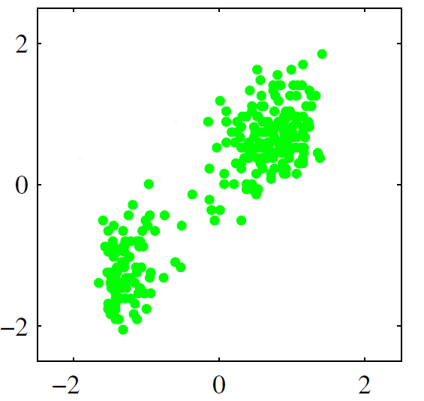
Bayesian Nonparametric Classification
Question: How to cluster smart meter big data
For multi-dimension data
Model selection: How many clusters are there?
What’s the hidden process created the observations?
What are the latent parameters of the process?
Classic parametric methods (e.g. K-Means)
Need to estimation the number of clusters
Can have huge performance loss with poor model
Cannot scale well
The questions can be solved by using Nonparametric Bayesian Learning!
Nonparametric: Number of clusters (or classes) can grow as more data are observed and need not to be known as a priori.
Bayesian Inference: Use Bayesian rule to infer about the latent variables.

Slide 4
Main Objective
Key Idea
Bayesian rule
Posterior Likelihood Prior
μ contains information such as how many clusters, and which sample belongs to which cluster
μ should be nonparametric and can be any value
Sample the posterior distribution P(μ|Observations), and get values of the parameter μ.
p(μ|Observation)=p(Observation|μ)p(μ)/p(Observation)

Slide 5
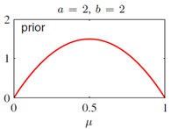

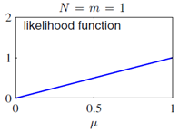


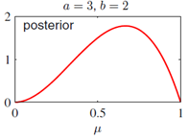
Examples of Bayesian inference used for parameter update
A Beta distribution is chosen to be prior:
Example: a=2, b=2 (head and tail prob. are equal)
A Binomial distribution is the conjugate likelihood:
One trial (N=1) and the result is one head (m=1)
Lead to the Posterior:
Update of parameters given the observations
The probability of head happening is higher

Slide 6
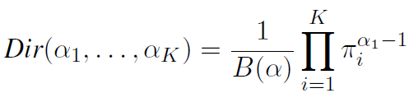
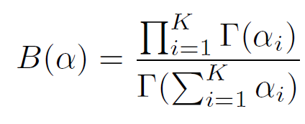
Dirichlet distribution
An extension of the Beta distribution to multiple dimensions.
K: number of clusters
πi: weight with marginal distribution
αi: prior

Slide 7
Dirichlet process
A random distribution G on Θ is Dirichlet process distributed with base distribution H and concentration parameter α, written as G ∼ DP(α,H), if for every finite measurable partition A1, . . .,AK of Θ
H(·), the mean of the DP,
α, strength of the prior

Slide 8
Bayesian nonparametric update
Have t observation x1,…,xt. Define
The posterior distribution on Θ
The posterior Dirichlet process
Small number of observation t, the prior dominates
When t increases, the prior has less and less impact
α controls the balance between the impact of prior and trials
Can be used to learn and combine any distributions

Slide 9
Applications
Distribution estimation
Cognitive radio spectrum bidding
Estimate the aggregated effects from all other CR users
Primary user spectrum map
Different CR users see the spectrum differently
How to combine the others’ sensing (as a prior) with own sensing.
Classification
Infinite Gaussian mixture model

Slide 10
Bayesian Nonparametric Classification
Generative model vs. Inference algorithm
Generative model
Start with the parameters and end up creating observations
Concept and framework
Inference algorithm
Start with observations and end up inferring about the parameters
Practical applications

Slide 11

A Dice with Infinite Number of Faces
Generative model: A general idea
If sample the distribution of each
face, we will obtain the weights, or
the probabilities for each face
(Dirichlet process)
1
2
3
4
5
6
7
∞
π₁
π₂
π₃
π₄
π₅
π₆
Question: If we have a dice with infinite number of faces, then how to deal with the situation?

Slide 12
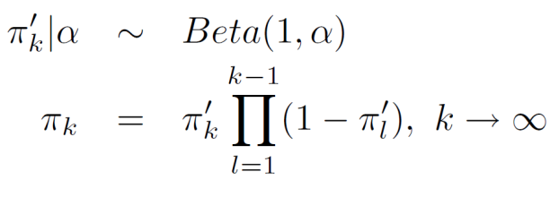
Model for Infinite Number of Faces
Generative model: Stick breaking process:
Generate an infinite number of faces, and their weights which sum up to 1.
_{Sample a breaking point:}
_{Calculate the weight:}
1
π₁’
1-π₁’
π₂’ (1-π₁’)
(1-π₂’ )(1-π₁’)

Slide 13
Infinite Gaussian Mixture Model
Generative model
Stick(α)
π₁
π∞
1
π₂
2
3
4
5
6
7
∞
Infinite number of faces/classes
Indicators are created according to multinomial distribution.
z₁, z₂ .. = 1
z₂₀, z₂₁ .. = 2
X_{1:N}
The observations follows a distribution such as Gaussian.
µ₁
Σ₁
µ₂
Σ₂
µ∞
Σ∞

Slide 14

Inference Model
Obtain label Z from sample X
Finding the posterior of the multivariate distribution P(Z|X)
Given observation X, what are the probability that it belongs to cluster Z
Which cluster a sample belongs to?
Painful due to the integrations needed to carry out.
Finding a univariate distribution is more easily to implement
For new observation, can get marginal distribution of indicator
In other word, find the marginal distribution of Zi given the other indicators.
Gibbs sampling method to sample a value for a variable given all other variables.
The process is repeated and proved to be converged after a few iterations.

Slide 15
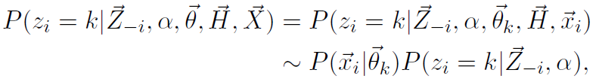


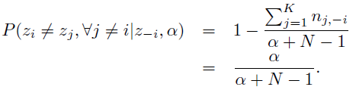

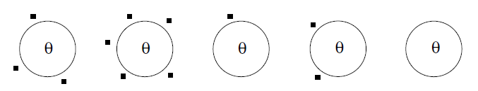
Chinese Restaurant Process
Nonparametric Bayesian Classification inference
Goal:
is the set of all other labels except the current one, i^{th}
Posterior
Likelihood
(e.g. given as Gaussian)
Prior
(Chinese Restaurant Process)
Probability assigned to a represented class
Probability assigned to an unrepresented class
is the number of observations in the same class, k, excluding the current one, i^{th}
?
?

Slide 16
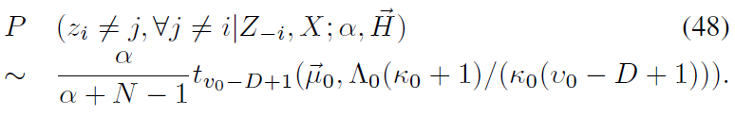
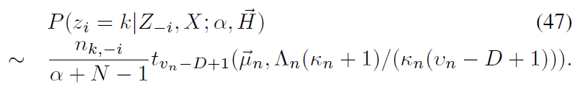
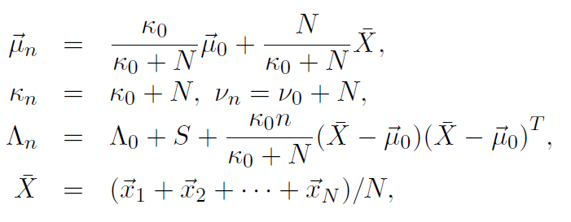
Student t Distribution
Inference model: Posterior distributions
Given the prior and the likelihood, we come up with the posterior:
Probability of assigning to a unrepresented cluster:
Probability of assigning to a represented cluster:
(1)
t is the student-t distribution
(2)
Intuitive:
Provide a stochastic
gradient!

Slide 17
Gibbs Sampler
Inference model: Gibbs sampler
Start with random indicator for each observation.
Remove the current i^{th} observation from its cluster
Update the indicator z_{i} according to (1) and (2) given all the other indicators
No
Converge?
Yes
STOP

Slide 18
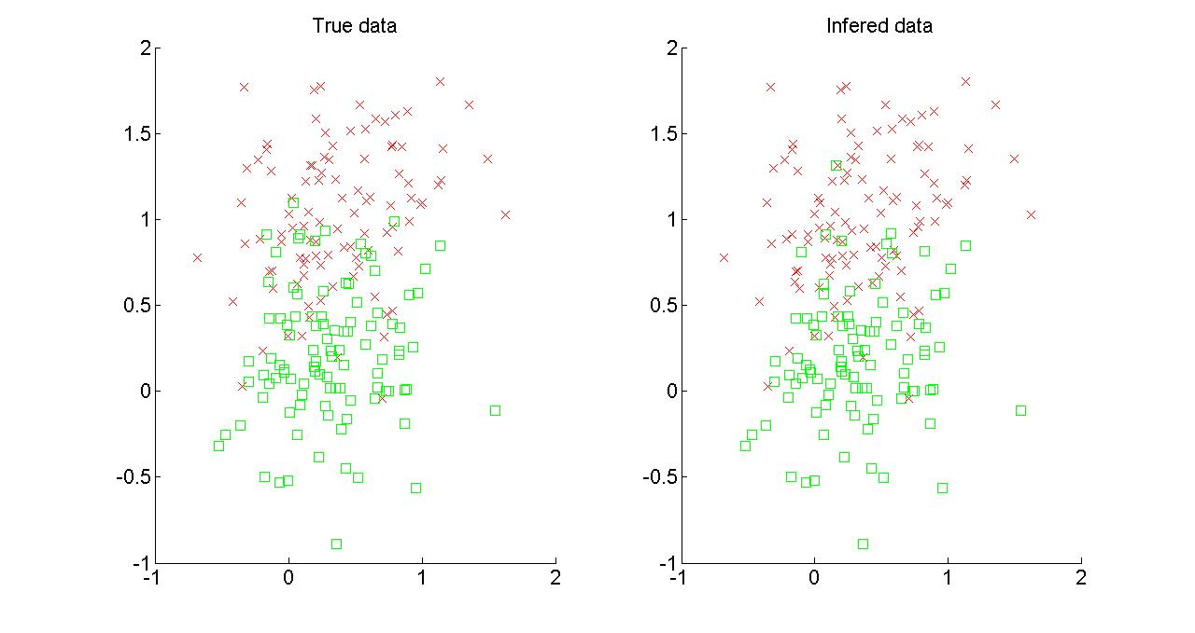
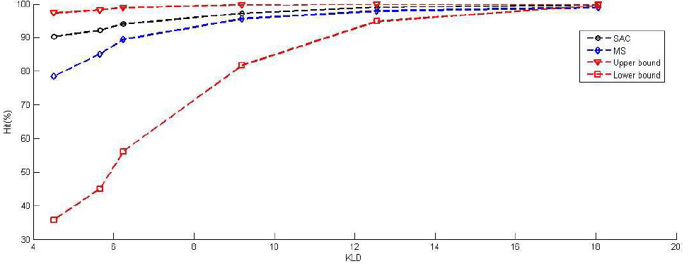
Amazing Clustering Results
Two Gaussian distributed clusters with KL divergence (KLD) 4.5
Intuition why it works so well
Not the boundary or threshold. But clustering so that each cluster looks more like the distribution (Gaussian).
No prior information on probabilities

Slide 19
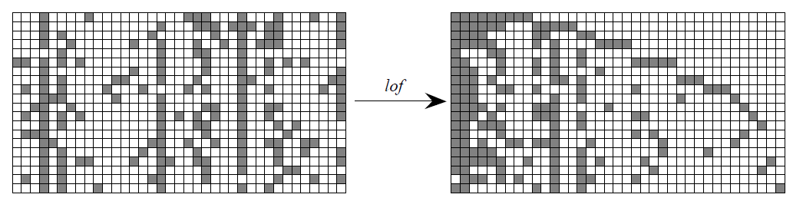
Indian Buffet Process (IBP)
Chinese restaurant problem: one point only belongs to one cluster
Indian buffet process: Multiple assignment clustering, in which, one observation can be caused by multiple hidden sources:
Binary matrix rep. of IBP:

Slide 20
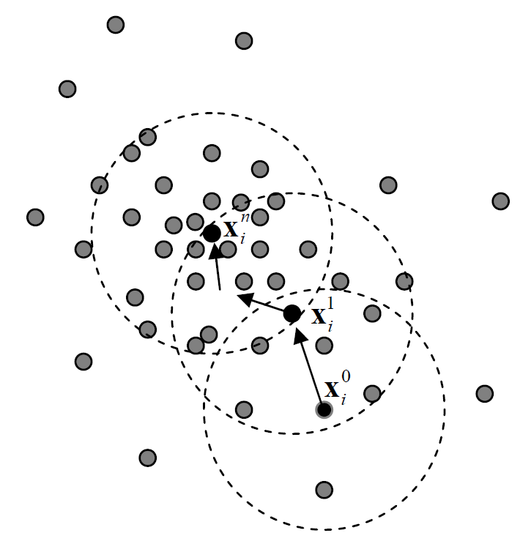
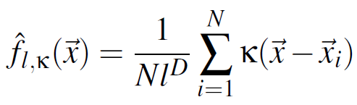
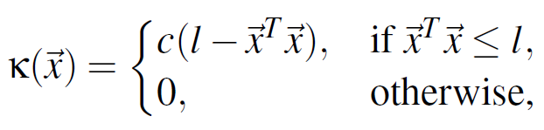
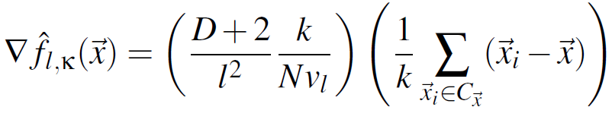
Nonparametric classification: Mean shift
Density estimation:
The gradient of the density:
Move toward the densest region of the observations, i.e., the region with 0 gradient.

Slide 21
outline
Nonparametric classification techniques
Applications
Smart grid
Bio imaging
Security for wireless devices

Slide 22
Smart Pricing for Maximizing Profit
The profit = sum of utility bill – cost to buy power
Different shape of loads cost different
Incentive using pricing to change the loads
The cost reduction is greater than loss of bills

Slide 23
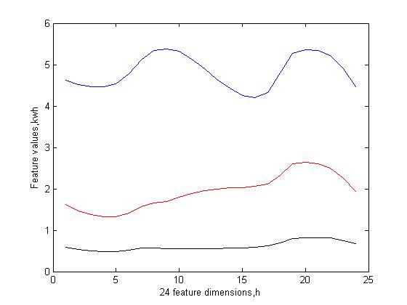
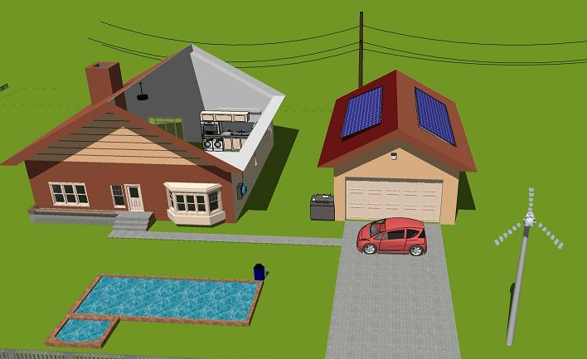
Load Profiling
From smart meter data, try to tell users’ usage behaviors
CEO, 1%, Audience here
Worker, middle class, myself
Homeless, slave, Ph.D. students

Slide 24
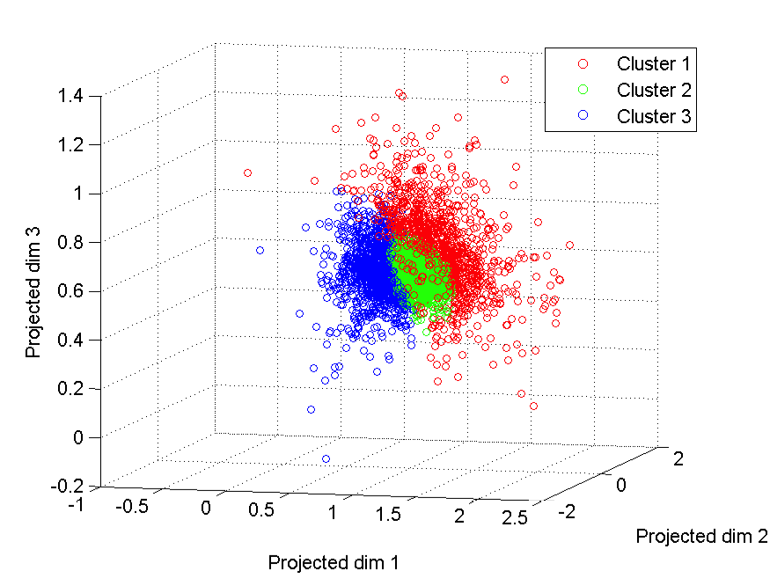
Load Profiling Results
Utility company wants to know benchmark distributions
Nonparametric: do not know how many benchmarks
Bayesian: posterior distribution might be time varying
Scale: Daily, weekday, weekend, monthly, yearly.

Slide 25
outline
Nonparametric classification techniques
Applications
Smart grid
Bio imaging
Security for wireless devices

Slide 26
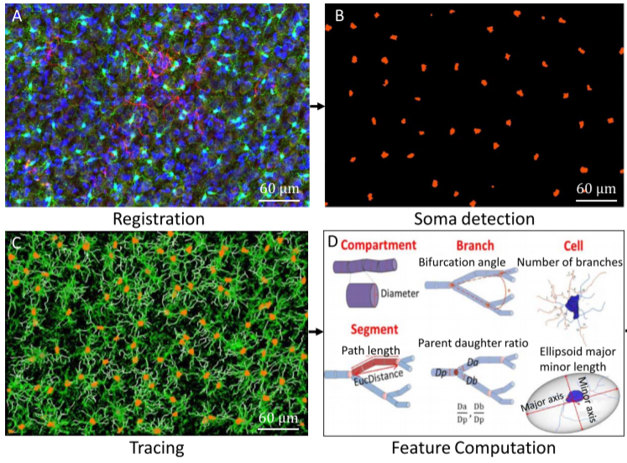
Image processing pipeline
A maximum-intensity projection of a small region from the 3-D image montage;
Middle 2-D optical slice from the 3-D microglial soma segmentation results (in orange);
3-D volume rendering of automated microglia reconstruction results (in white) overlaid on the Iba-1 channel (green), and the soma segmentations in orange.
Illustrating the L-measure feature computation at multiple levels of granularity, at the compartment, segment, branch and cell levels.

Slide 27
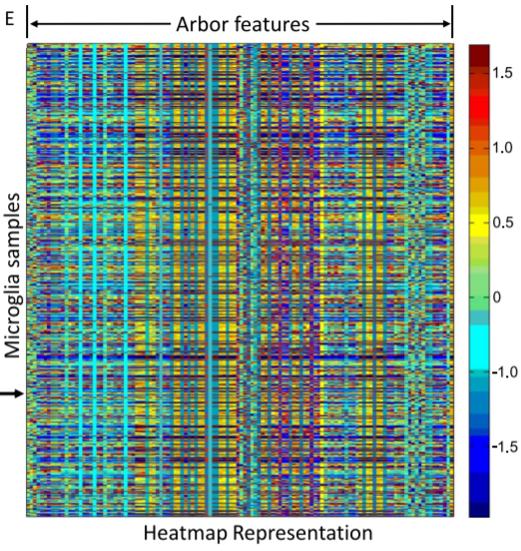
Image processing pipeline
(E) Heatmap summary display of the combined L-measure feature table for the datasets in Figs. 1(a) and 1(c), with each row corresponding to a cell and each column corresponding to an L-measure feature.

Slide 28
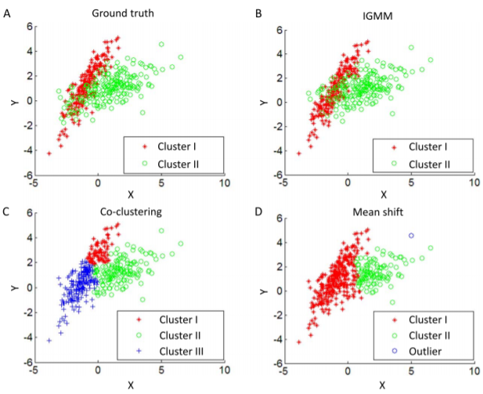
Comparison of IGMM with other Techniques

Slide 29
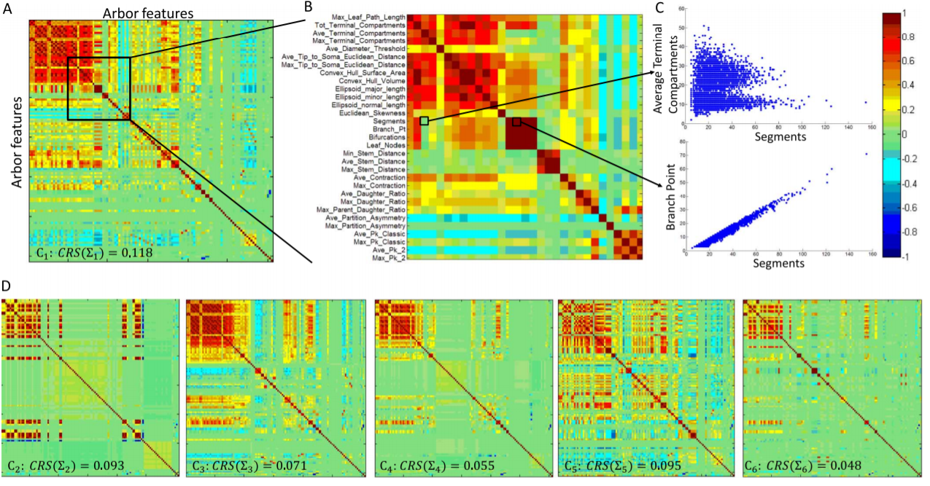
Comparisons of the correlation matrices

Slide 30
outline
Nonparametric classification techniques
Applications
Smart grid
Bio imaging
Security for wireless devices

Slide 31


Introduction: Security
Security Enhancement for Wireless Network
Masquerade attack
Sybil attack
Use device dependent radio-metrics as fingerprints.
Contributions:
Unique and hard-to-spoof device fingerprint
An unsupervised and passive attack detection method.
Upper bound and lower bound of classification performance.

Slide 32
Wireless device security
Masquerade attack
Sybil attack
Mechanism:
If the number of devices can be found, compare that number to the number of associated devices to detect an attack.
Based on the label of the observations generated from the devices to mark the malicious nodes.
Device1
00-B0-D0-86-BB-F7
Device2
00-0C-F1-56-98-AD
Device1
00-B0-D0-86-BB-F7
00-0C-F1-56-98-AD
Device2
00-A0-C9-14-C8-29
Device3
00-0C-F1-56-98-AD

Slide 33
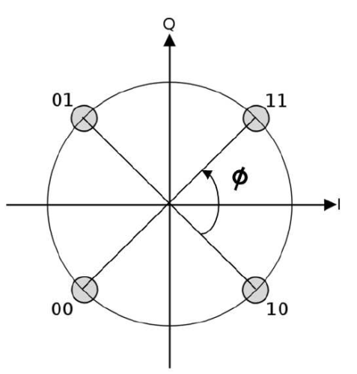
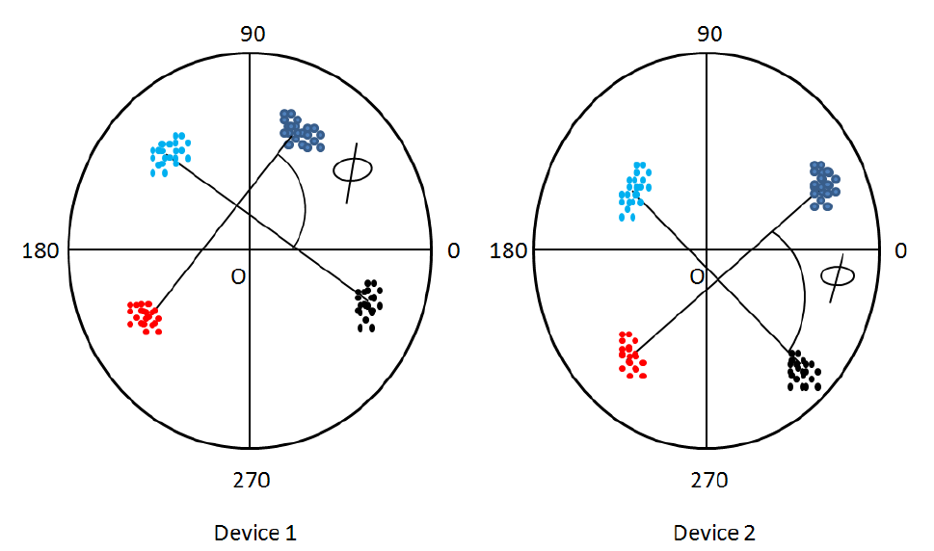
Security – Features selection
The Carrier Frequency Difference (CFD)
Defined as the difference between the carrier frequency of the ideal signal and that of the transmitted signal.
Depends on the oscillator within each device.
The Phase Shift Difference (PSD)
Using QPSK modulation technique.
Transmitter amplifiers for I-phase and Q-phase might be different. Consequently, the degree shift can have some variances.

Slide 34

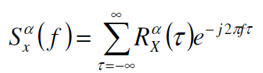
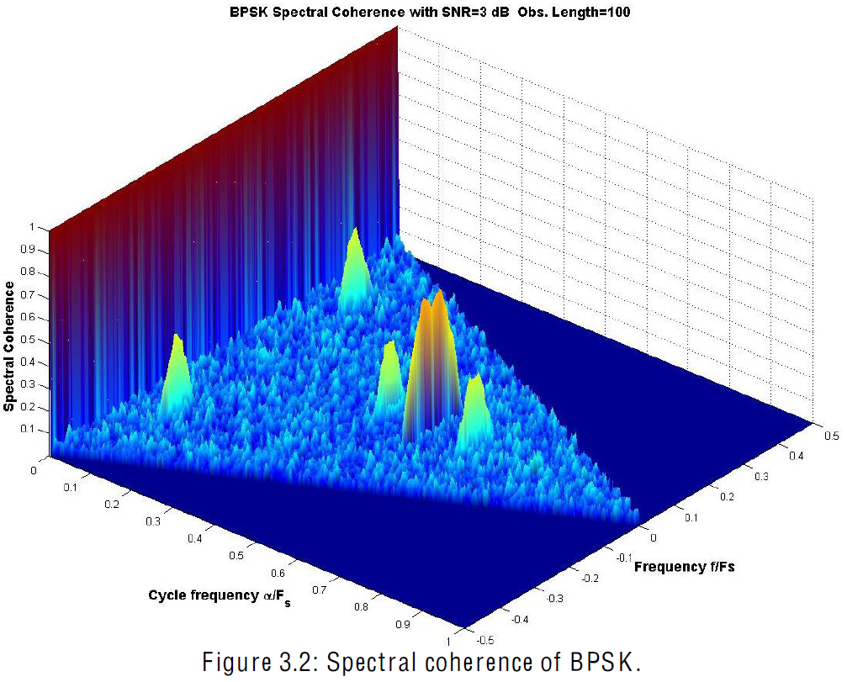
Security – Features selection
Autocorrelation
BPSK Spectral coherence
The Second-Order Cyclostationary Feature (SOCF)
The Received Signal Amplitude
Spectral coherence
Cycle frequency
Frequency

Slide 35
Security – Inference Algorithm
Collect data
Unsupervised clustering method
Two clusters with the same MAC addresses?
Two MAC address with the same cluster?
No
No
Yes
Yes
Masquerade attack.
Sybil attack.
Determine the number of attackers
Update the “black” list with the Mac address

Slide 36
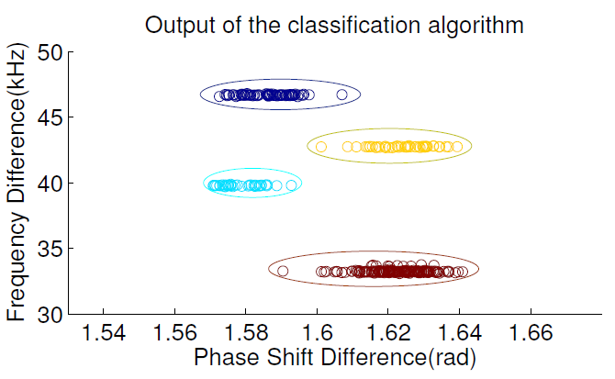
Masquerade and Sybil attack detection: Preliminary USRP2 experiment
We collected the fingerprints from some WiFi devices by the USRP2 and tried the algorithm, below is the result:

Slide 37
Applications: Prime User emulation (PEU) attack detection
In Cognitive radio, a malicious node can pretend to be a Primary User (PU) to keep the network resources (bandwidth) for his own use.
How to detect that? We use the same approach, collect device dependent fingerprints and classify the fingerprints.
We limit our study to OFDM system using QPSK modulation technique.

Slide 38
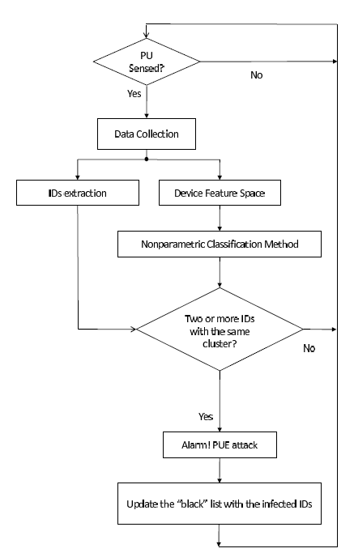
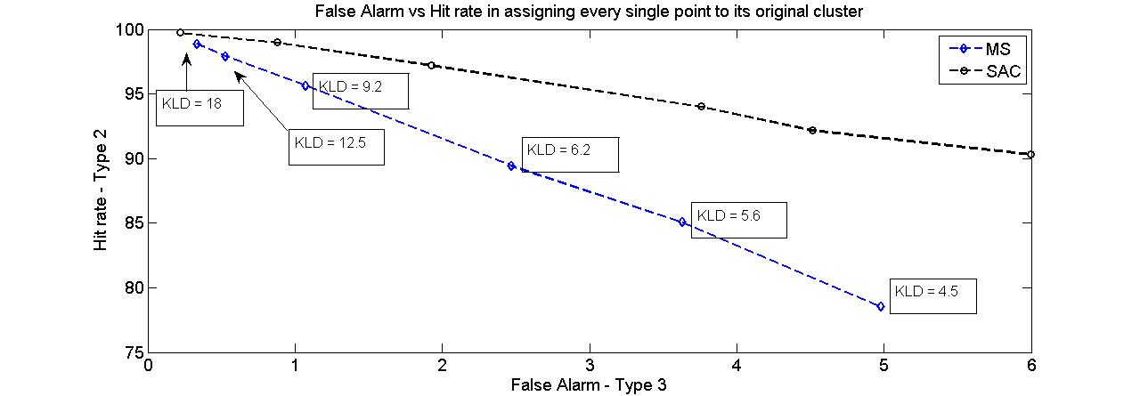
PUE attack detection
DECLOAK algorithm
ROC curve

Slide 39
Thanks

