Slide 1
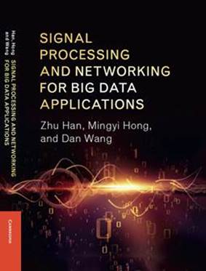
Signal processing and Networking for Big Data Applications Lecture 2: Preliminary Review
Zhu Han
University of Houston
http://www2.egr.uh.edu/~zhan2/big_data_course/

Slide 2
Outline for this year course plan
This visit
Today Computation, Thursday Game Theory and Friday Machine Learning
Preliminary of Convex Optimization
Parallel Computing; Mixed Integer Programming; Sparse Optimization
May 27-31
Course 1: 5G: D2D, Full Duplex, and LTE-U
Course 2: UAV
Course 3: Smart Grid
December around Xmas
Course 1: Other Machine Learning: Multiarm Bandit, Bayesian Nonparametric,
Course 2: Other Big Data and game theory
Course 3: Security and Privacy, Blockchain
Course 4: Other 5G: Femtocell, NOMA, RF energy harvesting
Course 5: Martingale, Stochastic Network calculus, Satellite communication
Course 6: Quickest detection, belief propagation, Hypergraph

Slide 3
outline
Convex optimization (thanks for Dr. Mingyi Hong’s slides)
Convex Optimization
Gradient descent and Newton methods
Duality and KKT conditions
Interior Point Method
Steven Boyd’s book and slides
http://wireless.egr.uh.edu/Optimization/sourse/bv_cvxslides.pdf

Slide 4
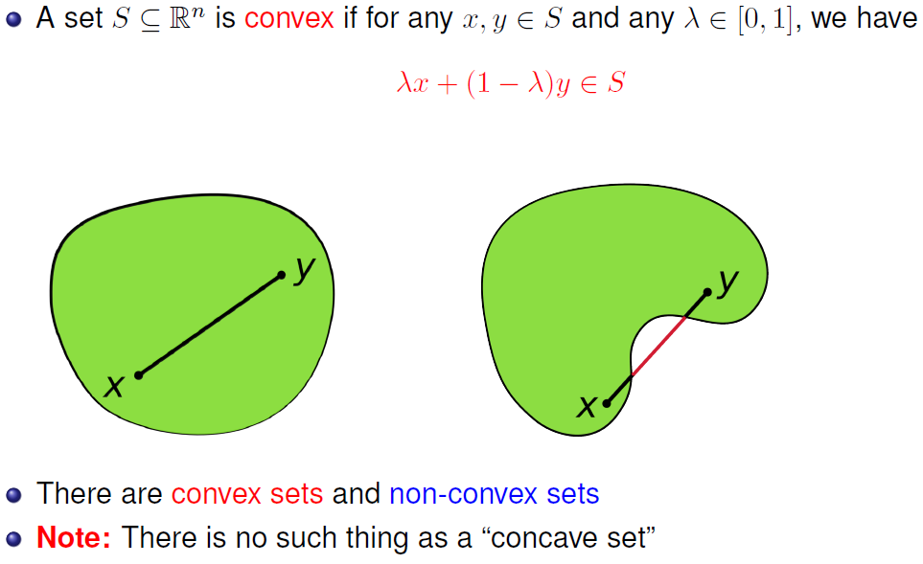
Convex Set

Slide 5
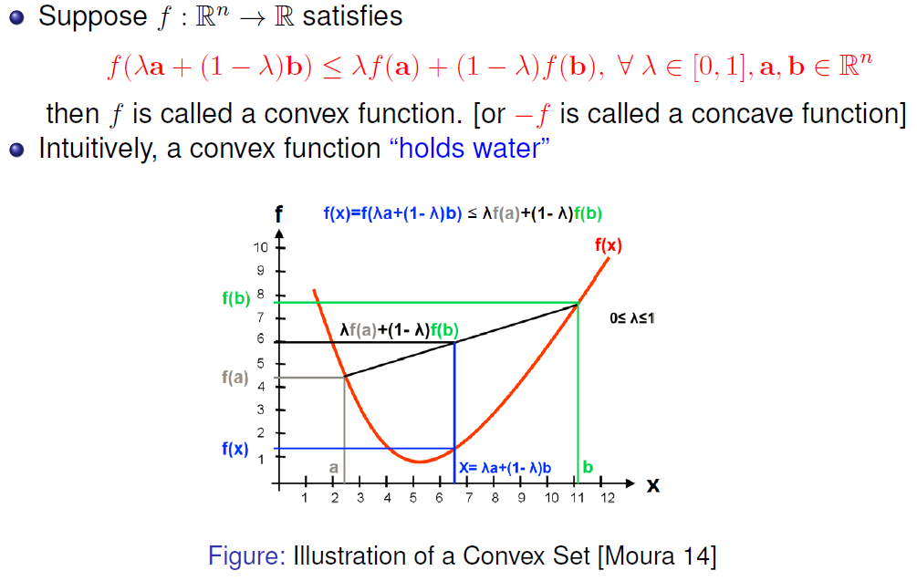
Convex Function

Slide 6
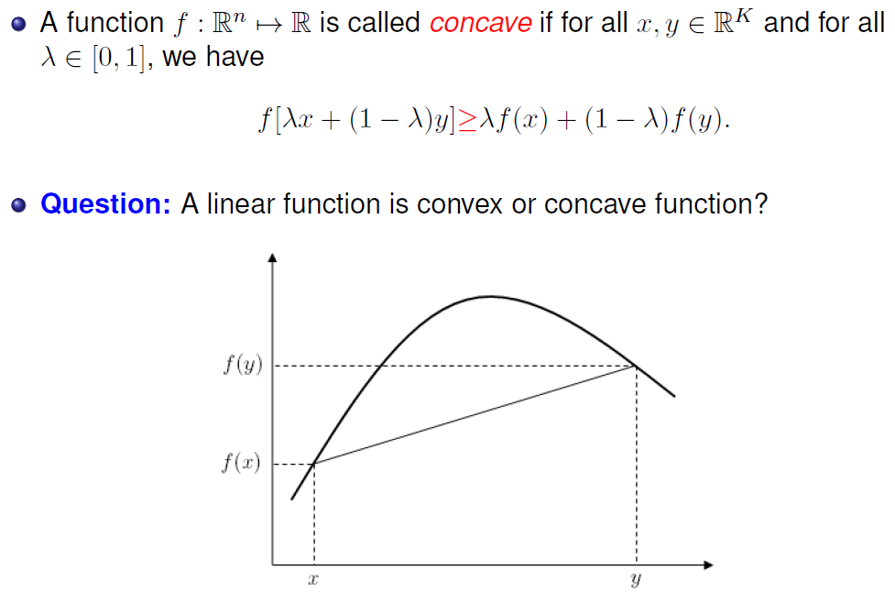
Concave Function

Slide 7
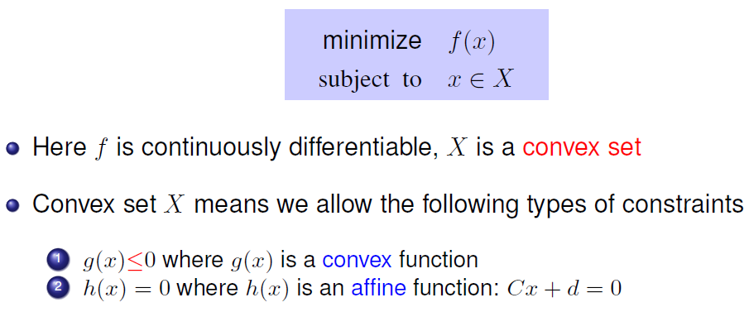
Convex Optimization
Convex means local minimum = global minimum

Slide 8
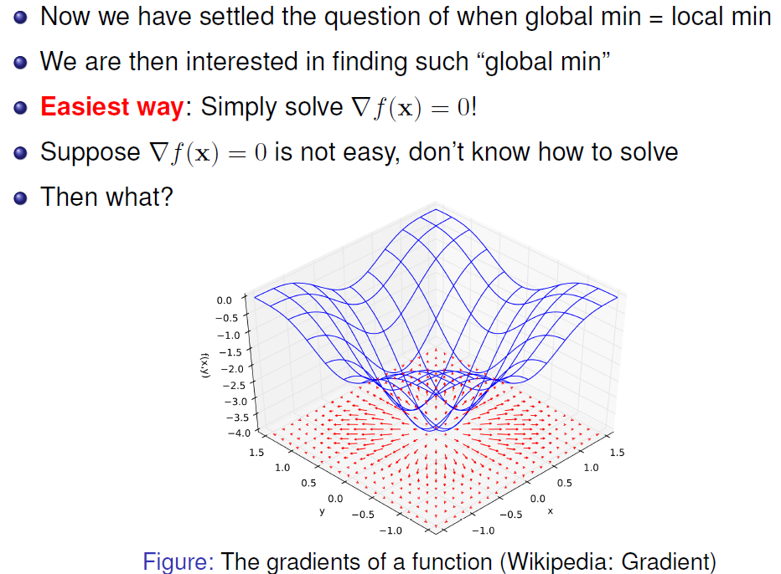
Algorithms to Find Optimum

Slide 9
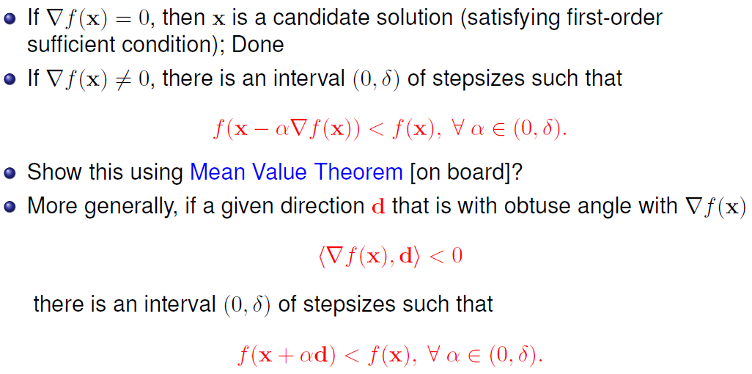
Gradient Descent Method
Notes:
Check what is mean value theorem

Slide 10
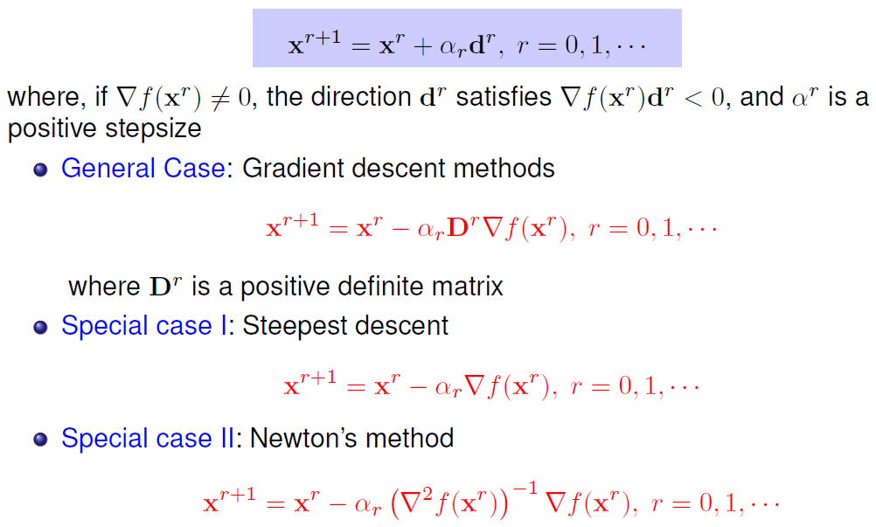
Iterative Descent Method
Step size needs to be adaptive

Slide 11
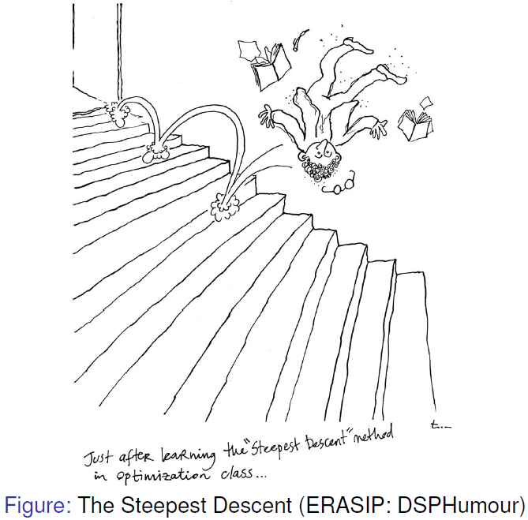
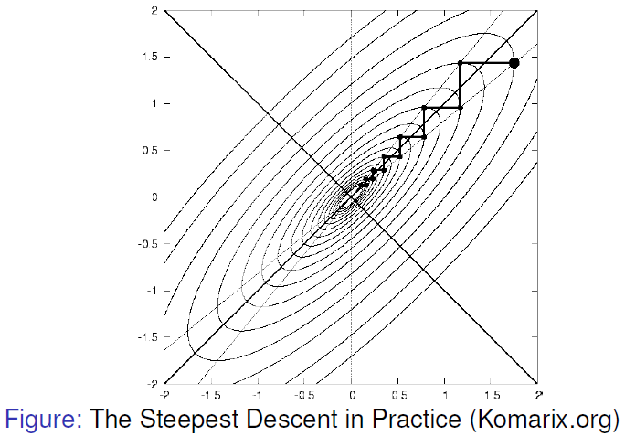
Shortcoming of Gradient Method
However, in practice steepest descent may have slow convergence

Slide 12
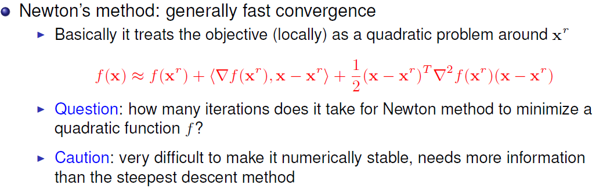
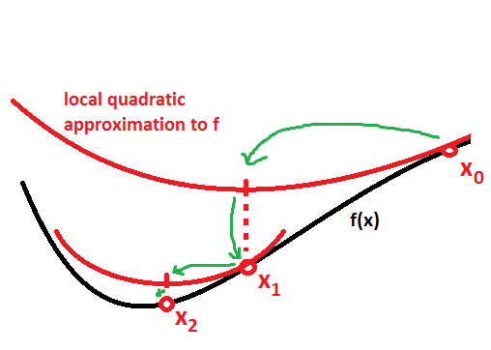
Newton’s Method

Slide 13
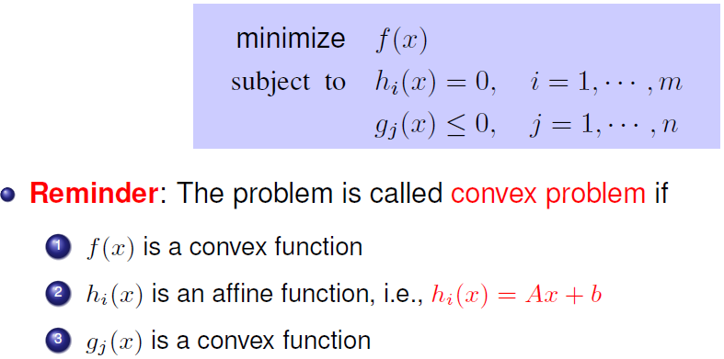
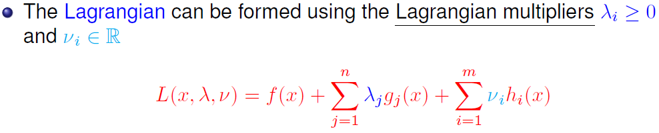
Lagrangian Multiplier

Slide 14
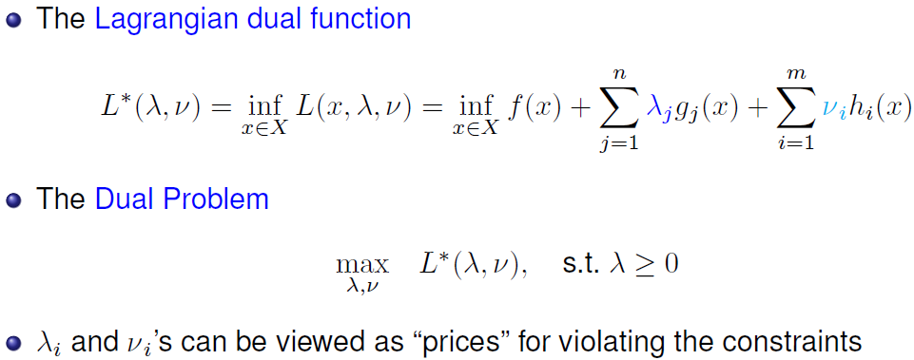
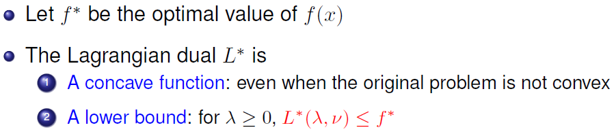
Duality

Slide 15
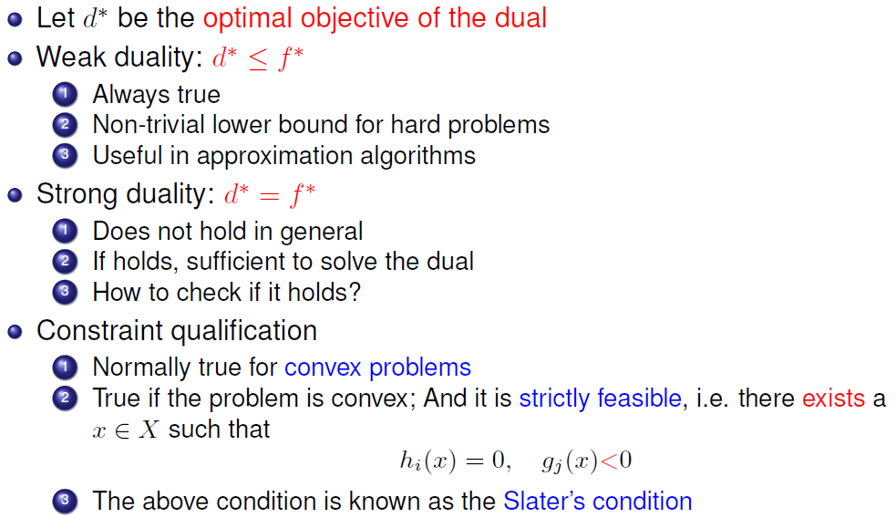
Duality
Notes:
Slater’s condition, what is h and what is g

Slide 16
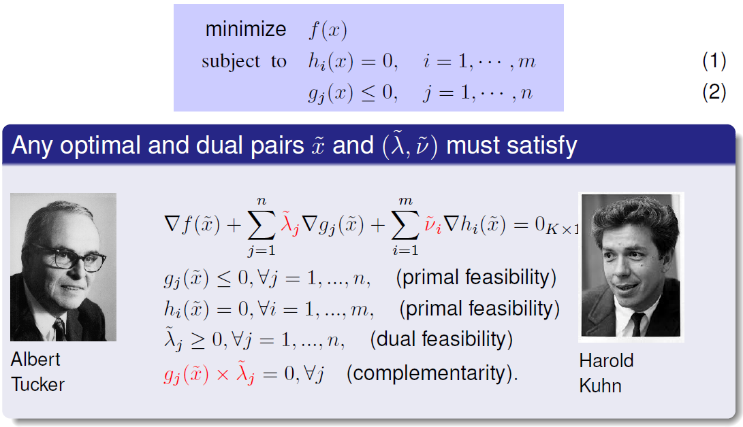
KKT Condition: When to Stop?
Draw a figure on the board
Notes:
Use board to explain

Slide 17
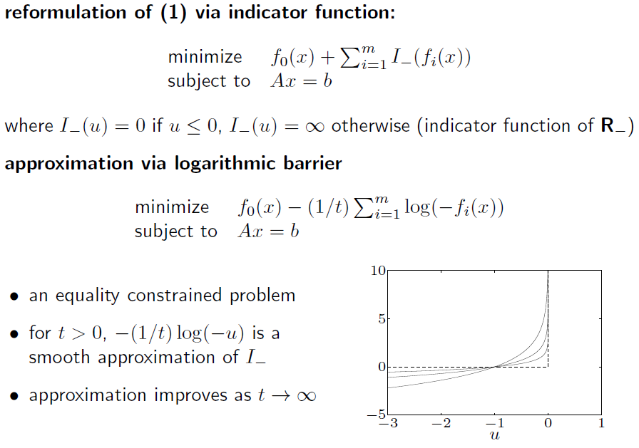
Barrier Function

Slide 18
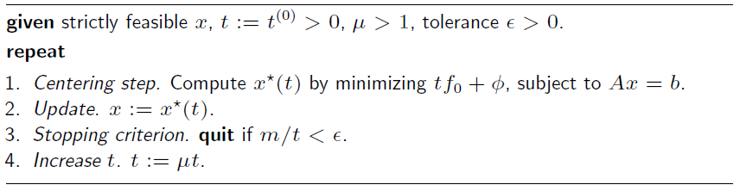
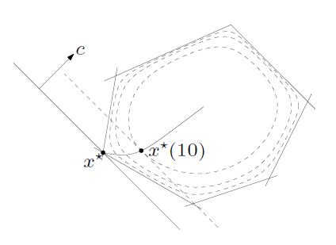
Interior Point Method

