Slide 1
Signal processing and Networking for Big Data Applications Lecture 3: Block Structured Optimization for Big Data Optimization
http://www2.egr.uh.edu/~zhan2/big_data_course/
Zhu Han
University of Houston
Thanks for Dr. Mingyi Hong’s slides

Slide 2
Outline (Chapter 3.3-3.4)
Block Structured Problems
Introduction: Block Structured Problems
The BSUM Framework
Properties of BSUM
Algorithms Covered By BSUM
Applications of BSUM in SP, ML, COM
Extension
Conclusion
M. Hong, M. Razaviyayn, Z.-Q. Luo, and J.-S. Pang, “A unified algorithmic framework for block structured optimization involving big data," IEEE Signal Processing Magazine, vol. 33, no. 1, pp. 57 - 77, 2016.
M. Razaviyayn, M. Hong, and Z.-Q. Luo, “A unified convergence analysis of block successive minimization methods for nonsmooth optimization," SIAM Journal on Optimization, vol. 23, no. 2, pp. 1126 - 1153, 2013.

Slide 3
Large-Scale Optimization
Generally, optimization algorithms for solving problems of such huge sizes should satisfy
Simple Subproblem: Each of their computational steps must be simple and easy
Parallel Implementable: Algorithm is implementable in distributed and/or parallel manner (e.g., in HPC clusters)
Fast Convergence: A high-quality solution can be found using a small number of iterations
Key: Explore intrinsic decomposability of the problem

Slide 4
BCD Algorithm
A popular family of optimization algorithms: block coordinate descent (BCD) method (a.k.a. the alternating minimization)
The basic steps:
Partition the entire optimization variables into small blocks
Optimize one block variable (or few blocks of variables) at each iteration, while holding the remaining variables fixed.
Example of writing a paper

Slide 5
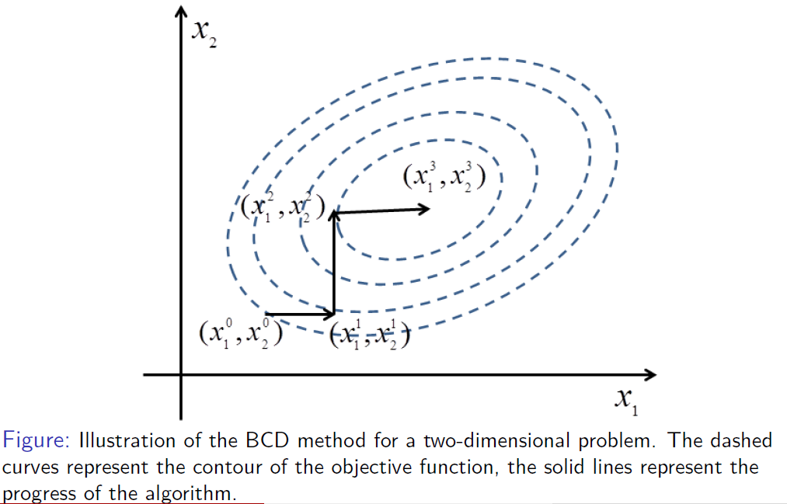
Graphically

Slide 6
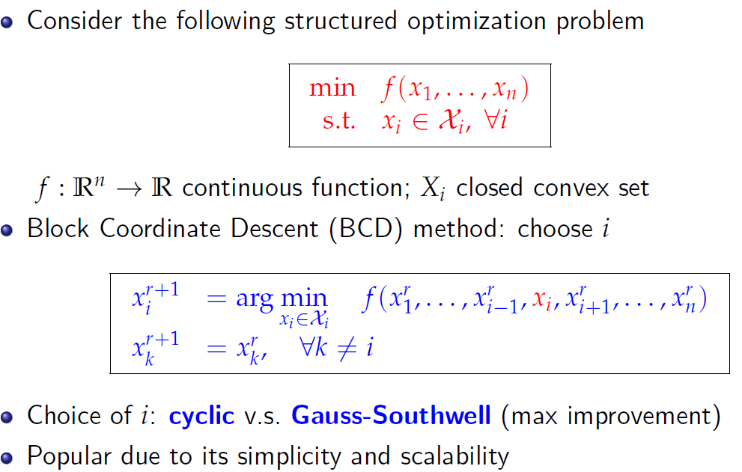
Introduction

Slide 7
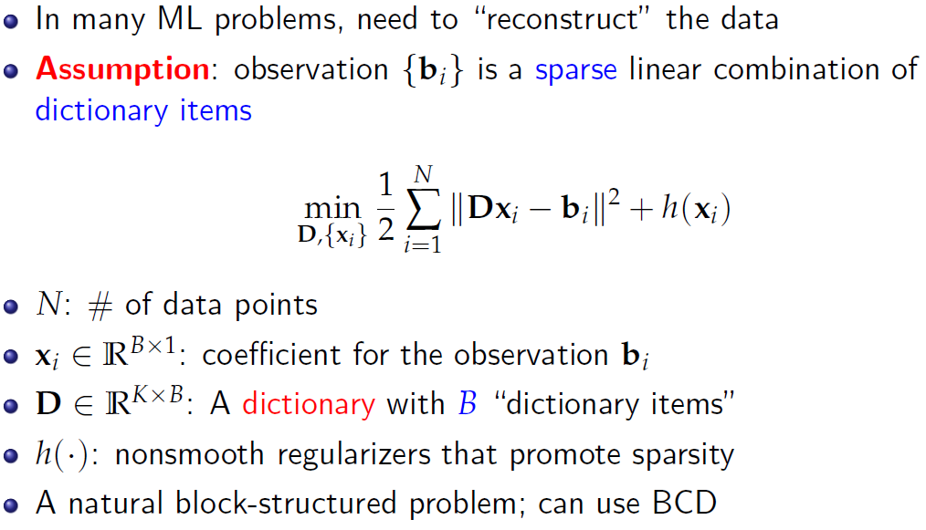
Example: Dictionary Learning for Sparse Representation

Slide 8
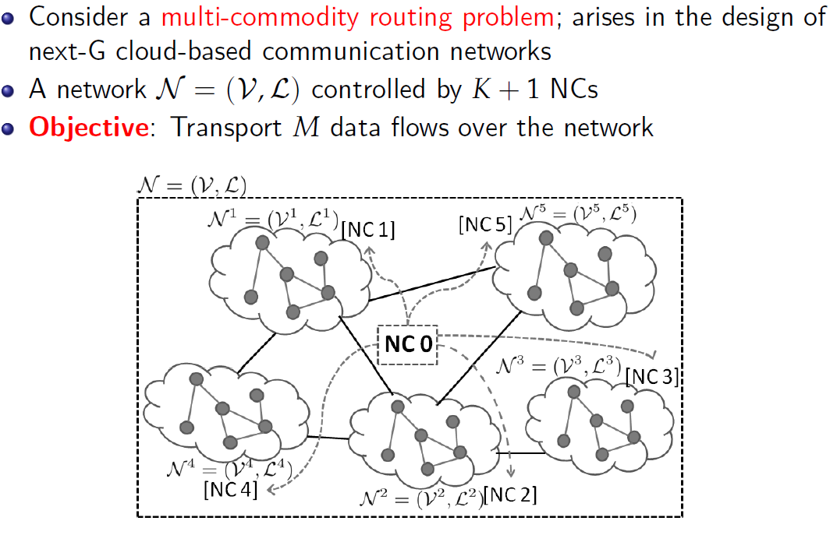
Example: Multi-Commodity Routing Problem
Microgrid?

Slide 9
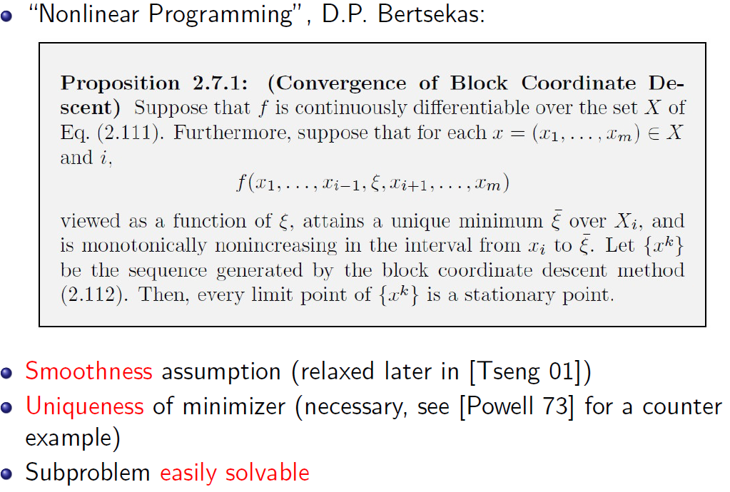
Convergence of BCD
Notes:
Need to study this slide more

Slide 10
Limit of BCD
BCD becomes quite limited for solving large-scale problems
What if the optimizer is not unique (the tensor decomposition problem)?
What if the sub-problem is not easy e.g. non-convex, or convex but not closed form, or is very expensive to obtain an exact global min (the precoder design problem)?
Coupling constraints (the multi-commodity TE problem)?
How to enable parallelization?
Any theoretical guarantees?
Possible cycling solutions between blocks

Slide 11
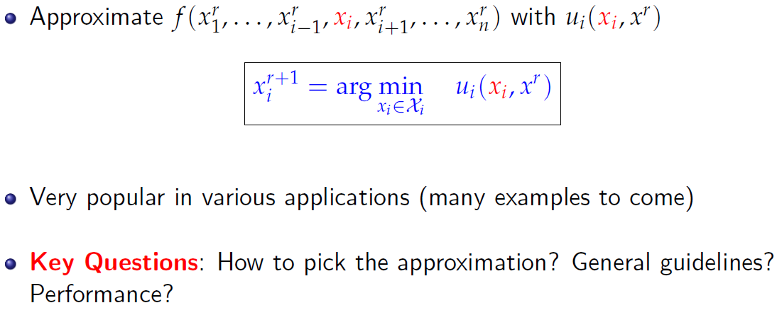
Practical solution

Slide 12
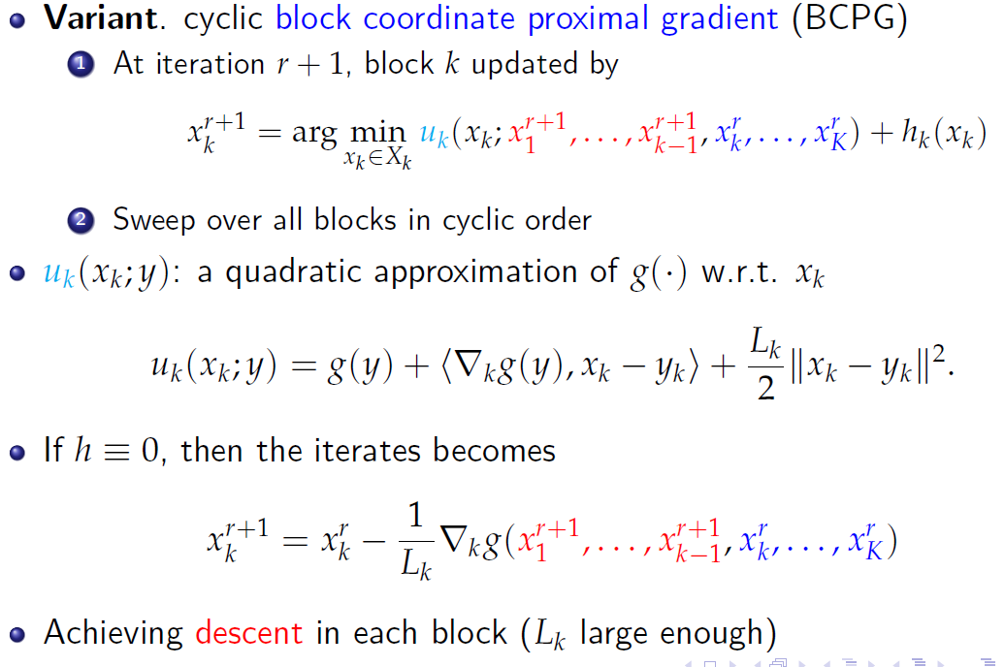
block coordinate proximal gradient

Slide 13
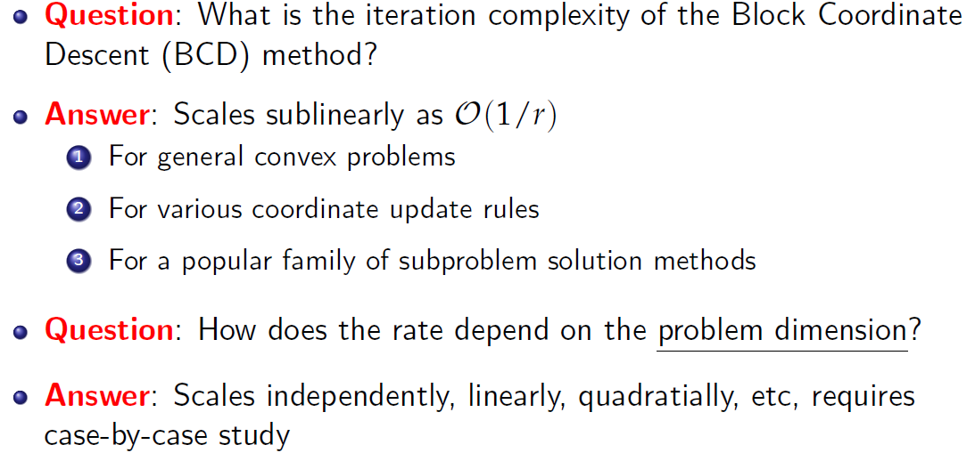
Iteration Complexity of BCD

Slide 14
outline
Block Structured Problems
Introduction: Block Structured Problems
The BSUM Framework
Properties of BSUM
Algorithms Covered By BSUM
Applications of BSUM in SP, ML, COM
Extension
Conclusion
M. Hong, M. Razaviyayn, Z.-Q. Luo, and J.-S. Pang, “A unified algorithmic framework for block structured optimization involving big data," IEEE Signal Processing Magazine, vol. 33, no. 1, pp. 57 - 77, 2016.
M. Razaviyayn, M. Hong, and Z.-Q. Luo, “A unified convergence analysis of block successive minimization methods for nonsmooth optimization," SIAM Journal on Optimization, vol. 23, no. 2, pp. 1126 - 1153, 2013.

Slide 15
BSUM Method
Introduce a unifying framework - the Block Successive Upper Bound Minimization (BSUM) [Razaviyayn-H.-Luo 13]
Generalizes all BCD type algorithms
Main Idea: Successively optimize certain upper-bounds of the original objective, in a block-by-block manner
Significantly expands the application domain of BCD
Covers many classical algorithms
Expectation Maximization (EM) [Dempster et al 77]
Concave-Convex Procedure (CCCP) [Yuille 03]
Multiplicative Nonnegative Matrix Factorization (NMF) [Lee and Seung 99]

Slide 16
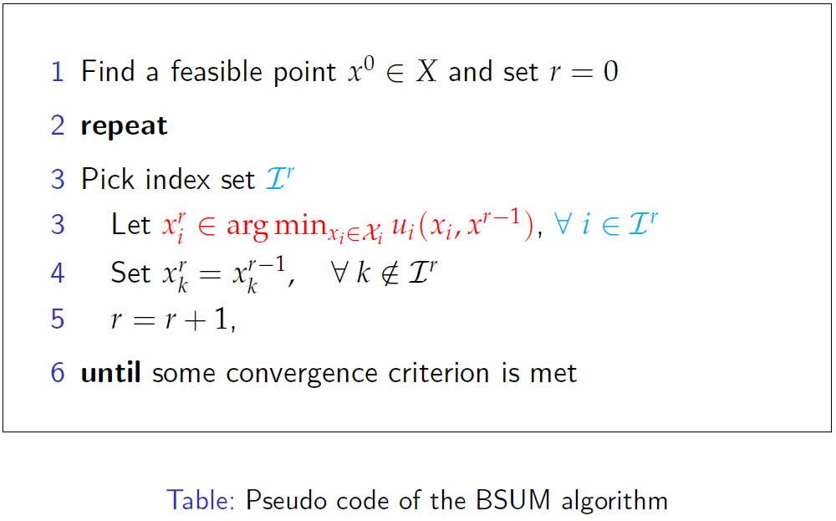
BSUM Algorithm

Slide 17
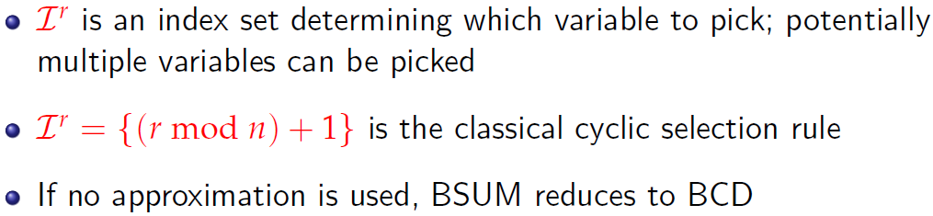
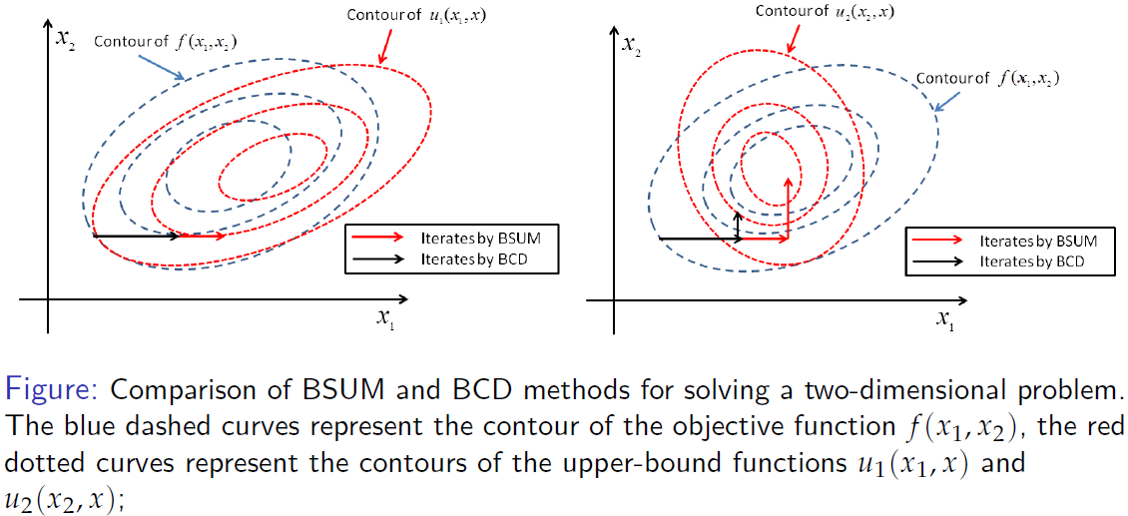
BSUM Algorithm

Slide 18
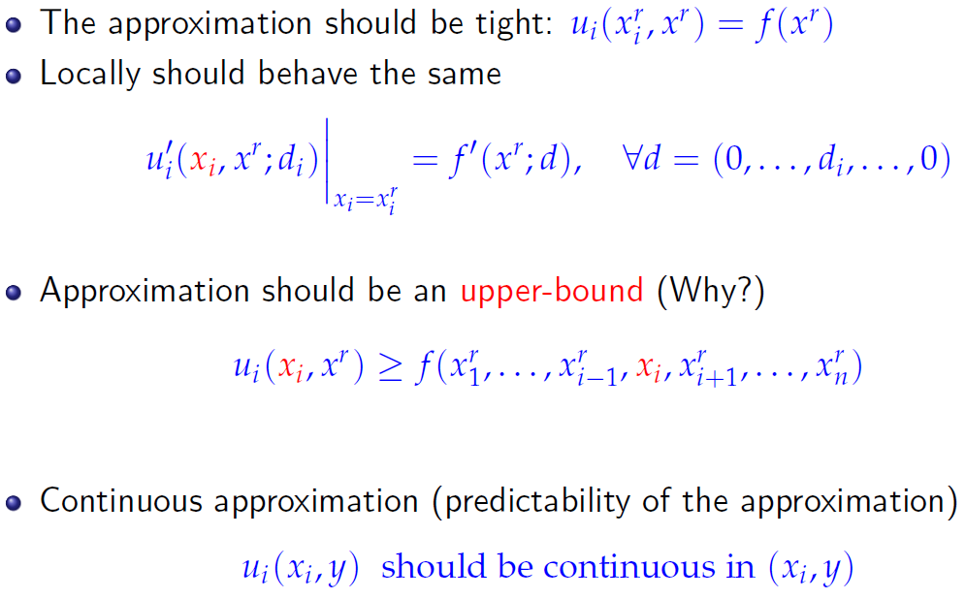
What is an “appropriate" approximation?

Slide 19
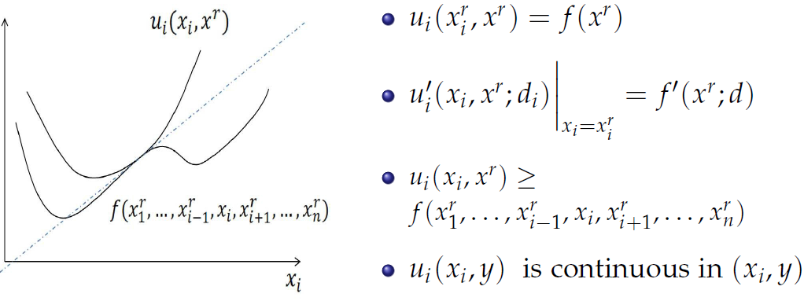
Assumption A for BSUM

Slide 20
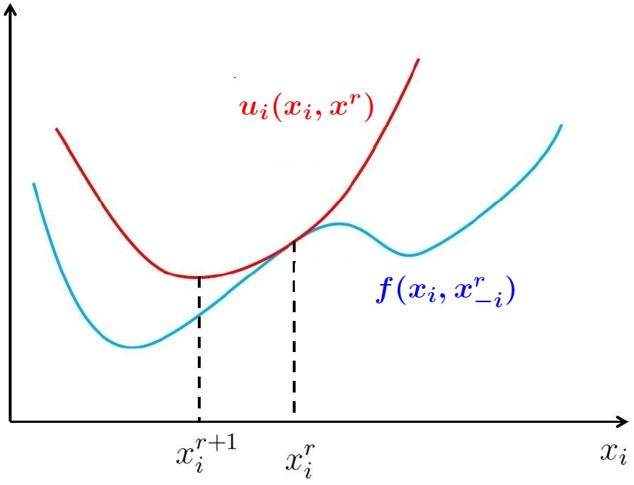
Idea of BSUM

Slide 21
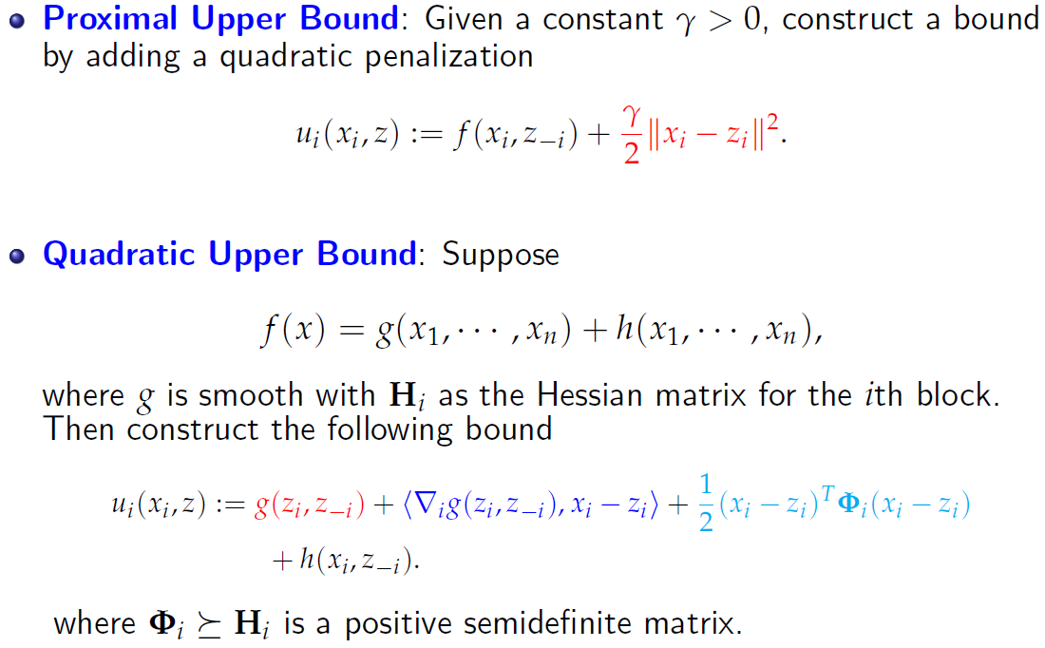
Popular Upper-Bounds

Slide 22
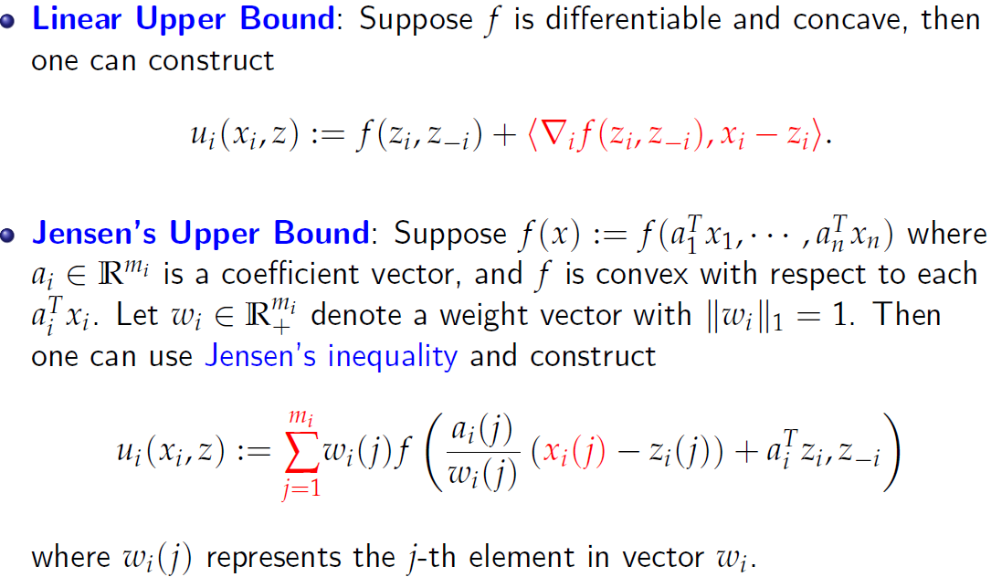
Popular Upper-Bounds (Cont.)

Slide 23
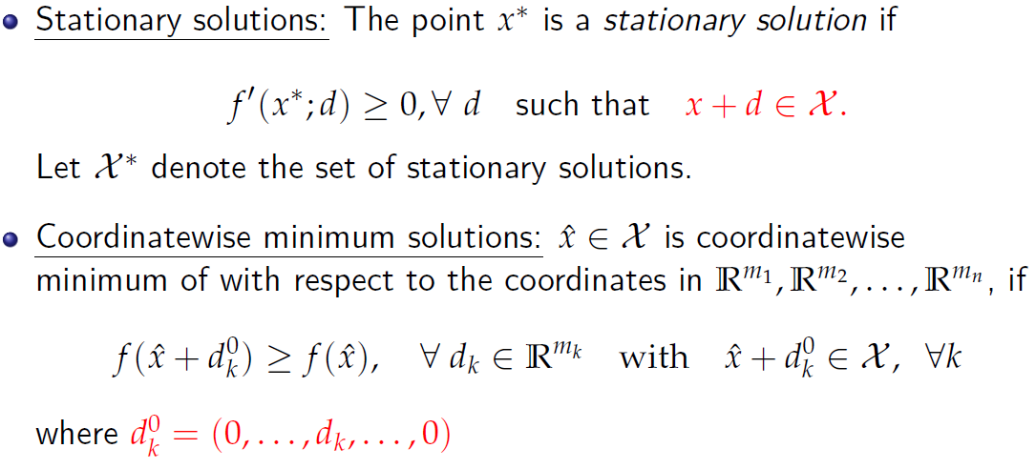
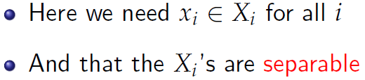
Optimality Condition

Slide 24
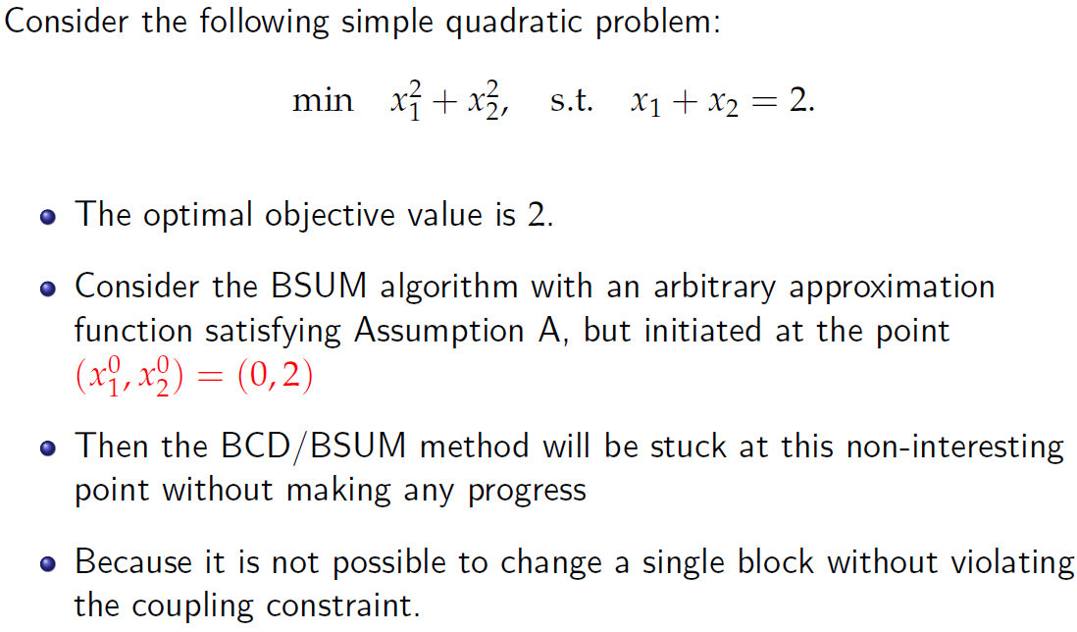
Separable Constraints

Slide 25
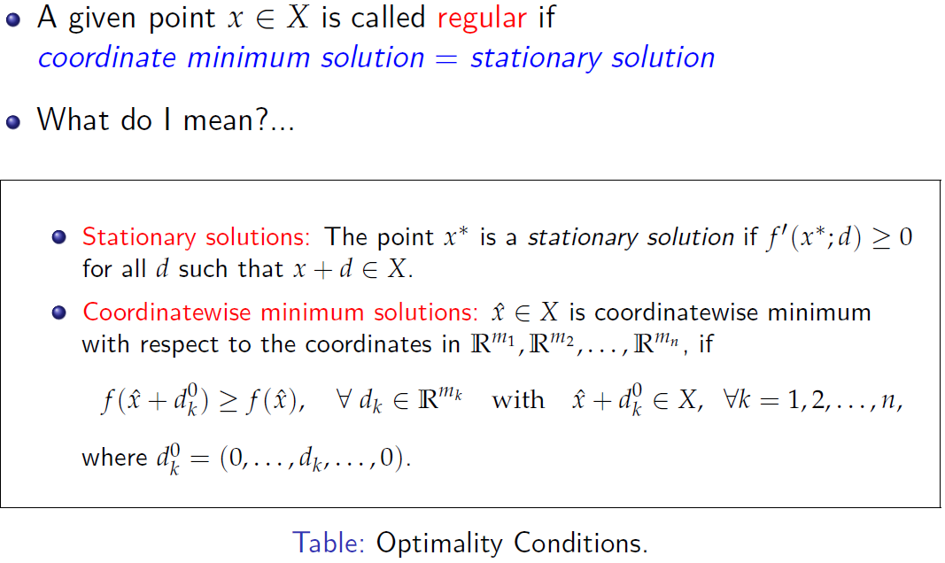
Regularity

Slide 26
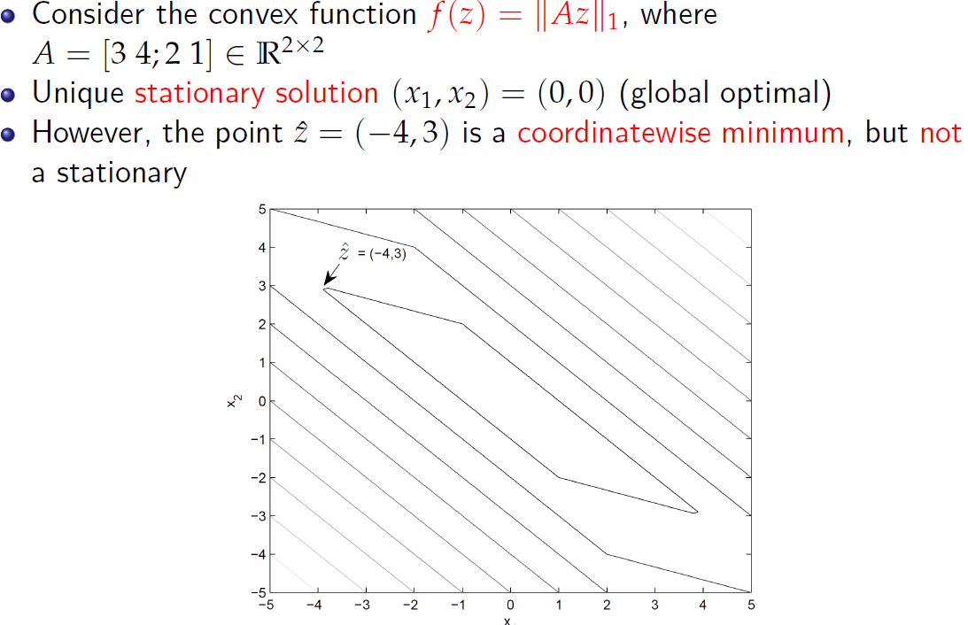
Illustration: The Regularity Condition

Slide 27
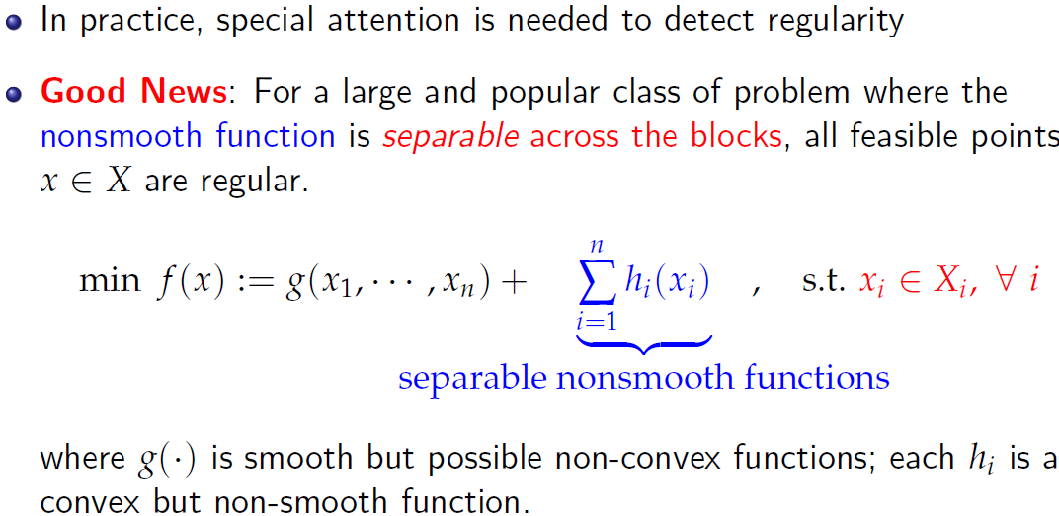
Regularity Condition

Slide 28
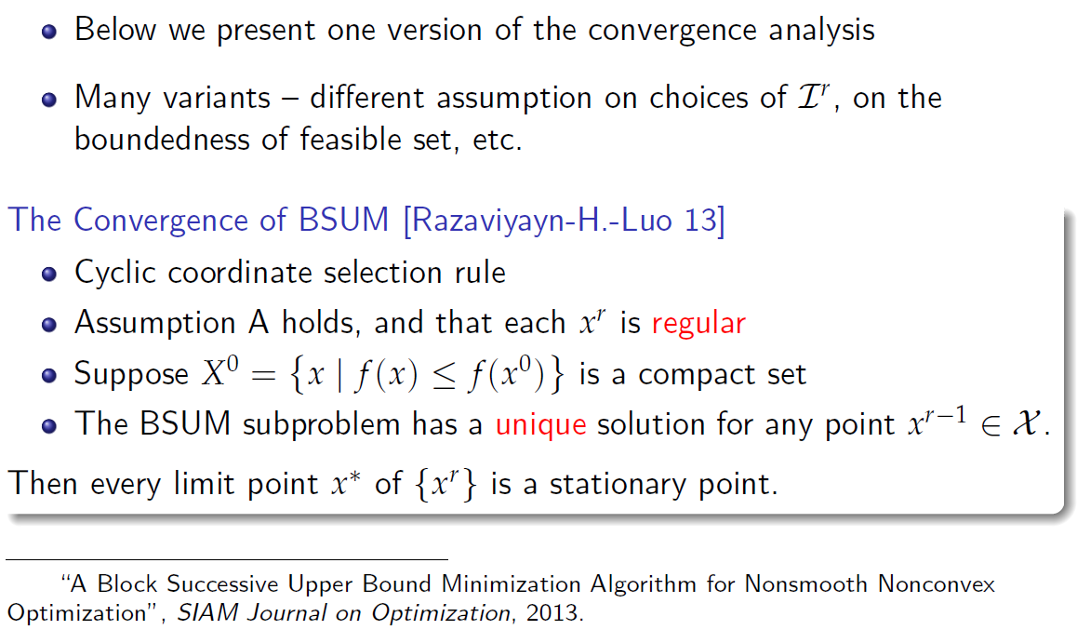
Main convergence analysis

Slide 29
Main convergence analysis
Works for a large family of approximation functions
Uniqueness of subproblems easy to achieve - choose an appropriate upper bound
Regularity has to be verified beforehand
Convergence to stationary point - almost the best one can hope for considering the nonconvexity involved
Result can be significantly improved for convex problems

Slide 30
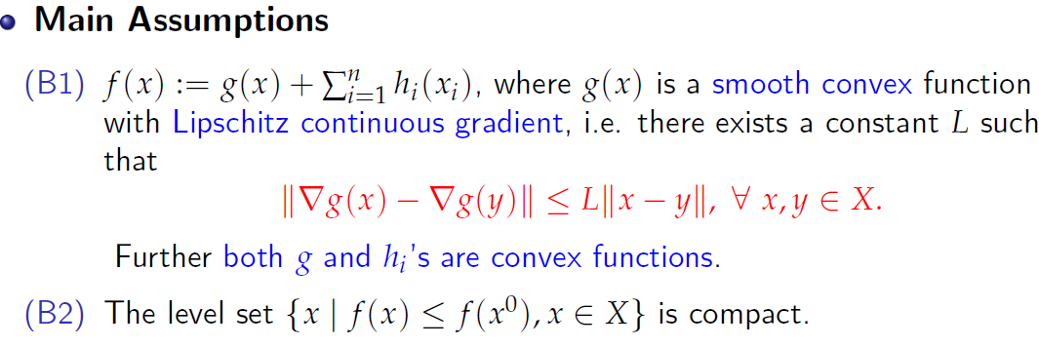
How Fast Does BSUM Converge?
Important issue, especially for big data problems
Extensive work on analyzing special cases of BSUM [Nesterov 12] [Richtarik et al 14] [Lu and Xiao 13] [Beck and Tetruashvili 13]
Convergence Rate Analysis (Convex Case)

Slide 31
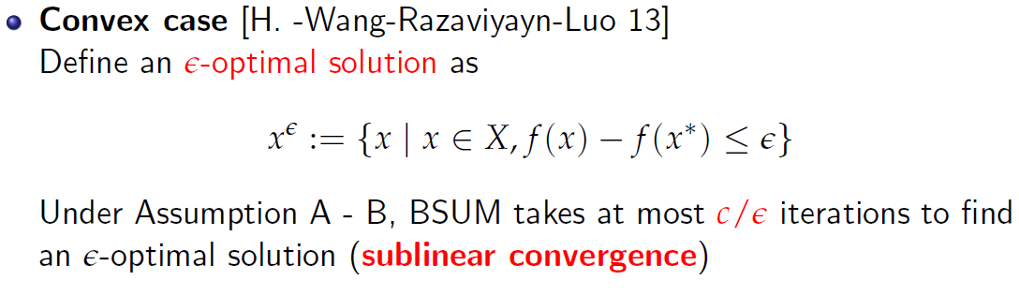
Convergence Rate Analysis: Main Result
“Iteration Complexity Analysis for Block Coordinate Descent Type Methods", Math Programming, minor revision, 2015.

Slide 32
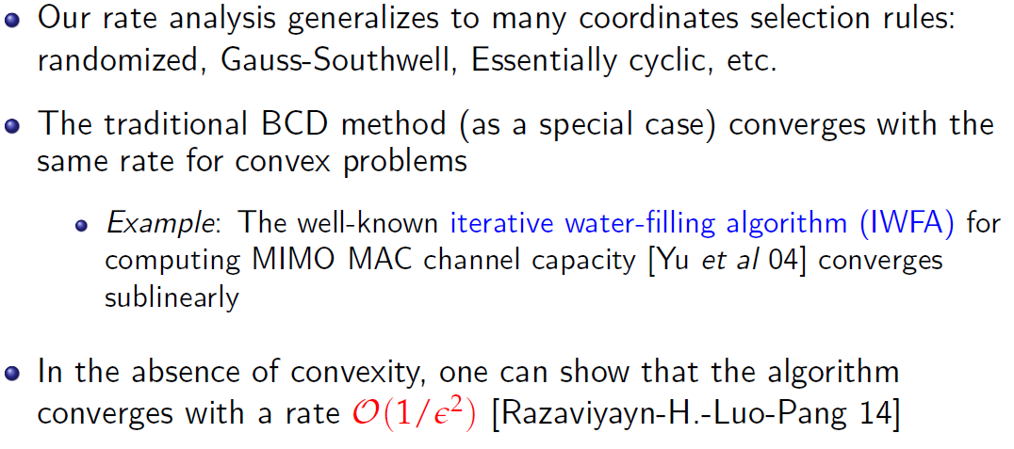
Implications and Generalizations
“Parallel successive convex approximation for nonsmooth nonconvex optimization", NIPS, 2014.

Slide 33
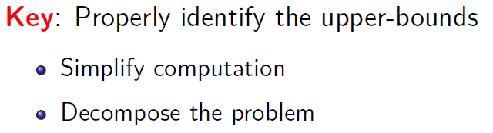
outline
Block Structured Problems
Introduction: Block Structured Problems
The BSUM Framework
Properties of BSUM
Algorithms Covered By BSUM
Applications of BSUM in SP, ML, COM
Extension
Conclusion
M. Hong, M. Razaviyayn, Z.-Q. Luo, and J.-S. Pang, “A unified algorithmic framework for block structured optimization involving big data," IEEE Signal Processing Magazine, vol. 33, no. 1, pp. 57 - 77, 2016.
M. Razaviyayn, M. Hong, and Z.-Q. Luo, “A unified convergence analysis of block successive minimization methods for nonsmooth optimization," SIAM Journal on Optimization, vol. 23, no. 2, pp. 1126 - 1153, 2013.

Slide 34
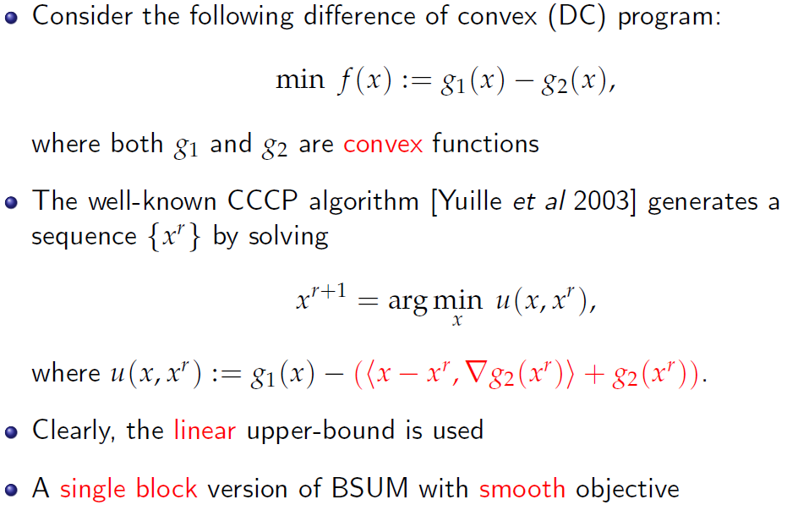
Algorithm 1: Concave Convex Procedure (CCCP)
Notes:
What is CCCP? This slide needs to ask

Slide 35
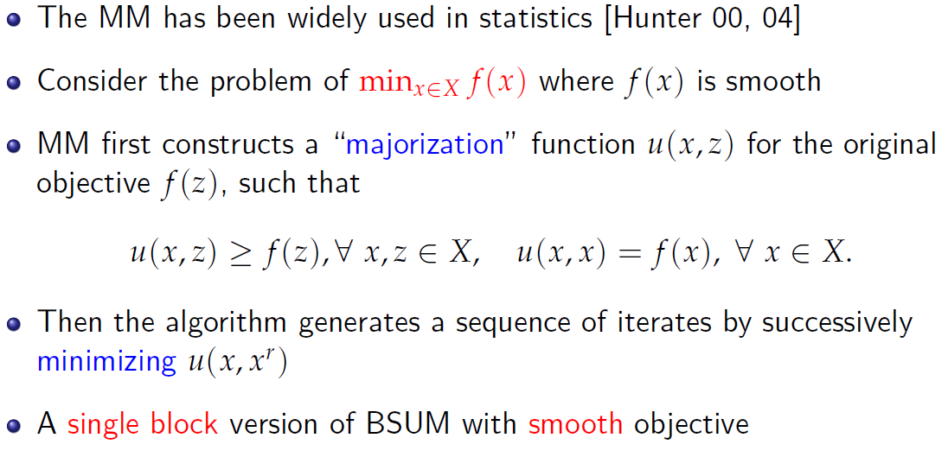
Algorithm 2: Majorization-Minimizatoin (MM) Algorithm

Slide 36
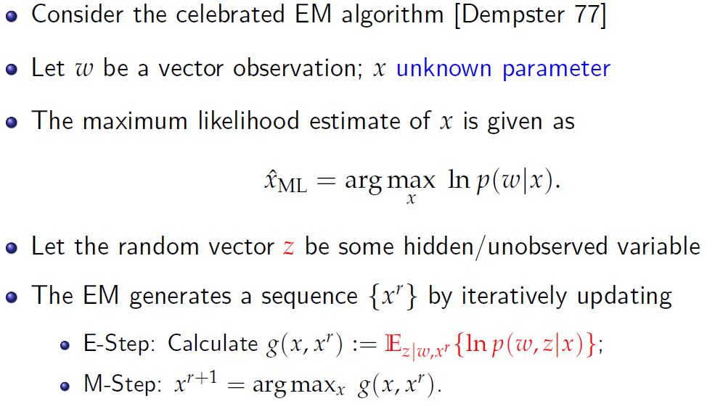
Special Case: the EM algorithm
Notes:
Check em algorithm for z again

Slide 37
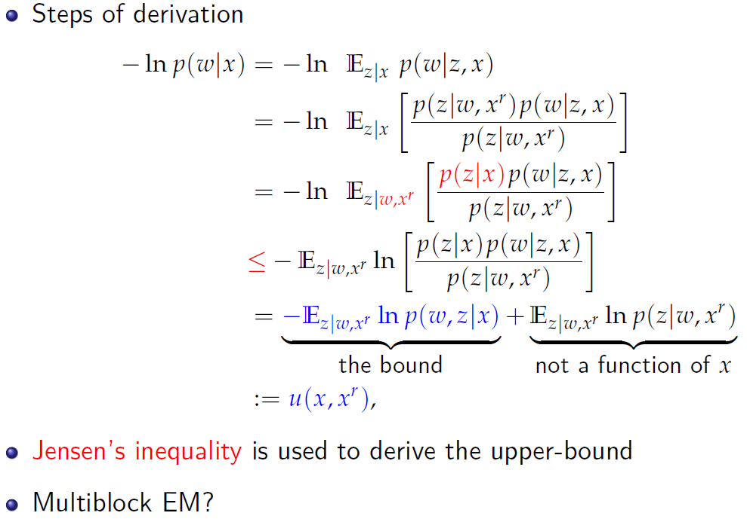
Special Case: the EM algorithm
Notes:
Need to ask Mingyi again

Slide 38
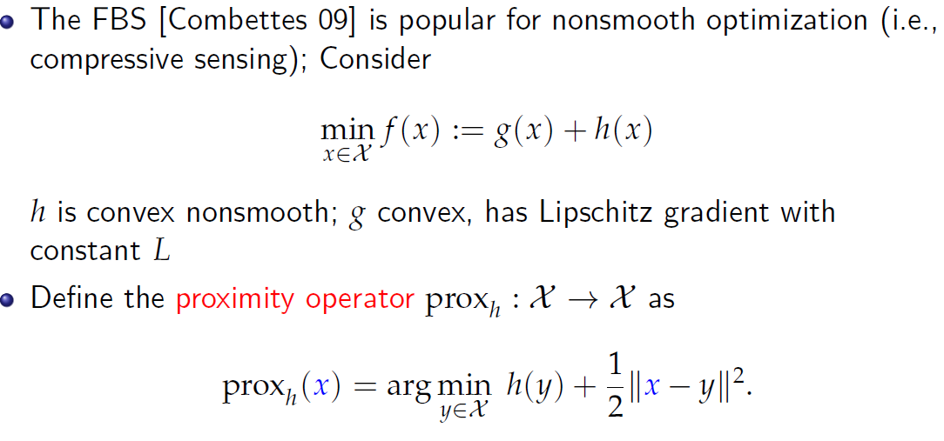
Algorithm 3: The Forward-Backward Splitting (FBS)

Slide 39
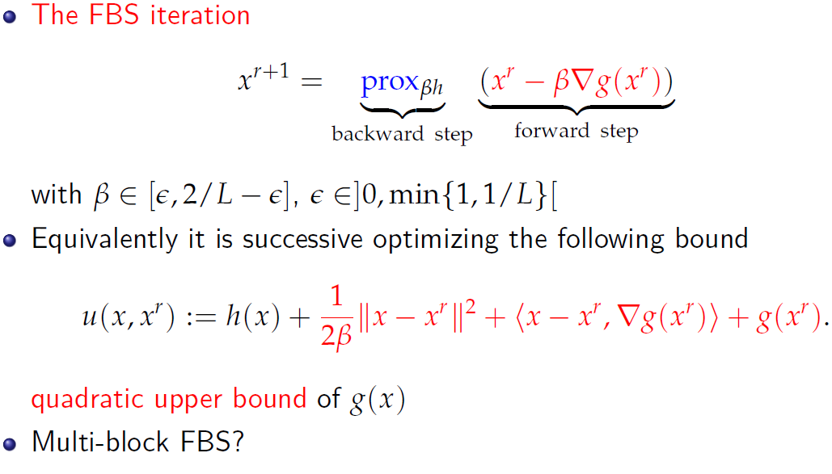
Algorithm 3: The Forward-Backward Splitting (FBS)
Notes:
I do not understand the backward and forward step.

Slide 40
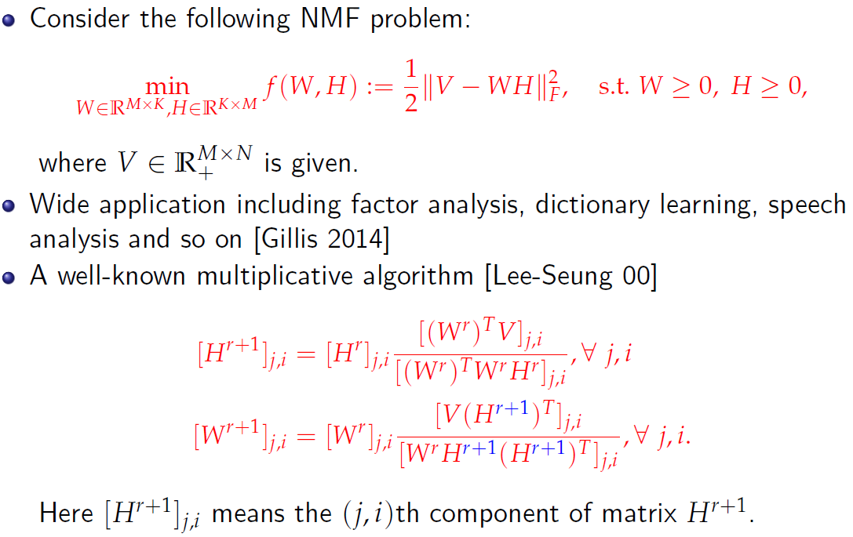
Algorithm 4: Multiplicative NMF (M-NMF)

Slide 41
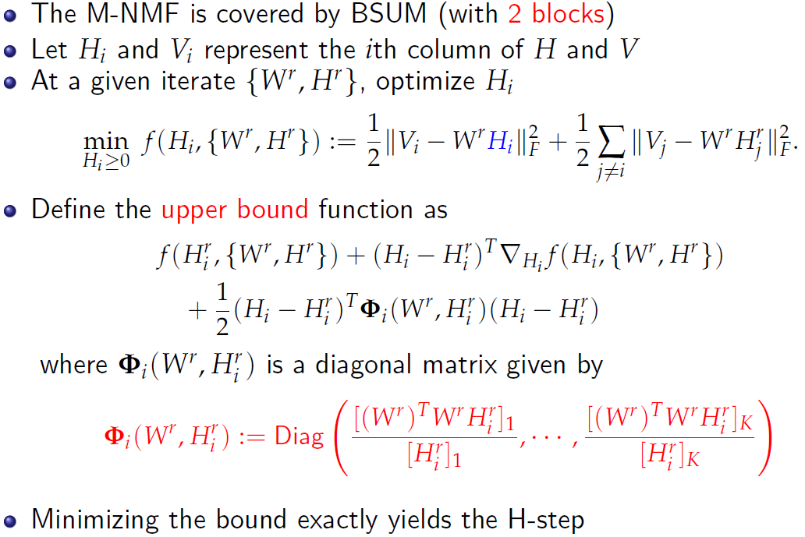
Algorithm 4: Multiplicative Non-negative Matrix Factorization (M-NMF)

Slide 42
outline
Block Structured Problems
Introduction: Block Structured Problems
The BSUM Framework
Properties of BSUM
Algorithms Covered By BSUM
Applications of BSUM in SP, ML, COM
Extension
Conclusion
M. Hong, M. Razaviyayn, Z.-Q. Luo, and J.-S. Pang, “A unified algorithmic framework for block structured optimization involving big data," IEEE Signal Processing Magazine, vol. 33, no. 1, pp. 57 - 77, 2016.
M. Razaviyayn, M. Hong, and Z.-Q. Luo, “A unified convergence analysis of block successive minimization methods for nonsmooth optimization," SIAM Journal on Optimization, vol. 23, no. 2, pp. 1126 - 1153, 2013.

Slide 43
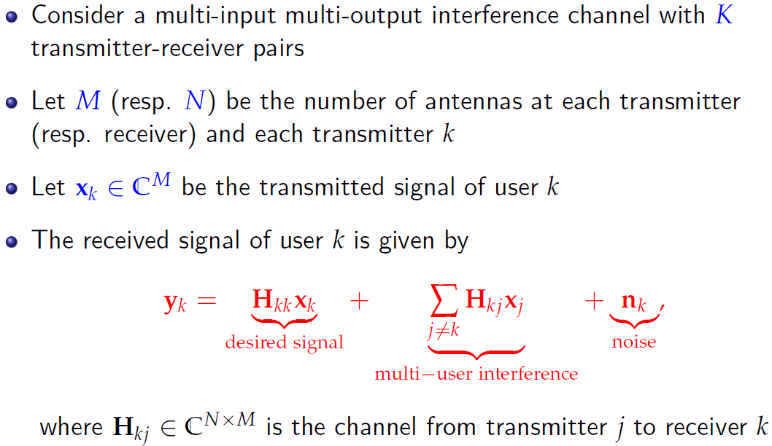
Application in Transceiver Design

Slide 44
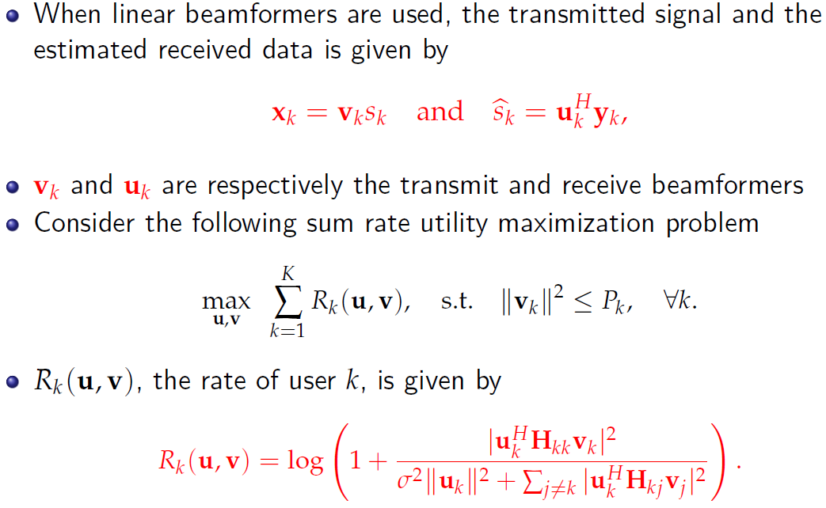
Application in Transceiver Design

Slide 45
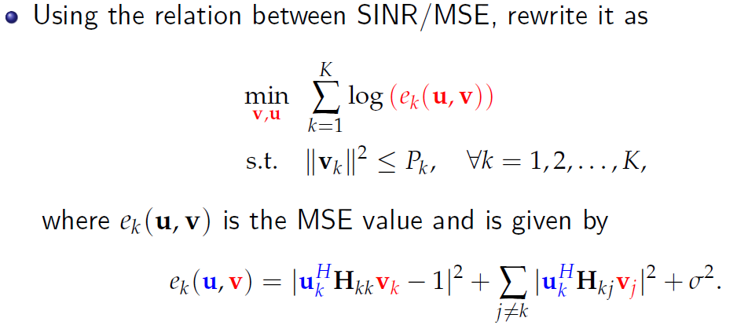
Application in Transceiver Design

Slide 46
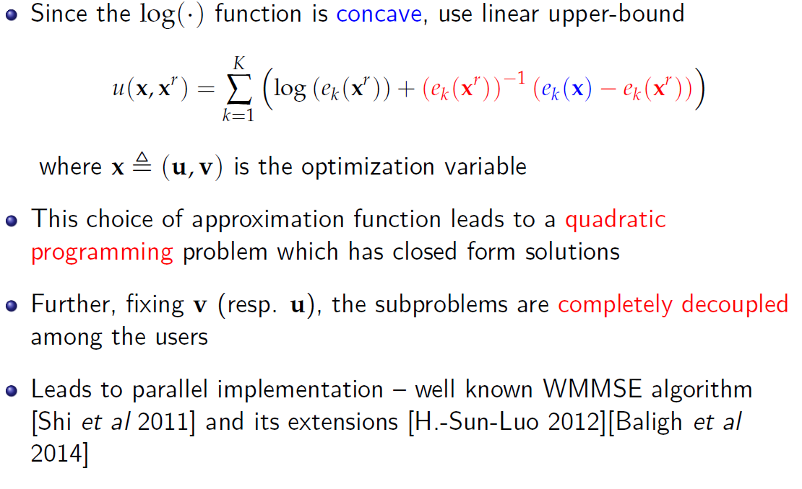
Application in Transceiver Design

Slide 47
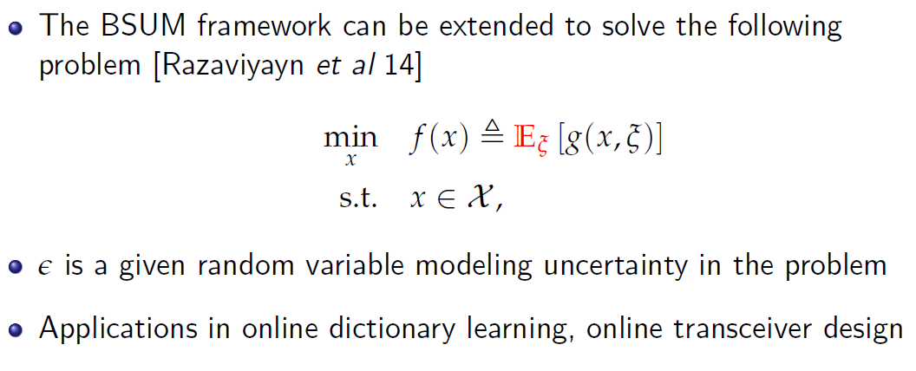
Stochastic Optimization
Notes:
Third line type for episolon

Slide 48
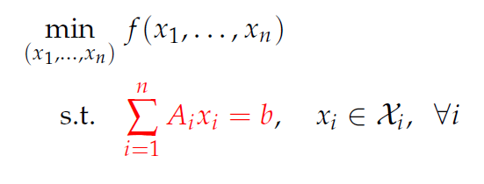
Linearly Coupling Constraints
Convex case: Alternating Direction Method of Multipliers
Nonconvex case: primal- dual method

Slide 49
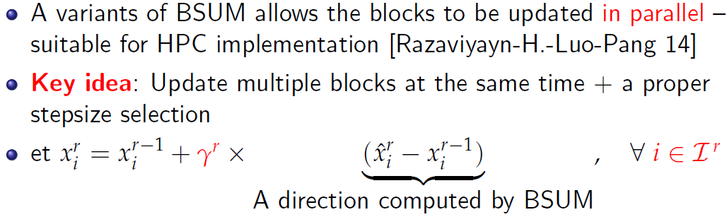
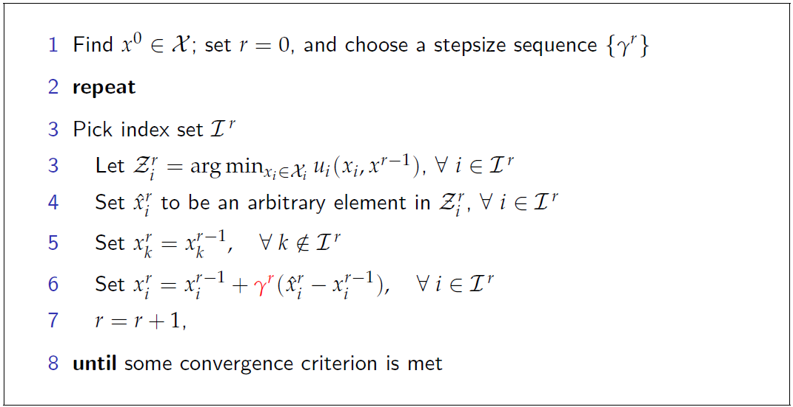
Parallelization

Slide 50
Conclusion
We have introduced a framework for optimizing block-structured optimization problems
Generic convergence/rate of convergence analysis
Covers lots of known algorithms as special cases (with possible generalizations)
Many applications in SP, ML, COM
Active research areas, many open problems

Slide 51
Reference
[Richtarik-Takac 12] P. Richtarik and M. Takac, “Iteration complexity of randomized block-coordinate descent methods for minimizing a composite function," Mathematical Programming, 2012.
[Nestrov 12] Y. Nestrov, “Eciency of coordinate descent methods on huge-scale optimization problems," SIAM Journal on Optimization, 2012.
[Shalev-Shwartz-Tewari] S. Shalev-Shwartz and A. Tewari, “Stochastic methods for L1 regularized loss minimization," Journal of Machine Learning Research, 2011.
[Beck-Tetruashvili 13] A. Beck and L. Tetruashvili “On the convergence of block coordinate descent type methods," SIAM Journal on Optimization, 2013.
[Lu-Lin 13] Z. Lu and X. Lin, “On the complexity analysis of randomized block-coordinate descent methods", Preprint, 2013
[Saha-Tewari 13] A. Saha and A. Tewari, “On the nonaymptotic convergence of cyclic coordinate descent method," SIAM Journal on Optimization, 2013.
[Luo-Tseng 92] Z.-Q. Luo and P. Tseng, “On the convergence of the coordinate descent method for convex dierentiable minimization," Journal of Optimization Theory and Application, 1992.
[Hong et al 14] M. Hong, T.-H. Chang, X. Wang, M. Razaviyayn, S. Ma and Z.-Q. Luo, “A Block Successive Minimization Method of Multipliers", Preprint, 2014
[Hong-Luo 12] M. Hong and Z.-Q. Luo, “On the convergence of ADMM", Preprint, 2012
[Hong-SUN 15] M. Hong and R. Sun, “Improved Iteration Complexity Bounds of Cyclic Block Coordinate Descent for Convex Problems", Preprint, 2015
[Necoara-Clipici 13] I. Necoara and D. Clipici, “Distributed Coordinate Descent Methods for Composite Minimization", Preprint, 2013.
[Kadkhodaei et al 14] M. Kadkhodaei, M. Sanjabi and Z.-Q. Luo “On the Linear Convergence of the Approximate Proximal Splitting Method for Non-Smooth Convex Optimization", preprint 2014.
[Razaviyayn-Hong-Luo 13] M. Razaviyayn, M. Hong, and Z.-Q. Luo, “A unied convergence analysis of block successive minimization methods for nonsmooth optimization," 2013.
[Marial 13] J. Marial, “Optimization with First-Order Surrogate Functions", Journal of Machine Learning Research, 2013.
[Sun 14] R. Sun, “Improved Iteration Complexity Analysis for Cyclic Block Coordinate Descent Method", Technical Note, 2014.

