Slide 1
Signal processing and Networking for Big Data Applications Lecture 4: Alternating Direction Method of Multipliers (ADMM)
http://www2.egr.uh.edu/~zhan2/big_data_course/
Zhu Han
University of Houston
Thanks for Dr. Mingyi Hong’s slides

Slide 2
Outline (Chapter 3.5-3.6)
Review and Overview
Algorithm
Applications
Non-convex ADMM
Multiblock ADMM
“Distributed Optimization and Statistical Learning via the Alternating Direction Method of Multipliers”, S. Boyd, N. Parikh, E. Chu, B. Peleato, J Eckstein, Foundation and Trends in Machine Learning, 2011
M. Hong, Z.-Q. Luo, and M. Razaviyayn, “Convergence analysis of alternating direction method of multipliers for a family of nonconvex problems," SIAM Journal On Optimization, vol. 26, no. 1, pp. 337-364, 2016
Lanchao Liu and Zhu Han, “Multi-Block ADMM for Big Data Optimization in Smart Grid,” ICNC 2015

Slide 3
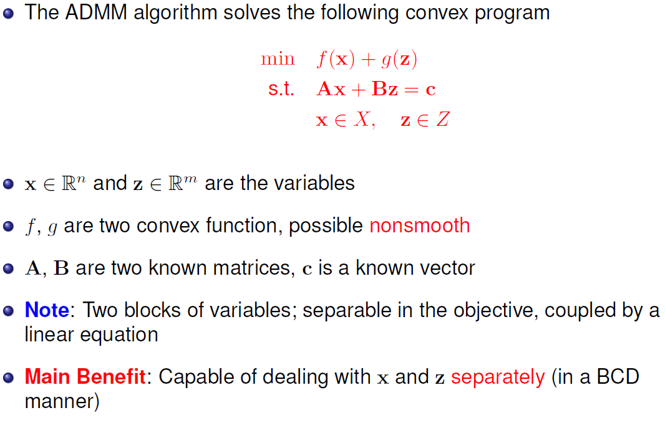
The Problem to be Solved

Slide 4
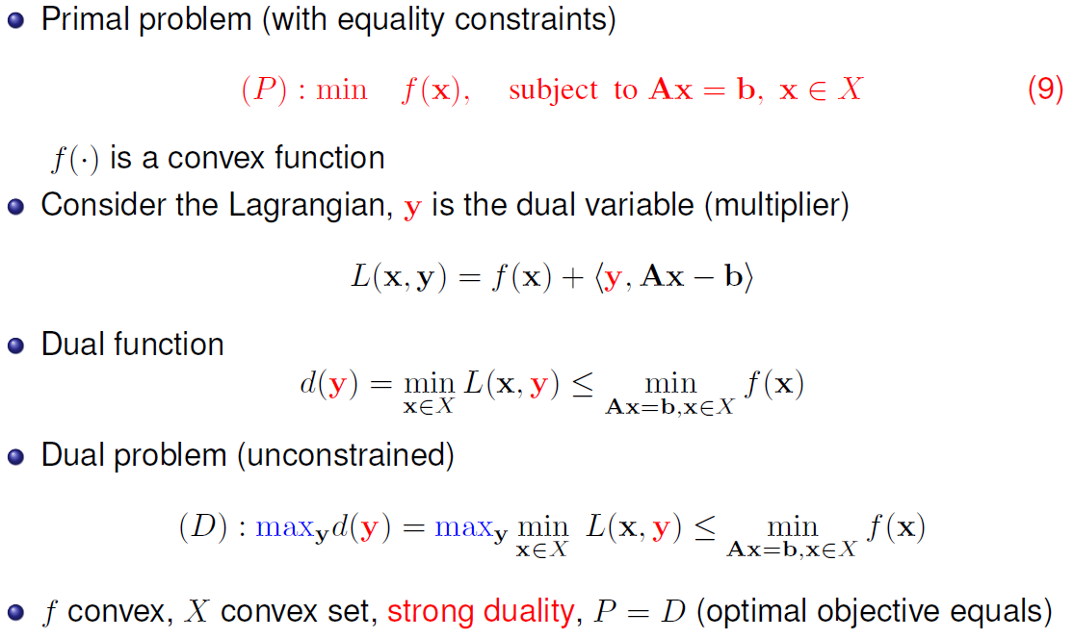
Review: Dual Problem for Constrained Optimization

Slide 5
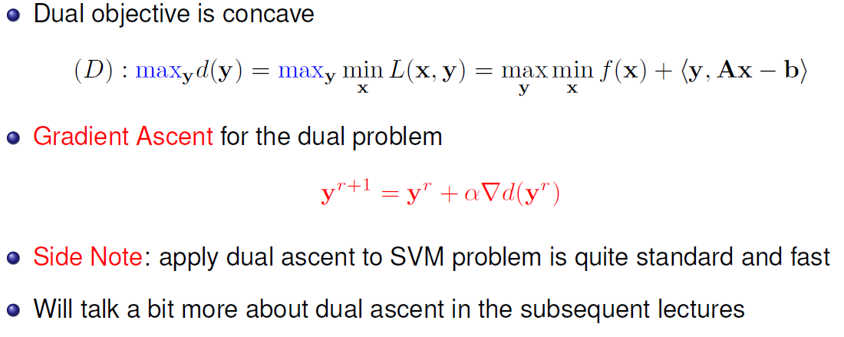
Dual Ascent

Slide 6
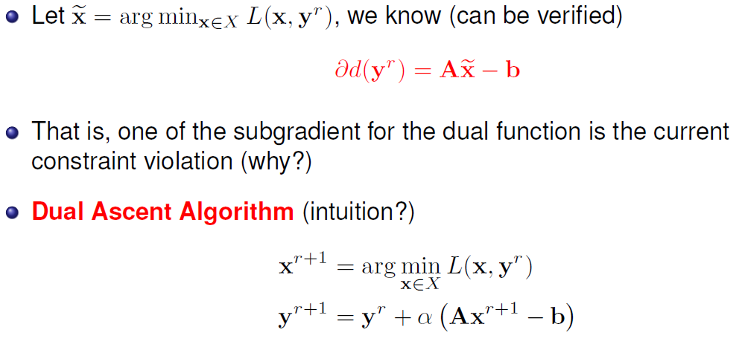
Dual Ascent (Cont.)

Slide 7
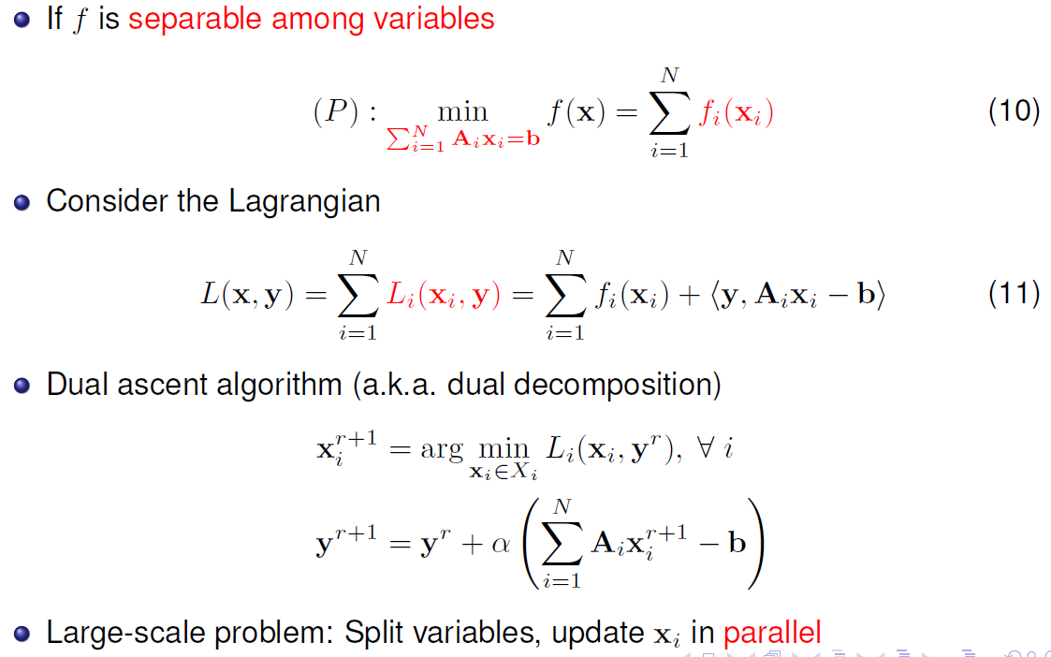
Dual Decomposition

Slide 8
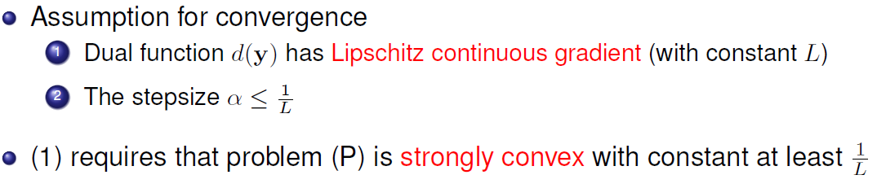
Convergence of Dual Decomposition

Slide 9
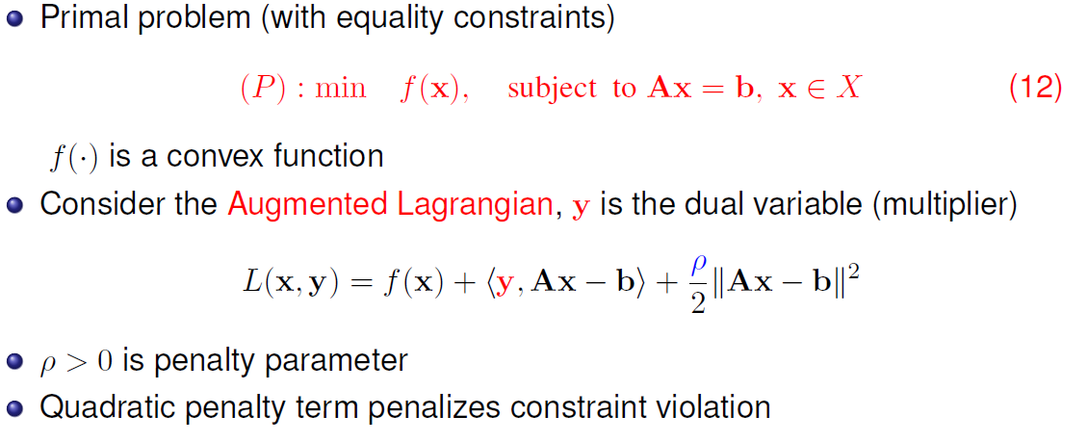
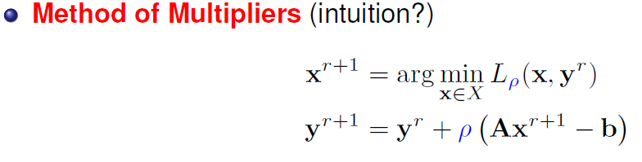
Method of Multipliers

Slide 10
Method of Multipliers
Good
Weak Assumptions: f only needs to be convex
Dual function has Lipschitz continuous gradient
Bad
Objective not separable anymore
Dual decomposition no longer works
ADMM combines
Method of multiplies: Use augmented Lagrangian
Dual decomposition: Can do variable splitting

Slide 11
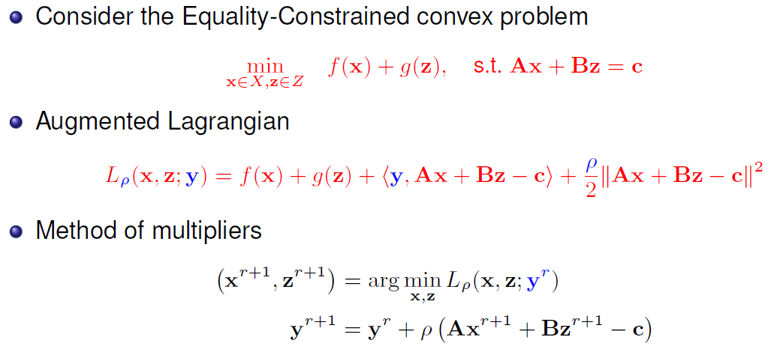
The ADMM Algorithm

Slide 12
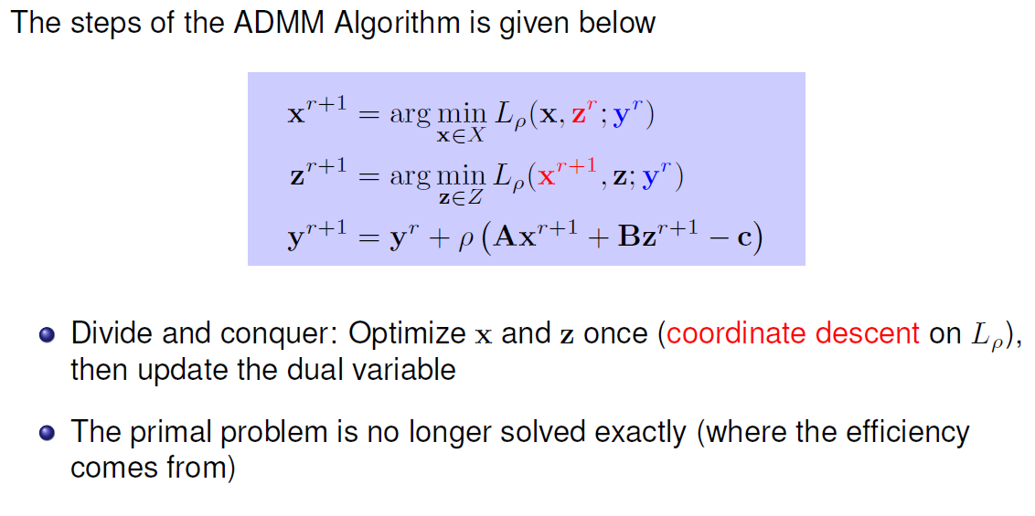
The ADMM Algorithm
California Government
Texas Government
US Congress

Slide 13
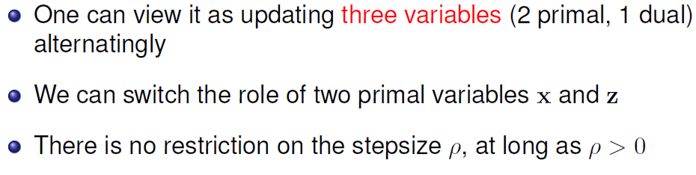
The ADMM Algorithm

Slide 14
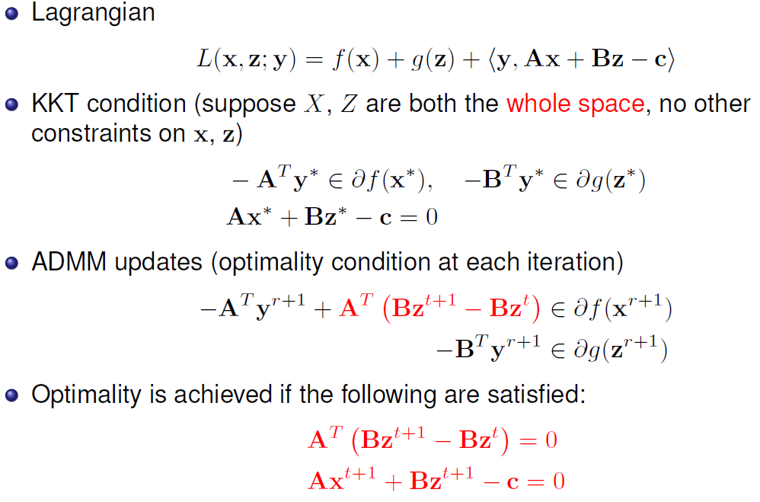
Optimality Conditions (READ)

Slide 15
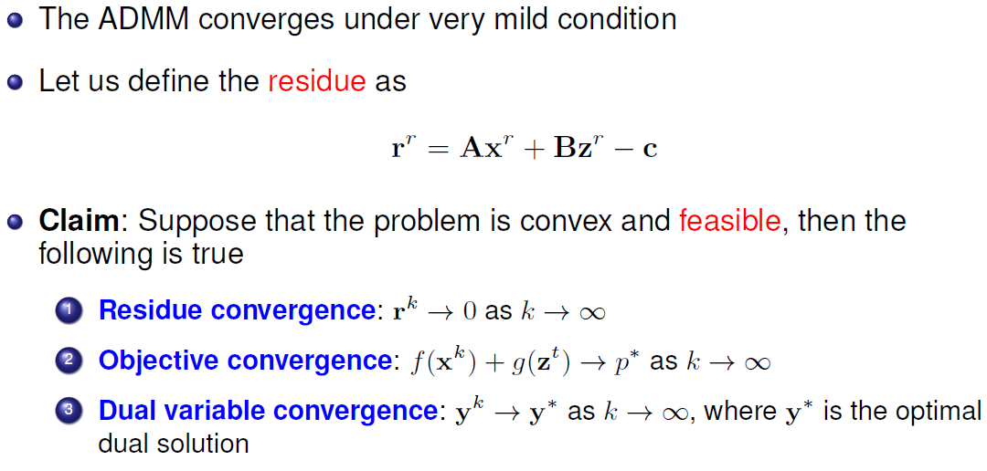
Convergence

Slide 16
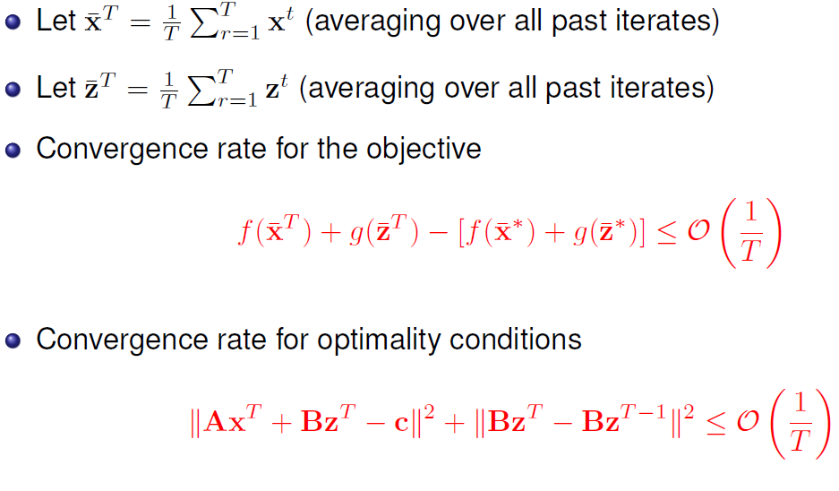
Convergence Rate

Slide 17
outline
Review and Overview
Algorithm
Applications
Non-convex ADMM
Multiblock ADMM

Slide 18
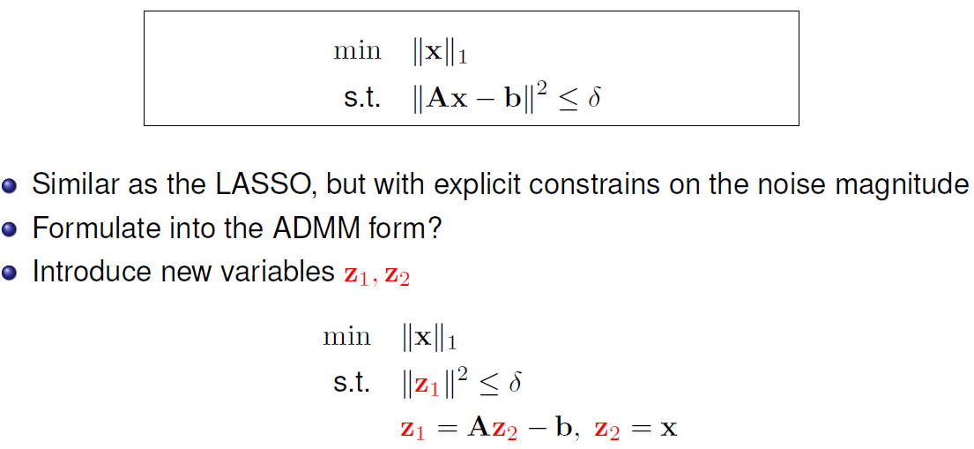
Application 1: Constrained l1 problem

Slide 19
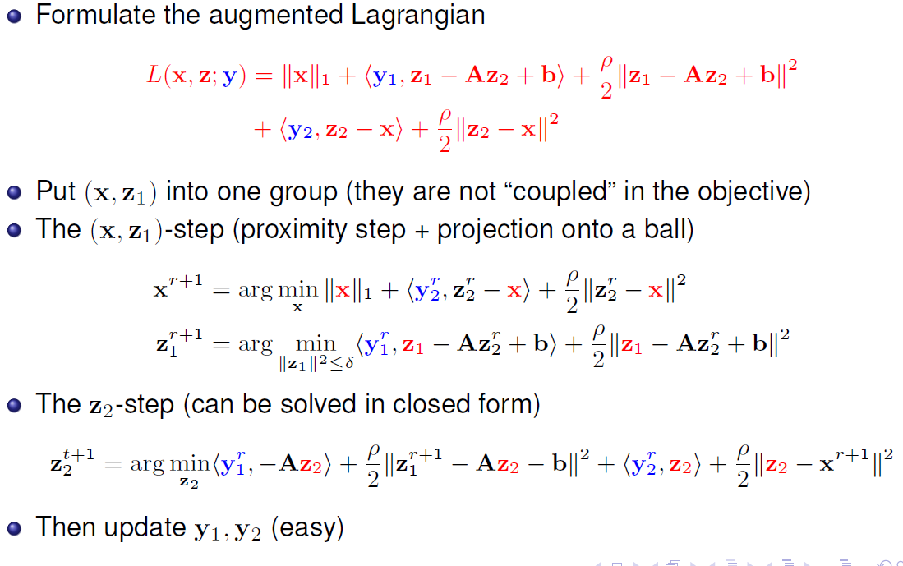
Application 1: Constrained l1 problem

Slide 20
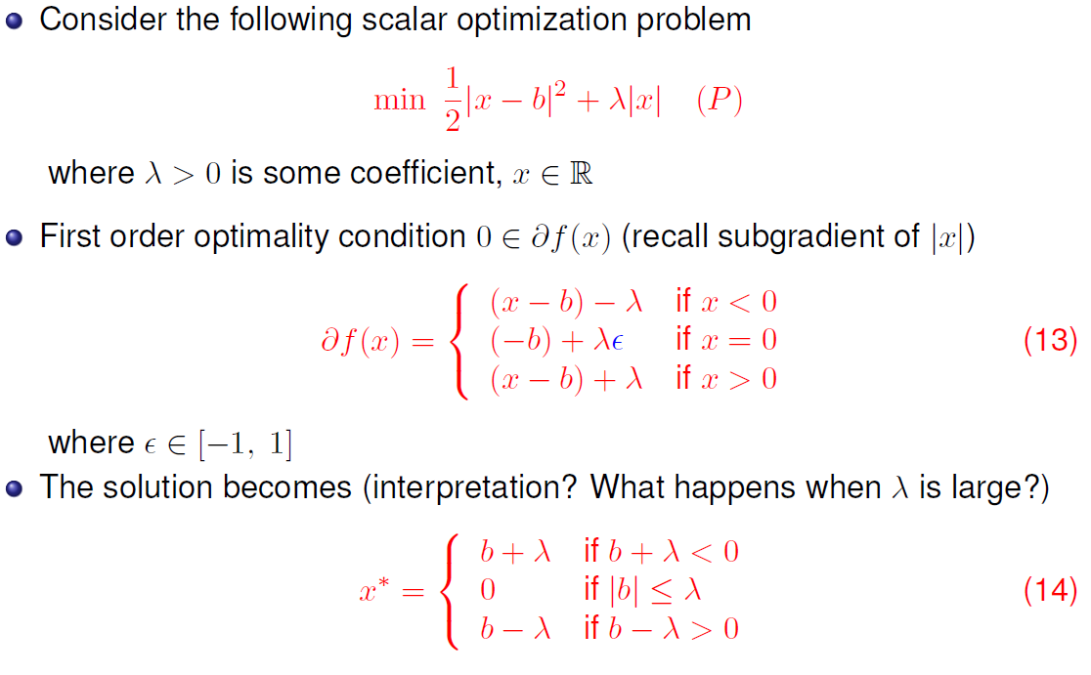
How to solve x problem? The Soft-Thresholding

Slide 21
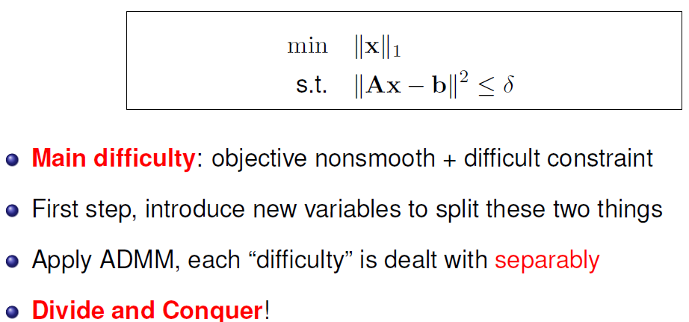
Application 1: Constrained l1 problem
Summary

Slide 22
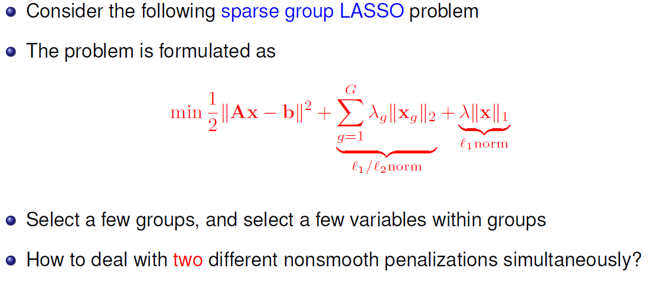
Application 2: Multiple Regularizations

Slide 23
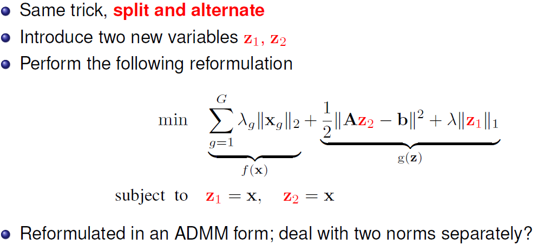
Application 2: Multiple Regularizations

Slide 24
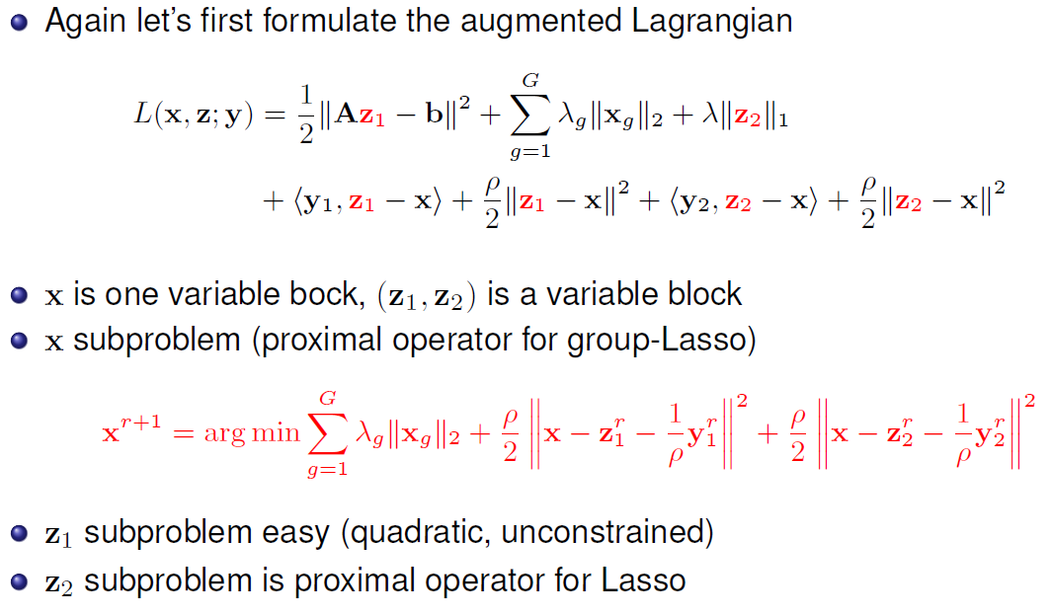
ADMM for Multiple Regularizations

Slide 25
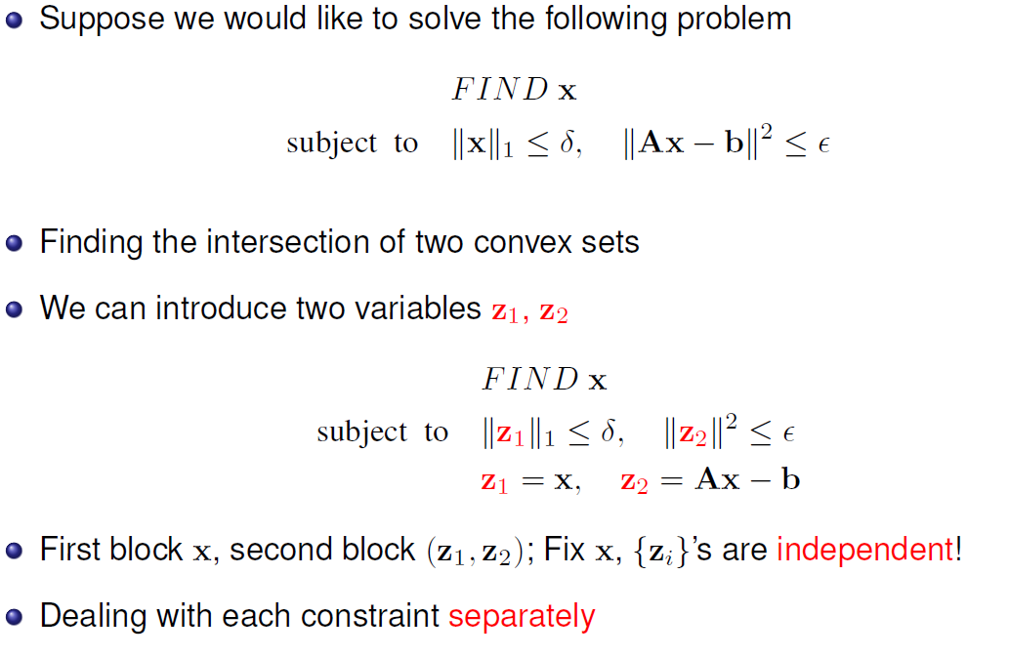
Application 3: Intersection of Two Sets

Slide 26
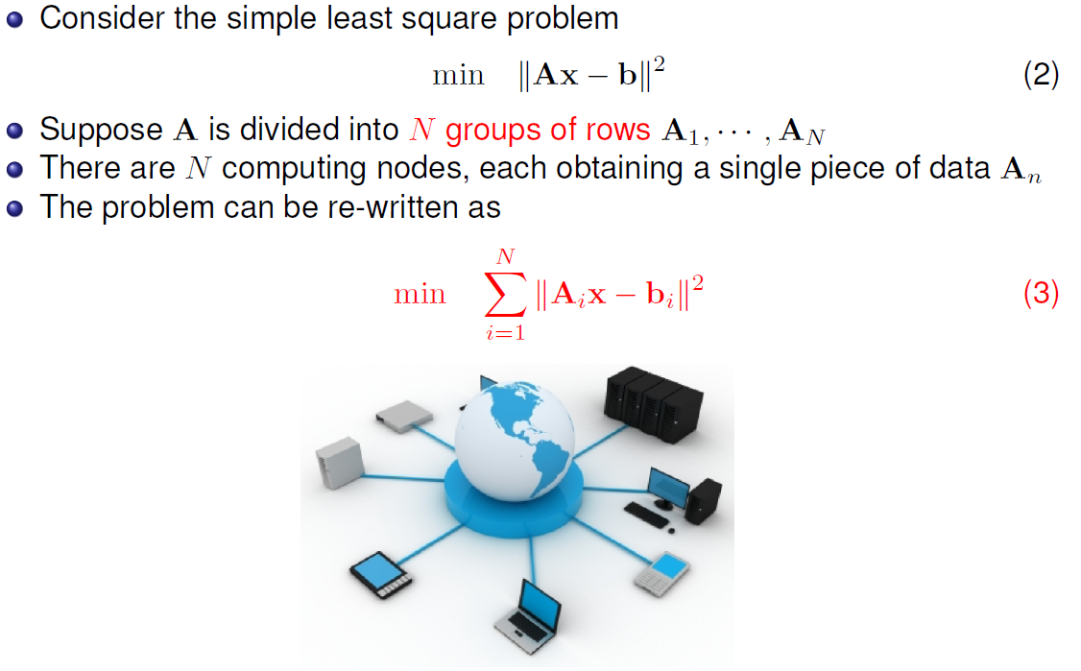
Application 3: Consensus Problem

Slide 27
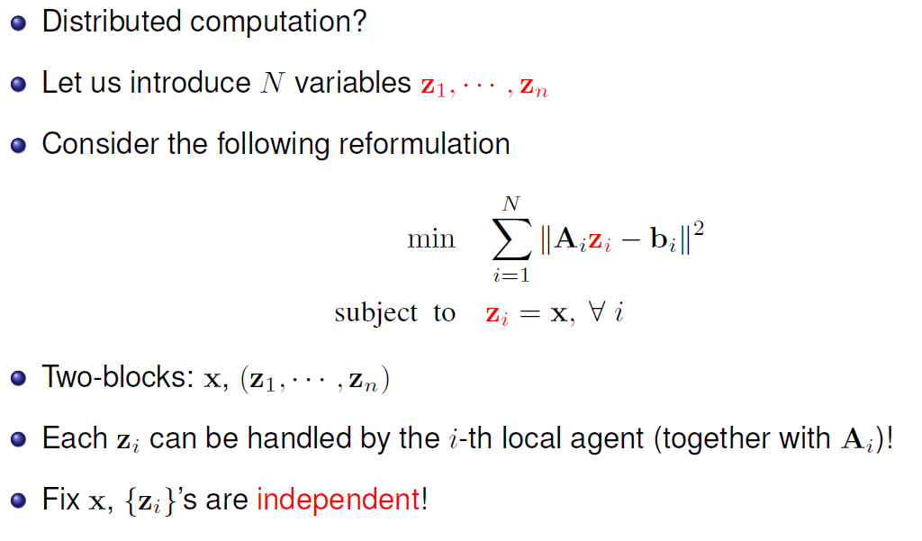
Application 3: Consensus Problem

Slide 28
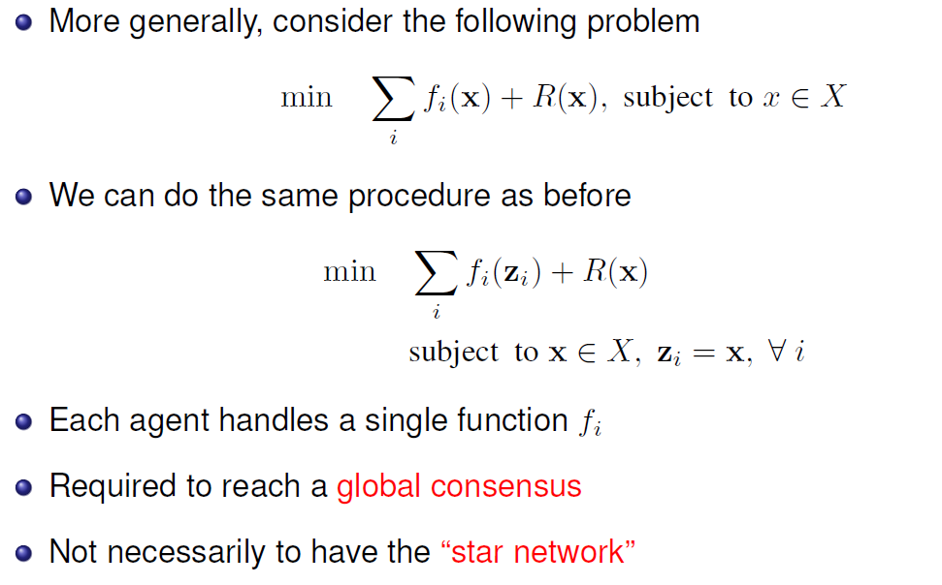
Application 3: Consensus Problem

Slide 29
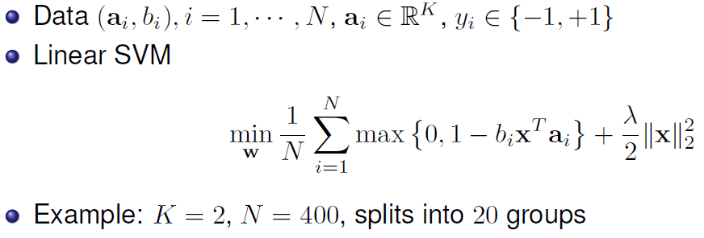
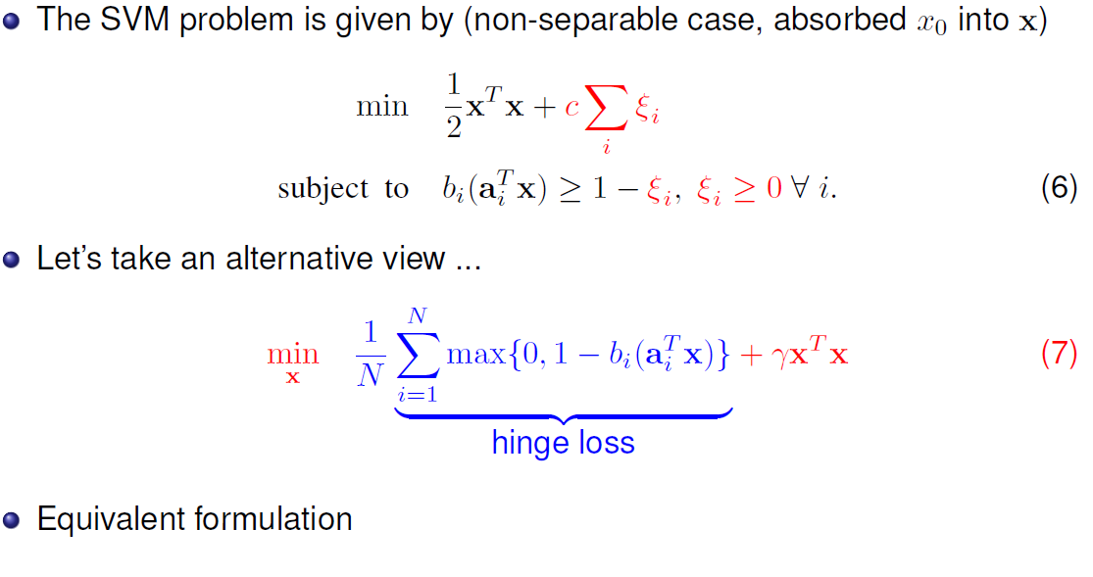
Consensus SVM (from Boyd)

Slide 30
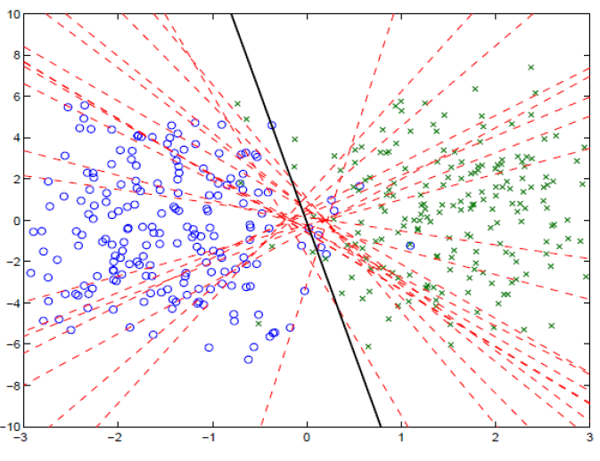
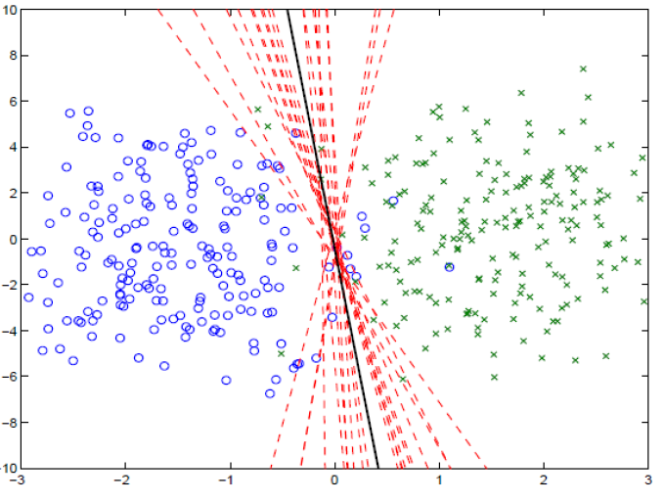
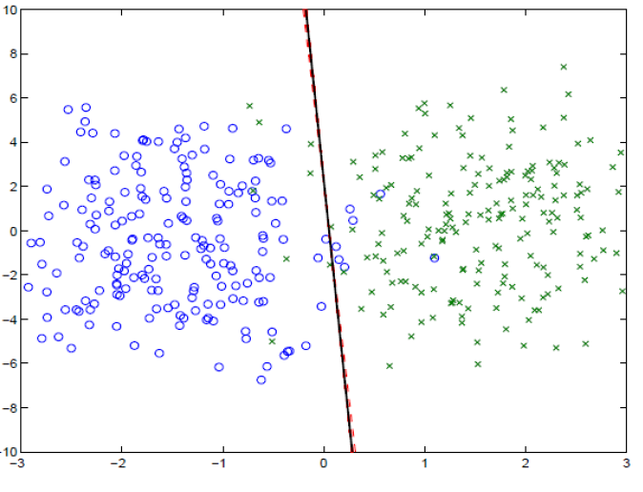
Consensus SVM (from Boyd)
Iterations 1, 5, and 40

Slide 31
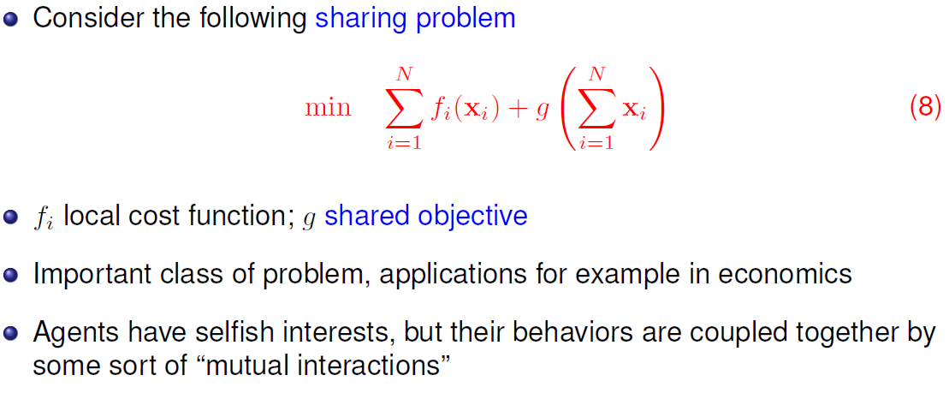
Application 5: Sharing Problem

Slide 32
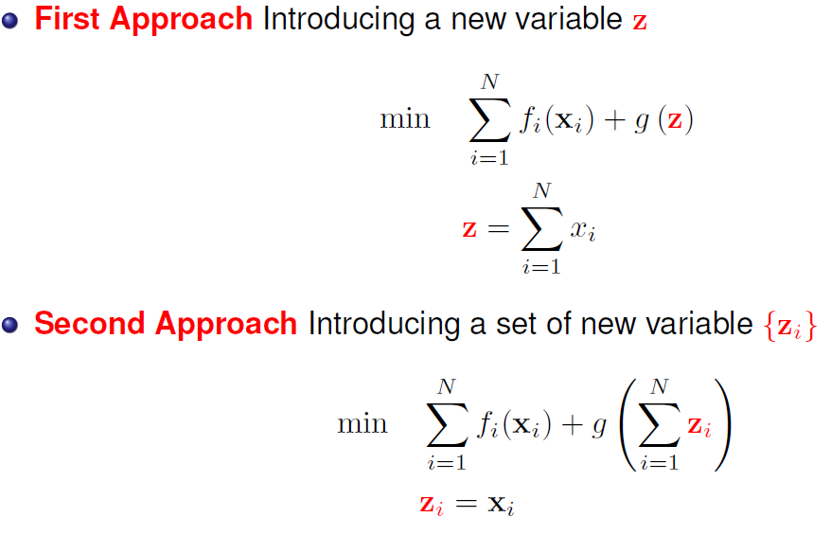
Application 5: Sharing Problem

Slide 33
outline
Review and Overview
Algorithm
Applications
Non-convex ADMM
Multiblock ADMM

Slide 34
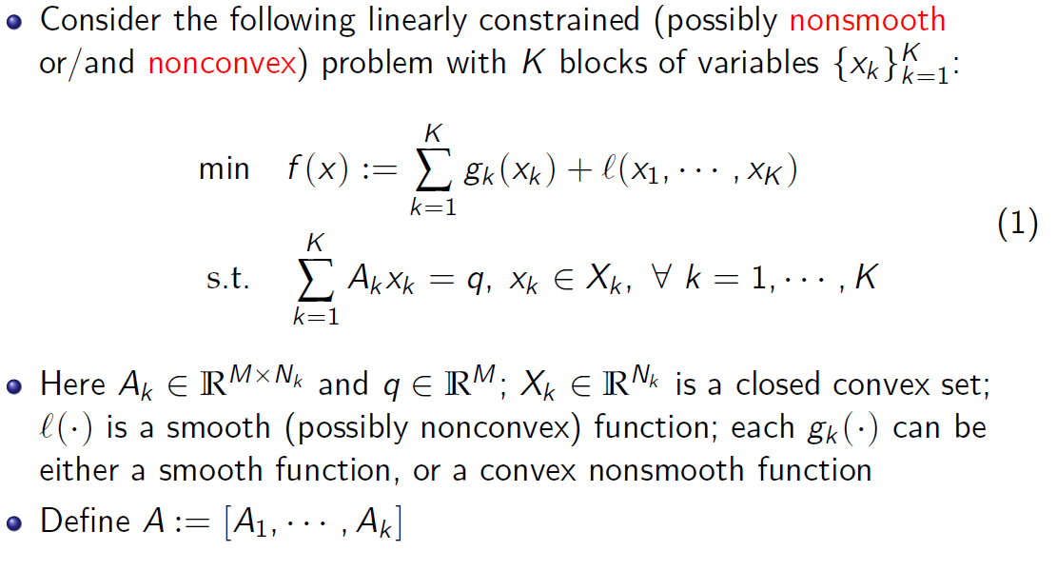
Non-convex ADMM: Basic setup

Slide 35
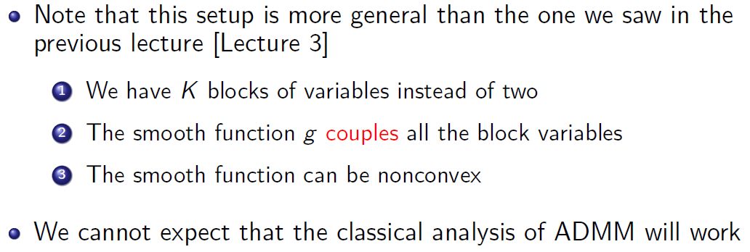
Non-convex ADMM: Basic setup

Slide 36
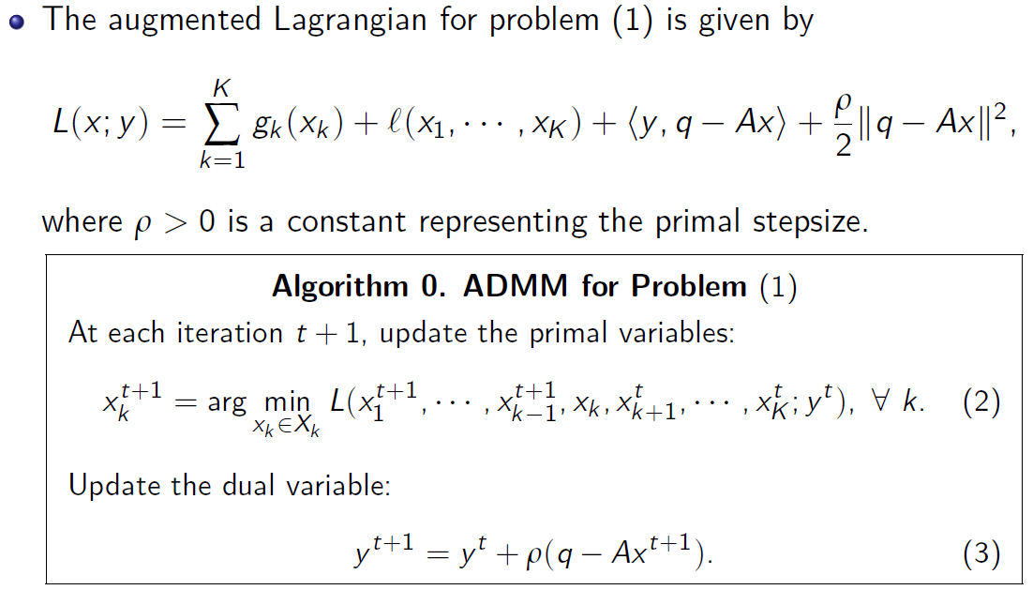
Non-convex ADMM: Basic setup

Slide 37
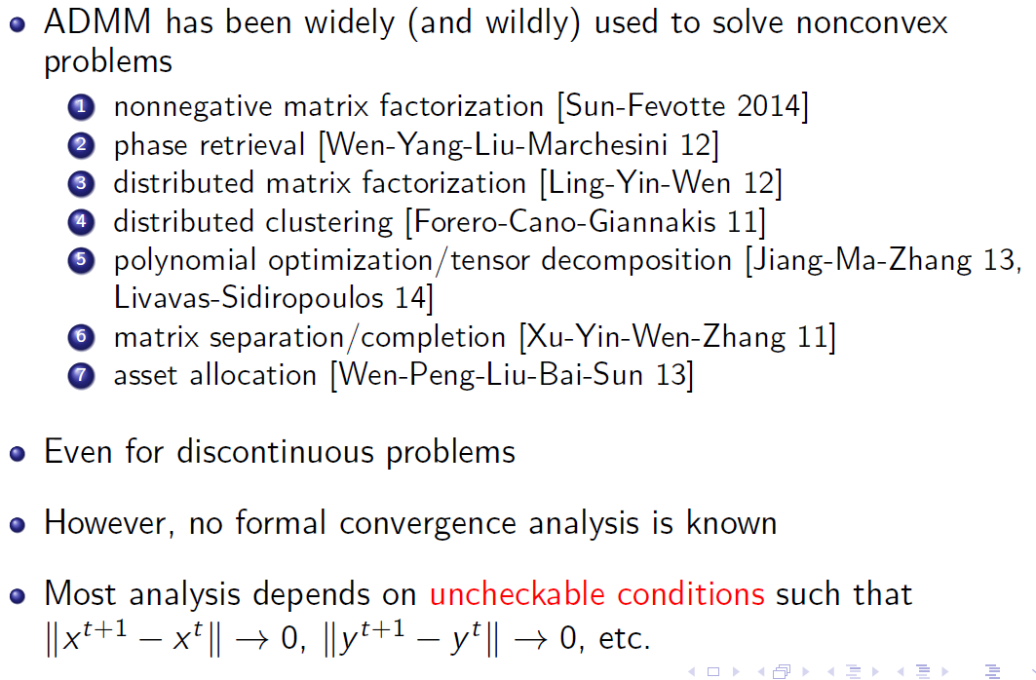
Overview of Applications
Notes:
Non convex ADMM is not done yet

Slide 38
outline
Review and Overview
Algorithm
Applications
Non-convex ADMM
Multiblock ADMM

Slide 39

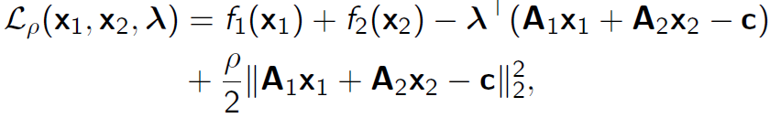
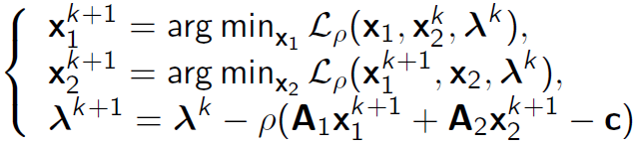
Two Block ADMM Review
Divide one problem into multiple subproblems
Augmented Lagrangian function with quadratic penalty
ADMM embeds a Gauss-Seidel decomposition:
The third step is consensus that needs to be exchanged.
Each iteration is not feasible, converge O(1/k) speed

Slide 40
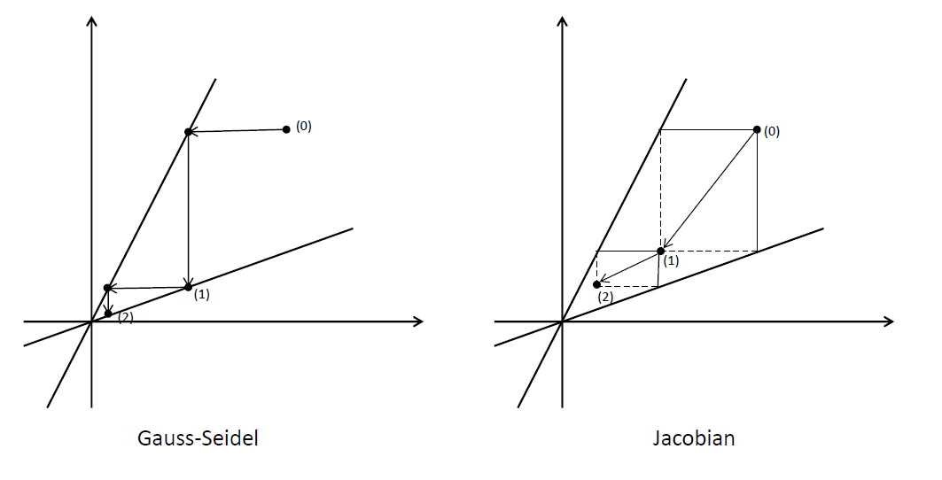
Guass-Seidel v.s. Jacobian
Solve the linear system Ax = b
Extension to multi-block case

Slide 41
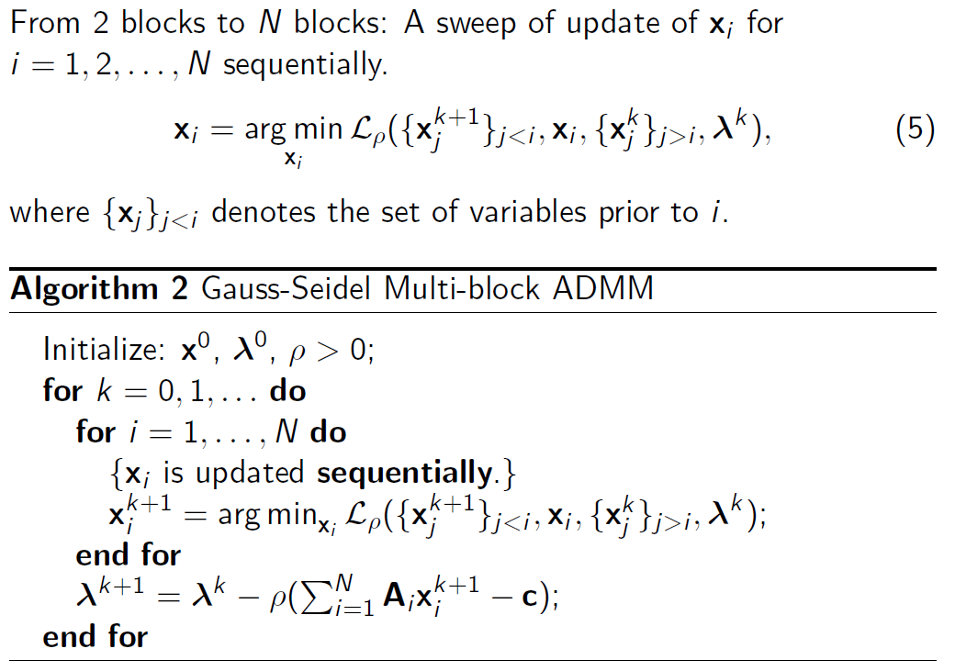
Gauss-Seidel type extension

Slide 42
Gauss-Seidel Type Extension
Direct extension of Gauss-Seidel multi-block ADMM is not necessarily convergent.
Prof. Hong proved the convergence of Algorithm 2 with sufficient small step size for Lagrangian multiplier update and additional assumptions on the problem.
Prof. Ye conjugates that an independent uniform random permutation of the update order for blocks in each iteration will result in a convergent iteration scheme.
Some slightly modified versions of Algorithm 2 with provable convergence and competitive iteration simplicity and computing efficiently have been proposed.

Slide 43
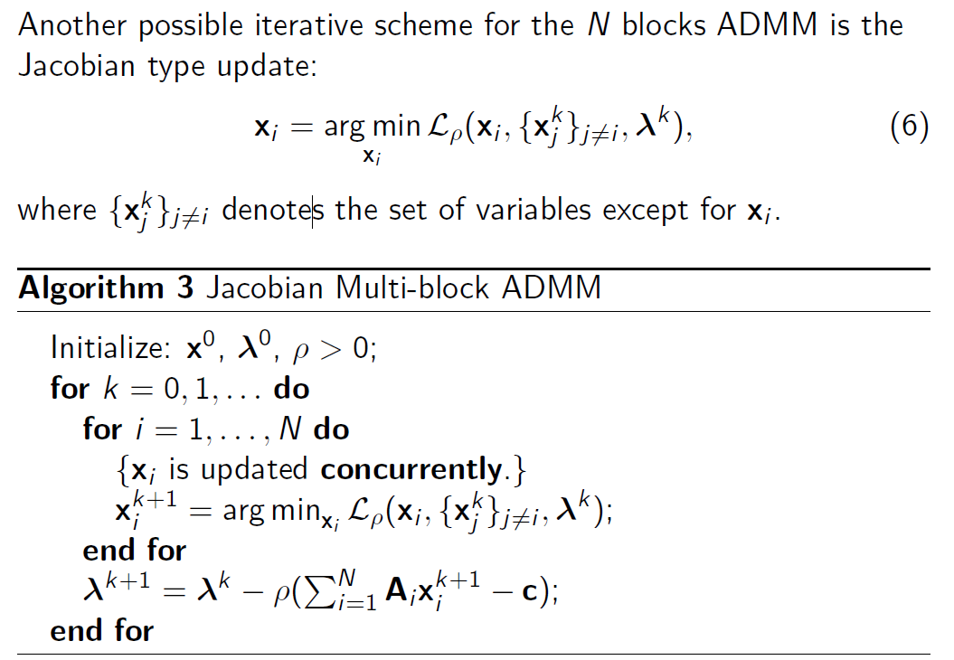
Jacobian Type Extension

Slide 44
Jacobian Type Extension
More computational efficient in the sense of parallelization.
Algorithm 3 is not necessarily convergent in the general case, even in the 2 blocks case.
Yin proves that if matrices Ai are mutually near-orthogonal and have full column-rank, the Algorithm 3 converges globally.
Need schemes to improve convergence

Slide 45
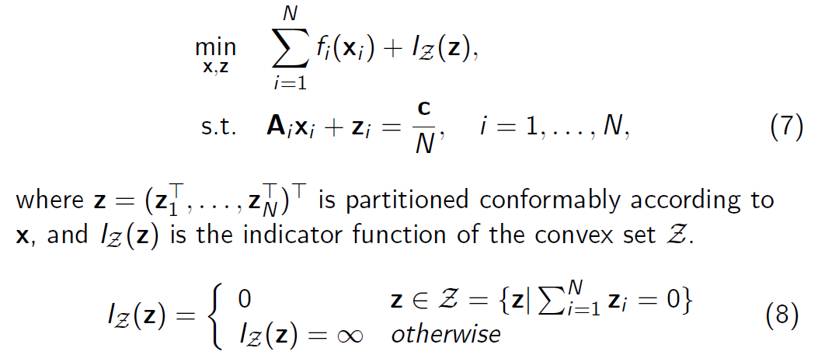
Variable Splitting ADMM
The optimization problem can be reformulated by introducing auxiliary variable z to deal with the multi-block case.

Slide 46
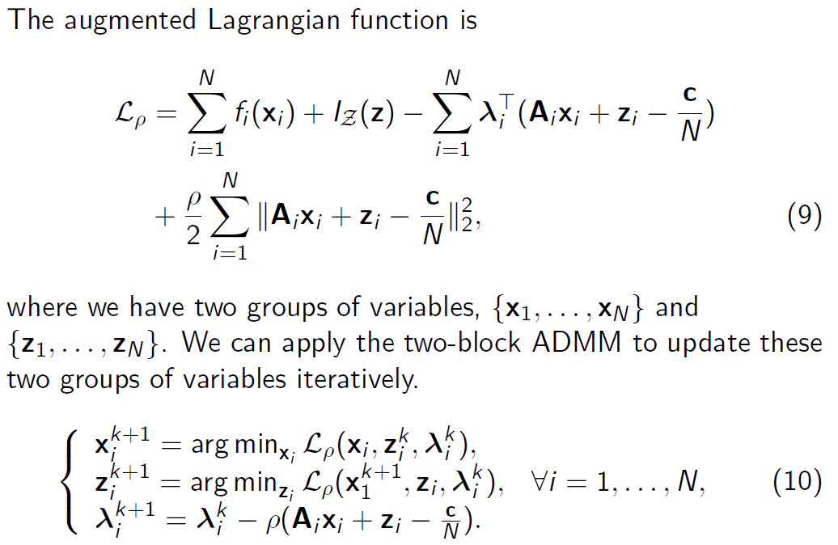
Variable Splitting ADMM

Slide 47
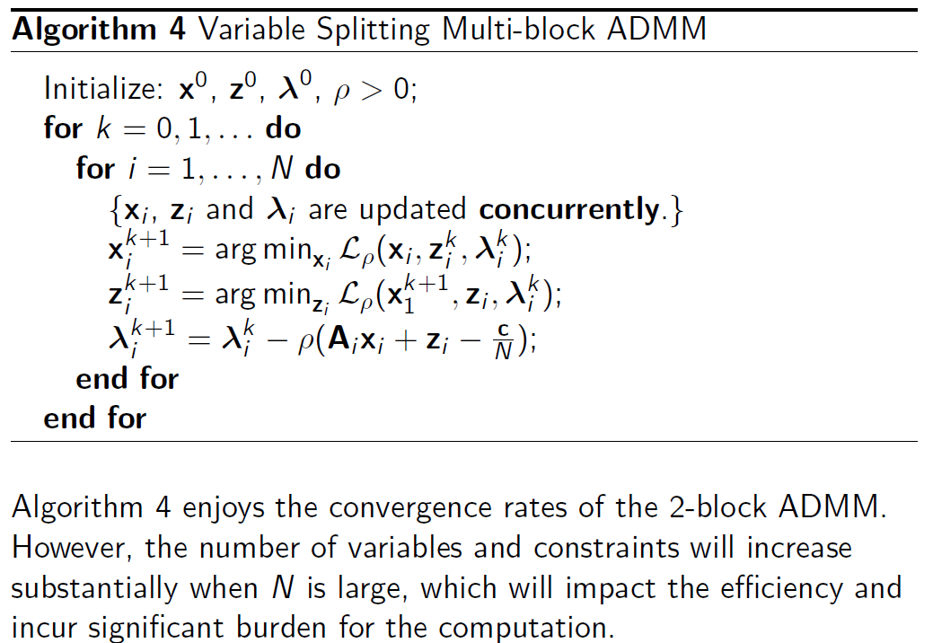
Variable Splitting ADMM

Slide 48
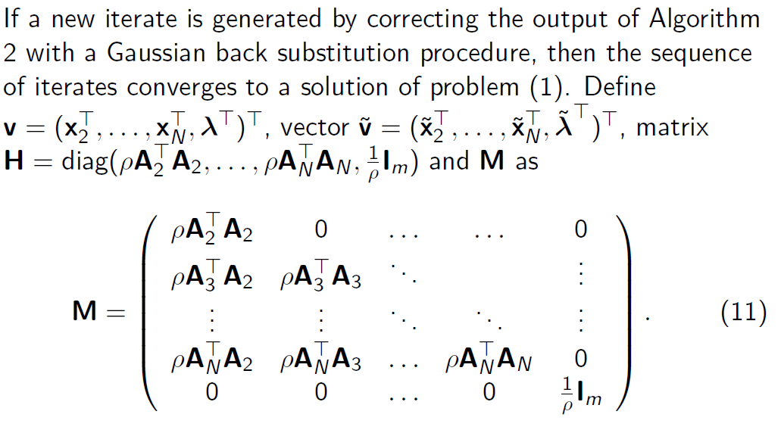
ADMM with Gaussian Back Substitution

Slide 49
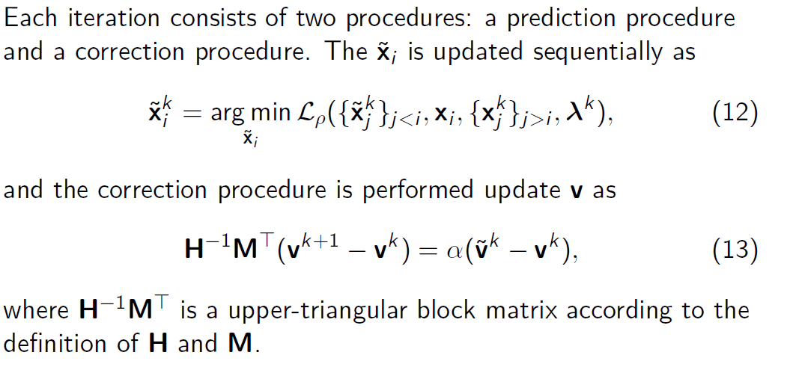
ADMM with Gaussian Back Substitution

Slide 50
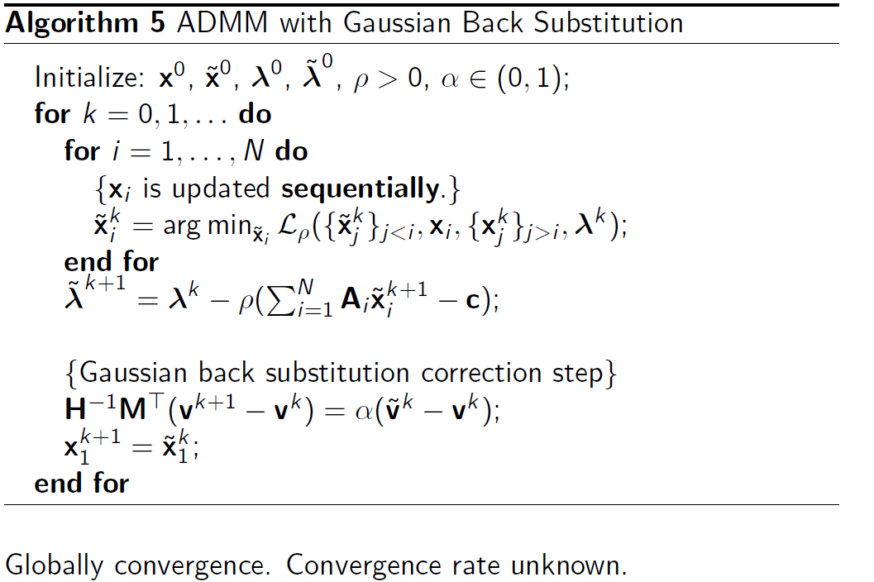
ADMM with Gaussian Back Substitution

Slide 51
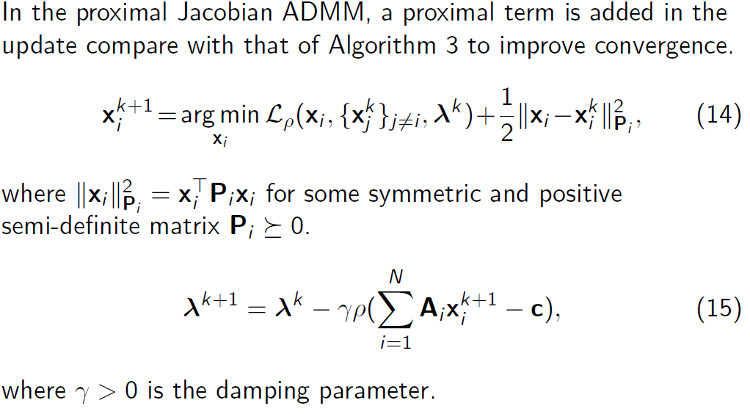
Proximal Jacobian ADMM

Slide 52
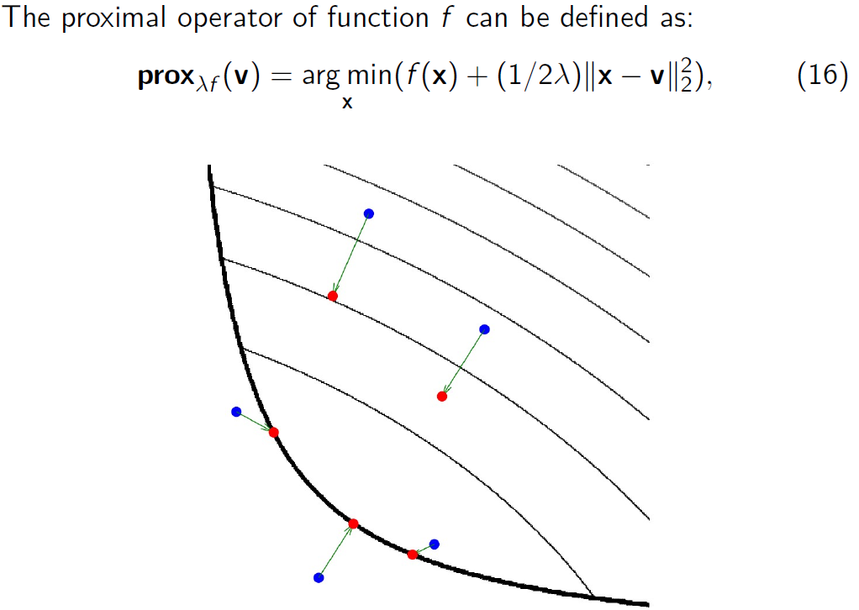
Proximal Operator
Feasibility
Boundary
Penalty for Large Step
Can Suffer infeasibility

Slide 53
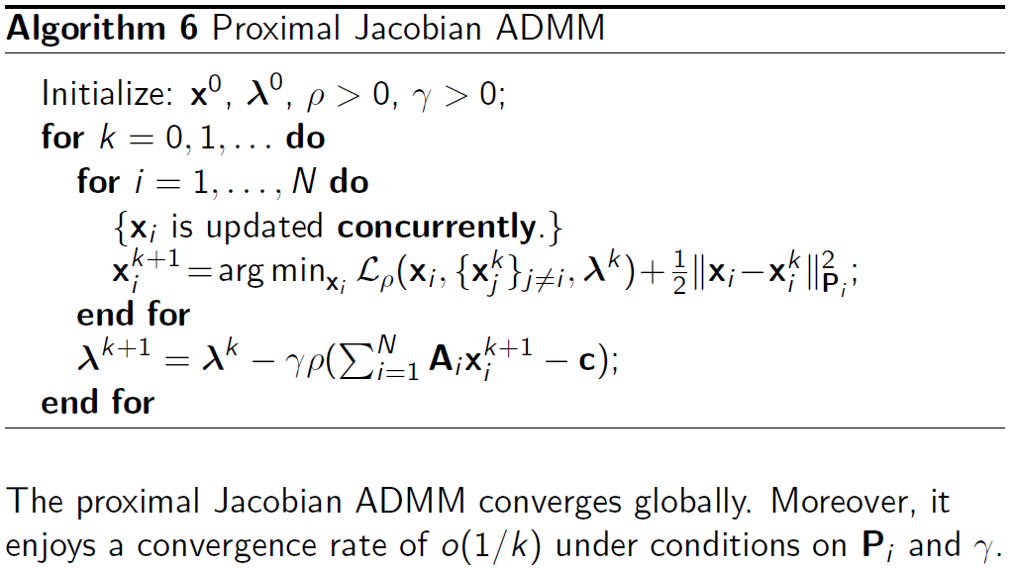
Proximal Jacobian ADMM

Slide 54

Summary For Different Types

Slide 55
Summary
ADMM
Algorithm
Applications
Non-convex ADMM
Multiblock ADMM
“Distributed Optimization and Statistical Learning via the Alternating Direction Method of Multipliers”, S. Boyd, N. Parikh, E. Chu, B. Peleato, J Eckstein, Foundation and Trends in Machine Learning, 2011
M. Hong, Z.-Q. Luo, and M. Razaviyayn, “Convergence analysis of alternating direction method of multipliers for a family of nonconvex problems," SIAM Journal On Optimization, vol. 26, no. 1, pp. 337-364, 2016
Lanchao Liu and Zhu Han, “Multi-Block ADMM for Big Data Optimization in Smart Grid,” ICNC 2015

