Slide 1

Signal processing and Networking for Big Data Applications: Lecture 7 Mix Integer Programming: Benders decomposition, Branch & Bound, and Other algorithms
http://www2.egr.uh.edu/~zhan2/big_data_course/
Zhu Han
University of Houston
Thanks for Ye Yu’s help on slide preparation
Notes:
NOTE:
To change the image on this slide, select the picture and delete it. Then click the Pictures icon in the placeholder to insert your own image.

Slide 2

Outline
Introduction/Rlaxation
Benders decomposition
Linear programming problem
Nonlinear programming problem
Mixed-integer linear programming
Mixed-integer nonlinear programming
Branch-and-Bound
Other algorithms
Knapsack
Dynamic programming
Reweighted l1 norm minimization
Block coordination descend (BCD)
Belief propagation

Slide 3
Introduction

Slide 4
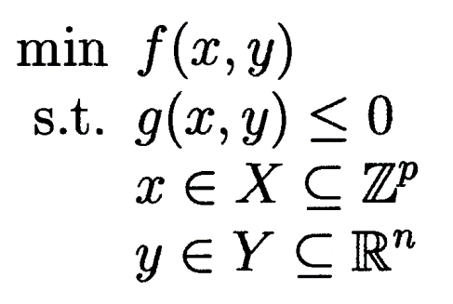


Optimization problems
General form of the optimization problem:
Notes:
Dance with handcuff

Slide 5
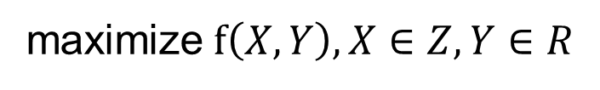





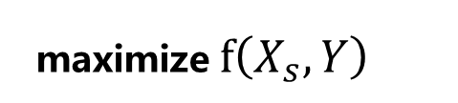

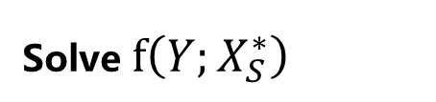
Relaxation
What’s relaxation
Scale discrete variables to continuous variables;
Optimize via continuous optimization method;
Mapping from continuous variables to discrete variables;
Relaxation
Mapping
Empirical

Slide 6

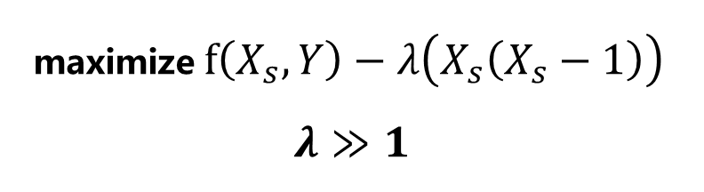


Relaxation
What’s relaxation
Relaxation discrete variables to continuous variables;
Optimization via continuous optimization method;
Punish the deviation of discrete variables
Relaxation

Slide 7
Relaxation
Advantages:
Easy to conduct;
Disadvantages:
Empirically Mapping between discrete/continuous
Local optimum

Slide 8
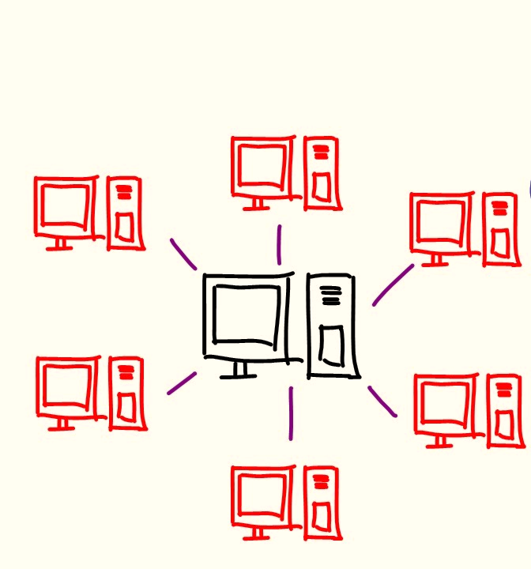
Why decomposition?
Split the large scale problems into smaller problems which are easier to handle
Apply distributed applications
Release the burden of computation
Privacy protection

Slide 9

Two special forms obstruct decomposition
maximize objective1 + objective2
subject to constraints1
constraints2
complicating constraints complicating constraints
maximize objective1 + objective2
subject to constraints1 & constraints1(compl. variables)
constraints2 & constraints2(compl. variables)
Complicating constraints
Complicating variables
Notes:
Complicating constraints and Complicating variables/coupling variables make the problem hard to decompose

Slide 10
Algorithms
Complicating constraints:
The Dantzig-Wolfe decomposition algorithm
Complicating variables:
Benders decomposition
Dual problem
Notes:
They can transform to each other using dual problem

Slide 11
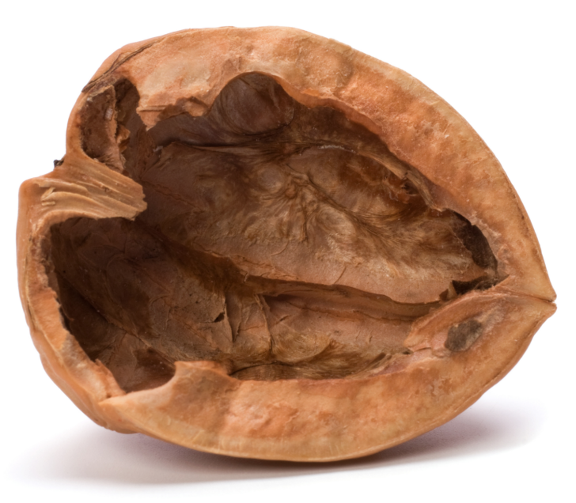
Benders decomposition in a nutshell
Benders algorithm:
Was invented by J.F. Benders, 1962
A decomposition algorithm for solution of optimization problems with complicating variables. Requires iterative procedures
Approximate objective function from below using hyperplanes.
Solve master problem using the approximation of objective function.
Improve the approximation using additional hyperplanes. These additional hyperplanes are obtained solving the so-called subproblems.
If the approximation of the objective function is good enough, stop; otherwise, continue with Step 2.
Benders decomposition

Slide 12
linear programming problem
Benders decomposition

Slide 13
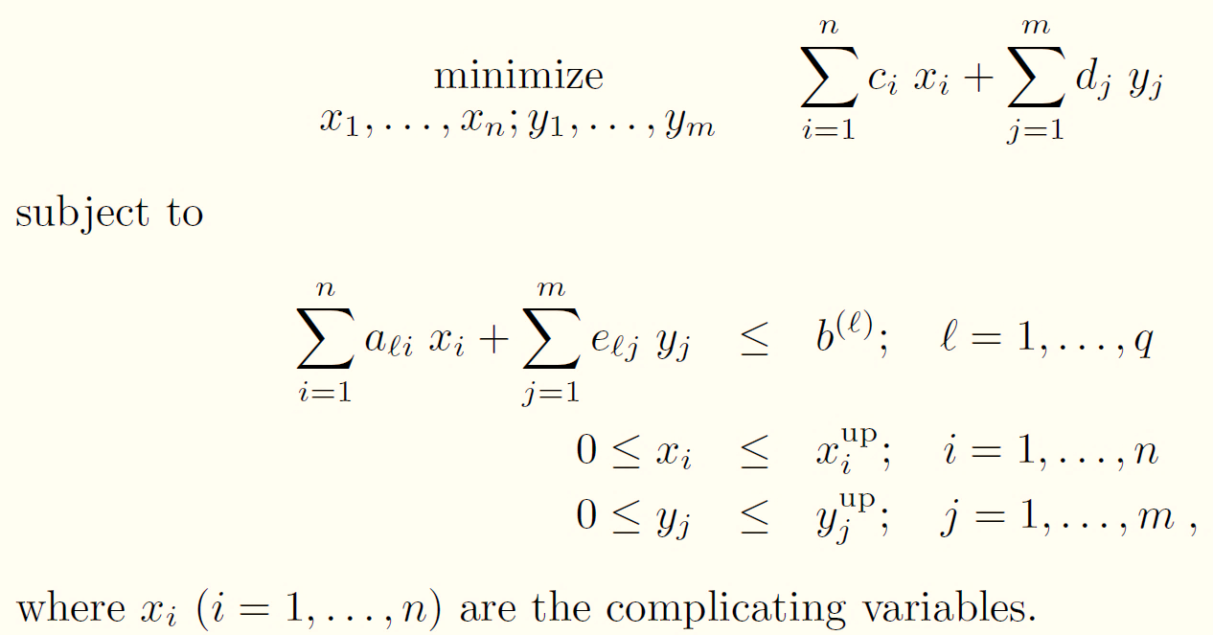
Linear optimization problem with complicating variables

Slide 14
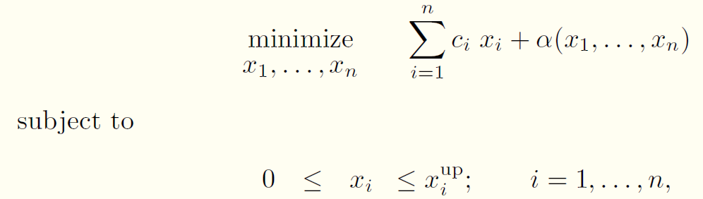
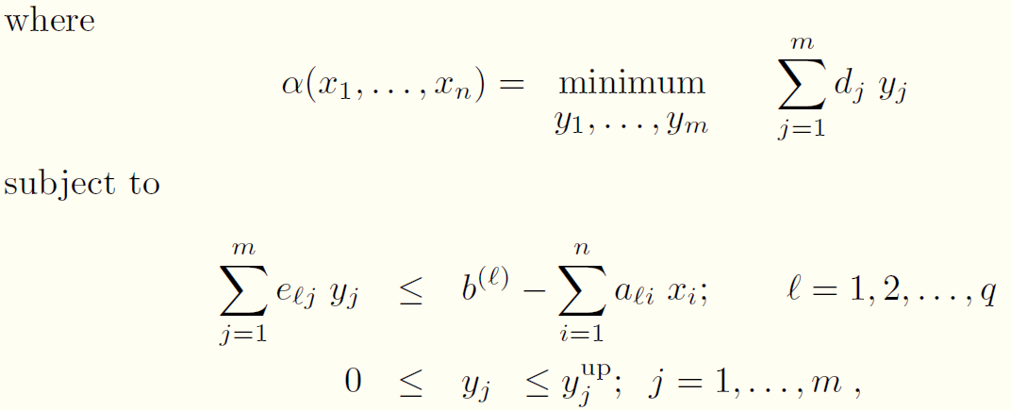
Initial idea
Another form:
Stage 1
Benders cuts
Solution values
Stage 2

Slide 15
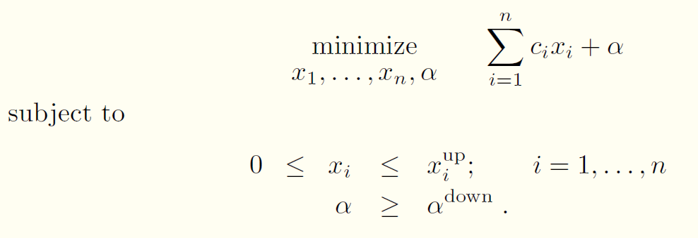


Benders decomposition for linear programming problem
Initialization
Loop index ν = 1
Solve
This problem has the trivial solution:

Slide 16
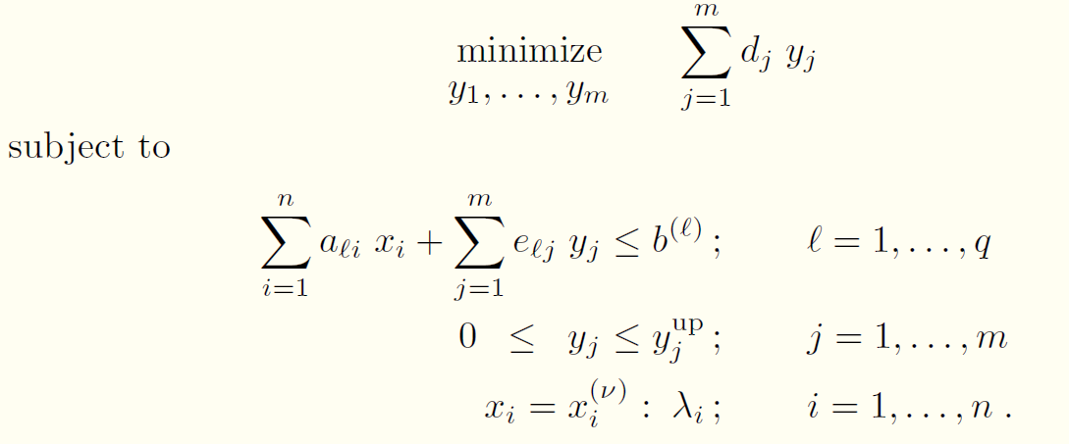


Benders decomposition for linear programming problem
Subproblem
Solve
The solution of the subproblem is:
Dual variable values:
Constraints of fixing integer variables
Notes:
This problem, which is denominated the subproblem, either it decomposes by blocks in subproblems or it attains such a structure such that
it is much easier to solve than the original problem.

Slide 17
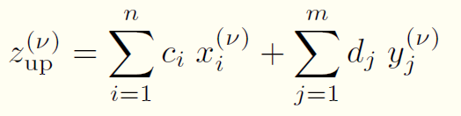
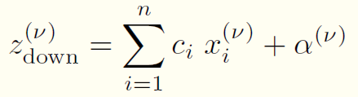

Benders decomposition for linear programming problem
Convergence checking
Upper bound: due to variable is in the middle and not the final one yet
Lower bound: due to objective function is lower bound and the constraints are relaxed
Stopping criterion:
Monotonously increasing
Notes:
Lower bound: because it is a relaxed version of the original problem and its objective function approximates from below the
objective function of the original problem.
Upper bound: because subproblem, is a further restricted version of the original problem.

Slide 18
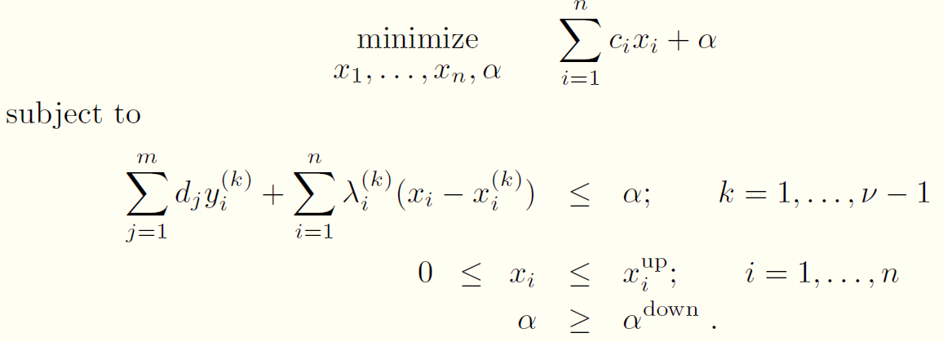
Benders decomposition for linear programming problem
Master problem
Update loop index ν = ν +1
Solve:
Obtain the optimal solution and continue to solve subproblem
Benders cuts

Slide 19
Benders Decomposition
Master problem
Update loop index ν = ν +1
Solve:
Obtain the optimal solution and continue to solve subproblem
The geometric interpretation
Benders cuts’ slope is generated from dual variables
Current upper bound
Current lower bound
Approximation using hyperplanes
Notes:
Derived from the duality theory
Assume the objective function is convex

Slide 20

Remarks
is a scalar and is a bound that can be determined from physical or economical considerations pertaining to the problem under study
In each iteration, new Benders cuts are added to the master problem
Master problem and subproblem are solved iteratively

Slide 21
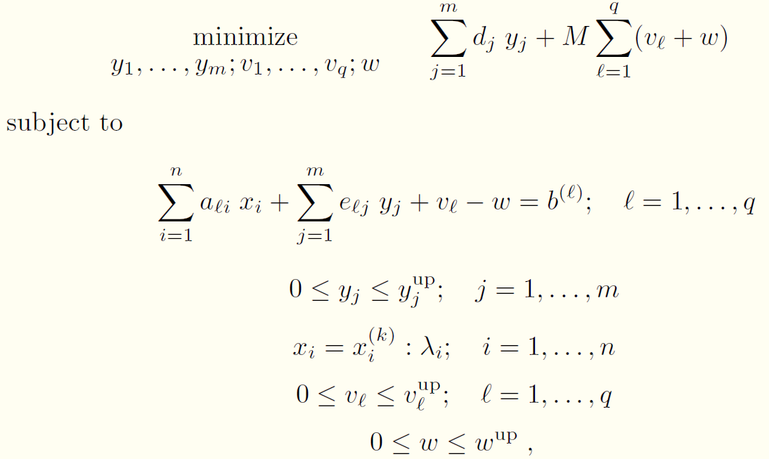

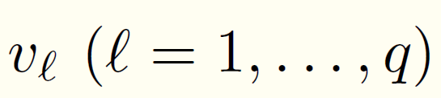

Subproblem infeasibility
It is possible that the subproblem is infeasible. Method of Big M
Always feasible problem form:
is a large enough positive constant, and are the artificial variables
Constraint from inequality to equality, and M is big so that artificial variables will be small.

Slide 22
Flow chart
Distinguish complicating variables from common variables
Search over complicating variables (master problem)
For each trial value of complicating variables, solve problem over common variables (subproblem)
If solution is suboptimal/infeasible, find out why and design a constraint that rules out not only this solution but a large class of solutions that are suboptimal/infeasible for the same reason (Benders cut)
Add Benders cut to the master problem and resolve
START
Solve master problem
yes
Terminate?
no
Solve sub problem
Add Benders cut
END

Slide 23
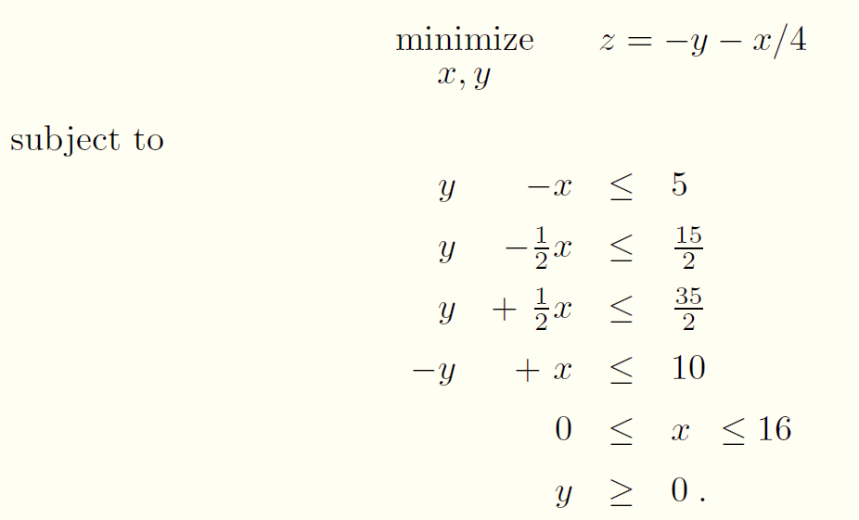
Example
Solve the linear programming problem

Slide 24
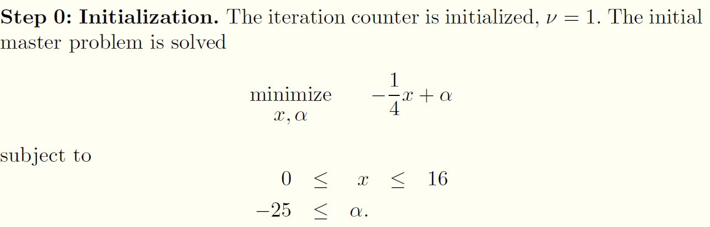
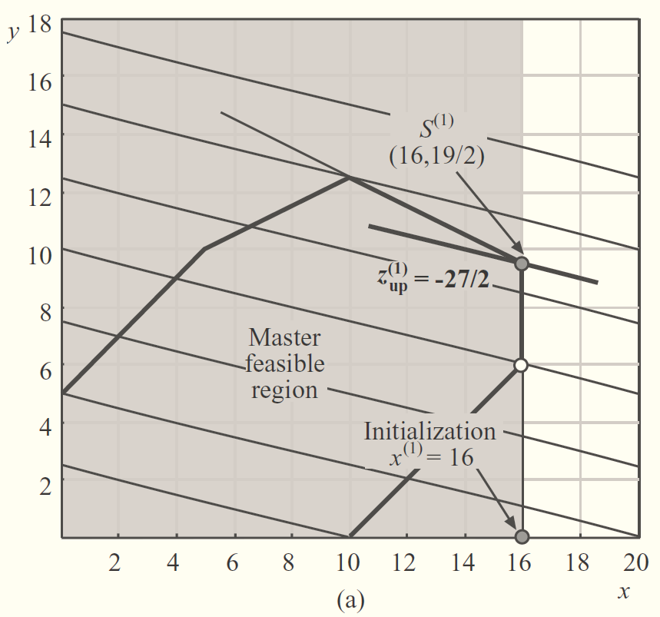

Example

Slide 25
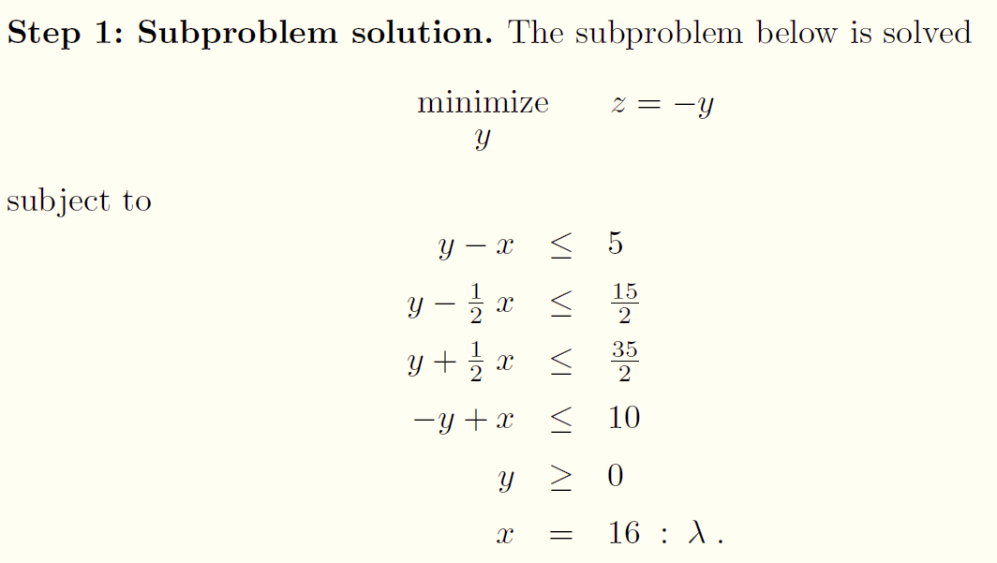
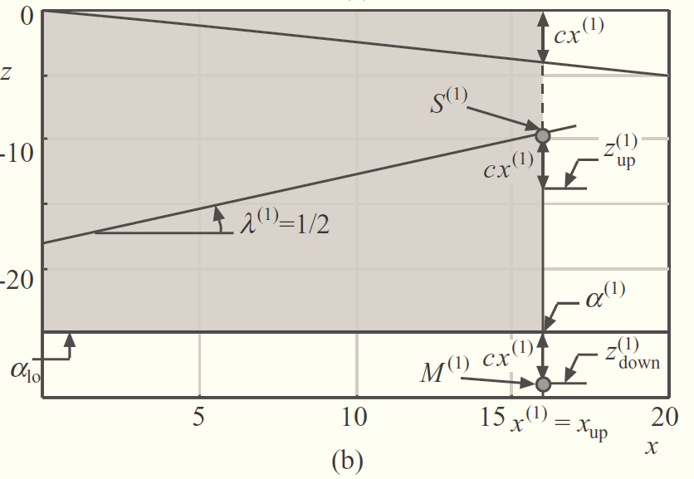

Example
,
which is located inside the initial feasible region
Note that the optimal value of the dual variable associated with the constraint

Slide 26
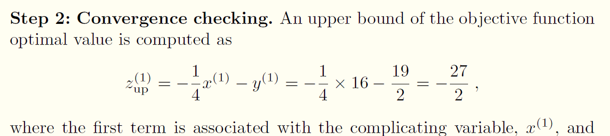
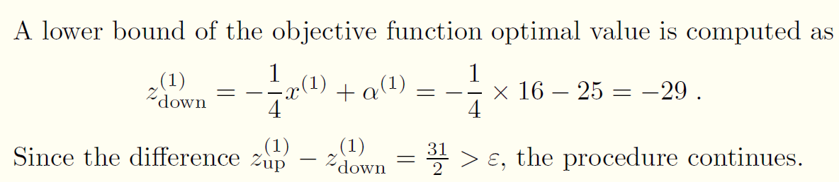
Example

Slide 27
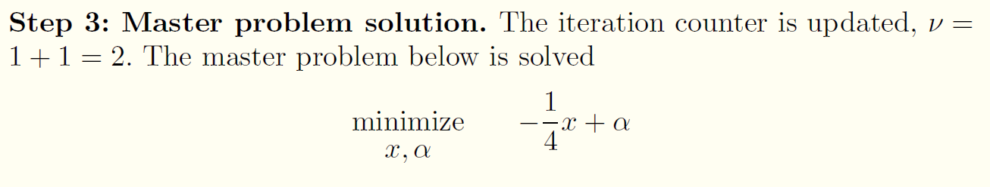
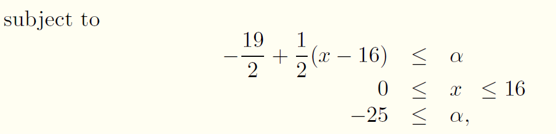
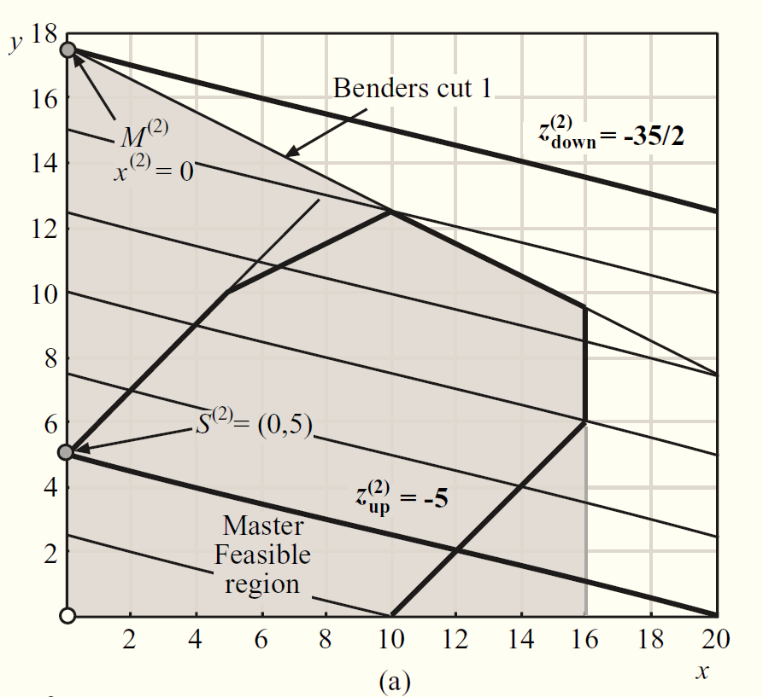

Example
where the first constraint is the Benders cut 1.
Notes:
The point M(2) in Fig a is the intersection of the Benders
cut obtained in the previous iteration (active constraint for subproblem
1) and the line x = 0 (lower bound of the complicating variable x). Similarly,
the point M(2) in Fig. b is the intersection of the tangent hyperplane and the α function at the point x(1) = 16 (lower bound of the shadow region in
Fig. b) and the line x = 0.

Slide 28
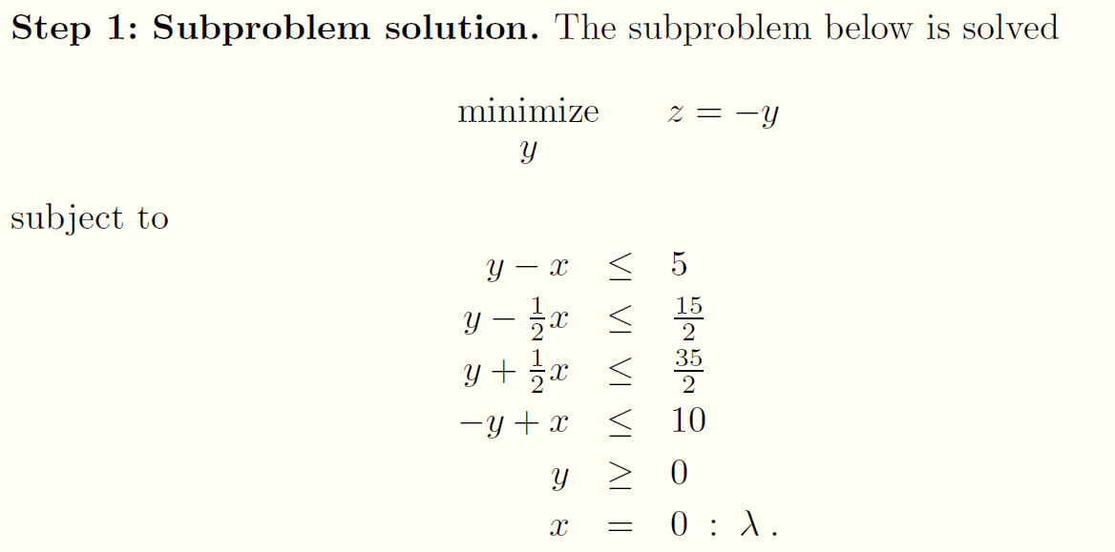
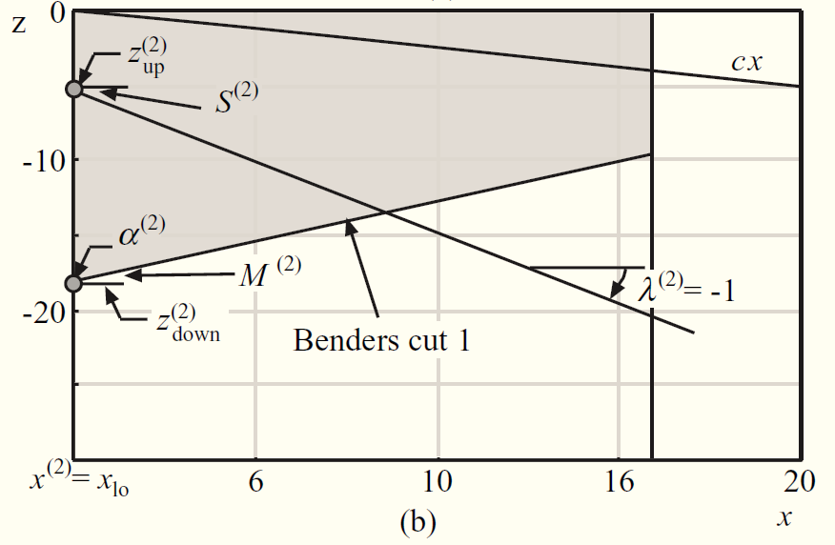

Example

Slide 29
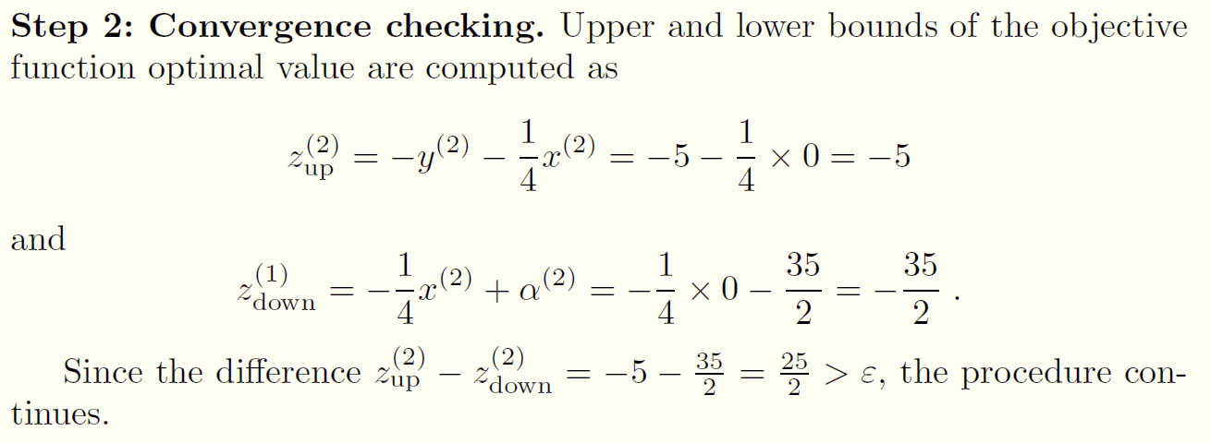
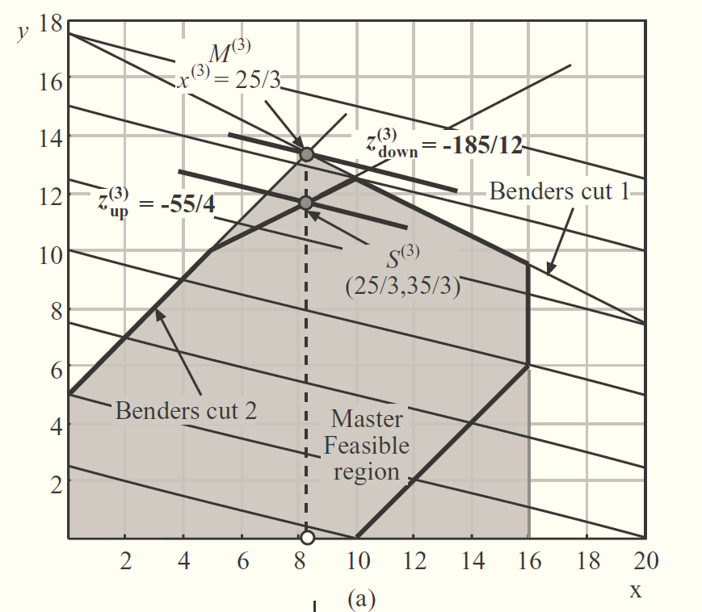
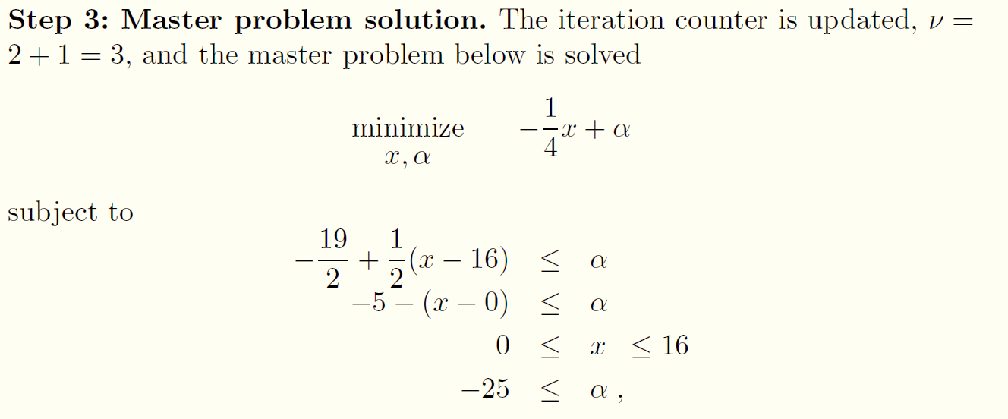
Example

Slide 30

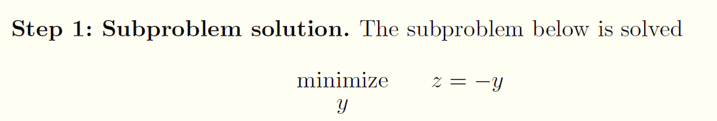
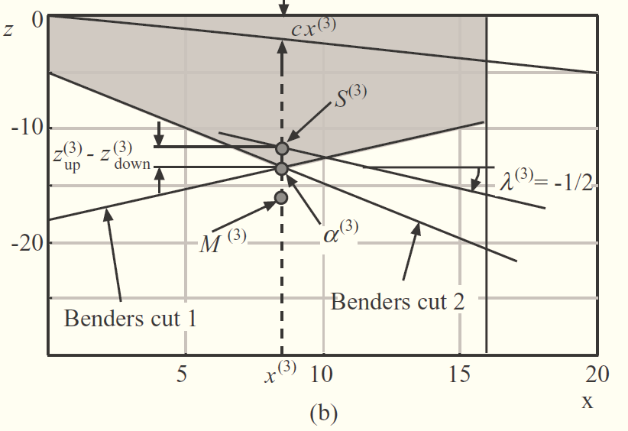
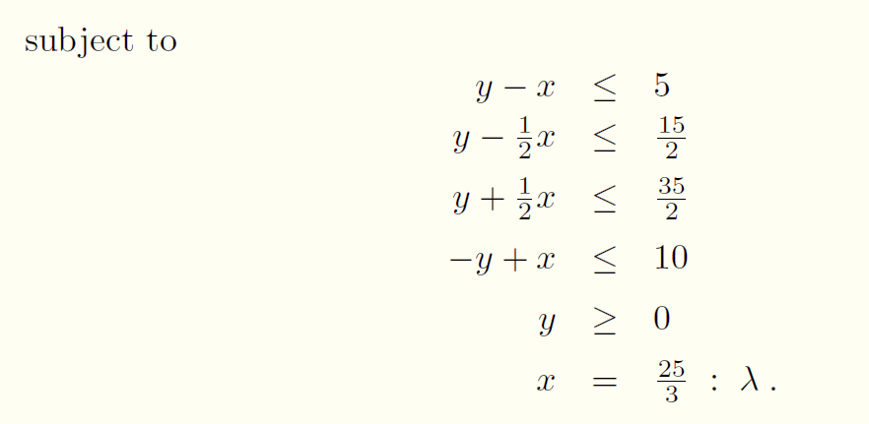

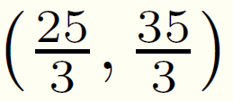

Example

Slide 31
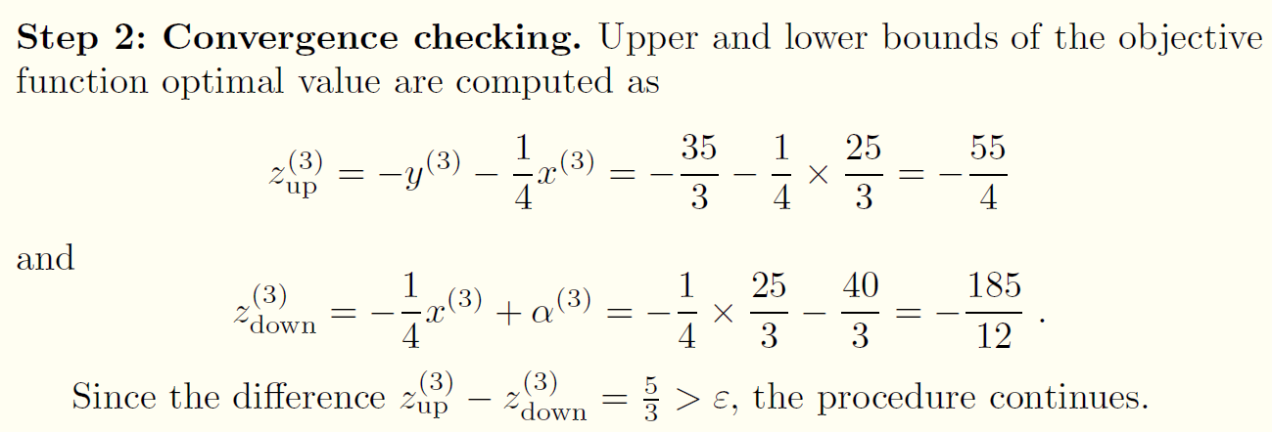
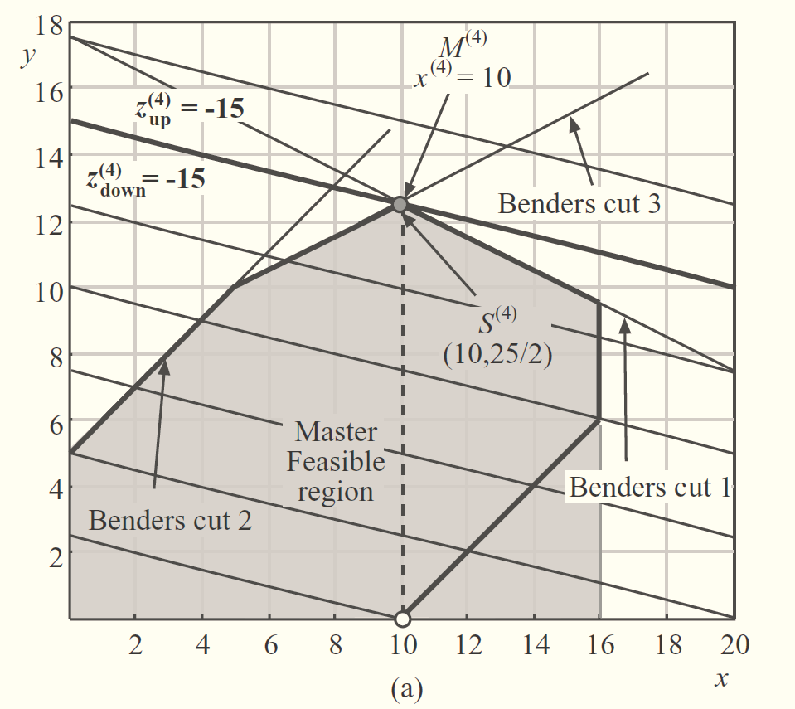
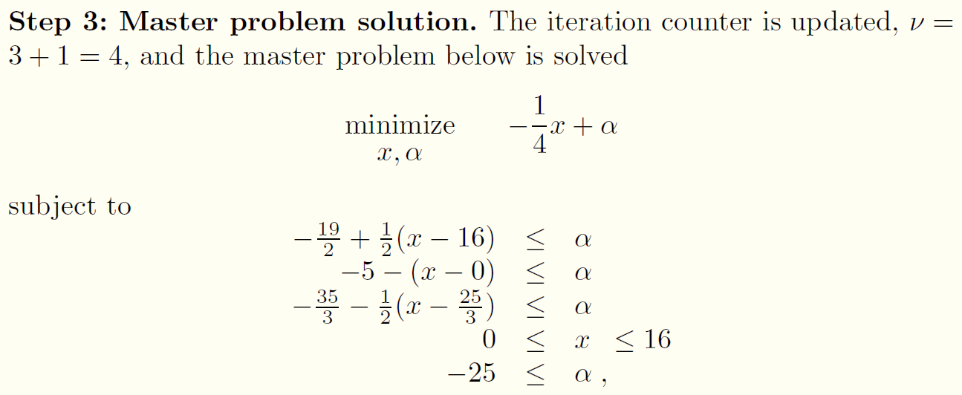
Example

Slide 32

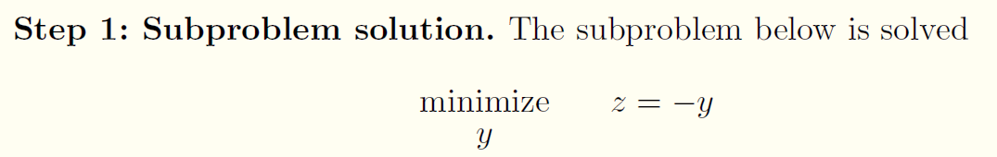
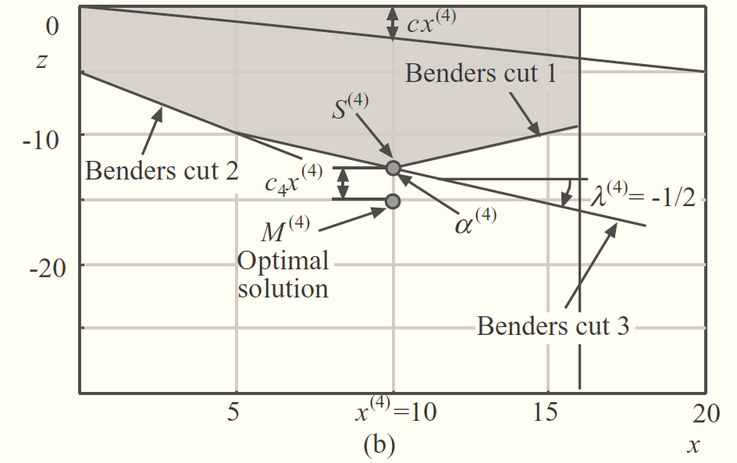
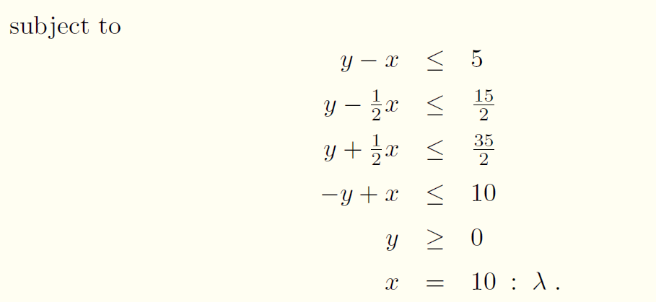

Example

Slide 33
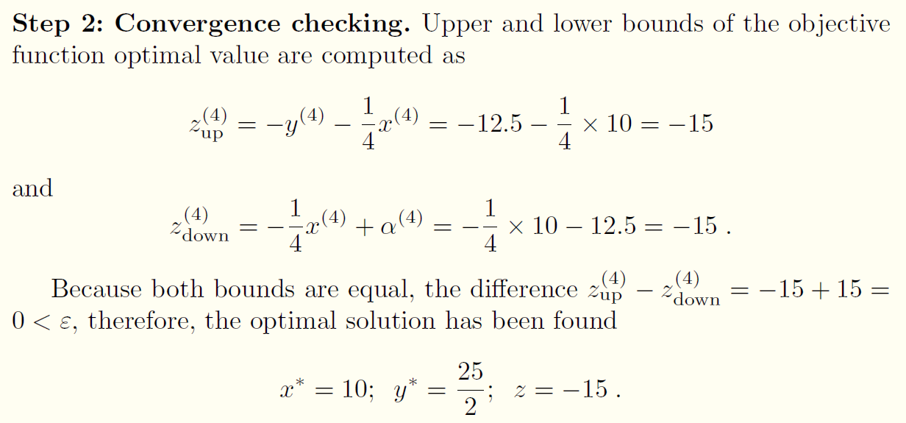
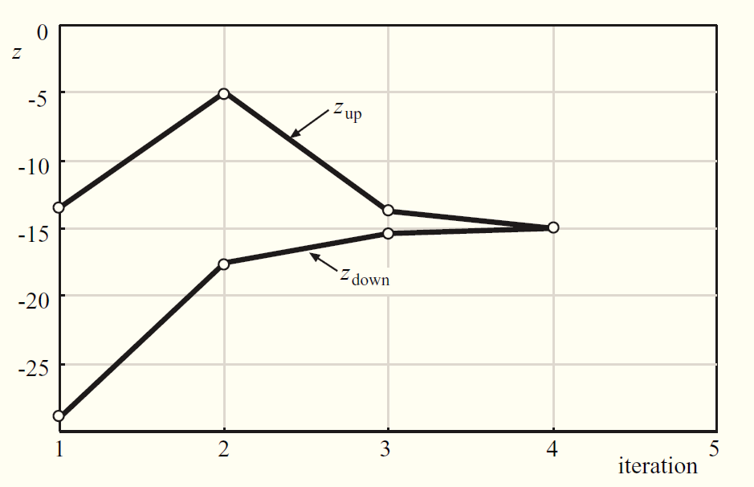
Example

Slide 34
Nonlinear programming problem
Benders decomposition

Slide 35
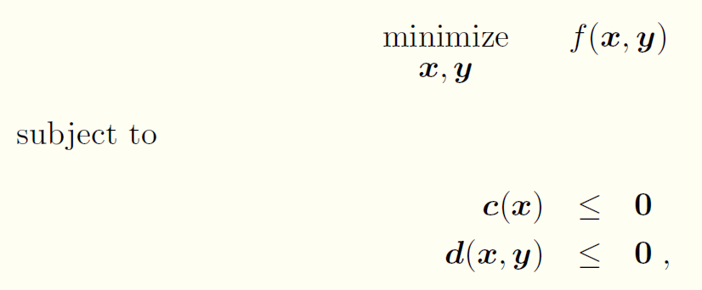
Benders decomposition for nonlinear programming problem
Problem structure:
are complicating variables

Slide 36

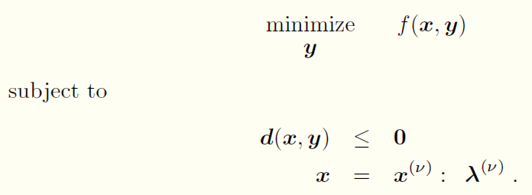
Benders decomposition for nonlinear programming problem
Initialization
Set
Subproblem
Solve

Slide 37



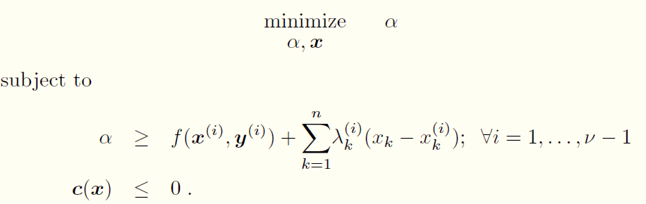
Benders decomposition for nonlinear programming problem
Convergence check
Upper bound: Lower bound:
Master problem: This is different from linear which is only a function of x
Solve

Slide 38
MIXED-INTEGER PROGRAMMING PROBLEM
Benders decomposition

Slide 39
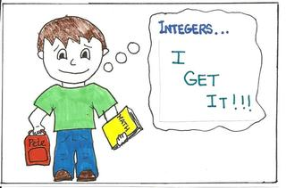
Benders decomposition for mixed-integer programming
Consider integer variables as complicating variables
Assumption: The continuous programming problem resulting from fixing integer variables to given is convex (Obvious for mixed-integer linear programming)

Slide 40
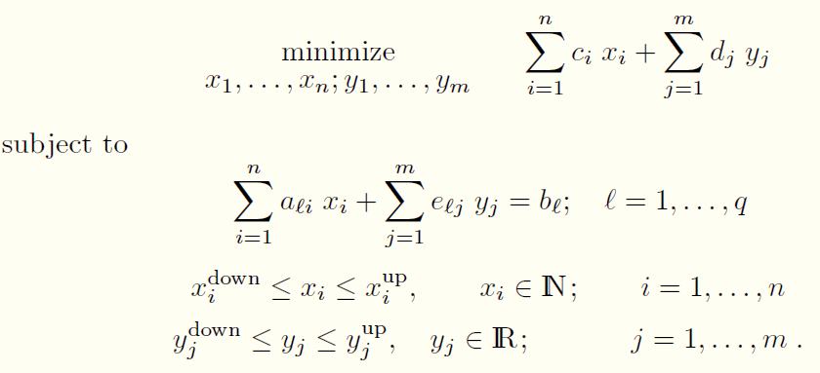
General form of mixed-integer linear programming
MILP

Slide 41
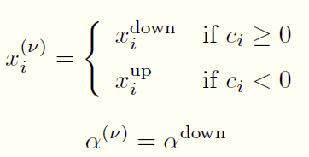

Benders decomposition for MILP problems
Initialization
Loop index ν = 1
Set
Subproblem
Solve linear programming

Slide 42


Benders decomposition for MILP problems
Convergence checking
Upper bound
Lower bound
Stopping criterion

Slide 43

Benders decomposition for MILP problems
Master problem
Solve
Obtain the optimal solution and continue to solve subproblem
Pure integer programming and can be solved by simplex

Slide 44

General form of mixed-integer nonlinear programming
MINLP

Slide 45


Benders decomposition for mixed-integer nonlinear programming
Initialization
Loop index :
Solve
Obtain trivial solution:

Slide 46

Benders decomposition for mixed-integer nonlinear programming
Subproblem
Solve NLP

Slide 47


Benders decomposition for mixed-integer nonlinear programming
Convergence checking
Upper bound
Lower bound
Stopping criterion

Slide 48


Benders decomposition for mixed-integer nonlinear programming
Master problem

Slide 49


Convergence
The convergence of the Benders decomposition algorithm for MINLP problems is guaranteed as long as the envelope of function is convex
In practice, local convexity (vs. global convexity) normally suffices because in engineering or science applications variable limits usually tightly bound the feasibility region

Slide 50



Example
Solve MINLP problem

Slide 51




Example

Slide 52

Example

Slide 53


Example

Slide 54

Example

Slide 55




Example

Slide 56
BRANCH-AND-BOUND

Slide 57
Branch-and-Bound
In Benders decomposition
An alternative to cutting plane in the master problem of Benders decomposition
An enumerative approach for solving an integer programming problem
In Branch and bound, two operations:
Branching: Refers to the enumeration part of the solution technique
Bounding: Refers to the fathoming of possible solutions by comparison to a known upper or lower bound on the solution value.

Slide 58

General idea
The general idea may be described in terms of finding the minimal value of a function f(x) over a set of admissible values of the argument x called feasible region. Both f and x may be of arbitrary nature
Branching: Covering the feasible region by several smaller feasible subregions (ideally, splitting into subregions)
Bounding: Finding upper and lower bounds for the optimal solution within a feasible subregion
Search tree or branch-and-bound-tree

Slide 59

General idea
The core of the approach: Pruning
Worse than the other branch
Infeasible solution
Ideal: The procedure stops when all nodes of the search tree are either pruned or solved
In practice :The procedure is often terminated after a given time
Notes:
Pruning:(for a minimization task)If the lower bound for a subregion A from the search tree is greater than the upper bound for any other (previously examined) subregion B, then A maybe safely discarded from the search.
It is usually implemented by maintaining a global variable m that records the minimum upper bound seen among all subregions examined so far; any node whose lower bound is greater than m can be discarded

Slide 60


Example
Maximize the constrained integer optimization:
(8.15)

Slide 61

Example

Slide 62

Example

Slide 63


Example
Branch-and-Bound tree

Slide 64
Other Algorithms
Knapsack
Dynamic Programming
Reweighted L1 minimization
Relaxation
BCD
Belief propagation

Slide 65

Knapsack Problem
Notes:
p: profit value
W: weight

Slide 66


Knapsack Problem
General form:
Two methods to solve Knapsack problem:
Greedy
Branch-and-bound
Dynamic programming
Notes:
p: profit value
W: weight

Slide 67


Knapsack Problem
In order to solve master problem, we can transform the master problem first:
Original problem:
Master problem:
Notes:
Assume linear case

Slide 68



Equivalent Master Problem
In iteration K:
Update in iterations:
Knapsack problem

Slide 69

Dynamic Programming
Notes:
we might try to start by solving only a small subproblem of (KP) and then extend this solution iteratively until the complete problem is solved. In particular, it may be useful not to deal with all n items at once but to add items iteratively to the problem and its solution. This basic idea leads to the use of the concept of dynamic programming.

Slide 70


Dynamic Programming Example
Notes:
We show an example first then give the general algorithm. w and p are the weight. c is the capacity. The values are given in the chart.

Slide 71

Dynamic Programming Example
The computation is done column wise from left to right and inside a column from top to bottom.
Row 0 and column 0 are initialized with entries equal to 0.
Notes:
Inner: left to right
outter: top to bottom
The values in boxes correspond to the profits of the optimal solution set.

Slide 72




Dynamic Programming
Notes:
The subproblem j
(in the iteration)

Slide 73

Dynamic Programming
Notes:
The case d < Wj means that we consider a knapsack which is too small to contain item j at all. Hence,
item j does not change the optimal solution value Z j_1 (d)
If item j does fit into the
knapsack, there are two possible choices: Either item j is not packed into the knapsack and the previous solution Zj-I (d) remains unchanged or item j is added into
the knapsack which contributes Pj to the solution value but decreases the capacity
remaining for items from {1, ... ,j - I} to d - Wj.

Slide 74



Reweighted l1 norm minimization
What’s reweighted l1 nornm minimization
l0 norm problem;
Approximate l0 norm by weighted l1 norm
Change the weight iteratively
Non-convex
Convex
Reference: E. J. Candes, M. B. Wakin, and S. P. Boyd, “Enhancing sparsity by reweighted l1 minimization,” Journal of Fourier Analysis & Applications, vol. 14, no. 5 , pp. 877-905, 2007.
Notes:
What is reweighted l1 minimization?
In this method, we approximate l0 norm by weighted l1 norm,
But different from conventional methods, the weight are changed iteratively.
Why we need this?
We can see here, in P_0, the problem is non-convex, so it is hard to solve it by convex optimization methods.
P_1, it is a convex problem, which is easy to solve.
But the result of P_1 can not approximate the result of P_0, we have to find some methods to link them together.

Slide 75


Reweighted l1 norm minimization
What’s reweighted l1 minimization
Why add weight？
Notes:
Here, we can see a new problem, WP_1 is proposed to approximate P_0,
It is a weighted version of P_1.
Can this method work well?

Slide 76


Reweighted l1 norm minimization
What’s reweighted l1 minimization
Solution is equal of WP1 and P0
Notes:
If we choose the weight in WP_1 like this method (left-middle), we can prove that WP_1 and P_0 are equivalent. But a problem is we can know the optimal solution x^* in advance, and we also need to approximate infinite properly.

Slide 77


Reweighted l1 norm minimization
Compare some approximation methods
Notes:
Before we detail how to choose the weight, we compare different approximation methods, and then deduce the method to choose the weight.
We can see in this picture, this line is l0 norm (black)
This line is l1 norm (red)
This line is log(xi)
We can see that the log(xi) function can approach l0 norm quite well.

Slide 78




Reweighted l1 minimization
Compare some approximation methods
Notes:
Therefore, In P_0, the optimization goal is replaced by log(xi) function, as (middle-top) function shows.
It is equivalent to (middle-middle) function, with u_i introduced.
Then, use taylor extension here, we can get this form (right-bottom)
The optimization goal can be transformed to (left-bottom), with the constraint y= Phi*x be reserved. Hereby, we get the method to choose the weight. x^l_i is the x value in previous iteration.

Slide 79


Reweighted l1 minimization
How to conduct reweighted l1 minimization
A: If too large, can not approximate； If too small, local optimum.
slightly smaller than the expected nonzero magnitudes of x vector
Notes:
So, when we acquire the x value in each iteration, we update w value, and then we update x value again.
How to choose xi? ( as the PPT shows)

Slide 80

Reweighted l1 minimization
Advantages:
Easy to conduct;
Combine it with other convex optimization method
Disadvantages:

Slide 81



Block coordination descend
What’s BCD method
Two blocks: continuous variables, discrete variables;
Optimize two blocks variables in turn;
Reach local optimum
Continuous
Discrete
Notes:
We can also use BCD method to solve mixed-integer programming problem.
In this method, we try to divide integer variables and continuous variables in to two blocks. Then solve the problem in terms of those two blocks iteratively.
Generally speaking, this method can only reach local optimum.

Slide 82
Block coordination descend
What’s BCD method
Mixed integer programming
BCD
Continuous optimization
Discrete optimization
CVX, ADMM, OCD, etc
Belief propagation, etc
Notes:
When we optimize the original problem in terms of continuous variables, it is a continuous optimization problem, which can be solved by CVX, ADMM, OCD, and other methods.
If we optimize the original problem in terms of discrete variables, it is a discrete optimization method, we can solve it by some methods such as belief propagation. Which we will explain in the following PPT.

Slide 83


Belief Propagation
What’s belief propagation
X* which maximize joint probability distribution p(X);
P(X) can be decomposed to factors;
Each factor links to a subset of variables (sparse);
Can be conducted in a distribute way;
Example
Notes:
For example, let's consider such optimization problem. We want to find out the optimal solution of vector X, which can maximize the joint distribution p(X). And, we can see, the joint distribution can be decomposed into four functions, namely f_a, f_b, f_c and f_d. X may be continuous or integer variable. P(x) may be non-convex.
This picture is called factor graph. Circles denote variables, and rectangles denote functions. If variable x_i is variable of a function, then we draw a line between them.
If we consider this problem in log domain, then the continued product will become summation instead.

Slide 84

Belief Propagation
What’s belief propagation
Messages from factor nodes to variable nodes;
Messages from variable nodes to factor nodes
Variable to factor :
Multiple other messages together
Factor to variable :
Multiple other messages and factor function, maximize it
Notes:
Now, as we have introduced the optimization problem, let's discuss how to solve it by belief propagation.
Belief propagation is an iterative algorithm, in which messages are transferred between factor nodes and variable nodes, such as $\mu_{x to a }$ and $\mu{a to x}$. Those messages are "functions" of variables in corresponding variable nodes.
For instance, the message from variable node $x_1$ is a "function" of variable $x_1$. If x_i is binary integer variable, then $\mu_{x_i to a }$ and $\mu{a to x_i}$ are also binary values.
As we have explain the messages, we explain the calculation details of each node.
We can see the two equations here ( left-up). What is the meaning of those equations?
If we want to calculate the message from factor node f_a to $x_2$, firstly, we can see that beside $x_2$, $x_1$ also links to factor f_a. we multiple the function f_a with the message from $x_1$ (if there are more than one variables link to function f_a besides x_2, then we simply multiple those messages together). Them, we maximize the product in terms of variables of f_a besides x_2.
If we want to calculate the message from variable node $x_2$ to factor node $f_a$, we simply multiple messages from the factor nodes (besides f_a), which link to variable $x_2$, to variable $x_2$ together.
We iteratively update those messages, until them do not change any more, then then algorithm trend to converge.
So, at here, we demonstrate how to conduct the belief propagation.
In the next PPT, we introduce how to conduct the BP algorithm in log domain, and how to decide final optimal value of X.

Slide 85


Belief Propagation
What’s belief propagation
If use log function in message update
log
Notes:
As aforementioned, the BP algorithm can be conducted in log domain. Simply modify the continued product to sigma, change f to log(f).
When the algorithm trends to converge, the final value of X can be decided by the equation here(right - bottom). x_i should maximize the sum of all the messages from linked factor nodes.

Slide 86
Belief Propagation
What’s belief propagation
Continuous, the message is a function;
Discrete, the message is discrete values;
Sparse connected graph, low complexity
Why distributed?
Pro
Easy to conduct
Distributed
Optimum if no loop in the factor graph
Con
No convergence proven in loopy BP yet;
Dumping can guarantee converge, but sacrifice optimum;
Notes:
As aforementioned, the messages can be either a continuous function, or discrete values. As the calculation of messages can be decomposed by different variable nodes or factor nodes, it can naturally be conducted in a distributed way.
We have to note that, we only use BP algorithm when the factor graph is sparsely connected. Otherwise, the calculation complexity in factor nodes are very considerable.

Slide 87

Conclusion

Slide 88


Further reading
Decomposition Techniques in Mathematical Programming
Antonio J. Conejo, Enrique Castillo, Roberto Minguez and Raquel Garcia-Bertrand
Resource Allocation for Wireless Networks: Basics, Techniques, and Applications
Zhu Han, K. J. Ray Liu

