Slide 1


Resource Management for
Device-to-Device Communications
Lingyang Song* and Zhu Han⁺
* School of Electronics Engineering and Computer Science,
Peking University, Beijing, China
⁺ Department of Electrical and Computer Engineering
University of Houston, Houston, TX, USA
Tutorial Presentation at Globecom’13, Atlanta, US

Slide 2
Table of Content
Overview
Key Technologies
Resource Allocation and Game Theoretical Study
Variety of Applications
Conclusions

Slide 3
Table of Content
Overview
  Background
  Device-to-device Communication
  Device-to-device Local Area Networks
Key Technologies
Resource Allocation and Game Theoretical Study
Variety of Applications
Conclusions

Slide 4
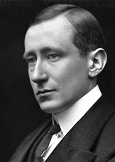
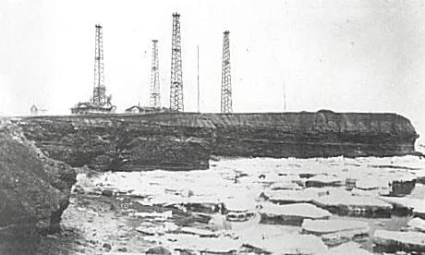
1900: Famous patent No. 7777, "tuned or syntonic telegraphy"
1900: Marconi's Wireless Telegraph Company Limited founded
History of Mobile Communications
1901: Transmitting the first wireless signals across the Atlantic between Poldhu, Cornwall, and St. John's, Newfoundland, a distance of 2100 miles.
1909: The Nobel Prize in Physics

Slide 5
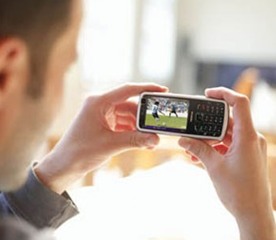
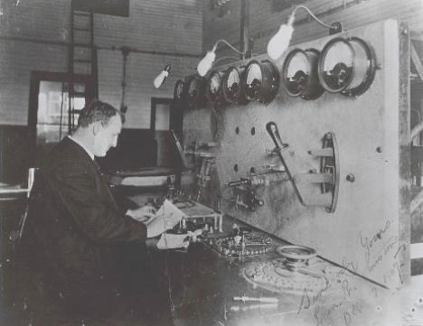
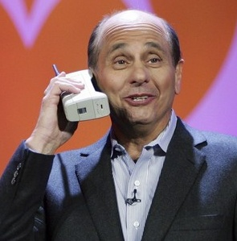
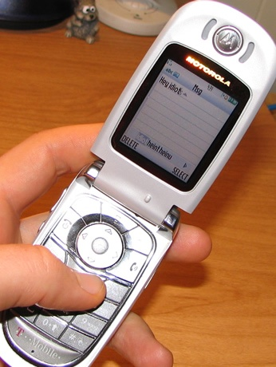

A Market Needs both Technology and Application
From data …
to voice …
to everything

Slide 6
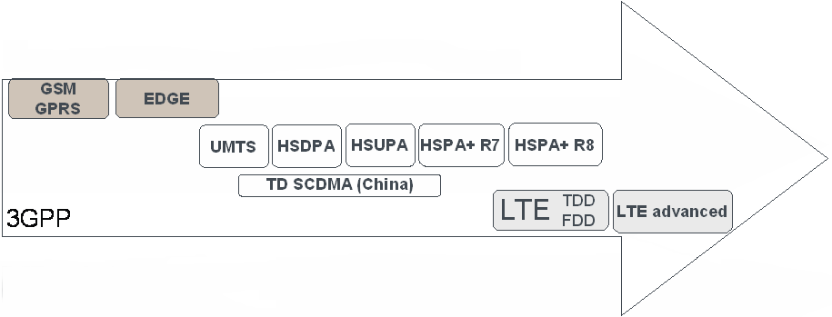
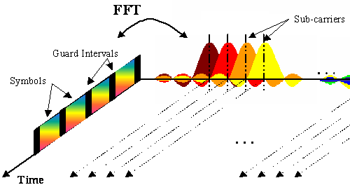
Standardization Facilitates Technology Evolution
Each new evolution builds on the established market of the previous
Backwards-compatible evolution
But larger technology steps require revolutions:
1995
2000
2005
2010
2015
From TDMA:
to CDMA:
to OFDMA:

Slide 7
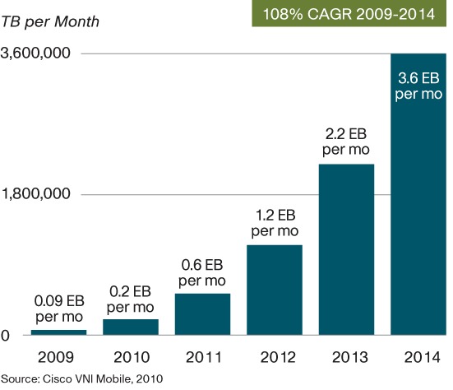
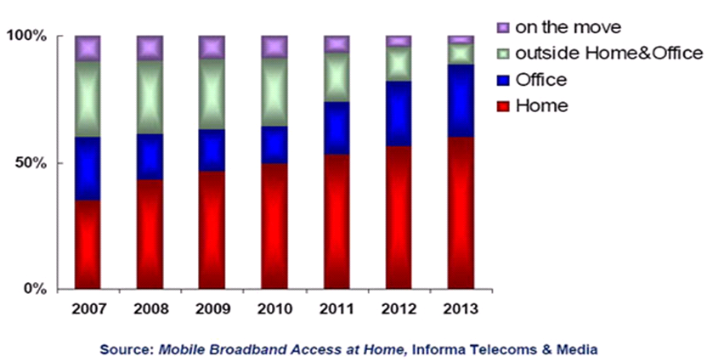
Future Wireless Challenges
Mobile Internet and Smart Phones
  Bandwidth and data traffic boost (Cisco)
    Data traffic increases 2 times/per year, 1000 times by 2020
    Wireless network cannot support that!
  Information aggregate to hotspot and local area
    70% in office and hotspot, over 90% in future
    Hotspot QoS cannot be guaranteed!
  Bandwidth demand over 1200MHz，ITU assignment less than 600MHz

Slide 8
Possible Solutions
Add fixed AP
Combine Cellular and Ad-hoc
Cell Capacity
Ad-hoc opti-mal rate
By “Shannon Theory”，network capacity relies on bandwidth and APs
Current：Add fixed APs
Sum rates
Number of UE
P. Gupta and P. Kumar, “The capacity of wireless networks,” IEEE Transactions on Information Theory, vol. 46, no. 2, pp. 388-404, Mar. 2000.

Slide 9






Definition and Benefits
Definition of Device-to-Device (D2D) Communications
  D2D communications commonly refer to the technologies that enable devices to communicate directly without an infrastructure of access points or base stations.
Increase network capacity
Extend coverage
Offload data
Improve energy efficiency
Create new applications
eNB
eNB

Slide 10


Deployment Roadmap
Cellular unaware D2D
Cellular network is not aware of D2D
2 RATs, e.g. 3G + Wifi
No cooperation between cellular and D2D
Cellular aware D2D
Cellular network is aware of D2D
2 RATs, e.g. LTE + Wifi
Kind of cooperation between cellular and D2D
Cellular controlled D2D
Cellular network fully controls D2D
A single RAT, e.g. LTE-A
D2D is a part of cellular communication
RAT1
RAT1
RATs converging
RAT1
flow1
flow1
flow1
flow2
RAT2
UE2
RAT2
flow2
UE2
flow2
UE2
UE1
UE1
UE1
Scenario A
Scenario B
Scenario C
D2D Benefits Scenario A Scenario B Scenario C
Traffic offload
Unified & Simplified comm.
User experience improvement
Cellular capacity enhancement

Slide 11



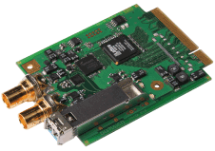








Scenario A: Cellular Unaware
Example structure:
Typical applications
  Data synchronization, Social networking, Mobile advertising, Automation control, etc.
New App
3G
3G
App
App
Data synchronization
Wifi
Wifi
BS
BS
Mobile advertising
Node functionality
  User device: application distribute flows among different RATs
  No impact on RAN & CN nodes
social network
Key technology
  D2D opportunity identification & neighbor discovery
  Flow distribution among different RATs
Benefits/Gains
  Offload cellular traffic
  Unified & Simplified communications

Slide 12

Scenario B: Cellular aware
Node functionality
  User device: new D2D coordination function
  RAN node: No impact
  CN node: new D2D coordination function
Typical applications
  Cellular P2P: A, B, C receive data from CN, and share the non-achieved data among themselves
CN node
Core Network
Example structure:
NB
Core Network
New coordination function/services
NB
A
B
C
App
LTE
App
LTE
Key technology
  D2D opportunity identification
  D2D coordination
Benefits/Gains
  Better user experience, e.g. QoS, mobility, etc.
  Core network traffic offload
  Unified & Simplified communications
Wifi
Wifi

Slide 13


Scenario C: Cellular controlled
Node functionality
  User device: New D2D control & interface
  RAN nodes: New D2D control function
  CN nodes: New D2D control function
Typical applications
  Cooperative transmission: Mobiles interact to jointly transmit and/or receive information in cellular environments.
Example structure:
eNB
New D2D control function/services
Core Network
Key technology
  D2D control
  D2D air interface design
  Cooperative transmission
App
App
Cellular
Benefits/Gains
  Cellular capacity improvement
  Better QoS, security & mobility support
  Core network traffic offload
  Unified & Simplified communications
New Cellular D2D interface

Slide 14
Table of Content
Overview
  Background
  Device-to-device Communication
  Device-to-device Local Area Networks
Key Technologies
Resource Allocation and Game Theoretical Study
Variety of Applications
Conclusions

Slide 15
Device-to-Device Communications
Peer-to-peer Communications
Cooperative Communications
  Cooperative Mobile as Relay
  Cooperative Diversity
Wireless Network Coding
eNB
NB
NB
A
B
C

Slide 16
Peer-to-Peer Communications: UL
UE_{c}¹
UE_{c}¹
eNB
UE_{d}¹
eNB
H
UE_{d}²
UE_{d}¹
UE_{d}²
Assumption: H is known by multi-Tx eNB; Single-Tx UE
Proposal: Centralized Power Control
  eNB: Max sum SINR

Slide 17
Cooperative Mobile as Relay
Enhance the capacity of the cell.
Assist other mobile to communicate with network.
eNB
The link between User A (such as notebook, iPAD, etc) and BS is poor
The link between user B and BS/user A is good.
User B act as a relay for User A to forward the information between user A and BS.
Notes:
Cooperative communication among mobiles is also used to enhance the capacity of the cell. Some mobile is chosen as a relay station to assist other mobile to communicate with network.

Slide 18
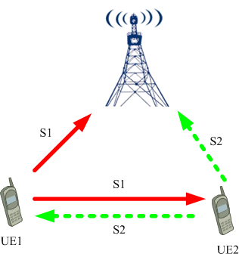
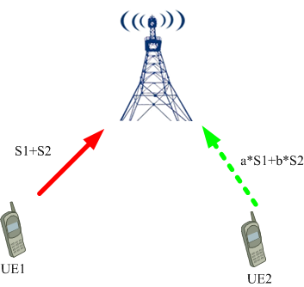
Cooperative Diversity
Objective
  To achieve spatial diversity through the idea of NC.
Protocols
  Phase 1: UE1 and UE2 transmit to eNB through different PRBs, and at the same time they can receive each other’s information.
  Phase 2: The network coded signals are sent to eNB by each UE.
phase-1, UE1 and UE2 transmit to eNB, and each UE receives the replica of the other UE’s signals.
phase-2, each UE sends the superimposed signals to eNB again to achieve additional spatial diversity gain.

Slide 19
Cooperative Diversity
The mobiles in the cell have been split into groups which are composed of adjacent mobiles:
  The grouping of mobiles is controlled by the BS;
  The mobile in the same group can communicate with each other;
  Each group could communicate with BS as one unit;
  Every mobile in the same group relays data for each other;
The typical application area of the system model may include:
  Dynamic network and temporary hot spots, such as world expo.
  High buildings, offices;
  Business quarter.

Slide 20
Wireless Network Coding (1)
Conventional Bi-Directional Relay Protocal

Slide 21
Wireless Network Coding (2)
Decode-and-Forward Bi-Directional Relay Protocal

Slide 22
Wireless Network Coding (3)
Amplify-and-Forward Bi-Directional Relay Protocal
Analog Network Coding

Slide 23
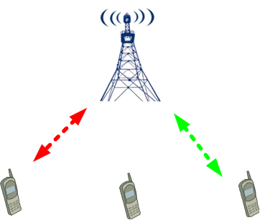
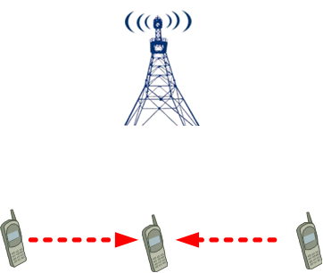
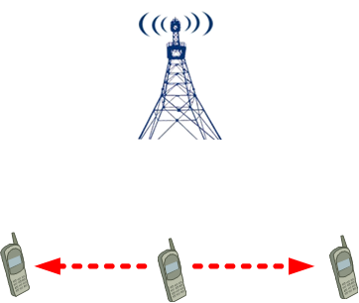
Wireless Network Coding (4)
D2D: an ad-hoc multi-hop relaying protocol (3GPP)
Application of network coding to multi-hop D2D networks is natural
  Better energy-efficiency, fairness, robustness, or coverage.
phase-1, exchange control information to set up the D2D link.
phase-2, D2D
phase-3, D2D
Notes:
D2D has been studied earlier in 3GPP as an ad-hoc multi-hop relaying protocol.
It requires the UEs to probe the neighborhood in regular intervals for potential relays.

Slide 24
Table of Content
Overview
  Background
  Device-to-device Communication
  Device-to-device Local Area Networks
Key Technologies
Game Theoretical Study
Variety of Applications
Conclusions

Slide 25
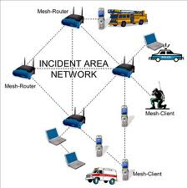
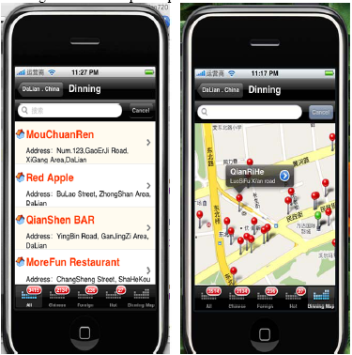
Introduction
RAT | Solution | Benefits | Frequency | Disadvantages
Wireless Mesh | WLAN + Ad Hoc | Flexible | Un-authorized | QoS in-guaranteed
D2D LAN | Cellular +Ad Hoc | Flexible | Authorized | QoS guaranteed
Smart-phones and data-service based mobile internet
eNB
eNB
D2D LAN
UEs can be connected in an Ad-hoc way and use cellular frequency with guaranteed QoS
Create new services for operators and vendors
Expand to many other areas
Wireless Mesh
Mobile social networks:
Mobile + social
Connected via mobiles
Information push, sharing, etc
New business model

Slide 26
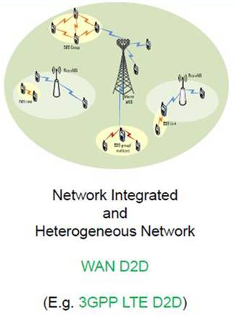
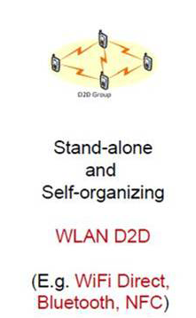
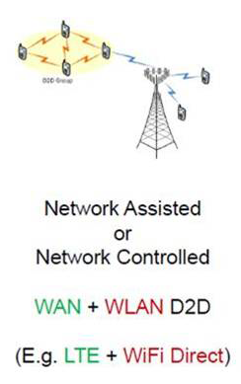
D2D LAN Roadmap
Source：Intel

Slide 27
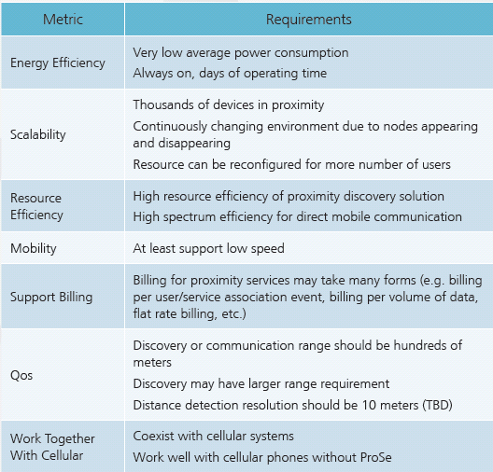
D2D LAN System
D2D LAN Protocol
MME
S-GW
System configuration
Frequency | Authorized
System | TDD
Network | Cellular network and D2D LAN
UE mode | Cellular/D2D
Topology | Multi-cell
Control | Core network, eNB, and UE
EPC
Key issues
Usage scenarios, services, and billing
Channel model
Physical layer
MAC layer
Network layer
Cellular
D2D LAN:
Subnet
Parallel to Cellular
Flexible topology
Controlled by core network and eNB
D2D
E-UTRAN

Slide 28
D2D LAN Problems
MME
S-GW
Realize full connection，networks become complicated
Core Net
Introduce“device”freedom
Space, Time, Frequency, and Device, joint optimization
Communication Freedom increase
Cellular
Support high-date transmission，interference becomes severe
Realize four dimension optimization，resource management is challenging
D2D LAN

Slide 29





Research Projects
Industry and Information Ministry of China:
Mobile D2D Direct
  QUALCOMM:
FlashlinQ
LTE-Direct
Science and Technology Ministry of China:
D2D LAN

Slide 30
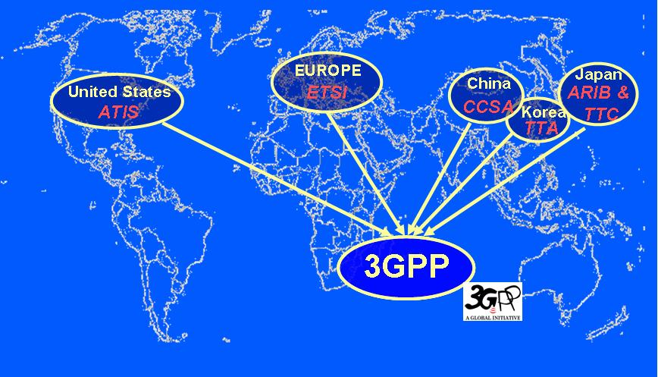
Standardization in a Global Partnership
3GPP: The 3rd Generation Partnership Project
A form of Open Innovation:
5 regions
Over 300 member companies

Slide 31
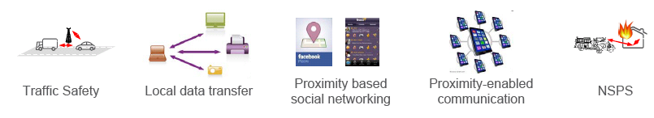
3GPP R12 on D2D
Drastically different requirements
The LTE platform would have the advantage over others, such as Wi-Fi and Bluetooth that operate device to device protocols, because they use license exempt spectrum.
Proximity-based applications and services represent a recent and enormous social-technological trend
  These applications and these services are based on the awareness that two devices or two users are close to each other
  Awareness of proximity carries value, and generates demand for an exchange of traffic between them
Direct D2D communication is also essential for public safety services
  e.g. in case of lack of network infrastructure in disaster situations)
3GPP has imitated work on enhancing the LTE-EPC platform to support these capabilities

Slide 32
3GPP R12 on D2D
Motivation of D2D SI and WI in 3GPP and other standardizations
Development within 3GPP
  SA1 TR22.803,TS22.278*
  SA2 WI TR22.703
  RAN SI** : Study on LTE Device to Device Proximity Services
    Objectives: evaluate LTE device-to-device proximity services
    ProSe Discovery over E-UTRA;
      Evaluation of discovery and communication performance
      Discovery research on carrier, timing, resource allocation, discovery signal/channel
      Communication research on synchronization, timing, resource allocation, control/share channel
    ProSe Communication over E-UTRA;
    EPC support of ProSe Communication over WLAN

Slide 33
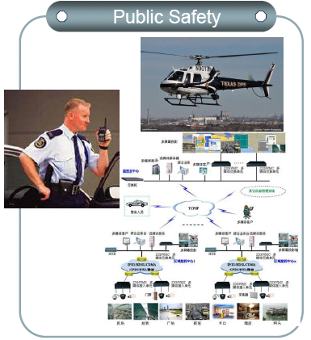
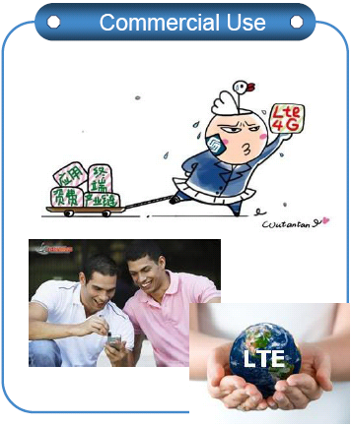
3GPP R12 on D2D
 | Within network coverage | Outside network coverage
Discovery | Non public safety & public safety requirements | Public safety only
Direct Communication | At least public safety requirements | Public safety only

Slide 34
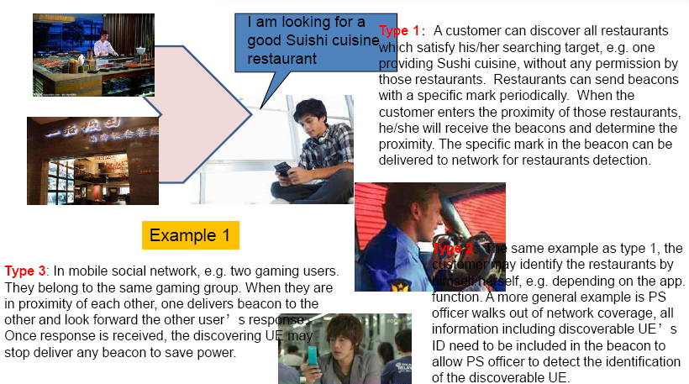
Application Scenarios
There are two important services of ProSe.
  The first one is proximity discovery with which users can discovery each other in proximity.
  The second is direct communication with which users can communicate with each other in proximity.
There is no causality between proximity discovery and direct communication.
  Proximity discovery can be stand alone services to users and doesn’t always trigger direct communication.
  Users may initiate direct communication directly without proximity discovery.
  However, users can use direct communication easily when they know the proximity information.

Slide 35
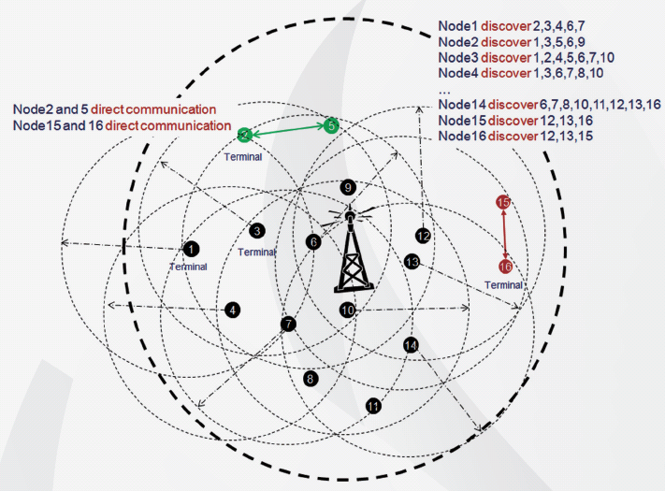
Application Scenarios
D2D scenarios include proximity discovery and direct communication.

Slide 36
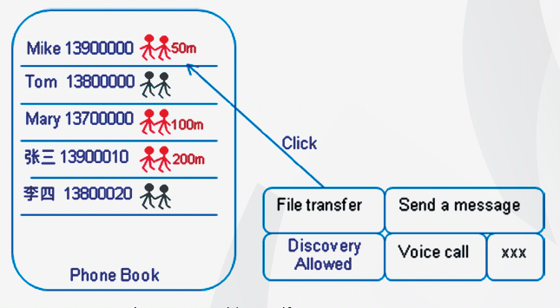
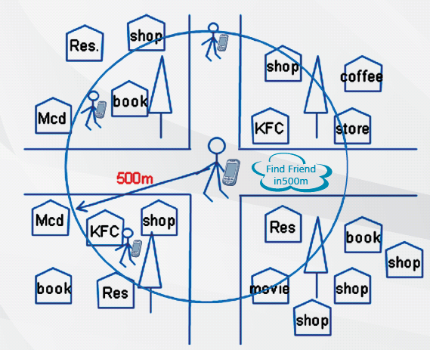
Application Scenarios (1)
Social Networking
  Without specific target users: ProSe applications discovery all the users in proximity and network helps to choose those of users’ interest.
  With specific target users: ProSe applications only discover the specific users, usually the friends of users and show the proximity information on the right of the target user.

Slide 37
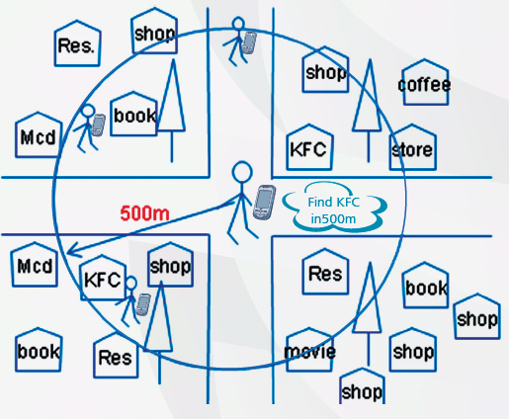
Application Scenarios (2)
Local Advertisement
  The shops will automatically distribute the advertisement to the passage nearby.
  Applications in users’ terminal discover the advertisers automatically and receive the information from them, including introduction, menus, coupons, etc.

Slide 38
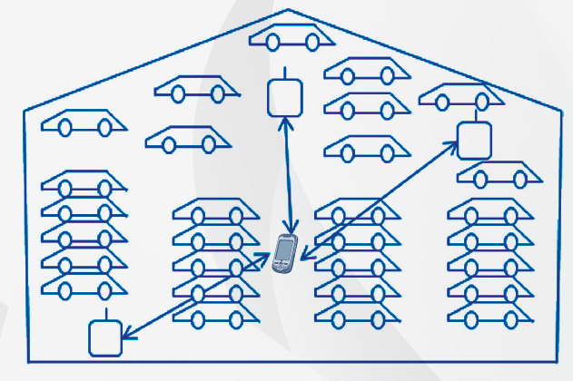
Application Scenarios (3)
Location Enhancement
  The D2D terminals receive the real-time parking space information that helps finding one’s parking space easily.
  It can provide more information than a GPS based application by D2D.

Slide 39
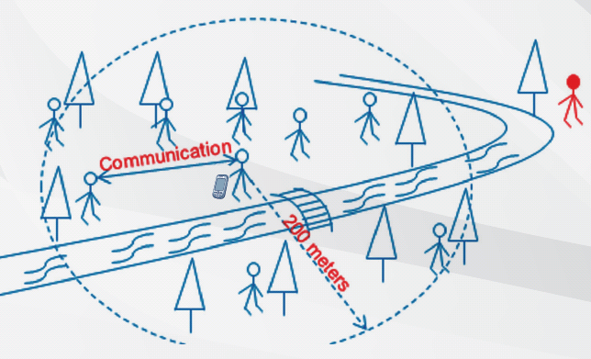
Application Scenarios (4)
Distance Based Applications
  Members of a team or group can obtain the sphere of activities for each other by D2D distance monitoring when touring, keeping a safe movement range to prevent occurring accident.

Slide 40
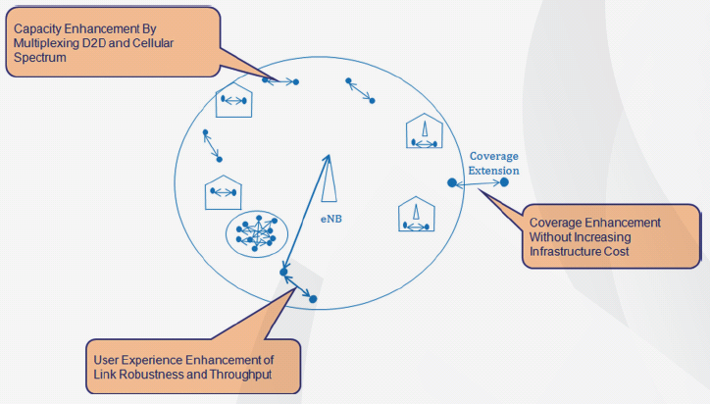
Application Scenarios (5)
Enhance Network Capability (Offloading)
  D2D applications can provide coverage enhancement without increasing infrastructure cost, capacity enhancement by multiplexing D2D and cellular spectrum and user experience enhancement of link robustness and throughput.
e.g.
Concert Networks
Stadium Networks

Slide 41
Application Scenarios (5)
Disaster and Public Safety
  In case of disastrous simulation, where the fixed infrastructures, such as BSs, are in failure, mobiles not in the coverage can possibly reach the BS with the aid of mobiles in the coverage area.
  This is similar to multi-hop relaying networks.
MME
S-GW
D2D
Emergency Communications
Mobile Adhoc networks
Active BS is the final destination

Slide 42
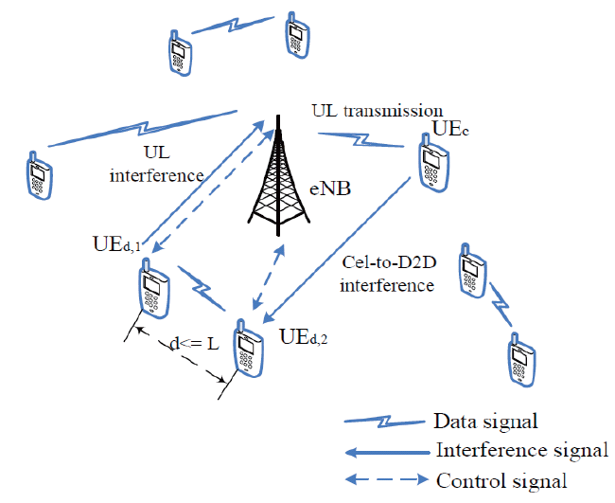
Application Scenarios (6)
Two Basic System Models
MME
S-GW
CN
Cellular
D2D LAN

Slide 43
Research Topics
Scaling law and capacity analysis
Channel measurement and modeling, and interference analysis
Device discovery
Proximity based applications, such as context-aware networks, and offload in concert and stadium networks
Distributed network coding for data dissemination
Interference cancellation
Group communication, multicasting, and broadcasting
Mobility measurement, modeling and management
Interference-aware resource allocation and routing
Connectivity and multiple-hop communication
Signaling overhead reduction
Limited backhaul issues for cross-cell D2D transmission
New applications and services, e.g. mobile social networks

Slide 44
Table of Content
Overview
Key Technologies
  Access Methods
  Mode Selection
  Neighbor Discovery
  Spectrum Sharing
  Interference Analysis
  Power Control
  MIMO Beamforming
  Signal and Interference Model
  Radio Resource Management
  Operation Protocol

Slide 45
Access Methods
The D2D networks can be configured in three ways to allow or restrict their usage by certain users:
  Network Controlled: In this scheme, the base station and the core network control the communication signaling setup and the there after resource allocation for both cellular and D2D users.
  Self-organized: In this scheme, D2D users themselves realizes the communications in a self-organizing way by finding the empty spectrum hole.
  Network Assisted : The D2D users operates in a self-organized way, and exchanges with cellular system limited controlling information for resource management. And the cellular network can obtain the status of D2D communications for better control purposes.
    This scheme comprises the merits of first two D2D users access methods.

Slide 46
Mode Selection
Mode selection criteria
  Cellular Mode: The mobile works in a traditional cellular way relaying data by a BS.
  D2D Mode: The mobiles exchanges information directly.
  Mode Adaptation: The mobiles can select the right mode for communication according to the predefined criterions.
Typically, all the UEs are implemented with two modes, i.e. cellular mode, and D2D mode, and can adaptively utilize the proper way for transmission.

Slide 47
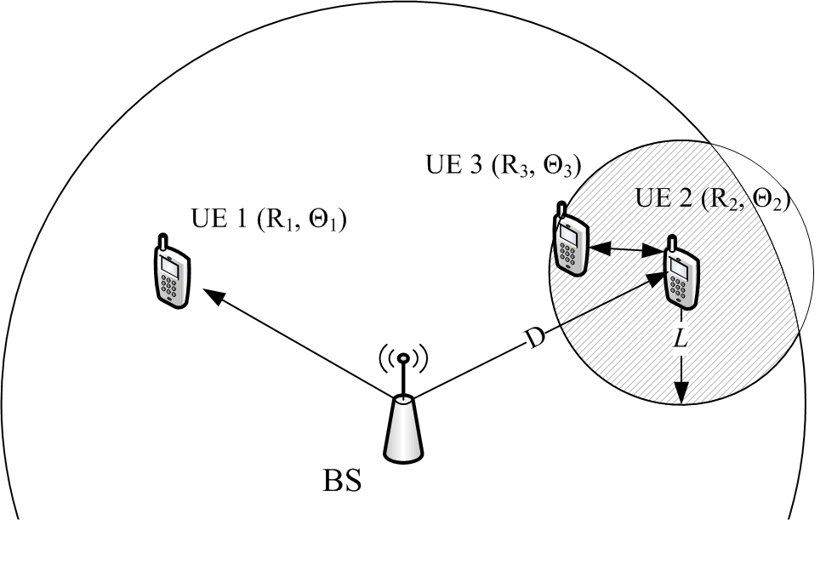
Simulation Results by Mode Selection:
Scenario
Cellular user (UE1) and D2D users (UE2 and UE3) share the same radio resources.
  The position of UE2 is fixed.
  UE3 follow a uniform distribution inside a region at most L from UE2.
  UE1 is free to be anywhere inside the cell, following a uniform distribution.
Scenario of D2D underlay communication

Slide 48
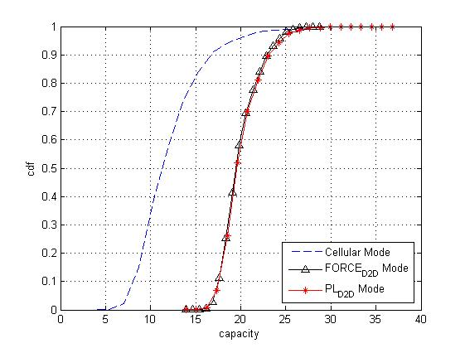
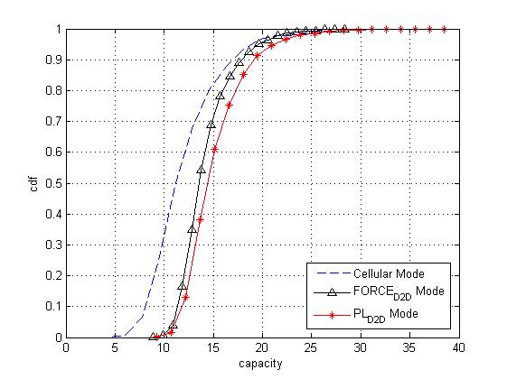
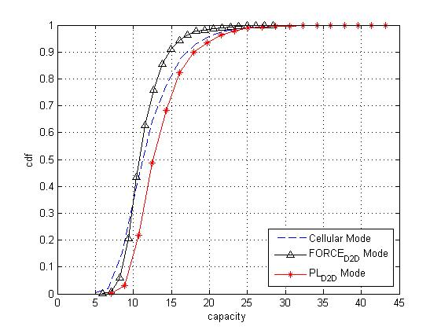
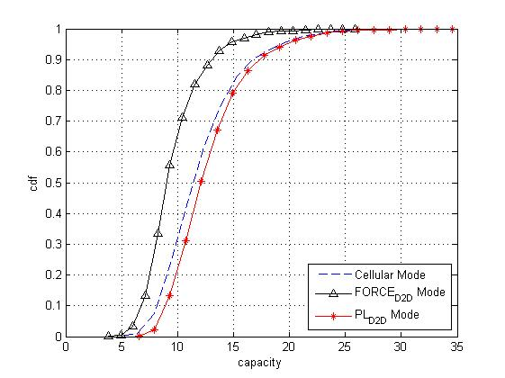
Simulation Results by Mode Selection
Capacity distribution under different L
L=5m.
L=15m.
L=25m.
L=35m.
Notes:
As the maximum distance between users in a pair increases, the performance of direct communication degrades. There exists a threshold value of L for deciding whether to use D2D communication.
PL mode is a method to solve the problem. Choose the better channel condition from cellular and D2D communication can obtain an optimal performance results.

Slide 49
Device Discovery and Synchronization (1)
For D2D communications, network time synchronization is necessary
  between cellular networks and D2D users
  among D2D users themselves
  to minimize multi-access interference, as well as for the proper performance of handoffs.
The fundamental problem of device discovery is that
  the two peer devices have to meet in space, time, and frequency. Without any coordination,
  this can be made possible via some randomized procedure and one of the peers assuming the responsibility of sending the beacon.
The approaches in IEEE 802.11 can be readily adopted to enable the synchronization among mobiles.

Slide 50
Device Discovery and Synchronization (2)
Traditional peer discovery: In both the ad hoc and the cellular cases, the discovery is made possible by one party transmitting a known synchronization or reference signal sequence (the beacon).
In the case of network assisted D2D, the network can mediate in the discovery process by
  recognizing D2D candidates,
  coordinating the time and frequency allocations for sending/scanning for beacons,
  and thereby making the pairing process more energy efficient and less time consuming.
Typical procedure
  Use direct signal to discover peer
  Set transmission power so that UEs in distance D can hear the broadcast.
  Whoever receives the broadcast confirm that with the eNodeB

Slide 51
Device Discovery and Synchronization (3)
From the aspect that there is response from discovering UE or not, two discovery approaches could be classified:
  Beacon-based discovery
  Request-based discovery
According to whether there is network participation for identification detection, discovery procedure could be categorized into:
  Network-assistance detection
  Non-Network-assistance detection

Slide 52
Spectrum Sharing
Spectrum sharing as an overlay:
  The D2D users occupies the vacant cellular spectrum for communication.
  This approach that completely eliminates cross-layer interference is to divide the licensed spectrum into two parts (orthogonal channel assignment).
  This way, a fraction of the subchannels would be used by the cellular users while another fraction would be used by the D2D networks.
  Although optimal from a cross-layer interference standpoint, this approach is inefficient in terms of spectrum reuse.
Spectrum sharing as an underlay:
  This scheme allows multiple D2D users to work as an underlay with cellular users, and thus to improve the spectrum efficiency.
  Therefore, co-channel assignment of the cellular and D2D users seems more efficient and profitable for operators, although far more intricate from the technical point of view.

Slide 53
Interference Analysis
D2D networks provides coverage at the customer premises, but radiates toward neighboring mobile users, introducing interference.
Considering that these networks define two separate layers, interference can be classified as follows:
  Cross-layer: This refers to situations in which the aggressor (e.g., a D2D user) and the victim (e.g., a cellular user) of interference belong to different network layers.
  Co-layer: In this case the aggressor (e.g., a D2D user) and the victim (e.g., a neighboring D2D user) belong to the same network layer.
Combating the interference
  Transmitter: Frequency, time, space, power etc, allocation
  Receiver: Signal processing for interference cancelation

Slide 54
Power Control
Power control can be performed by two approaches:
  Self-organized power control:
    the D2D users make power changes in a self-organized way according to a predefined SINR threshold in order to meet the QoS, and meanwhile not affect the cellular users.
  Network managed power control:
    Both cellular and D2D users adaptively adjust the transmit power according to the SINR report.
    Typically, the D2D users can control the transmit power at first, and then the cellular users make change afterward.
    This iterative process terminates until all the users meet their SINR requirements.
The first method is not going to change the behaviors of cellular users, such that D2D users are invisibly treated.
The second method allows all the users to adjust the transmit power, but requires a certain amount of signaling overhead

Slide 55
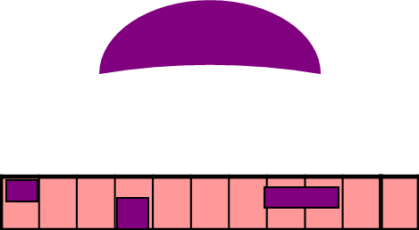
Threshold Based Power Control
Motivation & Problem
  Same frequency-time resources could be shared by cellular & D2D links to enhance the system capacity
  Power control is necessary to mitigate the interference & saving energy
    Limit the amount of interference to cellular users
    Achieve a reliable level of performance for D2D users
Spectrum
Cellular + D2D
Terminal 2
Cellular air link
Terminal 2
Cellular air link
D2D air link
BS
D2D air link
BS
Resource allocation
Terminal 3
Terminal 1
Terminal 1
Cellular & D2D
Resource reuse between D2D & cellular links

Slide 56
Iterative Algorithm
A power control method which can be utilized with distributed scheduling
Algorithm:
BS has no direct control on the D2D link transmission but notifies a threshold to D2D transmitter
BS feeds back the CSI of D2D transmitter UL channel (not needed for TDD system)
D2D trans. Power is calculated by D2D transmitter itself
D2D transmitter can freely decide whether to transmit according to allowed transmitter power and D2D link status
1. eNB notifies threshold value
3. eNB measures transmitter UL link quality and feeds back CSI
Transmitter
Independent with cellular trans.
Cellular User
2. Transmitter achieves D2D link status
Receiver
4. Transmitter calculates sending power and decides whether to transmit or not
Key benefits:
Better adapt to D2D link quality to improve performance
Better scalability as distributed characteristics
Could both restrain interference and guarantee the feasibility of D2D connection

Slide 57
Iterative Algorithm
Achieving D2D channel status info.
  D2D transmitter sends detection signals and the receiver detects
  D2D receiver sends detection result and the channel information to the transmitter
Achieving channel status Info. of link from D2D transmitter to BS
  D2D transmits detection signals to the BS
  The BS feedback CSI to D2D
Deciding whether D2D link usable
  D2D receiver measures SINR and judge by a threshold
BS assign radio resource and threshold value
D2D transmitter achieving D2D channel status Info.
BS feedbacks channel status Info. of link from D2D transmitter to BS
(not needed for TDD system)
D2D transmitter calculating D2D transmission power
Whether D2D link usable?
Yes
No
Send with calculated power
Cancel data sending

Slide 58
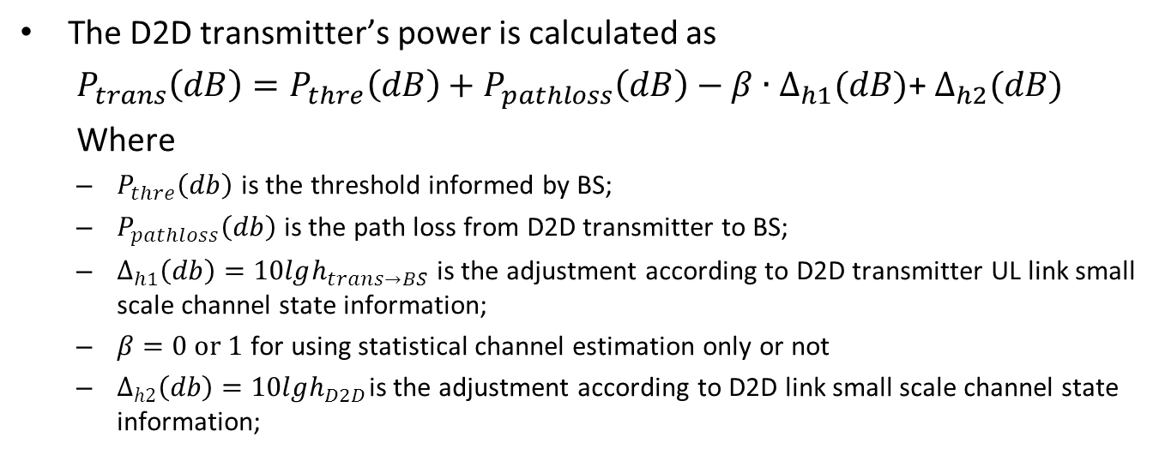
Iterative Algorithm
Example:

Slide 59
MIMO and Virtual MIMO
By performing transmit or receive beamforming ,the use of multiple antennas at the eNB and the UE can
  reduce the co-channel interference to other users,
  and thus to improve spectrum efficiency.
The methods can be summarized as follows:
  eNB beamforming: This sort of multi-user MIMO like approach can be performed at the cellular dowblink to reduce the interference to D2D users, such that D2D communications can be allowed.
  D2D beamforming: This avoids the D2D transmission to disturb the cellular and other D2D users.
  Virtual D2D beamforming: This borrows the ideas of cooperative mobiles, such that multiple D2D users collaboratively form the beamforming matrices to improve the system performance.

Slide 60
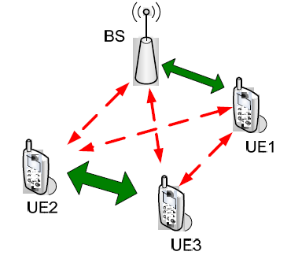
Signal and Interference Model
Resource allocation | Interference
Uplink (UL) | CEL— From: D2D user. To: BS D2D— From: cellular user. To: D2D user
Downlink (DL) | CEL— From: D2D user. To: cellular user D2D— From: BS. To: D2D user
D2D comm. reusing cellular resources. Solid arrows indicate the wanted signals and dashed arrows the interference.

Slide 61

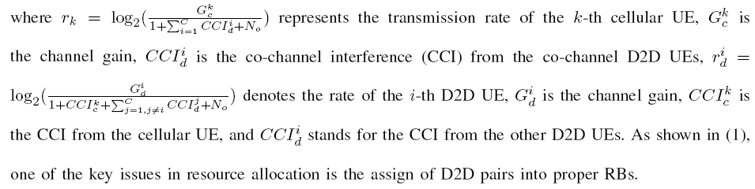
Signal and Interference Model
During the uplink period of the cellular system, both cellular and D2D UEs receive interference as they share the same sub-channels.
During the UL period, the sum rate of the cellular UEs and D2D UEs can be written as

Slide 62
Simulation Results
TABLE
Main Simulation Parameters
Parameter | Value
Cellular | Isolated cell, 1-sector
System area | User devices are distributed within a range of 500m from the BS
Noise spectral density | -174dBm/Hz
System bandwidth | 5MHz
Noise figure | 5dB at BS/9dB at device
Antenna gains and patterns | BS:14dBi Device: Omnidirectional 0dBi
Cluster radius | 5m,10m,15m,20m,25m
Transmit power | BS:46dBm Device: 24dBm (without power control)
Channel Model | WINNER II

Slide 63
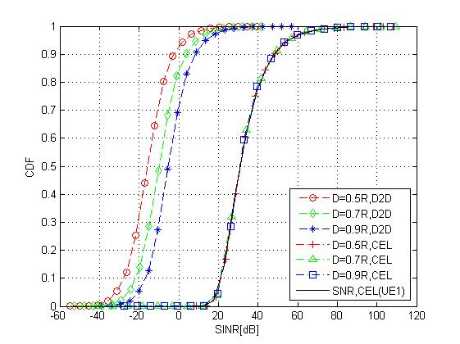
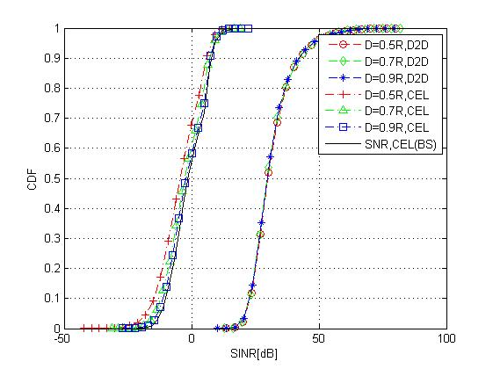
Simulation Results
SINR distribution without PC (DL)
SINR distribution without PC (UL)
SINR distribution of D2D underlay communication with L=25m (DL).
SINR distribution of D2D underlay communication with L=25m (UL).
Notes:
Downlink
D2D SINR is better when the pair is farther away from BS.
Cellular (UE1) SINR is less sensitive to the location of D2D users.
UE1 SINR is better than D2D SINR.
Uplink
D2D SINR is almost unchanged as the distance from BS to the pair changes.
BS SINR is better when D2D pair is farther away from BS.
D2D SINR is better than BS SINR.

Slide 64
Radio Resource Management (1)
With regards to the underlay approach, to mitigate cross- and co-layer interference, there would be a central entity in charge of intelligently telling each cell which subchannels to use.
This entity would need to collect information from the D2D users, and use it to find an optimal or a good solution within a short period of time.
The presence of large number of D2D users, and the allowance of multiple D2D users coexistence with cellular user makes the optimization problem too complex.
Latency issues arise when trying to facilitate the D2D communication with the central subchannels broker throughout the backhaul.
A distributed approach to mitigate cross- and co-layer interference, where the D2D users can manage their own subchannels, is thus more suitable in this case (i.e., self-organization).

Slide 65
Radio Resource Management (2)
In a non-cooperative solution, i.e. self-organized approach
  each D2D user would plan its subchannels so as to maximize the throughput and QoS for its users.
  this would be done independent of the effects its allocation that might cause to co-channel D2D and cellular users.
In a cooperative approach, i.e. network assisted approach
  the D2D users can gather partial information about subcarrier usage situation.
  may perform its allocation taking into account the effect it would cause to its co-channel neighbors.
  the average cellular and D2D users' throughput and QoS, as well as their global performance can be locally optimized.

Slide 66
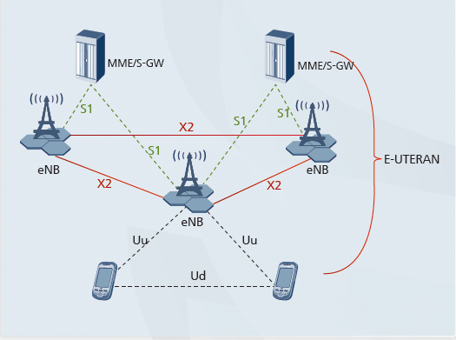
D2D Operating Protocol
Research Challenges
All UEs：Cellular
Network: Self-organization
MME：
Adjacent
No
Yes
UE probe
MAC：Dynamic resource allocation
No
Mode
Switch
Yes
D2D Network
Resource allocation
PHY：Efficient transmission
Propagation：Channel modeling
D2D transmission

Slide 67
Table of Content
Overview
Key Technologies
Resource Management and Game Theoretical Study
  Basics
  Non-Cooperative Static Game
  Dynamic Game
  Cooperative Game
  Auction Theory
Variety of Applications
Conclusions

Slide 68
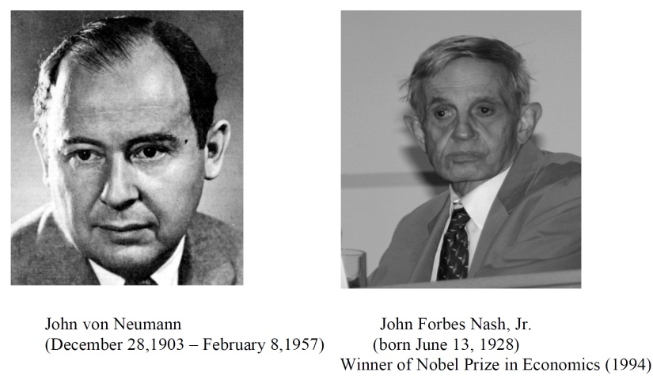

History of Game Theory
John von Neuman (1903-1957) co-authored, Theory of Games and Economic Behavior, with Oskar Morgenstern in 1940s, establishing game theory as a field.
John Nash (1928 - ) developed a key concept of game theory (Nash equilibrium) which initiated many subsequent results and studies.
Since 1970s, game-theoretic methods have come to dominate microeconomic theory and other fields.
Nobel Prizes
  Nobel prize in Economic Sciences 1994 awarded to Nash, Harsanyi (Bayesian games) and Selten (subgame perfect equilibrium).
  2005, Auman and Schelling got the Nobel prize for having enhanced our understanding of cooperation and conflict through game theory.
  2007 Leonid Hurwicz, Eric Maskin and Roger Myerson won Nobel Prize for having laid the foundations of mechanism design theory.

Slide 69
Introduction
Game theory - mathematical models and techniques developed in economics to analyze interactive decision processes, predict the outcomes of interactions, identify optimal strategies
Game theory techniques were adopted to solve many protocol design issues (e.g., resource allocation, power control, cooperation enforcement) in wireless networks.
Fundamental component of game theory is the notion of a game.
  A game is described by a set of rational players, the strategies associated with the players, and the payoffs for the players. A rational player has his own interest, and therefore, will act by choosing an available strategy to achieve his interest.
  A player is assumed to be able to evaluate exactly or probabilistically the outcome or payoff (usually measured by the utility) of the game which depends not only on his action but also on other players’ actions.

Slide 70
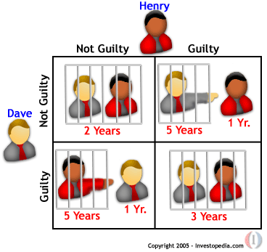
Examples: Rich Game Theoretical Approaches
Non-cooperative Static Game: play once
  Mandayam and Goodman (2001)
  Virginia tech
Repeated Game: play multiple times
  Threat of punishment by repeated game. MAD: Nobel prize 2005.
  Tit-for-Tat (infocom 2003):
Dynamic game: (Basar’s book)
  ODE for state
  Optimization utility over time
  HJB and dynamic programming
  Evolutional game (Hossain and Dusit’s work)
Stochastic game (Altman’s work)
Cooperative Games
  Nash Bargaining Solution
  Coalitional Game
Prisoner Dilemma
Payoff: (user1, user2)
Notes:
John Edwards

Slide 71
Games in Strategic (Normal) Form
A game in strategic (normal) form is represented by three elements:
  A set of players N
  Set of strategies of player Si
  Set of payoffs (or payoff functions) Ui
Notation s_{i} strategy of a player i while s_{-i} is the strategy profile of all other players.
Notice that one user’s utility is a function of both this user’s and others’ strategies.
A game is said to be one with complete information if all elements of the game are common knowledge. Otherwise, the game is said to be one with incomplete information, or an incomplete information game.

Slide 72
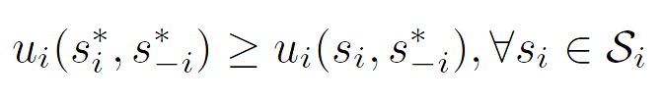
Nash Equilibrium
Dominant strategy is a player's best strategy, i.e., a strategy that yields the highest utility for the player regardless of what strategies the other players choose.
A Nash equilibrium is a strategy profile s* with the property that no player i can do better by choosing a strategy different from s*, given that every other player j ≠ i .
In other words, for each player i with payoff function u_{i} ,
No user can change its payoff by Unilaterally changing its strategy, i.e., changing its strategy while s_{-i} is fixed

Slide 73
The price of Anarchy
Centralized system: In a centralized system, one seeks to find the social optimum (i.e., the best operating point of the system), given a global knowledge of the parameters. This point is in many respect efficient but often unfair.
Decentralized: When the players act noncooperatively and are in competition, one operating point of interest is the Nash equilibrium. This point is often inefficient but stable from the players’ perspective.
The Price of Anarchy (PoA), defined as the ratio of the cost (or utility) function at equilibrium with respect to the social optimum case, measures the price of not having a central coordination in the system
PoA is, loosely, a measure of the loss incurred by having a distributed system!

Slide 74
Example: Prisoner’s Dilemma
Two suspects in a major crime held for interrogation in separate cells
  If they both stay quiet, each will be convicted with a minor offence and will spend 1 year in prison
  If one and only one of them finks, he will be freed and used as a witness against the other who will spend 4 years in prison
  If both of them fink, each will spend 3 years in prison
Components of the Prisoner’s dilemma
  Rational Players: the prisoners
  Strategies: Stay quiet (Q) or Fink (F)
  Solution: What is the Nash equilibrium of the game?
Representation in Strategic Form

Slide 75
Example: Prisoner’s Dilemma
Price of Anarchy 3
 | P2 Quiet | P2 Fink
P1 Quiet | 1,1 | 4,0
P1 Fink | 0,4 | 3,3
Pareto optimal
(recall we’re minimizing)
Nash Equilibrium

Slide 76
Algorithms for Finding the NE
For a general N-player game, finding the set of NEs is not possible in polynomial time!
    Unless the game has a certain structure
Some existing algorithms
  Fictitious play (based on empirical probabilities)
  Iterative algorithms (can converge for certain classes of games)
  Best response algorithms
    Popular in some games (continuous kernel games for example)
  Useful Reference
  D. Fundenberg and D. Levine, The theory of learning in games, the MIT press, 1998.

Slide 77
Game-theoretic Methods for RRM in D2D
Given resource allocation methods, corresponding games can be applied.
Global Optimization: Optimize both cellular and D2D users
  Non-cooperative game
  Stackelberg-type game
  Cooperative game: coalition game
  Auction game: combinatorial auction
Local Optimization: Given the current cellular networks, optimize D2D users only
  Non-cooperative game
  Cooperative game : coalition game
  Auction game: combinatorial auction

Slide 78
Non-Cooperative Game Preliminaries
Best response
Given other players’ strategies, a player has a best strategy that maximizes its utility.
Nash Equilibrium
Given other players’ strategies, every player has a best strategy that no one wishes to deviate.
Pareto Optimality
A state of equilibrium in which it is impossible to make any one individual better off without making at least one individual worse off.

Slide 79

Energy-Aware Resource Allocation for
Device-to-Device Underlay Communication
A single cell environment, uplink period
C cellular UEs occupying orthogonal channels
D D2D pairs
Interference: Cellular to D2D, D2D to eNB
Feiran Wang, Chen Xu, Lingyang Song, Qun Zhao, Xiaoli Wang, and Zhu Han, “Energy-Aware Resource Allocation for Device-to-Device Underlay Communication," IEEE International Conference on Communications, Budapest, Hungary, June 2013.
Notes:
D2D communication can cause serious interference to the cellular networks
Cellular and D2D communication needs elaborate coordination.
UEs are typically handheld equipments with limited battery lifetime.
We study joint power control and channel allocation for D2D communications

Slide 80

System Model
The received SINR at the i-th D2D receiver on channel c
Channel rate given by
$p_{0}^{c},p_{j}^{c}$ -- the transmit power of the c-thcellular UE and the j-thD2D transmitter on channel c, respectively
$g_{ci}$-- the channel gain between the c-thcellular UE and i-thD2D receiver
$g_{ji}$-- the channel gain between the j-thD2D transmitter and the i-thD2D receiver
$N_{0}$- noise power
Notes:
The battery lifetime is considered as our optimization objective.
We focus on the scheduling of D2D communication while the power and channel for the cellular UEs are fixed.
We want to extend the battery lifetime while achieving a reasonable target rate for every D2D pair.

Slide 81

Problem Formulation
The energy consumption of D2D users includes two parts,
  the transmission energy
  circuit energy Pc: energy consumed by all the circuit blocks along the signal path. We assume all D2D UEs have the same constant circuit power consumption.
The total power consumption of the i-thD2D transmitter is $P_{i}=\sum_{c}{p_{i}^{c}}+P_{c}$
According to Peukert’s law, the battery lifetime L is approximately
Q – battery capacity, I – discharge current, b – constant

Slide 82
Non-cooperative Game
Consider D2D transmitters as players.
The players are self-interested and each player wants to maximize its own battery lifetime subject to a rate constraint R.
The best strategy for each player is to minimize its own transmit power at any given time.

Slide 83

Non-cooperative Game - Utility Function
Define the power vector $p_{i}=(p_{i}^{1},p_{i}^{2},…,p_{i}^{C})$ as the transmit power of D2D transmitter i on each channel – the strategy of player i.
Player i’s utility
$p_{−i}$ – the strategy of other players
By taking proper strategy pi, each user wants to maximize its utility.

Slide 84

Non-cooperative Game - Best Response
We begin by characterizing the best response for any player i.
  Define $x^{+}=\max{(x,0)}$, $x^{+}=(x_{1}^{+},x_{2}^{+},…,x_{n}^{+})$
  Define $q_{i}=g_{ii}^{−1}(p_{0}g_{ci}+\sum_{j≠i}{p_{j}g_{ji}}+N_{0})$
  Assume $q_{i}^{1}≤q_{i}^{2}≤…≤q_{i}^{C}$ (It is obvious that $q_{i}^{c}≥0,∀c$)
Proposition 1
Given other players’ strategies, the best response of player i, i.e., the strategy that maximizes its utility is
where

Slide 85
Resource Allocation Algorithm
The channels are auctioned one by one.
Each player calculates its best transmit power and corresponding utility.
The player and channel (i∗,c∗) with the highest utility wins the auction.
The cost of player i∗ for any resource and the cost of any player for channel c∗ is increased.
If multiple players share the same channel c, and a new player comes in, the transmit power is adjusted by solving
The auction repeated the above steps until all the players get at least one channel.

Slide 86

Simulation Results

Slide 87


Simulation Results

Slide 88
Stackelberg-type Game Preliminaries
Leader-follower game
  A hierarchical game with one leader and one/multiple followers.
  The leader acts first.
  The follower observes the leader’s behavior, and decides its own strategy
Solving Stackelberg game
  The leader knows ex ante that the follower observes his action.
  The follower has no means of committing to a future non-Stackelberg follower action and the leader knows this.
  The game can be solved by backward induction.

Slide 89

  Stackelberg-type Game Preliminaries
Leader-Follower Strategy
  Given a two-person game, where Player 1 wants to minimize a cost function $J_{1}\left(u_{1},u_{2}\right)$ and Player 2 wants to minimize a cost function $J_{2}\left(u_{1},u_{2}\right)$ by choosing and from the strategies set.
  The strategy set $J_{1}\left(u_{1}^{∗},u_{2}^{∗}\right)$ is called a Stackelberg strategy with Player 2 as the leader and Player 1 as the follower if for any $u_{2}$ and $u_{1}$
  where

Slide 90
Stackelberg-type Game Preliminaries
Applications in D2D Resource Allocation
  Appropriate for classes of system problems consisting of multiple criteria, multiple decision makers, decentralized information, and natural hierarchy of decision making levels.
  To study the interactions between source-destination pairs and cooperative relays.
D2D User as Buyer:
  The buyer-level game
  Aim to achieve the best security performance with the relays/jammers’ help with the least reimbursements to them.
Cellular User as Sellers:
  The seller-level game
  Aim to gains as many profits as possible.

Slide 91

Joint Scheduling and Resource Allocation for Device-to-Device Underlay Communication
A single cell environment, uplink period
K cellular UEs occupying orthogonal channels
D D2D pairs (D > K)
Interference: Cellular to D2D, D2D to eNB
During each TTI, K D2D pairs are selected to reuse the channels, other D2Ds wait
Feiran Wang, Lingyang Song, Zhu Han, Qun Zhao, Xiaoli Wang, “Joint Scheduling and Resource Allocation for Device-to-
Device Underlay Communication,” 2013 IEEE Wireless Communications and Networking Conference (WCNC), Shanghai
China, Apr. 2013.
Notes:
D2D communication can cause serious interference to the cellular networks
Cellular and D2D communication needs elaborate coordination.
We study joint scheduling, power control and channel allocation for D2D communications

Slide 92

System Model
The received SINR at the i-thD2D receiver
The SINR at the eNB corresponding to cellular UE k
Channel rate given by
$x_{ik}$ - binary variables to denote if D2D UE i shares channel k
$p_{i}$ - transmit power
$g_{ij}$ - channel gains
$N_{0}$ - noise power
Notes:
Transmit power and channels of the cellular UEs assumed fixed
Focused on scheduling and resource allocation for D2D UEs
Three goals are considered
Limiting the interference from D2D to the cellular
Improving D2D throughput performance
Guaranteeing fairness among D2D UEs

Slide 93
Stackelberg-type Game - Introduction
We employ the Stackelberg game to coordinate the system.
A hierarchical game with a leader and a follower
The leader acts first
The follower observes the leader’s behavior, and determines its own strategy
The leader knows ex ante that the follower will react to the leader’s strategy
Cellular UEs – leaders
D2D UEs – followers
The leader can charge the D2D UE some fees for using the channels, and has the right to decide the price.
The leader has an incentive to share the channel with the D2D UE if it is profitable.
The follower can choose the optimal power to maximize its payoff.

Slide 94

Stackelberg Game – Utility Function
Cellular UE k, D2D pair i – a leader-follower pair
  The utility of the leader can be defined as its own throughput performance plus the gain it earns from the follower.
  We set the fee proportional to the interference the leader observes.
The utility function of the leader can be expressed as
The utility function of the follower is
$α_{k}$ - the charging price, $β$- scale factor

Slide 95
Stackelberg Game – Utility Function
The optimization problem for the leader is to set a charging price that maximizes its utility, i.e.,
The optimization problem for the follower is to set proper transmit power to maximize its utility, i.e.,

Slide 96

Stackelberg Game – Follower Analysis
Given $α_{k}$ decided by the leader, the best response is derived by solving
The solution is
The second order derivative is
The solution is a maximum point. Note that pmin≤ pi≤ pmax, and thus, the best response is searched in {$p_{min}$,$p$ˆpi}.

Slide 97

Stackelberg Game – Leader Analysis
The leader knows ex ante that the follower will react to his price by searching in {pmin,pmax,ˆpi}. Thus, we have
and $α_{kmin}≤α≤α_{kmax}$. Substituting the followers strategy into the leaders utility function, we get

Slide 98

Stackelberg Game – Leader Analysis
Let $A=p_{k}g_{ke}$, $B=1/ln2$, $C=−g_{ie}(p_{k}g_{ki}+N_{0})$, we have
To get the optimal price, by taking the first order derivative, we obtain
After some analysis, we derive that the solution is searched in
where

Slide 99

Joint Scheduling and Resource Allocation
During each TTI, the D2D UEs form a priority queue for each channel.
The eNB selects K D2D UEs with the highest priorities sequentially.
The priority is based on the utilities of the followers.
Fairness is considered as an important goal.
The follower has to pay an additional fee for using the channel at TTI t if it has been selected in previous TTIs.
The priority for follower i at TTI t can be defined as
$δ$is the fairness coefficient.

Slide 100

Joint Scheduling and Resource Allocation
During each TTI,
Every cellular UE and D2D UE form a leader-follower pair.
Search the optimal αkin a given set
Calculate the optimal power $p_{ik}^{∗},∀i,k$
Calculate priorities $p_{ik}^{∗},∀i,k$
The eNB schedules the D2D pairs sequentially according to their order in the queue.
When each channel is allocated to one D2D pair, the eNBrecord the outcome and the scheduling is over.

Slide 101

Simulation Results

Slide 102


Simulation Results

Slide 103

Coalitional Games Preliminaries
Coalitional game (N,v)
  A set of players N, a coalition S is a group of cooperating players
  Value (utility) of a coalition v
  User payoff x_{i} : the portion received by a player i in a coalition S
Transferable utility (TU)
  The worth v(S) of a coalition S can be distributed arbitrarily among the players in a coalition hence,
  v(S) is a function over the real line
Non-transferable utility (NTU)
  The payoff that a user receives in a coalition is pre-determined, and hence the value of a coalition cannot be described by a function
  v(S) is a set of payoff vectors that the players in S can achieve

Slide 104


Coalitional Games System Model
Rongqing Zhang, Lingyang Song, Zhu Han, Xiang Cheng, and Bingli Jiao “Distributed Resource
Allocation for D2D Communications Underlaying Cellular Networks,” 2013 IEEE International
Conference on Communications (ICC), Budapest, Jun2013.

Slide 105

Utility Function Definition
The utilities of cellular UEs and D2D pairs can be obtained as:
  $U_{A_{m}}=\sum_{k=1}^{K}{\frac{α_{m,k}W}{K}\log_{2}\left(1+{\text{SINR}}_{A_{m}}^{k}\right)}$
  $U_{D_{n}}=\sum_{k=1}^{K}{\frac{β_{n,k}W}{K}\log_{2}\left(1+{\text{SINR}}_{D_{n}}^{k}\right)}$
Each player ($V$, $V=A_{m} \text{or} D_{n}$) in the game has two individual attributes:
  The identity order list $ℒ\left(V\right)$: a vector of RB indices;
  The current identity $δ\left(V\right)$: the first element in $ℒ\left(V\right)$ indicating the current interesting RB index of the player.
105

Slide 106

Coalitional Game Definition
We define the distributed resource assignment process as a coalitional TU game $\left(𝒯,v\right)$, where $𝒯$denotes the set of players, i.e.,$𝒯=𝒜∪𝒟$, and$v\left(𝒮\right)$ is the value of a coalition$𝒮$, $𝒮⊆𝒯$.
There are totally $K$ types of coalitions, denoted by $𝒮^{k}$, corresponding to the$K$ RBs.
The coalition value is defined as:
$$v\left(𝒮^{k}\right)=\left\{\begin{matrix}0, & \text{if} 𝒮^{k}=Φ, \\ \frac{W}{K}\sum_{i=1}^{|𝒮^{k}|}{\log_{2}\left(1+{\text{SINR}}_{V_{i}}^{k}\right)}, & \text{otherwise},\end{matrix}\right.$$
106

Slide 107

Coalitional Game Definition
Only one coalition with the maximum coalition value of each coalition type can be allocated the corresponding RB for data transmission of the players within it.
Thus, each player has the incentive to find optimal partners with the same interested RB forming larger coalitions to increase its counter to obtain the RB finally.
The payoff of the player $V_{i}$ in a coalition $𝒮^{k}$ is defined as the individual contribution to the coalition value that the player offers:
$$φ_{i}^{k}=v\left(𝒮^{k}\right)−v\left(\left.{𝒮^{k}}/\{V_{i}\right\}\right)$$
107

Slide 108

Coalitional Game Definition
Only the coalitions of the same type can be merged together.
We divide the defined coalitional game $\left(𝒯,v\right)$ into K coalitional sub-games, denoted by $\left(𝒯^{k},v^{k}\right)$, where $𝒯^{k}=\left\{V_{i}∣δ(V_{i})=k,V_{i}∈𝒯\right\}$, $𝒯=𝒯^{1}∪𝒯^{2}∪⋯∪𝒯^{K}$, $𝒯^{k_{1}}∩𝒯^{k_{2}}=Φ$, $k_{1},k_{2}∈𝒦$, $k_{1}≠k_{2}$.
Each player can change its current identity due to the payoff it will obtain in the current coalitional sub-game group and join in another coalitional sub-game group to seek for the corresponding RB which may bring it higher potential payoff.
108

Slide 109

Coalition Formation Concept
Consider two collections $P=\left\{𝒮_{1},…,𝒮_{p}\right\}$ and $𝒬=\left\{𝒮_{1}^{∗},…,𝒮_{q}^{∗}\right\}$ with the same players in them. Then, the Max-Coalition orderis defined as
$$P≻𝒬⇔\left\{\left.max\{v(𝒮_{1}),…,v(𝒮_{p})\}>max\{v(𝒮_{1}^{∗}),…,v(𝒮_{q}^{∗})\right\}\right\}$$
Merge Rule: Merge any set of coalitions $\left\{𝒮_{1},…,𝒮_{l}\right\}$ whenever the merged form is preferred, i.e., where $\left\{\overset{l}{\underset{j=1}{∪}}𝒮_{j}\right\}≻\left\{𝒮_{1},…,𝒮_{l}\right\}$, then, $\left\{𝒮_{1},…,𝒮_{l}\right\}→\left\{\overset{l}{\underset{j=1}{∪}}𝒮_{j}\right\}$.
Split Rule: Split any coalition $\left\{\overset{l}{\underset{j=1}{∪}}𝒮_{j}\right\}$ whenever a split form is preferred, i.e., where $\left\{𝒮_{1},…,𝒮_{l}\right\}≻\left\{\overset{l}{\underset{j=1}{∪}}𝒮_{j}\right\}$, then, $\left\{\overset{l}{\underset{j=1}{∪}}𝒮_{j}\right\}→\left\{𝒮_{1},…,𝒮_{l}\right\}$.
109

Slide 110

Merge-and-Split Based Coalition Formation Algorithm
Phase 1: State Initialization
  Each player ($V_{i}$) initializes its attributes ($ℒ\left(V_{i}\right)$ and $δ\left(V_{i}\right)$).
  $V_{i}$chooses to join in one of the $K$ coalitional sub-games based on $δ\left(V_{i}\right)$.
  $V_{i}$ is regarded as a disjoint independent coalition.
  Phase 2: Iterative Coalition Formation
    Repeat
    Each sub-game $\left(𝒯^{k},v^{k}\right)$ deals with the merge-and-split based coalition formation concurrently and independently until reaching a temporal stable partition.

Slide 111

Merge-and-Split Based Coalition Formation Algorithm
    $V_{i}$ checks whether it is in the coalition with the highest value in the current sub-game.
      If so, $V_{i}$ with the current identity $δ(V_{i})=k^{∗}$, $k^{∗}∈𝒦$, stays the current state;
      Else, $V_{i}$removes $k^{∗}$ from the vector of its identity order list and changes its identity by updating $\left.δ(V_{i}\right)$.
    Each sub-game updates its own player group and gets ready to start another round merge-and-split based coalition formation process to reach a new temporal stable partition if the player group of it is changed.
    Until each player either stays in the coalition with the highest value of a certain type or has an empty vector of the identity order list left ($δ(V_{i})=0$).
  Phase 3: Resource Assignment
    Each coalition reports its current identity and coalition value to the BS, based on which the BS allocates each RB to the coalition with the highest value of the corresponding identity for the data transmission of its players.

Slide 112

Simulation Results and Analysis
Optimal Scheme via Exhaustive Search
Near Optimal Performance
Resource Sharing among different communication links is forbidden.
112

Slide 113
  Auction Theory Preliminaries (1)
Recently, auction theory (pioneered by Vickrey, etc) has been widely employed in wireless networks to solve the resource allocation issues.
In an auction, each bidder bids for an item, or items, according to a specific mechanism, and the allocation(s) and price(s) for the item, or items, are determined by specific rules.
Auctioneers: The players own resources (spectrum, power, etc) and expect to earn rewards by offering the resources.
Bidders: The players hope to obtain the resources from the auctioneers to improve their performance but in return need to provide some rewards.

Slide 114
  Auction Theory Preliminaries (2)
Various Types:
  Vickrey Auction [Vickrey’1961]
  Ascending Auction [Ausubel’1997, Cramton’1998]
  First Price Auction, Second Price Auction
  Single Object Auction, Multiple Object Auction
  Double Auction (multiple auctioneers and multiple bidders)
  Combinatorial Auction
  Hot Application Scenarios:
  Cognitive Radio Networks (PU as auctioneer and SUs as bidders)
  WLAN (users compete for the transmission resources)
  Cellular Networks (D2D, Femtocell)

Slide 115
Properties of Auctions
Allocative efficiency means that in all these auctions the highest bidder always wins (i.e., there are no reserve prices).
It is desirable for an auction to be computationally efficient.
Revenue Equivalence Theorem: Any two auctions such that:
  The bidder with the highest value wins
  The bidder with the lowest value expects zero profit
  Bidders are risk-neutral 1
  Value distributions are strictly increasing and atomless
have the same revenue and also the same expected profit for each bidder. The theorem can help find some equilibrium strategy.

Slide 116

Mechanism Design
Definition of Mechanism

Slide 117

Design goal and properties
The objective of a mechanism M = (S, g) is to achieve the desired game outcome
Desired properties
  Efficiency: select the outcome that maximizes total utility.
  Fairness: select the outcome that achieves a certain fairness criterion in utility.
  Revenue maximization: select the outcome that maximizes revenue to a seller (or more generally, utility to one of the players).
  Budget-balanced: implement outcomes that have balanced transfers across players.
  Pareto optimality

Slide 118
Combinatorial Auction Preliminaries
In a combinatorial auction, bidders are allowed to place bids on combinations of resources, called “packages”, rather than just individual resource.
Combinatorial auctions motivate bidders to fully express their preferences, which is an advantage in improving system efficiency and auction revenues.
The main problems in combinatorial auctions are winner determination problem (WDP).
Combinatorial auctions (CAs) have been employed in a variety of areas, e.g., truckload transportation, airport arrival and departure slots, as well as wireless communication services.

Slide 119

Radio Resource Allocation for Device-to-Device Communication Underlaying Cellular Networks
A single cell environment
Downlink period
Two types of UEs
  Cellular UEs
  D2D UEs
D2D UEs are in pairs
Interference
  BS -> D2D UEs
  D2D -> Cellular UEs
Chen Xu, Lingyang Song, Zhu Han, Qun Zhao, Xiaoli Wang, and Bingli Jiao, “Efficient Resource Allocation for Device-to-Device Underlaying Networks using Combinatorial Auction”, IEEE Journal on Selected Areas in Communications, special issue on “Peer-to-Peer Networks”, Jun. 2012
Chen Xu, Lingyang Song, Zhu Han, Dou Li, and Bingli Jiao, “Resource Allocation Using A Reverse Iterative Combinatorial Auction for Device-to-Device Underlay Cellular Networks,” IEEE Global Communication Conference (Globecom), Anaheim, CA, Dec. 2012.

Slide 120


Problem Formulation
Our objective is to maximize sum rate and coordinate the interference between cellular and D2D UEs.
We define D as a package of variables representing the index of D2D pairs that share the same resources.
if the members of the k-thD2D user package share resources with cellular user c, the channel rates of UE c can be written as
$P_{B}$,$P_{d}$ - transmit power of base station and D2D UE d, respectively
$h_{Bc}$ - channel response from BS to cellular UE c
$h_{Bc}$ - channel response from D2D UE d to cellular UE c
$N_{0}$ - thermal noise power

Slide 121



Problem Formulation
When assigning resources of UE c to the k-th package of D2D pairs, the channel rate is given by
The pay price for the k-th package is
p(d) is unit price
The utility function of bidder c for package k is

Slide 122
Resource Allocation Algorithm
Basic ideas
The auction is based on ask prices. We use linear price for its simplicity and efficiency.
Because of the interference from D2D links, cellular channels should guarantee the performance of cellular system. Hence, we consider a descending price criterion in the algorithm.
Prices update by a greedy mode that once a bidder submits a bid for items or packages the corresponding prices are fixed, otherwise the prices are decreased.

Slide 123

Resource Allocation Algorithm
The BS collects the location information of all the D2D pairs. In addition, the round index t = 0, the initial ask price $p_{0}(d)$for each item (D2D pair) d, and the fixed price reduction $Δ$>0 are set up.
Each bidder submits bids, which consist of its desired packages and the corresponding pay prices.
Bidder c bids for package $D_{k}$as long as $U_{c}(k)$≥ 0.
If the goods exceeds the demand of bidders, the BS sets t = t+1, p_{t+1}(d) = p_{t}(d)−$Δ$, where d is the over-supplied item, and the auction moves on to the next round.
If the bidder submits a valid bid for a package, the BS allocates the package to the bidder, and fixes the corresponding prices of items. The bidder is not allowed to participate the following auction rounds.
If there is a tie, the BS sets a fine tuning p_{t+1}(d) = p_{t}(d)+$δ$where $δ$is the temporary over-demanded item.
If all items are sold, the auction concludes.

Slide 124

Simulation Parameters

Slide 125

Simulation Results
Figure: System sum rate for different allocation algorithms

Slide 126

Simulation Results
System sum rate for different allocation algorithms.

Slide 127
Table of Content
Overview
Key Technologies
Game Theoretical Study
Variety of Applications: D2D-LAN
  Wireless Vehicular Ad-hoc Networks
  Mobile Social Networks
Conclusions

Slide 128




Joint Spectrum Sensing and Channel Access for Collaborative Data Dissemination
Emerging technology which provides applications ranging from traffic safety, traffic efficiency to infotainment.
V2R : Vehicle-to-Roadside communication
V2V : Vehicle-to-Vehicle communication
OBU : On-Board Units equipped by vehicles
RSU : Road-side Units equipped by infrastructure
V2R
V2R
V2V
V2V
Tianyu Wang, Lingyang Song, and Zhu Han, “Popular Content Distribution in CR-VANETs with Joint Spectrum Sensing and Channel Access” IEEE Journal on Selected Areas in Communications, special issue “on Emergying Technologies” , Jun. 2012
Tianyu Wang, Lingyang Song, and Zhu Han, “Joint Spectrum Sensing and Channel Access for Collaborative Data Dissemination in Cognitive VANETs”, 7th International Conference on Communications and Networking in China (ChinaCom2012), Kunming, People‘s Republic of China, Aug. 8-10, 2012 Best Student Paper Award
Notes:
Vehicular communication is one of the emerging wireless technology whose sole aim is to provide safety and efficiency in the intelligence transportation systems. Now-a-days, VANETs can also provide content downloading services, which covers videos, audios and software.
Vehicular Communication system consists of two major units known as Road Side Unit which is usually fixed and On-board Unit which is usually mobile and is located in the vehicles. The communication between Road-side Unit and On-board Unit is known as Vehicle-to-Roadside communication (V2R) and the communication between On-Board Units is known as Vehicle-to-Vehicle communication (V2V) communication.

Slide 129
Background
Popular Content Distribution (PCD) in VANETs
Distribution of popular multimedia contents to OBUs inside a geographical area by RSUs
  Examples:
    Local Advertisement
    Traffic information
    GPS map updating
  Challenges:
    Deep fading of V2R channels
    Short time for V2R communications
Notes:
One particular type of service, popular content distribution (PCD) has attracted lots of attentions recently, where multimedia contents are distributed from roadside units (RSUs) to on-board units (OBUs) driving through an area of interest.
Examples of PCD may include: a local hotel periodically broadcasts multimedia advertisements to the vehicles entering the city on suburban highway; a local travel company advertising the current activities in scenic areas to the passing vehicles; and a traffic authority delivers real-time traffic information ahead, or disseminates an update version of local GPS map.
There are several challenges for PCD in VANETs. The OBUs suffer from the fading V2R channels with severe Doppler affect, which may leads to large packet lost. Also, since it takes less than 1 minute for vehicles passing the coverage of a single RSU, the RSU may not have the chance for retransmissions, or even, can not accomplish the first transmission when the popular file is a large multimedia file.

Slide 130

Background
V2R solution with multiple RSUs
  cost and feasibility
Hybrid V2V and V2R solution with a single RSU
  Which OBU to broad?
  Which packets to be broadcasted?
Notes:
Facing the challenges, there are basically two solutions.
First, we can still relay on V2R transmissions by setting multiple RSUs along the road, in which the RSUs cover different sections to increase the sum V2R communication time. However, this solution cost more money for infrastructure and may consume considerable power for large area broadcasting. Further, in some situations, it is impossible to set multiple RSUs due to geometry, policy or commercial reasons.
Therefore, we consider to utilize V2V communications for PCD. In this solution, the OBUs experience two phases, V2R phase and V2V phase. In the V2R phase, the OBU are inside the coverage of the RSU and receive from the broadcasting channel. In the V2V phase, the OBUs are outside and can exchange information between each other. As long as every packet of the popular content has been downloaded by at least one vehicle in the V2R phase, the OBUs will have a chance to accomplish full content by exchanging packets in the V2V phase.
The question is which OBUs should broadcast in the V2V phase, and which packets should by broadcasted. Considering the changing network topology and the random content distribution, this question is not easy to answer.

Slide 131
Background
Cognitive Radio
Introduction of cognitive radio (CR)
  Primary user (PU) : with license
  Secondary user (SU) : without license
    Spectrum sensing
    Spectrum decision
    Spectrum access
    Spectrum mobility
Motivation for introducing CR in the V2V phase
  The spectrum in PCD scenarios is quite clean.
  The OBUs have sufficient power and space for CR devices.
Notes:
Cognitive Radio, which can highly increase spectrum efficiency by utilizing spectrum holes, has been well studied in recent years.
The components of the CR network architecture can be classified as two groups: the primary network and the CR network.
The primary network (or licensed network) is referred to as an existing network, where the primary users have a license to operate in a certain spectrum band.
The CR network (secondary network, or unlicensed network) does not have a license to operate in a desired band. Hence, additional functionality is required for CR users to share the licensed spectrum band.
Four main functions:
• Spectrum sensing: A CR user can allocate only an unused portion of the spectrum. Therefore, a CR user should monitor the available spectrum bands, capture their information, and then detect spectrum holes.
(Matched filter detection, Energy detection, Feature detection, Cooperative/collaborative detection)
• Spectrum decision: Based on the spectrum availability, CR users can allocate a channel. This allocation not only depends on spectrum availability, but is also determined based on internal (and possibly external) policies.
(first, each spectrum band is characterized, based on not only local observations of CR users but also statistical information of primary
networks. Then, based on this characterization, the most appropriate spectrum band can be chosen.)
• Spectrum sharing/access: Because there may be multiple CR users trying to access the spectrum, CR network access should be coordinated
to prevent multiple users colliding in overlapping portions of the spectrum.
(based on architecture: centralized and distributed)
(based on allocation behavior: cooperative/collaborative and non-cooperative)
(based on access technology: underlay, overlay and interweave)
(based on types of solutions: Intranetwork spectrum sharing and Internetwork spectrum sharing:)
• Spectrum mobility: CR users are regarded as visitors to the spectrum. Hence, if the specific portion of the spectrum in use is
required by a primary user, the communication must be continued in another vacant portion of the spectrum.
(spectrum handoff)
Our motivation for introducing CR are: the spectrum is quite clean; the OBUs have sufficient power and space for CR devices. In the V2V phase, the OBUs exchange packets as secondary users by spectrum sensing and access.

Slide 132
Background
Game Theory
A game can be co-operative and non-cooperative.
  Non-cooperative games
    Games in which the players do not co-operate and they are focused to achieve their own goals
    Players do not communicate
    Example : Auction games
  Cooperative games
    Games in which players cooperate with each other by following some set of defined rules
    Players communicate with each other
    Example : Coalition formation game
Notes:
A game can be cooperative and non-cooperative. Non-cooperative games are such games where players do not cooperate with each other and do not communicate as well. Auction game is an example of Non-cooperative game. Cooperative games are such games where players cooperate with each other and they communicate as well. Coalition formation game is an example of cooperative games.

Slide 133


Background
Coalition Formation Game
A game in which the individual benefits are related and the players form coalitions by following preference rules.
  Socialist (social well fare improved by the decision)
  Capitalist (individual benefit improved)
Merge rule: merge any group of coalitions where
Split rule: split any group of coalitions where
Any merge and split iteration converges in a final partition.
Notes:
Merge and split decision can be implemented by individual players in a distributed manner with no reliance on any centralized entity.

Slide 134

System Model
CR-VANET: N OBUs engaged in sensing one PU channel, M packets for dissemination.
Notes:
We consider the V2V phase of the hybrid solution for PCD in CR-VANETs. There are N OBUs in the network and M packets for dissemination. Each OBU initially possesses only part of the entire content, and need to exchange packets with others. As secondary users, OBUs sense the only PU channel, cooperatively or non-cooperatively, and then access the spectrum when it is unoccupied. The PU data is modeled as a Poisson process with arriving rate lambda. The initial possessed packets of each OBU is randomly distributed among the M packets.

Slide 135


System Model
V2V channel capacity
Each OBU broadcasts at most one packet in each slot, with the probability of success
Notes:
We divide the V2V phase into slots, and in each slot the V2V channel is assumed to be static. We assume the broadcasted packets can only be received only when a line of sight exists between the transmitter and receiver. Here, we only consider the path-loss without any small-scale fading, and the V2V channel capacity is given by. In each slot, we assume each OBU broadcasts at most one packet, with the probability of success given by. The probability of success is assumed to be proportional to the channel capacity.

Slide 136
Non-cooperative scheme
Non-cooperative spectrum sensing
  Probability of missing detection :
  Probability of false detection:
Non-coordinated spectrum access
  Access when the PU is absent
  Hidden terminal problems
Random packet selection
  Broadcast randomly chosen packets
  Meaningless transmissions
Notes:
We propose a scheme with no cooperation among OBUs, in which each OBU apply individual spectrum sensing, non-cooperative spectrum access, and random packet selection.

Slide 137


Cooperative scheme
Cooperative spectrum sensing (OR-rule)
  Probability of missing detection :
  Probability of false detection:
Coordinated spectrum access
  Which OBUs to access? coalition formation game
Greedy packet selection
  Broadcast the most wanted packets.
Notes:
For improving the total performance from the three aspects, we propose the cooperative scheme, in which cooperation among OBUs are introduced. In the cooperative, the broadcasting OBUs, the set of which is denoted by S, cooperatively sense the PU channel, and access the spectrum by broadcasting the most wanted packets of its neighbors. Note that it is easy to know which is most wanted by neighbors if communication between OBUs are allowed. The question is how to decide S?

Slide 138




Coalition Formation Game
Throughput with no collision to the PU
Throughput with collisions to the PU
Cost function
Value function
Notes:
The utility of each OBU is not only decided by its own decision, but also the decisions of other vehicles. For example, if node A successfully broadcast packet x to 2 neighbors lacking x, the corresponding utility is 2. However, if one of A’s neighbor B also received signal from C in the same slot, the hidden terminal problem, then B can not achieve any useful data, which decrease A’s utility to 1. Thus, the utility should not be individually defined, but should be a function of the set of all broadcasting OBUs, or we say, the broadcasting coalition. Also, the cooperation among OBUs needs overhead information, which should be formulated as a cost function. We assume the cost is a linear with the coalition size.
Explain the meaning of each equation and variables.

Slide 139

Coalition Formation Game
Preferences for merging and splitting
Algorithm for coalition formation:
Initial partition in which each OBU forms a coalition
Iterations of merging and splitting based on preferences
final partition
Notes:
We say i prefers S1 rather than S2, if Vi(S1)>Vi(S2) and S1 belongs to A(i), which is the set of those coalitions that welcomes i’s joining, or equally every other member’s value is increased or at least maintained by I’s joining.
This definition implies that OBU i prefers being a member of S1 over S2 only when OBU i gains an increase in individual
profit and meanwhile no other OBUs in S1 suffers a decrease because of OBU i’s joining.
Except for the overhead information, the coalition formation algorithm is accomplished in distributed manner. The result is a final partition where no OBU has the willing to switch to another coalition, which is therefore Nash-stable.
Among all the coalition in the final partition, the one with the highest sum value, which implies the highest throughput, will access the sepctrum by broadcasting their most wanted segments.

Slide 140


Simulation Results

Slide 141
Table of Content
Overview
Key Technologies
Game Theoretical Study
Variety of Applications: D2D-LAN
  Wireless Vehicular Ad-hoc Networks
  Mobile Social Networks
Conclusions

Slide 142



Mobile Social Networks
Yanru Zhang, Lingyang Song, Walid Saad, Zaher Dawy, and Zhu Han, “Exploring Social Tires for Enhanced Device-to-Device Communications in Cellular Networks,” IEEE Global Communication Conference (Globcom 2013), Atalanta, US., Dec, 2013

Slide 143
Introduction
Imminent wireless capacity crunch
  Facebook and YouTube
  smartphones and tablets
    anywhere, anytime wireless communications
Technology to solve the problem
  Device-to-device (D2D) communication
    user equipments (UEs) transmit data signals to each other directly
    over the licensed band
    under the control of the cellular system’s operator

Slide 144


Introduction
Why traffic can be offloaded?
  Popular contents are requested more
  eNBs serving different mobile users
    with the same contents
    using multiple duplicate transmissions
The main idea to offload traffic
  Request “new” content
    eNB serves directly
  Request “old” contents
    directly through D2D communication
4
3
2
5
6
1

Slide 145









System Model
Links spread out by users’ influence to each other in OnSN
4
5
offline social network (OffSN)
  stable connection for D2D communication
    social relations tend to be stable over time
online social network (OnSN)
  Reflect the influence among users
1
6
2
3
Link
OnSN
Content
OffSN
2
4
3
1
5
6
Contents transmit to users in OffSN

Slide 146




















System Model
OffSN
high density locations
  forming D2D networks as an OffSN
    Users’ distribution
      High in public areas: office buildings, commercial sites
      Low in sideways, open fields
“white” areas
  served directly by eNB
COMPANY
HOSPITAL
SCHOOL
MUSEMUM
‘White’ Area

Slide 147
Offline Social Network Model
T
i
time
Social ties are stable over time
  high degree of temporal and spatial regularity
  returns to a few highly frequented locations with a significant probability
  users’ connection degree
  cumulative communication probability
  Get from encounter history
j

Slide 148





Offline Social Network Model
T
i
Contact duration
  X~ =
probability density function (PDF)
Define the closeness w_{i,j}
  the cumulative probability of establishing a successful communication
time
j

Slide 149
Online Social Network Model
Indian Buffet Process
  diner samples from infinite dishes
  first customer selects preferred dishes
    Poisson(α) distribution
  following customers
    based on the first customer’s feedback
  Popular dishes are chose by more
Dish
 | 1 | 2 | 3 | 4 | 5 | 6 | 7 | 8 | 9 | 10 | …
1 | 1 | 1 | 1 | 1 | 0 | 0 | 0 | 0 | 0 | 0
2 | 1 | 0 | 0 | 1 | 0 | 1 | 0 | 0 | 0 | 0
3 | 0 | 1 | 0 | 1 | 1 | 1 | 0 | 0 | 0 | 0
4 | 1 | 0 | 1 | 0 | 0 | 1 | 1 | 1 | 0 | 0 | …
5 | 1 | 0 | 0 | 1 | 0 | 1 | 1 | 1 | 0 | 0
6 | 1 | 1 | 0 | 0 | 1 | 1 | 0 | 0 | 0 | 1
… |  |  |  |  | … |  |  |  |  |  | …
customer
content selection behavior in OnSN ------- dish selection in an IBP
OnSN ------- an Indian buffet
online contents ------- dishes
users ------- customers

Slide 150
Online Social Network Model
The probability of each selection
  the first customer
    equal probability of a/K
  subsequent customers n
    P(old content)= m_{k} /n
    P(new content) ~ Poisson(a/n)
Dish
 | 1 | 2 | 3 | 4 | 5 | 6 | 7 | 8 | 9 | 10 | …
1
2
3
4 |  |  |  |  |  |  |  |  |  |  | …
5
6
… |  |  |  |  | … |  |  |  |  |  | …
Customer

Slide 151
Traffic Offloading Algorithm
OffSN and OnSN Generation
User Activity Detection
Service based on OnSN Activities
eNB collects encounter information in cellular network
  Find the closeness wi,j of UEs
    if w_{i,j} > w_{T} then
      Add UE i and UE j into OffSN
  Forming OnSN by the users of corresponding UEs
while user n is accessing the tagged websites do
  eNB detects user’s location
    if in “white” areas then
      serves directly
    if in an OffSN then
      keep watching user’s activities
while User n is selecting contents online
  eNB maintains prior information
  if old content then
    eNB locates the content holder with highest closeness wn,i to user n in OffSN
    Establish D2D communication
  if communication failed then
    eNB reverts back to continue the transmission
  if new content then
    eNB serves the request directly

Slide 152
Online Activity Degree Affects Traffic Amount
a small
  The data rate is nearly 0
    Users choose old contents more likely
    serve by D2D communication in most of the cases
a increases
  data rate begins to increase
    users make more selections and choose more new contents
    more contents downloading will cause more traffic
    traffic includes also the control signals the eNB needs to send for arrangement

Slide 153
D2D Communication Distance Affects the Performance of Traffic Offloading
increasing the maximum communication distance
  more possibilities for detecting available contents providers
  increase in the amount of offloaded traffic
the associated UE costs (power consumption) will increase
provide additional benefits to the eNB, but not for users

Slide 154
Cost for Control Signal Affects the Performance of Traffic Offloading
eNB has to arrange the inter change process between cellular and D2D communication
  for monitoring the D2D communication and checking its status
  additional feedback signals are required
increasing the cost on control signal
  counteract to the gain in data rate
  The offload traffic amount decreased

Slide 155
Conclusions
D2D and D2D-LAN Communications:
  Can perform BS-controlled short-range direct data transmission for local area services;
  Can share the resources with traditional cellular communications;
  Improved network spectral efficiency;
  Enhanced local user throughput;
Game theory can be readily used:
  Non-cooperative game
  Dynamic game
  Cooperative game
  Auction theory
Many applications in the frame work of D2D-LAN such as VANET and MSN can be easily integrated.

Slide 156
References
Books
Chen Xu, Lingyang Song, and Zhu Han, “Resource Management for Device-to-Device Underlay Communication”, Springer Briefs in Computer Science, 2014.
Tutorial
Lingyang Song and Zhu Han, “Resource Allocation for Device-to-Device Communications,” IEEE International Conference on Communications in China (ICCC 2013), Xi’ An, Aug. 2013
Lingyang Song and Zhu Han, “Device-to-Device Communications and Networks,” IEEE Globe Communication Conference (Globecom), Atlanta, USA, Dec. 2013.
Papers
Tianyu Wang, Lingyang Song, and Zhu Han, “Coalitional Graph Games for Popular Content Distribution in Cognitive Radio VANETs,” to appear, IEEE Transactions on Vehicular Technologies, special issue “on Graph Theory and Its Application in Vehicular Networking”
Chen Xu, Lingyang Song, Zhu Han, Qun Zhao, Xiaoli Wang, and Bingli Jiao, “Efficient Resource Allocation for Device-to-Device Underlaying Networks using Combinatorial Auction”, to appear, IEEE Journal on Selected Areas in Communications, special issue “on Peer-to-Peer Networks”
Tianyu Wang, Lingyang Song, Zhu Han, and Bingli Jiao “Popular Content Distribution in CR-VANETs with Joint Spectrum Sensing and Channel Access” to appear, IEEE Journal on Selected Areas in Communications, special issue “on Emerging Technologies”

Slide 157
References
Feiran Wang, Chen Xu, Lingyang Song, Qun Zhao, Xiaoli Wang, and Zhu Han, “Energy-Aware Resource Allocation for Device-to-Device Underlay Communication," IEEE International Conference on Communications, Budapest, Hungary, June 2013.
Rongqing Zhang, Lingyang Song, Zhu Han, Xiang Cheng, and Bingli Jiao, “Distributed Resource Allocation for Device-to-Device Communications Underlaying Cellular Networks," IEEE International Conference on Communications, Budapest, Hungary, June 2013.
Feiran Wang, Lingyang Song, Zhu Han, Qun Zhao, Xiaoli Wang, “Joint Scheduling and Resource Allocation for Device-to-Device Underlay Communication,” 2013 IEEE Wireless Communications and Networking Conference (WCNC), Shanghai China, Apr. 2013.
Feiran Wang, Chen Xu, Lingyang Song, Zhu Han, and Baoxian Zhang, “Energy-Efficient Radio Resource and Power Allocation for Device-to-Device Communication Underlaying Cellular Networks,” The IEEE International Conference on Wireless Communications and Signal Processing (WCSP), Anwei,China, Otc. 25 - 27, 2012.
Chen Xu, Lingyang Song, Zhu Han, Dou Li, and Bingli Jiao, “Resource Allocation Using A Reverse Iterative Combinatorial Auction for Device-to-Device Underlay Cellular Networks,” IEEE Globe Communication Conference (Globecom), Los Angels, USA, Dec. 2012.
Chen Xu, Lingyang Song, Zhu Han, Qun Zhao, Xiaoli Wang, and Bingli Jiao, “Interference-Aware Resource Allocation for Device-to-Device Communications as an Underlay Using Sequential Second Price Auction," IEEE International Conference on Communications (ICC), Ottawa, Canada, Jun. 2012.
Yanru Zhang, Lingyang Song, Walid Saad, Zaher Dawy, and Zhu Han, “Exploring Social Ties for Enhanced Device-to-Device Communications in Wireless Networks,” IEEE Globe Communication Conference (Globecom), Atlanta, USA, Dec. 2013.

Slide 158
Thanks for your attention!

