Slide 1

Smart Grid
Communications and Networking
Zhu Han
Department of Electrical and Computer Engineering
University of Houston, Houston, TX, USA
http://wireless.egr.uh.edu/research.htm

Slide 2
Outline
Introduction of Smart Grid
Major topics in Smart Grid (Tutorial)
  Smart Infrastructure system
  Smart Management system
  Smart protection system
Research topic examples (Our Works)
  Bad Data Injection Attack and Defense
  Demand Side Management
  Renewable and PHEV
  Smart Meter
  Smart Building
  Smart City/Microgrid
Conclusion

Slide 3
Existing vs. Smart Grid
Existing Grid | Smart Grid
One-way communication | Two-way communication
Centralized generation | Distributed generation
Few sensors | Sensors throughout
Manual monitoring | Self-monitoring
Manual restoration | Self-healing
Limited control | Pervasive control
Few customer choices | Many customer choices
Table 1 Comparison on properties of the grids

Slide 4
Benefit and Requirement of SG (NIST)
  Improving power reliability and quality;
  Optimizing facility utilization and averting construction of back-up (peak load) power plants;
  Enhancing capacity and efficiency of existing electric power networks;
  Improving resilience to disruption;
  Enabling predictive maintenance and self-healing responses to system disturbances;
  Facilitating expanded deployment of renewable energy sources;
  Accommodating distributed power sources;
  Automating maintenance and operation;
  Reducing greenhouse gas emissions by enabling electric vehicles and new power sources;
  Reducing oil consumption by reducing the need for inefficient generation during peak usage periods;
  Presenting opportunities to improve grid security;
  Enabling transition to plug-in electric vehicles and new energy storage options;
  Increasing consumer choice;
  Enabling new products, services, and markets.

Slide 5
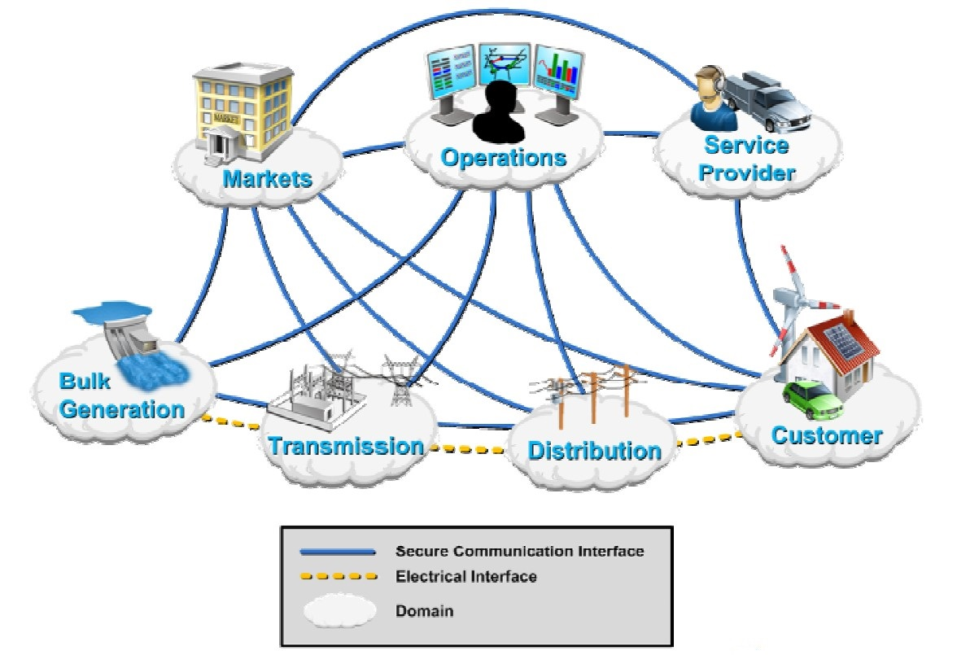
Smart Grid Domains
Smart Grid domains by the U.S. DOE

Slide 6
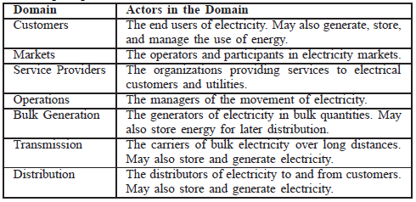
Smart Grid Domains
Smart Grid domains by the U.S. DOE

Slide 7
Smart Grid in U.S.
In 2001, U.S. Dept. of Energy began a series of communications and controls workshops focused on the integration of distribution energy resources.
In 2007, U.S. gov. established “Energy Independence and Security Act”
  Studies state & security of SG, forms agency task force, frames techology R&D, encourage investment.
In 2009, “American Recovery and Reinvestment Act”
  $3.4 billion for SG investment grant program
  $615 million for SG demonstration program
  It leads to a combined investment of $8 billion in SG capabilities.

Slide 8
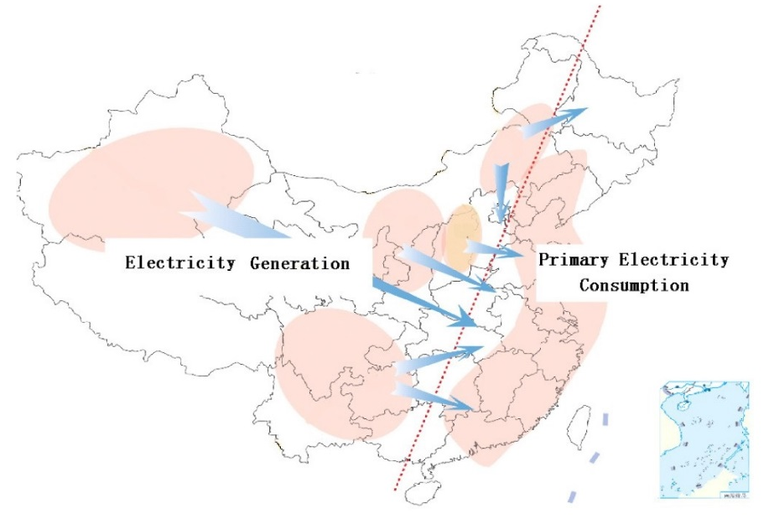
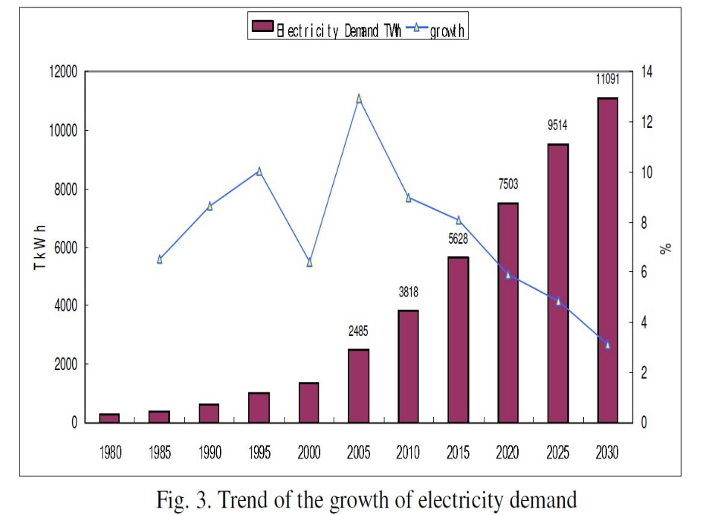
Smart Grid in China
Geographical distribution of generation and consumption in China
Trend of the growth of electricity demand

Slide 9
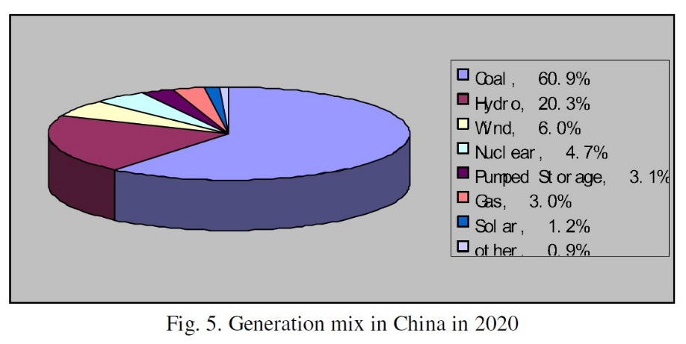
Smart Grid in China
Projected Generation capacity in China, 2020
Energy resources | Generation capacity (kW)
Coal | 1,030,000,000
Natural gas | 58,900,000
Nuclear | 80,300,000
Hydro | 340,000,000
Wind | 150,000,000
Solar | 24,000,000
Bio-fuel | 15,000,000
Others | 50,000,000
Total | 1,750,000,000
Projected energy resources generation capacity in China, 2020
Generation mix in China in 2020

Slide 10
Outline
Introduction of Smart Grid
Major topics in Smart Grid (SG)
  Smart Infrastructure system
    Smart energy subsystem
    Smart information subsystem
    Smart communication subsystem
  Smart Management system
  Smart protection system
Research topic examples
Conclusion

Slide 11
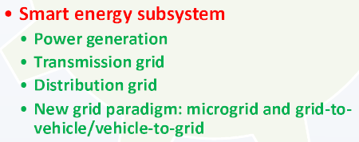
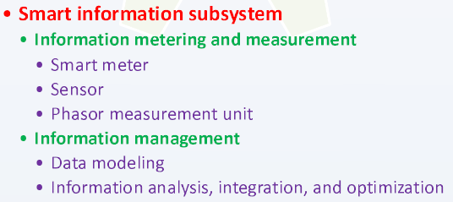
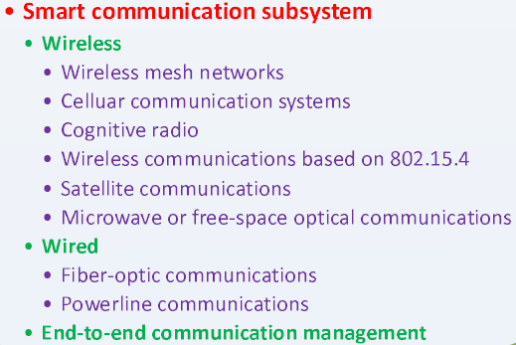
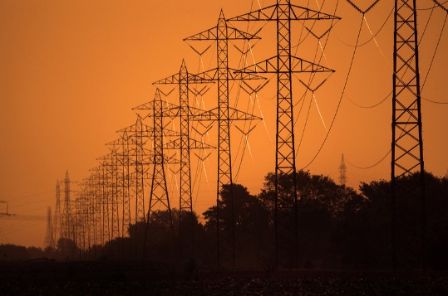
Smart Infrastructure System
Two-way flows of electricity and information lay the infrastructure foundation for SG.

Slide 12
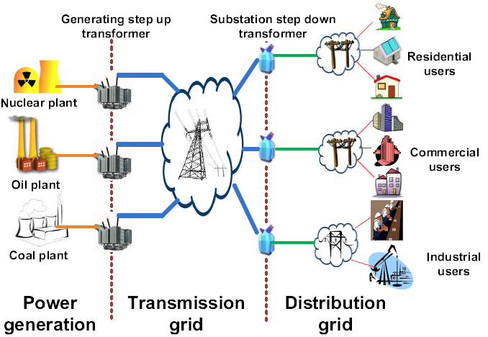
Smart Energy Subsystem
Energy subsystem in power grid

Slide 13
Power Generation of Smart Energy Subsystem
The distribution generation (DG) is a key power generation paradigm enabled by SG.
It improves power quality and reliability via distributed energy resource (DER)
  DER refers to small-scale power gen. such solar panels, small wind turbines (3kW~10MW)
  large deployment and operation cost
Users in a microgrid can unitize DG if need.
  Disturbance of microgrid can be isolated, so local power supply quality is improved.
  Multiple DGs has the same reliability, and lower capacity margin than a system of equally reliable generators.
A localized grouping of power generators and loads

Slide 14
Virtual Power Plant (VPP)
VPP is a concept of future develop. and deploy. of DG.
VPP manages a large group of DGs with total capacity comparable to that of a conventional power plant.
Higher efficiency , more flexibility
  React better to fluctuations (e.g. deliver peak load electricity or load-aware power generation at short notice.)
Some recent works on VPP
  Optimization of VPP structure via EMS - minimize the electricity production cost and avoid loss of renewable energy.
  Market based VPP – using bidding and price signal as two optional operations and provide indv. Distributed energy resource units with access to current electricity market.

Slide 15
Transmission (TX) Grid of Smart Energy Subsystem
2 factors affect the development smart TX grid:
  Infrastructure challenges
    increasing load demands, quickly aging components, ….
  Innovative technologies
    new materials, adv. power electronics, comm. Technologies, ….
3 interactive components:
  Smart control centers
    Analytical capabilities for analysis, monitoring, visualization
  Smart power TX networks (built-on current grids)
    Innovative technologies help to improve power utilization, quality, system security, reliability
  Smart substations (built-on current automated substations)
    digitalization, atomization, coordination, self-healing
    Enabling the rapid response and efficient operation
Notes:
In brief, with a common digitalized platform, in the smart
transmission grid it is possible to enable more flexibility in
control and operation, allow for embedded intelligence, and
foster the resilience and sustainability of the grid.

Slide 16
Distribution Grid of Smart Energy Subsystem
Goal: deliver power to serve the end users better.
Power flow control becomes complicated, when more DGs are integrated into the grid.
An interested research work:
Two in-home distribution systems:
  The electricity is distributed according to the given information.
  AC power circuit switching system and DC power dispatching system via power packets.
  Packetization of energy requires high power switching devices.
An intelligent power router has the potential .
  The electricity from the source is divided into several units of payload (e.g. a header and footer are attached to the unit to form an electric energy packet)
  Using energy packet, more efficient and easier to control energy control
Notes:
More specifically,
supplied electricity from energy sources is divided into several
units of payload. A header and a footer are attached to the unit
to form an electric energy packet. When the router receives
packets, they are sorted according to the addresses in the
headers and then sent to the corresponding loads. Using energy
packet, providing power is easily regulated by controlling the
number of sent packets. In addition, many in-home electric
devices are driven by DC power and have built-in power
conversion circuits to commutate AC input voltage. Thus, DCbased
power distribution is feasible. These systems will make
in-home power distribution systems more efficient and easier
to control energy flow.

Slide 17
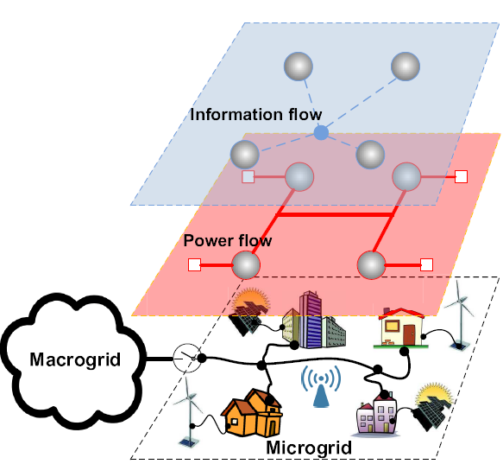
Microgrid
Improves the grid efficiencies, reliability, high penetration of renewable sources, self-healing, active load control.
  Plug and play integration
  Microgrid switches to the isolated mode, if outages at macrogrid
Notes:
In this subsection, we describe two of the most important
new grid paradigms, which benefit from smart energy subsystem
technologies and also further promote the development of
SG. These two paradigms are widely regarded as important
components of the future SG. Note that these two paradigms
also take advantage of other SG technologies as we will
explain in the corresponding sections.

Slide 18
G2V & V2G
Grid-to-Vehicle and Vehicle-to-Grid; EV represents both gully and plug-in hybrid electric vehicle.
G2V
  Charging EV leads a significant new load on existing grid (may cause power degradation, overloading,..)
  Solutions: coordinated charging of EVs can improve power losses and voltage deviations by flattening out peak power.
V2G
  A car is driven only 1 hour per day in average.
  At parking, EVs communicate w/ grid to deliver electricity into grid for helping balance loads by “peak shaving” or “valley filling”
  e.g. V2G-Prius at Google campus, CA; Xcel inc. performs V2G in Boulder, CO.
KEY: how to determine the appr. Charge & discharge time?
  A binary particle swarm optimization algorithm – optimal solution, maximize profits of EV owners, fit both constraint of EV and Grid.
High demands
low demands
Notes:
Note that particle swarm optimization is an iterative
stochastic optimization algorithm. The solution search
is performed in a stochastic nature allowing the algorithm
to overcome nonlinear, non-differentiable, and discontinuous
problems.

Slide 19
Summary & Challenges
The section reviews smart energy subsystem – power gen., transmission, distribution, and mircogrid, G2V.
Challenge_1. Effective utilization of intermittent and fluctuant renewables:
  In practice, the renewable power pattern is hard to predicate.
  online learning technique - to learn evolution of power pattern
  HMM model.
Challenge_2. Utilization of G2V/V2G:
  An analysis of large scale EV stochastic behavior (e.g. the availability of Evs in V2G, the new large load in G2V)
  central limit theorem (EV power profile distribution), queuing theory (EV charging station in G2V)
Challenge_3. Large-scale deployment:
  Top-down (distributed) or bottom-up (centralized) approach?
  A open, scalable, instructive SG standard for such hugh network
Notes:
Considering that in practice the power
pattern of renewable resources may not follow any simple
distribution or Markov process, Fang et al. [69] further used
non-stochastic multi-armed bandit online learning technique
to learn the evolution of power pattern of renewable energy
source. Note that online learning is a model of induction
that learns the label of one instance at a time. The goal in
online learning is to predict labels for instances. A typical
application could be that the instances are able to describe
the current conditions of the renewable sources, and an online
algorithm predicts tomorrow’s value of a particular source. In
summary, in order to effectively utilize the renewable energy,
more thorough mathematical analysis on modeling renewable
energy is desirable.
Another possible research topic is the optimal deployment
of the additional ancillary services (e.g. energy reserves) to
maintain reliability and meet operational requirements, taking
into account the uncertainty and variability of renewable
energy resources.
we can use probability theory or
experiments to model the power request profile for a large
number of EVs charging operations, and the total available
power profile provided by a large number of EVs. Although
we cannot accurately predict the behavior of each EV, it is
very likely that over a large dataset, the overall profile must
follow some distribution. Let us recall the normal distribution,
one of the most famous distributions. According to the central
limit theorem [63], the mean of a sufficiently large number
of independent random variables, each with finite mean and
variance, follows the normal distribution. This analysis can
help the operator pre-design the system capacity margins.

Slide 20
Smart Infrastructure System
Two-way flows of electricity and information lay the infrastructure foundation for SG.

Slide 21
Phasor measurement units is to measure the electrical waves on an electrical grid to determine the health of system.
PMU reading are obtained from widely dispersed locations in a power system network and sync. w/ GPS radio clock
ISO can use the reading for SG state estimation in a rapid and dynamic way
PMU leads system state estimation procedures, system protection functionalities, with goal of making system immune to catastrophic failures. (recently , Brazil, China, France, Japan, US….. Installed PMUs for R&W)
WSN, cost-effective sensing and comm. Platform for remote sys monitoring and diagnosis.
Access the realtime mechanical and electrical conditions of transmission line,
Diagnose imminent or permanent faults
Obtain physical and electrical picture of power system realtime
Determine appropriate control measures for autom action or sys operators
Requirements: Quality-of-Service, Resource constraints, Remote maintenance and configuration, high security requirement, Harsh environmental condition
Information Metering of Smart Information Subsystem
1. Obtaining information from endusers’ devices.
2. Automatic metering infrastructure (AMI) is to two-way comm. with meter in realtime on demand
Improve system operations and customer power demand management
Smart information subsystem is used to support information generation modeling, integration, analysis and optimization in the context of SG.
Information Metering, Monitoring, and measurement
Smart Monitoring & Measurement
Sensor
PMU
Smart Metering
Notes:
From a consumer’s perspective, smart metering offers a
number of potential benefits. For example, end users are able
to estimate bills and thus manage their energy consumptions
to reduce bills. From a utility’s perspective, they can use smart
meters to realize real-time pricing, which tries to encourage
users to reduce their demands in peak load periods, or to
optimize power flows according to the information sent from
demand sides

Slide 22
Information Management of Smart Information Subsystem
A large amount data need an advance Information management
Data Modeling
  The structure and meaning of the exchanged information must be understood by both application elements
  The system forward and backward compatibility. A well-defined data model should make legacy program adjustments easier
Information analysis is to support the processing, interpretation, and correlation of the flood of new grid observations.
Information integration
  Data generated by new components enabled in SG may be integrated into the existing applications.
  Metadata stored in legacy systems may share by new application in SG to provide new interpretation.
Information optimization is to improve information effectiveness. To reduce comm. burden and sore only useful information.
Notes:
Why is data modeling important? Let us look at the following
two reasons. First, the information exchange between two
application elements is meaningful only when both of them
can use the information exchanged to perform their respective
tasks. Therefore, the structure and meaning of the exchanged
information must be understood by both application elements.
Although within the context of a single application, developers
can strive to make the meaning clear in various user interfaces,
when data is transferred to another context (another system),
the meaning could be lost due to incompatible data representation.
Considering that the SG is a complicated system of
systems, design of a generally effective data representation is
very important.
important.
Second, the data modeling is also related to the system
forward compatibility and backward compatibility. On one
hand, a well-defined data model should make legacy program
adjustments easier. We hope that the data representation designed
for SG can also be (or at least partially) understood
by the current power system, in order to take advantage
of the existing infrastructure as much as possible. On the
other hand, thus far SG is more like a vision. Its definition
and functionality keep evolving. Suppose that in the current
implementation, all the data is particularly designed to be
stored in an optimized way that can be understood by a
current application X. After some time, a new application Y is
integrated into SG. Data modeling is the key to whether this
new application can understand the historical data and obtain
enough information from the historical data.

Slide 23
Summary
We review the smart information subsystem, including information metering, measurement and management in SG
Challenge_1: Effective information store
  What information should be stored so that meaningful system or user history can be constructed for this data. (e.g. System history for analyzing system operations; User history for analyzing user behaviors and bill.)
  Data mining, machine learning , and information retrieval techniques to analyze the information and thus obtain the representative data
Challenge_2: utilization of cloud computing
  Cloud providers have massive computation and storage capacities
  Improve the information integration level in SG
  Cloud computing security and privacy
  From the cloud provider’s perspective, which information management services should be provided to maximize its own profit?
  From the electric utility’ perspective, which information management functions should be outsourced and which should be operated by itself to maximize its own profit?

Slide 24
Smart Infrastructure System
Two-way flows of electricity and information lay the infrastructure foundation for SG.

Slide 25
Smart Communication Subsystem
Smart communication subsystem is responsible for communication connectivity and information transmission among system, devices and applications in the context of SG.
  What networking and communication technology should be used?
Many different types of networks exist, but they must:
  Support the quality of service of data (critical data must delivered promptly)
  Guaranteeing the reliability of such a large and heterogeneous network
  Be pervasively available and have a high coverage for any event in the grid in time.
  Guarantee security and privacy

Slide 26
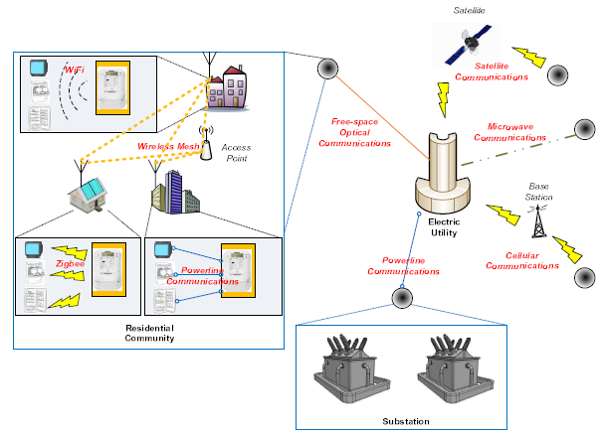
An example of network in SG
Example of network in SG
Notes:
An example of a communication network in SG:
User devices and smart meters use ZigBee, WiFi, and powerline
communications. Wireless mesh networks are used for
information exchanges between users. Communities are connected
to their electric utility via free-space optical, satellite,
microwave, or cellular systems. A substation communicates
with an electric utility over the powerline

Slide 27
Communication Technology
Wireless
  Wireless Mesh Network
  Cellular Communication Systems
  Cognitive Radio
  Wireless Communications based on 802.15.4
  Satellite Communication
  Microwave or Free Space Optical Communications
Wired technology
  Fiber-optic Communications
  Powerline Communications
End-to-end Communication Management using TCP/IP

Slide 28
Challenges
Interoperability of communication technologies
  Materializing interoperability is not easy, since each communication technique has its own protocols and algorithms
  Suggest studying adv. and disadv. Of cross-layer design in SG comm. subsystem, i.e. the tradeoff between crosslayer optimization and the need for interoperability
Dynamic of the communication subsystem
  This subsystem underlying an SG may be dynamic with topology chane being unpredictable (e.g. EVs plug-in-play)
  Suggest studying systematic protocol design and Dynamic resource allocation algorithms for supporting topology dynamics.
Smoothly updating existing protocols

Slide 29
Outline
Introduction of Smart Grid
Major topics in Smart Grid (SG)
  Smart Infrastructure system
    Smart energy subsystem
    Smart information subsystem
    Smart communication subsystem
  Smart Management system
  Smart protection system
Research topic examples
Conclusion

Slide 30
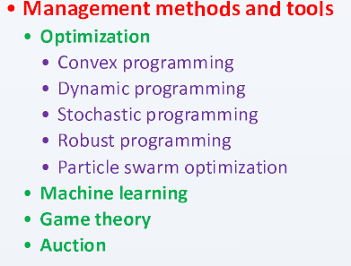
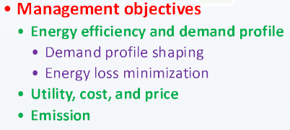
Smart Management System
SG two-way flow of power and data are lay the foundation for realizing various function and management objectives
  Energy efficiency improvement, operation cost reduction, demand and supply balance, emission control, and utility maximization

Slide 31
Energy efficiency & Demand Profile improvement of Management Objectives
Demand profile shaping:
  help match demand to available supply in order to reshape a demand profile to smoothed one, or reduce the peak-to-average ratio or peak demand of the total energy demand.
    shifting (network congestion game), scheduling (dynamic programming), or reducing demand (dynamic pricing scheme)
Energy loss minimization:
  DGs now are integrated in SG, it is more complicated.
  Decentralized optimization algorithm, the optimal mix of statistically-modeled renewable sources
Reduce overall plant and capital cost , increase the system reliability (reduce probability for brownouts and blackouts)

Slide 32
Utility & Cost Optimization and Price Stabilization of Management Objectives
Improving utility, increasing profit, and reducing cost are also important.
  User cost/bill or profit, cost or utility of electricity industry and system.
Stabilization of price in a close-looped feedback system btw. realtime wholesale market prices and end users
  Modeling for the dynamic evolution of supply, demand, and market clearing (locational marginal price LMP) price
Emission control is another important management objective
  Min. generation cost or max. utility/profit ≠ min. emission by using green energy as much as possible
  Cost of renewable energy gen. is not always lowest, related with demand scheduling
Notes:
We have reviewed the work on energy efficiency and
demand profile improvement in the above. Improving utility,
increasing profit, and reducing cost are also important management
objectives. Researchers realize these objectives in various
levels and from various perspectives, such as individual user
cost/bill or profit [32, 40, 53, 69, 95, 120, 170, 171, 188],
single energy bill or aggregate utility of a group of users
[98, 220], cost or utility of electricity industry and system
[37, 74, 83, 89, 120, 150, 171, 178, 206, 218]. Stabilization
of prices is also a research topic in SG, since relaying the realtime
wholesale market prices to the end consumers creates a
closed loop feedback system which could be unstable or lack
robustness, leading to price volatility. Roozbehani et al. [213]
therefore developed a mathematical model for characterization
of the dynamic evolution of supply, demand, and market
clearing (locational marginal) prices under real-time pricing,
and presented a stabilizing pricing algorithm

Slide 33
Smart Management System
In order to solve the management objective, we need management methods and tools:

Slide 34
Management Methods and Tools
Optimization
  Convex & dynamic programming
  For green energy supply (time-varying process), we need stochastic programming, robust programming
  Particle swarm optimization can quickly solve complex constrained optimization problems w/ low computation and high accuracy.
Machine learning
  Allow control systems to evolve behaviors based on empirical data
  It plays a major role in analysis and processing of user data and grid states for a large number deployment of smart meters, sensors, PMUs.
Game theory
  Not all users to be cooperative, so we need guarantee solution
  Emerging SG leads to the emergence of a large number of markets (i.e. it is akin to multi-player games, e.g. energy trading)
Auction
  Bidding & auction can be used for energy sale w/in microgrid market (e.g. demand reduction bid for reducing peak load)

Slide 35
Future Research and Challenges
Future Research
  Integration of pervasive computing and smart grid
  Smart grid store
Challenge
  1. Regulating emerging markets
  Microgrid leads to emergence of new market of trading energy
  e.g. How to guarantee truthful auction, Vickrey-Clarke-Groves scheme (a type of sealed-bid auction)
  2. Effectiveness of the distributed management system
  DGs and plug-in-play components are widely used and formed a autonomous distributed microgrid.
  Hard to compute globally optimal decision (i.e. limited time & information)
  3. Impact of utilization of fluctuant & intermittent renewables.
  System should maintain reliability and satisfy operational requirements, and taking into account the uncertainty and variability of energy source
  Stochastic programming or robust programming for green energy source

Slide 36
Outline
Introduction of Smart Grid
Major topics in Smart Grid (SG)
  Smart Infrastructure system
    Smart energy subsystem
    Smart information subsystem
    Smart communication subsystem
  Smart Management system
  Smart protection system
Research topic examples
Conclusion

Slide 37
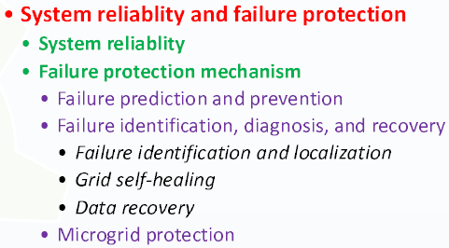

Smart Protection System
Inadvertent compromises of the grid infrastructure due user error, component failure, and natural disasters
Deliberate cyber attacks such as from disgruntled employees, industrial spies, and terrorist

Slide 38
System Reliability
In US, average annual cost of outages is $79B (32% of total electricity revenue)
In 2003 East Coast blackout, 50 million people were w/out power for several days
Some fluctuant and intermittent of green energy source (DGs) may compromise SG’s stability
  DGs serve locally, microgrid is isolated from macrogrid for better stability and reliability
Wide-area measurement system (WAMS) based on PMUs becomes an essential component for monitoring, control, and protection.

Slide 39
Failure Protection Mechanism
Failure Prediction and Prevention:
  Identify the most probable failure modes in static load distribution (i.e. the failures are caused by load fluctuations at only a few buses)
  Utilize PMU data to compute the region of stability existence and operational margins
Failure Identification, Diagnosis, and Recovery:
  Once failure occurs, 1st step is to locate, identify the problem to avoid cascading events
  Utilize PMU for line outage detection and network parameter error identification
  Use known system topology data with PMU phasor angle measurement for system line outage or pre-outage flow on the outage line

Slide 40
Self-Healing & Microgrid Protection
Self-Healing is an important characteristic of SG.
  An effective approach is to divide the macrogrid into small, autonomous microgrid
  Cascading events and further system failure can be avoided, because any failure, outage, or disturbance can be isolated inside the individual microgird.
Protecting microgrid during isolated or normal operations is also important.
  How to determine when an isolated microgrid should be formed in the face of abnormal condition ?
  How to provide segments of the microgrid with sufficient coordinated fault protection while acts independently?

Slide 41
Smart Protection System
Security is a never-ending game of wits, pitting attackers versus asset owners.
Attacker can penetrate a system, obtain user privacy, gain access to control software, and alter load conditions to stabilize the grid in unpredictable way.

Slide 42
Security in Smart Metering
Tens of millions of smart meters controlled by a few central controllers.
Easily to be monetized
  The compromised smart meter can be immediately used for manipulating the energy cost or fabricate meter reading to make money
Injecting false data misleads the utility into making incorrect decisions about usage and capacity.
  Outage, region blackout, generator failure, ….
A secure method for power suppliers to echo the energy reading from meters back to users so that users can verify the integrity of smart meters.

Slide 43
Privacy in Smart Metering
The energy use information stored at the meter acts as an information-rich side channel
  Personal habits, behaviors, activities, preferences, and even b beliefs.
A distributed incremental data aggregation approach
  Data aggregation is performed on all meters, data encryption is used.
A Scheme to compress meter readings and use random sequences in the compressed sensing to enhance the privacy and integrity of meter reading
A load signature moderation system, a privacy-preserving protocol for billing, an anonymizing method for dissociating information and identified person.

Slide 44
Security in Monitoring and Measurement
Monitoring and measurement devices (e.g. sensors, PMUs) can also lead to system vulnerabilities.
Stealth attack or false-data injection attack is to manipulate the state estimate w/out triggering bad-data alarms in control center
  Profitable financial misconduct, purpose blackout
The encryption on a sufficient number of measurement devices
  Place encrypted devices in the system to max. utility in term of increased system security

Slide 45
Security in Information Transmission
It is well-known that communication technologies we are using are often not secure enough
Malicious attacks on information transmission in SG:
  Network availability: attempt to delay, block, or corrupt information transmission in order to make network resource unavailable (DoS attack)
  Data Integrity: attempt to deliberately modify or corrupt information
  Information privacy: attempt to eacesdrop on communication to acquire deired information.

Slide 46
Challenges
Interoperability btw. Cryptographic systems
  Many different communication protocol and technologies are in SG, each has its own cryptography requirements, security needs,
  A method of securely issuing and exchanging cryptographic keys (a public key infrastructure approach)
Conflict btw. privacy preservation and information accessibility
  Balance btw. Privacy preservation and information accessibility
  More information, smarter the decision but less privacy
Impact of increased system complexity and expanded communication paths
  Advance infrastructure is a double-edge sword; increasing system complexity and communication paths provides better service for endusers, but may leads to an increase on vulnerability to cyber attack and system failure
  A method of dividing whole system into autonomous sub-grid (mircogrid)
Impact of increasing energy consumption and asset utilization
  Balance btw. Utilization maximization and the risk increase.
Complicated decision making process
  Solving complex decision problems w/in limited time
  A distributed decision making systems, but considering balance btw. Response time and effectiveness of local decision

Slide 47
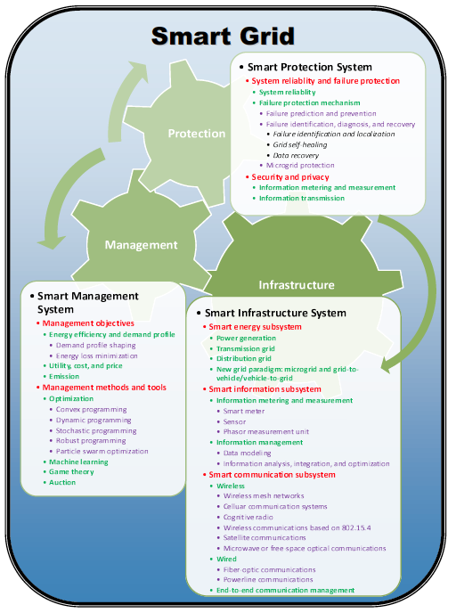
Quick Recap…
Fig. 11 Smart Grid System Review

Slide 48
Outline
Introduction of Smart Grid
Major topics in Smart Grid (Tutorial)
  Smart Infrastructure system
  Smart Management system
  Smart protection system
Research topic examples (Our Works)
  Bad Data Injection Attack and Defense
  Demand Side Management
  Renewable and PHEV
  Smart Meter
  Smart Building
  Smart City/Microgrid
Conclusion

Slide 49
Overview
Power System State Estimation Model
  Bad Data Injection
Defender Mechanism
  Quickest Detection
Attacker Learning Scheme
  Independent Component Analysis
Electrical Market

Slide 50
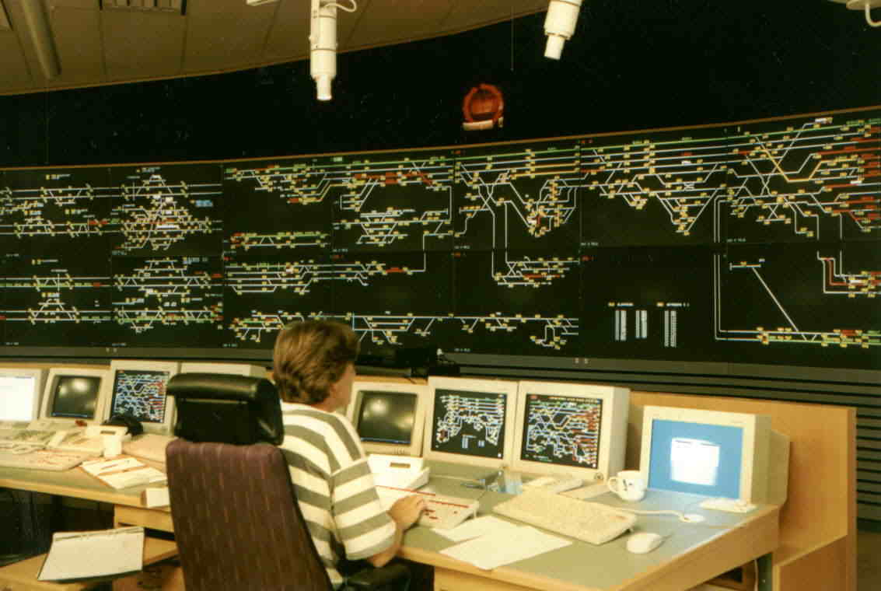
Supervisory Control and Data Acquisition Center
Real-time data acquisition
  Noisy analog measurements
    Voltage, current, power flow
  Digital measurements
State estimation
  Maintain system in normal
  state
  Fault detection
  Power flow optimization
  Supply vs. demand
SCADA TX data from/to Remote Terminal Units (RTUs), the substations in the grid
Notes:
In the power grid network, (pic) the apprearance of the control center. It also know as SCDA center. the supervisory control and data acquisition center, Two of major funcationalityies is Readtime data acquisition and State estimation. In readtime data accquisition, the voltage, current, power flow btw. Each bus have been colleced , For state estimation, it is the place where the control center determine the status of power grid network. Which include the fault detection, power flow optimization, …..
…
[click] In the graphic-theoretic view of SCDA center and power network, it can be represented as…….Green box rep. as SCDA center, RTU is substation of SCDA center. As you can see in the figure, point A1,2,3 , are the some of weak links in SG communication, that allow the hacker to gain the access. The smart grid integration helps the power grid networks to be smarter, but it also increases the risk of adversaries because of the currently obsoleted cyberinfrastructure.
Adversaries can possiblibly paralyzes the power facility by misleading the energy management system with injecting false data. For example of point A! A2(in pic), the attack can hack from either the RTU or just simple tranmission line to gain the information.

Slide 51

Privacy & Security Concern
More connections, technology to the obsolete infrastructure.
  Add-on network technology: sensors and controls estimation
  More substations are automated/unmanned
Vulnerable to manipulate by third party
  Purposely blackout
  Movie Matrix
  Financial gain
  Story of Enron
Notes:
However, Many people concern about cyberterrorism and attacks on the energy infras- tructure since more connection are linked to the power management facility and more technology are implemented into the grid, especially on signal processing and communication.
For example, The smart grid incorporates some new networking technol- ogy, including sensors and controls mechina that make it possible to monitor electricity use in realtime and make automatic changes that reduce energy waste. Furthermore, more and more substation of the power management system has be replaced automated or unmanned which allows hacker t oeasily access the data.
and, indeed, it is vulnerable to manip- ulation by the third party in SG communication.
attackers can manipulate power-grid data by breaking into sub- stations and intercepting communications between substations, grid operators, and electricity suppliers. If someone wanted to cause a blackout, the load data about how much power is flowing could be used to fool grid operators into overloading parts of the grid, tripping generators and leading to cascading failures. Again, A blackout could then occur before grid operators have the chance to correct for the problem.
With similar hacking technique, this data is also used by grid operators to set prices for electricity and to balance supply and demand. Grid hackers could make millions of dollars at the expense of electricity consumers by influencing electricity markets.
From the article in 2009

Slide 52

Power System State Estimation Model
Transmitted active power from bus i to bus j
  High reactance over resistance ratio
  Linear approximation for small variance
  State vector , measure noise e with covariance Ʃe
  Actual power flow measurement for m active power-flow branches
  Define the Jacobian matrix
  The linear approximation
  H is known to the power system but might not known to the attackers.
(1)
(2)

Slide 53
Bad Data Injection and Detection
State estimation from z
Bad data detection
  Residual vector
  Without attacker
  where
  Bad data detection (with threshold γ):
  without attacker:
  with attacker: otherwise
Stealthy (unobservable) attack: c=Hδx
  Hypothesis test would fail in detecting the attacker, since the control center believes that the true state is x + δx.
z=Hx+c+e,

Slide 54
Overview
Power System State Estimation Model
  Bad Data Injection
Defender Mechanism
  Quickest Detection
Attacker Machine Learning Scheme
  Independent Component Analysis
Electrical Market

Slide 55
Basics of Quickest Detection (QD)
  Detect distribution changes of a sequence of observations
    as quick as possible
    with the constraint of false alarm or detection probability.
  min [processing time]
s.t. Prob(true ≠ estimated) < ŋ
  Classification
    Bayesian framework:
      known prior information on probability
      SPRT (e.g. quality control, drug test, )
    Non-Bayesian framework:
      unknown distribution and no prior
      CUSUM (e.g. spectrum sensing, abnormal detection )
Notes:
Therefore, a advance digital signal processing technique is need to battle for this security issue in SG communiction. One popular approach is QD by H. Vince Poor. , it is a implementalbe realtion …….., and the information……
The concept of QD is to be able to deconde online….. It can be discribed as minimize the processing time whith the error probability is less then a certain threhold \ in the other words, this techqnies is to …..less or equal to the pre-defined threshold

Slide 56



QD System Model
Assuming Non-Bayesian framework with non-stealthy attack
  the state variables are random with
The binary hypothesis test:
The distribution of measurement z under binary hypotheses: (differ only in mean)
We want a detector
  False alarm and detection probabilities
Notes:
We will first formulate a detection problem, which we assume the bayesian framework under the multivariant normal distribution with \um_z as mean vector and crosscorrelation matrix \exlo _z.
From this assumption , we can form a binary hypothesis test H0 as normal state, mean of H1 follows the condition of [Lin2009 paper] of k-sarpse attack.
Therefore, we can catalogize the oberservation Z under two possible hypotheses H0 and H1. and We wish to design a detector; when \delta_z=1 is indicating a detection of attack H1 is true, otherwise is null hyp. In addition, P_F is the false rate wherer given H0 is true but the decision is made for 1, P_Detection is H1 is true

Slide 57

Detection Model - NonBayesian
Non-Bayesian approach
  unknown prior probability, attacker statistic model
The unknown parameter exists
  You do not know when the attacker attacks
  You do not know how the attacker attacks.
Minimizing the worst-case effect via detection delay:
We want to detect the intruder as soon as possible while maintaining P_{D.}
Detection delay
Detection time
Actual time of active attack
Notes:
However, in the detection mode, the non-Bayesian approach is applied because of the unknown prior probability of the adversary and unknown statistical model for the adversary vector.
To notes that , the unknown parameter exists in the post-change distribution and may change over the detection process.
For the detection problem, one of popular apporach is to minimizing the worst case effect by maximizing the detection delay. T_d is average detection delay, and given that the real detection time or stopping time, T_h,\ subtracts \tau, the acutal time of active attack.
We will like to detect the active malicious data attack as quickly as possible while maintaining a certain level of Detection probabilty.

Slide 58

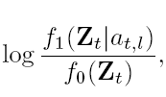
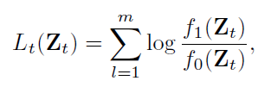



Multi-thread CUSUM Algorithm
CUSUM Statistic:
  where Likelihood ratio term of m measurements:
By recursion, CUSUM Statistic S_{t} at time t:
Average run length (ARL) for declaring attack with threshold h
How about the unknown?
Declare the attacker is existing!
Otherwise, continuous to the process.
Notes:
We first consider the Page’s CUSUM test, because it is non-bayesian framework , which don’t require complete knowledge about the distributions so that The decision can be made directly by analysizing the observation data. Therefore, we further modify the Page’s CUSUM test, to the multi-thread CUSUM since we have multi measurement in a single observation at the time t. Lets start deriving the multithread cusum test:
T_h is average run length or stopping time for declaring the existance of introdor given St>h, in which the detection threshold h is a function of FAR, MDR, and the process variance, St. is cumulative sum statistic which considers and cooperates the likelihood ratio term of m measurements at time t
S_t is the cumulate the likelihood ratio from each time, Lt- the log likelihood ratio for m measurements at time t,
Lt is the sum of …., in which f1 is PDF of H1 given the active intruder
.
And, we can describe CUM statistic by recursion at time t, given that current St is the sum of previous CUSUM statistic + the current culative sum of log likelihood ratio of m measurements. In order to have accurate result, zero is our base line.
St will keep cumulating time by time until it excess the predefined value “h”[click] as shown here…..
However, there is the unknown in the prob density function H1, so, can we deal with it?

Slide 59


Linear Solver for the Unknown
Rao test:
The linear unknown solver for m measurements:
Recursive CUSUM Statistic w/ linear unknown parameter solve:
  Modified CUSUM statistics
  Asymptotically equivalent model of GLRT
The unknown is no long involved
Notes:
we consider the Rao test [18], which is the asymptotically equivalent test model of GLRT. GLRT is to min the worst case effect by maximizing the unknown using ML estimation. But giving us high Complexity, near impossible to implement in the reality.
The derivation of Rao test is similar to the locally most powerful (LMP) test but only much simpler; Rao test has the straight-forward calculation by taking derivative with respect to the unknown parameter evaluated at the unknown parameter equal to zero. Thus, for at near ^ a0 t , we can achieve approximate maximum outcome with a certain level of FAR by maximizing @fe(Ztjat) @at
By inspected the EQ, we can omitting the ne…… it is damend for multi parameter envirement. , then we can simplify the quadratic form because the unknown is always greater the zero. So, the our part of proposed scheme : linear unknown solver will be just a partial dervative of PDF over unknown while repecting the unknown to close zero.
By the recursion and partial dervative of likelihood function repect to zero, the unknwon will be no longer existed in the system.

Slide 60
Simulation: Adaptive CUSUM algorithm
2 different detection tests: FAR: 1% and 0.1%
Active attack starts at time 5
Detection of attack at time 7 and 8, for different FARs
Notes:
The 1st simulation of the proposed scheme is shown with 2 case : case 1 has FAR of 1% and case 2 as the 0.1%. The attacker becomes active at time 6, where the a change distribution from H0 to H1, The proposed algorithm singal the alarm and terminates the pdetection process at time 7, for case 2 is time 8, each has its own threshold h1 h2 repectively, in term of different FAR . As you can see the missing detection occurs , for case is T_d =1 and case 2 is T_d=2. We also can conclude that the higher constraint will need more time to make decision, therefore, the slower detection,. That why we have longer detection delay in case 2.
(FAR is 1% as same as MDR).
The adversary becomes
active and injects the malicious data at time t = 6. In other
words, a change distribution is at τ = 6 from N(0,z)
to N(a,z), where a is unknown. The curve of adaptive
CUSUM statistic (St) shows the sudden increase right after
a change of distributions. The proposed algorithm quickly
responses the abnormal event by signaling an alarm of out-of control.
As a result, ARL (Th) of adaptive CUSUM algorithm
is 7 at St = 13.2351, and ARL (Td) of detection delay is 1
in this simulation.
The proposed algorithm signals the alarm
and terminates the process at time 7 ; the detection delay
occurs because of the missing detection at time 6 as shown in
Figure 3. The system continuos the detection process until the
CUSUM statistic St, which excesses the threshold. However,
the detection accuracy of the proposed scheme is comparable
high while maintaining a certain level of detection error rate.

Slide 61
Overview
Power System State Estimation Model
  Bad Data Injection
Defender Mechanism
  Quickest Detection
Attacker Machine Learning Scheme
  Independent Component Analysis
Electrical Market

Slide 62
Independent Component Analysis (ICA)
Question for bad data injection:
  Without knowing H, the attacker can be caught.
  Could attacker launch stealthy attack to the system even without knowledge about H?
  Using ICA, attacker could estimate H and consequently, lunch an undetectable attack.
Linear Independent Component Analysis
  Find a linear representation of the data so that components are as statistically independent as possible.
  i.e., among the data, find how many independent sources.

Slide 63
ICA Basics
A special case of blind source separation
u = G v
u = [u_{i}, i = 1, 2, … m]: observable vector
G = [g_{ij}, i = 1, 2, … m, j = 1, 2, … n]: mixing matrix
(unknown)
v = [v_{i}, i = 1, 2, … n]: source vector (unknown)
Linear ICA implementation: FastICA from [Hyvärinen]

Slide 64
Stealth False Data Injection with ICA
Supposing small noise, we what to do the mapping:
u = G v z = H x
Problem: state vector x is highly correlated
Consider: x = A y, where
  A: constant matrix that can be estimated
  y: independent random vectors
Then we can apply Linear ICA on z = HA y
  We cannot know H, but we can know HA
  Stealthy attack: Z=Hx+HAδy+e

Slide 65
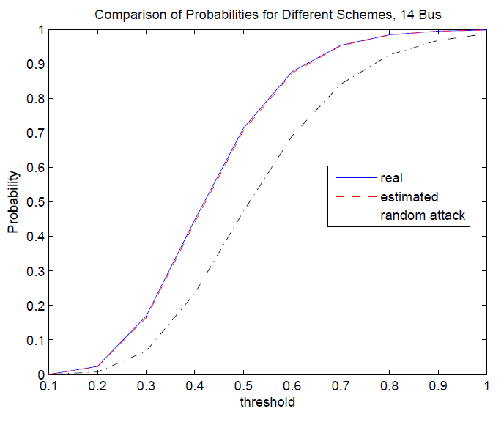
Performance of the Attack
The CDF is the same w or w/o attacking.
So log likelihood is equal to 1– unable to detect

Slide 66
Overview
Power System State Estimation Model
  Bad Data Injection
Defender Mechanism
  Quickest Detection
Attacker Learning Scheme
  Independent Component Analysis
Electrical Market

Slide 67
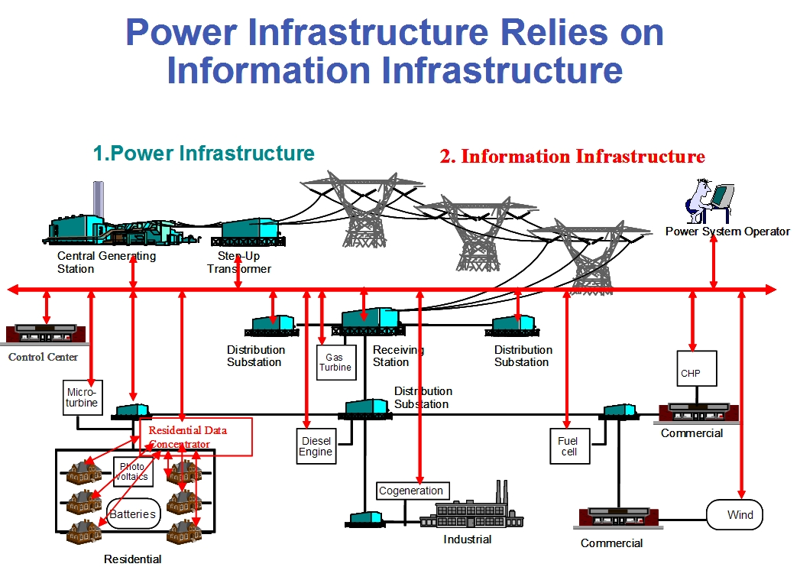
Electrical Market
Directly
Power flow (PF)
Estimation
Optimal Power Flow (opf)
Control Center
Power system Management
Notes:
Due to increase in electricity demand and limited energy resources, power systems become more and more complex in
structure and should operate in a secure and optimal conditions. After deregulation, the physical and financial operations
of electric power systems become significantly different and challenging. State estimation (SE), introduced to improve the
operating point of the power system from both technical and economical viewpoints, helped engineers in energy control
centers (ECC) to monitor all states of the power system, which was previously not practical (or economical) to monitor.
Currently, SE plays an important rule in secure and optimal operation of power systems. Accuracy of state estimation
can be affected by bad data in measurements. These bad data could be caused by unintended measurement abnormalities
or topology errors, or even by injection of malicious attacks. Cyber-attacks can be increased by integrating more advanced
cyber technologies into the energy management system (EMS) and can cause major technical problems such as blackouts
in a power system. These attacks also can be designed for illicit financial benefit by changing the optimal operation of
the system, thereby increasing the net cost of electricity for consumers.

Slide 68

Electricity Market Overview
Electricity Market
(OPF)
Bid’s from Gen and loads, Structure of network, etc
Electricity Prices, Schedule for gen, etc
Day-Ahead
Market:
Predicted values for power network
DCOPF for EX-Ante Electricity Market
Real-time Market:
Direct Measurements
in power network
State
Estimation
DCOPF for EX-Post Electricity Market
Attacker

Slide 69

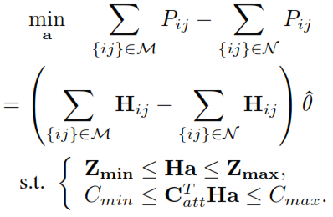
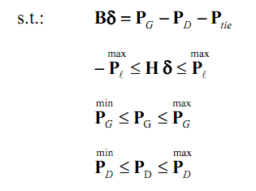
Problem Formulation
DC Optimal Power Flow:
Objective Function:
Gen & Consumption
Cost
Estimated transmitted Power in group “M”
Power Balance
Estimated transmitted Power in group “N”
Line limits
Injected Bad
Data limit
Total Cost of att
Gen limits
Load limits
Notes:
DC Optimal Power Flow
In the Ex-Ante model, the generation dispatches and LMPs are obtained from the same optimization model. In the Ex-Post model, the dispatch is performed at Ex-Ante, while the LMP is calculated after the cycle of the spot market, i.e., at Ex-Post such as after the 5-minute or hourly real-time market, using an incremental dispatch model. The problem formulation is given as above.
where CG is bid vector for supplying active power, CD is bid vector for consumption of active power, PG is the active power generation vector in Mega-Watt (MW), PD is the active power consumption vector in Mega-Watt (MW), PL = Hθ is the vector of transmitted active power, and B is defined as Bij = − 1/Xij
and Bii = Σj Xij.
First constraint of this optimization shows the balance between generation and consumption of active power in each bus. Second, third and fourth constraints consider the thermal limitation in transmission lines, active power generation limits, and active power consumption limits, respectively.
Objective Function
The attacker can compromise the measurement vector and change the state of the system. Changing in transmitted power can modify congestion levels, which is also closely related to the price of trading electricity in most of electricity markets. We formulate the problem to increase or decrease transmitted active power
in the desired transmission lines by injecting bad data.
The objective of the above optimization is to decrease and increase transmitted power, respectively, in group M and N of transmission lines represented by {ij}.

Slide 70
Outline
Introduction of Smart Grid
Major topics in Smart Grid (Tutorial)
  Smart Infrastructure system
  Smart Management system
  Smart protection system
Research topic examples (Our Works)
  Bad Data Injection Attack and Defense
  Demand Side Management
  Renewable and PHEV
  Smart Meter
  Smart Building
  Smart City/Microgrid
Conclusion

Slide 71
Overview
Demand Side Management
  Management objectives and basic concept
  Models and algorithms
  Auction game approach for DSM
    Auction game: Mechanism design and the AGV mechanism
    Problem formulation and algorithm
    Propositions and Proofs
    Simulation results
  Conclusions

Slide 72
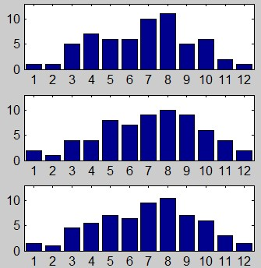
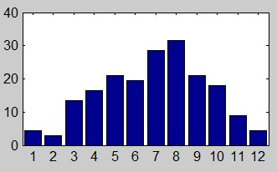
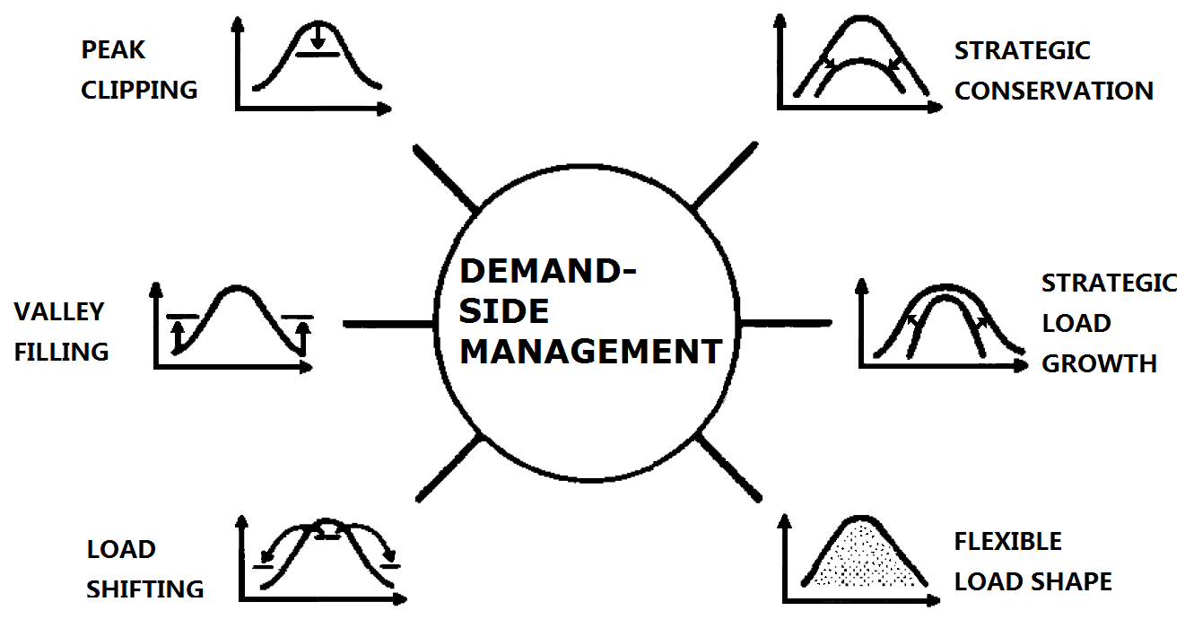
Management Objectives: Load Shaping
User1
Total load shape
On-peak hours
Mid-peak hours
User2
Off-peak hours
User3
Power resources allocations
Load shaping objectives in DSM
Notes:
Peak clipping is generally considered as the reduction of peak load by using direct load control. Direct load control
is most commonly practiced by direct utility control of customer‘s appliances.
Valley filling encompasses building off-peak loads. This may be particularly desirable for those times of the year where the long-run incremental cost is less than the average price of electricity. Adding properly priced off-peak load under those circumstances decreases the average cost to customers.
Load Shifting is the last classic form of load management. This involves shifting load from on-peak to off-peak periods.
Strategic Conservation is the load-shape change that results from utility-stimulated programs directed at end-use
consumption. The change reflects a modification of the load shape involving a reduction in sales often as well as a
change in the pattern of use.
Strategic Load Growth is the load-shape change that refers to a general increase in sales, stimulated by the utility, beyond the valley filling described previously. Load growth may involve increased market share of loads that are, or can be, served by competing fuels, as well as economic development in the service area.
Flexible Load Shape is a concept related to reliability, a planning constraint. Once the anticipated load shape, including demand-side activities, is forecast over the planning horizon, the power supply planner studies the final optimum supply-side options.
We can see that the DSM mainly deal with power resources allocation problems, in which we consider it possible to apply auction games. We can let the consumers be the bidders and the energy provider the auctioneer.

Slide 73

Basic Concept
Demand-side management (DSM)
is the planning and implementation of those electric utility activities designed to influence customer uses of electricity in ways that will produce desired changes in the utility’s load shape.
to reach a balance of utilities’ supply and customer needs.
to enable more efficient and reliable grid operation.
to get higher utilization in power grids rather than extensive constructions.

Slide 74

Main Techniques
Direct Load Control(DLC)
Based on an agreement between the utility company and the customers, the utility or an aggregator, which is managed by the utility, can remotely control the operations and energy consumption of certain appliances in a household.
Smart Pricing
Encourages users to individually and voluntarily manage their loads, e.g., by reducing their consumption at peak hours.
  Real-time pricing (RTP)
  Time-of-use pricing(ToUP)
  Critical-peak pricing(CPP)
Notes:
One of the most serious contenders and a popular research topic in the DSM research arena is RTP. Instead of shielding the customer completely from the real fluctuations of energy costs in the spot market (as it is done when using flat rates and TOU tariffs), in RTP, price signals delivered to the customers will act as an economic incentive to modify their demand and alleviate the pressure on the grid, with the
reward of lowering their bill. The key difference in the RTP model, as the name suggests, is that the price is updated and
provided only hours/minutes before consumption, so that the signal can reflect actual grid congestion.
In TOU pricing strategies, the price is usually decided months or years before the actual TOU. Due to their slow update rate, TOU rates do
not require substantial communication with customers. One of the problems with TOU rates is that they are not dynamic,
so they only enable a response to the gross diurnal differences in peak load and not to specific circumstances occurring in
real time.
Recently, more complex nonflat billing rates have been made possible through the deployment of the so-called advanced metering infrastructure (AMI), with smart meters in the homes. An example of this includes CPP programs, which use TOU rates except for
the duration of a number of emergency and peak events.

Slide 75
Overview
Demand Side Management
  Management objectives and basic concept
  Models and algorithms
    Electricity market model
    Basic definitions
    Utility function
    Centralized problem designs
    Distributed problem designs
    Algorithms
  Auction game approach for DSM
  Conclusions

Slide 76
Electricity Market Model
The power generators and the energy providers are linked to the wholesale market.
Each energy provider serves several load subscribers or users.
For each user, the smart meter contains a communication terminal and can collect user’s consumption information.
Fig. 14 Electricity market in DSM

Slide 77
Basic Definitions
Time slot
  The intended time of operation is divided into K equal-length time slots. K is the set of all time slots.
Power Consumption of Users
Energy Cost Model
  Represents the cost of providing L_{k} units of energy in time slot k by the energy provider.
  written as
C_{k}(L_{k}) = h_{k1}L_{k}² + h_{k2}L_{k} + h_{k3}
  where h_{k1} ≥ 0, h_{k2} ≥ 0, and h_{k3} ≥ 0 are the fixed parameters.
  : the set of users, where N represents the number of users.
  : user n.
  : the power consumption of user n in time slot k.
Notes:
The cost function should obey the following assumptions [3], which are based on power grid’s operation.
Assumption 1: The cost functions are monotonously increasing to the aggregate offered energy capacity, since it will cost
more fuel and sources.
Assumption 2: The cost functions are strictly convex.
Assumption 3: The cost function is differentiable.

Slide 78
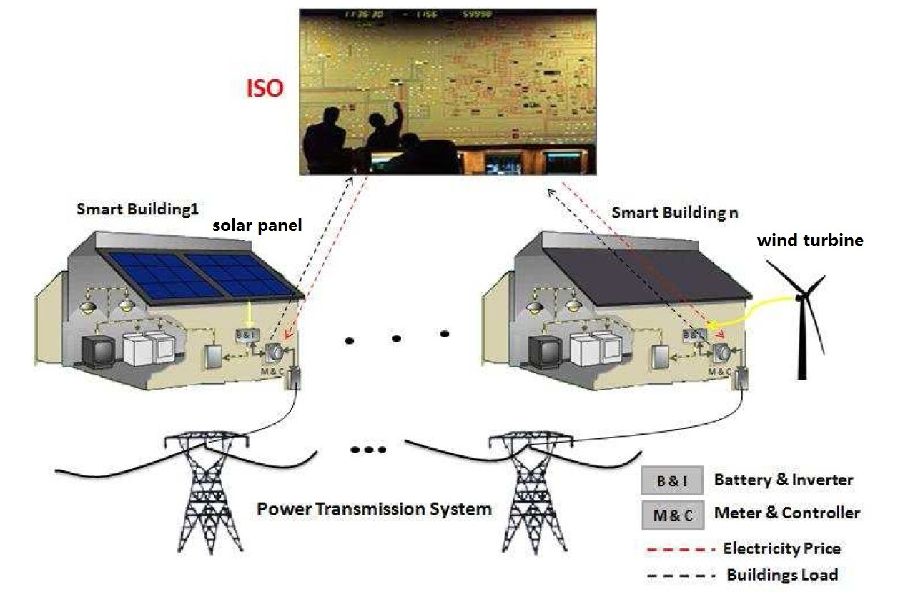
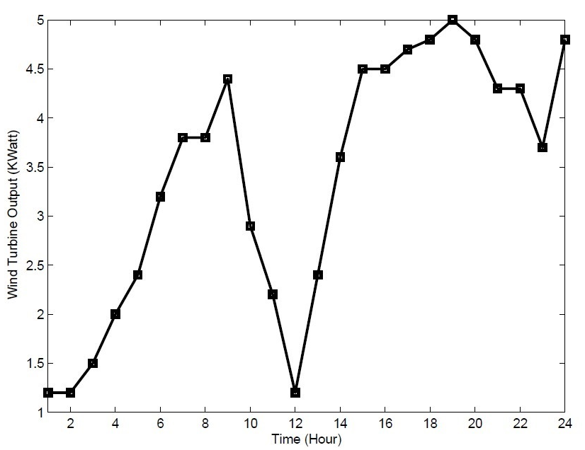

Renewable Source Models
Smart buildings
residential wind turbine
roof-top solar panel
Generated output to charge the battery.
The output power of the renewable generator can be modeled as
W + e.
Fig. 16 System with renewable sources
Fig. 17 Predicted Output of Wind Turbine
W: the renewable output prediction
e: the prediction error

Slide 79
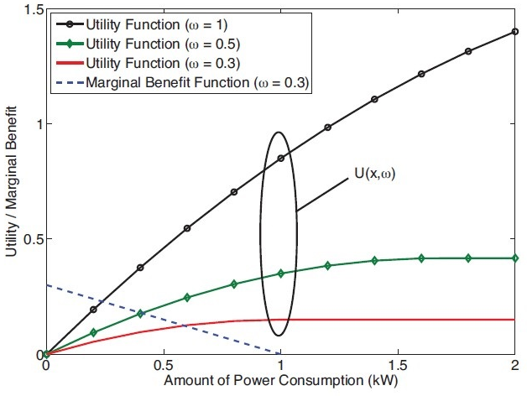
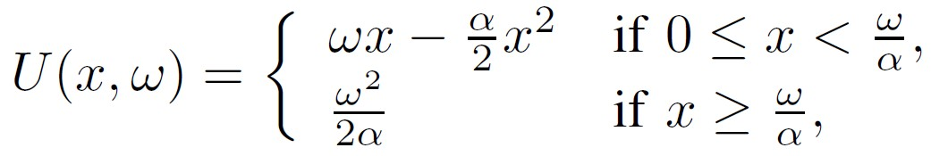
Utility Function
Adopt the concept of utility function from microeconomics.
To model
  different objectives that each user may consider for its different appliances.
  the general behavior of each user.
  the level of satisfaction of each user is model as a function of its total power consumption in each time slot.
The quadratic utility functions corresponding to linearly decreasing marginal benefit
ω representing the value of power consumption for the user, and x is power consumption.
(2)
Utility functions and marginal benefit

Slide 80
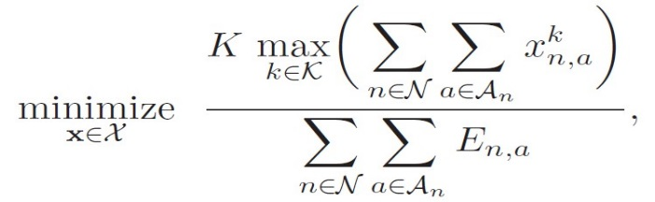
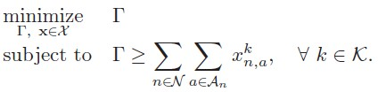
Centralized Problem Designs
Peak-to-Average Ratio(PAR) Minimization
is an optimal energy consumption schedule aiming to minimize the PAR.
Characterized as:
This can be resolved by introducing a new auxiliary variable and rewriting in equivalent form as
Linear program and can be solved in a centralized fashion by using either the simplex method or the interior point method (IPM).
May have more than one optimal solution.
The maximum one-slot loads
(3-1)
(3-2)

Slide 81
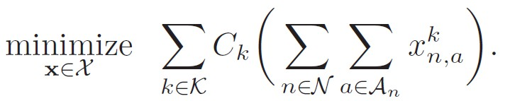
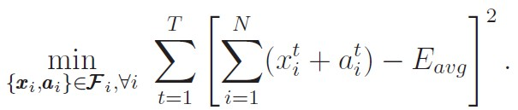
Centralized Problem Designs
Energy Cost Minimization
aims to minimize the energy costs to all users.
Expressed as:
Convex and can be solved in a centralized fashion using convex programming techniques such as IPM.
Has a unique optimal solution.
SED Minimization
aims to minimizes the square Euclidean distance between the target load profile and the average value. To reduce the peak load and load variability of the system.
Convex and can be solved in a centralized fashion using convex programming techniques such as IPM.
Has a unique optimal solution.
(4)
(5)

Slide 82
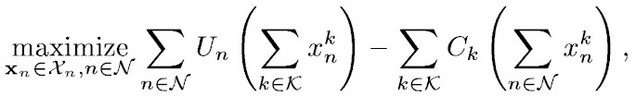
Centralized Problem Designs
Social Welfare Maximization
aims to maximize the sum of the utility functions of all users and minimize the cost imposed on the energy provider.
Utility functions and centralized control.
Expressed as:
Concave maximization and can be solved in a centralized fashion using convex programming techniques such as the IPM.
May not have sufficient information and need additional scheme.
Utility Function
Energy Cost
(6)

Slide 83

Overview
Demand Side Management
  Management objectives and basic concept
  Main techniques and mathematical key words
  Models and algorithms
  Auction game approach for DSM
    Motivation and Contribution & System Model
    Auction game: Mechanism design and the AGV mechanism
    Problem formulation and algorithm
    Simulation results
  Conclusions

Slide 84
  Auction Theory Preliminaries
Recently, auction theory (pioneered by Vickrey, etc) has been widely employed in wireless networks to solve the resource allocation issues.
In an auction, each bidder bids for an item, or items, according to a specific mechanism, and the allocation(s) and price(s) for the item, or items, are determined by specific rules.
Auctioneers: The players own resources (spectrum, power, etc) and expect to earn rewards by offering the resources.
Bidders: The players hope to obtain the resources from the auctioneers to improve their performance but in return need to provide some rewards.

Slide 85
  Auction Theory Preliminaries
Various Types:
  Vickrey Auction [Vickrey’1961]
  Ascending Auction [Ausubel’1997, Cramton’1998]
  First Price Auction, Second Price Auction
  Single Object Auction, Multiple Object Auction
  Double Auction (multiple auctioneers and multiple bidders)
  Hot Application Scenarios:
  Cognitive Radio Networks (PU as auctioneer and SUs as bidders)
  WLAN (users compete for the transmission resources)
  Cellular Networks (D2D, Femtocell)

Slide 86
Properties of Auctions
Allocative efficiency means that in all these auctions the highest bidder always wins (i.e., there are no reserve prices).
It is desirable for an auction to be computationally efficient.
Revenue Equivalence Theorem: Any two auctions such that:
  The bidder with the highest value wins
  The bidder with the lowest value expects zero profit
  Bidders are risk-neutral 1
  Value distributions are strictly increasing and atomless
have the same revenue and also the same expected profit for each bidder. The theorem can help find some equilibrium strategy.

Slide 87
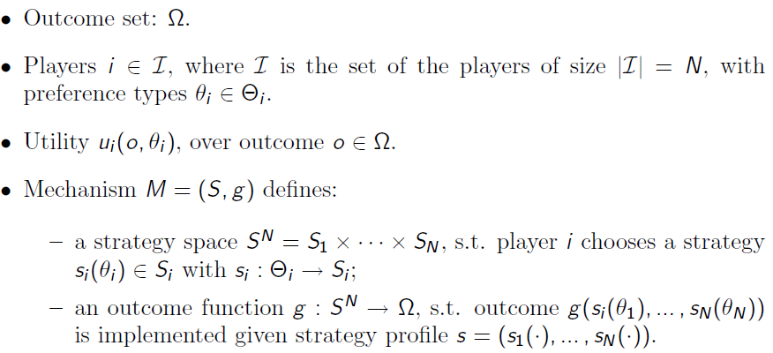
Mechanism Design
Definition of Mechanism

Slide 88

Design goal and properties
The objective of a mechanism M = (S, g) is to achieve the desired game outcome
Desired properties
  Efficiency: select the outcome that maximizes total utility.
  Fairness: select the outcome that achieves a certain fairness criterion in utility.
  Revenue maximization: select the outcome that maximizes revenue to a seller (or more generally, utility to one of the players).
  Budget-balanced: implement outcomes that have balanced transfers across players.
  Pareto optimality

Slide 89
Outline
Introduction of Smart Grid
Major topics in Smart Grid (Tutorial)
  Smart Infrastructure system
  Smart Management system
  Smart protection system
Research topic examples (Our Works)
  Bad Data Injection Attack and Defense
  Demand Side Management
  Renewable and PHEV
  Smart Meter
  Smart Building
  Smart City/Microgrid
Conclusion

Slide 90

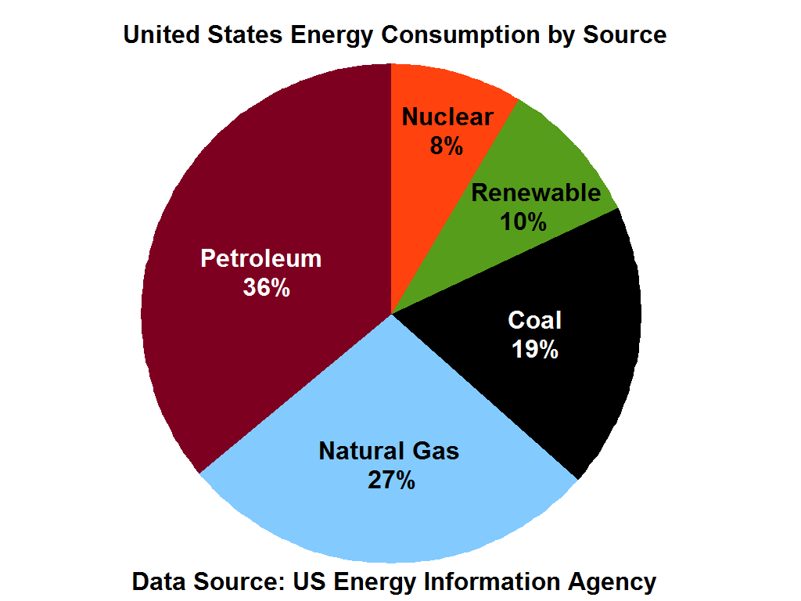


Motivation
2014

Slide 91


Limitation of Renewable Energy
Ramping constraint for the existing power plants
Gap due to the unpredicatable renewable energy is filled by diesel generator

Slide 92
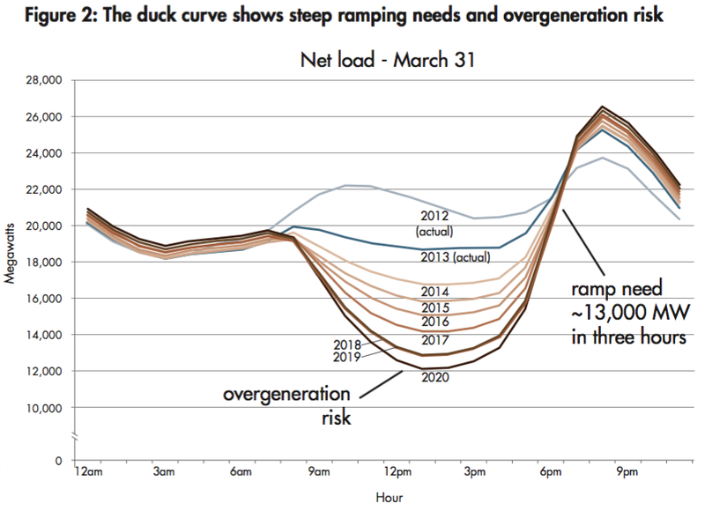
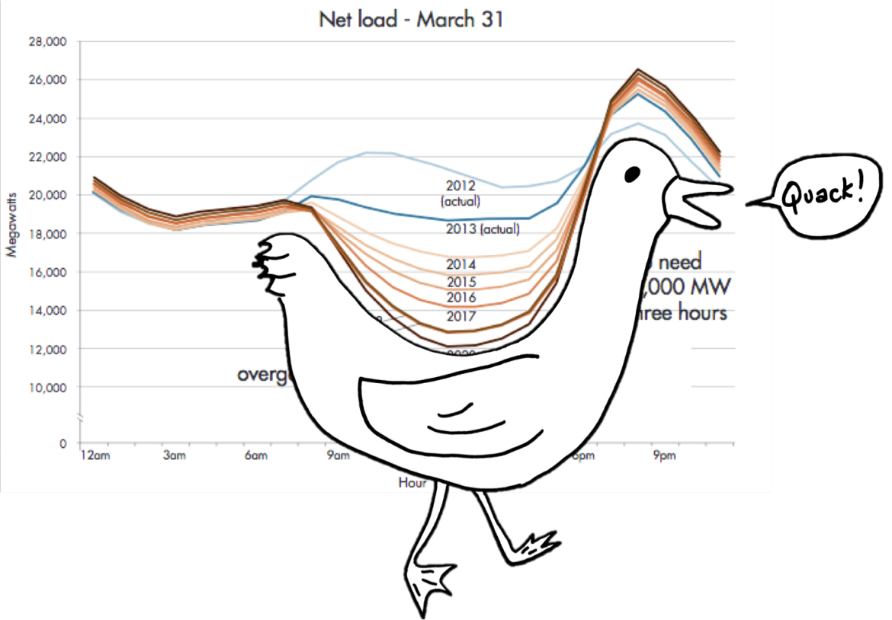
Threat
Duck curve
microgrids reschedule energy resource to minimize the peak ramp

Slide 93



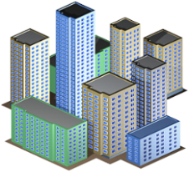



System model
power link
communication link
DSO
Residential load
….
Microgrid 1
Microgrid 2
Microgrid N
A set of N microgrids and a distribution system operator (DSO)
Set of T energy consumption periods

Slide 94
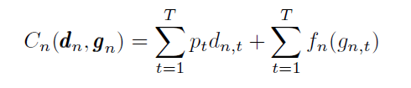
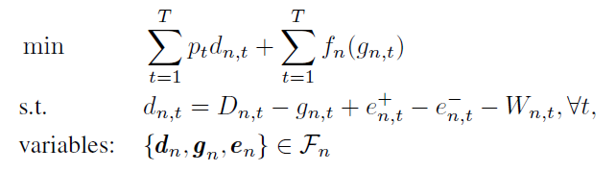

Microgrid energy cost
price
Power buy from the grid
Power generate locally
Power buy from the grid
Total demand
Local generation
Power from energy storage
Renewable generation
Power balance
Total cost

Slide 95



Microgrid ‘s payoff
Net load
Ramp between 2 time slots
Peak ramp
Extra cost when microgrid deviates from the original optimal point
New total cost
Microgrid’s payoff
Reimbursement

Slide 96

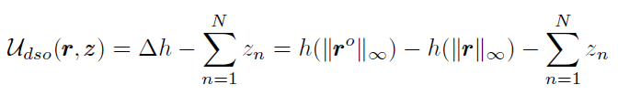
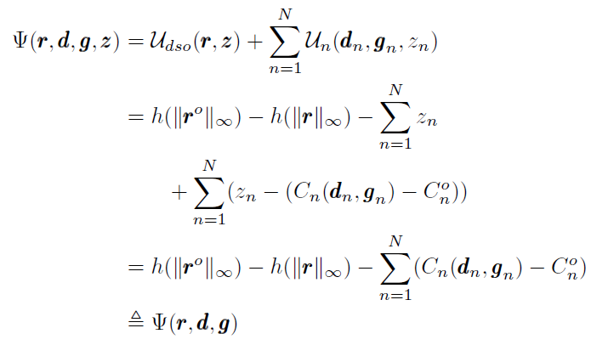

DSO’s payoff
Saving cost due to peak ramp reduction
Cost function to satisfy the peak ramp
DSO’s payoff
max
Social welfare
Cannot determine the reimbursement

Slide 97

Nash bargaining solution
Nash bargaining game is a simple two-player game used to model bargaining interactions. In the Nash bargaining game, two players demand a portion of some good (usually some amount of money)
Maximize the Nash’s product (U1 – d1)*(U2-d2)
Fairness

Slide 98
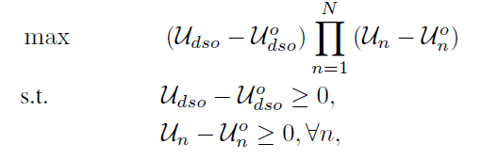
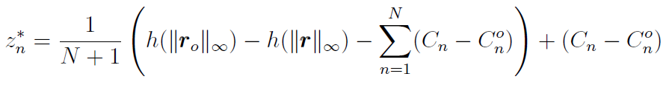

Nash bargaining solution
DSO’s payoff
microgrid’s payoff
Solution
maximizes the social welfare problem
Extra cost
Social welfare

Slide 99
Alternating Direction Method of Multipliers (ADMM)
Augmented Lagrangian function
Iterative procedure to solve an optimization problem using ADMM

Slide 100
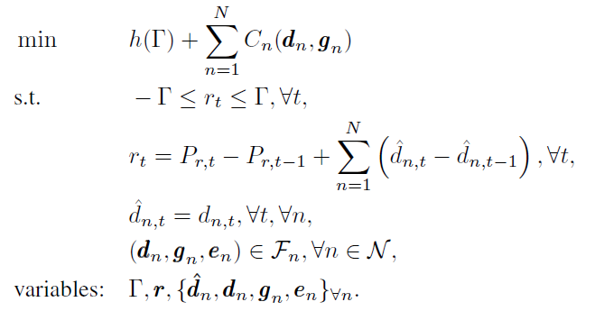
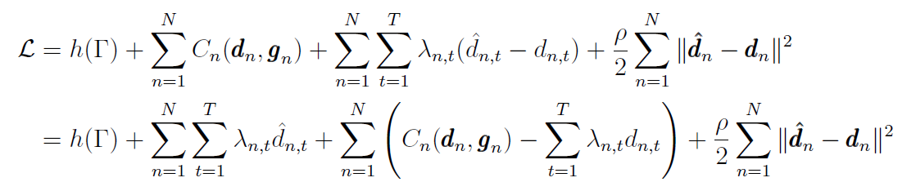
Distributed algorithms for NBS
Transform into an equivalent problem
The augmented Lagrangian function
Penalty term
Lagrange multiplier

Slide 101
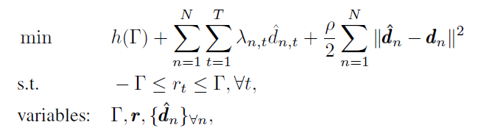
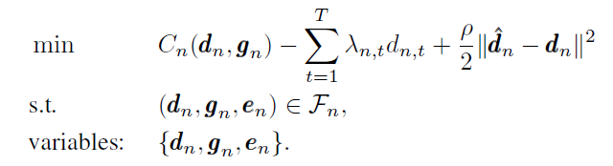

Problem decomposition
DSO problem
Individual microgrid problem
Dual variables update:

Slide 102











Synchronous ADMM
DSO
Solve local problem for $Γ,$ $d_{n}^{^}, r$
$$d_{2}^{^}$$
$d_{N}^{^}$
$$λ_{1},d_{1}^{}$$
$$d_{1}^{^}$$
$$λ_{2},d_{2}^{}$$
$$λ_{N},d_{N}^{}$$
Microgrid 1
Microgrid 2
Microgrid N
Solve local problem for$d_{1}^{}$
Update $λ_{1}$
Solve local problem for$d_{2}^{}$
Update $λ_{2}$
…
Solve local problem for$d_{N}^{}$
Update${ λ}_{N}$
DSO
Microgrid 1
idle
idle
Microgrid 2
……
idle
idle
Microgrid N
Iteration k = 0
Iteration k = 1

Slide 103


Asynchronous ADMM
Consider an optimization problem
Solve in asynchronous fashion

Slide 104


Asynchronous ADMM
DSO problem
Individual microgrid problem

Slide 105

Asynchronous ADMM
DSO
Microgrid 1
Microgrid 2
……
…
Microgrid N
Iteration k = 0
1
2
3
4
5
6
7
8

Slide 106



Simulation results
Synchronous Alg. 1 converges after about 70 iterations (497 sec.). Asynchronous Alg. 2 needs 250 iterations (325 sec.)
Peak ramp reduces 53% compared to original net load
Microgrids receive benefit by participating in peak ramp minimization problem

Slide 107

PHEV charging
  Investigate the public electric vehicle (EV) charging market
  Objective:
  Time-based pricing mechanism for heterogeneous charging stations (CSs)
  CS allocation mechanism for EVs

Slide 108

Equilibrium Competition with Equilibrium Constraint
  Charging curve for level 3 charging
Lower-layer Strategy:
EVs determine optimal charge time
Apply matching game to solve the CS allocation problem
Upper-layer Strategy:
Heterogeneous CSs sets the price at the upper layer as the leader
Apply the BCD-based method to solve the pricing problem
Equilibrium Programming with Equilibrium Constraint
Two level competitions
Within each level competitions.

Slide 109
Outline
Introduction of Smart Grid
Major topics in Smart Grid (Tutorial)
  Smart Infrastructure system
  Smart Management system
  Smart protection system
Research topic examples (Our Works)
  Bad Data Injection Attack and Defense
  Demand Side Management
  Renewable and PHEV
  Smart Meter
  Smart Building
  Smart City/Microgrid
Conclusion

Slide 110


Load Profiling
From smart meter data, try to tell users’ usage behaviors
  CEO, 1%, audience here
  Worker, middle class, myself
  Homeless, slave, Ph.D. students

Slide 111

Smart Meter Data and Load Profiles
Data set: smart meter data from the utility company over the entire Houston city area
Over 2 million users
Data Sampling frequency: every 15 min
Recorded from 2013 ~ 2014
Data size over 150 GB
Load profiles of electricity users: a graph of the variation in the electrical load versus time.
Load profiles of some typical energy users

Slide 112

Pragmatic Features
Data compression by key pragmatic features
Perform Principal Component Analysis (PCA) to pragmatic features
Use PCA results as the input feature points {X}

Slide 113


Probabilistic Clustering Formulation
Formulate clustering problem:
  M: number of clusters, N: number of users
Clustering objective
Total within-cluster scatter
Cluster indicator
Cluster centroid
Distance measure
Cluster indicator matrix

Slide 114


Distance Measure
Distance measure: modified Mahalanobis distance
Clustering algorithm:
Mahanalobis distance
Determinant of cov matrix

Slide 115

Stopping Rule
Stopping rule:
  Stability indicator: clustering shift ξ(k)
size of set difference between CLUm(k) and CLUm(k+1)
cardinality of the m-th cluster generated at the k-th iteration

Slide 116


Clustering Quality
Separation indicator: strong separation index, SEP.
Definition and algorithms for SEP:
Quality of terminal clustering (the smaller the better):

Slide 117
Probabilistic Clustering: Overall Algorithm
1> Data preprocessing to corrupted recordings
2> Extract pragmatic features
3> GMM analysis of TOT values for subgroup splitting and outlier detection
4> PCA to de-correlate the pragmatic features
5> Iterate probabilistic clustering with the modified Mahalanobis distance
6> Compute quality of terminal clustering by the strong separation index

Slide 118
Probabilistic Clustering: Numerical Results
Gap statistic to infer optimal number of clusters
Fast convergence speed
Gap statistic to determine optimal number
of clusters, M
Convergence performance of proposed algo.

Slide 119


Probabilistic Clustering: Numerical Results
Separation quality by SEP and visualization:
3-d visualization of 3 terminal clusters

Slide 120

Probabilistic Clustering: Numerical Results
Convergence and separation quality for sub-clustering:
Stability/Convergence of sub-clustering CLU2

Slide 121
Outline
Introduction of Smart Grid
Major topics in Smart Grid (Tutorial)
  Smart Infrastructure system
  Smart Management system
  Smart protection system
Research topic examples (Our Works)
  Bad Data Injection Attack and Defense
  Demand Side Management
  Renewable and PHEV
  Smart Meter
  Smart Building
  Smart City/Microgrid
Conclusion

Slide 122


Topic 1: Smart Buildings Controls
System Model
Upper Level: Independent System Operator
  Solves a social welfare maximization problem,
  Decides how much power to buy from generators and what are prices.
Lower Level: Number of buildings
  Solves a electricity bill minimization problem
  Decides HVAC and energy storage controls

Slide 123

Smart Buildings Controls
System states:
x₁ : The amount of electricity energy stored in the battery array
x₂ : The indoor temperature of the home
Control Variables:
u₁: The amount of power from battery to home usage
u₂: Air conditioner usage of electricity

Slide 124






Smart Buildings Controls
Battery Storage Dynamics:
β= Rate of energy loss of the battery

Slide 125

Smart Buildings Controls
Temperature Dynamics [P. Constantopoulos, 1991]:
ε= The thermal time constant of the building
γ= Efficiency of the air conditioning unit
tOD = Outside temperature

Slide 126



Smart Buildings Controls
Building i
Consumption
Building i
Generation
Price Model
Cost:
Constant Price
Penalty of Violating
Desired Temperature
Price
Building consumption

Slide 127




Smart Buildings Controls
The optimal control strategy for building i can be obtained as
where
Solution of Ricatti equation

Slide 128



Smart Buildings Controls
Simulation Results
All the houses connected to one bus are assumed to be homogeneous
As price increases, the battery tends to discharge in order to cover a portion of the building power consumption and the indoor temperature tends to increase due to lowering HVAC consumption
load during peak hours.

Slide 129

Smart Buildings Controls
Simulation Results
All the houses connected to one bus are assumed to be homogeneous
For both day-ahead and real-time pricing techniques, the peak load is reduced around 8 PM

Slide 130

Topic 2: Distributed HVAC Control
System Model
There are a total of n zones in an energy-smart building
At the beginning of each 24 hours, the temperature control unit of zone i decides:
A constrained daily electricity cost optimization
Electricity cost of building i at time t
Distribution feeder load Constraint
Indoor Temperature comfort range

Slide 131

Distributed HVAC Control
System Model
There are a total of n zones in an energy-smart building
At the beginning of each 24 hours, the temperature control unit of zone i decides:
A constrained daily electricity cost optimization for each zone
Price
HVAC ‘s Efficiency
Thermal constant
Outdoor Temperature

Slide 132



Distributed HVAC Control
Game in Normal Form :
Set of players: zones temperature control units
Set of strategies: HVAC units power consumption quantized vectors amounts
Set of payoffs:
Indicator for satisfaction of constraints
Electricity cost
Payoff Function
Distribution load constraint

Slide 133

Distributed HVAC Control
Game in Satisfaction Form :
Set of players: zones temperature control units
Set of strategies: HVAC units power consumption quantized vectors amounts
Satisfaction functions:

Slide 134

Distributed HVAC Control
Satisfaction Equilibrium
An equilibrium is observed when all players are simultaneously satisfied

Slide 135


Distributed HVAC Control
Proposed Learning Algorithm
The state of each player:
  Mood : content (c) and discontent (d)
  Benchmark Strategy
  Benchmark Payoff

Slide 136

Distributed HVAC Control
Properties
The players’ actions at the stochastically stable state of the learning algorithm maximize the social welfare of all players
By selecting the stochastically stable state of the game is such that the largest set of players is satisfied.

Slide 137

Distributed HVAC Control
Simulation Results
The proposed learning algorithm is able to meet the optimal solution for most of the time (stochastically stable state)
At NE, the payoff of players is considerably lower than the maximum social welfare

Slide 138

Distributed HVAC Control
Simulation Results
The effect of exploration rate on the convergence of the game
By decreasing the exploration rate from 0.05 to 0.01, the players tend to stick to their choices
By increasing the exploration rate from 0.05 to 0.09, the payoff decreases, players choose their actions more dynamically

Slide 139
Outline
Introduction of Smart Grid
Major topics in Smart Grid (Tutorial)
  Smart Infrastructure system
  Smart Management system
  Smart protection system
Research topic examples (Our Works)
  Bad Data Injection Attack and Defense
  Demand Side Management
  Renewable and PHEV
  Smart Meter
  Smart Building
  Smart City/Microgrid
Conclusion

Slide 140

Motivation
Joint optimal scheduling for gird-connected and islanded operation

Slide 141










System model
Main grid
…
Microgrid 1
Microgrid 2
Microgrid N
Power balance constraints
Self generation
Power from main grid
Power from neighbors

Slide 142
Islanded operation
Main grid
…
Microgrid 1
Microgrid 2
Microgrid N

Slide 143




Islanded constraints
For microgrid in islanded mode
Fraction of load curtailment
For microgrid in normal mode
Ramping constraints

Slide 144

Problem formulation
Microgrid generation cost and load curtailment minimization problem
Large-scale problem

Slide 145
Asynchronous ADMM
Consider an optimization problem
Solve in asynchronous fashion

Slide 146











Parallel algorithm
Normal operation
Solve normal problem for $y^{o},{\left\{x_{i}^{o}\right\}}_{∀i}$
Master computer
$y^{o,1}, {\left\{x_{i}^{o,1}\right\}}_{∀i}$,$λ^{1},μ^{1}$
$$y^{o}{,\left\{x_{i}^{o}\right\}}_{∀i}$$
$y^{o}{,\left\{x_{i}^{o}\right\}}_{∀i}$
$$y^{o}{,\left\{x_{i}^{o}\right\}}_{∀i}$$
$y^{o,2}, {\left\{x_{i}^{o,2}\right\}}_{∀i}$,$λ^{2},μ^{2}$
$y^{o,N}, {\left\{x_{i}^{o,N}\right\}}_{∀i}$,$λ^{N},μ^{N}$
Computer 1
Computer 2
Computer N
Islanded operation
Solve for $y^{o,1}, {\left\{x_{i}^{o,1}\right\}}_{∀i}$
Update $λ^{1},μ^{1}$
Islanded operation
Solve for $y^{o,2}, {\left\{x_{i}^{o,2}\right\}}_{∀i}$
Update $λ^{2},μ^{2}$
Islanded operation
Solve for$y^{o,N}, {\left\{x_{i}^{o,N}\right\}}_{∀i}$
Update $λ^{N},μ^{N}$

Slide 147


Simulation results
Converge to optimum after about 40 iterations
The fraction of load curtailment
when switching into the islanded mode: sparse number of microgrids have to reduce loads

Slide 148

Big data algorithm implementation
MapReduce programming model
Normal operation
Solve normal problem for $y^{o},{\left\{x_{i}^{o}\right\}}_{∀i}$
Master computer
Islanded operation
Solve for $y^{o,1}, {\left\{x_{i}^{o,1}\right\}}_{∀i}$
Update $λ^{1},μ^{1}$
Computer 1
Islanded operation
Solve for $y^{o,2}, {\left\{x_{i}^{o,2}\right\}}_{∀i}$
Update $λ^{2},μ^{2}$
Computer 2
Islanded operation
Solve for$y^{o,N}, {\left\{x_{i}^{o,N}\right\}}_{∀i}$
Update $λ^{N},μ^{N}$
Computer N

Slide 149

MapRedcue algorithm for ADMM

Slide 150

Running time on cluster
Faster with a larger number of microgrids

Slide 151

Catastrophe Modeling
If we model the catastrophe and provide detailed plans for the workforces and resources before the catastrophe, the power system can be recovered much quicker.
This requires two types of analytic researches.
  First, how to model and predict the catastrophe based on the weather information. Some fast learning algorithms are needed from past experiences.
  Second, with different catastrophe level, how to design the corresponding plans. This can be modeled mathematically as Recourse, which optimizes different plans with different level of natural disasters, respectively

Slide 152



1. Post-Storm Restoration
Storm Strikes
Generation units fail
Substations fail
Transmission lines fail
How the limited restoration resources to be allocated to minimize restoration cost, generation cost, and load interruption?

Slide 153


2. Pre-Storm Planning
Storm is about to Strike
Information e.g. wind gust speed is available
Limited resources to respond to the storm are available
How to mobilize the resources?
How much resource is required?

Slide 154





Pre-Storm Framework
Predicted Wind Gust Speed
Structural Fragility and Damage Likelihood Analysis
Optimal resource mobilization to the sites
Predictive Load Interruption Analysis
Proactive Restoration
Resource Allocation
Local Terrain
and Characteristics

Slide 155


Conclusion
Overview of smart grid
Try to sell our research
http://wireless.egr.uh.edu/research.htm
Questions?
Thank you very much!

Slide 156

Management of Smart Meter Big Data
Exploiting optimization techniques for big data management and improve the solution of existing methods
Parallel/decentralized computing, application of computing clusters and cloud computing
Improving system controllability
Enhanced reliability

Slide 157
Transmission and Distribution Expansion Planning
Determining the optimal size, time and location of the investments required to meet the forecasted load
Prevent overinvestment/underinvestment
Consider the role of distributed energy resources, responsive demands, and new types of loads such as plug-in vehicles
Objective: Develop efficient analytical models to optimally expand the transmission and distribution networks while taking the smart grid developments into account

Slide 158

Customer Participation in Grid Operation, Control and Reliability
Electricity customers have the opportunity to understand and reduce their energy use.
If properly utilized, significant benefits will be achievable in power system operation, control and reliability.
  Peak shaving, load shaping, reduction in capital-intensive peak unit installation, reduction in transmission congestion, increased system reliability

Slide 159


Customer Satisfaction
Customer satisfaction is in the heart of power system developments
Power system reliability is met to guarantee generation adequacy and supply the customers with no interruption in the electricity supply
The current digital age calls for enhanced power quality

Slide 160

Asset Management
Timely maintenance of the aging power system infrastructure
Prevent unintended equipment outages and keep the system running with no interruption
Prevailing operation and economical constraints
  Budget limitation, labor restrictions and customer interruption costs.

Slide 161
Smart Homes and Smart Buildings
Residential consumers use more than one third of the total energy consumed in the United States
Smart homes and buildings:
  Enhanced conservation levels, lowered greenhouse gas emissions, lowered stress level on congested transmission lines.
The financial incentives offered to consumers, who would consider load scheduling strategies according to real-time electricity prices, is the most momentous driver for adjusting consumption habits.

Slide 162

Impact of PHEVs on the Existing Power Network
PHEVs will replace the traditional fuel powered vehicles in the foreseeable future
The PHEV charging will cause significant load in the power network
PHEVs contain a lot of energy which will only be used during the traffic hour. The energy can be used to reduce the power hour demand as well by serving as the battery reserves.
Optimal PHEV charging, so that the power system will not be overloaded

Slide 163

Electric Power Analytics Consortium
Goal:
Increase the university-industry collaborations in solving the existing and future power and energy problems, via development of viable computational techniques and mathematical models and benefiting from the available smart grid big data.
EPAC
Industry
University
Industry Driven
University Inspired
Innovative Research

