Slide 1

A Survey on High Altitude Platform Station (HAPS) Zhu Han
Thanks for Zirui Jia

Slide 2
Outline
Motivation and Background
Introduction of HAPS
HAPS, Satellite, and UAV
Existed Research Cases
What can we do on HAPS

Slide 3
Motivation and Background

Slide 4
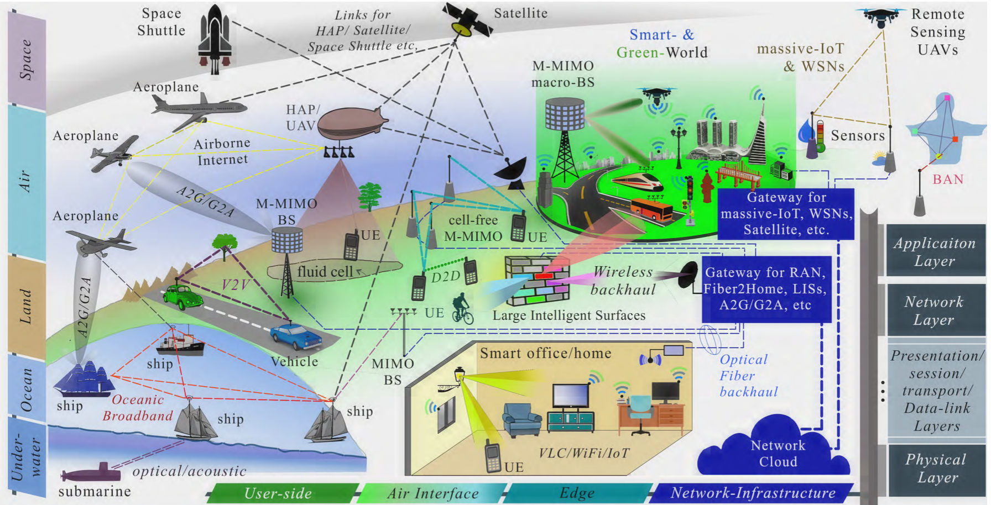
B5G Communication networks
[1]S. J. Nawaz, S. K. Sharma, S. Wyne, M. N. Patwary, and M. Asaduzzaman, “Quantum machine learning for 6G communication networks: State-of-the-art and vision for the future,” IEEE Access, vol. 7, pp. 46 317–46 350, 2019.
Notes:
different types, layers, sides, and levels of B5G communication networks

Slide 5
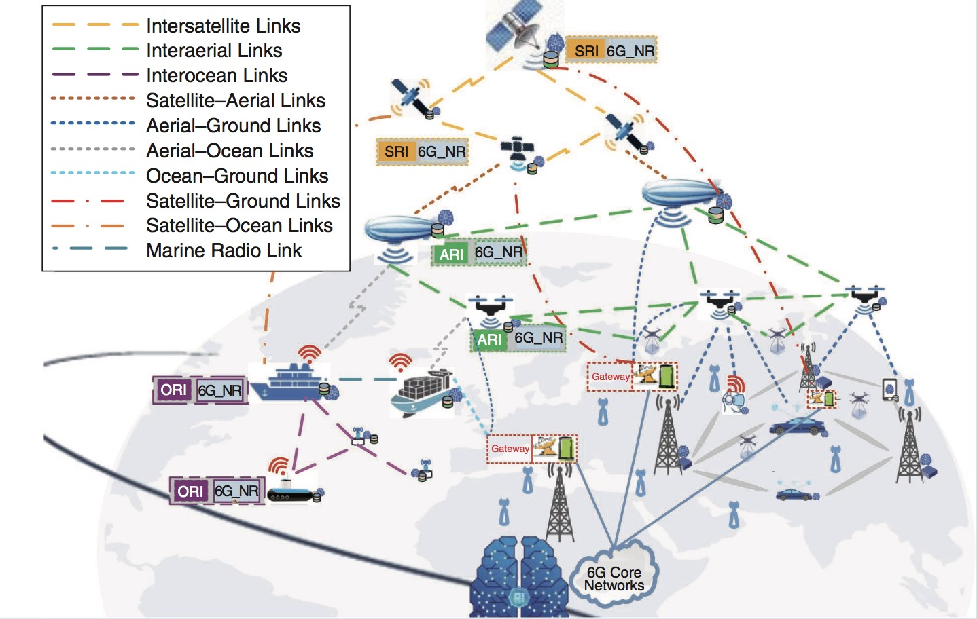
6G Wireless Vision
Commercial application of 5G
6G is on the way
Global coverage and service
Integration of space, air, ground and ocean
[2] Z. Zhang, Y. Xiao, Z. Ma, M. Xiao, Z. Ding, X. Lei, G. K. Karagiannidis, and P. Fan, “6G wireless networks: Vision, requirements, architecture, and key technologies,” IEEE Veh. Technol. Mag., vol. 14, no. 3, pp. 28–41, Sep. 2019.

Slide 6
Introduction of HAPS

Slide 7
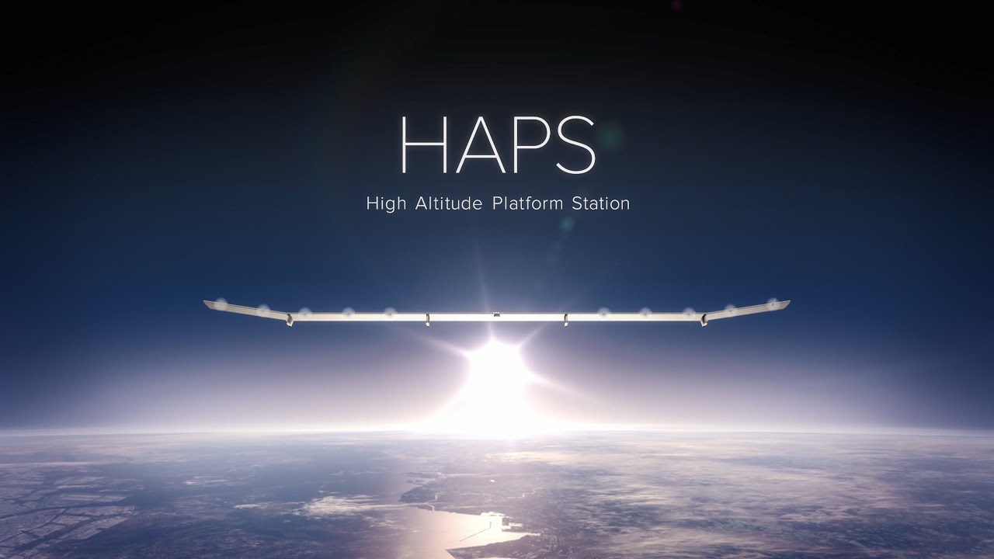
Background and Motivation
20 km
Stable in the air
Low launching cost
Super loading capacity

Slide 8

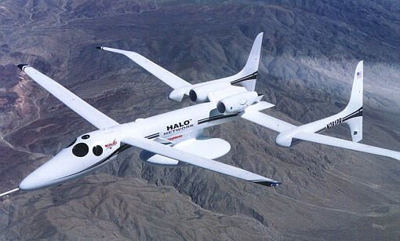

What is HAPS ?
High-altitude platform stations (HAPS) are aircraft positioned above 20 km altitude, in the stratosphere, in order to compose a telecommunications network or perform remote sensing, for civilian or military applications. These aircraft may be airplanes, airships or balloons, manned or unmanned. They can be defined as a telecommunications station at a specified fixed point relative to the Earth.
There was a growing interest in HAP utilization as a complement to terrestrial and satellite-based communications network.
Programs: Google’s Solara 50, Facebook’s Aquila, Airbus’ Zephyr, Thales’ Stratobus, Lockheed Martin’s HAA, and NASA’s HELIOS, etc.
[3] https://www.hapsmobile.com/en/, Dec. 2017.
[4] www.airbus.com/defence/uav/zephyr.html, Aug. 2018.
[5] https://www.thalesgroup.com/en/worldwide/space/news/whats-stratobus, Mar. 2017.

Slide 9
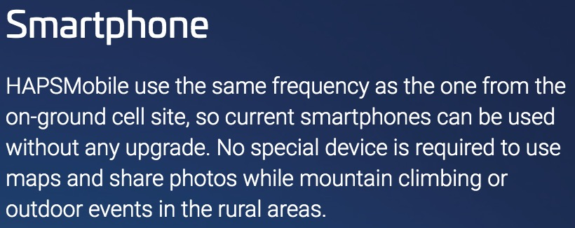
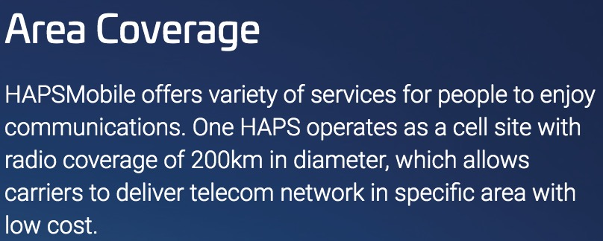
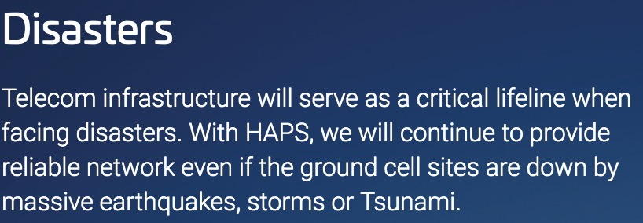
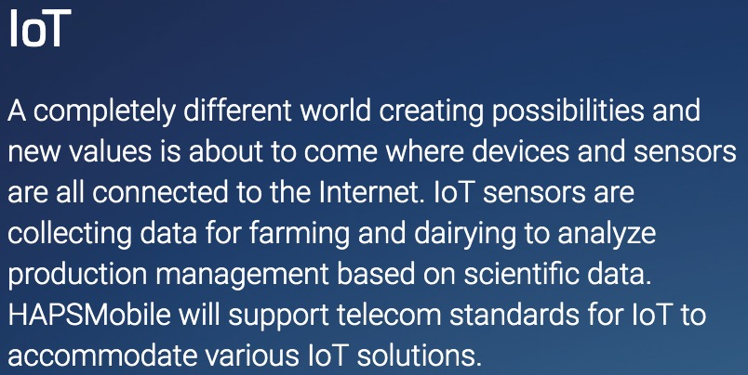
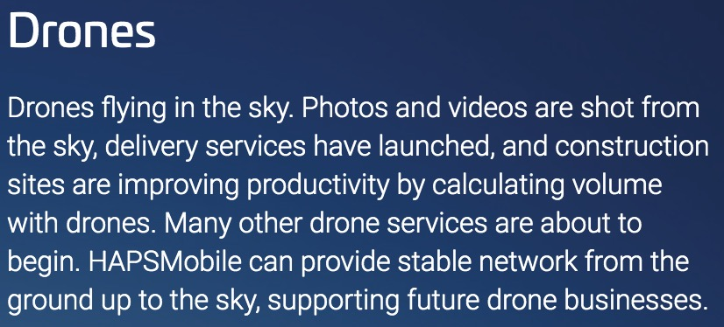
What can HAPS do ?
[6] https://www.hapsmobile.com/en/, Dec. 2017.

Slide 10
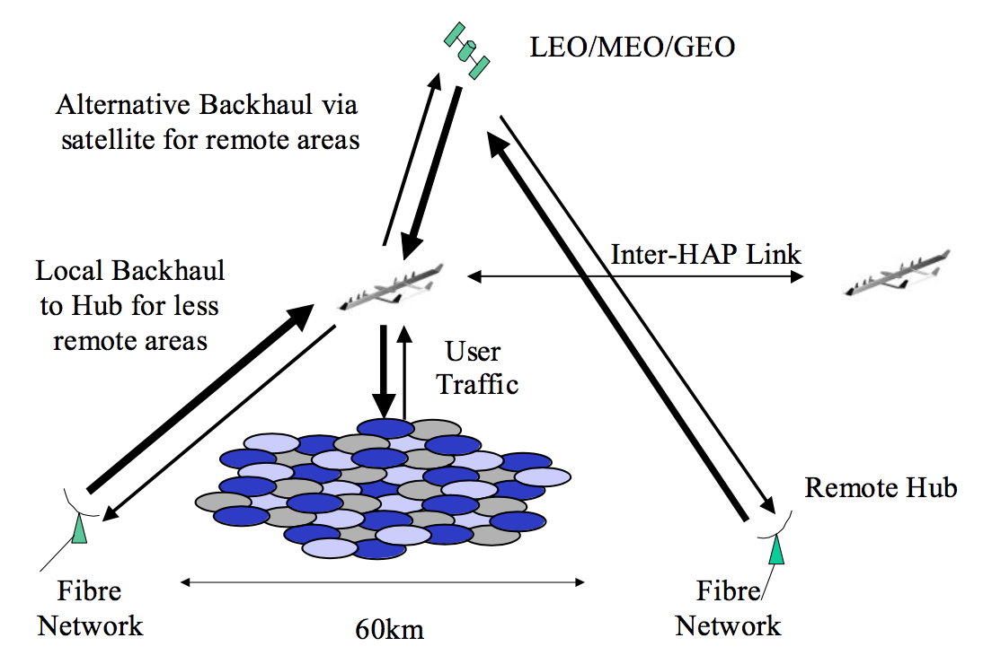
Why we need HAPs ?
Demands from theatre for rapid information transfer.
Terrestrial and maritime LOS links limited to <20km (no satellite) relays for long ranges.
Continuous and detailed (high scrutiny) remote monitoring.
HAPs fill the gap between terrestrial and satellite services.
Base-station payload on HAPs.

Slide 11
Frequency bands for HAPS
ITU-R bands for HAPS
48/47 GHz
31/28 GHz
2 GHz
6 GHz
– 300 MHz BW in both directions – worldwide. – Most of the world (but not currently Europe). + Potential other bands (subject to appropriate sharing constraints).
X-band (8/7 GHz SHF satcom band).
EHF (45/20 GHz satcom band)
Lower NATO bands (various from 225 MHz – 2245 MHz).
Civil WiMAX or 3G bands (e.g. 2.5 GHz, 3.5 GHz, 5.8 GHz)
Free Space Optical (FSO)
Well suited to HAPs (HAP-ground, HAP-HAP, HAP- Satellite).
High data rates (1.25 Gbit/s demonstrated in CAPANINA trials).
（ CAPANINA was a project exploring the development of broadband communications capability from aerial platforms or HAPs (High Altitude Platforms)
[7] D.Grace,T.Tozer,andN.Daly,“Communicationsfromhighaltitudeplatformsacomplementaryordisruptivetechnology?”IET Conference Proceedings, pp. 8–8(1), January 2000.

Slide 12
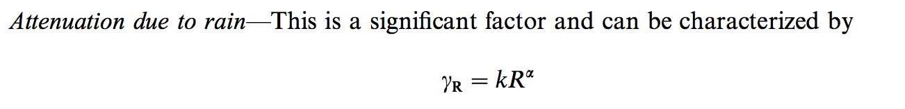
Channel characteristic
The specific attenuation H (dB/km) is obtained from the rain rate R (mm/h) using the power law relationship. The values of k and α can be obtained from ITU-R PN 838-1 and depend on climatic zone and transmission frequency. The higher the frequency the greater the attenuation experienced, i.e. it is more difficult to use 48 GHz bands than 30 GHz bands.
[9] Grace, D. , Daly, N. E., Tozer, T. C., Burr, A. G. and Pearce, D. A. (2001), Providing multimedia communications services from high altitude platforms. Int. J. Satell. Commun., 19: 559-580.
Notes:
[389]

Slide 13
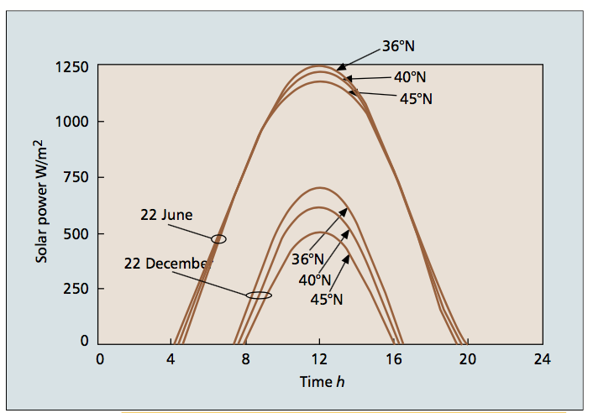
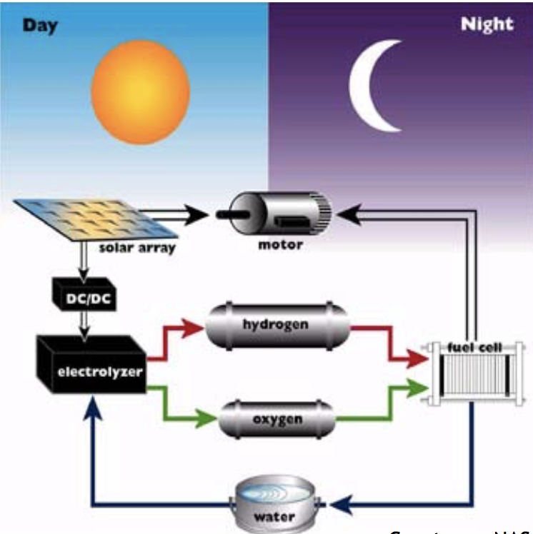
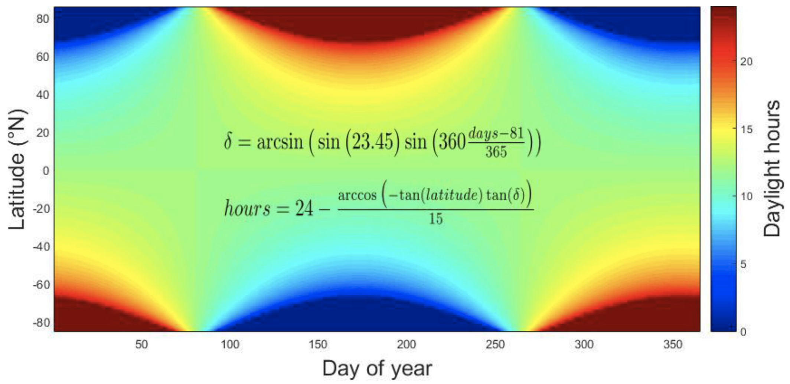
Energy harvesting
At the operational altitude of HAPS the solar irradiance is high and unaffected by clouds, so solar power is the most popular energy source for HAPS. Other alternative methods such as reception of remotely beamed energy have also been considered, both through microwaves or laser beams. However, they are not currently applied due to the high power irradiation risks.
Most HAPS programmes worldwide investigating unlimited operation endurance were considering the use of regenerative fuel cells (RFCs) onboard HAPs.
Solar power flux on a HAP at an altitude of 17 km as a function of seasonal extreme, time, and latitude.
Day hours calculated using the Sunrise equation and simple geometry considerations.
[10] J. Gonzalo, D. Lopez, D. DomÃnguez, A. GarcÃa, and A. Escapa, “On the capabilities and limitations of high altitude pseudo-satellites,” Prog. Aerosp. Sci., vol. 98, pp. 37 – 56, 2018.
[11] S. Karapantazis and F. Pavlidou, “Broadband communications via high-altitude platforms: A survey,” IEEE Communications Surveys Tutorials, vol. 7, no. 1, pp. 2–31, Jan. 2005.
Notes:
[379]

Slide 14
HAPS, satellites, and UAV

Slide 15
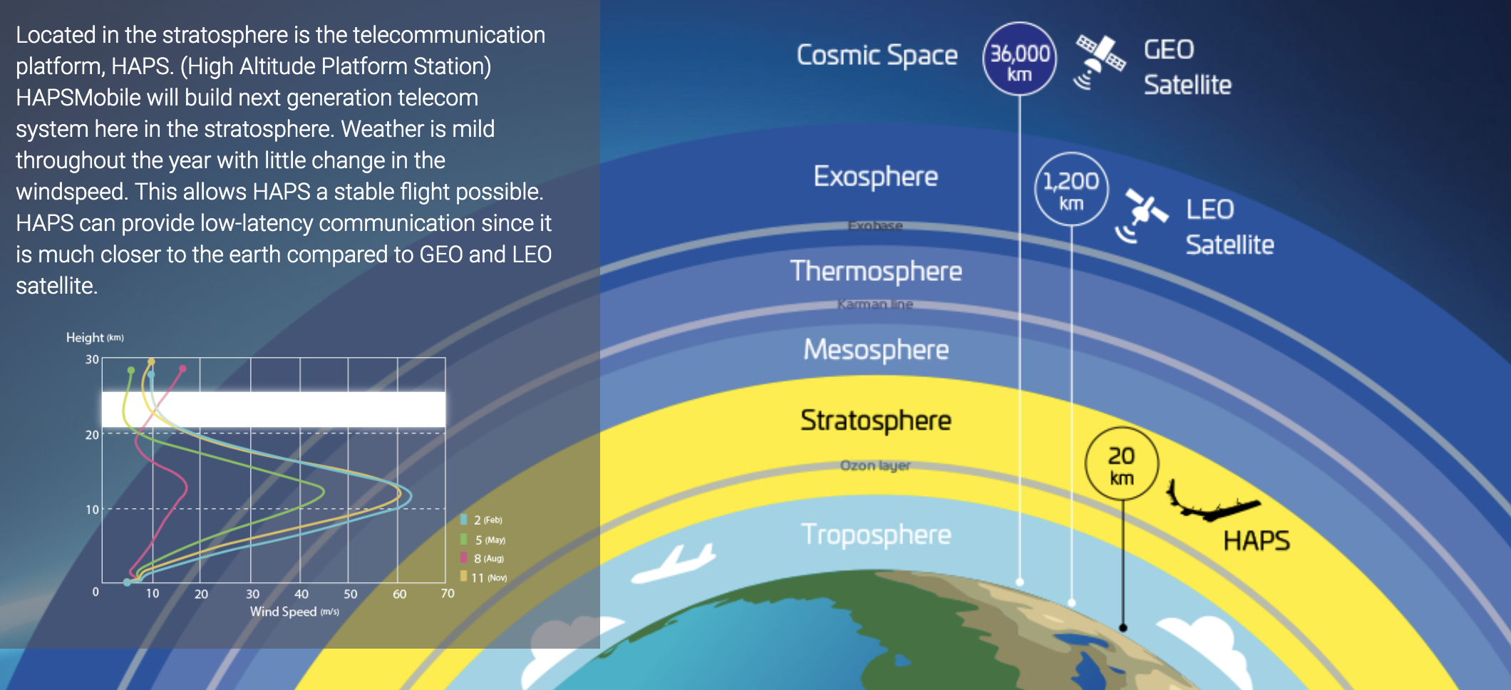
Vertical Position of HAPS
[6] https://www.hapsmobile.com/en/, Dec. 2017.

Slide 16

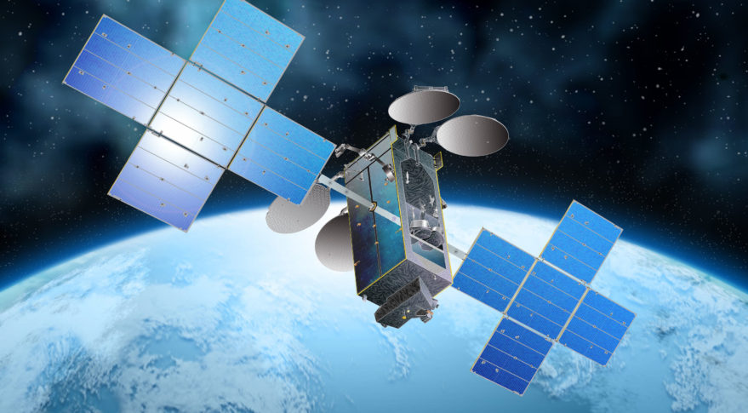
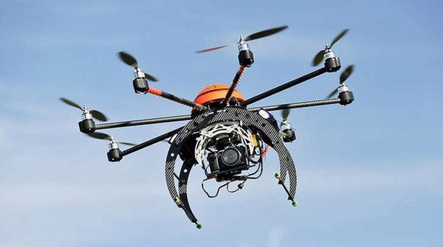
HAPS, satellite and UAV
 | HAPS | Satellite | UAV
Height | 17-22 km | >=160km | 600m-18km
Time duration | Months to years | Years | Minutes to hours
Coverage | Medium and fixed | Large and periodic | Small and changing
Energy | Solar panel, battery | Solar panel, battery | Lithium battery
Controller | Satellite and ground | Ground | Ground
Applications | Real-time monitoring Communication relay Emergency recovery Rocket launch platform … | Communication Observation Navigation Weather Astronomy … | Sensing Communication Surveillance …

Slide 17
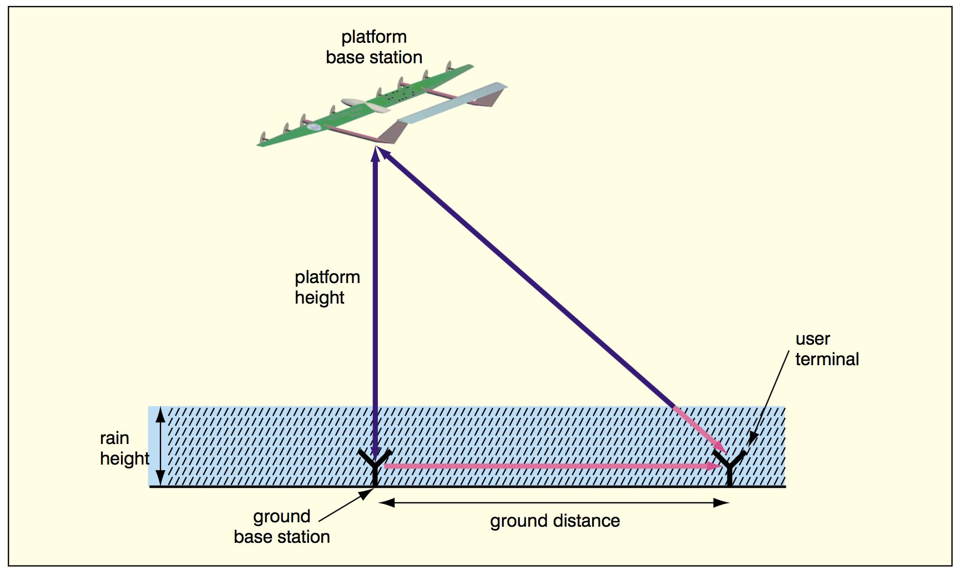
Advantages of HAPs
Compared with terrestrial services:
Replace extensive ground based infrastructure
1 HAPS can provide multicellular services over area>200km radius.
Eliminates cost, risk, site acquisition problems.
No need for local terrestrial backbone.
Backhaul can be provided to where fiber is available.
Better propagation in many scenarios
Unobstructed line of sight paths.
May be less affected by rain attenuation over wide areas.
Large system capacity through:
Use of mm-bands (e.g. 600 MHz, 48GHz)
Extensive frequency reuse
Flexible adaptive resource allocation
Rapid deployment

Slide 18
Advantages of HAPs
Compared with satellite,
Lower latency (transmission delay)
Easy to be launched
Possibility of return for maintenance
Payload reconfiguration and retrieve
For remote sensing, HAP can remain continuously over an area for long time (persistence) and can get better resolution images for they are closer to the covered areas.
Compared with UAV,
Larger coverage area
Longer duration time
Less interference by obstacles
Better energy supply

Slide 19

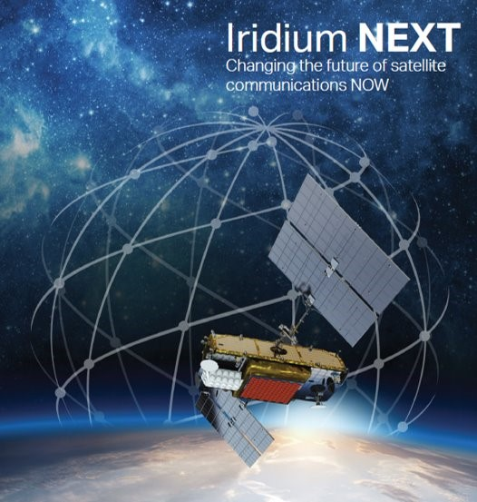
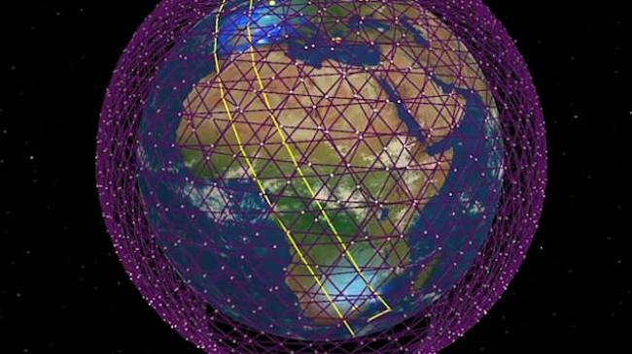
LEO Satellite Constellation
Notes:
current situation of satellites development, especially for the satellite constellation
Wide coverage, global service, multiple applications
Iridium NEXT, O3B, Oneweb, Hongyan, starlink

Slide 20
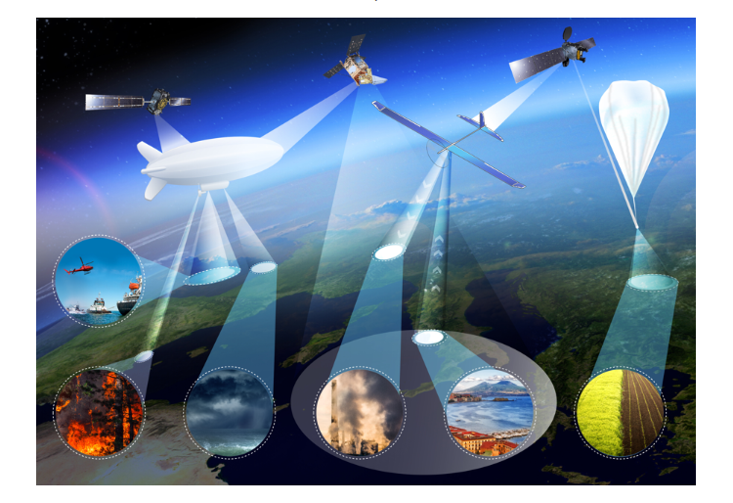
Satellite + HAPS
Satellite + HAPS for multiple applications:
Flight in the sky
Voyage at sea
Vehicle on the land
Agriculture
Emergency rescue
…
Notes:
HAP, Balloon, airship

Slide 21
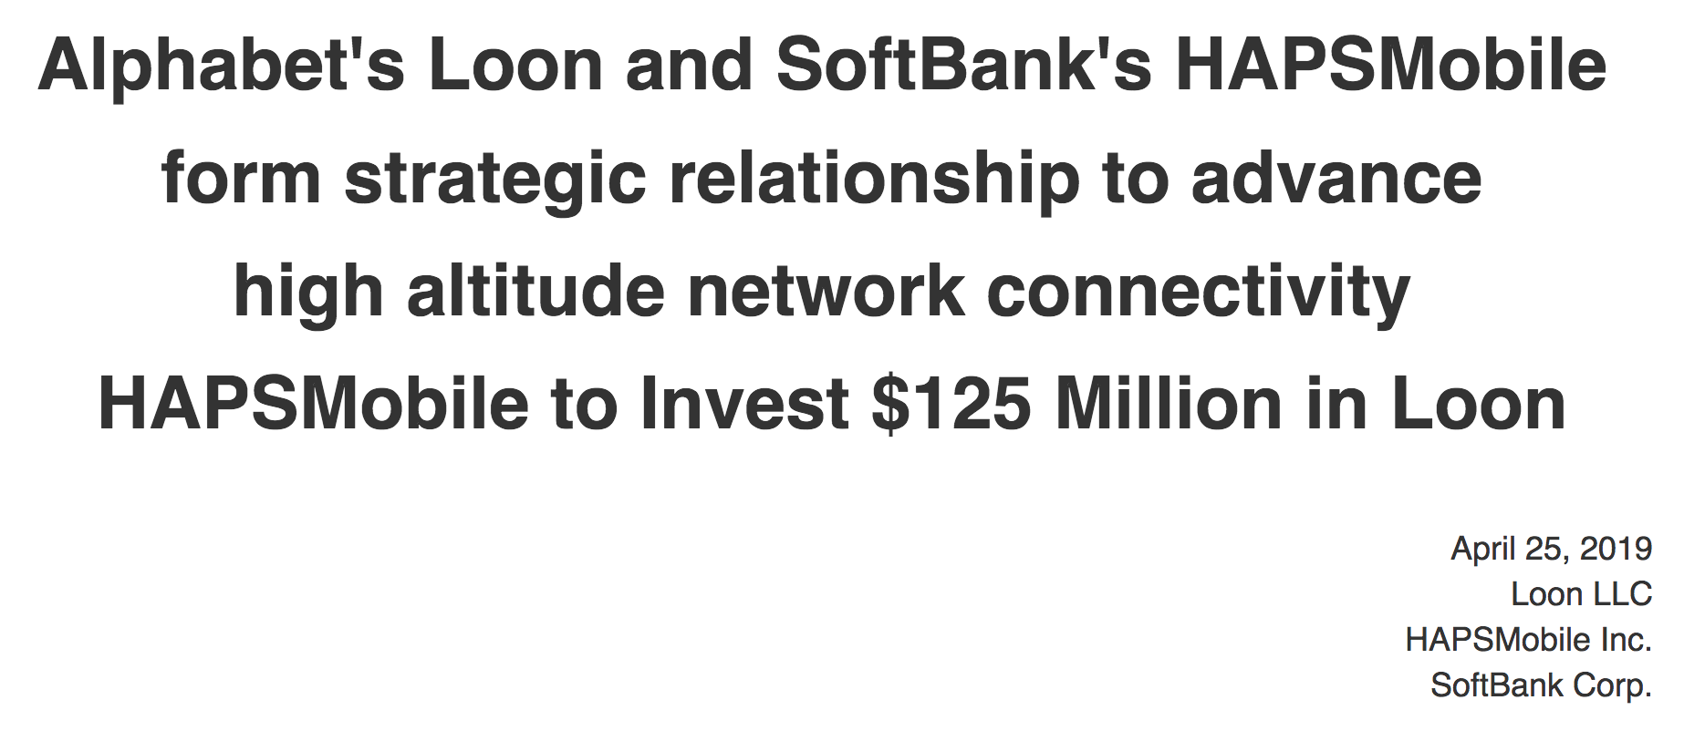



Satellite + HAPS + UAV
Space
+
Air
+
Ground
&
Notes:
SoftBank Corp.'s HAPSMobile and Alphabet's Loon have formed a long-term strategic relationship to advance the use of high altitude vehicles, such as balloons and unmanned aircraft systems (UAS), to bring connectivity to more people, places, and things worldwide. As part of the new relationship and HAPSMobile's financial and investment strategy, HAPSMobile has made a decision to invest $125 million USD in Loon. Loon has obtained the right to invest the same amount in HAPSMobile in the future. Furthermore, to strengthen the relationship, the companies are actively exploring commercial collaborations to accelerate the deployment of high altitude network connectivity solutions, with a focus on expanding mobile internet penetration, enabling internet of things (IoT) applications, and assisting in the deployment of 5G.

Slide 22
Existed Research Cases

Slide 23
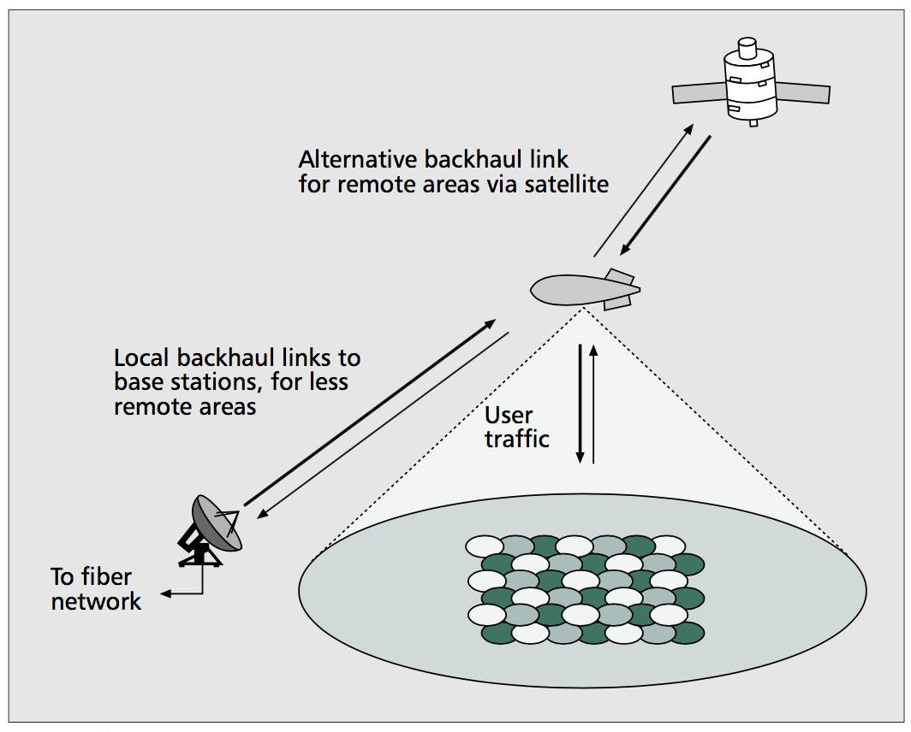
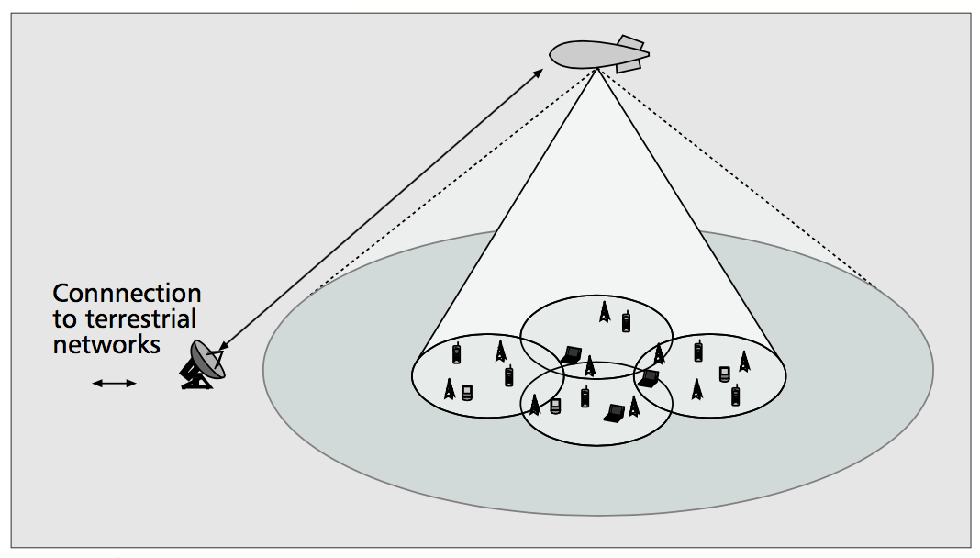
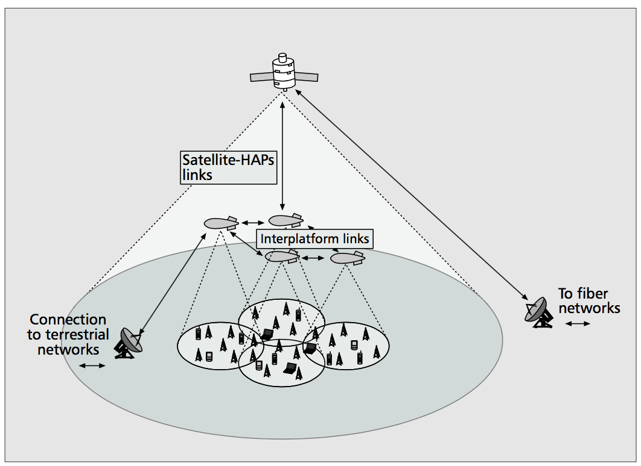
Three Classical Scenarios of HAPS
An integrated terrestrial-HAP system.
An integrated terrestrial-HAP-satellite system.
A standalone HAP system.
A rural macrocell is served by a HAP and surrounded by cells served by terrestrial base stations. A HAP is considered to project several macrocells and serve high-mobility users characterized by low bit rates. Terrestrial base stations are employed to provide access to users with high bit rates. It is not essential for terrestrial base stations to cover the whole area. Rather, they can be placed only at hot spots (e.g., shopping malls). The HAP network will be connected to terrestrial networks through a ground gateway.
HAPs can provide communication services in rural, remote, and impervious areas since it is rather difficult and economically inefficient to cover these areas with cellular and fiber networks. It is economically more efficient to cover a large area with many HAPs rather than with a satellite system or many terrestrial base stations. Backhaul links can be provided via a satellite, while a ground gateway can be used to connect the platform to terrestrial networks.
A mixed infrastructure of HAPs, terrestrial and satellite systems is a powerful integrated network infrastructure. Satellite systems can be employed for the distribution of Multimedia broadcast and multicast services (MBMS) by virtue of their intrinsic capability of broadcasting and multicasting. The choice of multiple feeder links was considered to give great flexibility to content providers. Inter-platform links could exist for unifying far-flung groups of people.
[12] S. Karapantazis and F. Pavlidou, “The role of high altitude platforms in beyond 3g networks,” IEEE Wireless Commun., vol. 12, no. 6, pp. 33–41, Dec 2005.
Notes:
[404]

Slide 24
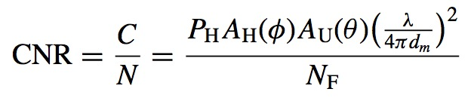
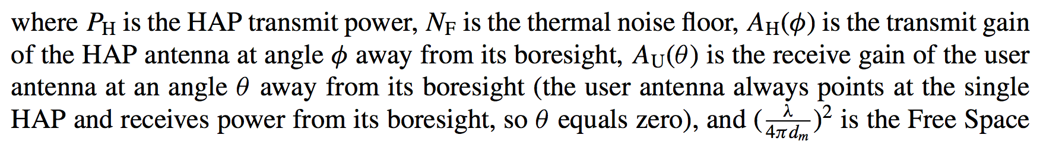
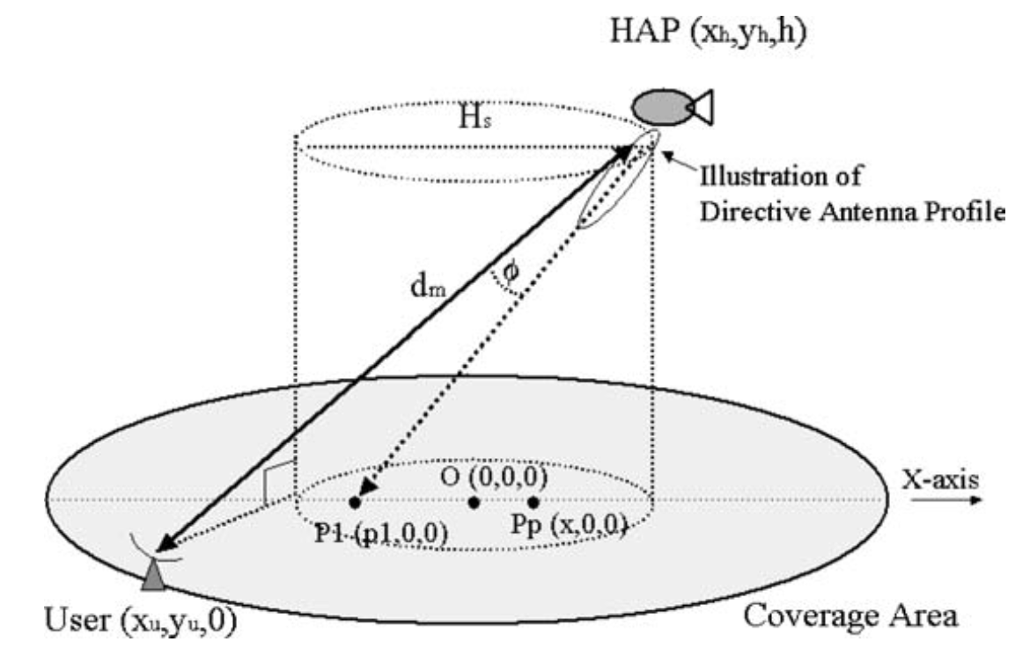
Channel Model
One HAP scenario with a directive antenna
Downlink Carrier to Noise Ratio (CNR):
Path Loss (FSPL).
Spectral efficiency (η) using the Shannon equation given by
[13] G. Chen, D. Grace, and T. C. Tozer, “Performance of multiple high altitude platforms using directive hap and user antennas,” Wireless Personal Communications, vol. 32, no. 3, pp. 275–299, Feb 2005.
Notes:
318-Channel_modeling_for_satellite_and_HAPS
[405]

Slide 25
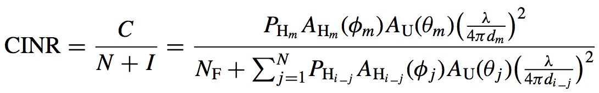
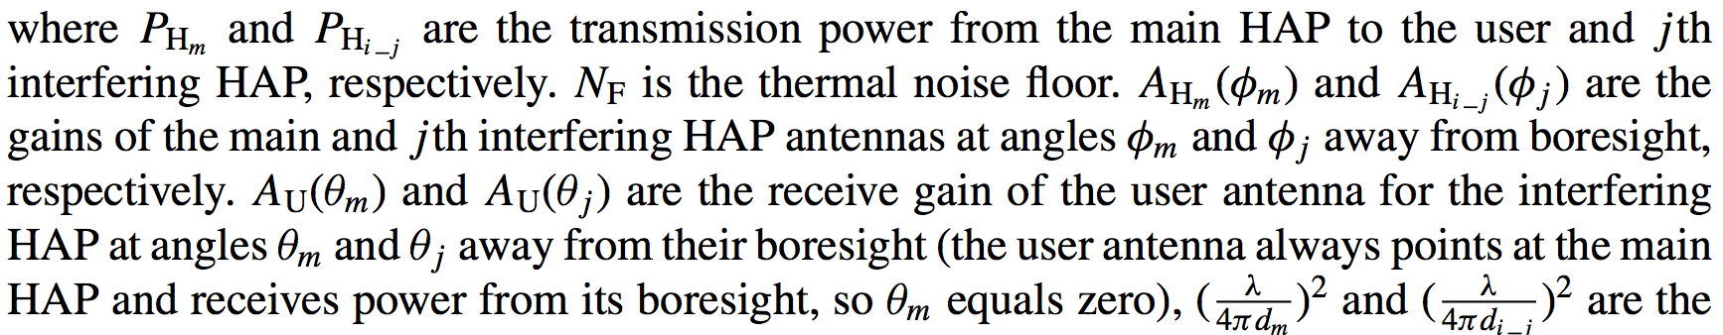
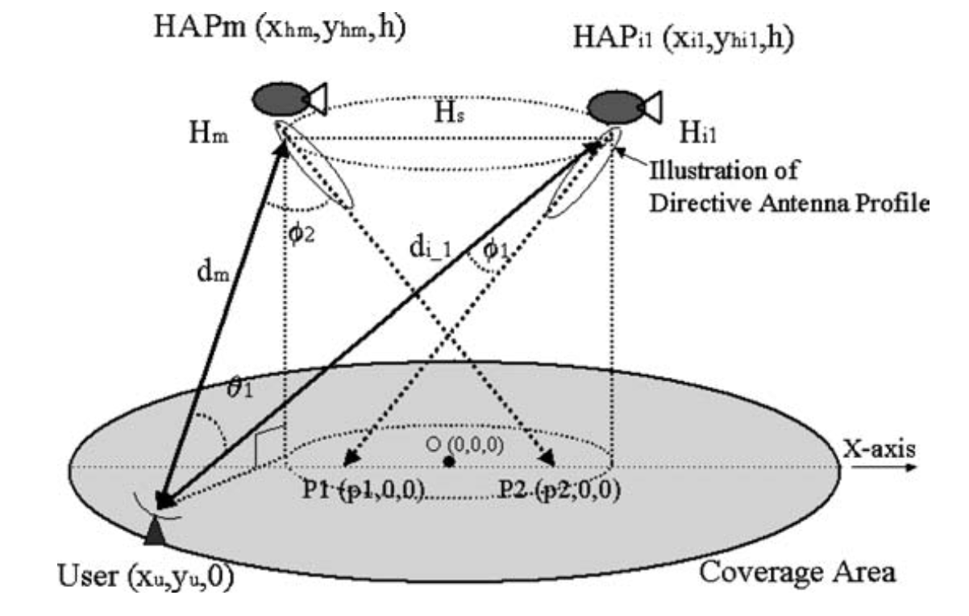

Channel Model
For a system of N HAP’s the CINR at an arbitrary point (x, y, 0) on the coverage area can be calculated as:
Spectral efficiency (η) using the Shannon equation given by
[14] G. Chen, D. Grace, and T. C. Tozer, “Performance of multiple high altitude platforms using directive hap and user antennas,” Wireless Personal Communications, vol. 32, no. 3, pp. 275–299, Feb 2005.
Notes:
318-Channel_modeling_for_satellite_and_HAPS
[405]

Slide 26
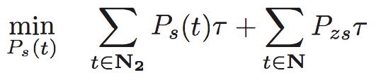
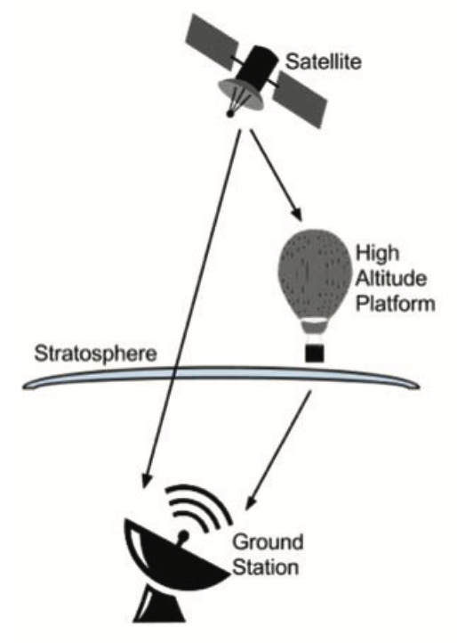
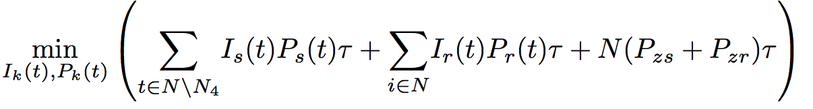
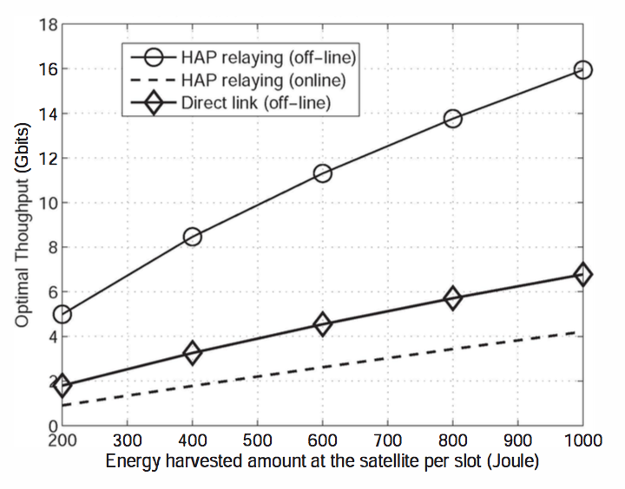
Case1: HAPS assisted satellite downlink
The satellite-HAP channel is a high quality channel with higher throughput due to the HAP’s location in the atmosphere. The combination of a high rate satellite-HAP link, with a high availability HAP-ground station link, has the potential to improve throughput/energy performance of the LEO satellite downlink significantly, relative to the conventional direct downlink.
Single hop satellite downlink channel: a optimization problem to minimize the energy usage at the satellite node,
HAP-assisted downlink transmission: a joint schedule and power allocation problem,
HAPS as a relay for satellite
[15] Zhi Chen, Teng Joon Lim, and M. Motani, “Hap-assisted LEO satellite downlink transmission: An energy harvesting perspective,” in 2014 IEEE 15th International Workshop on Signal Processing Advances in Wireless Communications (SPAWC), Toronto, ON, Jun. 2014, pp. 194–198.
Notes:
[322]

Slide 27

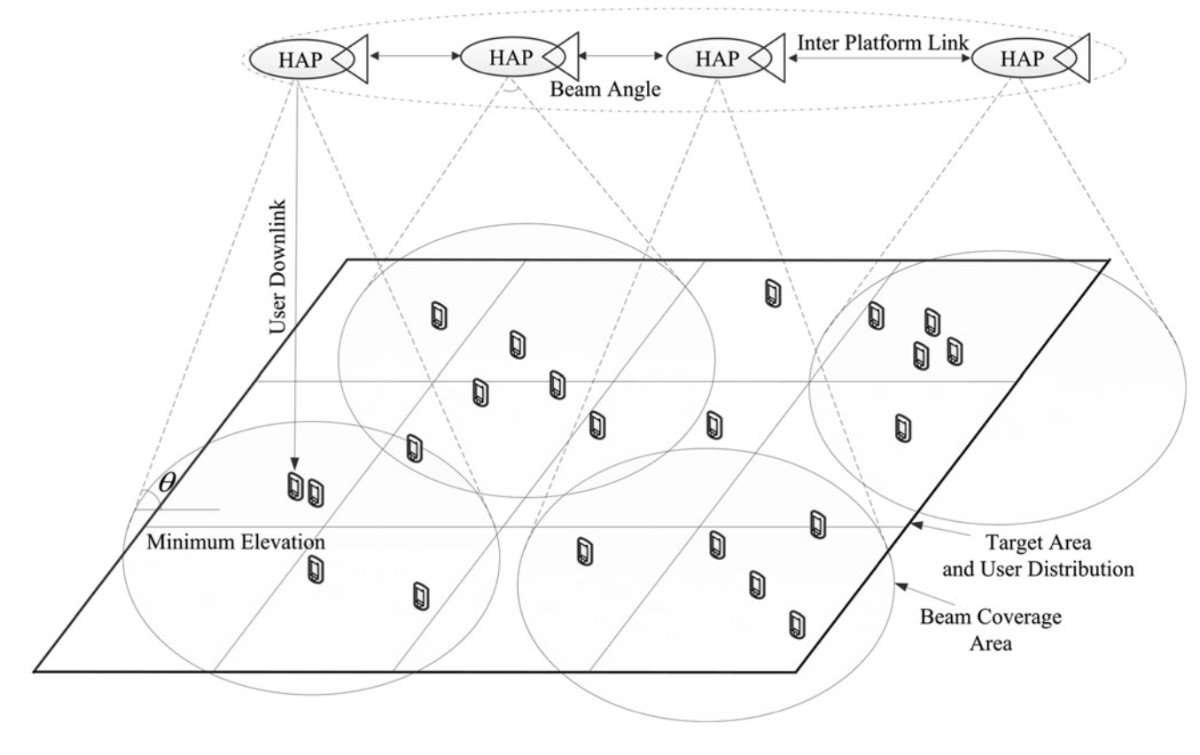
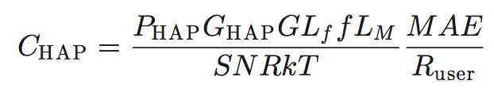
Case2: coverage design
An investigation into the constellation design methodology of high-altitude platform (HAP) broadband networks.
The required equivalent isotropic radiated power (EIRP) of HAP transmitting antenna is:
where [CINR] is the CINR in dB, [f] is the gain caused by channel propagation models in dB in shadowed Rician fading, LHAP or LOS depended on frequency bands, Y is the factor of power allocation, G is the gain of user terminal antenna, L_{f} is the signal free-space loss, [BO]_{o} is the back-off of output power in dB, A_{atoms} is the atmospheric absorption loss, A_{drop} is the troposphere flashing loss.
Transmitted power of HAP :
where GH A P is the gain of HAP transmitting antenna:
[16] F. Dong, H. Han, X. Gong, J. Wang, and H. Li, “A constellation design methodology based on QoS and user demand in high-altitude platform broadband networks,” IEEE Trans. Multimedia, vol. 18, no. 12, pp. 2384–2397, Dec. 2016.
Notes:
[317]

Slide 28
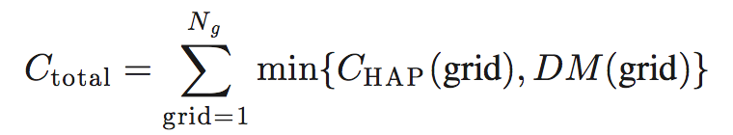

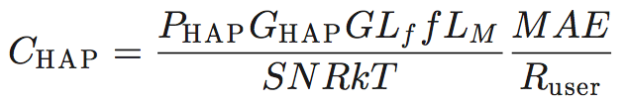
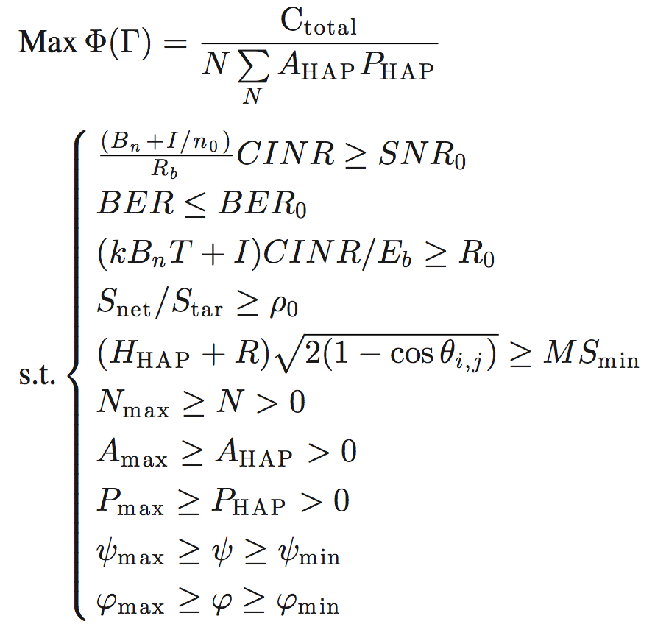
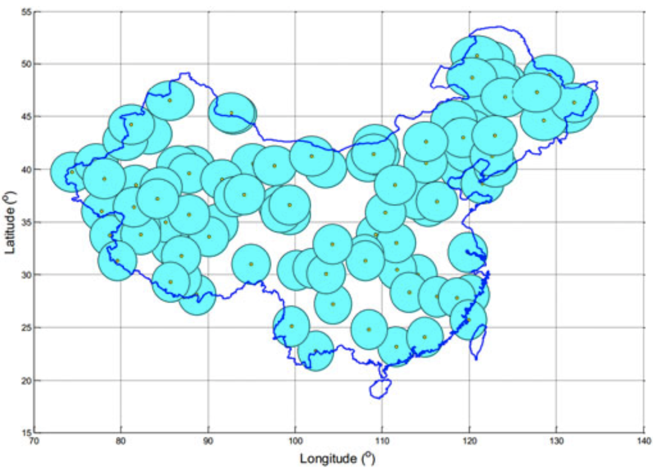
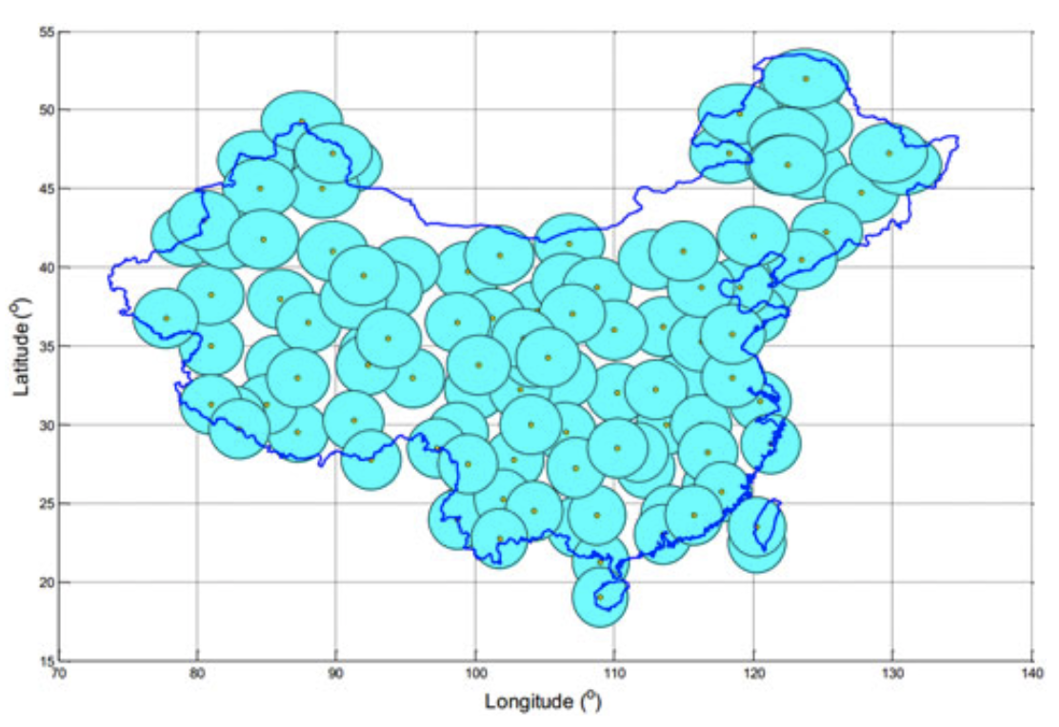
Case2: coverage design
The total capacity of the HAP is the sum of served users in all the target grids:
Since the capacity of each HAP is calculated as the maximum number of users between each HAP and each demand map grid given the full resources, the capacity can be adjusted based on the HAP resources allocation to the demand map grid .
Given the finite payload power, it is sensible to allocate more resources to the demand map grid links with the largest capacity. However, to provide geographical coverage, not all resources should be concentrated to a single or to a few grids. As a consequence, the maximum resources that can be allocated to one demand map grid are limited.
where, the demand map:
and HAP capacity:
Maximize the network capacity per cost under the constraints of QoS metrics:
Notes:
[317]

Slide 29
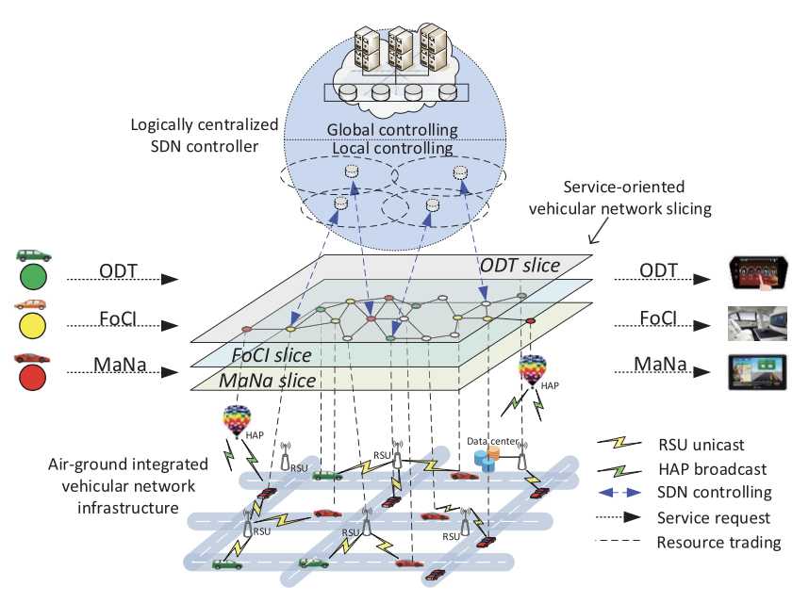
Case3: Air-Ground Integrated Vehicular Network (AGIVEN) with Slicing and Caching
HAPs proactively push contents to vehicles through large-area broadcast, while the ground roadside units (RSUs) provide high-rate unicast services on demand.
Each road block generates a map file of the same size Lm. The HAP broadcasts the maps of all blocks within coverage through radio resource sharing, while each vehicle only downloads the maps on demand.
ODT- on-demand transmission,
FoCI- file of common interest,
MaNa- map for navigation
[17] S. Zhang, W. Quan, J. Li, W. Shi, P. Yang, and X. Shen, “Air-ground integrated vehicular network slicing with content pushing and caching,” IEEE J. Sel. Areas Commun., vol. 36, no. 9, pp. 2114–2127, Sep. 2018.
Notes:
[360]
Service-oriented network slicing in AGIVENs

Slide 30
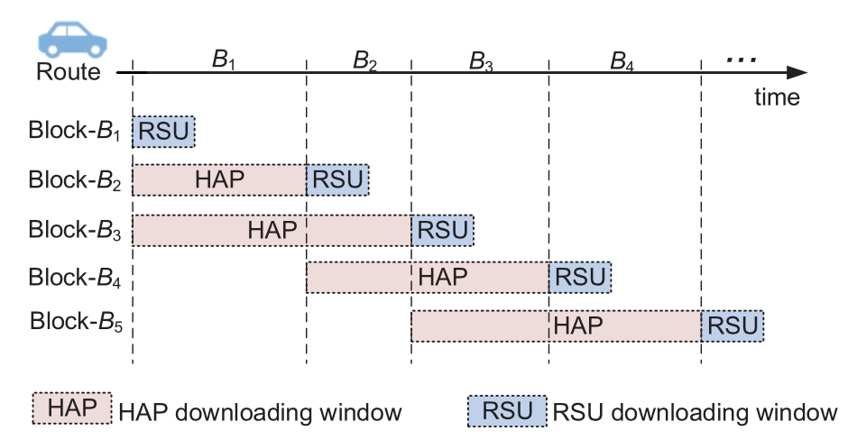
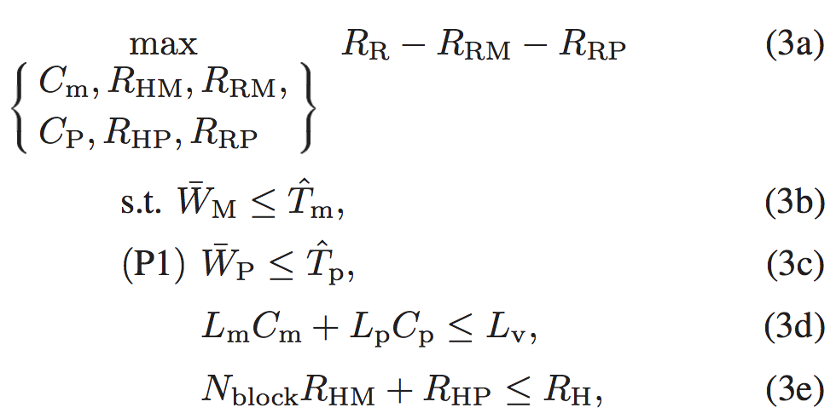
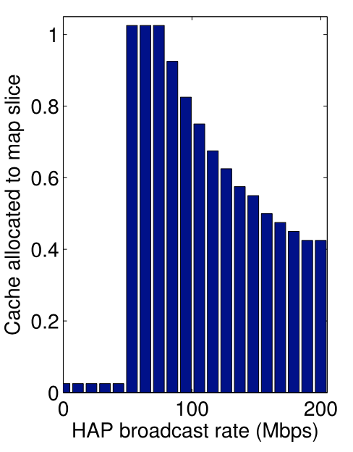
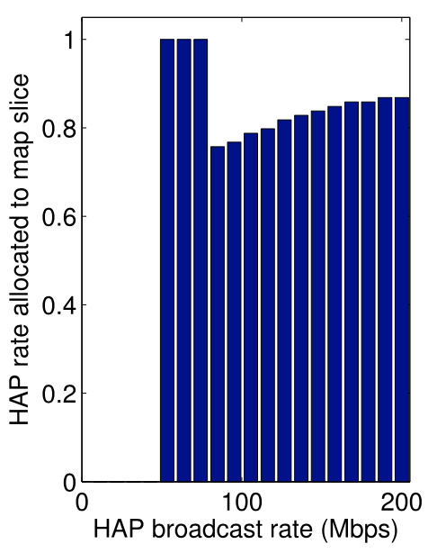
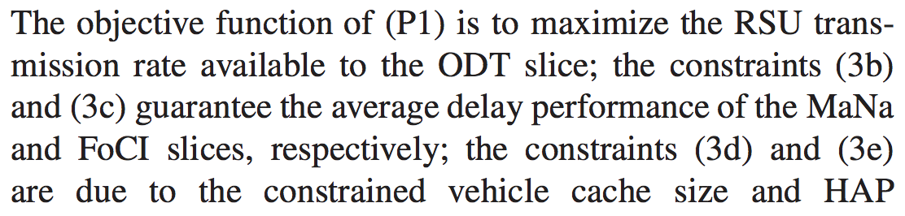
Case3: Air-Ground Integrated Vehicular Network (AGIVEN) with Slicing and Caching
An illustration of MaNa service process: each vehicle can cache map files of two blocks.
Resource Slicing and Sharing Modeling:
P1:
transmission rate.
Notes:
[360]
Service-oriented network slicing in AGIVENs

Slide 31
What can we do on HAPS

Slide 32
What can we do on HAPS
HAP + Satellite for ground users data uplink
HAP+UAV for ground vehicle caching
Satellite + HAP + UAV for global communication
HAP serves as relay for satellite downlink service
HAP networking
HAP constellation design
…

Slide 33
Thanks for your attention !

