Slide 1

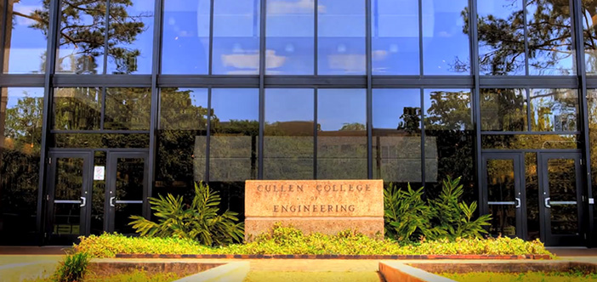

Satellite Communication System
Yan Zhu
09/21/2019

Slide 2


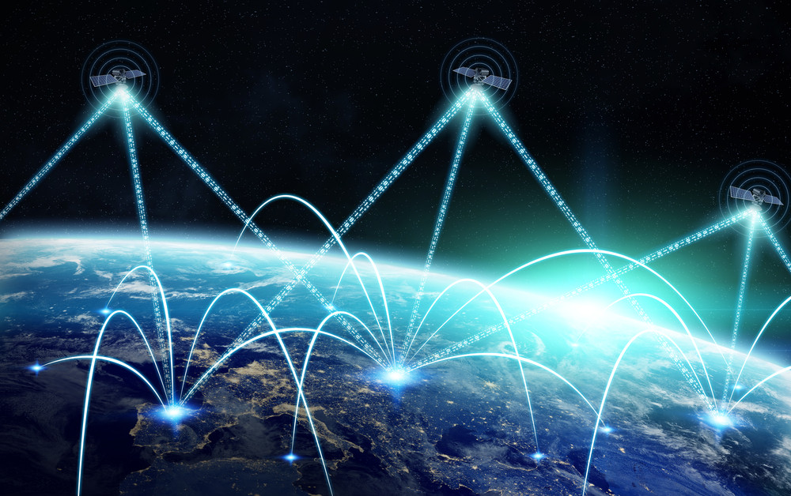
Outline
Introduction
Orbits and Related Issues
Frequency Band Selection
System Composition
Satellite Channel
Conclusion

Slide 3
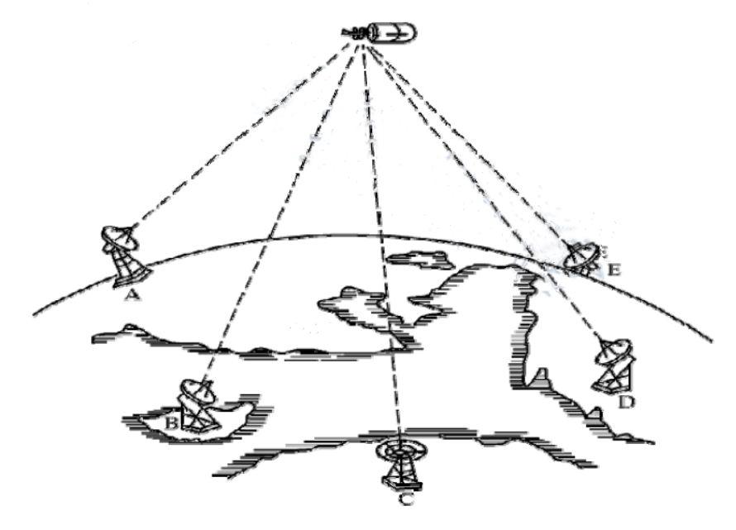
Introduction
What is the satellite communications?
Satellite communication is the communication between two or more earth stations (user terminals) by using artificial earth satellites as relay stations to forward radio waves.
Satellite communication has three forms:
Between satellite and earth station;
Between satellites;
Between earth stations via satellites.

Slide 4

Features
Communication distance is long
Service scope is wide
Communication quality is good
Not restricted by geographical conditions
Wide available bandwidth
Large communication capacity
Independent of the ground communication
Network routing is simple.
Network construction is fast and low cost.
Secure communication.
Communication costs are independent of communication distance.
Launch and control technology is complex
Propagation delay is large
Affected by outer space

Slide 5
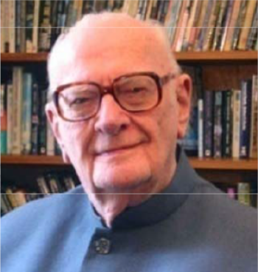
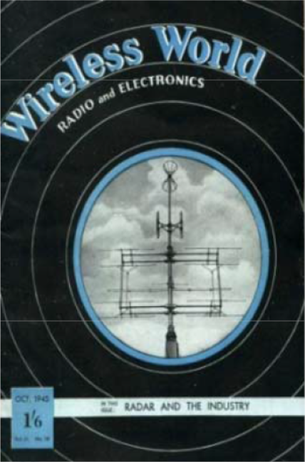
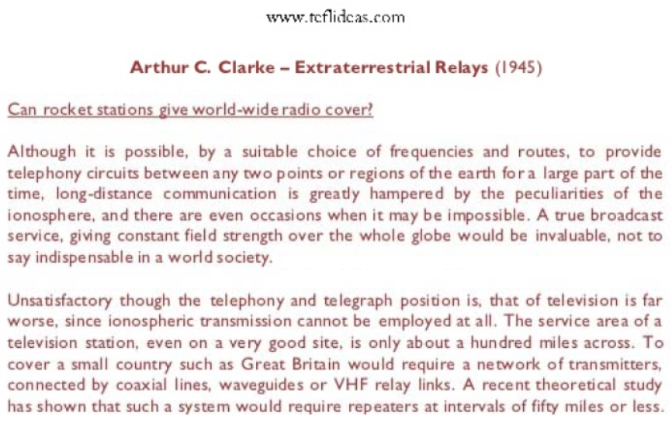
Development
The idea of satellite communications was first proposed by British Air Force officer Arthur C. Clarke (science fiction writer) in the “Wireless World" magazine "Extra-Terrestrial Relays" (1945).

Slide 6
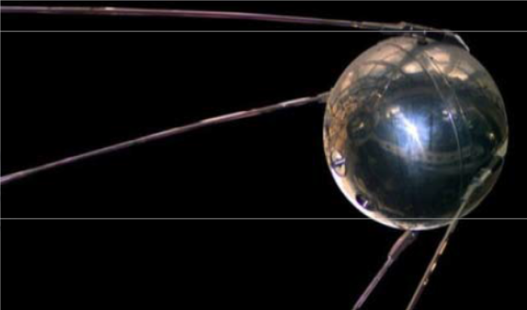
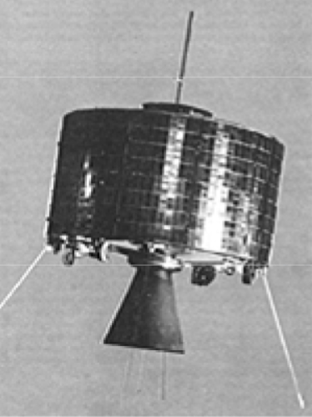
Development
Syncom 3: first truly geosynchronous orbit satellite.
1964.8
“TELESTAR-1” LEO satellite laid the technical foundation for commercial satellite communications.
1962.11
The US radio company RCA launched the "Relay-1“.
1962.7
The US launched the "Skool" broadcast test satellite for the transmission of tape recording signals.
1960.8
The US launched the "Echo" (ECHO) satellite, the first completed active delay relay communication.
1958.12
1957.10
The former Soviet Union launched the world's first artificial earth satellite, Sputnik I.

Slide 7
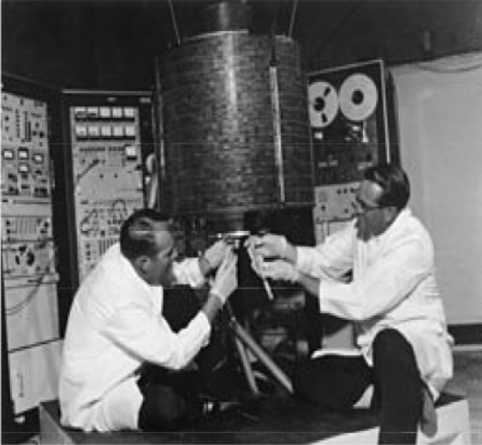

Development
International Telecommunications Satellite Organization launched the “International Communication Satellite” I in April 1965, which is the world’s first practical geosynchronous orbit communication satellite and marks the beginning of the practical phase of satellite communications.
For more than 50 years, satellite communications have developed rapidly:
Satellite weights: tens of kilograms -> more than 5,000 kilograms.
Life spans: 1.5 years -> more than 15 years.
Communication capacity: 480 tones -> tens of thousands of tones.
Traffic: TV, data, multimedia services.

Slide 8

v.s. Cell
More than 80% of the land and more than 95% of the sea area in the world lack effective broadband information coverage.
Problems of terrestrial networks:
Cells: constantly split, base station configuration problem
Expensive infrastructure investment in low population density areas
Limited communication in the air, ocean and special occasions
multi-hop network, high complexity, service quality cannot be guaranteed
Advantages of satellite communications
Battlefield individual personal communication system
Civil personal communication field
Wireless broadband multimedia applications
Global seamless coverage, etc.

Slide 9
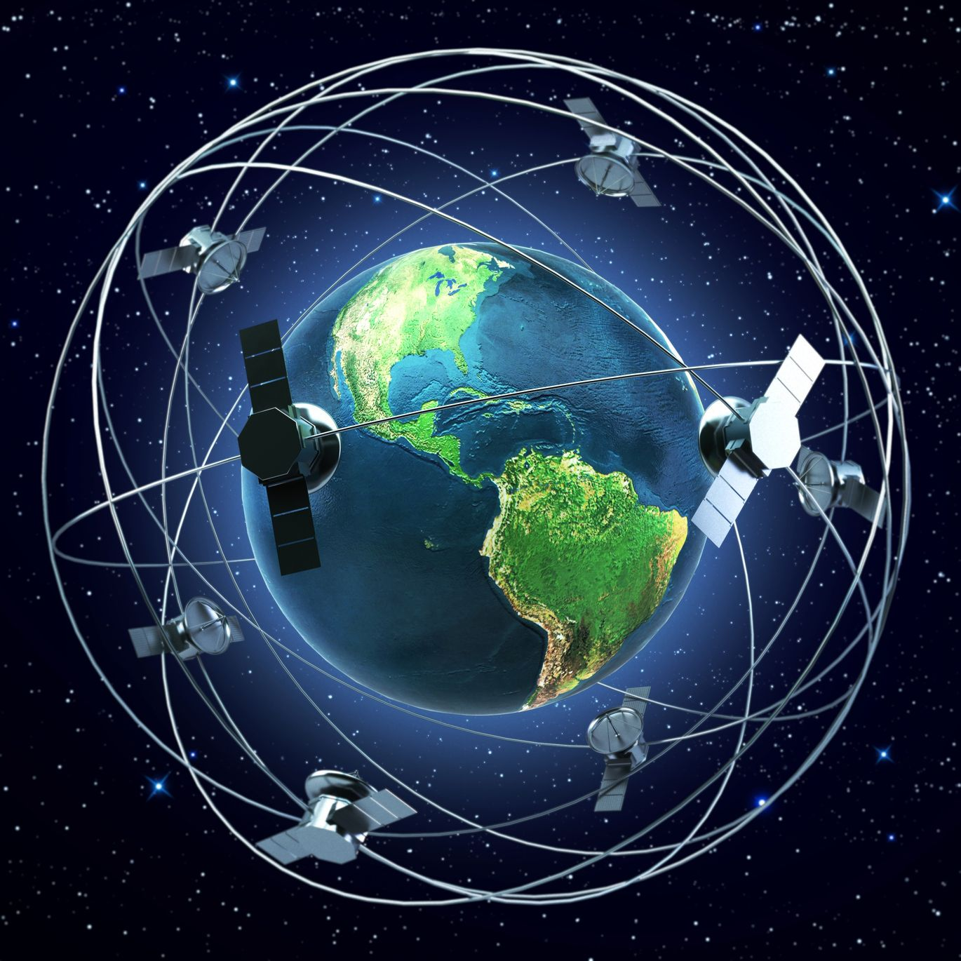
Outline
Introduction
Orbits and Related Issues
Frequency Band Selection
System Composition
Satellite Channel
Conclusion

Slide 10
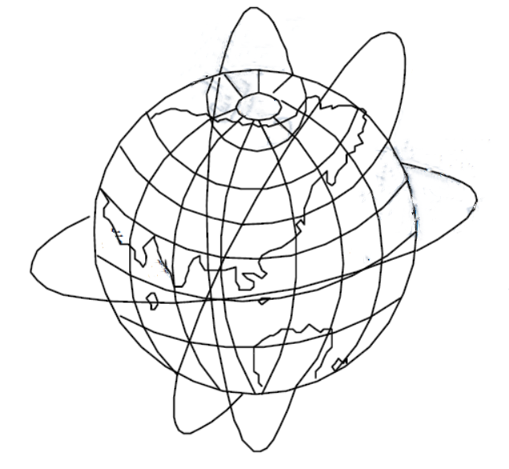
Orbits
Angle:
Equatorial orbit: 0°
Polar orbit: 90°
Inclined: 0° to 90°
Height:
Low orbit < 5,000km, operation period: 2~4 hours
Medium orbit: 5,000~20,000km, operation period: 4~12 hours
High orbit > 20,000km, operation period:12~ 24 hours
Shape:
Circular
elliptical orbit

Slide 11
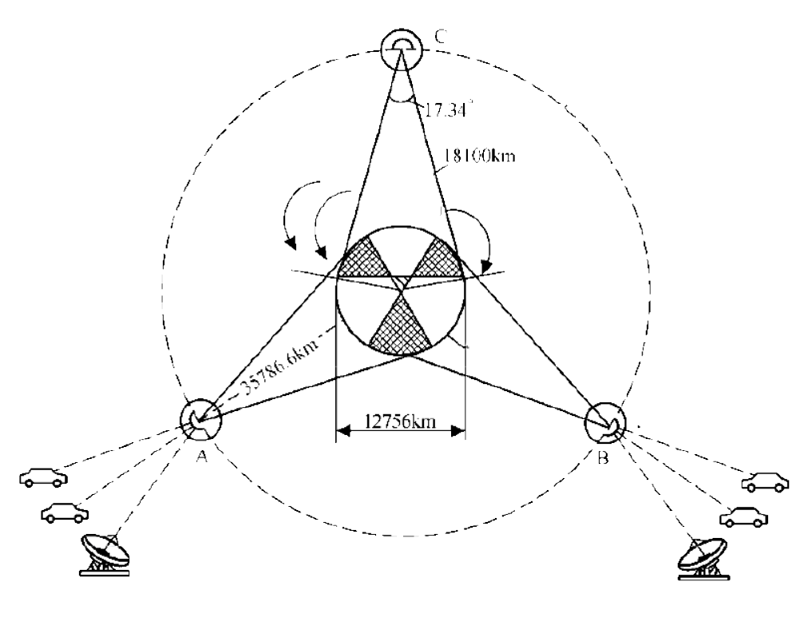
Orbits
MEO (medium earth orbit)
Height: 8000km~18000km
Orbital period: 5-10 hours
Propagation delay: 50ms.
Maximum visible time: a few hours.
LEO (low earth orbit)
Height: 500~1,500km
Orbital period: 1.5~2 hours
Propagation delay: < 10ms
Doppler effect
Maximum visible time: 20 minutes.
Signal propagation distance: short
Link loss: small
Transmission power: low
GEO (geostationary earth orbit)
Height: 36,000 km
Orbital period: 24 hours.
Propagation delay: 250ms.
The coverage area is stable.

Slide 12
Orbits
Advantages of GEO satellites:
Fixed to the Earth, Convenient to point to the satellite
Doppler shift is negligible.
Satellite tracking is simple.
Large coverage area.
Problems of GEO satellite:
Signal attenuation is large.
Launch and control technology of GEO satellites: complex.
Polar regions -> blind spots, and high latitudes communications are not good.
Eclipses and daily interruptions.
Large signal transmission delay and echo interference.
Hence, the future satellite orbit selection is turning to choose the LEO and correspondingly increase the number of satellites to deal with the problem of the coverage.

Slide 13
Orbits
Track height selection
Van Allen belt: A harsh electric radiation environment, strong electromagnetic radiation. α particles, protons and high energy particles are destructive to the circuit.
Inner layer: 1,500-5,000 km
Outer layer: 13,000-20,000 km
Atmospheric resistance on satellite motion: altitude < 700 km.
Three suitable windows: 700~1,500km; 5,000~Near 13,000km; more than 20,000 km.
Factors to select the track
Height: Higher the satellite -> Larger the coverage area -> Greater the fading
Elevation angle: Angle between the earth station antenna and the ground plane: 0 ~ 70 degree.
Propagation time: Propagation distance / speed of light.
Interference: Same and adjacent channel interference.
Launch vehicle performance: Rocket technology and reliability.

Slide 14
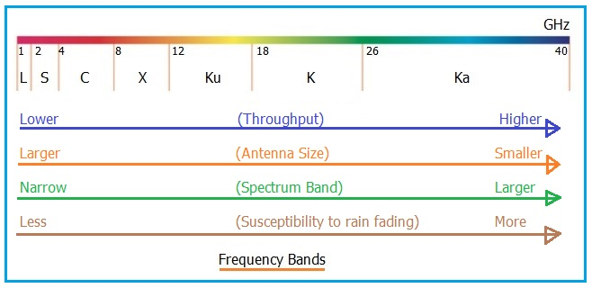
Outline
Introduction
Orbits and Related Issues
Frequency Band Selection
System Composition
Satellite Channel
Conclusion

Slide 15
Frequency
Satellite communication band (microwave)
Frequency | Range(GHz) | Frequency | Range(GHz)
UHF | 0.3~1.12 | Ku | 12.4~18
L | 1.12~2.6 | K | 18~26.5
S | 2.6~3.95 | Ka | 26.5~40
C | 3.95~8.2 | Millimeter wave | 40~300
X | 8.2~12.4
Frequency allocation
The ITU divides the world into three regions:
Region 1: Europe, Africa, the Middle East and some countries of the former Soviet Union;
Region 2: America;
Region 3: In addition to the Asian region of the Middle East and some countries of the former Soviet Union and Oceania

Slide 16
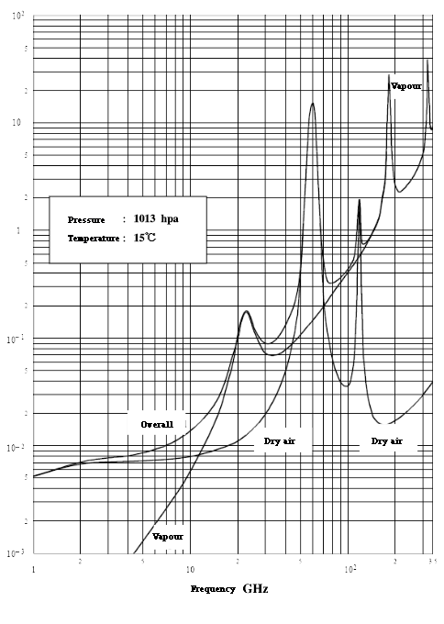
Frequency
Satellite communication:
Higher frequencies -> Higher information rates
Loss of electromagnetic waves related to frequency
Rain and fog
Scatter and absorb high frequency waves, causing greater losses, called rain attenuation
Higher frequency -> more severe rain attenuation.
Atmospheric absorption and rain attenuation
Frequency < 10 GHz, the loss is small and flat
Frequency > 12 GHz, the loss rises rapidly
Frequency > 60 GHz, unsuitable for satellite transmission
Atmosphere attenuation

Slide 17
Frequency
Main factors of selecting a working frequency band:
External interference noise received by the antenna system -> small
Wave propagation loss -> small
Equipment applicable to this frequency band -> light in weight and small in size
Available frequency bandwidth -> meet the requirements for transmitting information
Mutual interference with other terrestrial wireless systems -> as small as possible
Make use of existing communication technologies and equipment as much as possible.

Slide 18
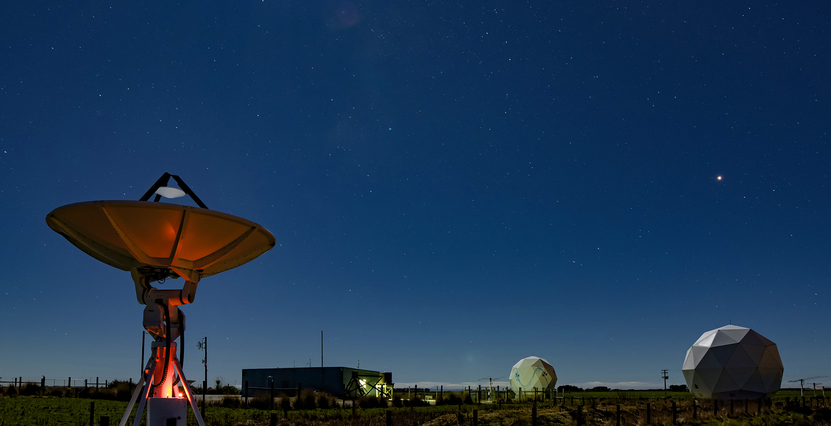
Outline
Introduction
Orbits and Related Issues
Frequency Band Selection
System Composition
Satellite Channel
Conclusion

Slide 19
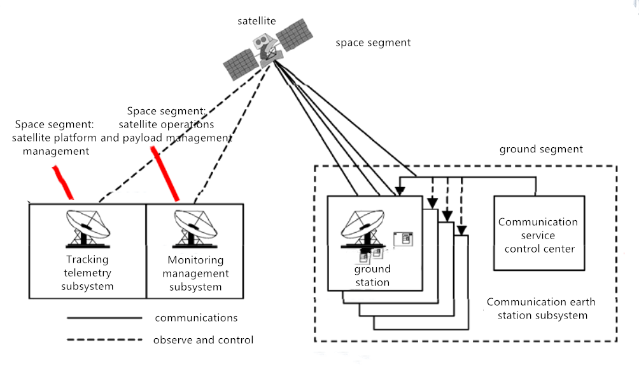
System
System composition
Space segment: including satellite and measurement and control;
Ground segment: earth station

Slide 20
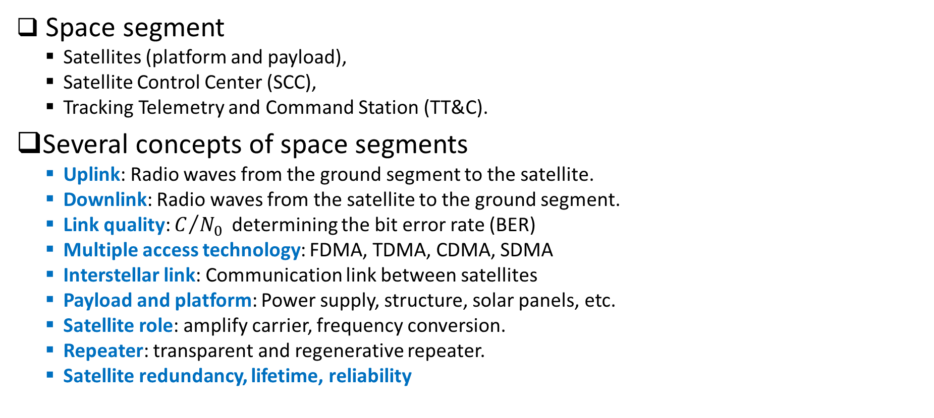
Space Segment
Space segment
Satellites (platform and payload),
Satellite Control Center (SCC),
Tracking Telemetry and Command Station (TT&C).
Several concepts of space segments
Uplink: Radio waves from the ground segment to the satellite.
Downlink: Radio waves from the satellite to the ground segment.
Link quality: $C/{N_{0}}$determining the bit error rate (BER)
Multiple access technology: FDMA, TDMA, CDMA, SDMA
Interstellar link: Communication link between satellites
Payload and platform: Power supply, structure, solar panels, etc.
Satellite role: amplify carrier, frequency conversion.
Repeater: transparent and regenerative repeater.
Satellite redundancy, lifetime, reliability

Slide 21
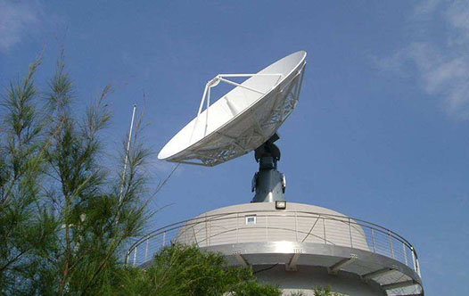
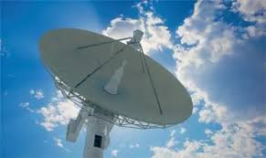
Ground Segment
Ground segment: In a narrow sense: the ground segment is the earth station.
Several concepts of the ground segment
Earth station classification: large station, small station / single receiving, and receiving
Earth station structure: antenna, duplexer, power supply, tracking, monitoring, etc.
Signal processing technology: multiplexing, encryption, voice interpolation, compression, etc.

Slide 22
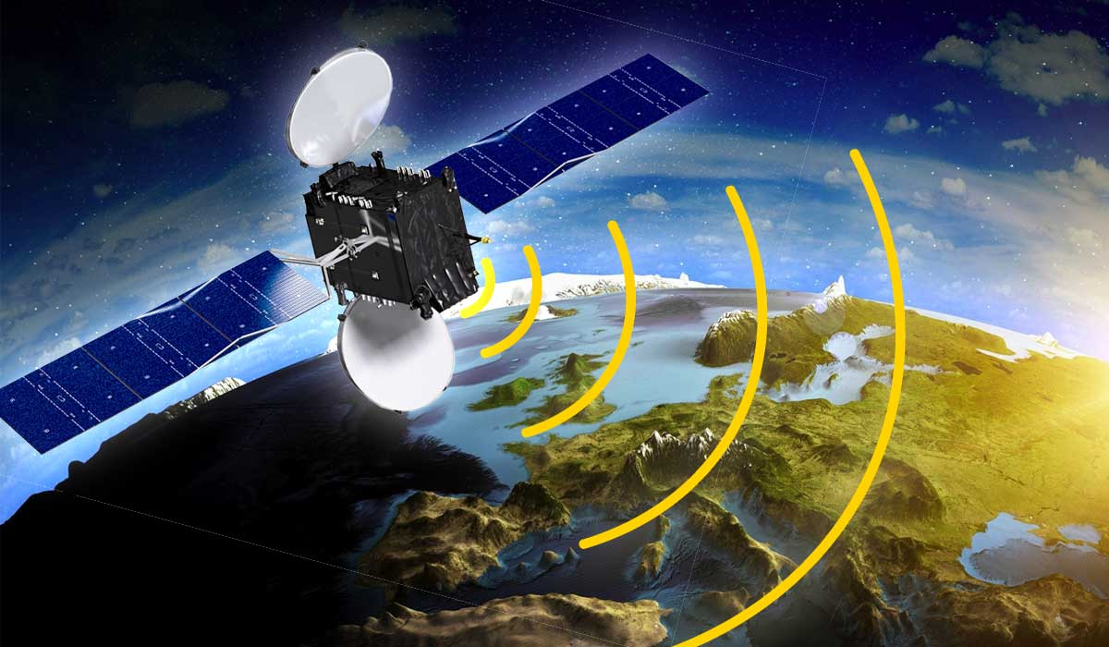
Outline
Introduction
Orbits and Related Issues
Frequency Band Selection
System Composition
Satellite Channel
Conclusion

Slide 23
Channel
Outside the ionosphere -> free space propagation
Propagation in the atmosphere can be corrected on free space propagation.
Except satellite mobile channel, the satellite channel between the satellite and earth station can be considered as a constant channel.
The radio waves are subject to loss in propagation atmosphere, rain, clouds, snow, fog, etc.
Satellite mobile communications (between NGEO satellite and mobile users) use lower communication frequencies and (semi) omnidirectional antennas, so as with ground mobile communications, there are multipath and shadow occlusions, which are fading channels.
Because the fixed earth station uses a directional antenna, the operating frequency is high, and the occlusion can be avoided, the satellite channel between the earth station and satellite can be regarded as a Gaussian white noise channel at this time.

Slide 24
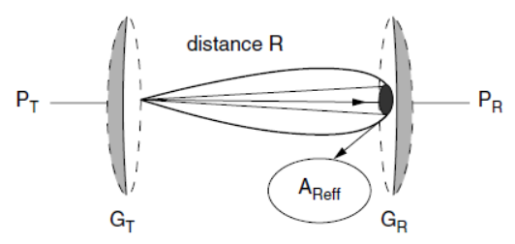
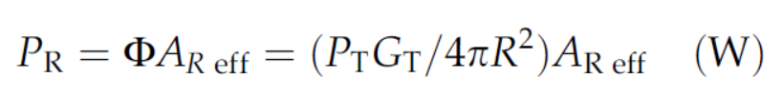

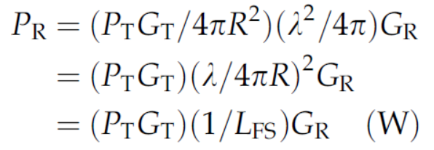

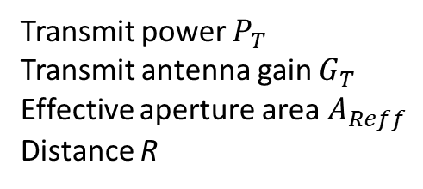

Channel (Inter-Satellite Link)
Inter-Satellite Link (free space loss)
Receiving power:
Effective area of an antenna:
Expression for the received power:
Transmit power $P_{T}$
Transmit antenna gain $G_{T}$
Effective aperture area $A_{Reff}$
Distance R
Fig. The power received by a receiving antenna.
Receiving gain $G_{R}$
Wave length $λ$
Where free space loss

Slide 25
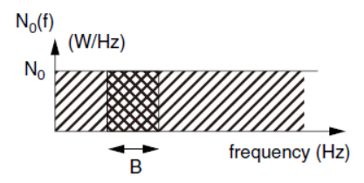

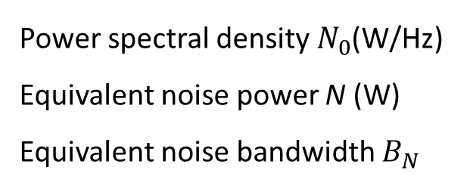
Channel (Inter-Satellite Link)
The origins of noise are as follows:
Natural sources
Noise in the receiving equipment.
Carriers from unwished transmitters
Noise characterization
Fig. Spectral density of white noise.
Power spectral density $N_{0}$(W/Hz)
Equivalent noise power N (W)
Equivalent noise bandwidth $B_{N}$
Real noise sources do not always have a constant power spectral density, but the model is convenient for representation of actual noise observed over a limited bandwidth.

Slide 26
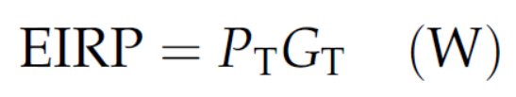

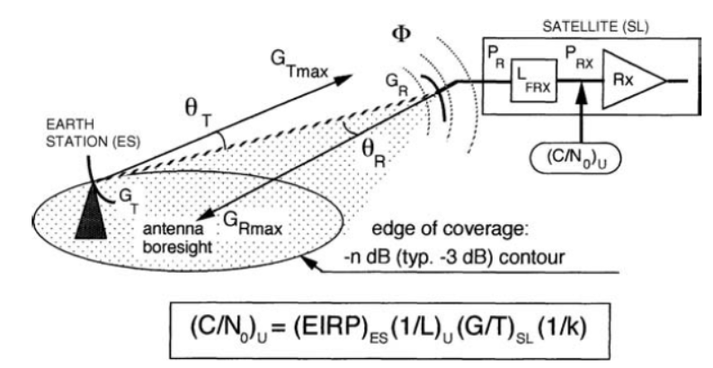
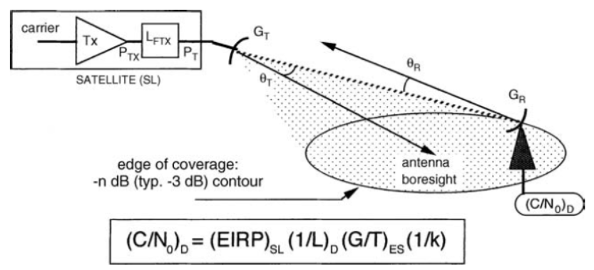
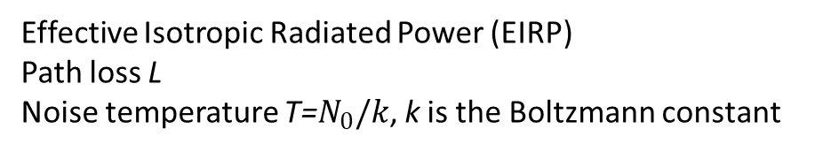
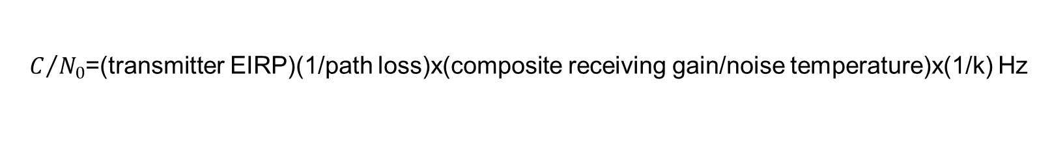
Channel (Inter-Satellite Link)
Carrier power to noise power spectral density ratio at receiver input
$C/{N_{0}}$=(transmitter EIRP)(1/path loss)x(composite receiving gain/noise temperature)x(1/k) Hz
Effective Isotropic Radiated Power (EIRP)
Path loss L
Noise temperature T=$N_{0}/k$, k is the Boltzmann constant
Fig. The geometry of an uplink.
Fig. The geometry of a downlink.

Slide 27

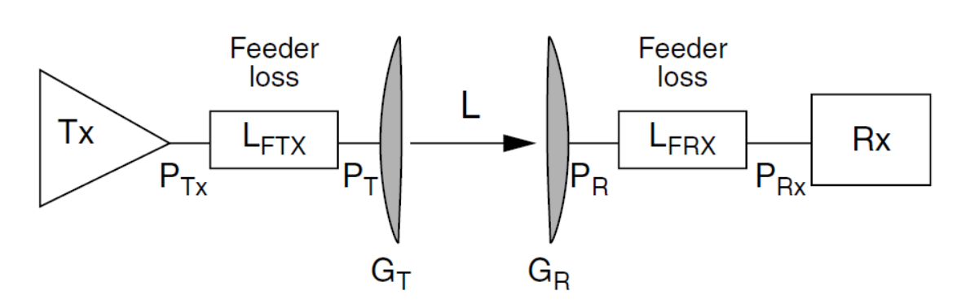
Channel (Inter-Satellite Link)
Satellite-Ground Link (free space loss + attenuation in the atmosphere)
The attenuation of waves in the atmosphere, denoted by $L_{A}$
The overall effect on the power of the received carrier can replace $L_{FS}$by the path loss, L:
Carrier power to noise power spectral density ratio at receiver input
Fig. Losses in the terminal equipment.

Slide 28
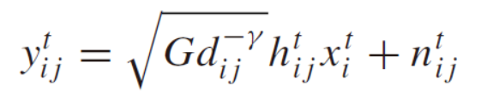
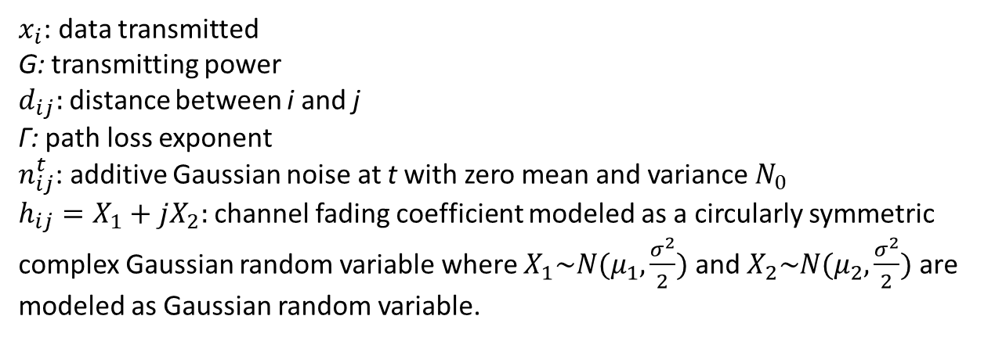
Channel (mobile channel)
General physical channel model
Line of sight (LOS) signal >> the others (different from ground networks).
The wireless channel (LEO satellites, relay satellite and ground stations): Rician fading channel model with AGWN.
The signal received at destination at the time slot t is
$x_{i}$: data transmitted
G: transmitting power
$d_{ij}:$ distance between i and j
Γ: path loss exponent
$n_{ij}^{t}$: additive Gaussian noise at t with zero mean and variance $N_{0}$
$h_{ij}=X_{1}+{jX}_{2}:$channel fading coefficient modeled as a circularly symmetric complex Gaussian random variable where $X_{1}\sim N(μ_{1},\frac{σ^{2}}{2})$ and $X_{2}\sim N(μ_{2},\frac{σ^{2}}{2})$ are modeled as Gaussian random variable.
J. Du, C. Jiang, J. Wang, Y. Ren, S. Yu, and Z. Han, “Resource allocation in space multiaccess systems,” IEEE Trans. Aerosp. Electron. Syst., vol. 53, no. 2, pp. 598–618, Jul. 2017.

Slide 29
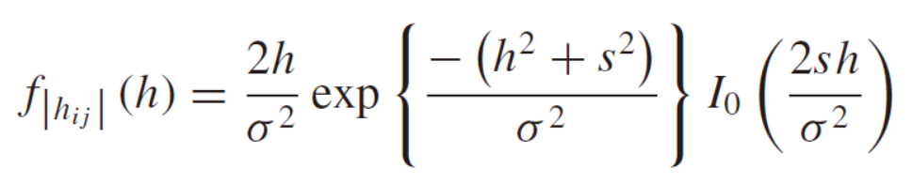
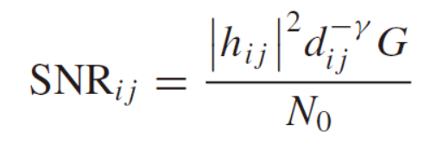
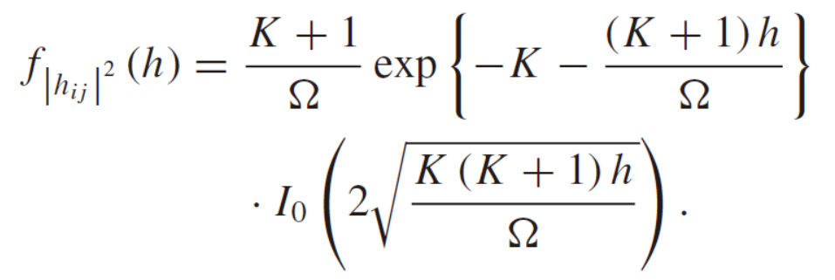
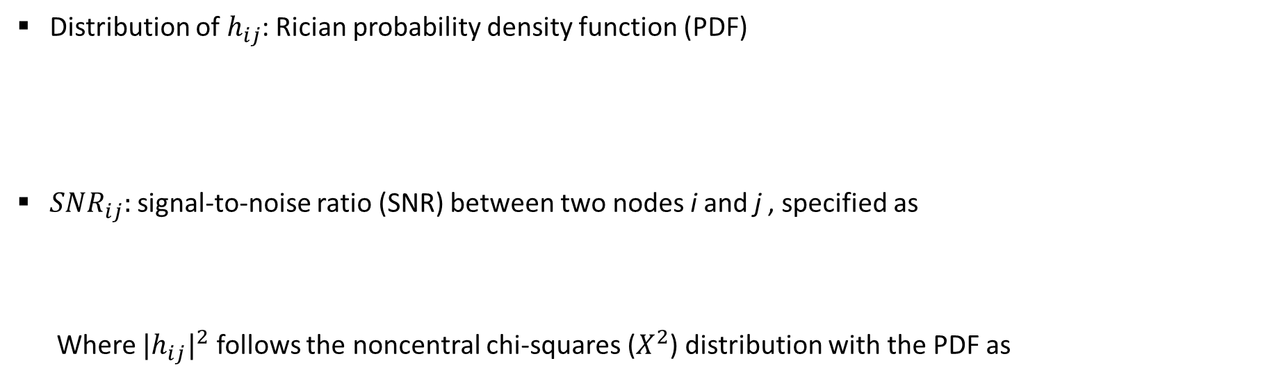
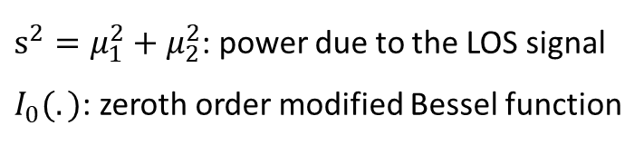
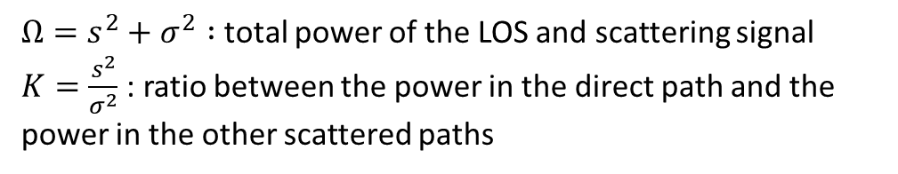
Channel (mobile channel)
Distribution of${ h}_{ij}$: Rician probability density function (PDF)
${SNR}_{ij}:$signal-to-noise ratio (SNR) between two nodes i and j , specified as
Where ${{|h}_{ij}|}^{2}$ follows the noncentral chi-squares ($X^{2}$) distribution with the PDF as
$s^{2}=μ_{1}^{2}+μ_{2}^{2}$: power due to the LOS signal
$I_{0}(.)$: zeroth order modified Bessel function
$Ω=s^{2}+σ^{2} :$total power of the LOS and scattering signal
$K=\frac{s^{2}}{σ^{2}}$: ratio between the power in the direct path and the power in the other scattered paths

Slide 30
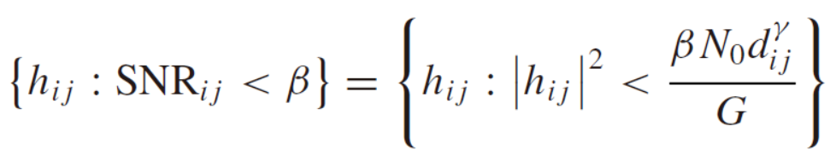
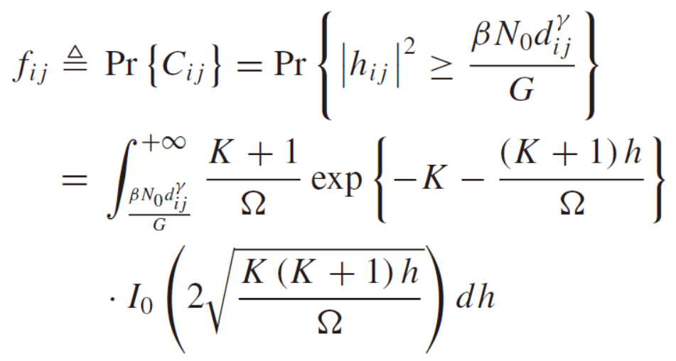
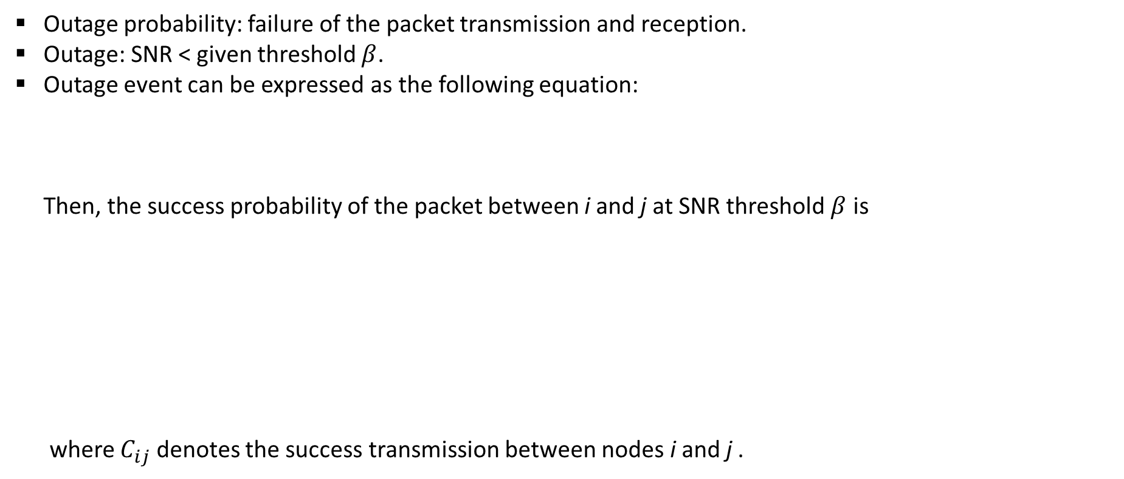
Channel (mobile channel)
Outage probability: failure of the packet transmission and reception.
Outage: SNR < given threshold $β$.
Outage event can be expressed as the following equation:
Then, the success probability of the packet between i and j at SNR threshold $β$ is
where $C_{ij}$ denotes the success transmission between nodes i and j .

Slide 31
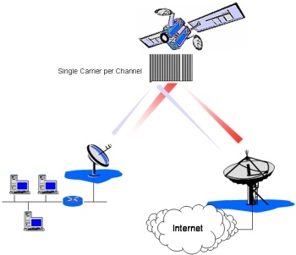


Channel (mobile channel)
Doppler effect
Fast moving satellites: frequency shift of dozens of kilohertz relative to a ground station.
Magnitude of Doppler effect: changes due to earth curvature
Doppler frequency in the forward link:
$V_{LEO}:$ 26820 km/h (H: 800 km)
$V_{MEO}:$ 13993 km/h (H: 18000 km)
Received carrier frequency at the satellite is
transmitted carrier frequency from the satellite access node for the i-th user terminal inside the n-th spot beam
fractional Doppler of feeder link
Fig. Geometry for Doppler effects
Q. Liu, "Doppler measurement and compensation in mobile satellite communications systems," in Proc IEEE MILCOM, Atlantic City, NJ, 1999

Slide 32

Channel (mobile channel)
Transmitted carrier frequency by satellite for the mobile link
satellite translation
frequency.
fractional satellite translation error
Received carrier frequency by user terminal
total frequency error caused by both Doppler and satellite translation error

Slide 33
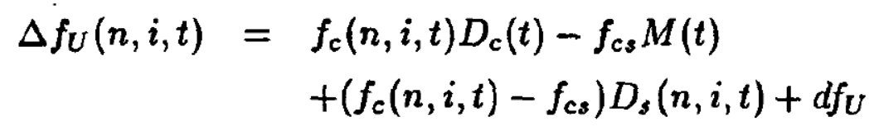

Channel (mobile channel)
Total frequency error
forward feeder link Doppler
satellite translation error
forward mobile link Doppler
Doppler frequency in the return link:
The received carrier frequency by the satellite
transmitted carrier frequency by the i-th user terminal in the n-th spot beam.
fractional Doppler of the mobile link for
the i-th user in the n-th spot beam.

Slide 34

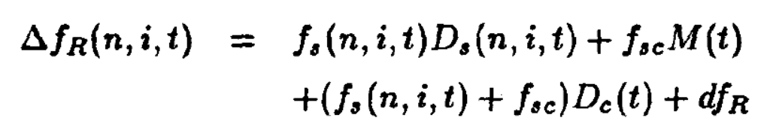
Channel (mobile channel)
Transmitted carrier frequency by the satellite
Received carrier frequency by the radio frequency terminal
satellite translation frequency from the mobile link to the feeder link.
Total frequency error for the return link
The random Doppler frequency errors of very large range in the forward link and the return link must be compensated to achieve carrier frequency synchronization,

Slide 35

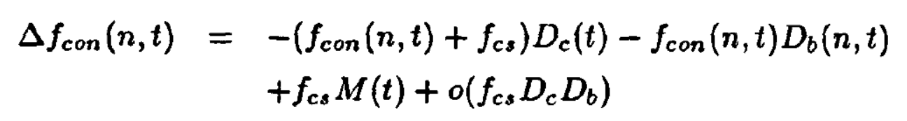
Channel (mobile channel)
Doppler Compensation
The goal of the Doppler compensation for each control channel is to make sure that the received carrier frequency on the median Doppler line is the preassigned nominal frequency.
Carrier frequency that should be transmitted by the radio frequency terminal
Nominal frequency for the n-th spot beam
Total frequency correction at the satellite access node
Total frequency correction at the satellite access node

Slide 36
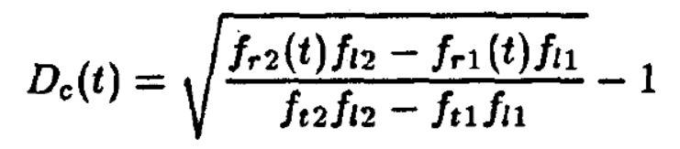
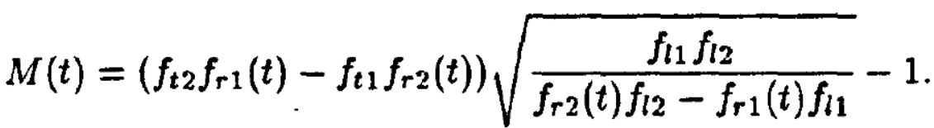
Channel (mobile channel)
Fractional Doppler of the feeder link and Fractional satellite translation error can be measured by two pilot loops in the feeder link operated by the radio frequency terminal
Transmitted frequency of the radio frequency terminal
satellite translation frequency
Derived instantaneous fractional Doppler in the feeder link
Derived fractional satellite translation error

Slide 37






Channel (rain attenuation)
Rain attenuation channel
SNR of a downlink in slot t can be expressed as follows
${ P}_{tr}^{t}$ is the transmission power (in W) of a relay satellite to one of its ground station in slot t.
The relay satellite transmitting antenna gain in slot t is presented as
$G_{max}:$ maximum antenna gain.
$θ_{i}^{t}$: off-axis angle with respect to maximum radiation
$θ_{3dB}$: half power angle of transmitting antenna.
$L_{f}^{t}$ is expressed as
D. Zhou, M. Sheng, R. Liu, Y. Wang and J. Li, "Channel-Aware Mission Scheduling in Broadband Data Relay Satellite Networks," in IEEE Journal on Selected Areas in Communications, vol. 36, no. 5, pp. 1052-1064, May 2018.

Slide 38




Channel (rain attenuation)
Rain attenuation $L_{p}^{t}:$mainly influenced by frequency, elevation angle, altitude above sea level.
Rainfall intensity can be expressed as:
$γ_{R}^{t}$ (dB/km): attenuation per kilometer in slot t.
$L_{e}$ (in km): equivalent effective slant-path length.
For the GEO satellite, $L_{e}$ can be denoted as
Here, $R_{e}$ and $θ$ are the effective radius of the Earth (6400 km) and the elevation angle, respectively.

Slide 39



Channel (rain attenuation)
Given the difference of longitude between a ground station and relay satellite α and the latitude of the ground station $β$, $θ$ can be calculated as
${ h}_{s}$ : height above mean sea level of the ground station (ITU-R P.839).
Besides, rain height $h_{R}$ can be expressed as

Slide 40


Channel (rain attenuation)
According to Recommendation ITU-R P.838, attenuation per kilometer $γ_{R}^{t}$ can be calculated according to the following equation
Where, R (mm/h) is rainfall intensity. Coefficients ρ and η are function of frequency f in 1 ∼ 1000 GHz (ITU-R P.838).

Slide 41
Channel Reference
Reference
[1] Chun Loo, "A statistical model for a land mobile satellite link," in IEEE Transactions on Vehicular Technology, vol. 34, no. 3, pp. 122-127, Aug. 1985.
[2] C. Loo, "Digital transmission through a land mobile satellite channel," in IEEE Transactions on Communications, vol. 38, no. 5, pp. 693-697, May 1990.
[3] B. Vucetic and J. Du, "Channel modeling and simulation in satellite mobile communication systems," in IEEE Journal on Selected Areas in Communications, vol. 10, no. 8, pp. 1209-1218, Oct. 1992.
[4] G. E. Corazza and F. Vatalaro, "A statistical model for land mobile satellite channels and its application to nongeostationary orbit systems," in IEEE Transactions on Vehicular Technology, vol. 43, no. 3, pp. 738-742, Aug. 1994.
[5] Yongjun Xie and Yuguang Fang, "A general statistical channel model for mobile satellite systems," in IEEE Transactions on Vehicular Technology, vol. 49, no. 3, pp. 744-752, May 2000.
[6] Wenzhen Li, Choi Look Law, V. K. Dubey and J. T. Ong, "Ka-band land mobile satellite channel model incorporating weather effects," in IEEE Communications Letters, vol. 5, no. 5, pp. 194-196, May 2001.
[7] J. Du, C. Jiang, J. Wang, Y. Ren, S. Yu, and Z. Han, “Resource allocation in space multiaccess systems,” IEEE Trans. Aerosp. Electron. Syst., vol. 53, no. 2, pp. 598–618, Jul. 2017.
[8] D. Zhou, M. Sheng, R. Liu, Y. Wang and J. Li, "Channel-Aware Mission Scheduling in Broadband Data Relay Satellite Networks," in IEEE Journal on Selected Areas in Communications, vol. 36, no. 5, pp. 1052-1064, May 2018.

Slide 42

Conclusion
Satellite network | Differences | Terrestrial network
Through Earth-orbiting satellites | Data transmission | Through land-based cell towers
Fewer gaps | Coverage | More potential for gaps
Usually available in any location | Use in remote locations | Can be difficult, even impossible
More expensive than cellular | Affordability | Less expensive than satellite
May experience delays due to long-distance data transfer or changes in weather | Reliability | May experience interruptions as machine moves through network
Less vulnerable | Disaster risk | More vulnerable

Slide 43
Conclusion
Satellite communications have many advantages especially in the aspects of the global coverage and long-distance communications.
However, the large propagation delay and the path loss are still the long-range problems of the satellite communications.
Future satellite communications are turning to miniaturization, functionalization. In virtue of the advantage of the LEO satellites, large-scale satellite networking and routing algorithm will undoubtedly increase the network capacity and decrease the network latency.
With the introduction of modern technologies, such as SDN/NFV, smart antenna, massive MIMO, beamforming, satellite communications must be the one of the most important component in the future generation of wireless communications.

Slide 44
Reference
Reference books
[1] J. Pelton, S. Madry, and S. Lara, Handbook of satellite applications, Springer, 2012.
[2] L. Lppolito, Satellite communications systems engineering, Wiley, 2017.
[3] G. Maral and M. Bousquet, Satellite communications system, Wiley, 2009.
[4] S. Ohmori, H. Wakana, and Seilchiro Kawase, Mobile satellite communications, Artech House, 1997.
[5] M. Rich haria, Mobile satellite communications: principles and trends, John Wiley & Sons, 2014.

Slide 45

THANK YOU

