Slide 1
Martingale Theory and Applications in Delay Analysis in High Speed Train HetNets
Zhu Han
Wireless Networking, Signal Processing and Security Lab
Electrical and Computer Engineering Department
University of Houston, Texas USA
Thanks for Dr. Yun Hu and Yan Zhu, Xidian University, China

Slide 2
Outline
Motivations
Martingale Theory
Martingale in High-Speed Train System
  Delay Bound Analysis Using Martingale Theory under Heterogeneous Network for High-Speed Trains
  Delay Bound Analysis Using Martingale Theory for Satellite Communications Systems
Other Applications
Summary
Overview of Our Research Lab

Slide 3
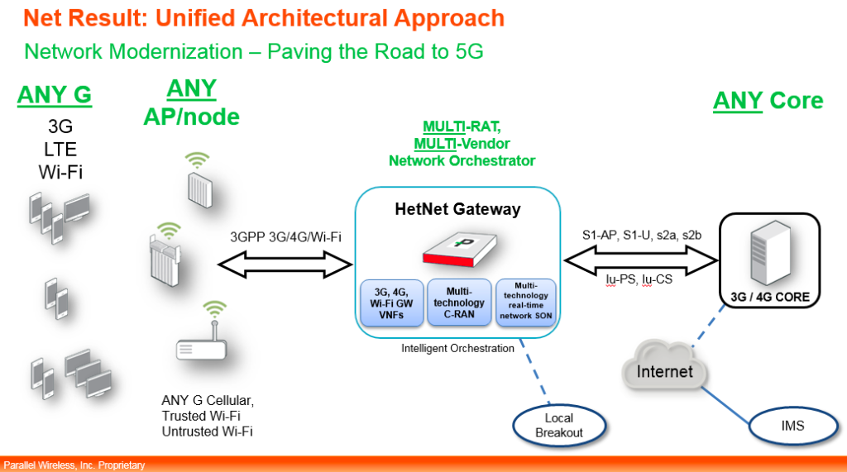
Future Heterogeneous Networks (HetNets)

Slide 4
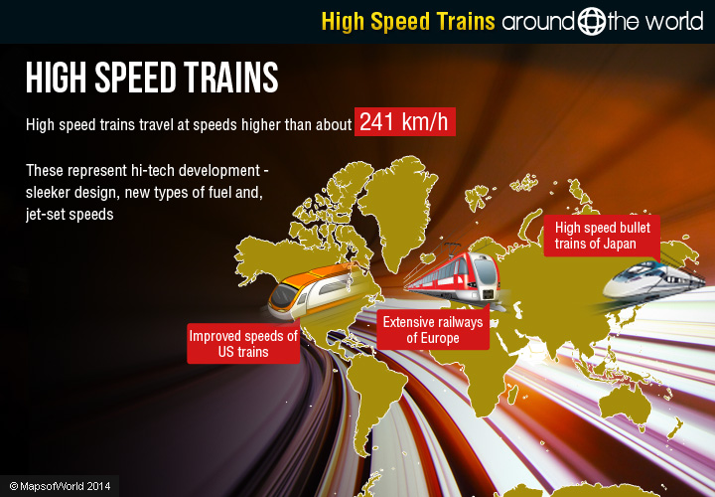

High Speed Train Communication System
Very high Doppler effect
Short, bursty and periodic time for access point

Slide 5





Delay Analysis
Different multimedia applications have different delay requirement
  Voice/gaming: strict
  Email/Twitter/Wechat: relatively low
  Video/multimedia has different requirement

Slide 6
Network calculus for delay analysis
Network calculus: deterministic network calculus (DNC) and stochastic network calculus (SNC)
DNC: deterministic arrival envelope and deterministic service envelope (work-conserving constant rate servers and leaky-bucket traffic regulators) —> worst case quality of service
SNC: statistical envelopes follow from moment generation functions (MGFs) by use of Chernoff’s bound
  Effective bandwidths theory: end-to-end probabilistic network calculus; inaccurate results for bursty arrivals
  Martingale theory: investigate end-to-end delay performance of different data services

Slide 7
Outline
Motivations
Martingale Theory
Martingale in High-Speed Train System
  Delay Bound Analysis Using Martingale Theory under Heterogeneous Network for High-Speed Trains
  Delay Bound Analysis Using Martingale Theory for Satellite Communications Systems
Other Applications
Summary
Overview of Our Research Lab

Slide 8


Martingale Concept
Martingale!
Horse’s Cage Set

Slide 9
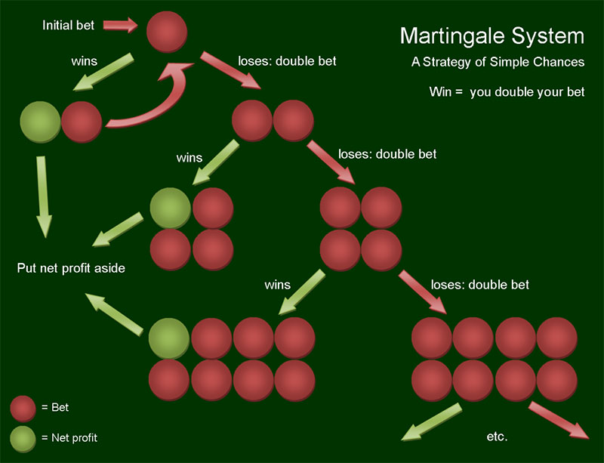
Martingale in Betting System
gambler double his bet after every loss
Betting strategy in 18th-century France: Gambler wins his stake if a coin comes up heads and loses it if the coin comes up tails
first win recover all previous losses plus win a profit equal to the original stake

Slide 10
Martingale in Betting System
Exponential growth of the bets would eventually bankrupt gamblers who chose to use the martingale
Wealth and available time approach infinity;
Probability of eventually flipping heads approaches 1;
Martingale betting strategy seem like a sure thing

Slide 11
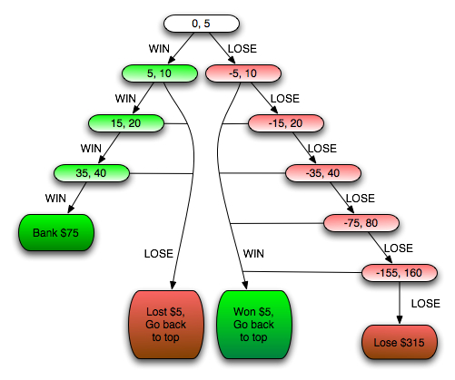


Martingale in Roulette
Roulette: probability of hitting either red or black is close to 50%

Slide 12
Basic Definition of Martingale Process
A discrete-time martingale is a discrete-time stochastic process (a sequence of random variables) that satisfies for any time n
Due to the linearity of expectation,
or

Slide 13
Martingale sequences with respect to another sequence
A sequence is a martingale with respect to another sequence if for all n
A continuous-time martingale:
The conditional expectation of an observation at time t, given all the observations up to time s , is equal to the observation at time s.

Slide 14
Submartingales
A sequence of integrable random variables satisfying
Discrete time:
Continuous time:
Examples:
  Every martingale is a submartingale;
  A convex function of a martingale is a submartingale;
  Betting strategy: suppose that the coin may be biased, so that it comes up heads with probability p. If p is greater than 1/2, the gambler wins money on average, and the gambler's fortune over time is a submartingale.

Slide 15
Supermartingales
A sequence of integrable random variables satisfying
Discrete time:
Continuous time:
Examples:
  Every martingale is a supermartingale;
  A concave function of a martingale is a supermartingale;
  Betting strategy: suppose that the coin may be biased, so that it comes up heads with probability p. If p is less than 1/2, the gambler wins money on average, and the gambler's fortune over time is a supermartingale.

Slide 16
Stopping Time
A stopping time with respect to a sequence of random variables is a random variable with integral values and the property that for each , the occurrence or non-occurrence of the event depends only on the values of .
Playing exactly five games corresponds to the stopping time τ = 5, is a stopping rule.
Playing until he has the maximum amount ahead he will ever be is not a stopping rule and does not provide a stopping time: Require information about the future, the present and past.

Slide 17
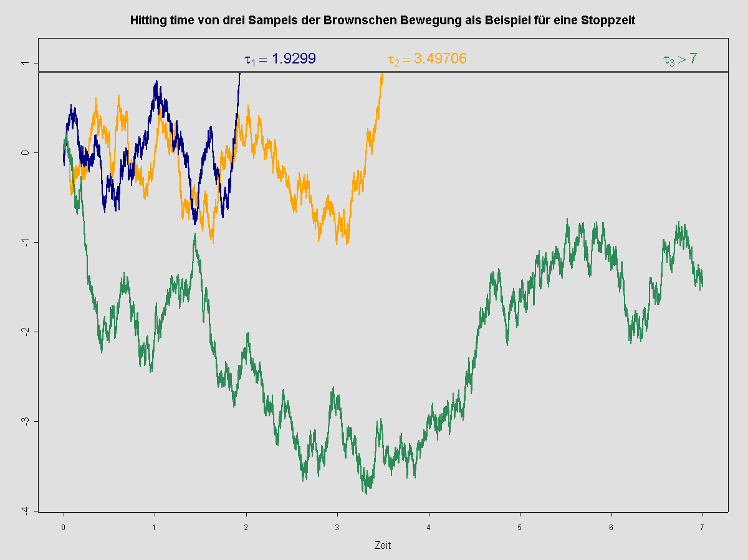
Stopping Time
River
Drunk guy
A hitting time of Brownian motion. The process starts and is stopped as soon as it hits threshold.

Slide 18
Stopping Time Process
X is a process and τ is a stopping time, then X^{τ} is used to denote the process X stopped at time τ:
Stopping times are frequently used to generalize certain properties of the stochastic processes
Local martingale process: A process X is a local martingale if it is right continuous left limit. There exists a sequence of stopping times τ_{n} , :
is a martingale for every n.
Locally integrable process:

Slide 19
Optimal Stopping Theory
The expected value of a martingale at a stopping time is equal to the expected value of its initial value:
  is a discrete time martingale and τ is a stopping time:
  A gambler’s fortune can be modeled as a martingale process in a fair game. It says that on the average nothing can be gained by stopping to play the game based on the information obtainable so far (i.e., by not looking into the future).

Slide 20
Outline
Motivations
Martingale Theory
Martingale in High-Speed Train System
  Delay Bound Analysis Using Martingale Theory under Heterogeneous Network for High-Speed Trains
  Delay Bound Analysis Using Martingale Theory for Satellite Communications Systems
Other Applications
Summary
Overview of Our Research Lab

Slide 21
High-Speed Train System
1. Voice over IP (VoIP): hard to guarantee successive voice service
2. Multimedia (gaming, UDP): delay insensitive, different delay requirements
3. Trackside access points (TAPs): heavy Doppler effect, time varying fast fading channel
4. Base stations (BSs): comparative slow speed channel
For a high-speed train system, an accurate and adaptive delay bound analysis is necessary!

Slide 22
Network Topology
What is the end-to-end delay bound of VoIP and multimedia when traversing the servers BS or TAP under a specific scheduling policy such as first in first out (FIFO) or earliest deadline first (EDF)?

Slide 23
Key Notations
Bivariate arrival process
Bivariate service process
  Service process acts like an impulse-response in linear and time invariant system
  Service curves describe versatile network functions such as routers, schedulers, and links in SNC
Departure process

Slide 24
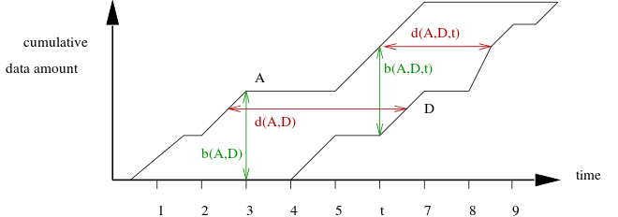
Physical Meaning
Delay process: the horizontal distance
Arrival process:
Martingale envelop
Q(A,D,t)
W(A,D,t)
Q(A,D)
Service process:
Martingale envelop
W(A,D)
Backlog process: the vertical distance

Slide 25
Key Notations
Backlog process :
  Amount of data at time n comprising of the stored data in the buffer and that are in transmission
  Queue length of the system at time n
Delay process :
  The time a data unit would have stayed in the system if it had departed at time unit n

Slide 26
Some Definitions
(Supermartingale Envelope for Arrivals). For monotonically increasing function and for every , it is said that the arrival flow admits -supermartingale envelope, such that the process
is bounded by the arrival supermartingale .
(Supermartingale Envelope for Services). For monotonically increasing function and for every , it is said that the service process admits -supermartingale envelope, such that the process
is bounded by the service supermartingale .
Martingale sample-path bound for
Markov arrivals and services;
Exponential transform determines
the decay rate of queuing metrics;
Very flexible analysis for arrival process and service process

Slide 27
Arrival Process Model
Bursty source is modelled by a Markov-Modulated On-Off (MMOO) process
is a Markov chain with state space
successful transmission probability
Transition matrix of the Markov chain
Steady-state distribution
failure transmission probability
Peak transmission rate in state 1

Slide 28
Service Process Model
CSMA/CA channel: Carrier sense and collision avoidance by transmitting only when the channel is sensed to be ‘‘idle’’
Service process: Markov chain with state space
probability of a successful transmission
Transition matrix of service process
Steady-state distribution
probability of a unsuccessful transmission

Slide 29
Martingale Envelope Parameters
exponential transition matrix for Markov process X(n) as A(n) or S(n)
spectral radius, largest positive eigenvalue
corresponding right eigenvector
for arrival supermartingale envelope
for service supermartingale envelope
threshold
29

Slide 30
Per-Flow Delay Analysis
Theorem 1. (Martingale Delay Bound for FIFO). The FIFO server schedules the arrival data units of A_{a} (n) and A_{b} (n) according to their coming times. The extended bivariate stochastic service process for FIFO scheduling algorithm can be presented as

Slide 31
Martingale Delay Bound for FIFO
Arrival processes bounded by
Service process bounded by
According to independence assumption, for
is a newly constructed supermartingale
By stationary, time-shifted supermartingale process is also a supermartingale

Slide 32
Martingale Delay Bound for FIFO
Backlog process:
Define a stopping time N for
Applying optimal stopping theorem
Expectation of a supermartingale is non-increasing
violation value of backlog

Slide 33
Martingale Delay Bound for FIFO
Backlog process distribution for A_{a} (n)
Delay process distribution for A_{a} (n)
initial value of supermartingale

Slide 34
Per-Flow Delay Analysis by Martingale
Theorem 2. (Martingale Delay Bound for EDF). An EDF server process is constructed by combing the relative deadlines and the arriving process. In EDF scheduling, all data units are transmitted in the order of their remaining deadlines. Here we use the definition of the extended bivariate stochastic service process for EDF scheduling algorithm from
where y denotes the difference of two arrivals’ deadlines.

Slide 35
Martingale Delay Bound for EDF
Delay process distribution for A_{a} (n):
for y>0,
for y<0,

Slide 36
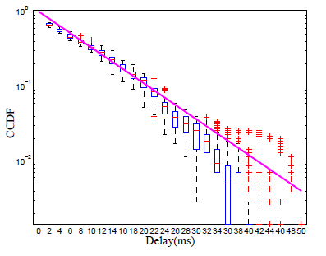
Simulation Results—FIFO
continuous line represents martingale bound, boxplot represents simulation result
Complementary cumulative distribution function (CCDF) of end-to-end delay for FIFO with VoIP and multimedia data sets

Slide 37
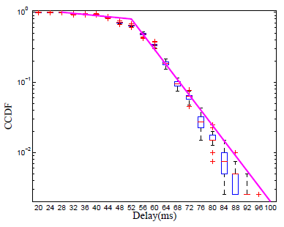
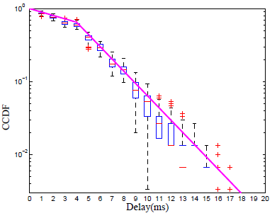
Simulation Results—EDF
Deadline of A_{a} (VoIP) is set 50ms, deadline of A_{b} (multimedia) is set 500ms
CCDF of end-to-end delay for EDF1 /EDF2 with VoIP and multimedia data sets

Slide 38
Outline
Motivations
Martingale Theory
Martingale in High-Speed Train System
  Delay Bound Analysis Using Martingale Theory under Heterogeneous Network for High-Speed Trains
  Delay Bound Analysis Using Martingale Theory for Satellite Communications Systems
Other Applications
Summary
Overview of Our Research Lab

Slide 39
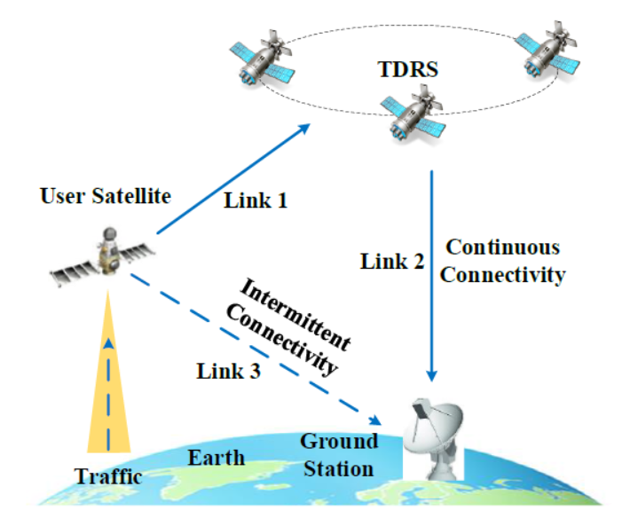
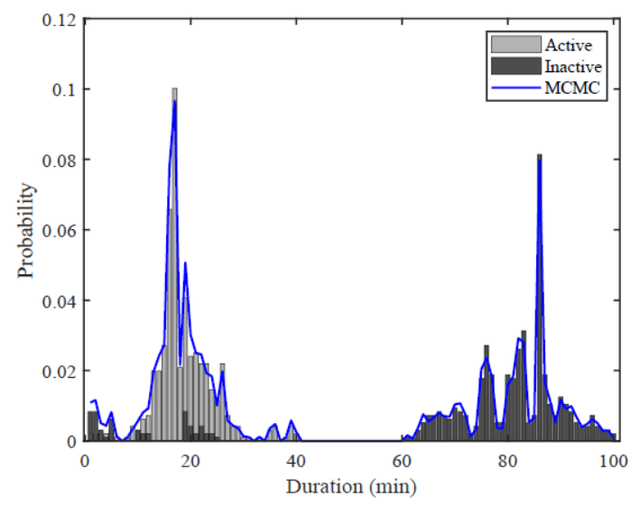




Satellite Communications System
1. Multimedia (VoIP, image, video): delay insensitive, different delay requirements
2. Ground Stations (GSs): time varying, fast speed intermittent channel
3. Relay Satellites (RSs): comparative slow speed channel
Fig. Intermittent link feature
For a high-dynamic satellite system, an accurate and adaptive delay bound analysis is necessary!
User satellite
Traffic input
Continuous
link
Intermittent
link
Ground
station
Relay
satellite

Slide 40
Network Topology
What is the end-to-end delay bound of traffic 1 and traffic 2 when traversing the servers RS or GS with a specific distribution ratio?

Slide 41
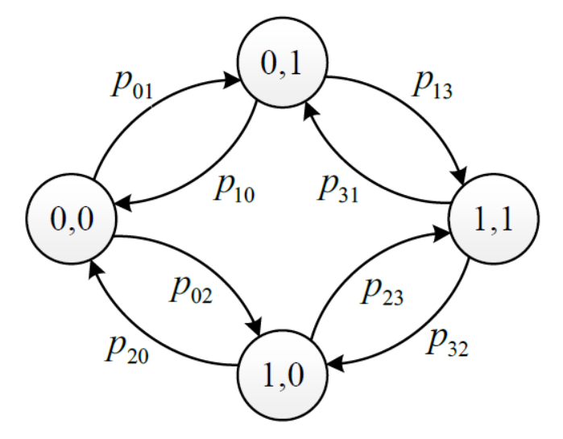
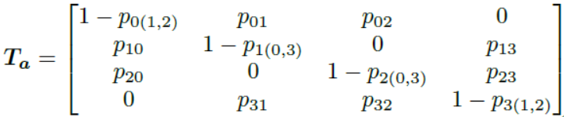
Arrival Process Model
Bursty source is modelled by a Markov-Modulated On-Off (MMOO) process
is a Markov chain with state space
Traffic 1 is generating
Transition matrix of the Markov chain
Traffic II is generating
Traffic I and II are both generating

Slide 42


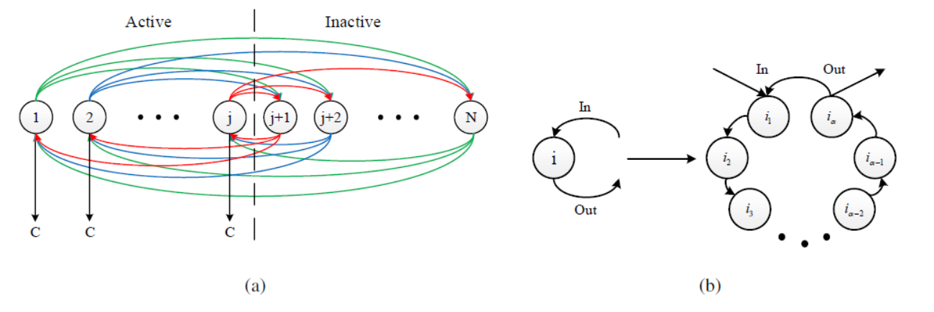

Service Process Model
Tandem link: User satellite transmits the data to the relay satellite, then the relay satellite forwards the data to the ground station
Intermittent link: User satellite directly transmits the data to the relay satellite.
Propagation
delay
Departure process
where
With MCMC, we can obtain service transition probability matrix of service process $S_{G}$

Slide 43
Martingale Parameters
exponential transition matrix for Markov process X(n) as A(n) or S(n)
spectral radius, largest positive eigenvalue
corresponding right eigenvector
for arrival supermartingale envelope
for service supermartingale envelope
threshold
43

Slide 44
Martingale Delay Bound for relay link
Arrival-Martingales
Service-Martingales
For U-T link
For T-G link
By stationary, time-shifted supermartingale process is also a supermartingale

Slide 45
Martingale Delay Bound for relay link
Backlog process distribution for relay link
Delay process distribution for relay link
initial value of supermartingale
Tandem service

Slide 46
Martingale Delay Bound for SGL
Arrival-Martingales
Service-Martingales
For U-G link

Slide 47
Martingale Delay Bound for SGL
Backlog process distribution for SGL
Delay process distribution for SGL
initial value of supermartingale
Intermittent service

Slide 48
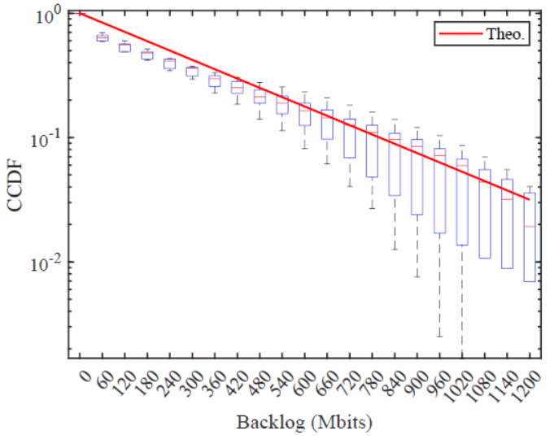
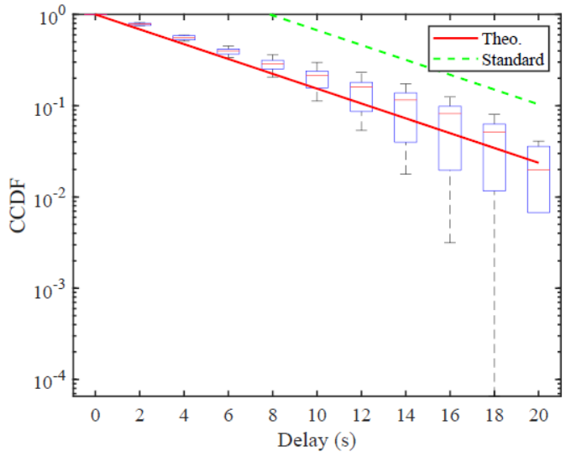
Simulation Results—ISL
The distribution ratio of both traffic to the ISL is set as 80%.
The traffic density of ISL is set as 88.62%.

Slide 49
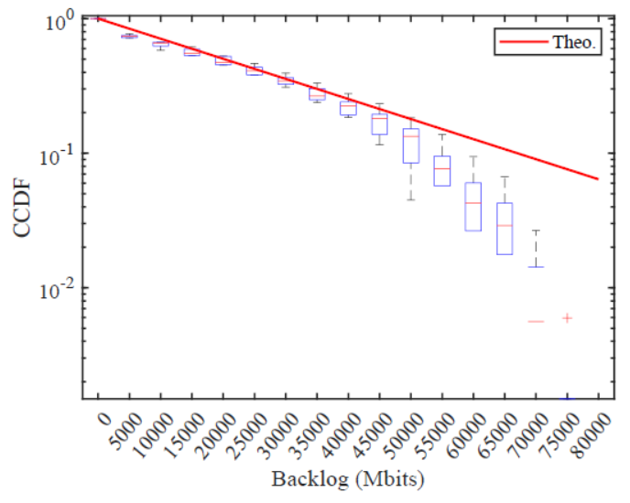
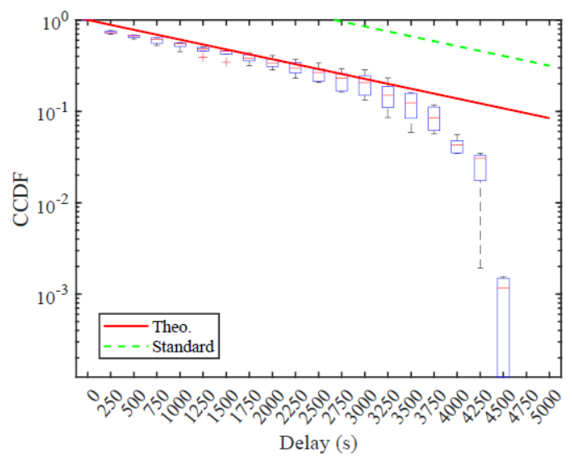
Simulation Results—SGL
The distribution ratio of both traffic to the SGL is set as 20%.
The traffic density of SGL is set as 88.25%.

Slide 50
Outline
Motivations
Martingale Theory
Martingale in High-Speed Train System
  Delay Bound Analysis Using Martingale Theory under Heterogeneous Network for High-Speed Trains
  Delay Bound Analysis Using Martingale Theory for Satellite Communications Systems
Other Applications
Summary
Overview of Our Research Lab

Slide 51
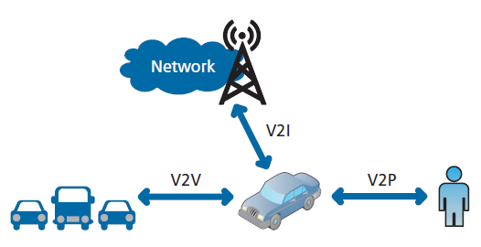
VANETS
Third Generation Partnership Project (3GPP) approves LTE support for vehicle-to-everything (V2X) services
V2X service covers LTE-based communication for vehicle-to-vehicle (V2V), vehicle-to-infrastructure (V2I), and vehicle-to-pedestrian (V2P) service

Slide 52
VANETs
Vehicles today are equipped with wireless communication functions
Federal Communications Commission (FCC) allocated 5.850 − 5.925 GHz band for Dedicated Short-Range Communications (DSRC) to promote wireless communications for safe and efficient highways

Slide 53
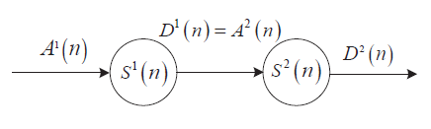
Two-Hop Relaying System
For service curve ,
For service curve ,
Summing the above,
Thus,

Slide 54
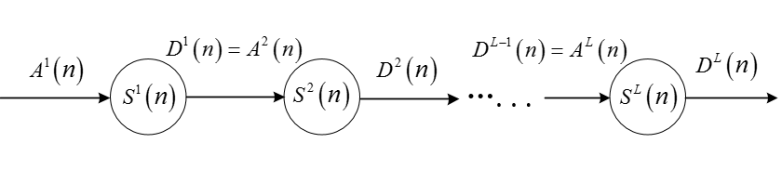
Min-Plus Convolution Network
Multi-hop relaying systems with L service curves:

Slide 55
Summary
A very flexible tools for delay analysis
  Concept and properties of martingale theory
  Apply optimal stopping property and supermartingale characteristics to analyze queuing performance
  Bound arrival and service processes by supermartingale envelopes
  MCMC as a bridge to any distribution
Martingale applications:
  Delay bound analysis for high-speed train networks
  Delay bound analysis for Satellite networks
  Connection to stochastic network calculus?

Slide 56

Thank you!

