Slide 1
An Guide to the Stochastic Network Calculus
Zhu Han
Thanks to Prof. Xuefang Liu and Dr. Yan Zhu

Slide 2
Outline
Stochastic Network Calculus
Arrival Envelopes
Service Envelopes
Backlog and Delay Bounds
Applications
Convolution-Form Networks
Statistical Multiplexing
Conclusion

Slide 3


Stochastic Network Calculus
How long will
it take?
Processing time is
too long.
Wait or not?
How to evaluate the network performance metrics?

Slide 4

Queueing Theory
General Queuing System
Output
Arrivals
Buffer
Service
Queueing theory helps plan and analyze the system performance.
Notes:
Queueing theory: maximize the performance and minimize the risk.

Slide 5
Network Calculus
R.Cruz. lays the foundation of Network Calculus.
[1] R. L. Cruz. A calculus for network delay, Part I: Network elements in isolation. IEEE Transactions on Information Theory, 37(1):114-131, January 1991.
[2] R. L. Cruz. A calculus for network delay, Part II: Network analysis. IEEE Transactions on Information Theory, 37(1):132-141, January 1991.
Goal:
A theoretical framework to analyze performance guarantees (maximum delays, maximum buffer space requirements…) in network.
Transform complex non-linear network systems into analytically tractable linear systems.

Slide 6
Network Calculus
Deterministic Network Calculus (DNC)
Provides deterministic service guarantee that all packets of a flow arrive at the destination within its required performance (as throughput, delay, and loss bounds).
Provides the highest QoS level.
Drawback---must reserve network resources based on the worst-case scenario and hence leaves a significant portion of network resources unused.

Slide 7
Network Calculus
Stochastic Network Calculus (SNC)
Provides stochastic service guarantee that allows the QoS to be guaranteed with a probability .
Allowing some packets to violate the required QoS measures.
Advantage—better exploit the statistical multiplexing gain at network links and hence improve network utilization.

Slide 8
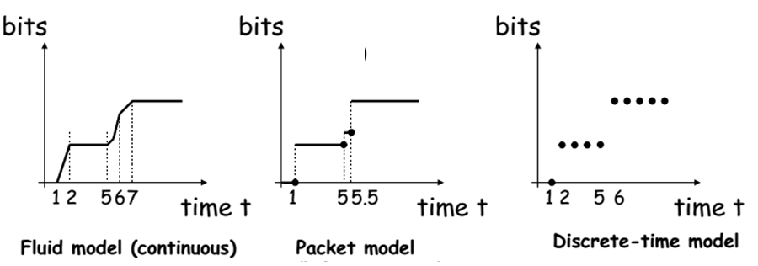
QoS
Cumulative function
Describe the data flow as the number of bits in time interval.
A1(t)
A2(t)
A3(t)
Notes:
It is convenient to describe data flows by means of the cumulative function
A1:continuous function of continuous time
A2:continuous time with discontinuities at packet arrival times,packet arrivals are ovserved when the packet has been fully received
A3:

Slide 9


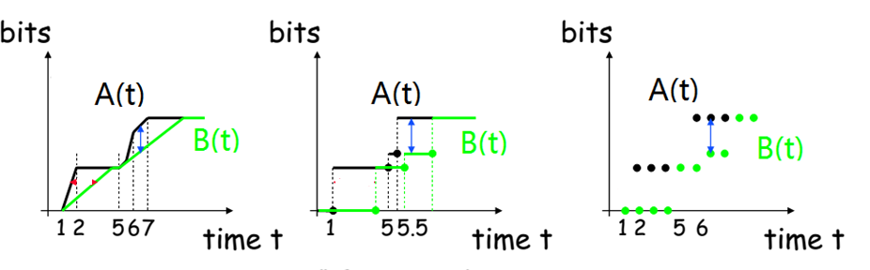
QoS---Backlog
Definition: For a lossless system
The amount of bits that are held inside the system.
vertical deviation between input and output functions

Slide 10
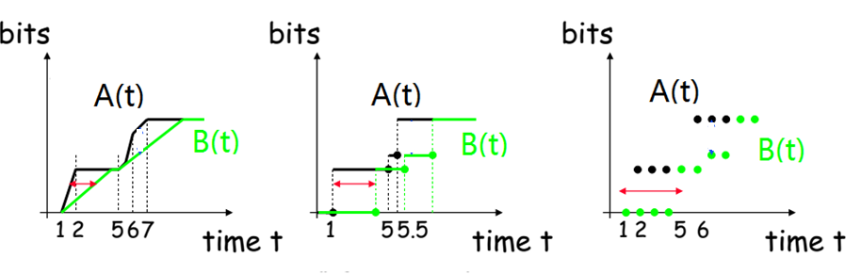
QoS ---Delay
Definition: For a lossless system, the virtual delay is
$$d\left(t\right)=inf⁡\{τ≥0:A(t)≤B(t+τ)\}$$
The delay that would be experienced by a bit arriving at time t if all bits received before it are served.
Horizontal deviation

Slide 11
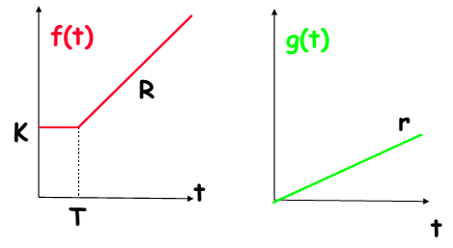
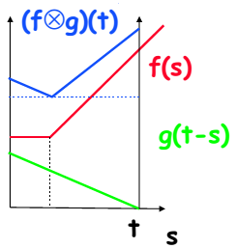
Mathematical basis for NC
Four network operations----reduce the complexity
Min-plus
algebra
Notes:
The second and last operator represent the point wise addition and subtraction of th einvolved functions

Slide 12

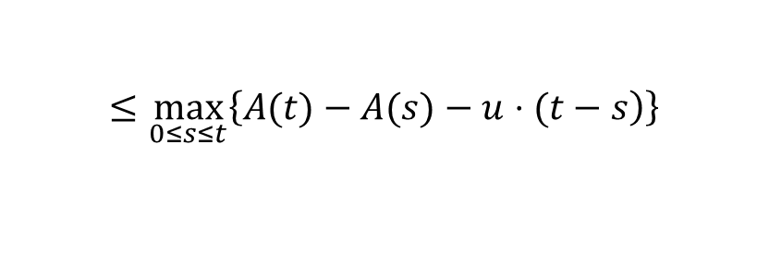
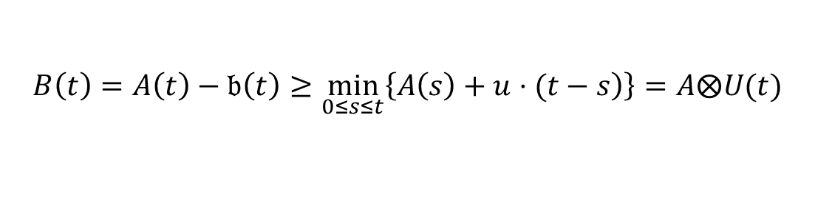

Ex: Why use convolution
Scenario
Service element has constant service rate u
Assumption
No data is lost or produced inside the service element
Backlog
New arrivals
$$b\left(t\right)≔A\left(t\right)⊖B\left(t\right)=A\left(t\right)−B(t)$$
Processed data
Service envelope
Backlog at time t
$$≤\max_{0≤s≤t}\left\{\left.A(t)−A(s)−u⋅(t−s\right)\right\}$$
$$B\left(t\right)=A\left(t\right)−𝔟\left(t\right)≥\min_{0≤s≤t}\left\{\left.A\left(s\right)+u⋅(t−s\right)\right\}=A⨂U(t)$$
Notes:
b(t-1): backlog of the previous slot
A(t): new arrivals
U:processed data

Slide 13
Outline
Stochastic Network Calculus
Arrival Envelopes
Service Envelopes
Backlog and Delay Bounds
Applications
Convolution-Form Networks
Statistical Multiplexing
Conclusion

Slide 14
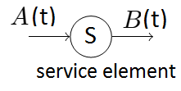
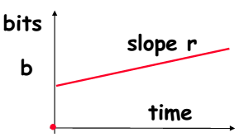



Arrival Envelopes
For any times 0 ≤ s ≤ t, the cumulative flow A(.) satisfies
$A\left(t\right)−A(s)≤ρ(t−s)$+b
A drawback of the deterministic envelope is it considers the worst-case but cannot take advantage of the statistical nature of traffic
Solution: introducing the Moment Generating Function (MGF)
$$ρ$$
$$\left.M_{A}(θ,t−τ)=E[e^{\left.θA(τ,t\right)}\right]$$
Notes:
In order to deterministically guarantee a certain level of QoS for a flow, the
traffic sent by the flow must be limited

Slide 15
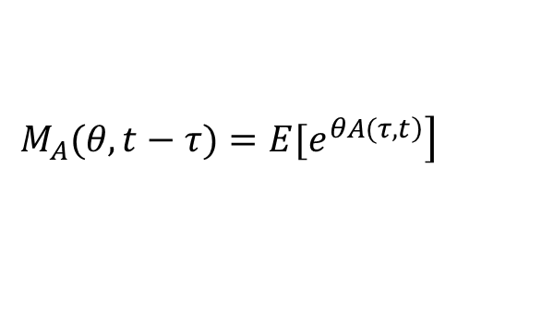
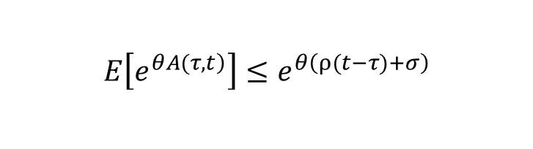
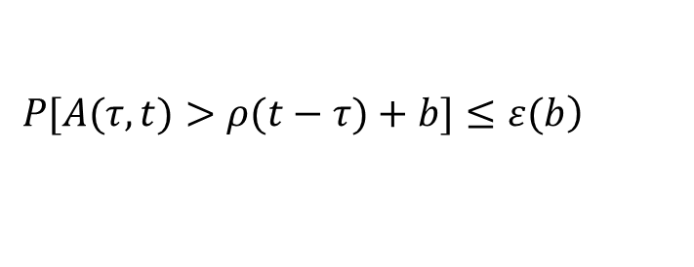

Arrival Envelopes
MGF
$$\left.M_{A}(θ,t−τ)=E[e^{\left.θA(τ,t\right)}\right]$$
MGF envelope [4], [8]
$$E\left[e^{\left.θA(τ,t\right)}\right]≤e^{θ\left(ρ(t−τ)+σ\right)}$$
A related statistical envelope, referred to as Exponentially Bounded Burstiness (EBB), is defined in [9] to provide a guarantee of the form
$$\left.P[A(τ,t)>ρ(t−τ)+b]≤ε(b\right)$$
$$ε\left(b\right)=αe^{−θb}≜e^{θσ}e^{−θb}$$
[4] C.-S. Chang, Performance Guarantees in Communication Networks London, U.K.: Springer-Verlag, 2000.
[8] C.-S. Chang, “Stability, queue length and delay of deterministic and stochastic queueing networks,” IEEE Trans. Autom. Control, vol. 39, no. 5, pp. 913–931, May 1994.
[9] O. Yaron and M. Sidi, “Performance and stability of communication networks via robust exponential bounds,” IEEE/ACM Trans. Netw., vol. 1, no. 3, pp. 372–385, Jun. 1993.
Notes:
In order to deterministically guarantee a certain level of QoS for a flow, the
traffic sent by the flow must be limited

Slide 16
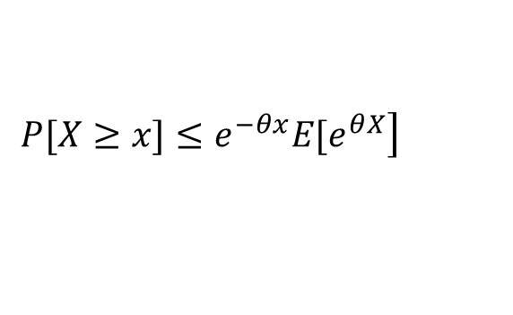

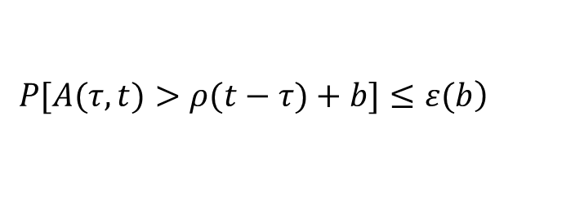
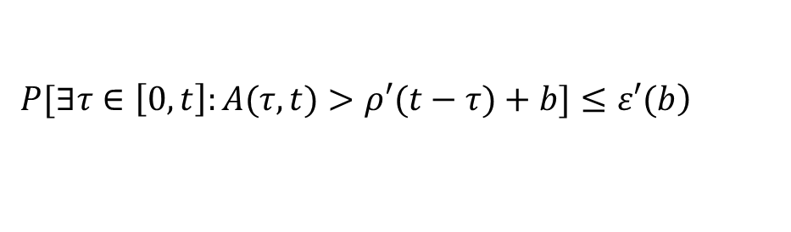

Arrival Envelopes
The EBB model is directly connected to the MGF envelope by Chernoff’s bound
$$\left.P[X≥x]≤e^{−θx}E[e^{θX}\right]$$
We obtain
$$ε\left(b\right)=e^{θσ}e^{−θb}$$
$$\left.P[A(τ,t)>ρ(t−τ)+b]≤ε(b\right)$$
Extend to the arbitrary
$$τ$$
$$\left.P[∃τ∈\left[0,t\right]:A(τ,t)>ρ′(t−τ)+b]≤ε′(b\right)$$
Notes:
In order to deterministically guarantee a certain level of QoS for a flow, the
traffic sent by the flow must be limited

Slide 17

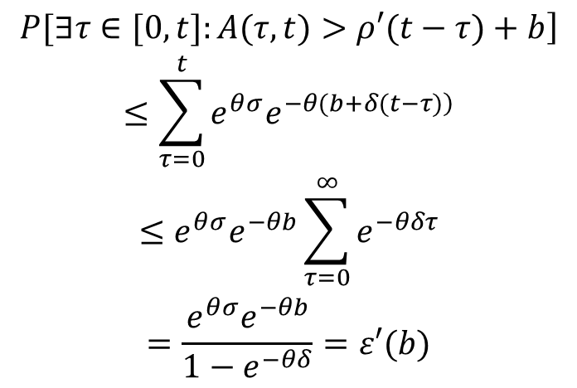
Arrival Envelopes
By the union bound
$$P[∃i:X_{i}≥x]≤∑_{i}P[X_{i}≥x]$$
We have
$$\begin{matrix}\left.P[∃τ∈[0,t]:A(τ,t)>ρ′(t−τ)+b\right] \\ ≤\sum_{τ=0}^{t}{e^{θσ}e^{\left.−θ(b+δ(t−τ)\right)}} \\ ≤e^{θσ}e^{−θb}\sum_{τ=0}^{∞}{e^{−θδτ}} \\ =\frac{e^{θσ}e^{−θb}}{1−e^{−θδ}}=ε′(b)\end{matrix}$$
Let ρ’ = ρ + δ.
where θ > 0 and δ > 0 are free parameters that can be optimized.
We obtain the relationship between the θ, σ, ε’, δ and b.
Notes:
In order to deterministically guarantee a certain level of QoS for a flow, the
traffic sent by the flow must be limited

Slide 18
Outline
Stochastic Network Calculus
Arrival Envelopes
Service Envelopes
Backlog and Delay Bounds
Applications
Convolution-Form Networks
Statistical Multiplexing
Conclusion

Slide 19

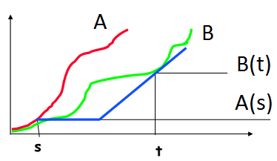

Service Envelopes
A service element has the input-output pair A and B.
The service element provides a service curve
$$B\left(t\right)−A(s)≥U(t−s)$$
A deterministic definition of service envelope for all t ≥τ ≥ 0 is
S(τ, t) ≥ ρ(t − τ ) − b
Notes:
a service curve defines a lower bound on the service provided by
a server.

Slide 20
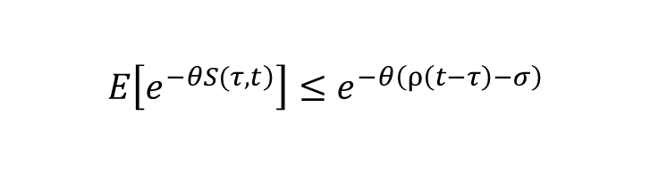
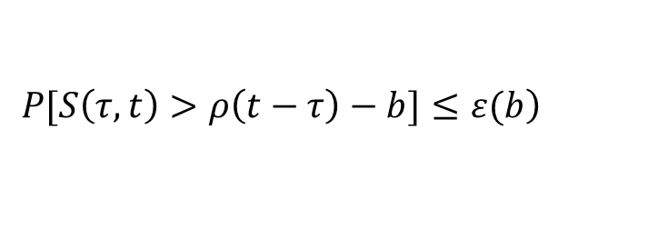

Service Envelopes
An affine envelope of the MGF can be defined for θ ≥ 0 as
$$E\left[e^{\left.−θS(τ,t\right)}\right]≤e^{−θ\left(ρ\left(t−τ\right)−σ\right)}$$
Statistical service envelopes that mirror the concept of EBB are defined in [27] as the so-called Exponentially Bounded Fluctuation (EBF) model with parameters ρ > 0, b ≥ 0 and
$$\left.P[S\left(τ,t\right)>ρ\left(t−τ\right)−b]≤ε(b\right)$$
$$ε\left(b\right)=αe^{−θb}≜e^{θσ}e^{−θb}$$
[27] K. Lee, “Performance bounds in communication networks with variablerate links,” in Proc. ACM SIGCOMM, Aug. 1995, pp. 126–136.
Notes:
a service curve defines a lower bound on the service provided by
a server.

Slide 21
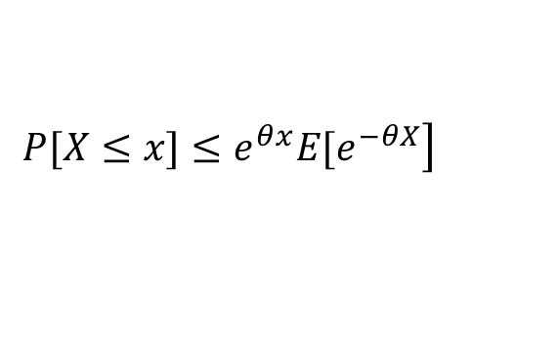

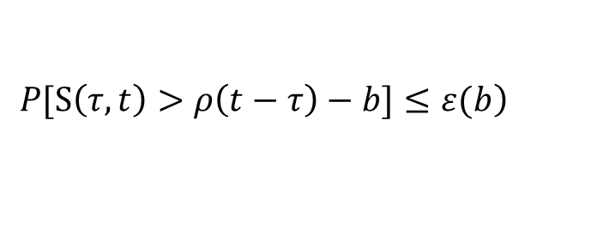
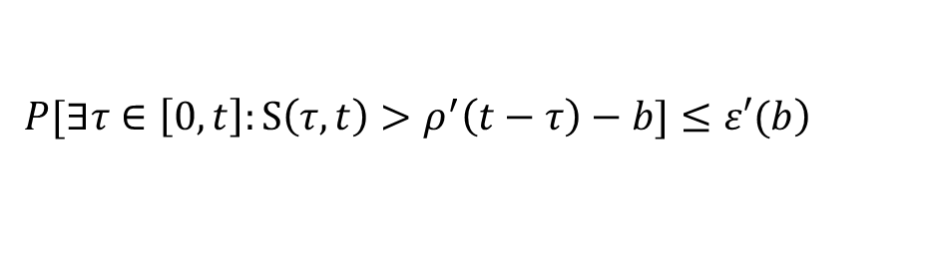

Service Envelopes
With Chernoff’s lower bound
$$\left.P[X≤x]≤e^{θx}E[e^{−θX}\right]$$
We obtain
$$ε\left(b\right)=e^{θσ}e^{−θb}$$
$$\left.P[S\left(τ,t\right)>ρ\left(t−τ\right)−b]≤ε(b\right)$$
Extend to the arbitrary
$$τ$$
$$\left.P[∃τ∈\left[0,t\right]:S\left(τ,t\right)>ρ^{′}\left(t−τ\right)−b]≤ε′(b\right)$$
Notes:
a service curve defines a lower bound on the service provided by
a server.

Slide 22
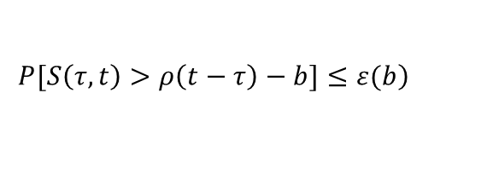


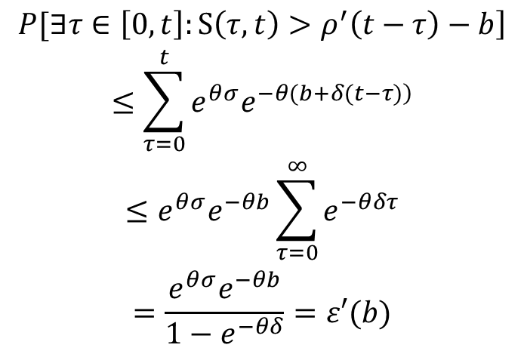
Service Envelopes
By the union bound
$$P[∃i:X_{i}≥x]≤∑_{i}P[X_{i}≥x]$$
We have
$$\begin{matrix}\left.P[∃τ∈\left[0,t\right]:S\left(τ,t\right)>ρ^{′}\left(t−τ\right)−b\right] \\ ≤\sum_{τ=0}^{t}{e^{θσ}e^{\left.−θ(b+δ(t−τ)\right)}} \\ ≤e^{θσ}e^{−θb}\sum_{τ=0}^{∞}{e^{−θδτ}} \\ =\frac{e^{θσ}e^{−θb}}{1−e^{−θδ}}=ε′(b)\end{matrix}$$
Let ρ’ = ρ - δ.
$$\left.P[S\left(τ,t\right)>ρ\left(t−τ\right)−b]≤ε(b\right)$$
$$ε\left(b\right)=αe^{−θb}≜e^{θσ}e^{−θb}$$
where θ > 0 and δ > 0 are free parameters that can be optimized.
We obtain the relationship between the θ, σ, ε’, δ and b.
Notes:
In order to deterministically guarantee a certain level of QoS for a flow, the
traffic sent by the flow must be limited

Slide 23
Outline
Stochastic Network Calculus
Arrival Envelopes
Service Envelopes
Backlog and Delay Bounds
Applications
Convolution-Form Networks
Statistical Multiplexing
Conclusion

Slide 24
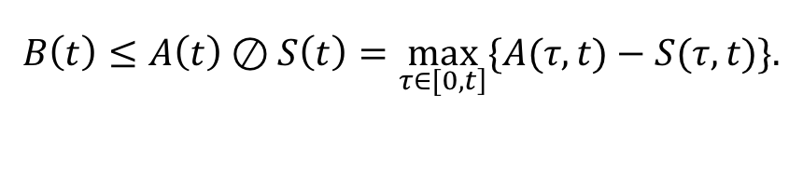


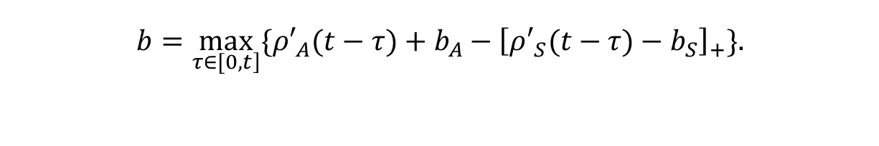

Backlog and Delay Bounds
Consider arrivals with envelope
$$A(τ,t)≤ρ′_{A}(t−τ)+b_{A}$$
Also, consider service with envelope
$$S(τ,t)≥ρ′_{S}(t−τ)+b_{S}$$
Backlog bound
$$B\left(t\right)≤A\left(t\right)⊘S\left(t\right)=\max_{\left.τ∈[0,t\right]}\{A(τ,t)−S(τ,t)\}.$$
$$b=\max_{\left.τ∈[0,t\right]}\{ρ′_{A}(t−τ)+b_{A}−{\left[ρ′_{S}(t−τ)−b_{S}\right]}_{+}\}.$$
$$P[B(t)>b]≤ε′_{A}(b_{A})+ε′_{S}(b_{S})=ε′$$

Slide 25

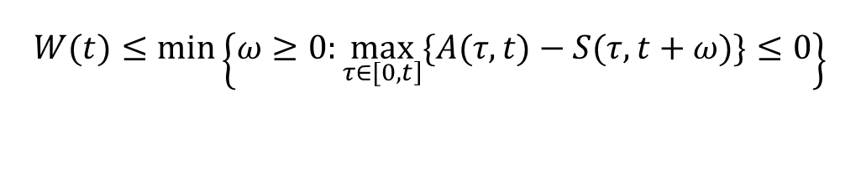

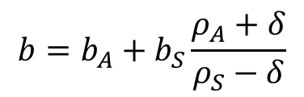

Backlog and Delay Bounds
Substitute and into b’s expression
$$ρ′_{A}=ρ_{A}+δ$$
$$ρ′_{S}=ρ_{S}−δ$$
We have
$$b=b_{A}+b_{S}\frac{ρ_{A}+δ}{ρ_{S}−δ}$$
Delay bound
$$W(t)≤min\left\{ω≥0:\max_{\left.τ∈[0,t\right]}\{A(τ,t)−S(τ,t+ω)\}≤0\right\}$$
Similarly，we can get
$$ω=\frac{b_{A}+b_{S}}{ρ_{S}−δ}$$

Slide 26
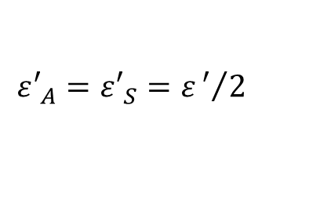
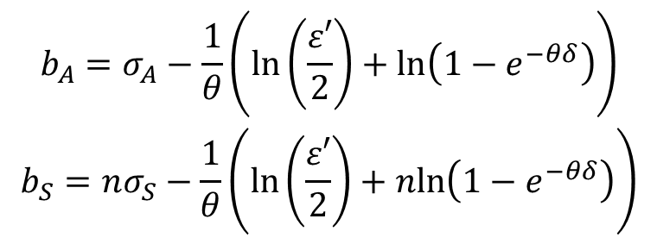
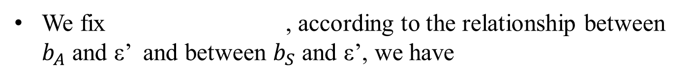
Backlog and Delay Bounds
We fix , according to the relationship between $b_{A}$ and ε’ and between $b_{S}$ and ε’, we have
$$ε′_{A}=ε′_{S}=ε′/2$$
$$\begin{matrix}b_{A}=σ_{A}−\frac{1}{θ}\left(ln\left(\frac{ε′}{2}\right)+ln\left(1−e^{−θδ}\right)\right) \\ b_{S}=nσ_{S}−\frac{1}{θ}\left(ln\left(\frac{ε′}{2}\right)+nln\left(1−e^{−θδ}\right)\right)\end{matrix}$$

Slide 27
Calculations Procedure
Step 1
Define the parameters of the MGF envelopes of the arrivals and service
Step 2
Transit from MGF to EBB envelopes
Step 3
Find backlog and delay bounds under the stability condition

Slide 28
Outline
Stochastic Network Calculus
Arrival Envelopes
Service Envelopes
Backlog and Delay Bounds
Applications
Convolution-Form Networks
Statistical Multiplexing
Conclusion

Slide 29
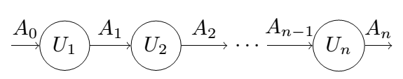

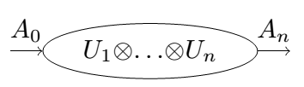

Convolution-Form Network
Concatenation-Theorem
The whole system has the service curve
Notes:
The initial arrival is denoted by A0 , n service elements and each departure Ai of service element i is fed directly into the next service element i +1. If each service element has a service curve Ui, then the whole system has the service curve

Slide 30
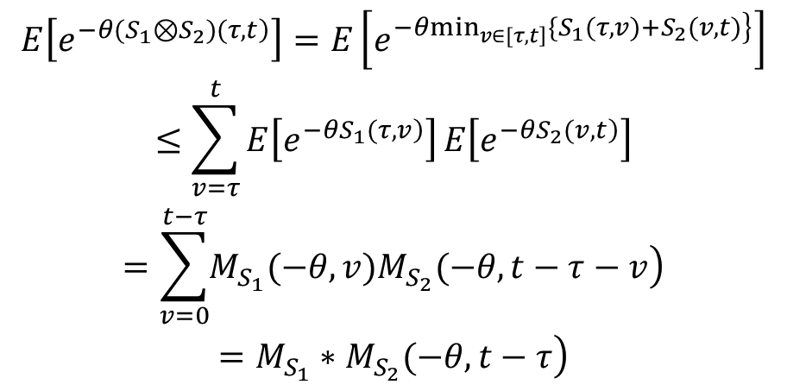
Convolution-Form Network
For the MGF of the min-plus convolution of two statistically independent and stationary service processes, it is known as
$$\begin{matrix}E\left[e^{\left.−θ(S_{1}⊗S_{2})(τ,t\right)}\right]=E\left[e^{\left.−θ\min_{\left.v∈[τ,t\right]}\{S_{1}(τ,v)+S_{2}(v,t)\right\}}\right] \\ ≤\sum_{v=τ}^{t}{E\left[e^{\left.−θS_{1}(τ,v\right)}\right]}E\left[e^{\left.−θS_{2}(v,t\right)}\right] \\ =\sum_{v=0}^{t−τ}{\left.M_{S_{1}}(−θ,v)M_{S_{2}}(−θ,t−τ−v\right)} \\ \left.=M_{S_{1}}∗M_{S_{2}}(−θ,t−τ\right)\end{matrix}$$
Notes:
The output of a system is bounded with the help of

Slide 31
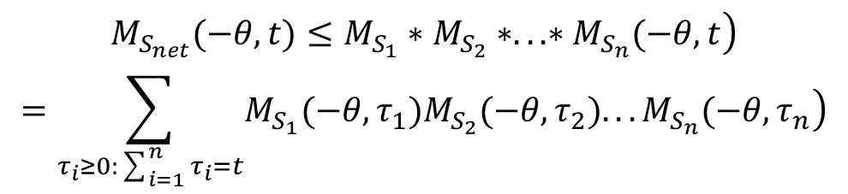


Convolution-Form Network
The MGF of the service process of an n node network follows by recursive insertion as
$$\begin{matrix}\left.M_{S_{net}}(−θ,t)≤M_{S_{1}}∗M_{S_{2}}∗...∗M_{S_{n}}(−θ,t\right) \\ =\sum_{τ_{i}≥0:\sum_{i=1}^{n}{τ_{i}=t}}{\left.M_{S_{1}}(−θ,τ_{1})M_{S_{2}}(−θ,τ_{2})...M_{S_{n}}(−θ,τ_{n}\right)}\end{matrix}$$
$$\left(\begin{matrix}t+n−1 \\ n−1\end{matrix}\right)$$
There are summands in the above equation [29], [30].
$$M_{S_{net}}(−θ,t)≤e^{nθσ}\left(\begin{matrix}t+n−1 \\ n−1\end{matrix}\right)e^{−θρt}$$
[29] S. Ross, A First Course in Probability, 6th ed. Upper Saddle River, NJ, USA: Prentice-Hall, 2002.
[30] H. Al-Zubaidy, J. Liebeherr, and A. Burchard, “A (min,x)-network calculus for multi-hop fading channels,” in Proc. IEEE INFOCOM, Apr. 2013, pp. 1833–1841.
Notes:
The output of a system is bounded with the help of

Slide 32
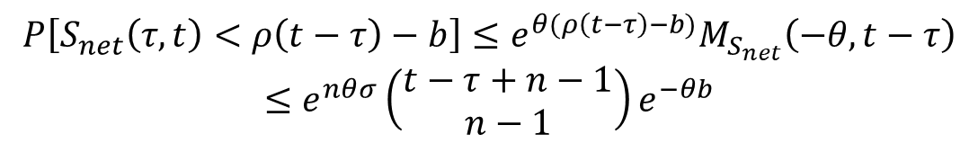
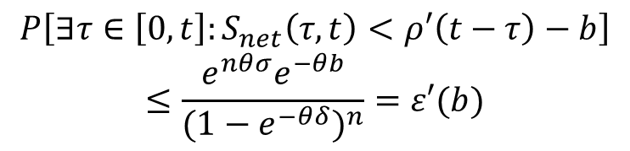
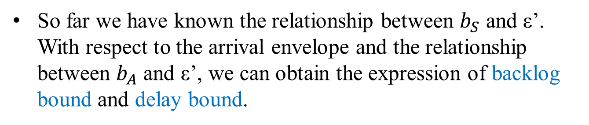
Convolution-Form Network
With Chernoff’s bound (EBB calculation)
$$P\left[S_{net}\left(τ,t\right)<ρ\left(t−τ\right)−b\right]≤{e^{θ(ρ\left(t−τ\right)−b)}M}_{S_{net}}\left(−θ,t−τ\right)$$
$$≤e^{nθσ}\left(\begin{matrix}t−τ+n−1 \\ n−1\end{matrix}\right)e^{−θb}$$
By the union bound
$$P\left[{∃τ∈\left[0,t\right]:S}_{net}\left(τ,t\right)<ρ′\left(t−τ\right)−b\right]$$
$$≤\frac{e^{nθσ}e^{−θb}}{{(1−e^{−θδ})}^{n}}=ε′(b)$$
So far we have known the relationship between $b_{S}$ and ε’. With respect to the arrival envelope and the relationship between $b_{A}$ and ε’, we can obtain the expression of backlog bound and delay bound.
Notes:
The output of a system is bounded with the help of

Slide 33
Outline
Stochastic Network Calculus
Arrival Envelopes
Service Envelopes
Backlog and Delay Bounds
Applications
Convolution-Form Networks
Statistical Multiplexing
Conclusion

Slide 34
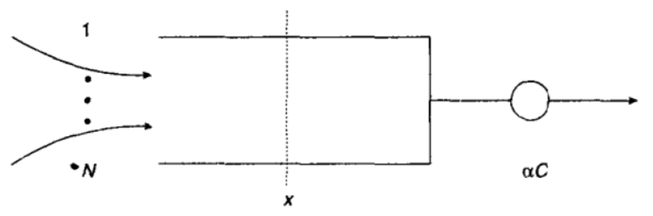
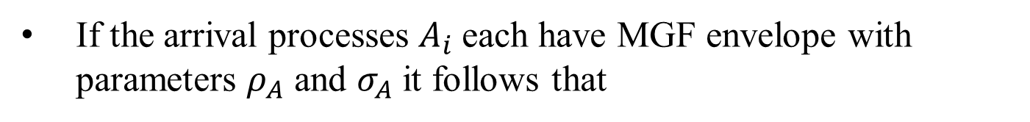
Statistical Multiplexing
Statistical multiplexing is the reason for the resource efficiency of packet data networks.
The aggregate arrival process of the superposition of m arrival processes is
If the arrival processes $A_{i}$each have MGF envelope with parameters $ρ_{A}$ and $σ_{A}$ it follows that
Notes:
The output of a system is bounded with the help of

Slide 35
Statistical Multiplexing
For homogeneous case
For heterogeneous case
Then observing the service envelope and with help of Chernoff bound and union bound, we could further have the backlog bound and delay bound.
Notes:
The output of a system is bounded with the help of

Slide 36
Outline
Stochastic Network Calculus
Arrival Envelopes
Service Envelopes
Backlog and Delay Bounds
Applications
Convolution-Form Networks
Statistical Multiplexing
Conclusion

Slide 37
Conclusion
SNC is another performance analysis method which can provide the performance bound to complex network.
SNC is feasible to the concatenation network by the mean of convolutional operation.
SNC is able to deal with the network multiplexing performance evaluation including homogeneous case and heterogeneous case.

Slide 38
Q&A
Thank You!
Department of Electrical and Computer Engineering
University of Houston, TX, USA

