Slide 1
Dynamic Control Algorithm Design
Based on Lyapunov Stability Theory
Zhu Han
Thanks for Zirui Zhuang and Ruoguang Li

Slide 2
Outline
1
Lyapunov and Stability Theory
- Lyapunov
- Lyapunov stability
- Asymptotically stability
- Second Method of Lyapunov
- Discrete form in time-slotted systems
2
Lyapunov Optimization
3
Dynamic Cache Placement, Node Association, and Power Allocation
4
Lyapunov-Based Reinforcement Learning for Network Routing
5
Conclusions

Slide 3
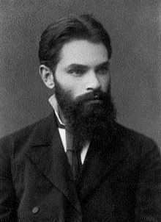
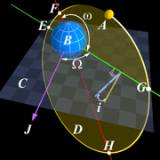
Lyapunov and Stability Theory
Aleksandr Mikhailovich Lyapunov, 1857-1918
  a mathematician, mechanician and physicist
Known for his contribution to the analysis of the stability of nonlinear dynamical systems
Original work done by Lyapunov in 1890s
Improved by N. G. Chetaev in 1930s
Skyrocketed in aerospace guidance systems in 1960s
Notes:
The original work is done by Lyapunov as his thesis “The General Problem of Stability of Motion”, 1892, in Russian.
Nikolay Gur'yevich Chetaev continued the work from 1930s to 1940s, all published in Russian. Some of his work were translated into English in 1961.
In 1960s, the so-called "Second Method of Lyapunov" (see the following pages) was found to be applicable to the stability of aerospace guidance systems which typically contain strong nonlinearities not treatable by other methods.

Slide 4

Lyapunov and Stability Theory
System Stability in the Sense of Lyapunov
  System state $x(t)∈X⊆R^{n}$
  System function $\dot{x}=f\left(t\right),f:X→R^{n}$
  $$∀ε>0,∃δ>0,$$
  $$\left\|x\left(0\right)−x_{e}\right\|<δ⇒\left\|x\left(t\right)−x_{e}\right\|<ε,∀t>0$$
System state starts “close enough” to the equilibrium
remains “close enough” forever

Slide 5

Lyapunov and Stability Theory
Asymptotical Stability
  System state $x(t)∈X⊆R^{n}$
  System function $\dot{x}=f\left(t\right),f:X→R^{n}$
  $$∀ε>0,∃δ_{e}>0,$$
  $$\left\|x\left(0\right)−x_{e}\right\|<δ_{e}⇒\lim_{t→∞}\left\|x\left(t\right)−x_{e}\right\|=0$$
System state starts “close enough” to the equilibrium
remains “close enough” forever,
eventually converges to the equilibrium

Slide 6
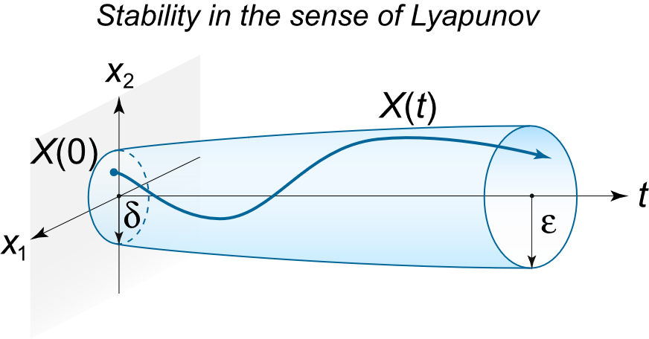
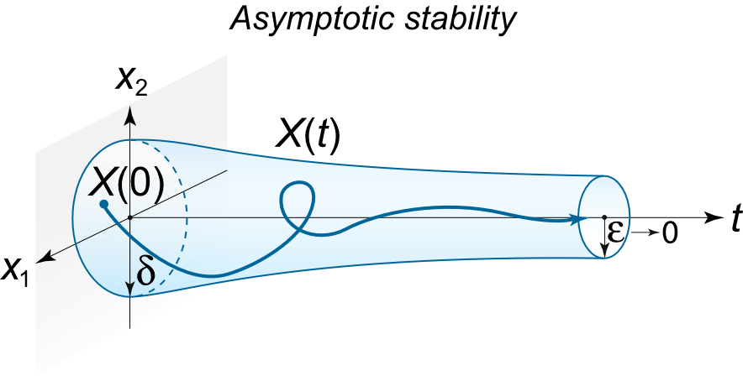
Lyapunov and Stability Theory
Another example

Slide 7
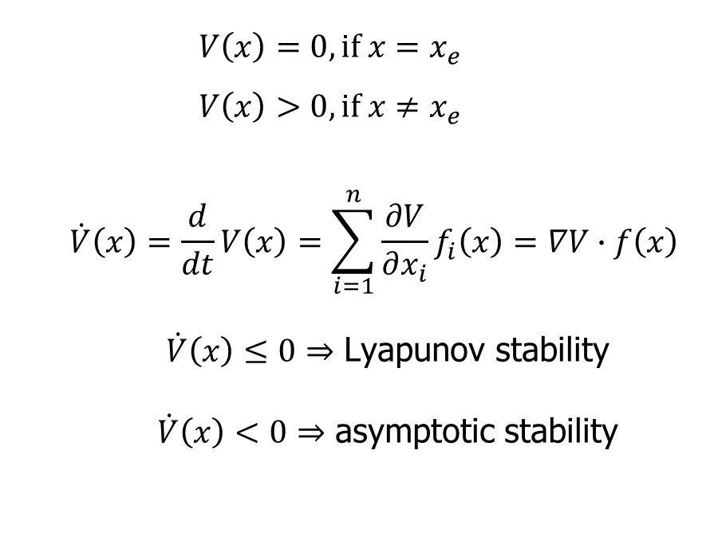
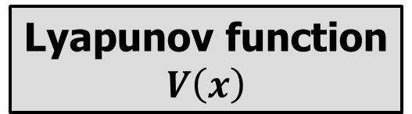
Lyapunov and Stability Theory
Second Method of Lyapunov
a.k.a. the Direct Method
  $$V\left(x\right)=0, if x=x_{e}$$
  $$V\left(x\right)>0, if x≠x_{e}$$
  $$\dot{V}\left(x\right)=\frac{d}{dt}V\left(x\right)=\sum_{i=1}^{n}{\frac{∂V}{∂x_{i}}f_{i}\left(x\right)}=∇V∙f\left(x\right)$$
  $\dot{V}\left(x\right)≤0⇒$ Lyapunov stability
  $\dot{V}\left(x\right)<0⇒$ asymptotic stability
Lyapunov function
$$V\left(x\right)$$
There is no need of explicitly knowing the systems’ functions.
It is extremely suitable for non-linear complex networked systems.
Notes:
The analog to energy in physical systems. The system’s state reaches the attractor when there is no more energy left.
And the Second Method of Lyapunov do not need the actual energy functions of physical systems.
For non-linear systems, the actual functions may be difficult to formulate. Yet a Lyapunov function may be easier to find, relatively.

Slide 8
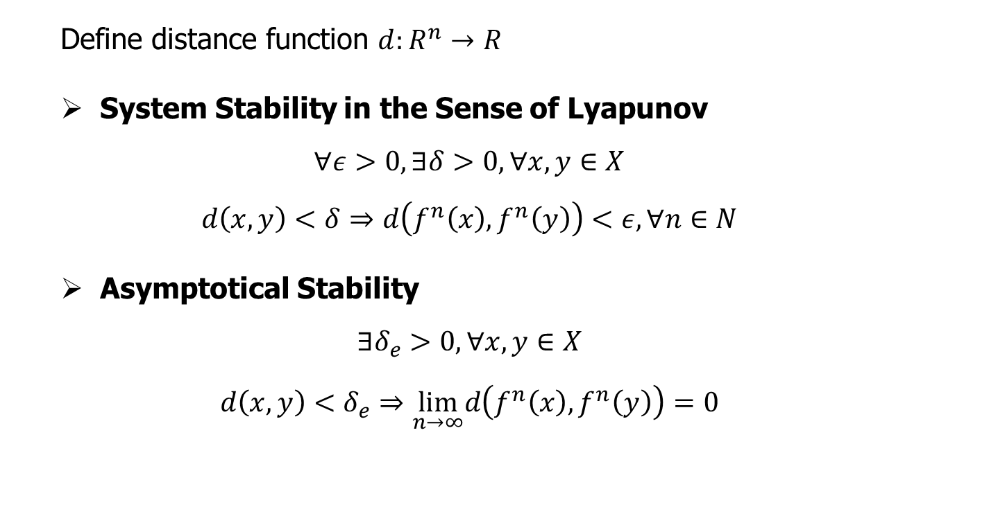
Lyapunov and Stability Theory
Discrete form in time-slotted systems
  Define distance function $d:R^{n}→R$
  System Stability in the Sense of Lyapunov
  $$∀ε>0,∃δ>0,∀x,y∈X$$
  $$d\left(x,y\right)<δ⇒d\left(f^{n}\left(x\right),f^{n}\left(y\right)\right)<ε, ∀n∈N$$
  Asymptotical Stability
  $$∃δ_{e}>0, ∀x,y∈X$$
  $$d\left(x,y\right)<δ_{e}⇒\lim_{n→∞}d\left(f^{n}\left(x\right),f^{n}\left(y\right)\right)=0$$

Slide 9
Outline
1
Lyapunov Stability
2
Lyapunov Optimization
- Static Networks with Fixed States
- Dynamic Networks
- Queue Model
- Queue Stability
- Lyapunov Optimization
- Details
- Performance-Backlog Tradeoff
- Application to Mobile Networks with Unreliable Channels
3
Dynamic Cache Placement, Node Association, and Power Allocation
4
Lyapunov-Based Reinforcement Learning for Network Routing
5
Conclusions

Slide 10
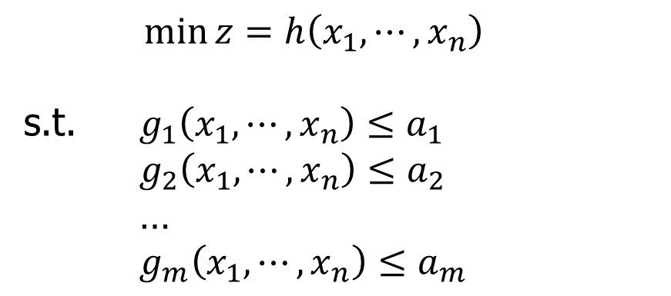
Lyapunov Optimization
Static Networks with Fixed States
General One-Shot Optimization Framework
$\min{z=h\left(x_{1},⋯,x_{n}\right)}$
s.t. $g_{1}\left(x_{1},⋯,x_{n}\right)≤a_{1}$
$g_{2}\left(x_{1},⋯,x_{n}\right)≤a_{2}$
…
$g_{m}\left(x_{1},⋯,x_{n}\right)≤a_{m}$
This optimization framework generally does not consider
the system-level features (e.g., stability of the system).

Slide 11


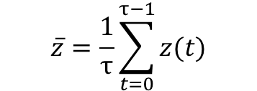
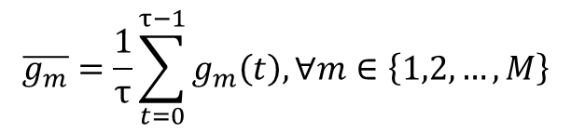
Lyapunov Optimization
Dynamic Networks
Random events, time variation, and uncertainty
  Wireless mesh networks with opportunistic scheduling
  Ad-hoc mobile networks with peer-to-peer communications
  Smart grid architecture with energy distribution
  ……
Focuses on queueing system
Time-average optimization subject to time-average constraints and queue stability
$$\overline{g_{m}}=\frac{1}{τ}\sum_{t=0}^{τ−1}{g_{m}\left(t\right),}∀m∈\left\{1,2,…,M\right\}$$
$$\min{\overline{z}}$$
$\overline{g_{m}}≤0,∀m∈\left\{1,2,…,M\right\}$
$$\overline{z}=\frac{1}{τ}\sum_{t=0}^{τ−1}{z(t)}$$
other constraints within current time slot
queue stability

Slide 12
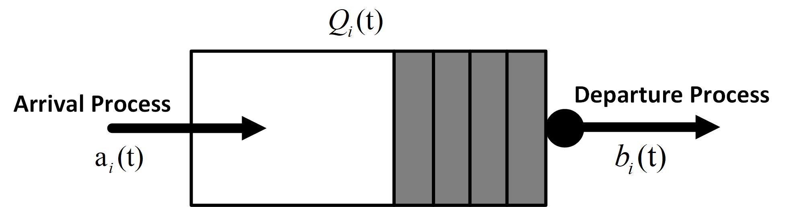
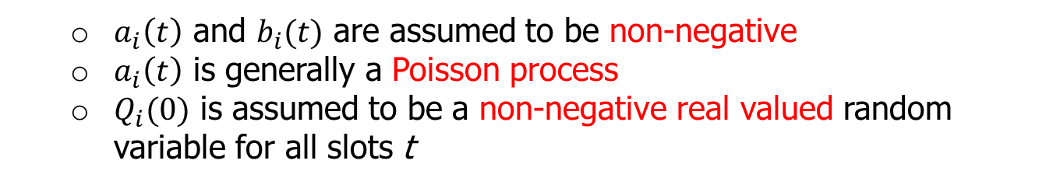
Lyapunov Optimization
Queue Model [1]
Fig.1 Queue Model
Queue Dynamics (Backlog): A single-server discrete-time queueing system
$$Q_{i}(t+1)=max\left\{Q_{i}(t)−b_{i}(t),0\right\}+a_{i}(t),∀t∈\left\{1,2,...\right\}$$
  $a_{i}\left(t\right)$ and $b_{i}(t)$ are assumed to be non-negative
  $a_{i}\left(t\right)$ is generally a Poisson process
  $Q_{i}(0)$ is assumed to be a non-negative real valued random variable for all slots t
[1] M. J. Neely, “Stochastic network optimization with application to communication and queueing systems,” in Synthesis Lectures on Com- munication Networks. San Rafael, CA, USA: Morgan & Claypool, 2010, vol. 3, pp. 1211, 1

Slide 13
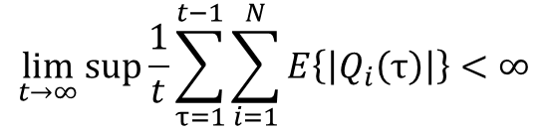


Lyapunov Optimization
Queue Stability
Rate Stable: A queue $Q_{i}\left(t\right)$ is rate stable if
$$\lim_{τ→∞}{\frac{Q_{i}\left(τ\right)}{τ}}=0$$
with probability 1
Mean Rate Stable: A queue $Q_{i}\left(t\right)$ is mean rate stable if
$$\lim_{τ→∞}{\frac{E\left\{\left|Q_{i}\left(τ\right)\right|\right\}}{τ}}=0$$
Strongly Stable: A queue $Q_{i}\left(t\right)$ is strongly stable if
$$\lim_{t→∞}{sup}\frac{1}{t}\sum_{τ=1}^{t−1}{\sum_{i=1}^{N}{E\left\{\left|Q_{i}\left(τ\right)\right|\right\}}}<∞$$
Considers the time average expected backlog

Slide 14
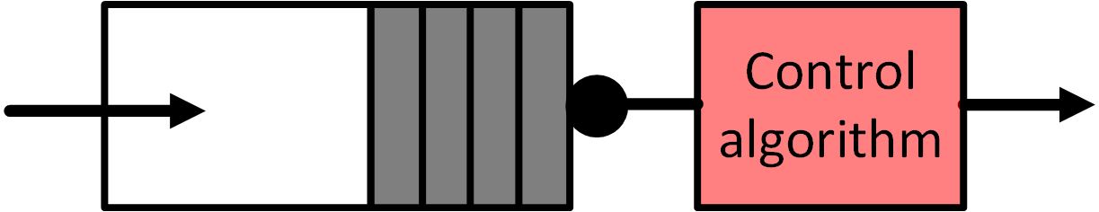
Lyapunov Optimization
Lyapunov Optimization
Sender
Receiver
Fig.2 Design algorithm to control the backlog
Two goals
  Make sure the queue to remain strongly stable
  Minimize the penalty/cost or maximize the reward
Tradeoff
  More departure in queue (good for queue stability) →larger departure rate→larger cost (i.e. more power consumption)
  →increased penalty
  Decrease penalty →smaller cost (less power consumption) →less departure in queue (bad for queue stability)
Find the tradeoff between objective optimization and queue stability

Slide 15

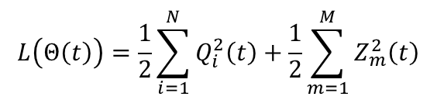




Lyapunov Optimization
Details
$$L\left(Q\left(t\right)\right)=\frac{1}{2}\sum_{i=1}^{N}{Q_{i}^{2}\left(t\right)}$$
Lyapunov Function:
i.i.d.: One-time slot
$$△\left(Q\left(t\right)\right)=E\left(L\left(Q\left(t+1\right)\right)−L\left(Q\left(t\right)\right)|Q\left(t\right)\right)$$
Lyapunov Drift:
Non i.i.d.: T-time slot
$$△\left(Q\left(t\right)\right)=E\left(L\left(Q\left(t+T\right)\right)−L\left(Q\left(t\right)\right)|Q\left(t\right)\right)$$
Tackle the time average constraint $\overline{g_{m}}≤0,∀m∈\left\{1,2,…,M\right\}$ : introducing the virtual queues
$$Z_{m}(t+1)=max\left\{Z_{m}(t),0\right\}+g_{m}(t),∀m∈\left\{1,2,…M\right\}$$
“Virtual” means $Z_{m}(t)$ does not represent a real data backlog
A way to turn the time average inequality constraint into a pure queue stability problem
$$L\left(Θ\left(t\right)\right)=\frac{1}{2}\sum_{i=1}^{N}{Q_{i}^{2}\left(t\right)}+\frac{1}{2}\sum_{m=1}^{M}{Z_{m}^{2}\left(t\right)}$$
Lyapunov Function:
i.i.d.: One-time slot
$$△\left(Θ\left(t\right)\right)=E\left(L\left(Θ\left(t+1\right)\right)−L\left(Θ\left(t\right)\right)|Θ\left(t\right)\right)$$
Lyapunov Drift:
Non i.i.d.: T-time slot
$$△\left(Θ\left(t\right)\right)=E\left(L\left(Θ\left(t+T\right)\right)−L\left(Θ\left(t\right)\right)|Θ\left(t\right)\right)$$
Notes:
The bound D and B are both related to the arrival rate a_i(t) and service rate b_i(t).
Z(T+1) >= Z(t) + g(t)

Slide 16
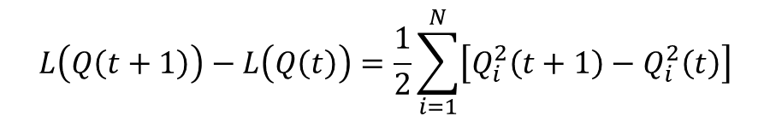
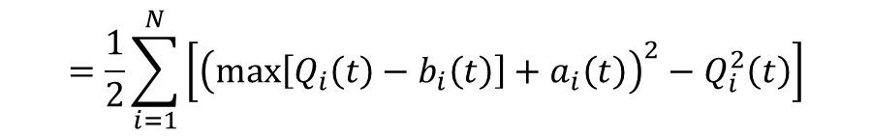
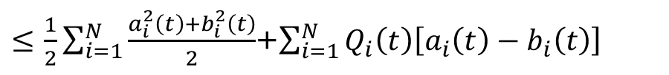
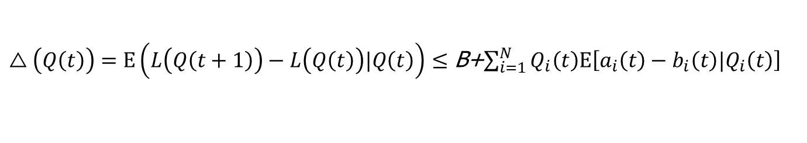
Lyapunov Optimization
Important Inequality (e.g. one time slot drift)
$$L\left(Q\left(t+1\right)\right)−L\left(Q\left(t\right)\right)=\frac{1}{2}\sum_{i=1}^{N}{\left[Q_{i}^{2}\left(t+1\right)−Q_{i}^{2}\left(t\right)\right]}$$
$$=\frac{1}{2}\sum_{i=1}^{N}{\left[{\left(max\left[Q_{i}\left(t\right)−b_{i}\left(t\right)\right]+a_{i}\left(t\right)\right)}^{2}−Q_{i}^{2}\left(t\right)\right]}$$
$≤$ $\frac{1}{2}\sum_{i=1}^{N}{\frac{a_{i}^{2}\left(t\right)+b_{i}^{2}\left(t\right)}{2}}$+$\sum_{i=1}^{N}{Q_{i}\left(t\right)\left[a_{i}\left(t\right)−b_{i}\left(t\right)\right]}$
where we use the fact that
${\left(max\left[Q_{i}\left(t\right)−b_{i}\left(t\right)\right]+a_{i}\left(t\right)\right)}^{2}≤Q_{i}^{2}\left(t\right)$+$a_{i}^{2}\left(t\right)$+$b_{i}^{2}\left(t\right)$+2$Q_{i}\left(t\right)\left[a_{i}\left(t\right)−b_{i}\left(t\right)\right]$
Finally, we have
$△\left(Q\left(t\right)\right)=E\left(L\left(Q\left(t+1\right)\right)−L\left(Q\left(t\right)\right)|Q\left(t\right)\right)$ $≤$ B+$\sum_{i=1}^{N}{Q_{i}\left(t\right)E\left[a_{i}\left(t\right)−b_{i}\left(t\right)|Q_{i}\left(t\right)\right]}$
Notes:
B(t)=1/2*Sum{[a(t)-b(t)]^2}

Slide 17

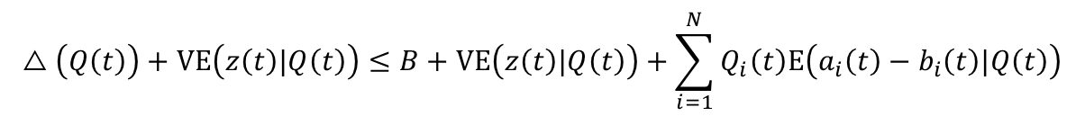
Lyapunov Optimization
Connection Between Objective and Queue
Drift plus penalty (minus reward) function:
$$△\left(Q\left(t\right)\right)+VE\left(z\left(t\right)|Q\left(t\right)\right)$$
V: 1. non-negative control parameter
2. larger V leads to more emphasis on penalty minimization
Optimize the drift plus penalty (minus reward) function:
$$△\left(Q\left(t\right)\right)+VE\left(z\left(t\right)|Q\left(t\right)\right)≤B+VE\left(z\left(t\right)|Q\left(t\right)\right)+\sum_{i=1}^{N}{Q_{i}\left(t\right)E\left(a_{i}\left(t\right)−b_{i}\left(t\right)|Q\left(t\right)\right)}$$
Obtain the control decision by minimizing the right-hand-side of the inequality at every time slot t

Slide 18
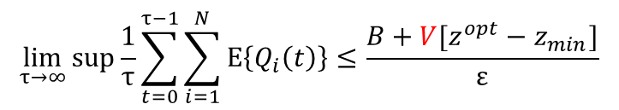
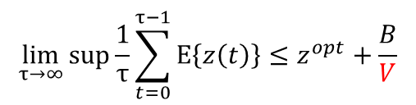
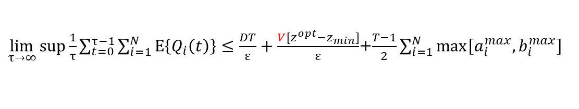

Lyapunov Optimization
Performance-backlog Tradeoff
The time-average queue length yields:
$$\lim_{τ→∞}{sup\frac{1}{τ}\sum_{t=0}^{τ−1}{\sum_{i=1}^{N}{E\left\{Q_{i}\left(t\right)\right\}}}}≤\frac{B+V[z^{opt}−z_{min}]}{ε}$$
i.i.d.
Non i.i.d.
$\lim_{τ→∞}{sup\frac{1}{τ}\sum_{t=0}^{τ−1}{\sum_{i=1}^{N}{E\left\{Q_{i}\left(t\right)\right\}}}}≤\frac{DT}{ε}+\frac{V[z^{opt}−z_{min}]}{ε}$+$\frac{T−1}{2}\sum_{i=1}^{N}{max\left[a_{i}^{max},b_{i}^{max}\right]}$
Minimum penalty bound:
$$\lim_{τ→∞}{sup\frac{1}{τ}\sum_{t=0}^{τ−1}{E\left\{z\left(t\right)\right\}}}≤z^{opt}+\frac{B}{V}$$
i.i.d.
[O(V),O(1/V)] tradeoff
$$\lim_{τ→∞}{sup\frac{1}{τ}\sum_{t=0}^{τ−1}{E\left\{z\left(t\right)\right\}}}≤z^{opt}+\frac{D}{V}$$
Non i.i.d.
Tuning V to be sufficiently large so that the minimum penalty can be achieved (+)
Time average queue backlog bound increase linearly with V. (-)
Notes:
independent and identically distributed random event process

Slide 19
Application to Mobile Networks with
Unreliable Channels
= Stationary Node
= Locally Mobile Node
= Fully Mobile Node
= Sink

Slide 20
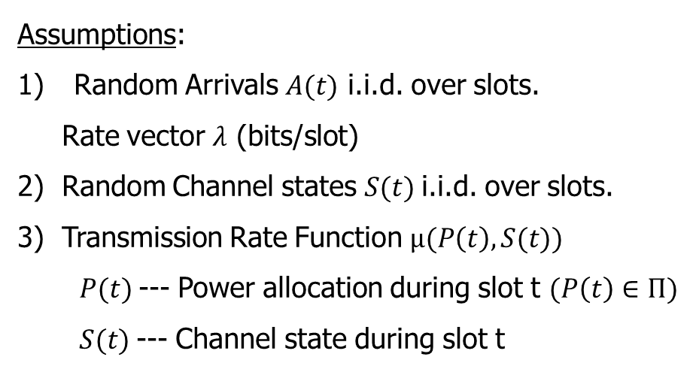

Application to Mobile Networks with
Unreliable Channels
Time slotted system ($t∈\{0, 1 , 2, …\}$)
t
0 1 2 3 …
Assumptions:
Random Arrivals $A(t)$ i.i.d. over slots.
Rate vector $λ$ (bits/slot)
2) Random Channel states $S(t)$i.i.d. over slots.
3) Transmission Rate Function $μ(P\left(t\right),S(t))$
$P(t)$--- Power allocation during slot t $(P\left(t\right)∈Π)$
$S(t)$--- Channel state during slot t
λ₁
λ₂
λ_{N}
Good
rate μ_{i}
Med
Bad
power P

Slide 21
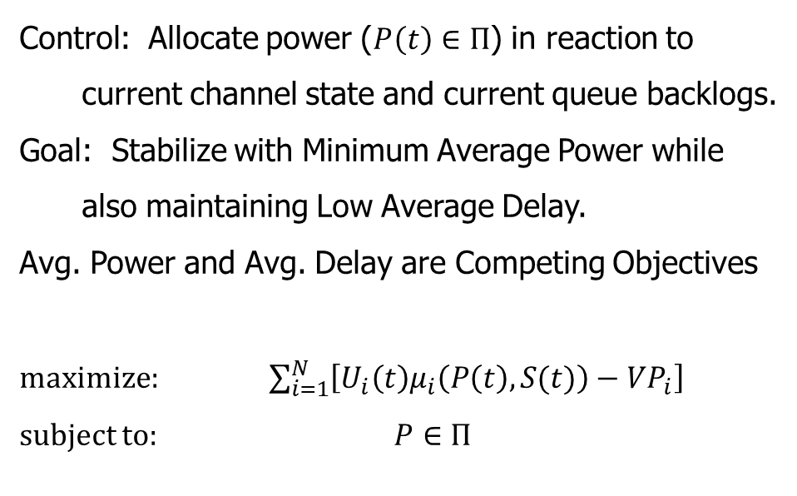
Application to Mobile Networks with
Unreliable Channels
Time slotted system ($t∈\{0, 1 , 2, …\}$)
t
0 1 2 3 …
Control: Allocate power ($P\left(t\right)∈Π$) in reaction to current channel state and current queue backlogs.
Goal: Stabilize with Minimum Average Power while also maintaining Low Average Delay.
Avg. Power and Avg. Delay are Competing Objectives
maximize: $\sum_{i=1}^{N}{\left[U_{i}\left(t\right)μ_{i}\left(P\left(t\right),S(t)\right)−VP_{i}\right]}$
subject to: $P∈Π$
λ₁
λ₂
λ_{N}
Good
rate μ_{i}
Med
Bad
power P

Slide 22
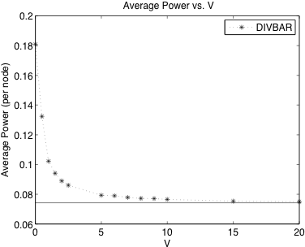
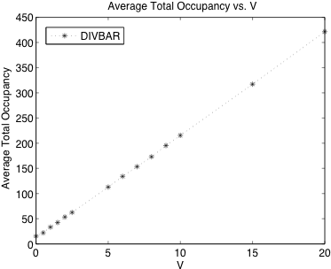
Application to Mobile Networks with
Unreliable Channels
Average Power Versus Delay
[Neely, Urgaonkar 2006, 2009]
Avg. Power
Avg. Delay
Performance-Delay Tradeoff: [O(1/V), O(V)]

Slide 23
Outline
1
Lyapunov Stability
2
Lyapunov Optimization
3
Dynamic Cache Placement, Node Association, and Power Allocation
- Contributions
- System Model
- Optimization Problem Formulation
- Lyapunov Optimization Framework
- Simulation Results
4
Lyapunov-Based Reinforcement Learning for Network Routing
5
Conclusions

Slide 24
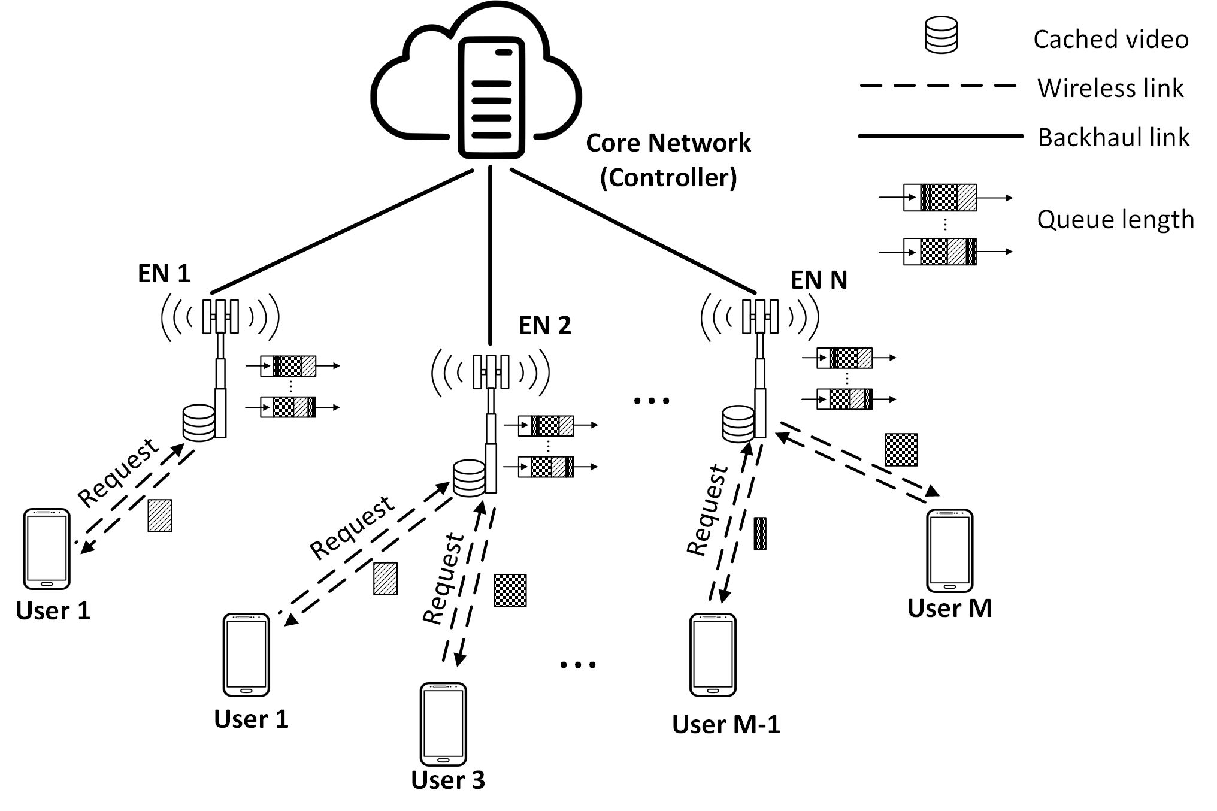
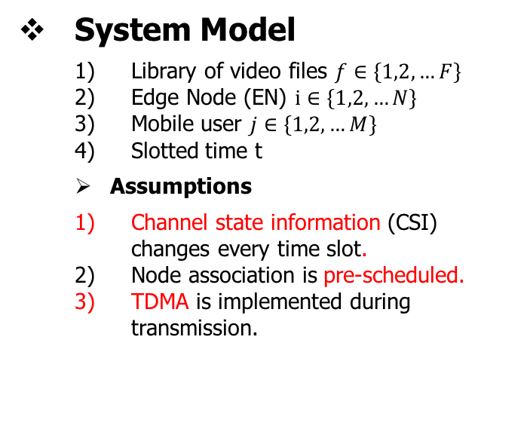
Dynamic cache placement, node association, and power allocation
Contributions [2]
Try to investigate the cache placement, node association, and resource allocation in the time slotted system.
Model the dynamic content popularity evolution.
Utilize Lyapunov optimization framework to connect utility maximization and queue stability.
Use greedy method and Generalized Benders decomposition to solve the proposed problem (online MINLP) at every time slot.
System Model
  Library of video files $f∈\left\{1,2,…F\right\}$
  Edge Node (EN) $i∈\left\{1,2,…N\right\}$
  Mobile user $j∈\left\{1,2,…M\right\}$
  Slotted time t
  Assumptions
  Channel state information (CSI) changes every time slot.
  Node association is pre-scheduled.
  TDMA is implemented during transmission.
Fig.3 Edge Caching in Fog-aided wireless Networks
[2] Ruoguang Li, Li Wang, Yanmin Gong, Mei Song, Miao Pan, and Zhu Han," Dynamic cache placement, Node association, and power allocation in fog aided networks," accepted, 2019 Global Communications Conference (Globecom), Waikoloa, HI, USA.

Slide 25
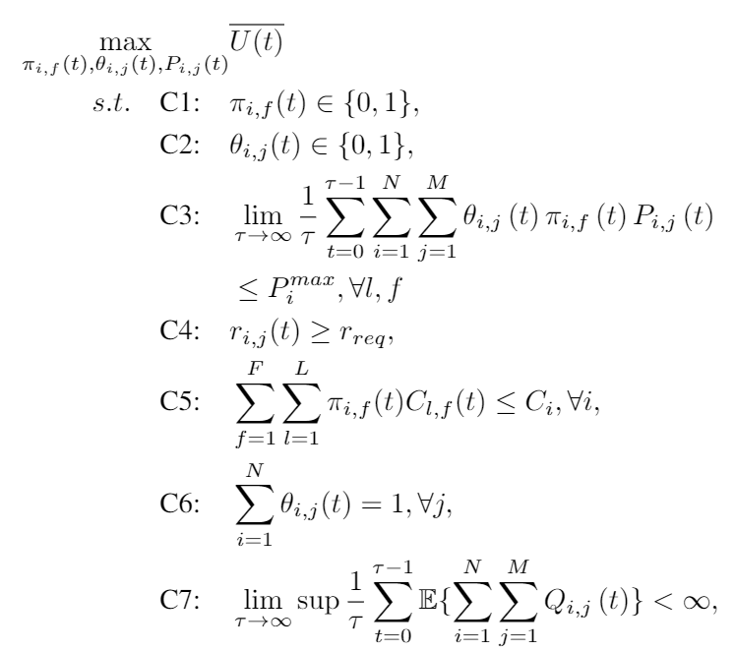
Dynamic cache placement, node association, and power allocation
Optimization Problem Formulation
Utility function
Caching decision
User-fog association decision
Average power consumption constraint
Storage capacity constraint

Slide 26
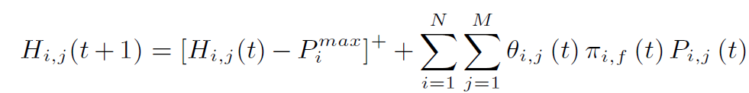
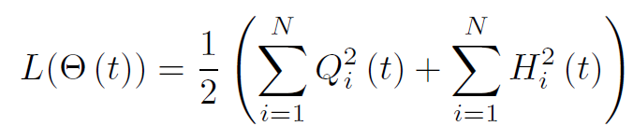


Dynamic cache placement, node association, and power allocation
Lyapunov Optimization
Step 1: construct a virtual queue, to eliminate the time-average constraint
Step 2: define Lyapunov function
Step 3: define T-slot Lyapunov drift
Step 4: define drift-minus-reward

Slide 27
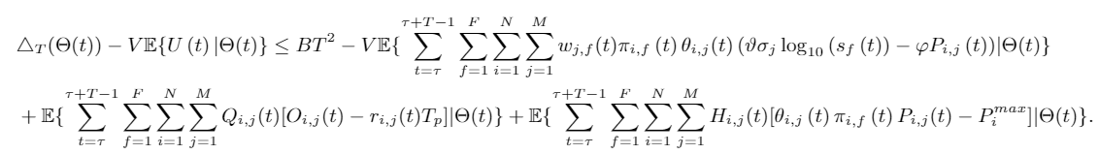
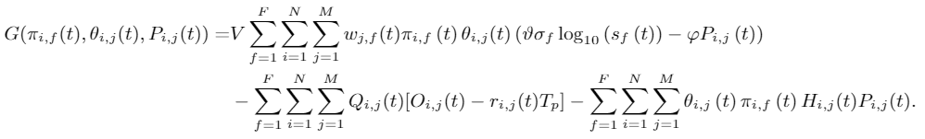
Dynamic cache placement, node association, and power allocation
Lyapunov Optimization
We have the inequality
Solving the right-hand-side, we define the new objective function
Greedy + Generalized Benders decomposition

Slide 28
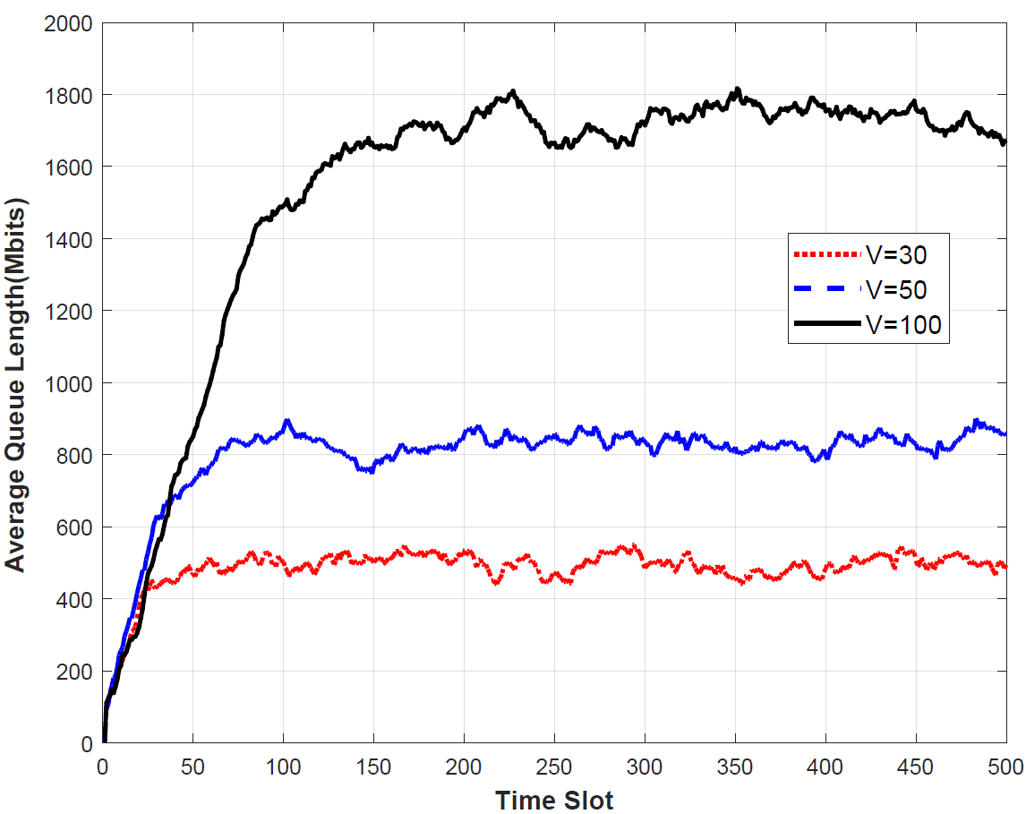
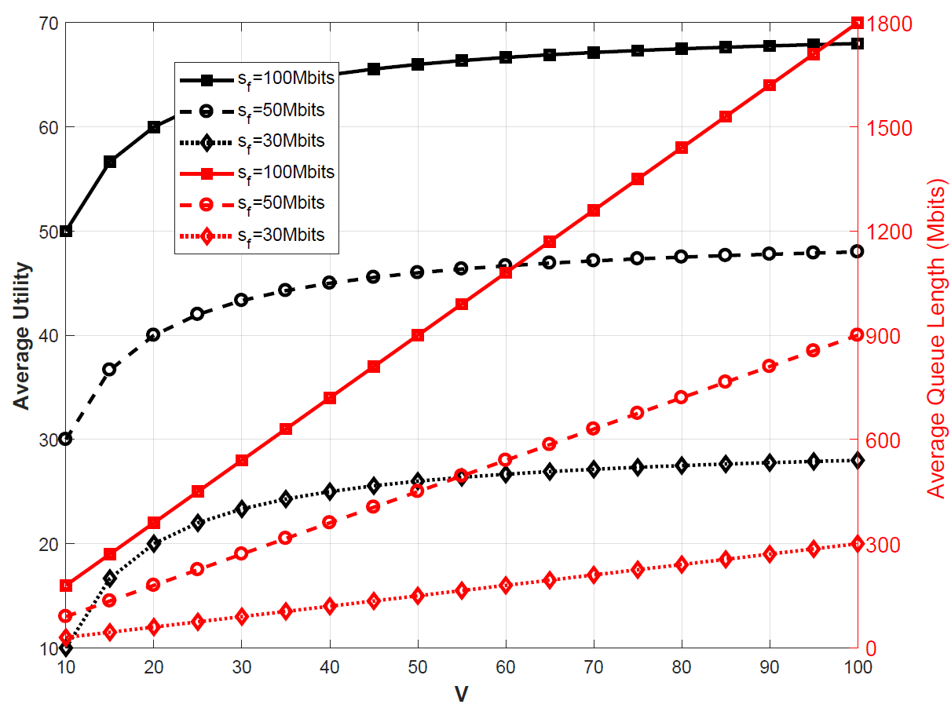
Dynamic cache placement, node association, and power allocation
Simulation Results
Average queue length becomes stable over a period of time and oscillates around a certain value;
Larger V leads to lager utility, as well as larger average queue length.

Slide 29
Outline
1
Lyapunov Stability
2
Lyapunov Optimization
3
Dynamic Cache Placement, Node Association, and Power Allocation
4
Lyapunov-Based Reinforcement Learning for Network Routing
- Challenges for Communication Networks Today
- State of the Art
- System Model
- Queuing Dynamics
- Lyapunov Drift
- Lyapunov-Based Reinforcement Learning
- Simulation Results
5
Conclusions

Slide 30
Lyapunov-Based Reinforcement Learning for Network Routing
Challenges for communication networks today
Multimedia streaming services generate large volume of delay-sensitive network traffic.
Emerging IoT services generate massive sensory and time-series data.
The network traffic burst as social event happens, exceeding the capacity on critical links.
The network operators face increasing cost on expanding the network’s capacity as we enters the Post-Moore Era.
We need to find out how to route the network traffic more optimally
Notes:
The death of Michael Jackson brought down the Internet, which is ten years ago when smartphones has limited functionality and the user generated traffic is relatively low compared with what it is today.
As the cost becomes higher, network operators cannot just simply add capacity to critical links. Optimization is needed.

Slide 31
Lyapunov-Based Reinforcement Learning for Network Routing
State of the Art
Stochastic network optimization, usually based on the Lyapunov’s methods, can be used to enforcing the networked system’s stability.
  Yet these methods maximizing the system’s stability and minimizing the penalty in the sense of t-time-slot time-average.
Reinforcement learning based methods are used to provide adaptive network control, maximizing the system’s rewards (minimizing the penalty),
  yet without mathematically proven stability guarantees.

Slide 32
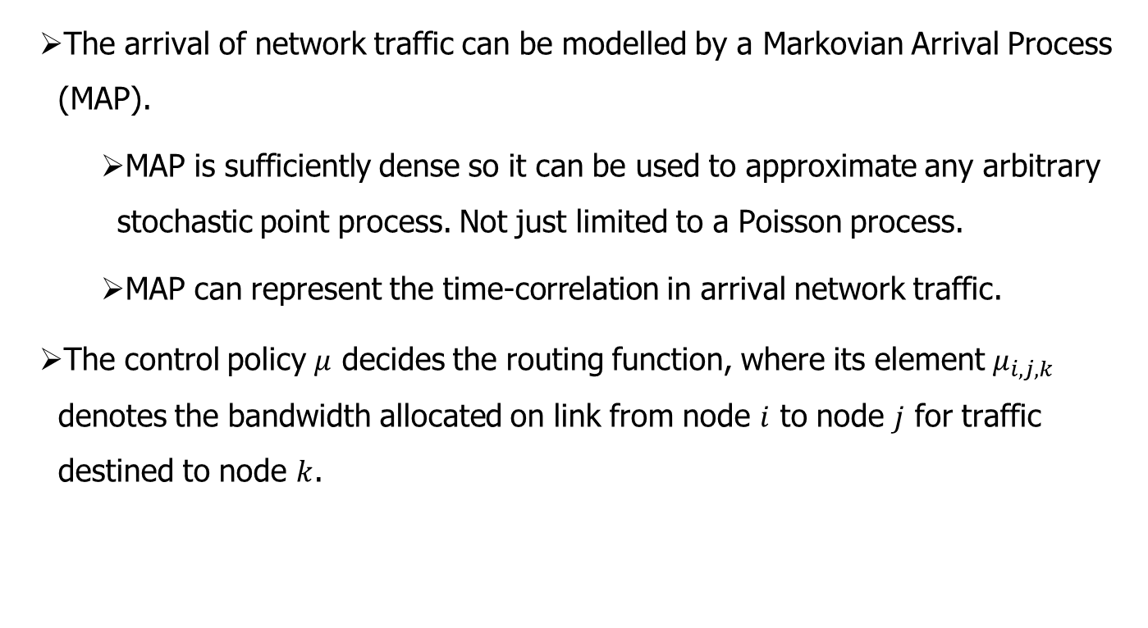
Lyapunov-Based Reinforcement Learning for Network Routing
System Model
The arrival of network traffic can be modelled by a Markovian Arrival Process (MAP).
  MAP is sufficiently dense so it can be used to approximate any arbitrary stochastic point process. Not just limited to a Poisson process.
  MAP can represent the time-correlation in arrival network traffic.
The control policy $μ$ decides the routing function, where its element $μ_{i,j,k}$ denotes the bandwidth allocated on link from node $i$ to node $j$ for traffic destined to node $k$.

Slide 33

Lyapunov-Based Reinforcement Learning for Network Routing
Queuing Dynamics
$$μ_{i,j}^{A}\left(t\right)=\sum_{a∈V}{μ_{a,i,j}\left(t\right)}$$
$$μ_{i,j}^{D}\left(t\right)=\sum_{b∈V}{μ_{i,b,j}\left(t\right)}$$
Queuing dynamics
$$Y_{i,j}\left(t+1\right)=Y_{i,j}\left(t\right)+I_{i,j}\left(t\right)+μ_{i,j}^{A}\left(t\right)−μ_{i,j}^{D}\left(t\right)$$
Departure by forwarding
Queue backlog size
Markovian arrival
Arrival by forwarding

Slide 34
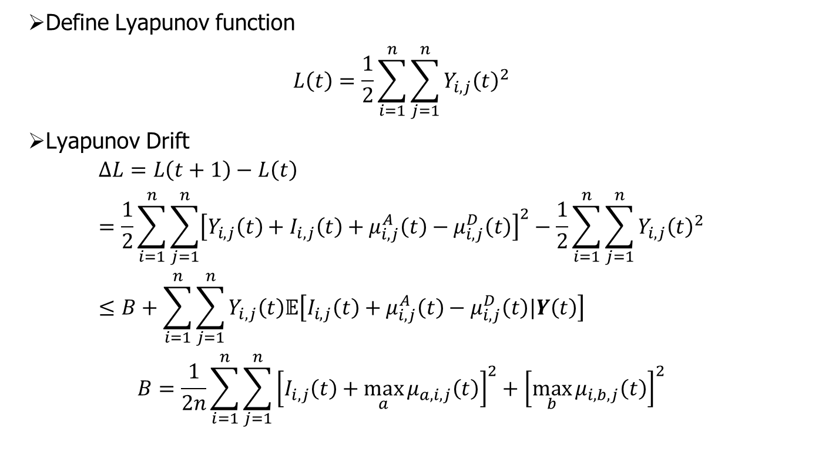
Lyapunov-Based Reinforcement Learning for Network Routing
Lyapunov Drift
Define Lyapunov function
$$L\left(t\right)=\frac{1}{2}\sum_{i=1}^{n}{\sum_{j=1}^{n}{{Y_{i,j}\left(t\right)}^{2}}}$$
Lyapunov Drift
$$∆L=L\left(t+1\right)−L\left(t\right)=\frac{1}{2}\sum_{i=1}^{n}{\sum_{j=1}^{n}{{\left[Y_{i,j}\left(t\right)+I_{i,j}\left(t\right)+μ_{i,j}^{A}\left(t\right)−μ_{i,j}^{D}\left(t\right)\right]}^{2}}}−\frac{1}{2}\sum_{i=1}^{n}{\sum_{j=1}^{n}{{Y_{i,j}\left(t\right)}^{2}}}≤B+\sum_{i=1}^{n}{\sum_{j=1}^{n}{Y_{i,j}\left(t\right)𝔼\left[I_{i,j}\left(t\right)+μ_{i,j}^{A}\left(t\right)−μ_{i,j}^{D}\left(t\right)|Y\left(t\right)\right]}}$$
$$B=\frac{1}{2n}\sum_{i=1}^{n}{\sum_{j=1}^{n}{{\left[I_{i,j}\left(t\right)+\max_{a}{μ_{a,i,j}\left(t\right)}\right]}^{2}+{\left[\max_{b}{μ_{i,b,j}\left(t\right)}\right]}^{2}}}$$

Slide 35
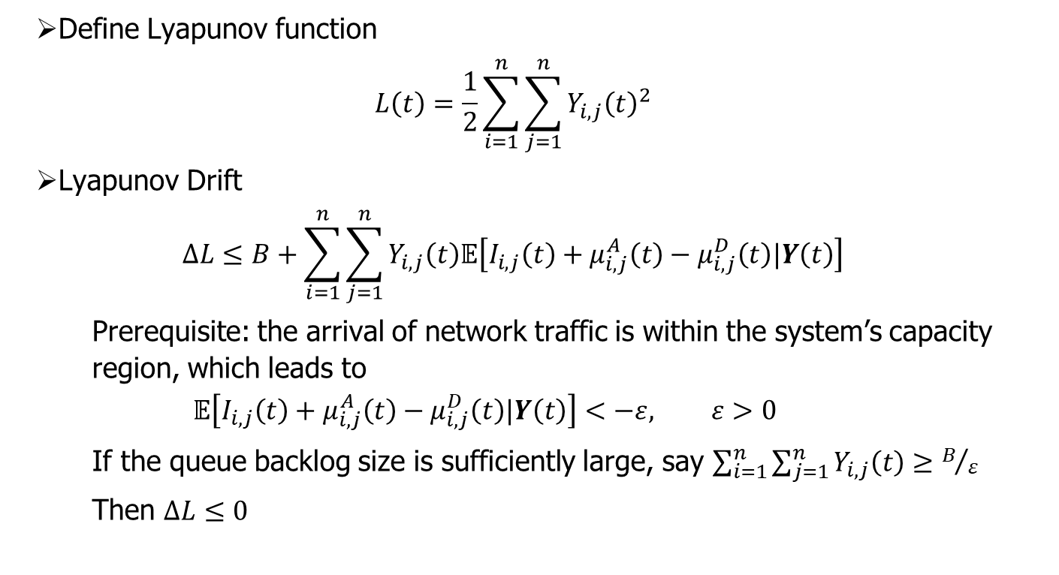
Lyapunov-Based Reinforcement Learning for Network Routing
Lyapunov Drift
Define Lyapunov function
$$L\left(t\right)=\frac{1}{2}\sum_{i=1}^{n}{\sum_{j=1}^{n}{{Y_{i,j}\left(t\right)}^{2}}}$$
Lyapunov Drift
$$∆L≤B+\sum_{i=1}^{n}{\sum_{j=1}^{n}{Y_{i,j}\left(t\right)𝔼\left[I_{i,j}\left(t\right)+μ_{i,j}^{A}\left(t\right)−μ_{i,j}^{D}\left(t\right)|Y\left(t\right)\right]}}$$
  Prerequisite: the arrival of network traffic is within the system’s capacity region, which leads to
  $$𝔼\left[I_{i,j}\left(t\right)+μ_{i,j}^{A}\left(t\right)−μ_{i,j}^{D}\left(t\right)|Y\left(t\right)\right]<−ε, ε>0$$
  If the queue backlog size is sufficiently large, say $\sum_{i=1}^{n}{\sum_{j=1}^{n}{Y_{i,j}\left(t\right)}}≥B/ε$
  Then $∆L≤0$
It is possible to design a control policy to make the queue backlog size stable

Slide 36

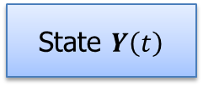
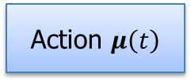
Lyapunov-Based Reinforcement Learning for Network Routing
Lyapunov-Based Reinforcement Learning
Optimization objective
  Minimizing the Lyapunov Drift to achieve better stability
  Minimizing the end-to-end latency of network traffic
  Drift plus penalty
  $$f=∆L+V∙P$$
Deep Reinforcement Learning
Environment
State $Y\left(t\right)$
Rewards
Action $μ\left(t\right)$
Lyapunov Optimization

Slide 37
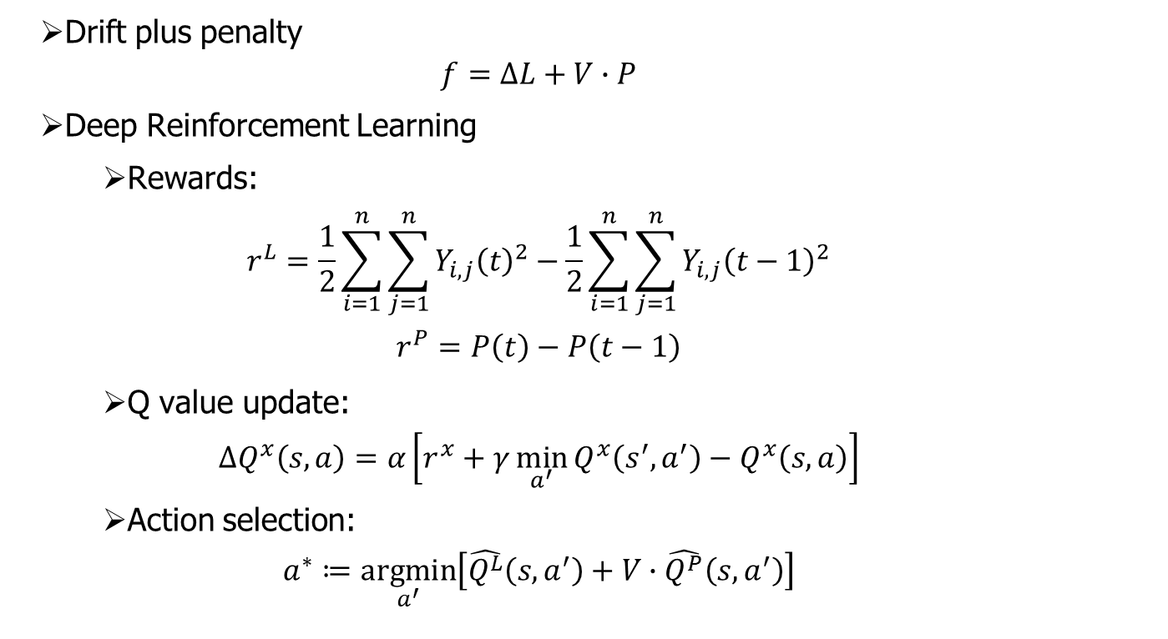
Lyapunov-Based Reinforcement Learning for Network Routing
Lyapunov-Based Reinforcement Learning
Drift plus penalty
  $$f=∆L+V∙P$$
Deep Reinforcement Learning
  Rewards:
  $$r^{L}=\frac{1}{2}\sum_{i=1}^{n}{\sum_{j=1}^{n}{{Y_{i,j}\left(t\right)}^{2}}}−\frac{1}{2}\sum_{i=1}^{n}{\sum_{j=1}^{n}{{Y_{i,j}\left(t−1\right)}^{2}}}$$
  $$r^{P}=P\left(t\right)−P\left(t−1\right)$$
  Q value update:
  $$ΔQ^{x}\left(s,a\right)=α\left[r^{x}+γ\min_{a^{′}}{Q^{x}\left(s^{′},a^{′}\right)}−Q^{x}\left(s,a\right)\right]$$
  Action selection:
  $$a^{∗}≔\underset{a^{′}}{argmin}\left[\hat{Q^{L}}\left(s,a^{′}\right)+V∙\hat{Q^{P}}\left(s,a^{′}\right)\right]$$

Slide 38
Experiment Setup
Link bandwidth 100 Mbps
Imbalance propagation delay
The propagation delay will shift from -10% to 10% every 4 seconds.
The traffic is generated using an ON-OFF model with probability p.
The mean value of traffic volume is from a set of uniformly generated traffic matrix.
The transition between the states follows a fixed state transition matrix.
10 ms
10 ms
10 ms
10 ms
10 ms
10 ms
10 ms
100 ms
10 ms

Slide 39
Lyapunov-Based Reinforcement Learning for Network Routing
Simulation Results
The proposed method achieves better stability compared with basic Lyapunov optimization method without reinforcement learning
The lower value of p is, the higher burstiness there will be in the system.
Notes:
The upper figure shows the proposed methods is better than the original backpressure routing which uses basic Lyapunov optimization without reinforcement learning part.

Slide 40
Lyapunov-Based Reinforcement Learning for Network Routing
Simulation Results
Also shows a tradeoff between queue stability and penalty minimization.
A larger V leads to smaller end-to-end latency, while the queue backlog size becomes larger as well.
Notes:
The performance is saturated after V being greater than 10.

Slide 41
Conclusions
Conclusions
  Content popularity evolves over time, how to design caching strategy under this scenario?
  New method to predict the content popularity, deep learning way, Monte Carlo Markov Chain…
  The true story behind Lyapunov optimization, the theoretical analyses of queue length bound, the choice of control parameter, etc.
  New solutions to handle the coupling of integer variables, e.g. McCormick envelope, big-M method, etc.
  Using Lyapunov-based reinforcement learning to solve problems where there are sophisticated pattern and time-correlation in the arrival process.

Slide 42
Conclusions
References
J. Wu, Y. Zhou, D. M. Chiu and Z. Zhu, “Modeling Dynamics of Online Video Popularity,” IEEE Transactions on Multimedia , vol. 18, no. 9, pp. 1882-1895, Sept. 2016.
M. J. Neely, “Stochastic network optimization with application to communication and queueing systems,” in Synthesis Lectures on Communication Networks. San Rafael, CA, USA: Morgan & Claypool, 2010, vol. 3, pp. 1211, 1.
J. Ji, K. Zhu, R. Wang, B. Chen, and C. Dai, “Energy Efficient Caching in Backhaul-Aware Cellular Networks with Dynamic Content Popularity,” Wireless Communications and Mobile Computing, 2018.
X. Xu, J. Liu and X. Tao, "Mobile Edge Computing Enhanced Adaptive Bitrate Video Delivery With Joint Cache and Radio Resource Allocation," in IEEE Access, vol. 5, pp. 16406-16415, 2017.
Y. Guo, Q. Yang, J. Liu and K. S. Kwak, "Quality-Aware Streaming in Heterogeneous Wireless Networks," in IEEE Transactions on Wireless Communications, vol. 16, no. 12, pp. 8162-8174, Dec. 2017.

Slide 43
Thank you!

Slide 44


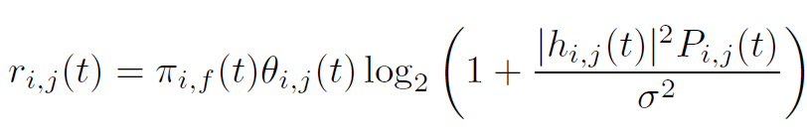
Case Study
Caching Model and Transmission Model
Transmission rate from EN i to user j
$$π_{i,f}(t)=\left\{\begin{aligned}1, if EN i caches video f \\ 0, otherwise\end{aligned}\right.$$
$$θ_{i,j}(t)=\left\{\begin{aligned}1, if EN i is associated with user j \\ 0, otherwise\end{aligned}\right.$$
The probability of user$j$ requesting video $f$ [6]
Transmission rate from EN i to user j
[6] X. Xu, J. Liu and X. Tao, "Mobile Edge Computing Enhanced Adaptive Bitrate Video Delivery With Joint Cache and Radio Resource Allocation," in IEEE Access, vol. 5, pp. 16406-16415, 2017.

Slide 45


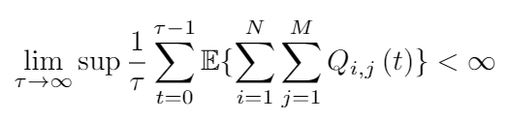
Case Study
Queue Length of Service Process
For EN i, the arrival of content delivering request from user j is
Backlog evolution
For any average requested content data rate inside the capacity region, all queues must be stable, i.e.,
Notes:
Add this one and last one between page 1 and page 3

Slide 46
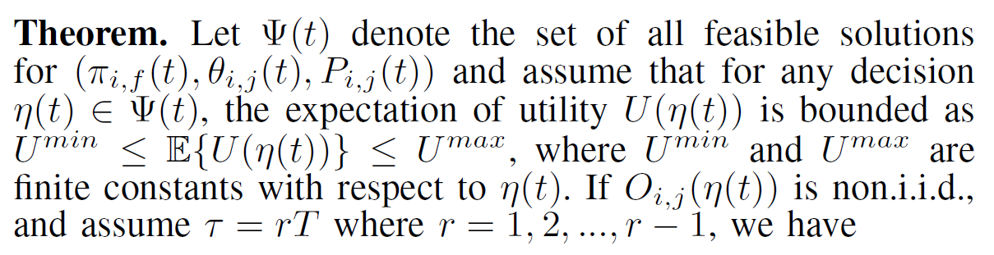



Case Study
Boundness
[O(V),O(1/V)] tradeoff
Notes:
Add this page before the simulation results

