Slide 1


Mean Field Game Tutorial
Zhu Han, John and Rebecca Moores Professor
Electrical and Computer Engineering Department
Computer Science Department,
University of Houston
Thanks for MURI funding and Reginald Banez

Slide 2
Overview
Introduction
Mean Field Game Framework
Analytic Methods
Probabilistic Method
Applications
Conclusion
Notes:
Introduction - contains the main difference between classical game theory and mean field game. It also presents the general mathematical framework of a stochastic differential game (a classic game theory method) and a mean field game.
Mean field game framework - discusses the MFG framework in more detail
Analytic methods - refer to methods used to prove existence and uniqueness of solutions to MFG.
Probabilistic method - uses probabilistic framework instead to analyze MFGs. It can also be used for MFTGs.

Slide 3
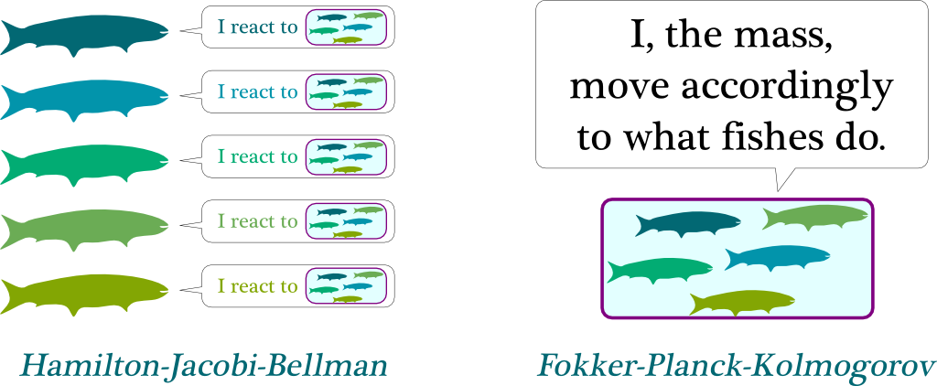
Classical Game Theory vs Mean Field Game
Classical game theory – models the interaction of a single player with each of the other players
  a fish reacts to what other nearby fishes do
Mean field game – models the interaction of a single (reference) player with the collective effect of the other players
  a fish reacts only to the mass of fish nearby
Notes:
MFG – considers a game of a single representative/reference player against the aggregate of the other players in the game

Slide 4
Mean Field Games
Mean field games (MFGs) study the existence of Nash equilibria in games involving a large number of asymptotically negligible players modeled by controlled stochastic dynamical systems.
MFGs refer to methods and techniques that study differential games with large population of indistinguishable, rational, and heterogeneous agents
  Indistinguishable – players share common structures of the model
  Rationality – players act optimally (maximize utility / minimize cost)
  Heterogeneity – players can have heterogeneous states
MFGs reduce to a standard control problem and an equilibrium.
Notes:
Negligible players - have no negligible effect on the mean field

Slide 5
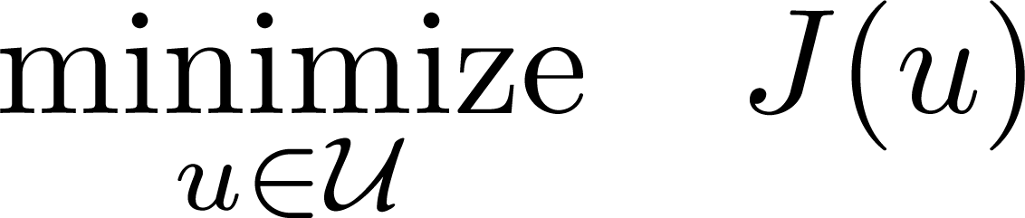
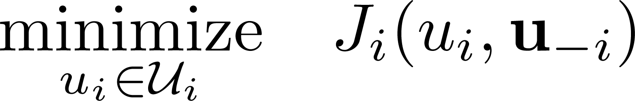
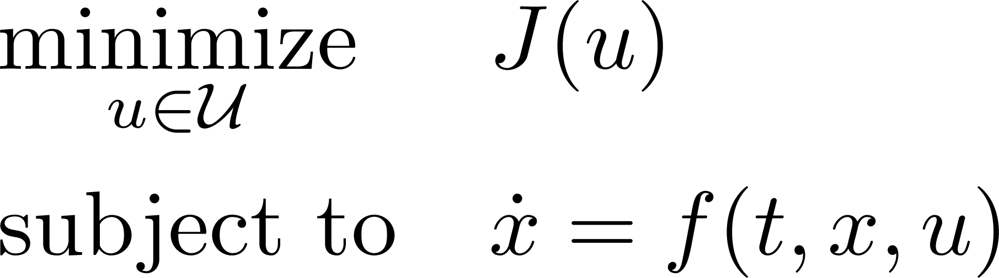
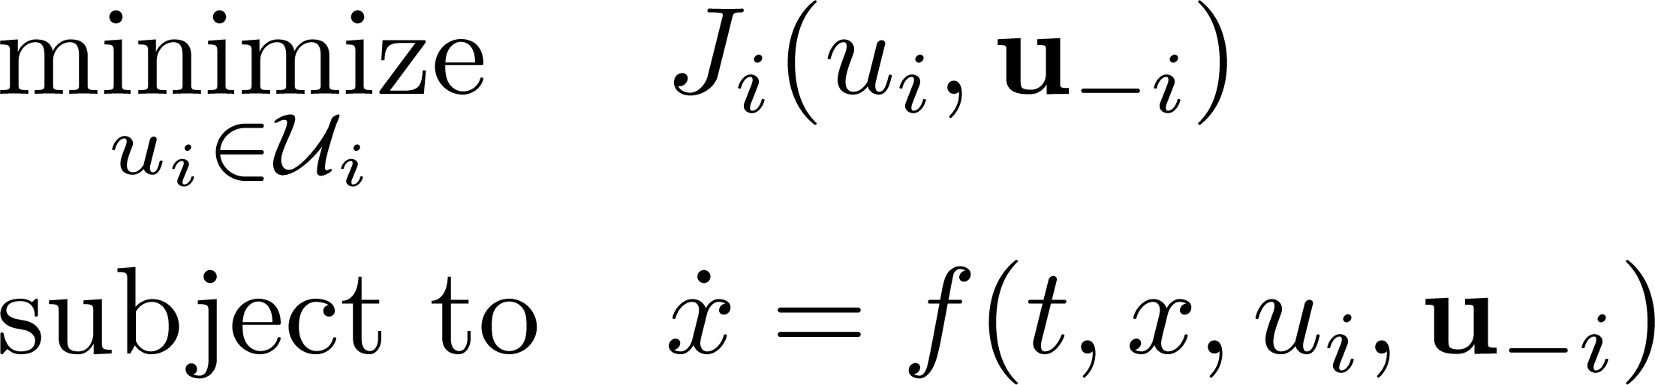
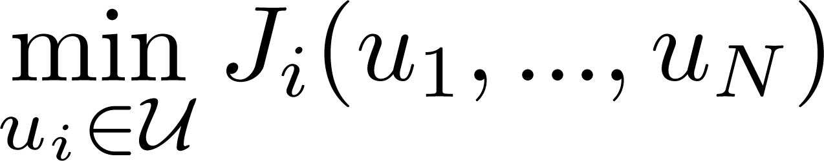
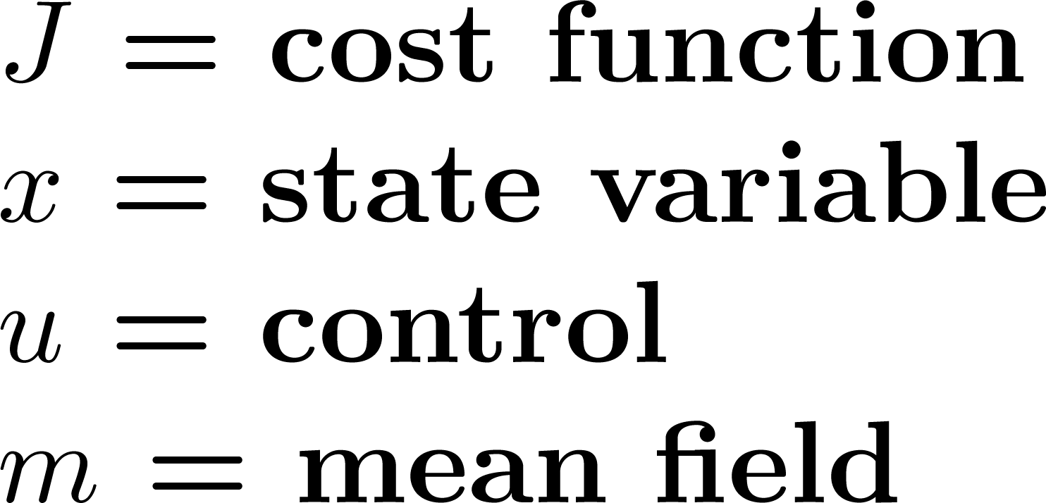
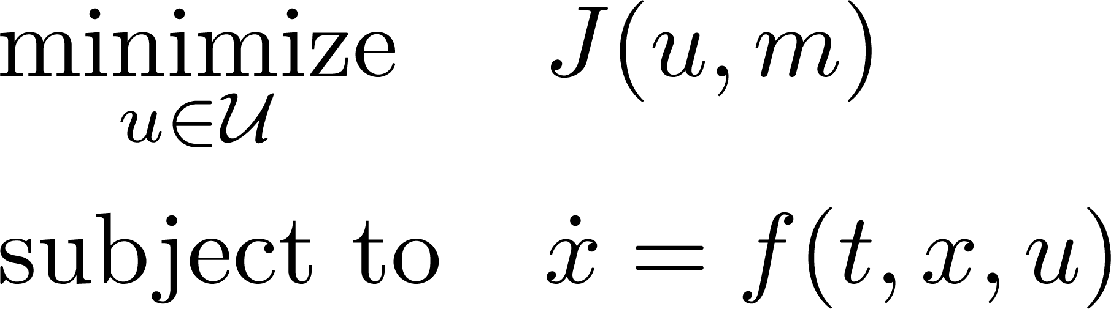
Mean Field Game as an
Optimal Control Problem
Optimization Problem
Game Theory
Optimal Control Problem
Differential Game
Mean Field Game
Notes:
Optimization problem - one player
Game theory - many players which may have conflicting objectives
Optimal control problem - optimization problem with differential equation constraint
Differential game - game theory problem with differential equation constraint
Mean field game - reduces a differential game among many players into an optimal control problem of
one player against the others

Slide 6


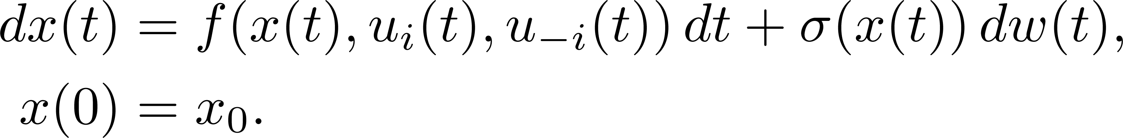
Classical Game Theory:
Stochastic Differential Games
SDGs are classical games with a stochastic differential equation constraint.
In a SDG with players, each player tries to solve the problem
subject to
running cost
terminal cost
drift term
diffusion term
Brownian Motion
Notes:
SDG - the constraint is a stochastic differential equation

Slide 7
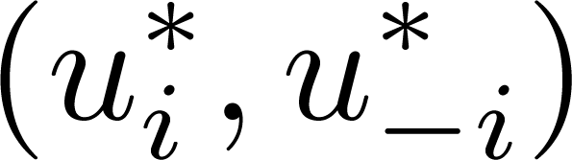
Stochastic Differential Games
A Nash equilibrium is a solution to an SDG such that
However, SDGs for large population of players are non-tractable.
Hence, Lasry and Lions proposed mean field game as a methodology that approximates Nash equilibriums for SDGs among large number of players with symmetric interactions.

Slide 8
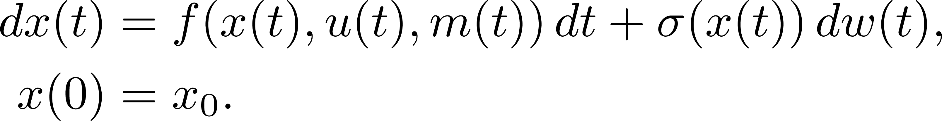
Mean Field Games
In MFG, a player chooses its optimal strategy given the available global information that results from the actions of all players.
A reference player solves the following optimal control problem:
subject to
cost function
running cost
terminal cost
state dynamics
drift term
diffusion term
Brownian Motion
Notes:
MFG does not need full knowledge of the states and strategies of the players. (Cost function and state dynamics are discussed in next section)

Slide 9
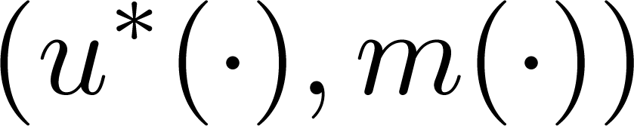
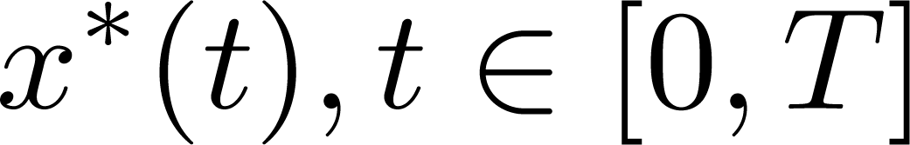
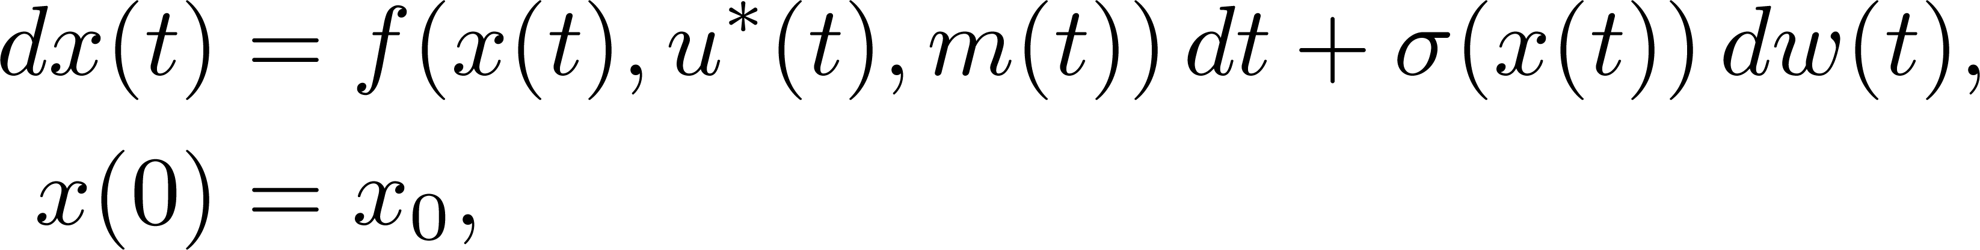
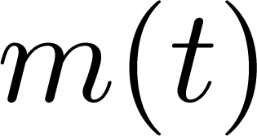
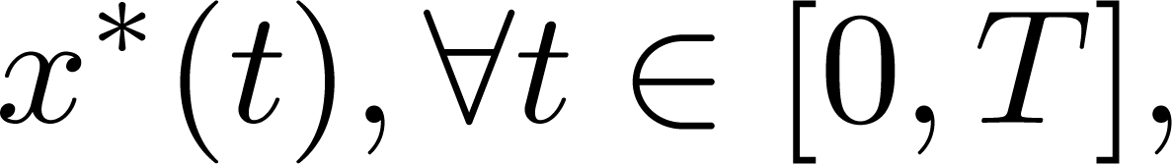
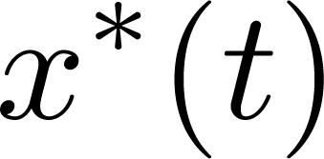
Mean Field Games
Hence, the goal of a reference player is to find a pair such that if is a solution of
then is the probability distribution of and
This condition describes a Nash equilibrium where represents a reference player in a differential game.
mean field
a solution concept
Notes:
Nash equilibrium is one solution concept for MFGs. Others are pareto optimum, stackelberg
equilibrium for MFGs in stackelberg form

Slide 10
Overview
Introduction
Mean Field Game Framework
  State Dynamics
  Cost Functions
  Solution Concept
Analytic Methods
Probabilistic Method
Applications
Conclusion
Notes:
This section focuses on MFG framework which includes the state dynamics, cost function, and solution concept.

Slide 11
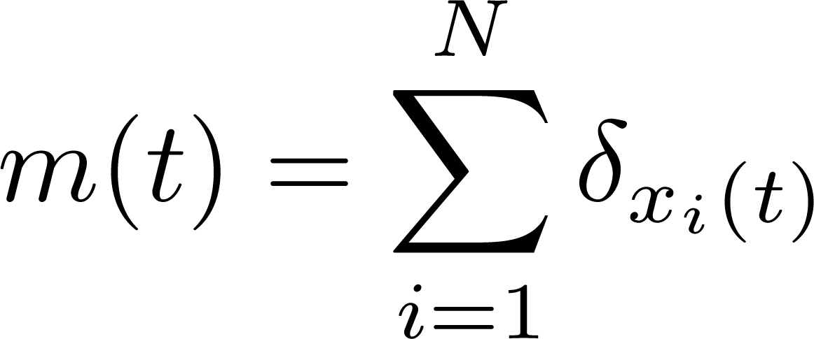
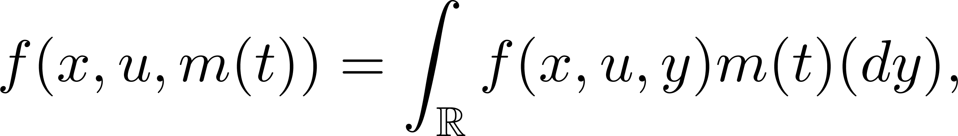
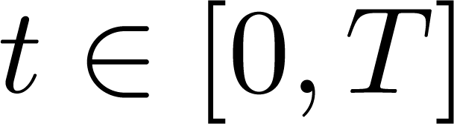
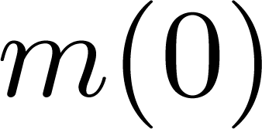
State Dynamics
evolution of state with time
In diffusion-based models, the state dynamics of a reference player in an infinite-population game is described by the following controlled McKean-Vlasov equation
for where
and refers to the distribution of the state of the reference player at and the initial distribution is specified.
mean field
Notes:
State dynamics - evolution of the states of a player with time.

Slide 12
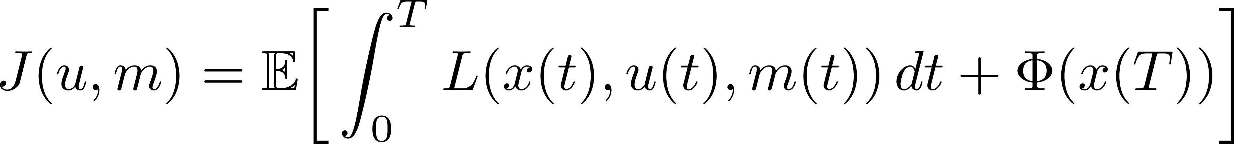
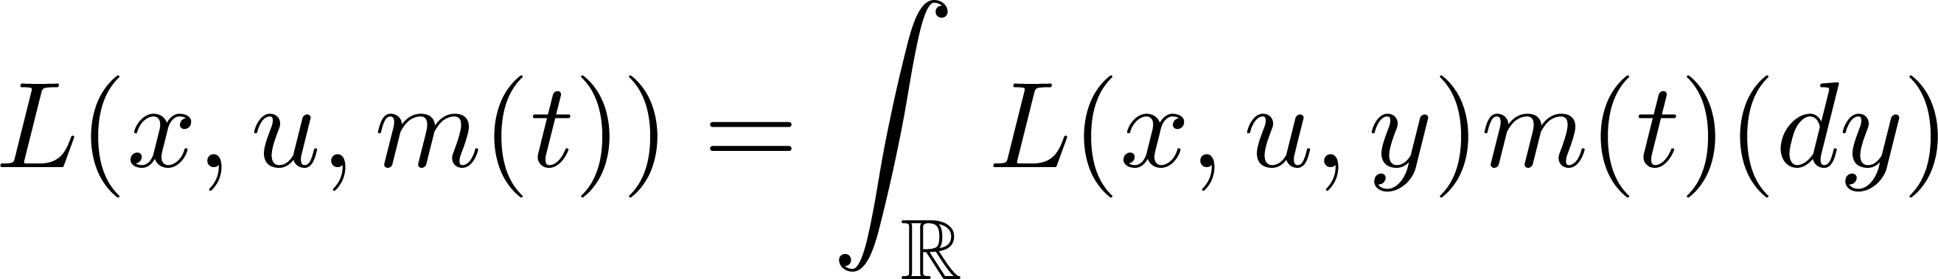
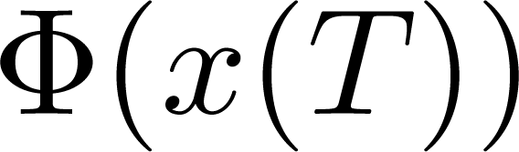
Cost Functions
In an infinite-population game, the expected cost for a reference player is given by
where the running cost is defined as
and is the terminal cost.

Slide 13
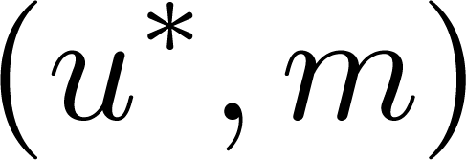
Solution Concept
A Nash equilibrium is a solution to a MFG such that
A solution profile is also known as a mean field equilibrium of a MFG if it satisfies the corresponding MFG equation/s:
  Analytic Methods
    Mean Field Games in HJB/FPK Form
    Mean Field Games in Master Form
    Mean Field Type Games
  Probabilistic Method
  …

Slide 14
Overview
Introduction
Mean Field Game Framework
Analytic Methods
  Mean Field Games in HJB/FPK Form
  Mean Field Games in Master Form
  Mean Field Type Games
Probabilistic Method
Applications
Conclusion
Notes:
Analytic methods -
HJB/FPK (or reduced) form - a form of MFG that can be written as a pair of HJB/FPK equations
Master form - more general formulation of an MFG

Slide 15
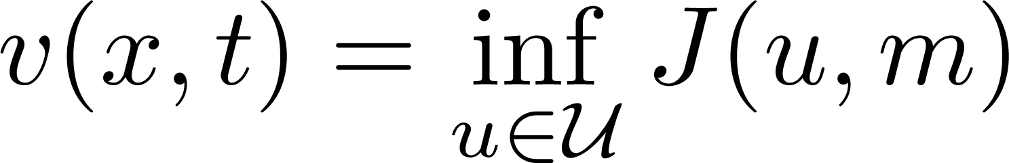
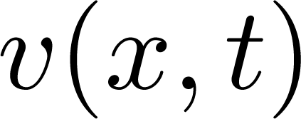
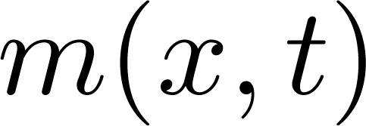
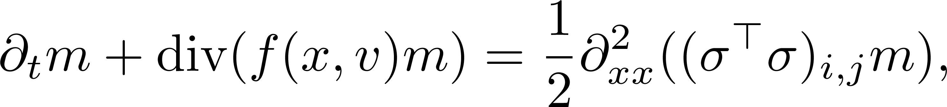
Mean Field Game in HJB/FPK Form
Bellman Optimality Principle
For MFGs in HJB/FPK (or reduced) form:
  HJB equation governs the computation of the optimal path of control of the player.
  FPK equation governs the evolution of the mean field function of players.
HJB
FPK
Mean Field Approximation
Notes:
HJB/FPK form - a MFG in reduced form expressed as a coupled HJB/FPK equations
HJB - covers the optimization of the cost; results when dynamic programming is applied to the value function
FPK - also known as a transport equation

Slide 16
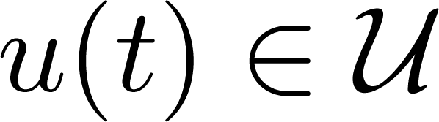
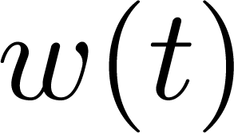
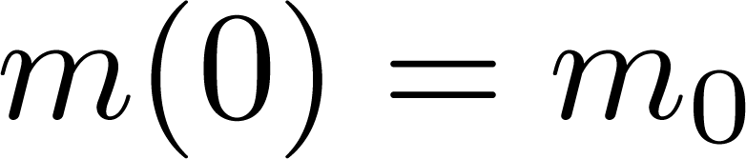
Mean Field Game in HJB/FPK Form
Consider a population where each player is allowed to choose a control . This control determines the dynamics of a player (i.e. evolution of state x(t)) through
Since the dynamics of a player is controlled by a Brownian motion independent from the other players, the population distribution will evolve according to the Fokker-Planck-Kolmogorov equation
with initial condition .

Slide 17
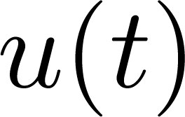
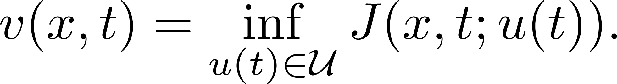
Mean Field Game in HJB/FPK Form
The goal of a reference player is to find a control which minimizes the cost
The value function associated with the optimization problem is
If this value function has enough regularity, then it is a solution to the following Hamilton-Jacobi-Bellman equation
v is twice differentiable with x and differentiable with t.
Notes:
When dynamic programming is applicable, the value function satisfies HJB.

Slide 18
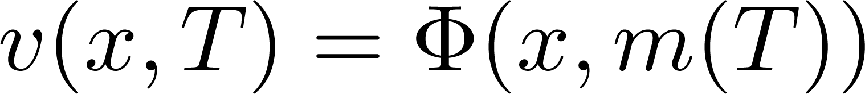

Mean Field Game in HJB/FPK Form
where the Hamiltonian is defined as
Moreover, the value function satisfies .
Suppose there exist a such that
Then, it follows that and is an optimal control and is a solution to the optimization problem.

Slide 19
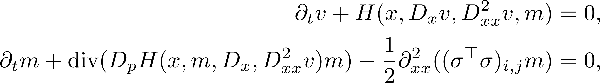
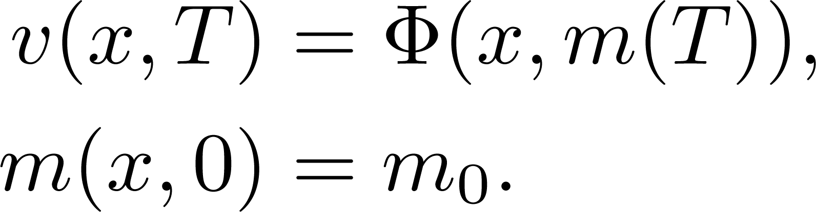
Mean Field Game in HJB/FPK Form
Hence, the mean field game system in HJB/FPK form is
with terminal and initial conditions
HJB
FPK

Slide 20
Mean Field Game in Master Form
The master equation is a more general formulation for MFG involving
  the optimization problem faced by the players and
  the evolution of the population’s states.
Instead of mean field term, we replace the formulation with a random variable that refers to the trajectory of the population of the players.
The master form of MFG is useful for the study of problems where players share common noise (i.e., Brownian motion).
Notes:
Master form - more general formulation where the mean field term is generalized as a random variable.

Slide 21
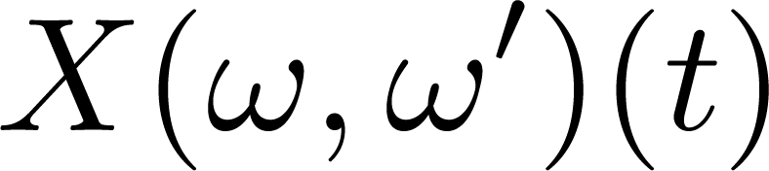




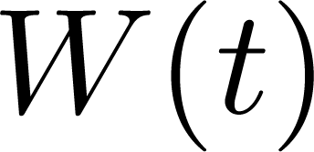
Mean Field Game in Master Form
Let or simply be a family of random variables for position of player at time . Consider that the players follow the random trajectories given by
where is a Brownian motion.
Here mean field term is a r.v. and might be different for different players
As before, also consider that a reference player has state dynamics given by
Notes:
X = family of rvs which refer to position of player w’ at time t
x = position of a reference player

Slide 22
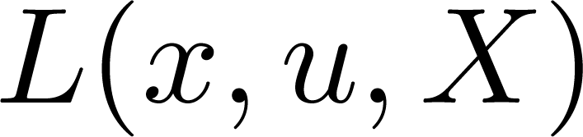
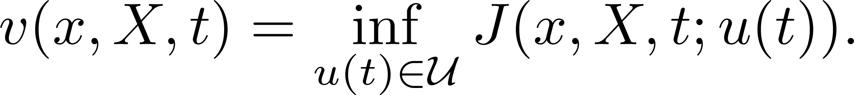
Mean Field Game in Master Form
In MFG, replace m by r.v. X, a reference player aims to minimize
where the Lagrangian is related to the Hamiltonian defined as
The value function associated with this optimization problem is
Notes:
Cost J is now also a function of X.

Slide 23
Mean Field Game in Master Form
Assuming the dynamic programming applies, the value function satisfies the following mean field equations
with terminal condition , and
the derivative operators are defined as
Notes:
The master equation contains the optimization problem and the evolution of the population states.

Slide 24
Mean Field-Type Games
MFTG is game in which the payoffs and/or state dynamics coefficient functions depend also on the distribution of the state-control pairs (u):
Can be applied when dynamic programming cannot be applied.
The number of interacting agents is not necessarily large.
MFTG extends MFG to include non-symmetry, non-negligible effect of individual decision on the mean field term.
Mean field-type games differ from mean field game since it takes into account higher-order statistics of the states such as the variance.
  Other quantities of interest, aside from the mean field term, include variance, skewness, kurtosis, value at risk, success probability, mean-variance payoff, etc.
Notes:
Dynamic programming cannot be applied since mean field m is a function of control u. SMP can be used which is discussed next.

Slide 25
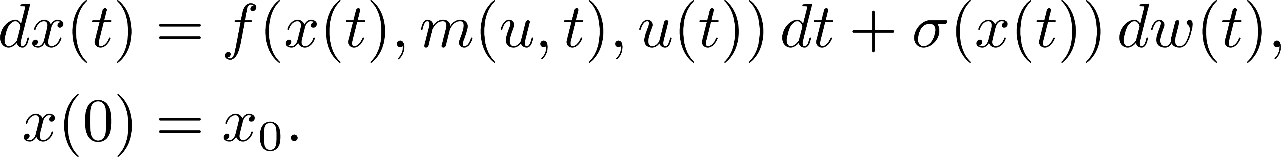
Mean-Field-Type Games
The objective of a reference player is to
subject to
Nash equilibrium is a solution concept such that
DP does not work since the mean field term depends on the control.
Notes:
The mean field m is now a function of control u as well.
Dynamic programming cannot be applied since mean field m is a function of control u.
SMP can be used which is discussed next.

Slide 26
Overview
Introduction
Mean Field Game Framework
Analytic Methods
Probabilistic Method
  Stochastic Maximum Principle
Applications
Conclusion
Notes:
This is a method that use probabilistic framework to determine the MFG solution as well as its uniqueness and existence.

Slide 27
Stochastic Maximum Principle
SMP is a probabilistic approach to finding the best response of a player in a MFG. It involves the following steps:
  Introduce a measure flow to specify the empirical state distribution associated with an infinite population.
  The optimal control problem for a player is solved through an adjoint process which determines the closed-loop system.
  The measure flow is required to be equal to the law of the closed-loop system.
SMP yields a forward-backward stochastic differential equation (FBSDE) of McKean-Vlasov type.
Can be applied when dynamic programming cannot be applied.
“dual”
Notes:
SMP can also be used in MFTG.

Slide 28
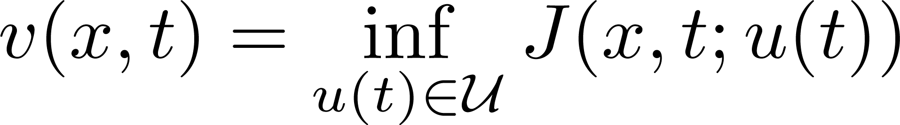
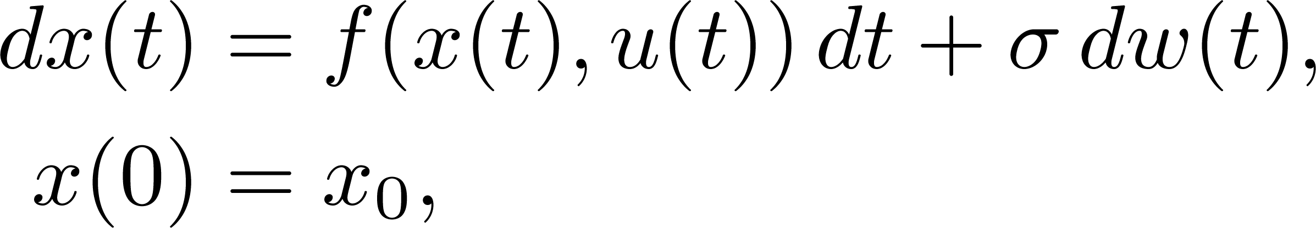
Stochastic Maximum Principle (step 2)
Consider the control problem for a representative player be
subject to
where the cost function is given by

Slide 29
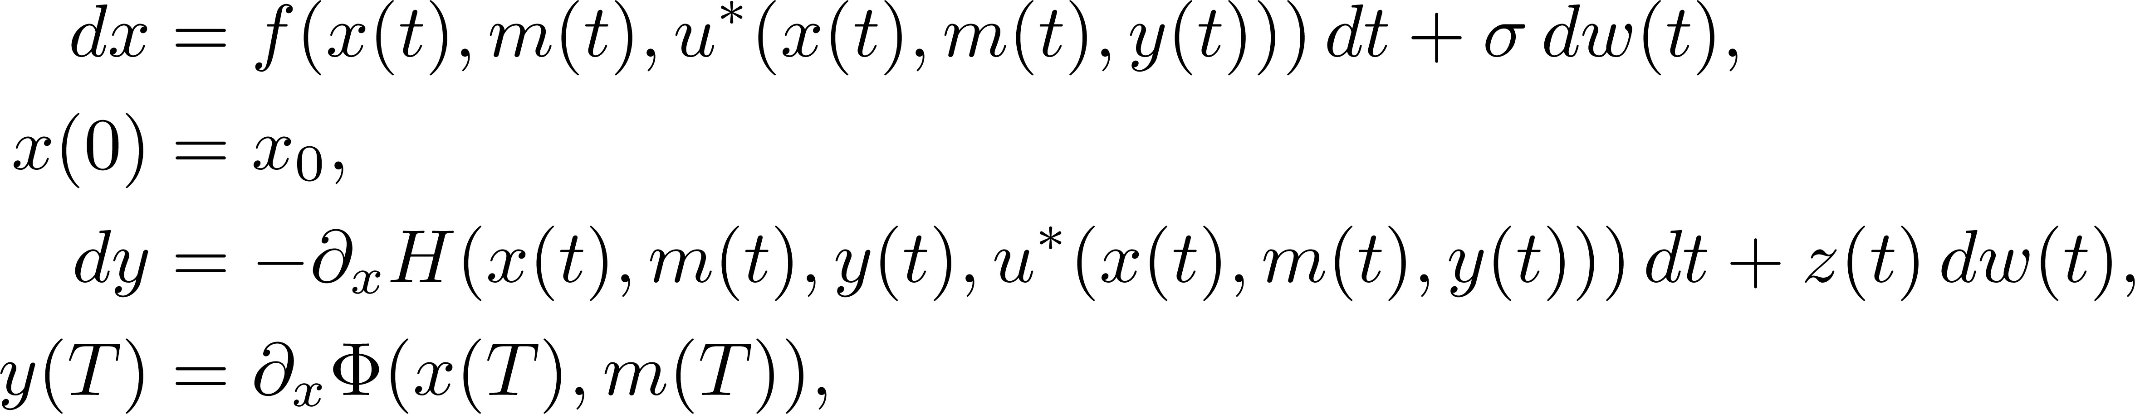
Stochastic Maximum Principle (step 2)
According to SMP, if the following FBSDE
has solution where
then is the optimal control.

Slide 30
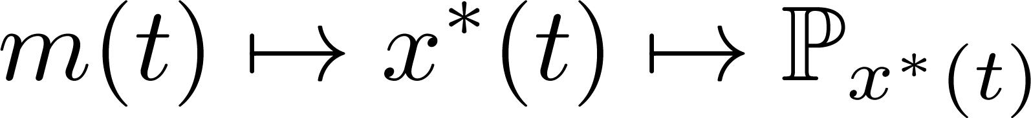
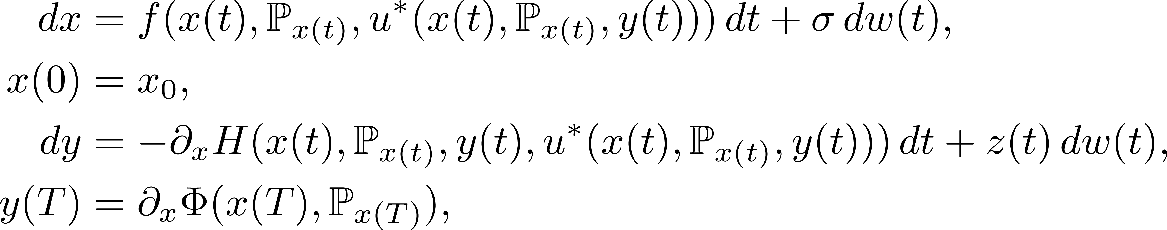
Stochastic Maximum Principle
m(t) = empirical distribution of states
P_{x*(t)} = distribution of optimal states
X* is state if the control is u*
Fixed point = provides approximate Nash equilibrium
To solve MFG using SMP, use fixed point strategy:
  Fix and solve the control problem.
  Get a map .
  Find a fixed point for this map.
This approach leads to a forward-backward SDE of McKean-Vlasov type:
Notes:
Get a map from m(t) (empirical state distribution) to the PX(t) (distribution of optimal states).
A fixed point in this mapping represents an approximate Nash equilibrium.

Slide 31
Overview
Introduction
Mean Field Game Framework
Analytic Methods
Probabilistic Method
Applications
Conclusion

Slide 32
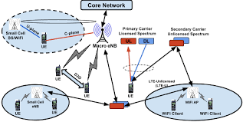
Many Applications in Wireless Networking
Power control for ultra-dense D2D networks
Joint power control and user scheduling in ultra-dense small cell network
Competition among electric vehicles in smart grid
Security enhancements in mobile ad hoc networks
Power control in small cells under macrocells
Interference management in heterogeneous networks
Distributed caching in ultra-dense small cell networks

Slide 33
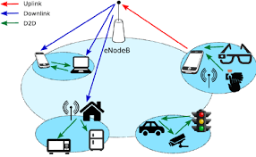
Example 1:
Power Control for Ultra-Dense D2D Networks
Device-to-device (D2D) communications can enhance
  spectrum efficiency due to frequency reuse and
  energy efficiency due to proximity communication.
Performance is limited by
  mutual interference among D2D transmitters and
  energy availability of the device battery.
MFG is used to model the power control of each device.
Notes:
In this application, MFG is used to solve for power strategies that minimize energy consumption of each device but at the same time guarantee a minimum performance.

Slide 34
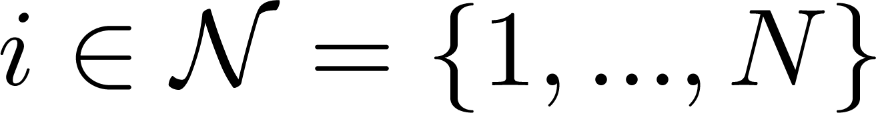



System Model
Players: D2D pairs,
Control: transmit powers,
States: energy level and interference levels,
Cost function:
Assumptions:
  The number of D2D communication pairs is very large: .
  Full frequency reuse.
  Most user devices select D2D communication mode.
Notes:
This is the system model used in this particular paper.
Also the following assumptions were made.

Slide 35




Differential Game Formulation
Interference to D2D pair :
Signal-to-noise ratio:
Cost function:
Notes:
The problem is first formulated as a classical game theory in the form of a differential game.
The first equation refers to the total interference from all the D2D links to a reference D2D link.
The total interference is then used in the SINR equation.
Then this SINR is used in the cost function.
The SINR threshold is the requirement for efficient communications between two D2D devices.
The cost function penalizes the excess on the SINR threshold and the transmit power used.
There is a trade-off here in the cost function. Each device aims to use minimum transmit power but the transmit power still has to be high enough to satisfy the SINR threshold.

Slide 36


Differential Game Formulation
Differential game problem:
subject to
“Channel gain”
Notes:
This is the differential game problem where the cost in each D2D link is minimized.
The goal in each D2D link is to find the optimal transmit powers that minimizes the cost.
Since differential game with large number of players is non-tractable, an equivalent MFG formulated has been formulated.

Slide 37





Mean Field Game Formulation
Mean field approximation of interference to D2D pair :
Mean field signal-to-noise ratio using :
Mean field cost function:
Notes:
Since it is difficult to solve a differential game among many players, the problem was reformulated as a mean field game.
In the first equation, the total interference was formulated in terms of a test power and a mean channel gain.
This mean field interference is then used in the SINR equation and consequently, this SINR is used in the new cost function.

Slide 38



Mean Field Game Formulation
Mean field problem:
subject to
or
FPK
HJB
Notes:
This is now the mean field formulation.
This MFG formulation can be transformed in to an HJB/FPK.

Slide 39


Simulation Results
Spectrum efficiency is improved when interference is minimized.
Energy efficiency is improved compared with blind power control (no energy constraint).
Notes:
The following result show the used of MFG in power control of D2D communications.
The first graph reveals that a MFG produces results that make sense. So we can opt to use MFG rather than DG in games with large number of players.
The second graph shows the advantage of using MFG power control over blind power control. The proposed MFG method improves the energy efficiency.

Slide 40


Example 2:
Challenges in 5G Ultra-Dense Networks
IoE: Internet of Everything
Mobile Internet
  5G Ultra-Dense Small Cells
  Social-Aware D2D Networks
Internet of Things
  M2M, V2V Networks
5G Characteristics: Ultra-Dense, Scalable, Self-Organizing; Energy Efficiency, Spectral Efficiency, Cost Efficiency

Slide 41
Example 2:
Challenges in 5G Ultra-Dense Networks
Technical Challenges
  Coupled Systems & Interference - Limited Resources
  Computationally Intractable & Analysis – Number Infinity
  Low Convergence Rate & Robustness - Dynamics
  Perfect Information & Backhauling Overhead - Others
Requirements
  Self-Organization & Distributed Control
  Space-time Dynamics
HJB and FPK equations
MFG with dominators

Slide 42


Example 3:
Unmanned Aerial Vehicle (UAV)
3-dimentional trajectory optimization
  QoS for UAV communication
  Successful sensing probability
Frequency allocation
  Interference avoidance
  UAV transmission scheduling
Power control
  Propulsion energy
  Transmission power

Slide 43




Example 3: Existing UAV Works Using MFG
Interference Management in Dense Drone Small Cells Networks Using MFG
Charging Policy and Interference Mitigation in Wireless Powered IoTs
Distributed Resource Allocation in NOMA-Based UAV Networks Using MFG
Adaptive Coverage Solution In Multi-UAVs Emergency Communication System

Slide 44

Example 4:
Communications, Caching, and Computation
Communications
  Device-to-Device (D2D)
  Machine-to-Machine (M2M)
  Internet of thing (IoT)
Caching
  Mobile edge caching
Computing
  Mobile edge computing (MEC)
  Fog computing
  Cloudlet
Promising Solutions
  Network function virtualization
  Software defined networks
Benefits
  Reduced latency
  Bandwidth reduction
  High energy efficiency
  Utilization of context information

Slide 45

Example 4:
Mean-Field-Type Game for 3C Networks
In MFG, the decision makers are
  One has negligible effect
  Infinitely many
  Indistinguishable
MFTG is more relaxed.
In 3C networks, nodes and/or users are:
  Finite in number
  Uniquely identified
  One can have significant effect on mean field distribution
Resource Allocation for 3C
  Computation offloading
  Optimal caching
  Power control

Slide 46


Example 5:
MFG for Caching in Small Cell Networks (SCN)
Aim of the SCN is to define a caching policy that reduces the load on the capacity limited backhaul links.
This cache control problem is formulated as an MFG by considering an ultra-dense network of SBSs in which the existence and uniqueness of the mean-field equilibrium is shown to be guaranteed.

Slide 47

Other Directions
Competition among electric vehicles in smart grid
Security enhancements in mobile ad hoc networks

Slide 48

Conclusion
Mean Field Games
Analytic Methods
HJB/FPK Form
Master Form
Probabilistic Method
Stochastic Maximum Principle
Many Applications
Resource Allocation in Wireless Networks
Social Networks
Security
UAV Networks
Smart Grid

Slide 49
References
UCLA summer workshop on mean field game, each year
J.-M. Lasry, and P.-L. Lions, “Mean field games,” Japanese Journal of Mathematics, vol. 2, no. 1, pp. 229-260, 2007.
O. Gueant, J.-M. Lasry, and P.-L. Lions, “Mean field games and application,” 2015.
P. E. Caines, M. Huang, and R. Malhame, “Mean Field Games,” Springer, 2017.
A. Bensoussan, J. Frehse, and P. Yam, “Mean Field Games and Mean Field Type Control Theory,” Aug. 2013.
D. Gomes and J. Saude, “Mean Field Game Models – A Brief Survey,” Dynamic Games and Applications, June 2014.
D. Gomes, L. Nurbekyan, E. Pimentel, “Economic Models and and Mean-field Games Theory,” IMPA, 2015.
C. Yang, J. Li, P. Semasinghe, E. Hossain, S. Perlaza, and Z. Han, “Distributed Interference, and Energy-Aware Power Control for Ultra-Dense D2D Networks: A Mean Field Game,” IEEE Transactions on Wireless Communications, vol. 16, no. 2, pp. 1205-1217, Feb. 2017.

Slide 50
References
K. Hamidouche, W. Saad, M. Debbah, and H. V. Poor, ``Mean-Field Games for Distributed Caching in Ultra-Dense Small Cell Networks,” ACC 2016.
C. Yang and Z. Han, “Distributed Interference-Aware Power Control in Ultra-Dense Small Cell Networks: A Robust Mean Field Game," IEEE Access, vol. 6, pp. 12608-12619, January 2018.
Zihe Zhang, Lixin Li, Xiaomin Liu, Wei Liang, Zhu Han, “Matching-Based Resource Allocation and Distributed Power Control Using Mean Field Game in the NOMA-Based UAV Networks," Asia-Pacic Signal and Information Processing 2018.
Z. Zhang, L. Li, W. Liang, X. Li, A. Gao, W. Chen, and Z. Han, Downlink Interference Management in Dense Drone Small Cells Networks Using Mean-Field Game Theory,” WCSP, 2018.
Y. Xu, L. Li, Z. Zhang, K. Xue, and Z. Han, “A Discrete-Time Mean Field Game in Multi-UAV Wireless Communication System," ICCC, 2018
C. Yang, Y. Zhang, J. Li, and Z. Han, “Power Control Mean Field Game With Dominator in Ultra-Dense Small Cell Networks," IEEE Globecom, 2017.

Slide 51


THANK YOU!

