Slide 1

Resource Allocation for Full-Duplex Communication and Networks
Zhu Han
Department of Electrical and Computer Engineering
University of Houston, Houston, TX, USA
Slides are available at :
wireless.egr.uh.edu/research.htm

Slide 2
Table of Content
Basic of Full-duplex Communications
Full Duplex Crosslayer Design
Full Duplex Cognitive Radio: Listen and Talk
Full Duplex RF CSMA/CD
Full Duplex HetNet
Resource Allocation Summary
Conclusions
Overview of research lab

Slide 3

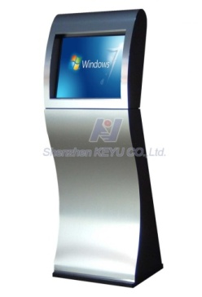




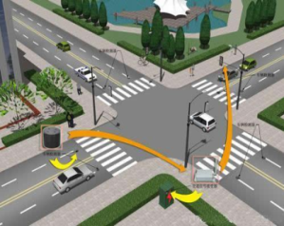

KPIs
6 Key Performance Indicators (KPIs) for 5G
10Gbps
1000X Capacity
(Traffic and Connections)
10X User Rate Anywhere
(100M-1Gbps)
10X Peak Data Rate
(10+Gbps)
But what is 5G? D2D, small cell, Massive MIMO or full duplex?
1000X Energy&Cost Reduce
10X Low Latency,
High reliability
5-10X Spectrum Efficiency

Slide 4
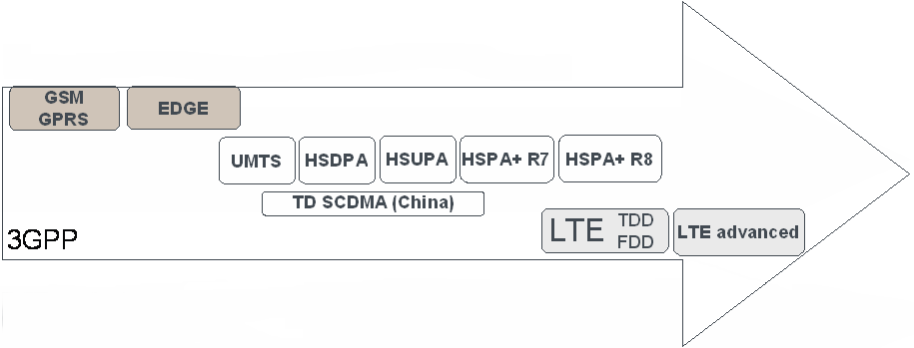
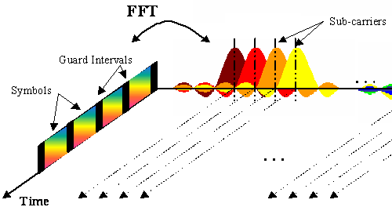
Standardization Facilitates Technology Evolution
Each new evolution builds on the established market of the previous
Backwards-compatible evolution
But larger technology steps require revolutions:
1995
2000
2005
2010
2015
From TDMA:
to CDMA:
to OFDMA:

Slide 5
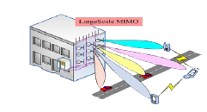









Link Efficiency: Massive MIMO, 3D-BF, Full-duplex
More Scenarios and Use Case： M2M, D2D, V2X
Signal to Noise plus Interference Radio
Scaled Transmission Time
Capacity：C = N * W * T * log(1 + SINR)
Bandwidth
No. of APs
Ultra Dense Deployment:
LTE-Hi and Further Evolution
New Spectrum： mmWaves, LTE-U, Cognitive radio

Slide 6



10X Peak Rate
10 X Peak Rate
5G Requirement
Full Duplex, NOMA
1Gbps
4G
Full-duplex communication can be one possible solution to meet the future wireless challenges
Ultra High Spectrum
10Mbps
Immediately Downloading
3G
100Kbps
Ultra-Dense Network
3D-UHDTV
2G
High Spectrum, mmWave
10Gbps Peak Rate

Slide 7
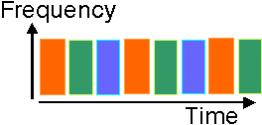
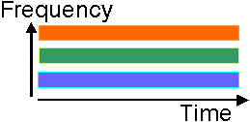
Background of Full-Duplex Techniques
Traditional half duplex: using orthogonal resources
Time-division duplex
Frequency-division duplex
Problems
Orthogonal resources are allocated for reception and transmission.
Solutions
Same resources are allocated for reception and transmission
Time-division duplex
Frequency-division duplex
Spectral loss
Full-duplex
Comms

Slide 8
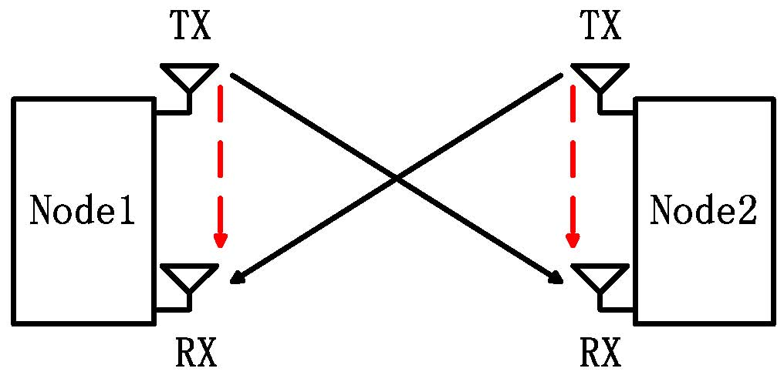
Full Duplex Introduction
Allows communication at the same time and frequency resources.
Advantages
High spectral efficiency
Same time & same frequency band
Low cost
Readily use the existing MIMO radios
Hardware advancement, etc.
: Signal of interest
: Self interference
Full duplex communication

Slide 9
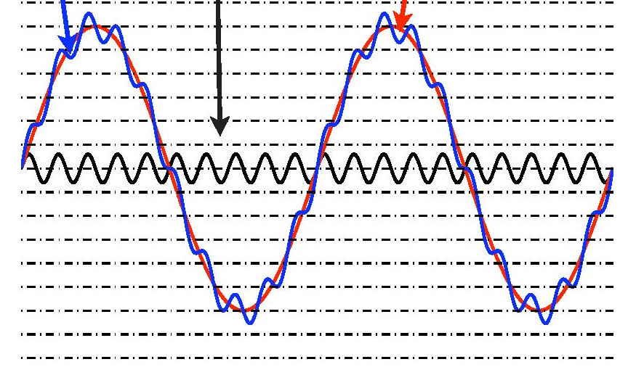
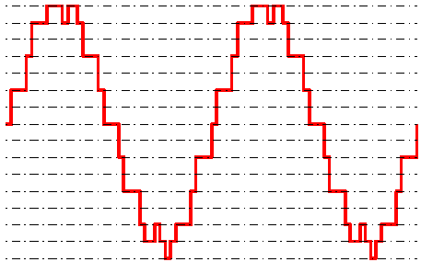
Main Challenges
Traditional Challenges
Very large self interference
50-110dB larger than signal of interest
Depending on inter-node distance
ADC is the bottleneck
Limited dynamic range: saturation distortion.
Limited precision: signal of interest is less than noise.
1 bit ADC is 6 dB in SNR
Self interference costs 8-18 bits
Need to reduce interference before ADC
Received signal
Signal of interest
Self interference
Fig. 6 Very large Self interference
Fig. 7 Signal after quantization

Slide 10
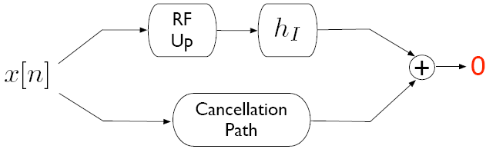
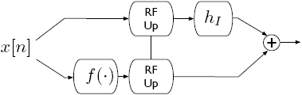
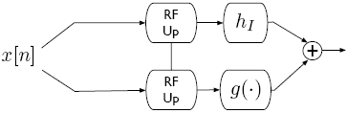
Self-interference Cancellation
Self interference channel
Passive antenna propagation suppression
Active cancelation
Active analog cancelation
Active digital cancelation
Pre-mixer Post-mixer

Slide 11
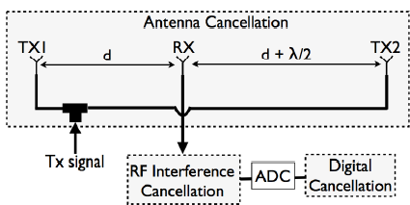
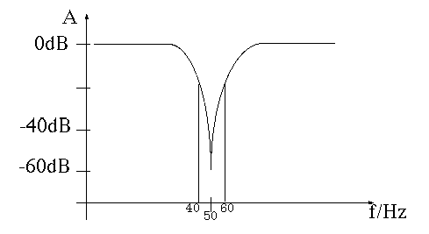
Passive Propagation Cancellation
MIMO system
Example, two transmitting antenna has 180 degree difference at the receiving antenna
Multiple antenna for beamforming, nulling and self-interference cancellation.
Challenges: For wideband, wavelength
is different, so the cancellation is not good

Slide 12
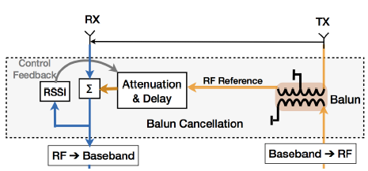
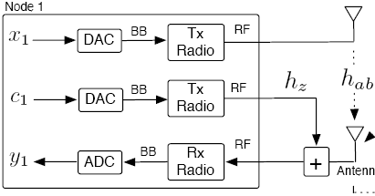
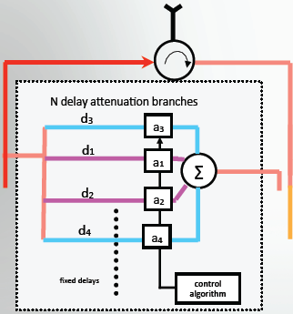
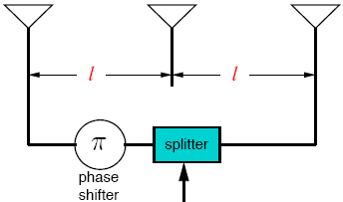
Active Analog Cancelation (2)
Post-mixer
Pre-mixer
Post-mixer
Post-mixer
x
Post-mixer
x
DAC
ADC

Slide 13
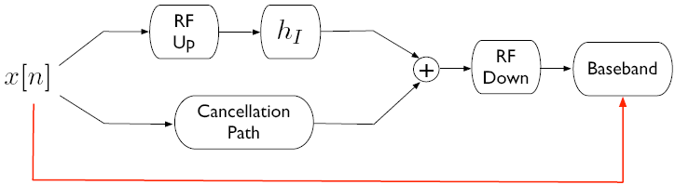
Active Digital Cancelation
Similar to equalizer
Two-step cancellation:
Estimate the self residual interference channel h_{RI} through training symbols
Cancel h_{RI}x[n] at baseband
Useless if interference is too strong (ADC bottleneck)

Slide 14
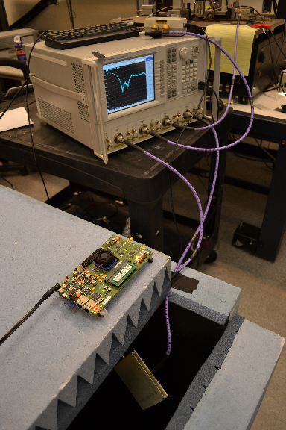
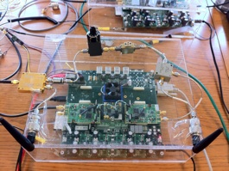
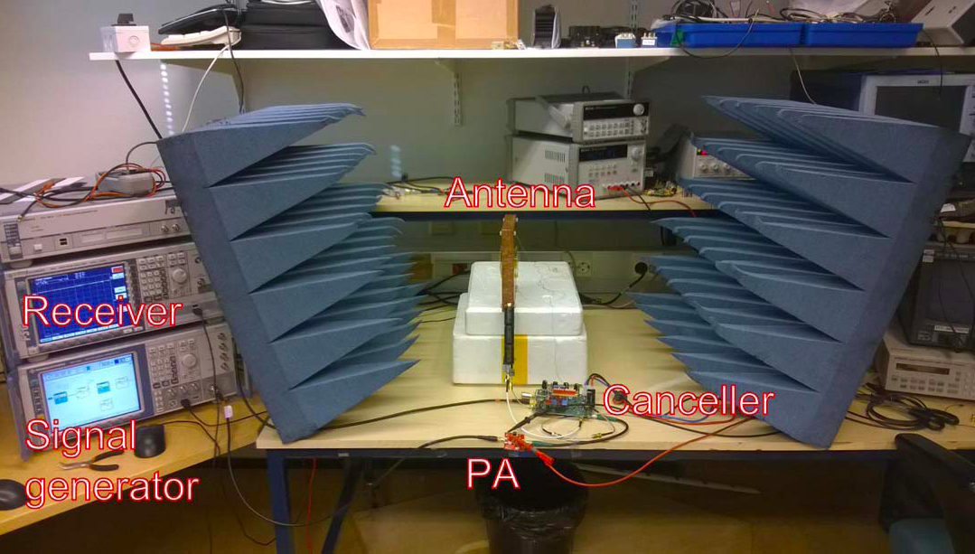
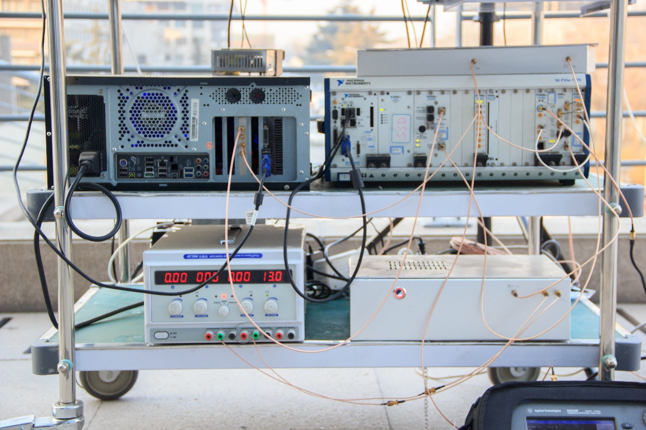
Some existing prototypes
Stanford
Rice
Finland Aalto University
Beijing University

Slide 15
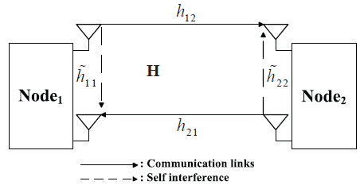
Full-Duplex Communication: Signal Model
It presents a two-node full-duplex system, where each node
transmits signal xi, i = 1, 2 to the other
has one antenna for transmission with another for reception
concurrently transmit sand receive s the signals at the same frequency carrier and time interval

Slide 16


Full-Duplex Communication: Signal Model
Each source receives a combination of the signal transmitted by the other source, the RSI, and noise
The instantaneous SINR at source i’s receiver for full-duplex is
The RSI depends largely on the transmit power, and also varies due to the practical constraint.
The values of |h_{ji}|², |h_{ii}|², and P_{s} have strong impact on SINR, which will affect the system performance significantly.
Thus, proper resource allocation that can further reduce the effects of residual self-interference is crucial for full-duplex communication.

Slide 17
Working Assumptions
Residual self interference after cancelation techniques
Rayleigh fading (or Rican fading)
Gaussian noise
Perfectly eliminated
Distortion caused by limited dynamic range
Gaussian
Consider it as Gaussian noise for lower bound
Ignored
residual self interference is small enough
Imperfect CSI
Estimation error of communication channel
Estimation error of self-interference channel

Slide 18
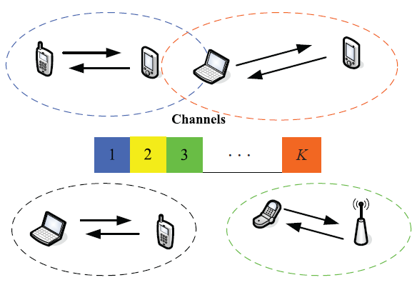
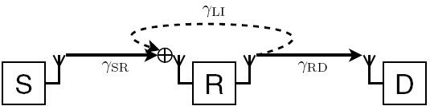
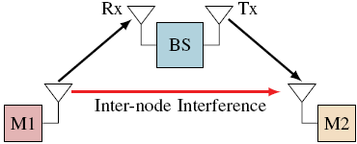
Main Application Scenarios
Full-Duplex Distributed Communication Systems
Two-node bi-directional MIMO system
Centralized Full-Duplex Communication Systems
Full-duplex relay network
DF relay
AF relay
Two-way relay
Full-duplex wireless network
FD cellular network
FD HetNet

Slide 19
Research Problems
Two nodes bidirectional full-duplex systems
Self-interference channel estimation
Self-interference cancellation
Achievable sum rate bounds
Optimal power allocation
Full-duplex MIMO systems
Adaptive Switching
Antenna selection
Interference-aware beamforming
Full duplex cooperative systems
Full duplex AF/DF relay design
Hybrid full duplex/half duplex relay
Node selection: relay/antenna selection
Antenna selection
Full duplex cellular/HetNet network
Distributed full duplex, use side-channel to cancel interference
Radio resources and users allocation

Slide 20
Table of Content
Basic of Full-duplex Communications
Full Duplex Crosslayer Design
Full Duplex Cognitive Radio: Listen and Talk
Full Duplex RF CSMA/CD
Full Duplex HetNet
Resource Allocation Summary
Conclusions

Slide 21
Listen-and-Talk Protocol For Cognitive Radio
Conventional Listen before talk
“listen-and-talk” (LAT) protocol
simultaneously sense and access the vacant spectrum.
Yun Liao, Tianyu Wang, Lingyang Song, and Zhu Han, “Listen-and-Talk: Full-duplex Cognitive Radio Networks,” in Proc. IEEE Globecom’14, Austin, TX, Dec. 2014. Best Paper Award
Yun Liao, Lingyang Song, Yonghui Li, and Zhu Han, “Full-Duplex Cognitive Radio: A New Design Paradigm for Enhancing Spectrum Usage,” to appear, IEEE Communications Magazine [arxiv: http://arxiv.org/abs/1503.03954]

Slide 22
The Listen Before Talk (LBT) Protocol
SUs sense the spectrum before transmission
Sensing and transmission separate in time domain
Discontinuous transmission
Discontinuous sensing

Slide 23
Motivation of Listen and Talk (LAT) Protocol
Continuous
Discontinuous transmission
Can never fully utilize spectrum holes for transmission
Discontinuous sensing
Inevitable collision and spectrum waste
Continuous
Detect PU’s state change in no time

Slide 24
System Model
One PU
Non-slotted
One FD-SU pair
Each with two antennas
SU₁: secondary transmitter
SU₂: secondary receiver
Slotted

Slide 25
Listen-and-Talk Protocol (1)
Ant₁ of SU₁ senses the spectrum
Ant₂ transmits if a spectrum hole is detected simultaneously

Slide 26
Listen-and-Talk Protocol (2)
Four states of the system:
1: only the PU uses the spectrum
2: only SUs use the spectrum
3: neither the PU nor SUs use the spectrum – spectrum waste
3-A: change of PU’s state – PU leaves in a slot
3-B: sensing error – false alarm
4: both the PU and SUs use the spectrum – collision
4-A: change of PU’s state – PU arrives in a slot
4-B: sensing error – miss detection

Slide 27
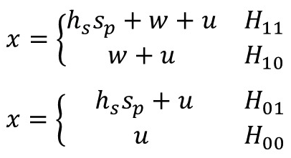
Sensing Threshold (1)
Received signal varies in association with SU₁’s activity.
Active SU₁
Silent SU₁
Thus, the varies sensing thresholds are needed according to SU₁’s state to achieve better sensing performance.
RSI

Slide 28
Sensing Threshold (2)
How to set ε₀ and ε₁?

Slide 29
Sensing Threshold (3)

Slide 30
Sensing Threshold (4): Sensing Error
Sensing error includes two parts:
false alarm and miss detection

Slide 31
Sensing Threshold (5): State Transition
State Transition: a discrete-time Markov chain
Notes:
consider the steady-state distribution of the Markov chain

Slide 32
Sensing Threshold (6): Collision Ratio
The sensing thresholds are determined by
Constraint of the maximum collision ratio

Slide 33
Power-Throughput Tradeoff (1): SU Throughput
The secondary throughput is
R is the rate of transmission
P_{w} is the time ratio of spectrum waste

Slide 34
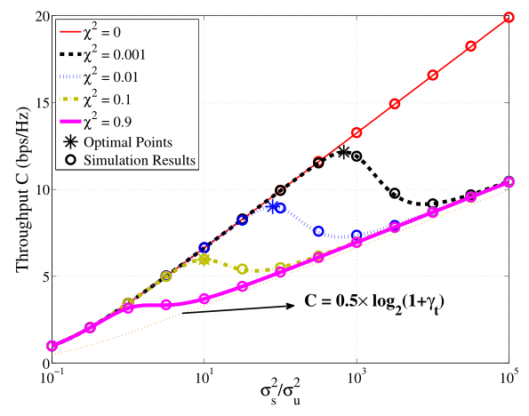
Power-Throughput Tradeoff (2)
Increase with RSI
Tradeoff between secondary transmit power and throughput
Optimal transmit power can be derived.

Slide 35
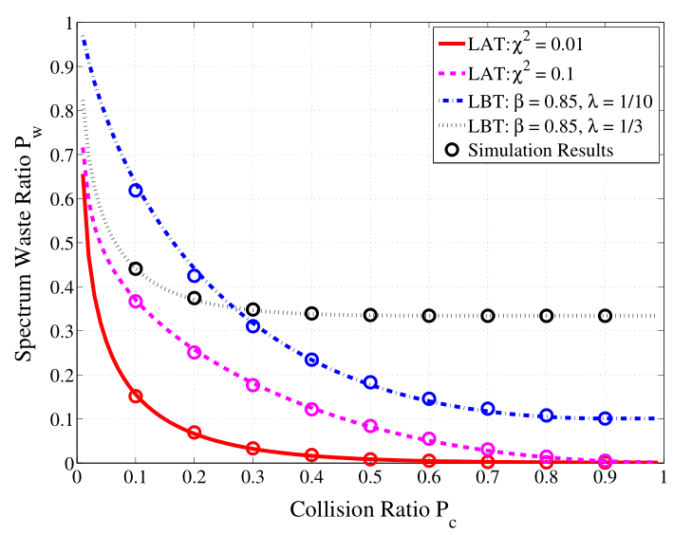
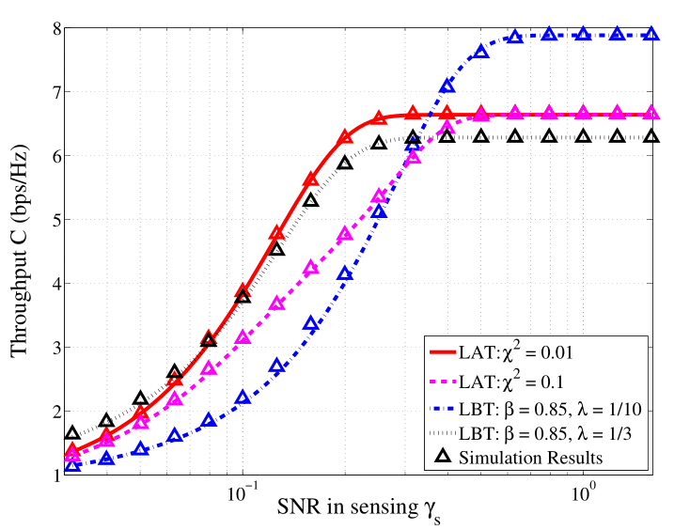
Adaptive Switching
Spatial correlation factor
Sensing duration / Slot length
Adaptive switching of the two protocol
Full utilization of spectrum holes
Comparison of the spectrum usage
Lower spectrum waste ratio
under strict constraint

Slide 36
Table of Content
Basic of Full-duplex Communications
Full Duplex Crosslayer Design
Full Duplex Cognitive Radio: Listen and Talk
Full Duplex RF CSMA/CD
Full Duplex HetNet
Resource Allocation Summary
Conclusions

Slide 37
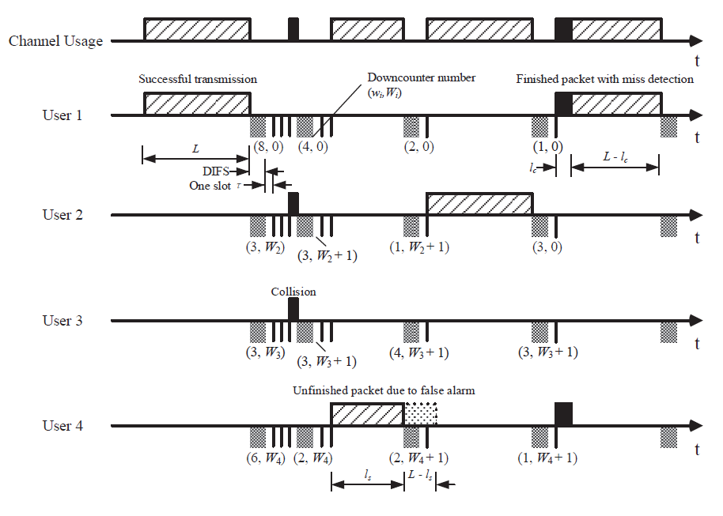
Full Duplex CSMA/CD
Roundabout example for CSMA, CSMA/CD and Aloha
RF half duplex can only use CSMA
Full duplex enable CSMA/CD
Performance gain when traffic is high
Liao Yun, Tianyu Wang, Kaigui Bian, Lingyang Song and Zhu Han, “Decentralized Dynamic Spectrum Access in Full-Duplex Cognitive Radio Networks,” IEEE International Conference on Communications (ICC), Best paper award, London, 2015.
Yun Liao, Kaigui Bain, Lingyang Song,and Zhu Han, “Full-duplex MAC Protocol Design and Analysis," appear, IEEE Communications Letters
Yun Liao, Kaigui Bian, Lingyang Song and Zhu Han, “Full-duplex WiFi: Achieving Simultaneous Sensing and Transmission for Future Wireless Networks,” ACM Mobihoc (poster), Hangzhou, China, 2015.

Slide 38
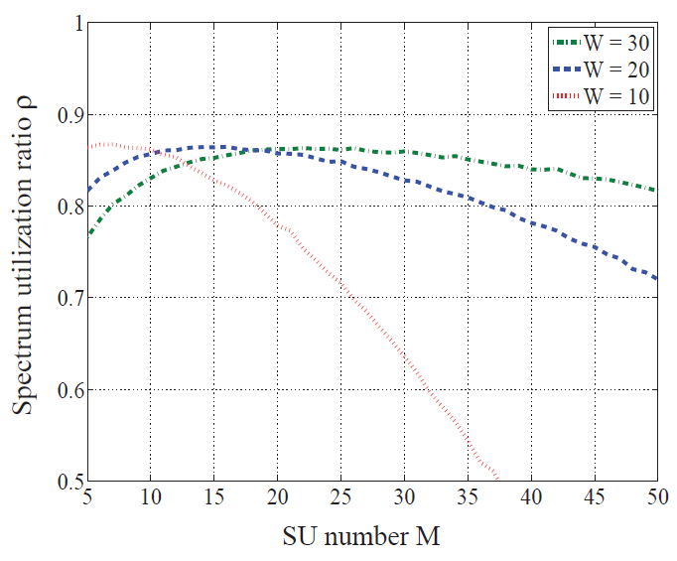
Full Duplex Radom Access MAC in CRNs
With FD techniques, SUs can keep sensing during transmission.
Contention window: determine the optimal backoff length.
Handling the RSI: the RSI results in false alarm and miss detection

Slide 39
Table of Content
Basic of Full-duplex Communications
Full Duplex Crosslayer Design
Full Duplex Cognitive Radio: Listen and Talk
Full Duplex RF CSMA/CD
Full Duplex HetNet
Resource Allocation Summary
Conclusions

Slide 40
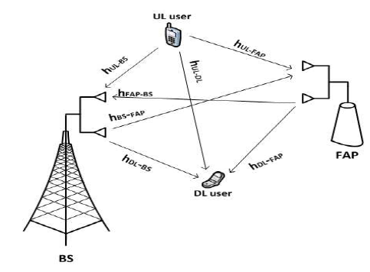
FD HetNet System Model
Single cell FDD OFDMA
Two-tier network
base station (BS) and femto cell access point (FAP)
MIMO is equipped in BS and FAP.
Option to either connect to BS or one of SAPs

Slide 41
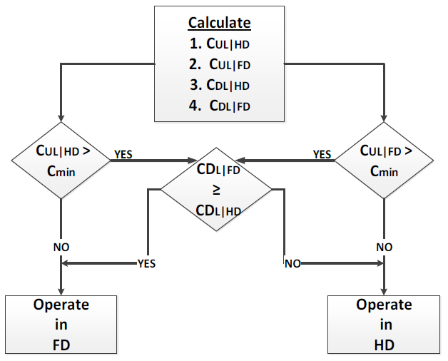
Resource Allocation for FD HetNet
Compared with resource allocation in HD-HetNet
Mode selection and connection selection
Other resources such as power and channels
Notes:
Since any node can operate either in FD or HD, and since frequency reuse is allowed on each subcarrier for one time, then each transmission on node (k) for user pair (n,m) on subcarrier (s) will have an interference transmission from node (k’) for transceiver pair (n’,m’).
Therefore, the throughput can be calculated by either case of the following cases.
Both concerned node (k) and interference node (k’) operate in FD.
The concerned node operates in FD and the interfering node operates in HD MU-MIMO.
The concerned node operates in HD MU-MIMO and the interfering node operates in FD.
Both nodes operate in HD MU-MIMO
→ The details of each case will be illustrated in the upcoming slides.

Slide 42
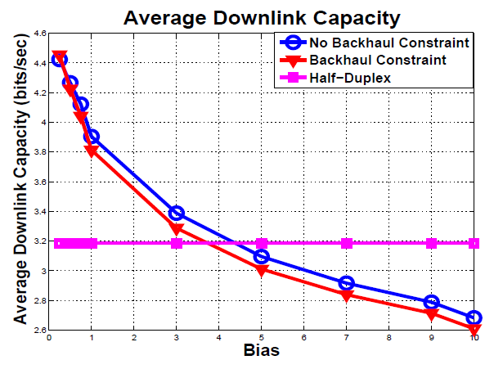
Numerical Results and intuition
Bias: connection to FAP and BS
Backhaul constraint
Switch between HD and FD
Notes:
It is expected that by increasing the spatial correlation coefficients between antennas that the HD performance will degrade.
However, FD performance is independent of the spatial correlation between the antennas.
It can be clearly noticed that the proposed scheme was able to switch between FD and HD to choose the transmission mode with the highest throughput

Slide 43
Resource Allocation Problem Summary
Adaptive Mode Switch
Half-duplex radio
Full-duplex radio
Power Control
High power will introduce self interference
Mode selection and power control are coupled
Transmit Beamforming
How many antenna for self interference cancellation
OFDM, Subcarrier Allocation
Link Selection
Routing

Slide 44
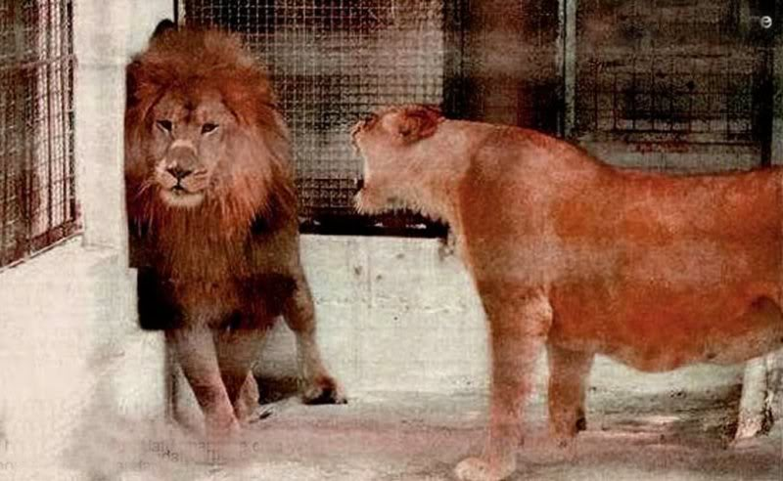
Conclusions
Full Duplex Basics
Key is self interference before ADC
Good thing: whole resource allocation can be redo
FD MIMO
FD Relay networks
FD Two Way Relay
FD D2D
FD OFDM
…
Bad thing: full duplex is
not always better than
half duplex
Human being is full duplex
Brain cancel self interference

Slide 45
Useful info for Research on FD Comms
Full-duplex communication website
http://wireless.pku.edu.cn/home/songly/fullduplex.html
Tutorial and survey, books, technical papers, standardization…
Books
Yun Liao, Tianyu Wang, Lingyang Song, and Zhu Han, “Listen-and-Talk: Full-Duplex Cognitive Radio,” with Springer, 2016.
Lingyang Song, Risto Wichman, Yonghui Li, and Zhu Han, “Full-Duplex Communications and Networks,” print, Cambridge University Press, UK.
Tutorials
Lingyang Song and Zhu Han, “Resource Allocation for Full-Duplex Wireless Communication and Networks,” IEEE International Conference on Communications (ICC), London, UK, Jun. 2015
Lingyang Song and Zhu Han, “Full-Duplex Wireless Communication and Networks: Key Technologies and Applications,” IEEE International Conference on Communications in China (ICCC 2014), Shanghai, China, Oct. 2014

