Slide 1
MAC Design and Resource Allocation for LTE-Unlicensed Coexistence
Zhu Han
ECE/CS Department
University of Houston

Slide 2
Outline
Background and Preliminary Work
MAC Design for LTE-Unlicensed Coexistence
Full Duplex Listen and Talk Scheme
Machine Learning LBT
Hybrid LBT
Resource Allocation for LTE-Unlicensed Coexistence
Matching Game
Coalition Formation Game
Stackelberg Game
3GPP Standard
Conclusion

Slide 3

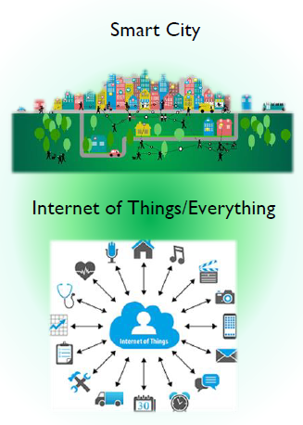
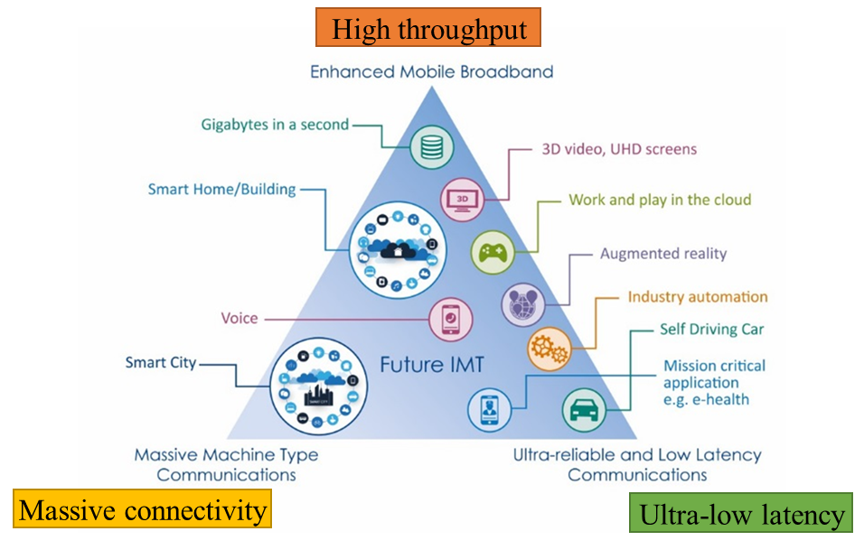
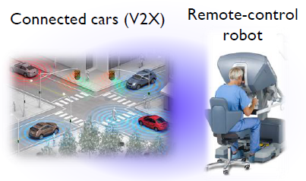
Background
Future issues
High throughput
Massive connectivity
Ultra-low latency

Slide 4
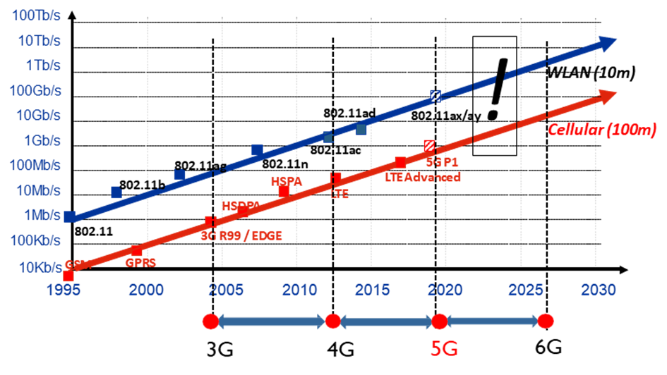
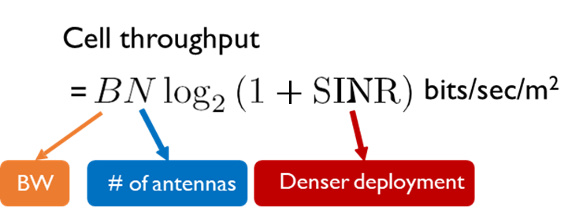
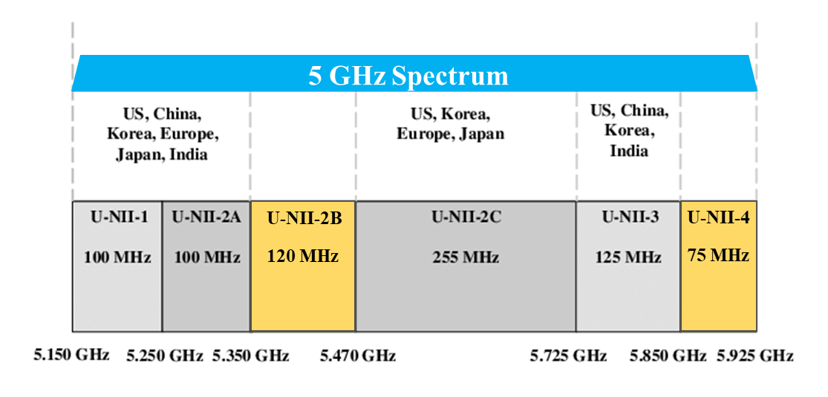
Background
Evolution of wireless systems
Spectrum sharing
LTE exploit the unlicensed band

Slide 5






Background
LTE-U vs. Wi-Fi on the unlicensed band
Wi-Fi Win
LTE-U Win
Collisions

Slide 6
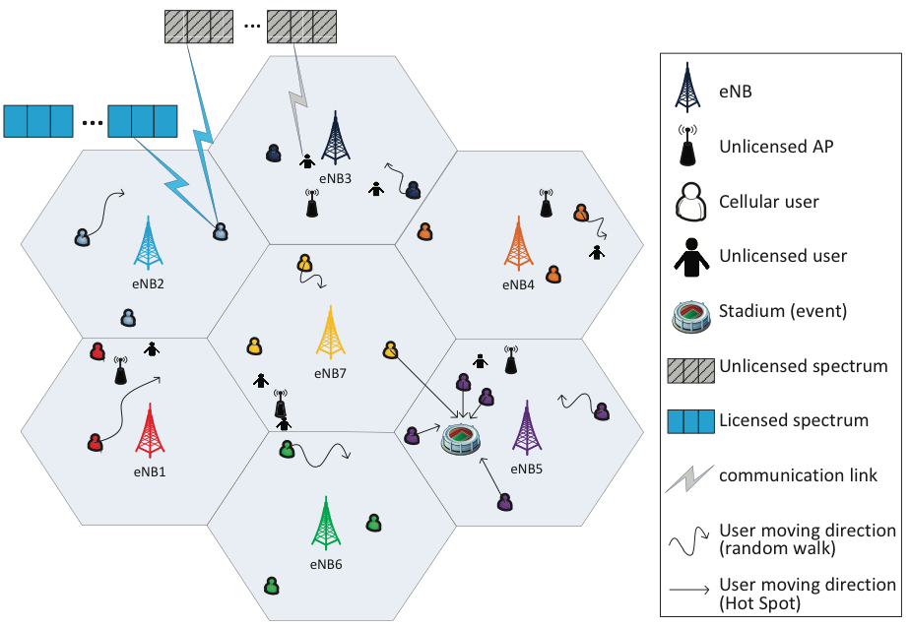
Background
LTE-Unlicensed Challenges
LTE-unlicensed issues
Unified network
Collision avoidance
Fairness
On demand

Slide 7
Preliminary Work
LTE-based unlicensed technologies
LTE unlicensed (LTE-U)
LTE-U is released in 3GPP Rel. 12.
Adaptive on/off duty cycle as a mechanism to share on the unlicensed band.
LTE-WLAN Aggregation(LWA)
LWA is release as part of Rel. 13.
Aggregates at the eNB and enables spectrum sharing via dual connectivity.
Licensed-Assisted Access (LAA)
LAA is released in the 3GPP Rel. 13/14
Extension of LTE carrier aggregation and using listen-before-talk (LBT) scheme.
[1] 3GPP, ``Study on Licensed-Assisted Access to Unlicensed Spectrum," 3GPP TR 36.889V13.0.0, Release 13, Jun. 2015.
[2] 3GPP, ``Channel Access Procedures for LAA," 3GPP TS 36.213V14.6.0 Release 14, Apr. 2017.

Slide 8
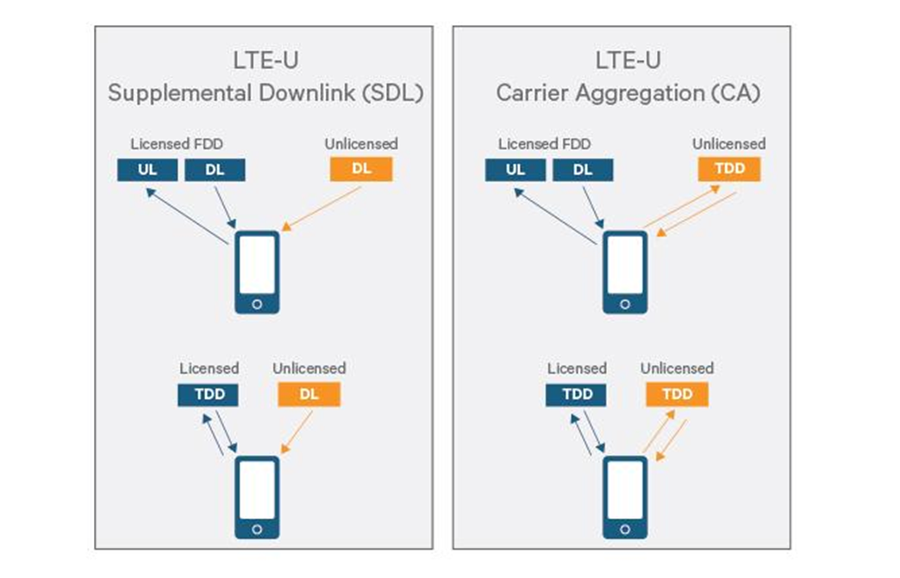
Preliminary Work
LTE-U Supplemental Downlink (SDL) / Carrier Aggregation (CA)
Supplemental Downlink (SDL)
DL in the unlicensed band while UL and control channel remain in the licensed spectrum.
Carrier Aggregation (CA)
CA is used for FDD/TDD, both UL and DL in the unlicensed band, the control channel remains in the licensed band.
Standalone
All carriers operating in the unlicensed band exclusively.

Slide 9
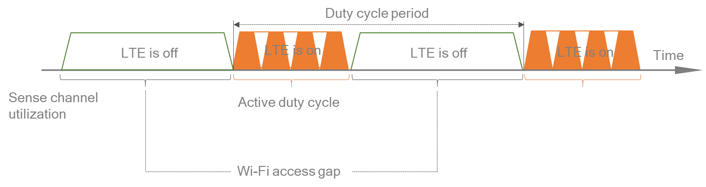
Preliminary Work
LTE-U basic access on the unlicensed band
An adaptively duty cycle (CAST) introduces the use of duty cycle periods and divides the time into LTE “ON” and LTE “OFF” slots. During the LTE “OFF” period, LTE remains silent. Otherwise, in the LTE “ON” period, LTE accesses the channel without sensing it before a transmission.
In CAST, the eNB senses the medium for a time period ranging from tens of ms up to 100 ms and defines the duration of the LTE “ON” and LTE “OFF” periods.
It is for early deployment in USA, Korea, China, India etc. using 3GPP Rel. 10/11/12.

Slide 10
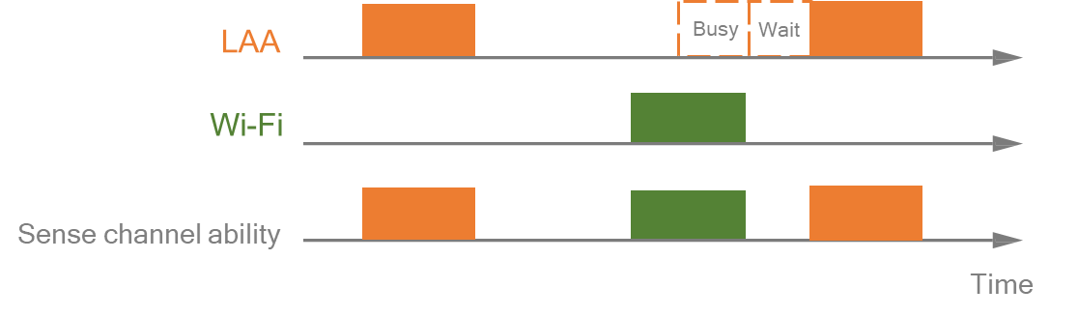
Preliminary Work
LAA basic access on unlicensed band
A “Listen before talk (LBT) ” procedure, also known as clear channel assessment (CCA) detection is developed,
LAA must perform the LBT procedure and sensing prior to a transmission in the unlicensed band. If channel is sensed as busy, LAA must defer its transmission by performing backoff. If the channel is sensed to be idle, it performs a transmission.
LAA mandating LBT is for deployment in Europe, Japan, and beyond using 3GPP Rel. 13/14.

Slide 11
Preliminary Work
Two types of access for LBT
Frame based equipment (FBE):
The transmit/receive structure is not directly demand-driven but has fixed timing.
Channel access is possible only once during one fixed frame period.
Load based equipment (LBE):
The transmit/receive structure is not fixed in time but demand-driven.
Channel access randomly occurs at any time but not limited to a fixed period.
Extended CCA (eCCA) in LBE is similar to the backoff in Wi-Fi.
eCCA is performed continuously.
Unlike Wi-Fi, eCCA is not exponential. The contention window size is always within a certain range and does not increase after a collision.

Slide 12
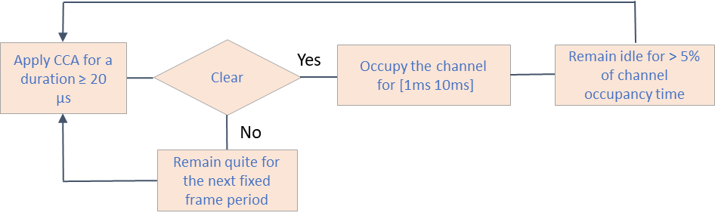
Preliminary Work
Frame based Equipment (FBE)
Apply clear channel assessment (CCA) using energy detect for channel observation time ≥ 20 μs.
If clear, transmits with a channel occupancy time (no need to re-evaluate during this period) between [1ms 10ms]. Follow by an idle time > 5% of channel occupancy time to perform a new CCA.
If not clear, keeps quiet for the next fixed frame period.
CCA is performed in each fixed frame period and channel access is limited in each fixed frame period.

Slide 13
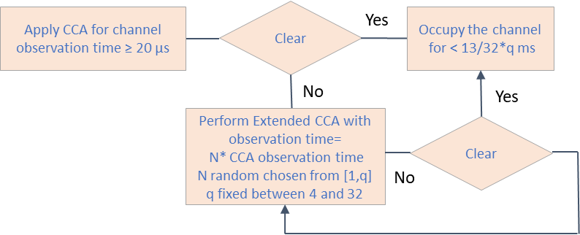
Preliminary Work
Load based Equipment (LBE)
Apply clear channel assessment (CCA) using energy detect for channel observation time ≥ 20 μs.
If clear, transmit within a channel occupancy time for less than 13/32*q ms where q is a fixed number in the range [4 32], Channel occupancy time: [1.625 13] ms.
If not clear perform an extension of CCA (eCCA, N*channel observation time need be observed, where N is a random number selected in the range of [1 q].
Similar to Wi-Fi, CCA is performed continuously without abiding any frame boundaries.

Slide 14
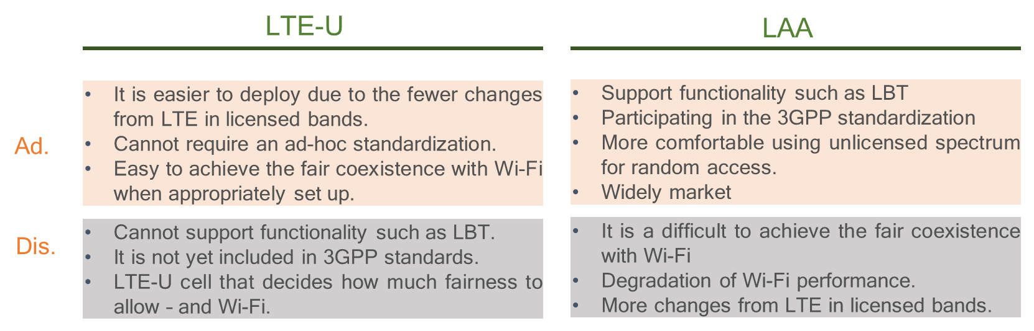
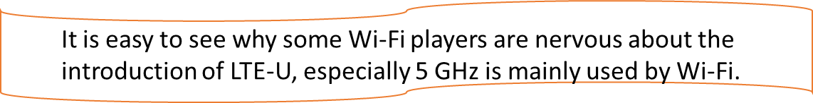
Preliminary Work
LTE-U vs. LAA for spectrum sharing

Slide 15
Outline
Background and Preliminary Work
MAC Design for LTE-Unlicensed Coexistence
Full Duplex Listen and Talk Scheme
Machine Learning LBT
Hybrid LBT
Resource Allocation for LTE-Unlicensed Coexistence
Matching Game
Coalition Formation Game
Stackelberg Game
3GPP Standard
Conclusion

Slide 16
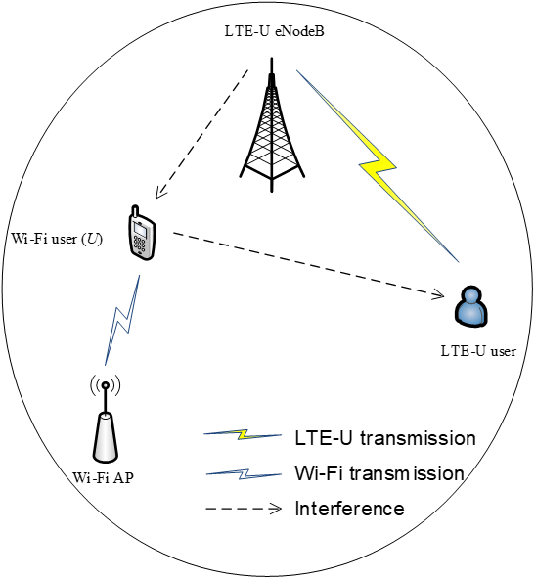
Full-duplex MAC: Simple Scenario
System model
Full Duplex enables listen and talk
LTE-U Downlink (DL) and Wi-Fi Uplink (UL) are considered on the unlicensed band
eNodeB and LTE-U can communicate on the unlicensed band
Inter-collisions between Wi-Fi and LTE-U
Wi-Fi user is enabled to listen and talk by full duplex
[4] X. Cao, Z. Song, B. Yang, and Z. Han, ``Full-Duplex MAC Protocol for Wi-Fi/LTE-U Coexistence Networks," in Proc. IEEE ICC Workshop, Kansas, MO, May 2018.

Slide 17
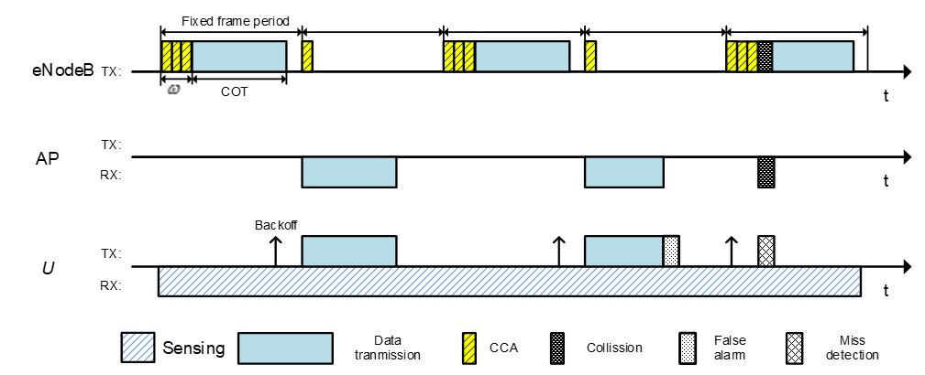
Full-duplex MAC: Simple Scenario
Listen and Talk (LAT) is enabled by full duplex
eNodeB adopts FBE-based LBT to access unlicensed band
Wi-Fi user employ LAT access scheme to improve its competitiveness
Channel utilization is improved and long collision is alleviated
[4] X. Cao, Z. Song, B. Yang, and Z. Han, ``Full-Duplex MAC Protocol for Wi-Fi/LTE-U Coexistence Networks," in Proc. IEEE ICC Workshop, Kansas, MO, May 2018.

Slide 18
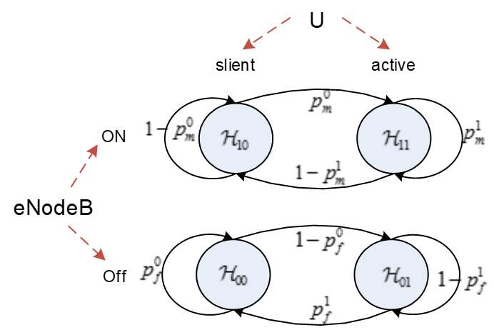
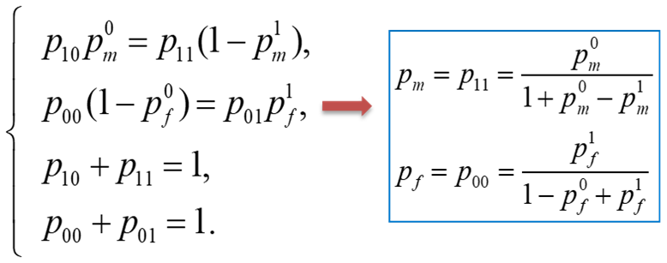
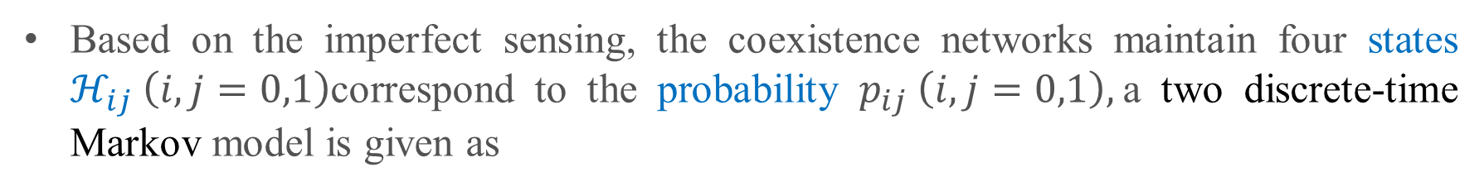
Full-duplex MAC: Simple Scenario
State Transition of Wi-Fi user based on two sensing errors
Due to residual self-interference of FD, two sensing errors are introduced when Wi-Fi user keeps silent or active, i.e., false alarm (p⁰_{f}, p¹_{f}) and miss detection (p⁰_{m}, p¹_{m})
Based on the imperfect sensing, the coexistence networks maintain four states ${\text{ℋ}}_{ij} \left(i,j=0,1\right)$correspond to the probability $p_{ij} \left(i,j=0,1\right),$a two discrete-time Markov model is given as

Slide 19
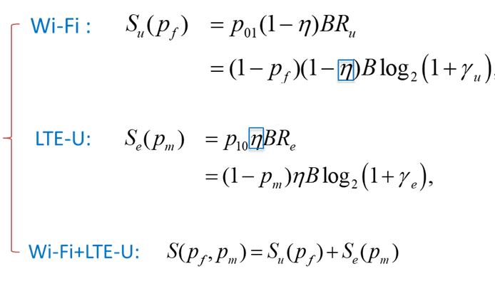
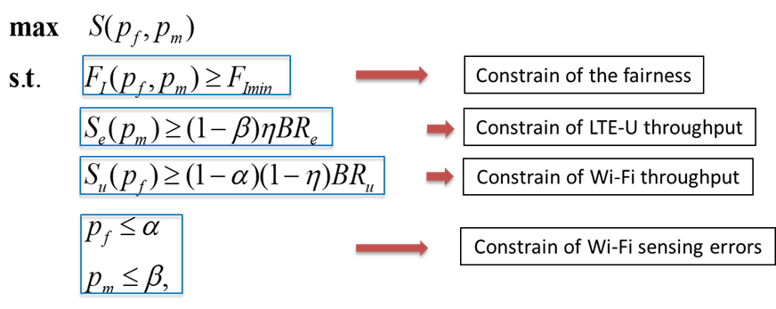
Full-duplex MAC: Simple Scenario
Performance analysis and problem formulation
Throughput of Wi-Fi and LTE-U
Problem formulation with fairness constrain
Denotes the channel access probability of eNodeB

Slide 20
Full-duplex MAC: Simple Scenario
Numerical Results
An optimal miss detection probability to maximize the throughput
As the CCA window size (ω) increases, LTE-U throughput decreases and Wi-Fi throughput increases

Slide 21
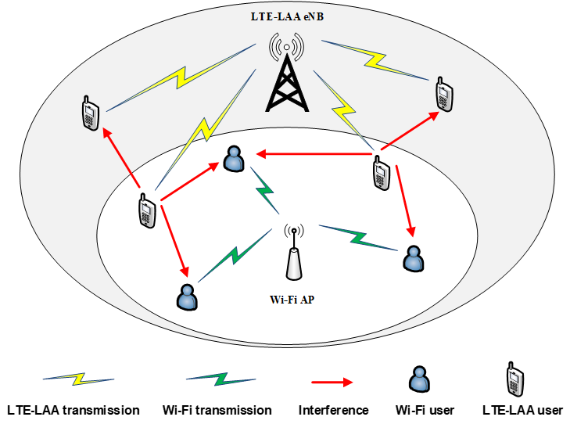
Full-duplex MAC: Complex Scenario
The simple scenario is extended to the complex scenario
Both UL/DL are considered for each system on the unlicensed band
Intra/Inter-collisions are introduced
Wi-Fi AP and Wi-Fi users are enabled to listen and talk by full duplex
Saturated traffic is assumed in Wi-Fi
[5] X. Cao, Z. Song, B. Yang, L. Qian, and Z. Han, `` Full-Duplex MAC in LAA/Wi-Fi Coexistence Networks: Design, Modeling and Analysis," IEEE Transactions on Wireless Communications, major revision, 2019.

Slide 22
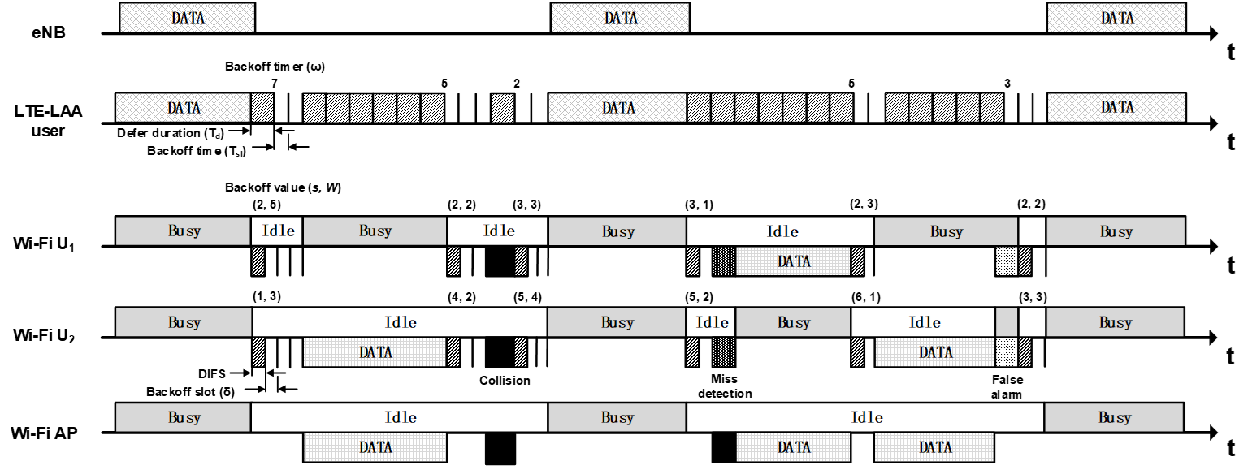
Full-duplex MAC: Complex Scenario
LAT-based MAC design with two sensing errors
eNB and LAA users adopt LBE-based LBT to access unlicensed band
Wi-Fi AP and users employ LAT access scheme to improve Wi-Fi competitiveness
[5] X. Cao, Z. Song, B. Yang, L. Qian, and Z. Han, `` Full-Duplex MAC in LAA/Wi-Fi Coexistence Networks: Design, Modeling and Analysis," IEEE Transactions on Wireless Communications, major revision, 2019.

Slide 23
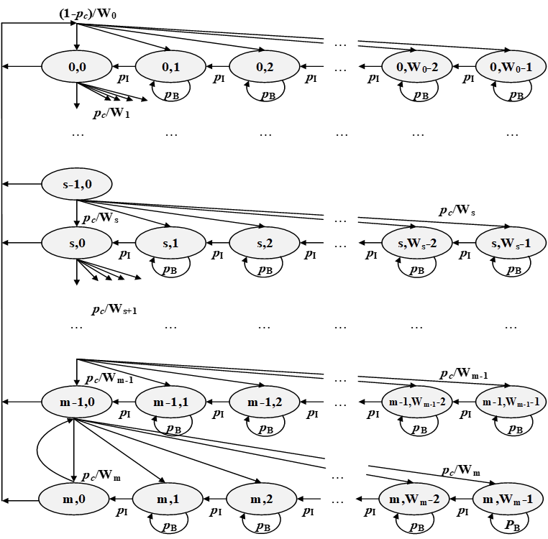

Full-duplex MAC: Complex Scenario
The enhanced Markov model
X axis: backoff counter (W) decreases
Y axis: backoff stage (s) increases
$$Ws=2^{s}Wmin$$
where W_{min} is the minimum contention window, p_{B} is the probability that channel is sensed as busy and p_{c} is the collision probability

Slide 24
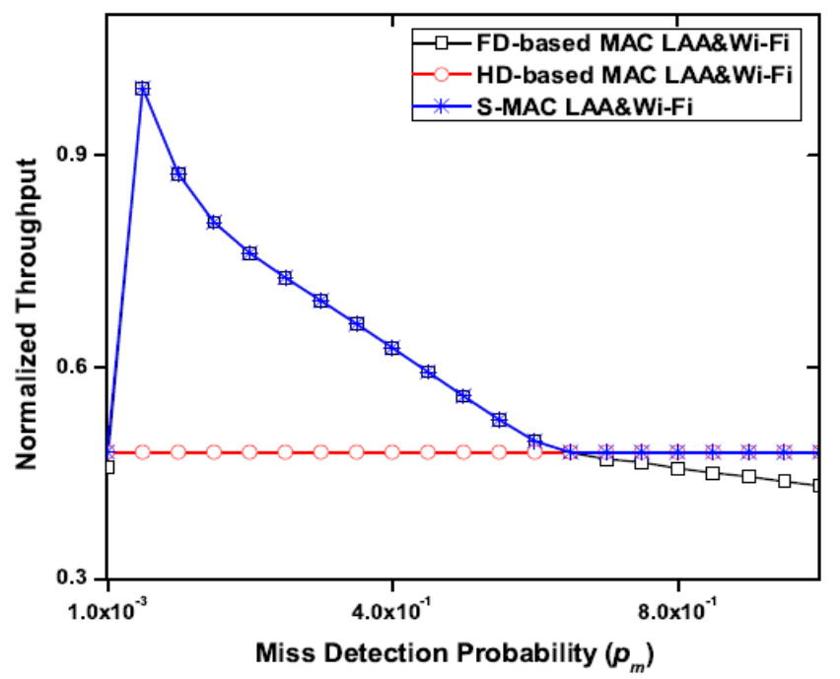
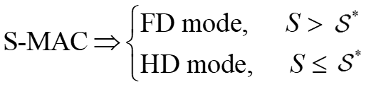
Enhanced FD/HD Switching MAC
S-MAC allows Wi-Fi users to adaptively switch between FD mode and HD
FD mode may be suppressed by the SIS. Conversely, HD mode can avoid the self-interference but suffers spatial correlation. And thus, an FD/HD switching MAC is presented to maximum throughput.
Switching criteria:

Slide 25
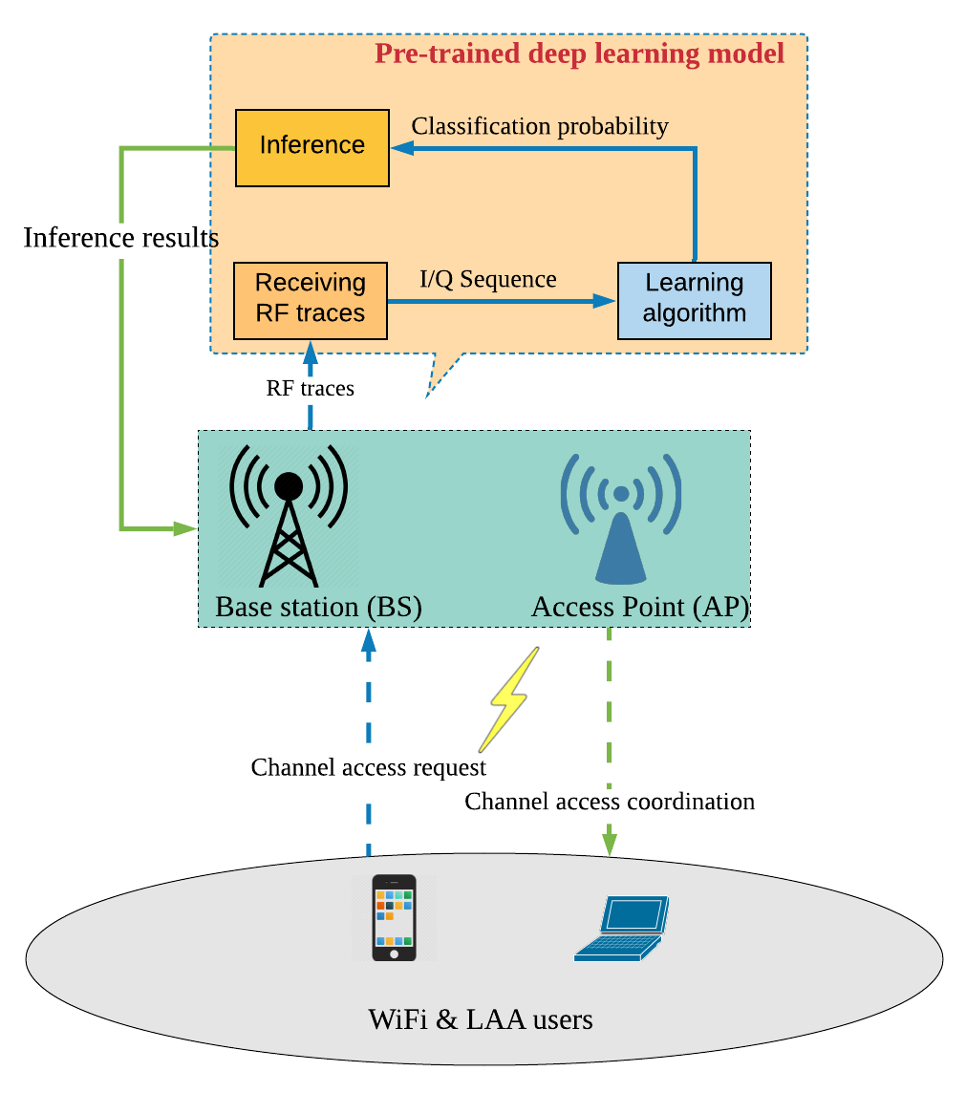
Machine Learning based MAC
System model
Wi-Fi and LAA users share the unlicensed band.
An pre-trained deep learning model is deployed, which is able to detect the type and the number of users from the received signal(s).
The inference results can help the AP and BS coordinate channel access.
[6] Bo Yang, Xuelin Cao, Zhu Han, and Lijun Qian, ``A Machine Learning Enabled MAC Framework for Heterogeneous Internet-of-Things Networks ,” IEEE Transactions on Wireless Communications, to appear, 2019.

Slide 26
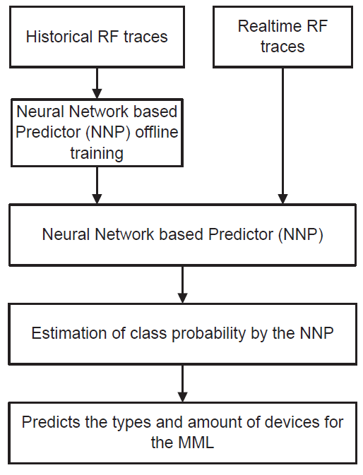
Machine Learning based MAC
Neural network based predictor (NNP)
We collect the RF trace (I/Q sequences) using USRP2.
The deep model is trained and tested offline based on the historical RF traces using TensorFlow on the GPU cluster.
After the offline training, the real-time RF traces are fed to the NNP in detecting, identifying and predicting the signals present in the RF environment and for channel resource coordination between Wi-Fi and LAA.

Slide 27
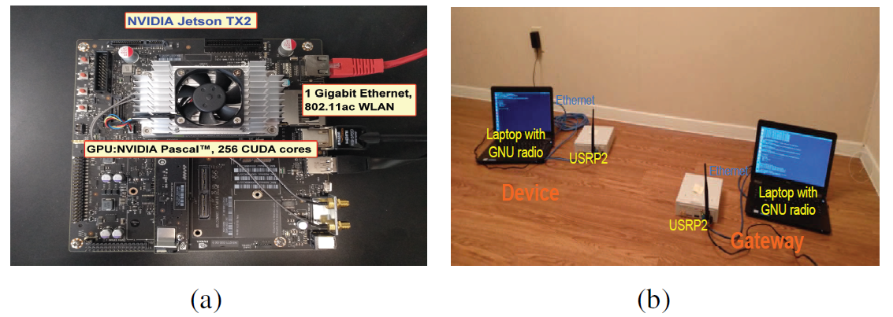
Machine Learning based MAC
Implementations
Considering that the excessive volume and power consumption on the GPU clusters, the embedded devices NVIDIA Jetson TX2 with NVIDIA Pascal 256 CUDA cores can be implemented into the AP/BS to achieve prediction more easily (see Fig. (a)).
An experimental scene for data collection in the USRP2 testbed is shown in Fig. (b), where the gateway and each device consist of two parts which are connected using Ethernet.

Slide 28
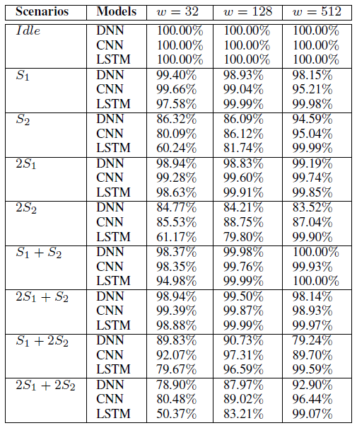
Machine Learning based LBT
Implementations
The DNN model contains 4 dense layers with fully connected weights of size 256, 256, 128 and 9-classes neurons at the output.
The CNN model consists of 2 convolutional layers and 2 dense fully connected layers.
The LSTM model consists of 3 stacked LSTM layers and a dense layer.
Table 1 shows that the deep learning based NNP module is able to learn the features of the new input RF traces and make the prediction of the number of signals from the overlapped signal(s).

Slide 29
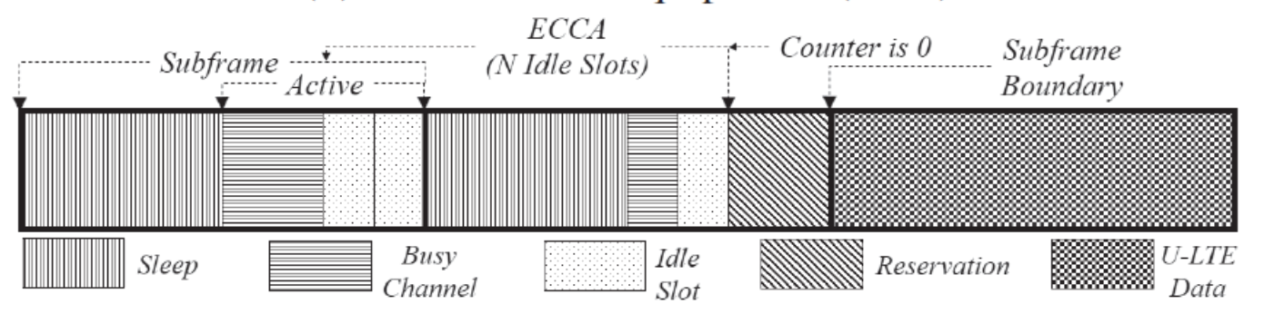
Hybrid MAC
Hybrid LBT including LBE and FBE
Combines the best features of LBE and FBE
U-LTE can keep sleep and active. Note that sensing and eCCA detection can only be operated during active period. When eCCA clear, U-LTE reserves the transmission in the following subframe.
[7] Sami Khairy, Lin X. Cai, Yu Cheng, Zhu Han, and Hangguan Shan, ``A Hybrid-LBT MAC with Adaptive Sleep for LTE LAA Coexisting with Wi-Fi over Unlicensed Band," IEEE Globecom, Singapore, December 2017.

Slide 30
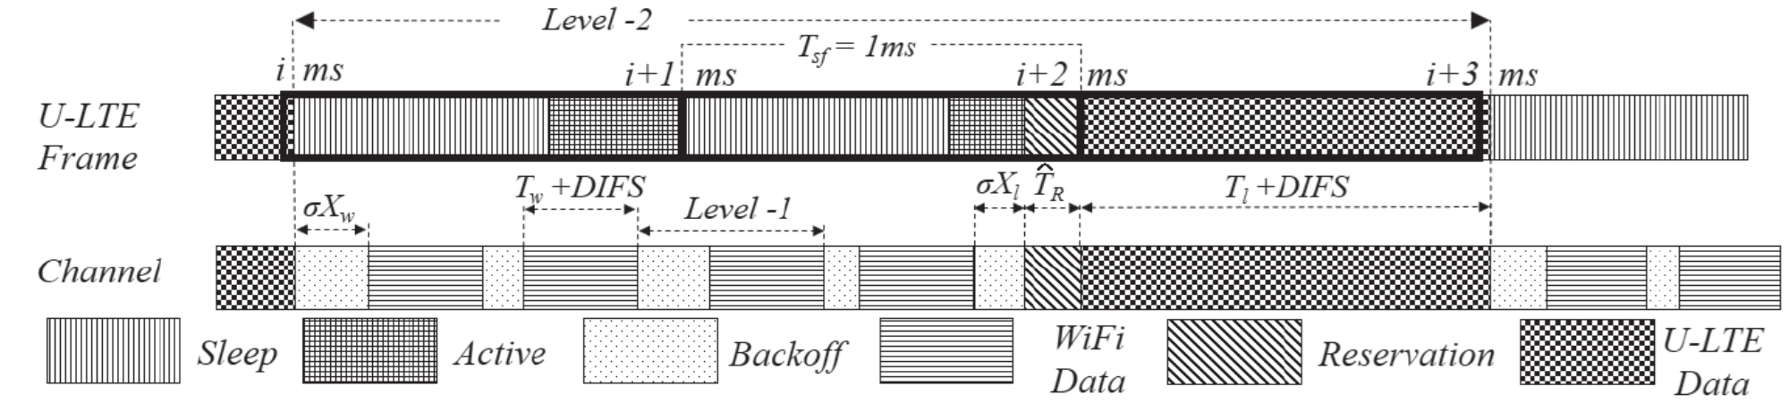
Hybrid MAC
Two level renewal process model
Two level renewal process model: Wi-Fi is modeled as level-1 renewal process (i.e., backoff and data transmission) while U-LTE is modeled as level-2 renewal process (i.e., sleep, active, reservation and data transmission)
The sleep period and the contention window size of U-LTE are adaptively changed to achieve the best performance
[7] Sami Khairy, Lin X. Cai, Yu Cheng, Zhu Han, and Hangguan Shan, ``A Hybrid-LBT MAC with Adaptive Sleep for LTE LAA Coexisting with Wi-Fi over Unlicensed Band," IEEE Globecom, Singapore, December 2017.

Slide 31
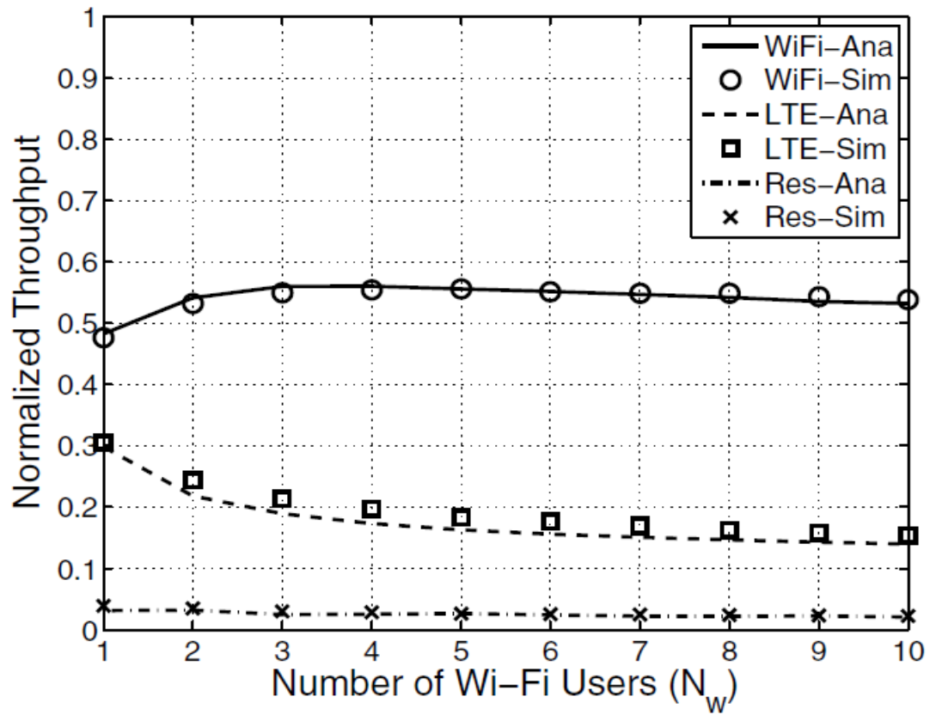
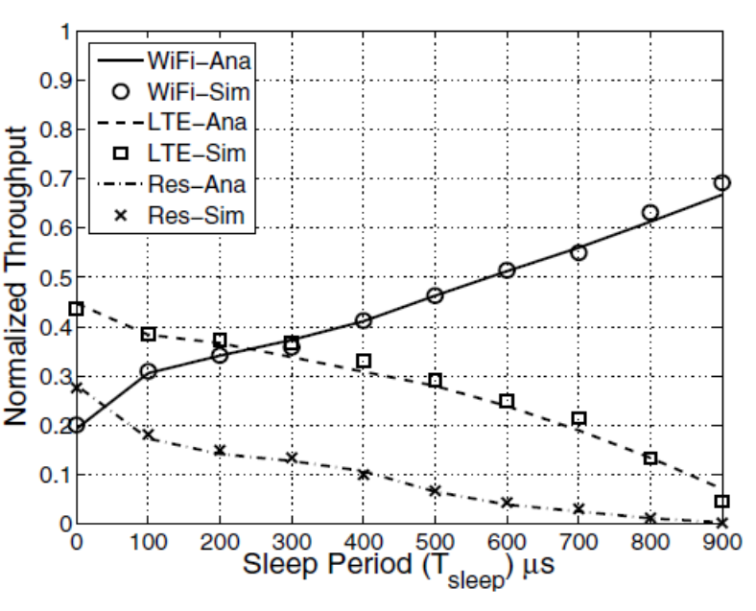
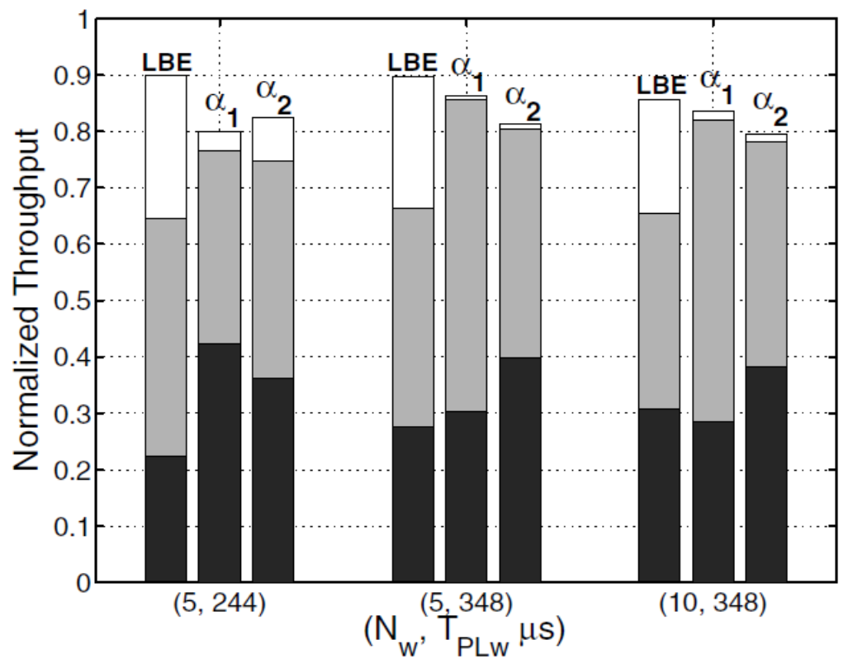
Hybrid MAC
Performance Evaluation
(a) Normalized throughput vs. number of Wi-Fi users with 𝑇_{𝑠𝑙𝑒𝑒𝑝} = 700𝜇𝑠
(b) Normalized throughput vs. sleep period 𝐶𝑊_{𝐿} = 15
(c) Normalized throughput at optimal
(𝑇∗_{𝑠𝑙𝑒𝑒𝑝}, 𝐶𝑊∗_{𝐿})

Slide 32
Outline
Background and Preliminary Work
MAC Design for LTE-Unlicensed Coexistence
Full Duplex Listen and Talk Scheme
Machine Learning LBT
Hybrid LBT
Resource Allocation for LTE-Unlicensed Coexistence
Matching Game
Coalition Formation Game
Stackelberg Game
3GPP Standard
Conclusion

Slide 33
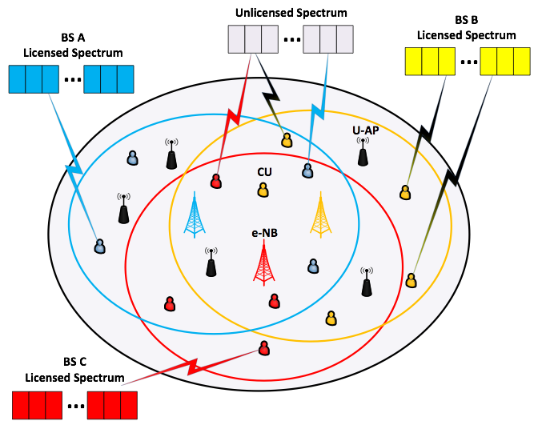


Matching Game
LTE-Unlicensed: Static system model
700MHz to 3.8GHz
LTE in Licensed Spectrum
Primary carrier
Uplink/Downlink
Carrier
Aggregation
Secondary carrier
LTE in Unlicensed Spectrum
Better network performance
Unified network management
Enhanced user experience
5 GHz
Coexistence issue?
[8] Yunan Gu, Chunxiao Jiang, Lin X. Cai, Miao Pan, Lingyang Song, and Zhu Han, ``Dynamic Path To Stability in the LTE-Unlicensed with User Mobility: A Dynamic Matching Framework," IEEE Transactions on Wireless Communications, vol. 15, no. 7, p.p. 4547-4561, July 2017.
[9] Yunan Gu, Yanru Zhang, Lin X. Cai, Miao Pan, Lingyang Song, and Zhu Han, ``LTE-Unlicensed Co-existence Mechanism: A Matching Game Framework," IEEE Wireless Communications, special issue for LTE in Unlicensed Spectrum, vol.23, no.6, pp.54-60, December 2016.
[10] Tuan LeAnh, Nguyen H. Tran, Duy Trong Ngo, Zhu Han, and Choong Seon Hong, ``Orchestrating Resource Management in LTE-Unlicensed Systems with Backhaul Link Constraints," IEEE Transactions on Wireless Communications, vol. 18, no. 2, p.p. 1360-1375, February 2019.

Slide 34
Matching Game
LTE-Unlicensed Coexistence Issues
Student Project Allocation Model
Impact of cellular users (CUs) on unlicensed users (UUs):
Listen before talk for UUs;
Impact of UUs on CUs:
Minimum SINR requirement for CUs;
Impact of CUs on other CUs:
TDMA to avoid CU-CU interference;
The more CUs, the smaller share of resource;
External effect in matching!
CU → student, UU → Project, LTE-U BS→ Lecturer;
Acceptable lists: coexistence constraints;
Preference of CU over UU:
Preference of LTE-U BS over (CU,UU):
SPA-(S,P) algorithm to find stable matching.

Slide 35
Matching Game
Initialize:
Build PLs;
Propose:
Students propose;
Stability is only guaranteed in conventional case.
TDMA brings external effect!
How to transform the matching into stable again?
Accept/Reject:
Lecturers make decisions;
No
No
Check:
Every student matched?
Check:
Every student’s PL empty?
Yes
Yes
Terminate:
A stable matching.

Slide 36
Matching Game
Inter Channel Cooperation (ICC)
Stability
Only CUs can make changes;
Two-sided stability becomes one-sided: Pareto optimal
No player is better off without any other player(s) being worse off;
ICC steps:
Firstly, search “unstable” CU-CU pairs regarding the current matching;
Secondly, check if the exchange is allowed (beneficial to all CUs);
Thirdly, find the allowed pair with the greatest throughput improvement, switch their partners, and update the current matching;
Keep searching “unstable” CU-CU pairs, until a trade-in-free environment.
The convergence is guaranteed by the irreversibility of each switch.

Slide 37
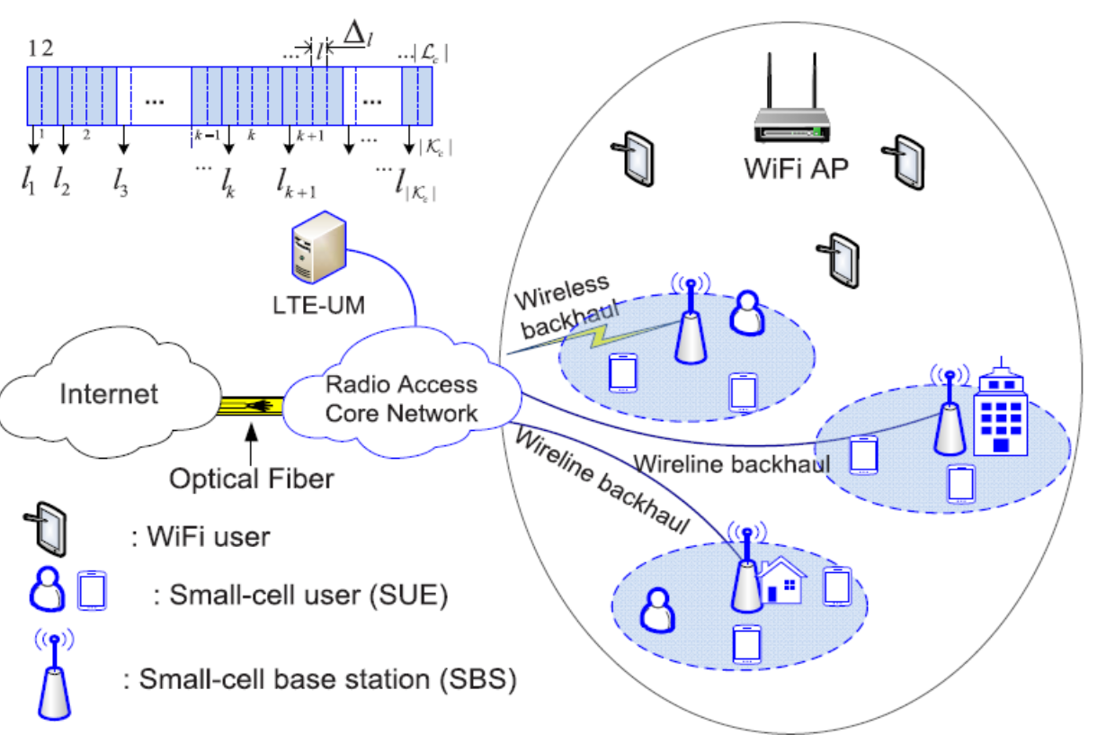
Matching Game
System model
Two sets:
A set M= {1, 2,...,M} of SBSs
A set N = {1, 2,...,N} of SUEs
Two assumptions:
SBSs and SUEs can operate on the unlicensed band.
SUEs have access to sufficient licensed resources
[10] Tuan LeAnh, Nguyen H. Tran, Duy Trong Ngo, Zhu Han, and Choong Seon Hong, ``Orchestrating Resource Management in LTE-Unlicensed Systems with Backhaul Link Constraints," IEEE Transactions on Wireless Communications, vol. 18, no. 2, p.p. 1360-1375, February 2019.

Slide 38
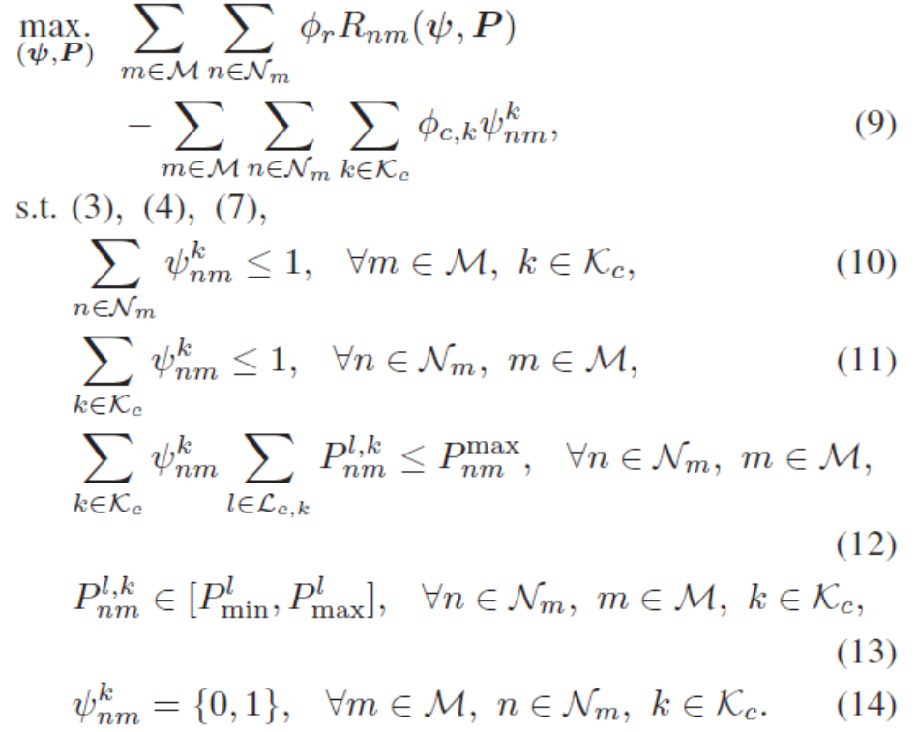

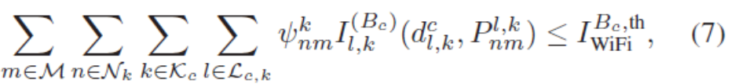
Matching Game
ROC problem formulation
Chunk based channel allocation decision
Power allocation matrix of all SUEs
Maximum backhaul link capacity of SBS m
Spectral distance between sub-band l of chunk k
Interference introduced from SUEs to Wi-Fi AP’s

Slide 39
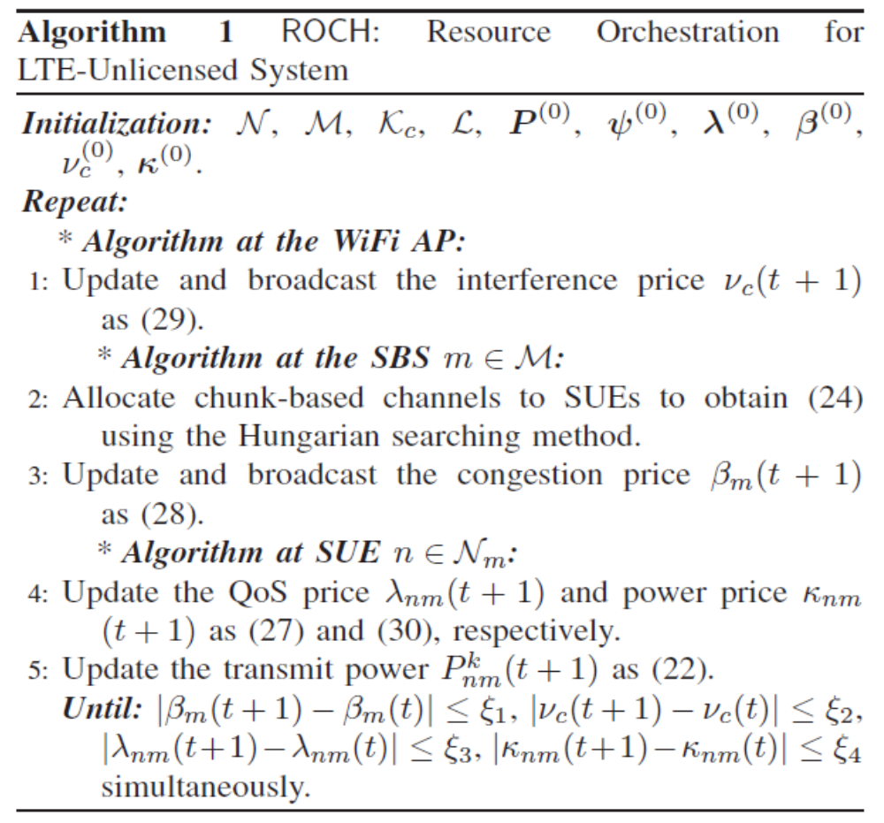
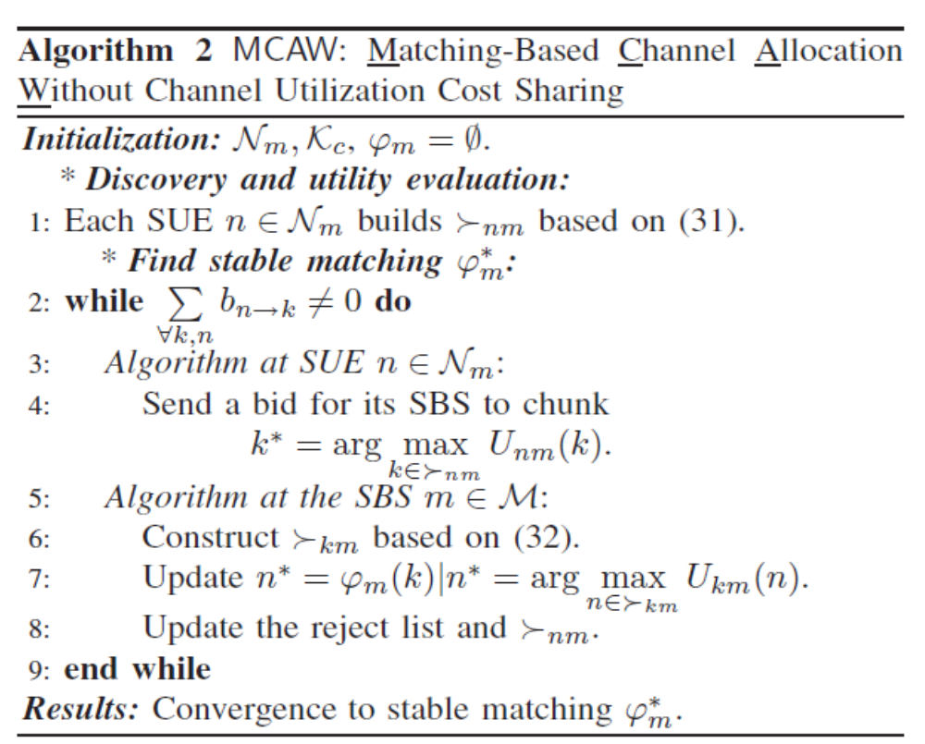
Matching Game
Algorithm for the ROC Problem

Slide 40
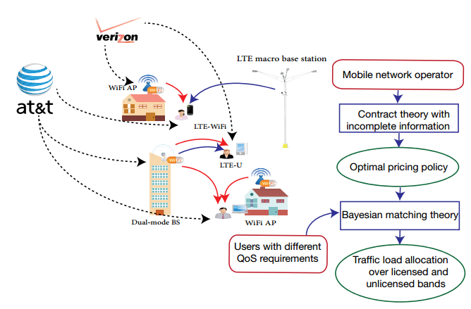
Contract-based Matching Game
System model
A fair usage of the unlicensed bands by developing new coexistence frameworks for LTE-U.
A network controlled by two mobile network operators (MNOs) that can serve users either over licensed band or unlicensed band.
On the unlicensed bands, no QoS guarantee and MNOs incentivize the users to accept the best effort service based on their traffic type.
Pricing and spectrum allocation in an LTE-U system.
[11] Kenza Hamidouche, Walid Saad, Merouane Debbah, My Tra Thai, and Zhu Han, ``Contract-based Incentive Mechanism for LTE over Unlicensed Channels," to appear IEEE Transactions on Wireless Communications.

Slide 41
Contract-based Matching Game
Contract design for unlicensed spectrum pricing
Contract theory is used to enable to each MNO to set a pricing mechanism for LTE-U users. To ensure the users have an incentive to collaborate with the MNO by accepting to be served via unlicensed bands. Three aspects should be required for MNO.
MNO must design feasible contracts that ensure the participation of the users by at least selecting one of the contracts that the MNO proposes.
MNO must motivate each user to select the contract designed for its own type.
MNO must take into account both the utility of users which is related to their requirements in terms of data rate as well as their traffic type and their willingness to pay for the service offered by the MNO.
The main advantage of using contract theory is able to model information asymmetry and incompleteness given that it is difficult for MNOs to gather information about users requirements.

Slide 42
Contract-based Matching Game
Licensed and unlicensed spectrum allocation as Bayesian matching game
Matching theory to determine the fraction of LTE traffic that should be offloaded to the unlicensed
bands while accounting for the QoS requirements of every content. Bayesian is considered because the BSs do not have information regarding users’ types and only have the distribution of the types.
Bayesian one-to-many matching game:
Two sets A ⊆ N × F of subfile-user pairs and M ⊆ C × S of licensed/unlicensed band, and BS pairs as two sets of players
Assignment of subfiles and users pairs in A to BSs and channels pairs in M, where the BSs act on behalf of the licensed and unlicensed bands selection for their served traffic.
Users act on behalf of the files and determine the BS and channel to accept or not.
Depending on the achievable rate and the price charged by the MNO, every user builds a preference relation in M and each BS builds a preference relation in A.

Slide 43

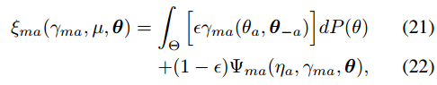
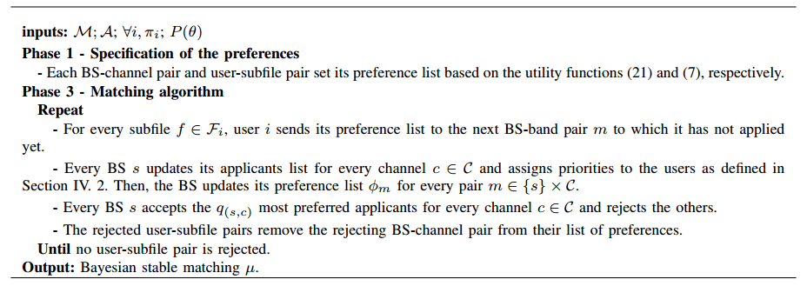
Contract-based Matching Game
Algorithm for matching problem
A distributed algorithm is proposed to assign the users to the licensed and unlicensed band.

Slide 44
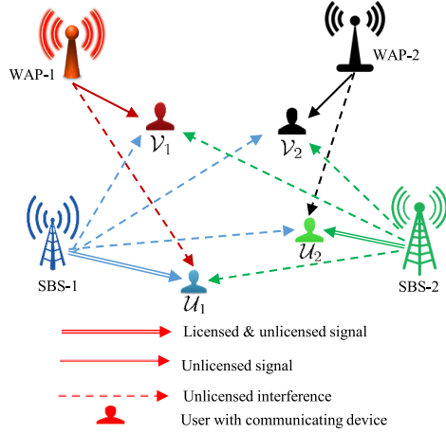
Nash Bargaining and Matching game
System model
A set W of non-overlapping WAPs
A set S of SBSs
A set U of users
A set V of active users
A set C^{i}l of orthogonal licensed sub-channels
[12] Anupam Kumar Bairagi, Nguyen H. Tran, Zhu Han and Choong Seon Hong, ``Game-Theoretic Approach for Fair Coexistence between LTE-U and Wi-Fi Systems," IEEE Transactions on Vehicular Technology, Vol. 68, No. 1, p.p. 442-445, January 2019

Slide 45

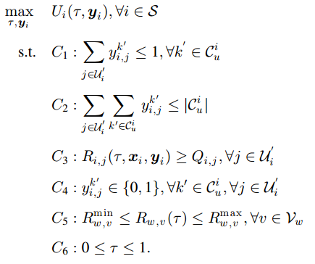

Nash Bargaining and Matching game
Problem Formulation
Maximize the sum-rate of the SBS after sharing a τ-fraction of time with the WAPs while maintaining QoS for most of the users.
one unlicensed sub-channel can be utilized by at most one LTE-U user
The limitations of resources in this spectrum for each SBS
The QoS requirement of LTE-U users
Every element of the allocation vector will be either 0 or 1
Wi-Fi users are protected by these two constraints
This problem is a Mixed Integer Non-Linear Programming (MINLP) problem, which is NP-hard

Slide 46
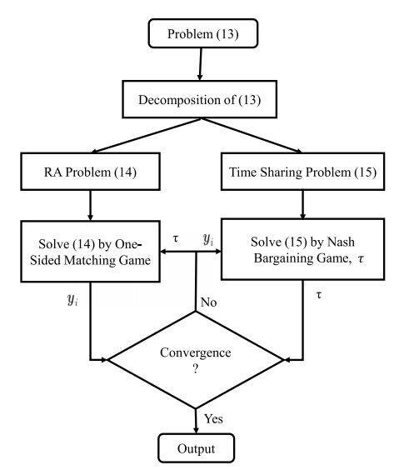


Nash Bargaining and Matching game
Nash Bargaining and Matching game based solution
The time sharing problem between SBSs and WAPs by using NBG, whereas the resource allocation problem of SBS is solved with the help of one-sided matching game.

Slide 47
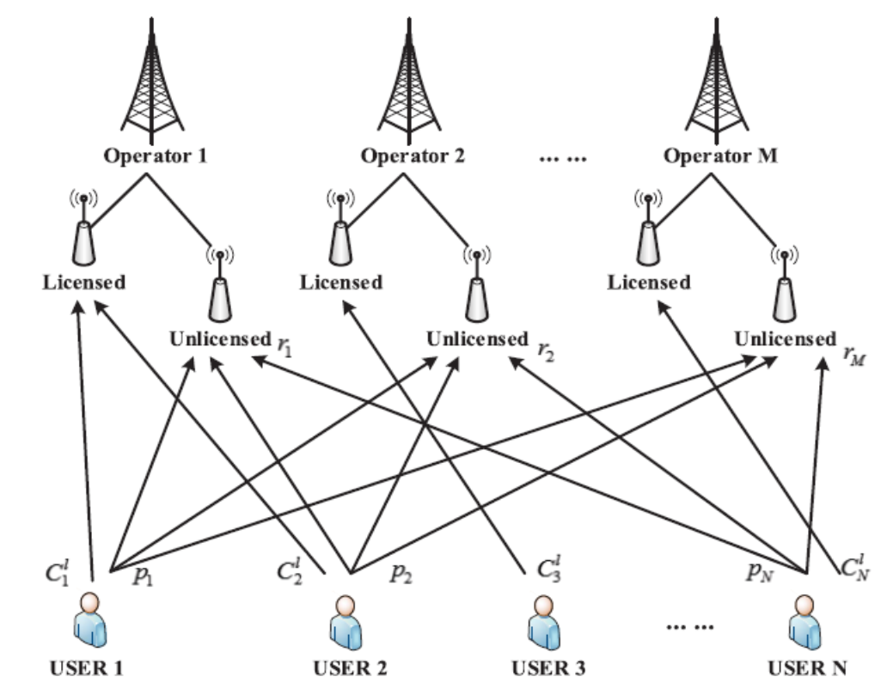
Multi-Leader/Follower Stackelberg Game
System model
Assume operator: i in [1,M]
Data transmission rate: C^{l}_{j}
Small cell base stations (SCBSs): Pi
Wi-Fi access points (WAPs): Q_{i}
UEs: j in [1,N]
Sub-band: s in [1, S]
Transmit power: p_{j,s}
[13] Huaqing Zhang, Yong Xiao, Lin X. Cai, Dusit Niyato, Lingyang Song, and ZhuHan, ``Multi-Leader Multi-Follower Stackelberg Game for Resource Management in LTE Unlicensed", IEEE Transactions on Wireless Communications, vol. 16, no. 1, pp. 348-361, January 2017.

Slide 48
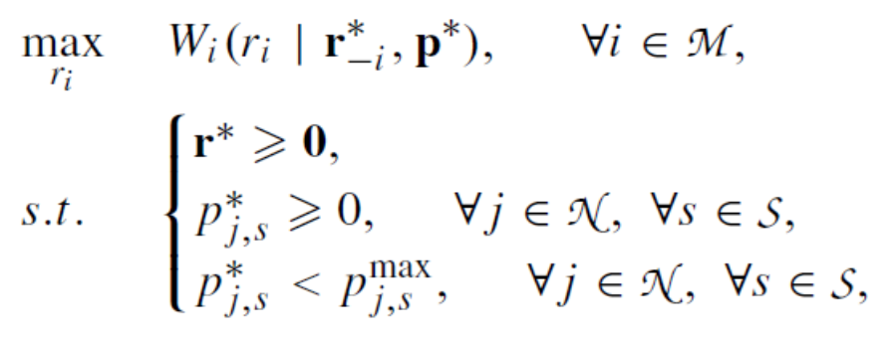
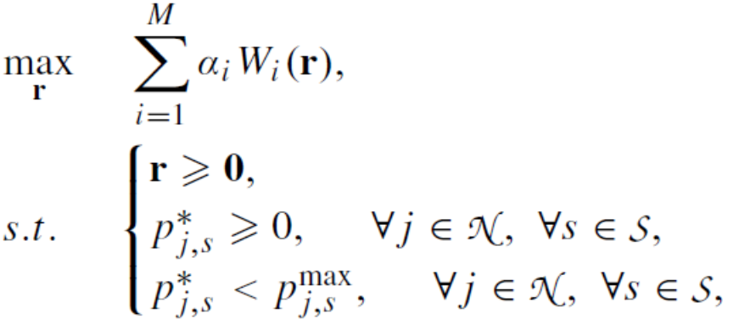

Multi-Leader/Follower Stackelberg Game
Problem formulation
Non-cooperate with each other
the utility of operator i
set of the optimal transmit powers of all UEs
set of the optimal pricing strategies
the utility of UE j
Fully coordinate with each other
the sub-band allocation results for all UEs except j

Slide 49


Multi-Leader/Follower Stackelberg Game
Sub-band allocation and operators strategy

Slide 50


Coalition Formation Game
Experiment environment
Relying on the LTE-U TDD-based OpenWrt wireless routers (WRs), we achieved precise synchronization and emulate the LTE-U network workflow in an economic way. The great interference on the CSMA-WR from the TDDWR due to the frame transmission mechanism.
(b) The interference between a TDD mechanism based WR (denoted by TDDWR) and a general CSMA-based WR (denoted by CSMA-WR)
(a) Experiment environment configuration
[14] Yaodong Zhang, Chunxiao Jiang, Jian Yuan, Zhu Han, and Merouane Debbah, ``Coalition Formation Game Based Access Point Selection for LTE-U and Wi-Fi Coexistence," IEEE Transactions on Industrial Informatics, vol. 14, no. 4, pp. 1552-1563, April 2018 (Best Journal Paper of IEEE Technical Committee on Green Communications & Computing.

Slide 51

Coalition Formation Game
Problem Formulation

Slide 52


Coalition Formation Game
Algorithm
A coalition formation game assisted AP selection algorithm is proposed in order to improve the throughput of lightly loaded users and to ensure the heavily loaded users to be still heavily loaded.
Simulations show that the overall throughput is about 6.4 times and 1.4 times than that when all the users access the LTE-U network and access Wi-Fi networks, respectively.

Slide 53
Outline
Background and Preliminary Work
MAC Design for LTE-Unlicensed Coexistence
Full Duplex Listen and Talk Scheme
Machine Learning LBT
Hybrid LBT
Resource Allocation for LTE-Unlicensed Coexistence
Matching Game
Coalition Formation Game
Stackelberg Game
3GPP Standard
Conclusion

Slide 54



3GPP standard
3GPP：570 member companies, 43 countries, 5 continents

Slide 55





3GPP standard

Slide 56
3GPP standard
Four typical scenarios with LAA
Scenario 1: Carrier aggregation between licensed macro cell (F1) and unlicensed small cell (F3).
Scenario 2: Carrier aggregation between licensed small cell (F2) and unlicensed small cell (F3) without macro cell coverage.
Scenario 3: Licensed macro cell and small cell (F1), with carrier aggregation between licensed small cell (F1) and unlicensed small cell (F3).
Scenario 4: Carrier aggregation between licensed small cell (F2) and unlicensed small cell (F3). An ideal backhaul between macro cell and small cell can enable carrier aggregation between macro cell (F1), licensed small cell (F2) and unlicensed small cell (F3).

Slide 57
Outline
Background and Preliminary Work
MAC Design for LTE-Unlicensed Coexistence
LAT Scheme
Machine Learning LBT
Hybrid LBT
Resource Allocation for LTE-Unlicensed Coexistence
Matching Game
Coalition Formation Game
Stackelberg Game
3GPP Standard
Conclusion

Slide 58

Conclusion
Conclusions
To resolve the collision problem and fairness issue for LTE-unlicensed, the LBT-based MAC protocols presented: i.e., LAT scheme using full-duplex technologies, ML-LBT including machining learning and hybrid LBT mechanism combines the features of LBE and FBE.
The resource allocation (e.g., channel band, transmit power, and serviced users/) for LTE-unlicensed can be formulated as the matching game, stackelberg game, and coalition formation game.

Slide 59


